Slide 1

حسابات الكيمياء الحيوية Biochemical Calculations (BCH 312)
King Saud University
College of Science
Department of Biochemistry

Slide 2
BCH 312
Biochemical Calculations
•Course Symbol & No. : BCH 312
•Credit Hours : 3 (2+2)
•Prerequisite : BCH 202
Midterm dates
1st Midterm: 00/00/2025
2nd Midterm: 00/00/2025

Slide 3
Marks distribution
Midterm 1 : 15 marks (15%)
Midterm 2 : 15 marks (15%)
Homework and assignments: 5 marks (5%)
Lab : 25 marks (25%)
Final exam : 40 marks (40%)

Slide 4
Reference
Biochemical calculations by Irwin H. Segel.
Online copy:
http://site.iugaza.edu.ps/bzabut/wp-content/uploads/biochemical%20calculation.pdf

Slide 5
No | List of Topics | Contact Hours
1 | Glassware and tools, molarity, normality, w/v%, v/v%, w/w%, molality. | 6
2 | Stock and standard solutions, simple dilutions , and serial dilutions. | 4
3 | pH theory, pH–meter calibration, standard buffers. | 4
4 | Ionization of week acids and bases, Buffers | 4
5 | Spectrophotometry, spectrum, Beer-Lambert law, absorption spectrum, calibration curves, extinction coefficient, applications in enzymology and clinical chemistry. | 8
6 | Data presentation and statistical analysis of data (use of MS Excel ) | 4
Total |  | 30

Slide 6
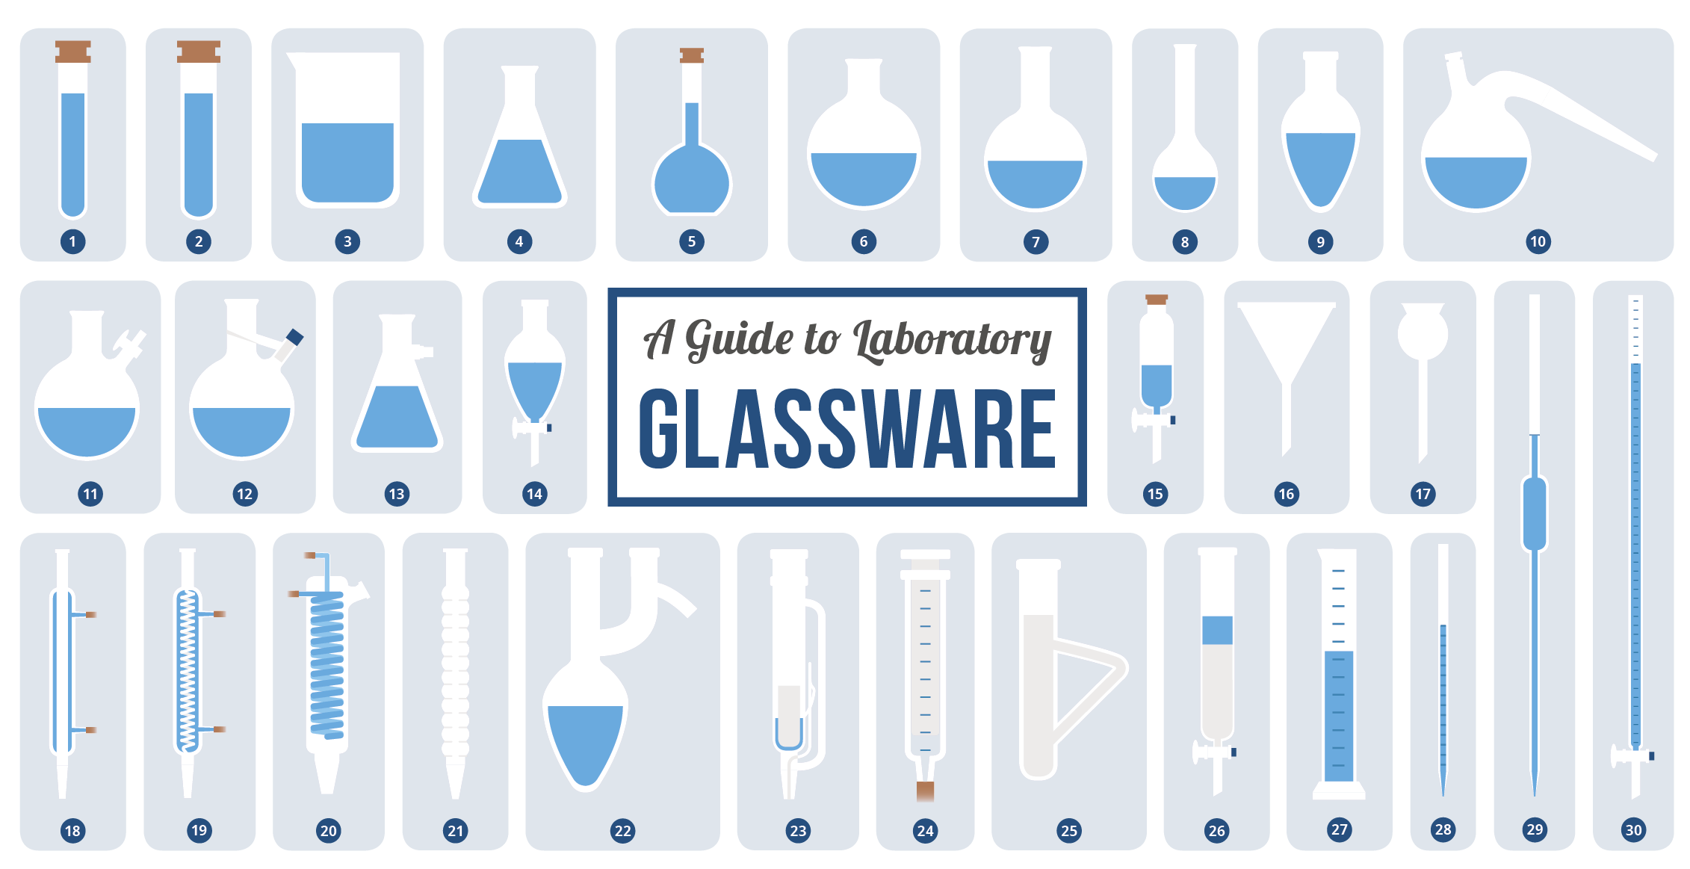

Slide 7
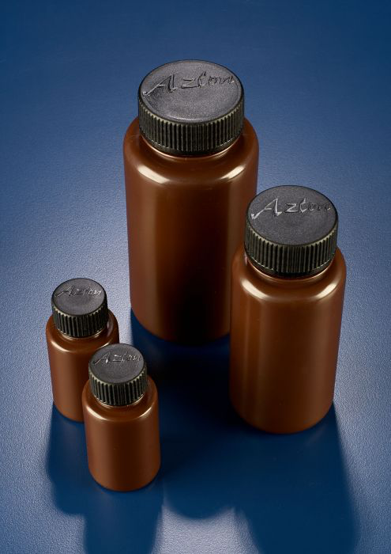
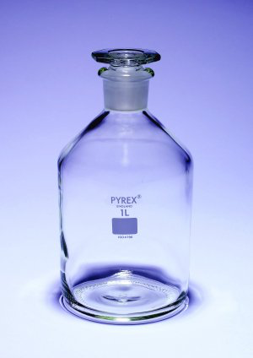
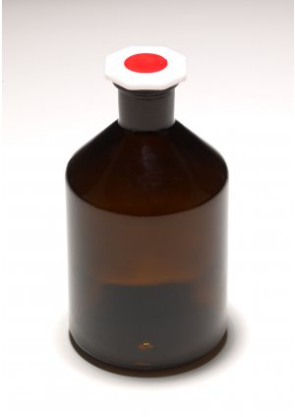
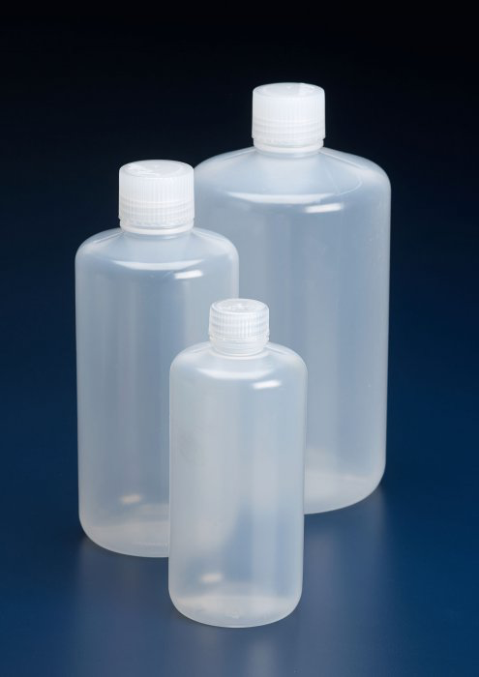
Glassware
Bottles
Wide neck, amber, bottles; can be used for a wide range of light sensitive liquid or solid storage.
Reagent bottles
Narrow neck bottles; can be used for a wide range of liquid storage, media preparation and sampling applications.

Slide 8
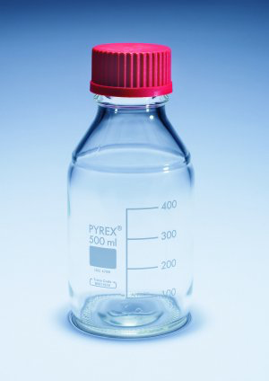
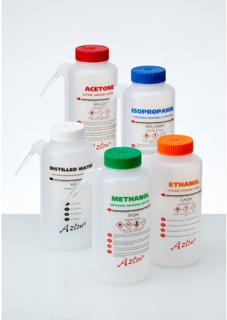
Glassware continued
Media-lab bottles
Wash bottles

Slide 9
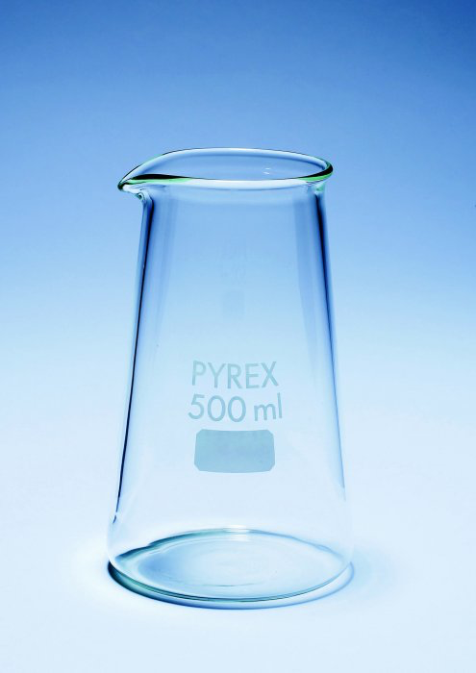
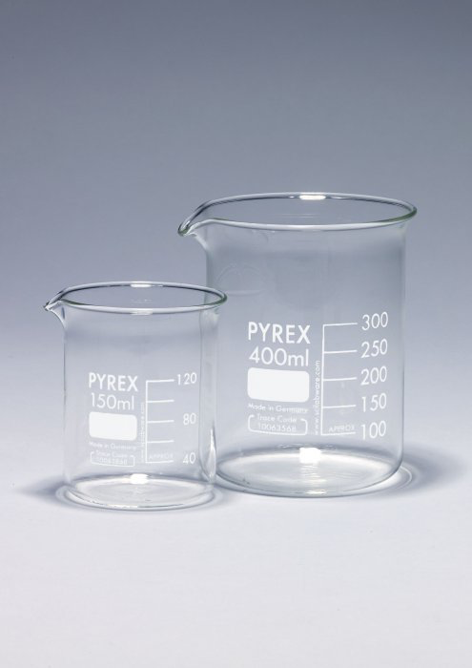
Glassware continued
Beakers
Conical shape beakers; ideally used for titrations and mixing application, these conical shape beakers are a cross between a standard beaker and conical flask.
Griffin beaker; is great for general laboratory use.

Slide 10
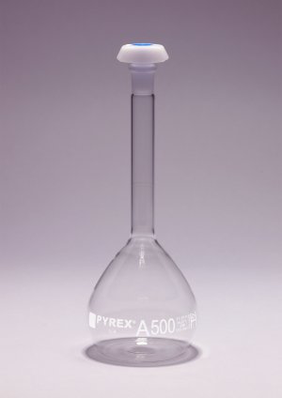
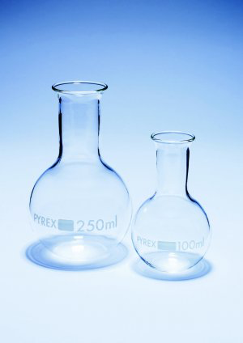
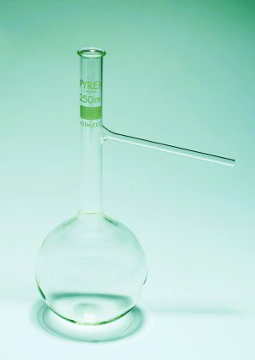
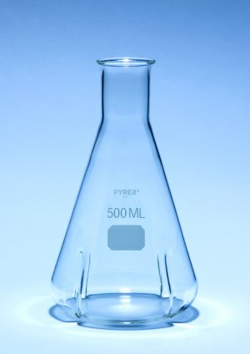
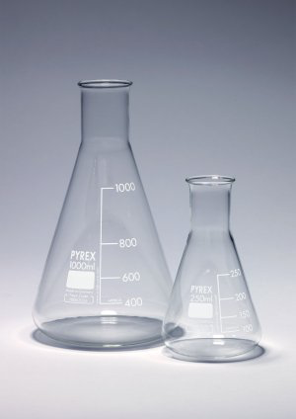
Glassware continued
Flasks
Boiling flasks
Distillation flasks
Cell culture flasks
Volumetric flasks; are precision measuring instruments.
Erlenmeyer
Conical flasks

Slide 11
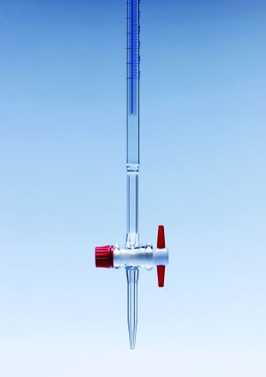
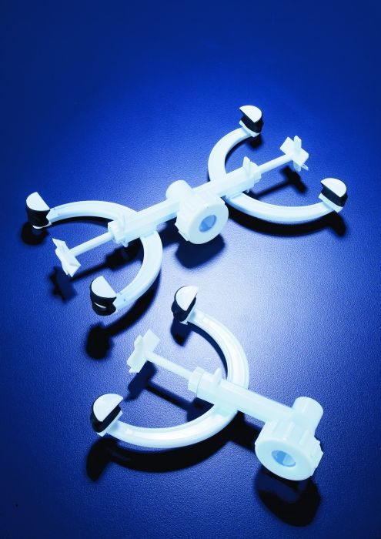
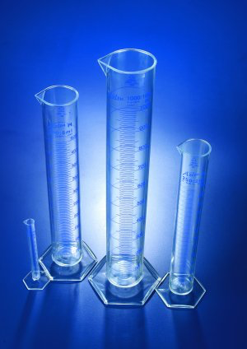
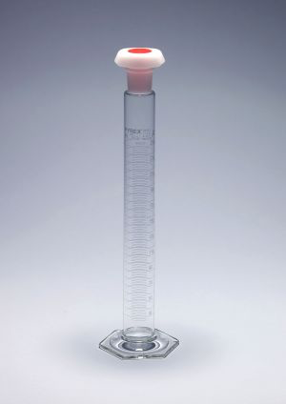
Glassware continued
Volumetric ware
Burette
Burette clamp
Cylinder
Mixing cylinder

Slide 12
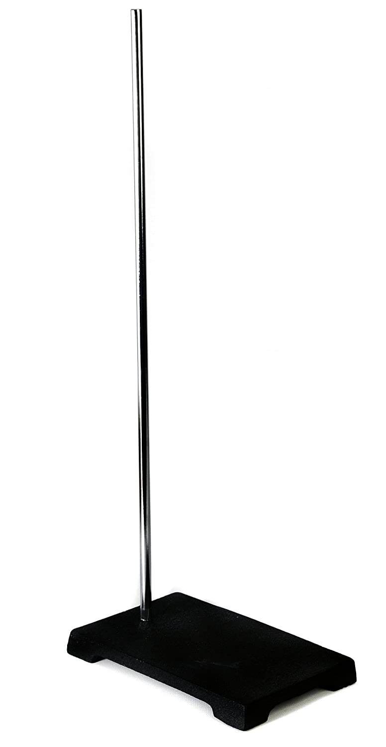
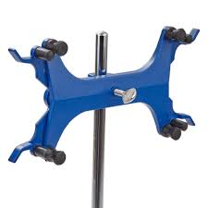
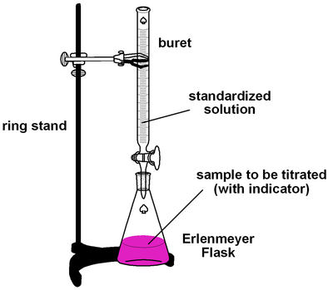
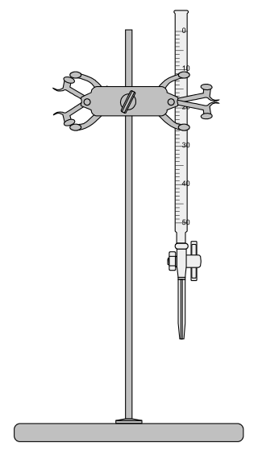
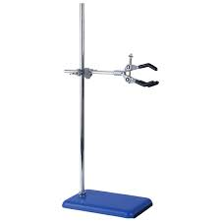
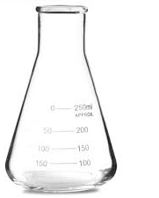
Volumetric ware
Burette clamp
Burette

Slide 13
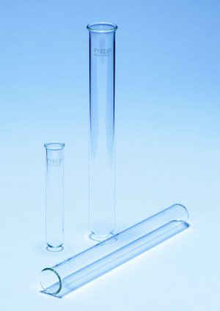
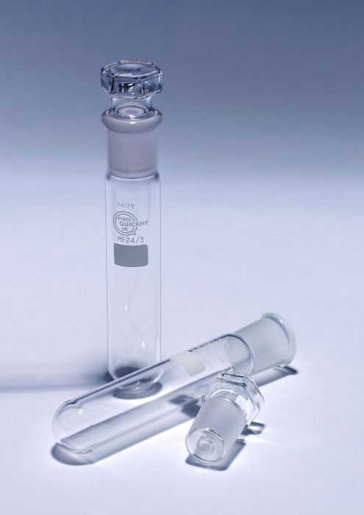
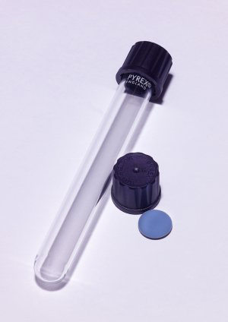
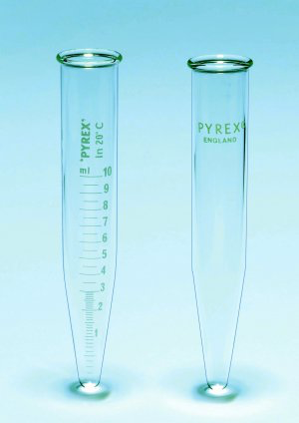
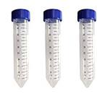
Glassware continued
Test tubes
Test tubes
Test tubes with ground socket joint.
Culture Tubes
Centrifuge Tubes

Slide 14
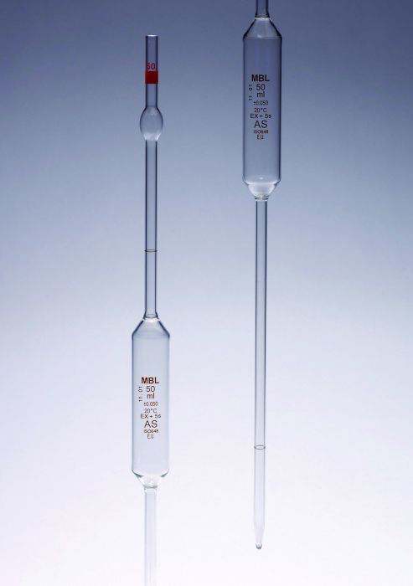
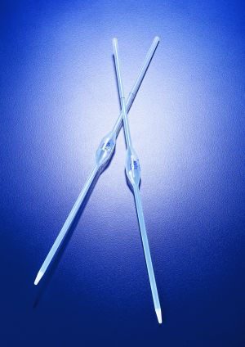
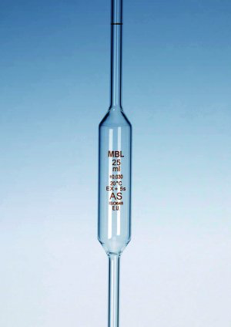
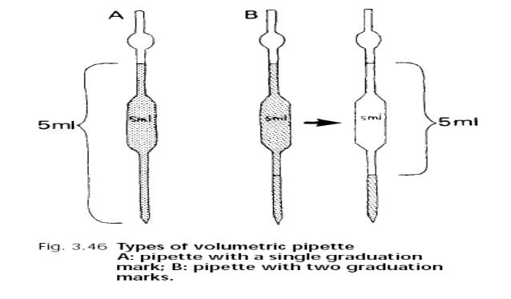
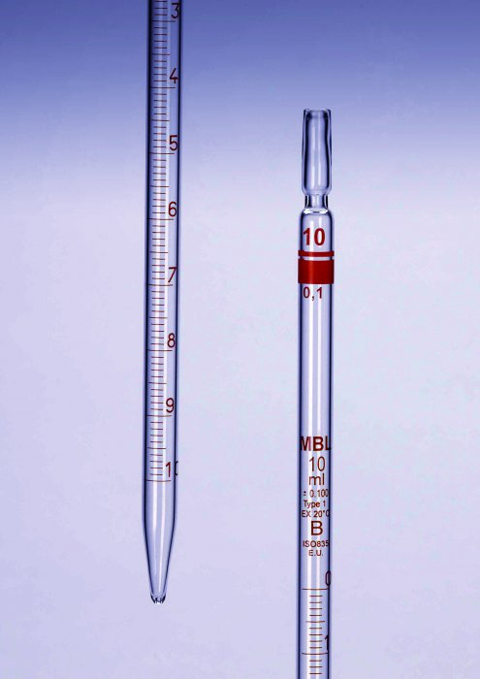
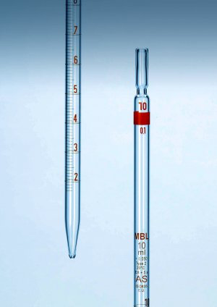
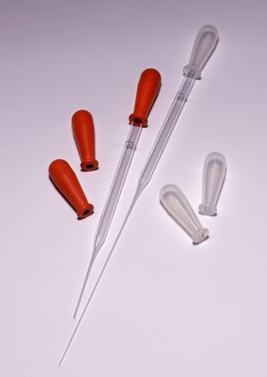
Glassware continued
Pipettes
One mark pipette
Two mark pipette with safety bulb at top.
Type 1 Type 2
Graduated pipettes
Pasteur Pipettes

Slide 15
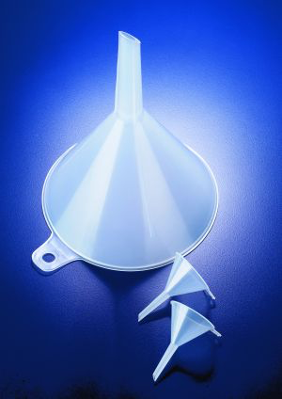
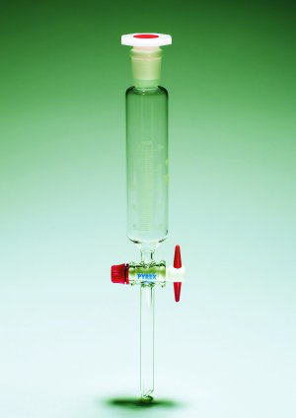
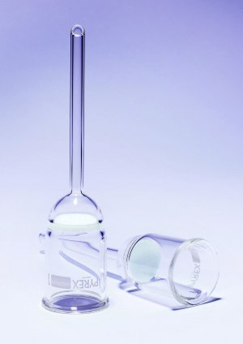
Glassware continued
Funnels
Filter funnels
Dropping & Separating Funnels
Buchner Funnels

Slide 16
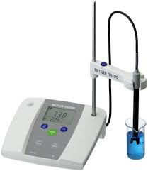
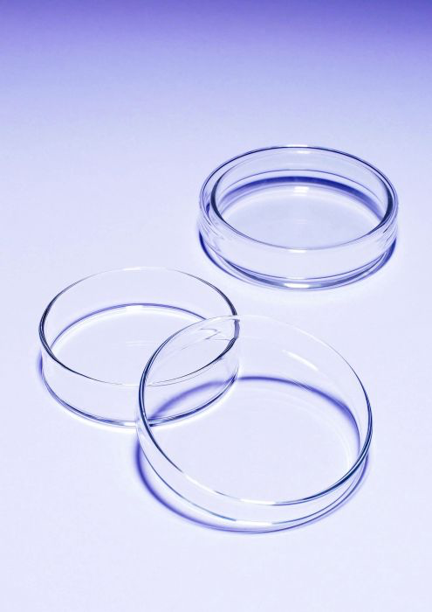
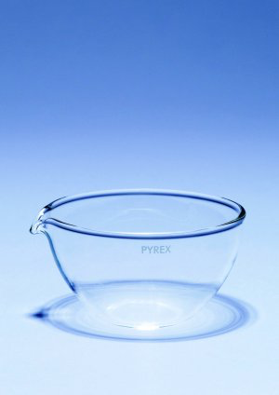
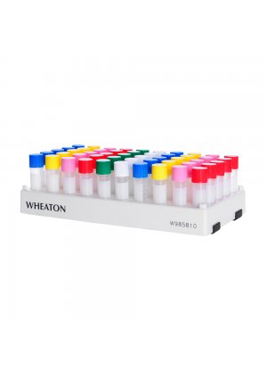
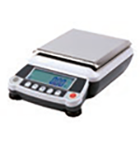
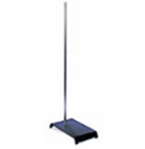
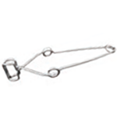
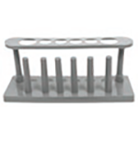
Lab equipment
Petri dishes
Evaporating dishes
Vial Racks
pH meter
Balance
Test Tube Clamp
Ring Stand
Test Tube Rack

Slide 17
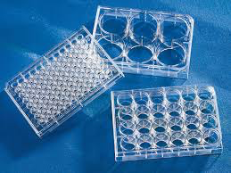
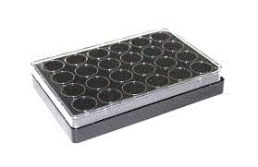
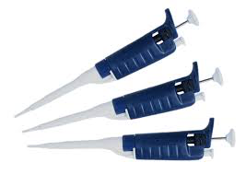



Lab equipment continued
Plates
Micropipettes
Multichannel micropipettes
Tips
Eppendorf tubes

Slide 18
General Properties of Aqueous Solutions

Slide 19

Solvent, Solute and Solution
H2O (Solvent)
Solution
Nacl2 (Solute)
A solution is a homogenous mixture of 2 or more substances
The solute is the substance present in the smaller amount / the substance being dissolved.
The solvent is the substance present in the larger amount / is the liquid in which the solute is dissolved.

Slide 20

A solute is dissolved in a solvent.
A substance that dissolves in a particular solvent is said to be soluble in that solvent.
An aqueous solution has water as solvent.

Slide 21

Aqueous Solution
The majority of reactions occur in solutions.
There are several ways to express the concentration of a substance in a solution based on:
The volume
The weight
Degree of saturation

Slide 22
Concentration based on volume
Here the concentrations are based on the amount of dissolved solute per unit volume
The calculations depending on volume include:
Molarity (M)
Normality (N)
Activity (a)
Weight/Volume percent (w/v %)
Volume/volume percent (v/v%)
Milligram percent (mg %)
Osmolarity (osm)

Slide 23
Concentration of Solutions
Molarity (M), or molar concentration= the number of moles of solute (n) per liter of solution (L).
Molarity – Measurement of the concentration of a solution (how much solute is in a volume of solution)
No. of moles = Wt_{g} /MWT (molecular weight)
M =
No. of moles
Volume of solution in L

Slide 24
No. of moles = Wt_{g} /MWT (molecular weight)
1 mole contains Avogadro’s number of molecules per liter (6.023 x 10²³).
* So 1mole of Na⁺ means = 6.023x10²³ numbers of Na⁺
* 1mole of H₂O means = 6.023x10²³ numbers of H₂O
Molar concentrations are usually given in square brackets.
[X]= molarity of X
Example: [H ] = molarity of hydrogen ion
[NaOH] = molarity of Sodium Hydroxide
[Nacl₂]= 2.5
+

Slide 25

Be careful not to get molarity and moles mixed up.
Moles measures the amount of SOLUTE you have.
Molarity measures the concentration of the SOLUTION.
OR
V (L) = n (mole)
M
n (mole)= M x V
Other common rearrangements:

Slide 26
Molarity cont’ed
Examples:
A solution of NaCL₂ had 0.8 moles of solute in 2 liters of solution. What is its molarity?
M =
M =
M = 0.4 molar
no. of moles
volume of solution in L
0.8
2

Slide 27
Molarity cont’ed
Examples: How many grams of solid NaOH are required to prepared 500 ml of 0.04 M solution?
M =
500 ml = 500 ÷ 1000 = 0.5 L M=
no. of moles = 0.04 × 0.5
no. of moles = 0.02 mole
no. of moles =
no. of moles
volume of solution in L
no. of moles
volume of solution in L
weight in gram
molecular weight (MWT)

Slide 28
MWT of NaOH
MWT = 23 + ( 16 + 1) = 40
Wt in grams = no. of moles × MWT
wt in grams = 0.02 × 40
wt in grams = 0.8 grams OR 0.8g
Element | Symbol | Atomic Mass
Sodium | Na | 22.989770
Hydrogen | H | 1.00794
Oxygen | O | 15.9994

Slide 29
2- Normality
Is the number of equivalents of solute per liter of solution
N =
no. of equivalents =
equivalent weight =
n = is the number of replaceable hydrogen (H⁺ in acids)or hydroxyl ions (OH⁻ in bases) per molecule
no. of equivalents
volume of solution in L
weight in gram
Equivalent weight (EW)
MWT
n

Slide 30
n = is the number of electrons gained or lost per molecule (in oxidizing or reducing agents)
N =
N =
N =
no. of equivalents
volume of solution in L
weight in gram
/
volume of solution in L
Equivalent weight
no. of equivalents
weight in gram
/
volume of solution in L
MWT / n
Equivalent weight

Slide 31
Normality cont’ed
weight in gram
/
volume of solution in L
N=
N =
M =
M =
N = n × M
For example: A 0.01 M solution of H₂SO₄ is 0.02 N
MWT / n
weight in gram × n
volume of solution in L
/
MWT
no. of moles
no. of moles = Wt g
MWT
volume of solution in L
weight in gram
volume of solution in L
/
MWT

Slide 32
Normality cont’ed
Example: What is the normality of H₂SO₄ solution that contains 24.5 g of solute in a total volume of 100 ml?
N = n × M
n = 2
M = No. of moles / V_{(L)}
100 ml = 100 ÷1000 = 0.1L
No. of moles = Wt_{g} /MWT
MWT of H₂SO₄ = 2 + 32 + (16 × 4) = 98 g/mol

Slide 33
Normality cont’ed
No. of moles = 24.5/ 98
No. of moles = 0.25 mole
M = No. of moles / V_{(L)}
M = 0.25/0.1 = 2.5 molar
N = n × M
N = 2 × 2.5 = 5 normal

Slide 34
Normality cont’ed
Another way to solve it:
Normality (N) = No. of equivalents / V_{(L)}
No. of equivalents = Wt_{g} of solute / equivalents weight (EW)
EW= MWT of solute / n
MWT of H₂SO₄ = 2 + 32 + (16 × 4) = 98 g/mol
EW= 98 / 2 = 49
No. of equivalents = Wt_{g} of solute / equivalents weight (EW)
= 24.5 g / 49 = 0.5 eq
Normality (N) = No. of equivalents / V_{(L)}
=0.5 / 0.1 = 5 Normal

Slide 35
Your Turn……
Sea water contains roughly 28.0 g of NaCl per liter. What is the molarity of sodium chloride in sea water?
What is the molarity of 245.0 g of H₂SO₄ dissolved in 1.00 L of solution?
How many moles of Na₂CO₃ are there in 10.0 L of 2.0 M solution?
What weight (in grams) of H₂SO₄ would be needed to make 750.0 mL of 2.00 M solution?
What volume of 18.0 M H₂SO₄ is needed to contain 2.45 g H₂SO₄?

Slide 36
6. Calculate the mass of NaOH needed to prepare 1.00 L of a 1.50 M solution?
7. 965 grams of NaOH is used in preparing a 1.5M solution. What volume of solution can be made?

Slide 37
Do you have questions?

