Slide 1
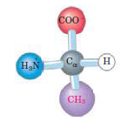
Chapter 1: Amino Acids
Protein Biochemistry (BCH 303)
2022-2023
Dr. Mansour Gatasheh
Biochemistry Department, Science College
King Saud University

Slide 2
Amino acids
Amino acids:
are organic molecules that are the building block of
proteins.
-There is 20 α-amino acids commonly found in proteins
( they have a carboxyl group and an amino group
bonded to the same carbon atom [the α-carbon]).
-The 20 α-amino acids of proteins are often referred as
the standard amino acids.

Slide 3
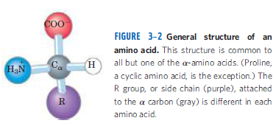
- Amino acids differ from each other in their side chains
(R-group) which vary in structure, size, and electric charge.
- And which influence the solubility of the amino acids in water.

Slide 4
-All amino acids have:
* free α-carboxyl group.
* free unsubstituted α-amino group (except proline ).
- The common amino acids of proteins have been assigned three-letter abbreviations and one letter symbols.
example:
Alanine : Ala
Serine : Ser

Slide 5
Classification of amino acids:
A) on the basis of their R-group
(depend on the polarity of
their R-group).
B) Nutritional classification
C) Metabolic classification

Slide 6
A) Classification on the basis of their R-group:
[depend on the polarity of their R-groups]
[tendency to interact with water at biological pH (near pH 7.0)]
The polarity of the R-groups varies widely from non-polar and hydrophobic (water-insoluble) to highly polar and hydrophilic (water-soluble).
Amino acids with:
1) non-polar (hydrophobic) R-groups.
2) polar, uncharged R-group.
3) aromatic R-groups
4) positively charged (basic) R-group.
5) negatively charged (acidic) R-group.

Slide 7
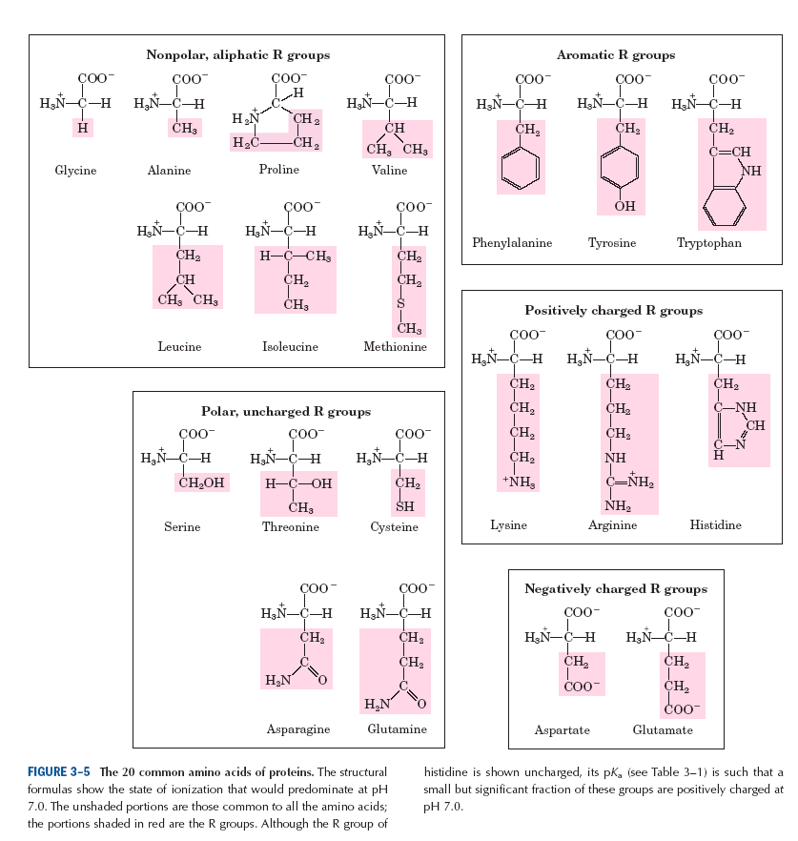

Slide 8
1) Amino acids with non-polar (hydrophobic)R-group:
The R-group in this class of amino acids are non-polar and hydrophobic.
● Glycine
Alanine
Proline
Valine have non-polar, aliphatic R-group
Leucine
Isoleucine
Methionine
● Glycine has the simplest structure.
● Methionine is sulfur-containing amino acid
● Proline has an aliphatic side chain with a distinctive cyclic structure.

Slide 9
2) Amino acids with polar, uncharged R-group:
The R-groups of these amino acids are more soluble in water, or more hydrophilic.
Because they contain functional groups that form hydrogen bonds with water.
This class of amino acids includes:
Serine
Threonine
Cysteine
Aspargine
Glutamine

Slide 10
●Polarity of serine and threonine is contributed by their hydroxyl groups.
● Polarity of cysteine is contributed by its sulfhydryl group (thiol group).
● Polarity of aspargine and glutamine is contributed by their amide groups.
- Aspargine is amide of aspartic acid (aspartate).
Glutamine is amide of glutamic acid (glutamate).
- Cysteine is readily oxidized to form covalently linked dimeric amino acid called cystine, in which two cysteine molecules or residues are joined by a disulfide bond.

Slide 12
3) Amino acids with aromatic R-groups :
- They are:
phenylalanine
tryptophan
tyrosine
The hydroxyl group of tyrosine can form hydrogen bonds (enzyme function).
with their aromatic side chains, are relatively nonpolar (hydrophobic).
Tryptophan and tyrosine, and to a much lesser extent phenylalanine, absorb ultraviolet light

Slide 13
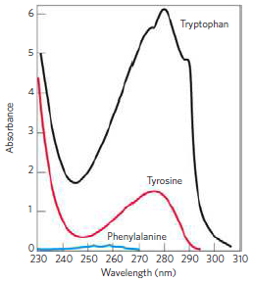
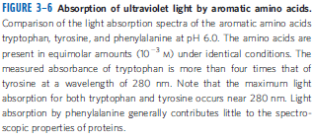

Slide 14
4) Amino acids with positively charged (basic) R-group:
- The most hydrophilic R-groups are those that are either positively or negatively charged.
- The amino acids in which the R-groups have significant positive charge at pH 7.0 are:
Lysine
Arginine
Histidine
- Lysine has amino group on ε-position of its R-group.
Arginine has positively charged guanidinium group in its R-group.
- Histidine has an aromatic imidazole group in its R-group.

Slide 15
5) Amino acids with negatively charged (acidic) R-group:
- The two amino acids having R-groups with a net negative charge at pH 7.0 are:
Aspartic acid (aspartate)
Glutamic acid (glutamate)
-These amino acids have carboxyl group in their side
chains (R-groups).

Slide 16
Uncommon amino acids
i) Rare amino acids of proteins:
- Have important functions.
- Proteins may contains uncommon amino acids which are derived from common (standard) amino acids.
Example:
4-hydroxyproline found in collagen.
5-hydroxylysine
γ-carboxyglutamate found in the blood clotting protein prothrombin.

Slide 17
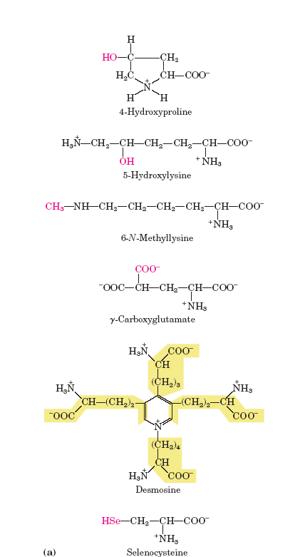

Slide 18
ii) Non-protein amino acids:
- Found in cells and occur biologically in free or combined form but not in proteins.
Example:
ornithine and citrulline they are intermediates in biosynthesis of arginine and in the urea cycle.

Slide 19
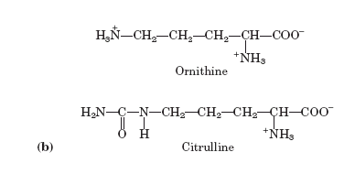

Slide 20
B) Nutritional classification:
i) Essential amino acids:
(can not be synthesized in the body, must be provided in diet).
Valine
Leucine
Isoleucine
Methionine
Phenylalanine
Tryptophan
Threonine
Lysine
Arginine
Histidine
ii) Non-essential amino acids: (they synthesized in the body).

Slide 21
C) Metabolic classification:
i) Glucogenic amino acids:
- which give glucose
e.g., glycine, serine, arginine,
glutamic acid.
ii) Ketogenic amino acids:
- That gives ketone bodies.
e.g., leucine
iii) Glucogenic and ketogenic amino acids:
- give both glucose ketone bodies.
e.g., phenylalanine, tyrosine, tryptophan, isoleucine

Slide 22
Properties of amino acids:
1) Optical activity of amino acids:
All standard amino acids except glycine have an asymmetric carbon atom [α-carbon atom bound to four different substituent groups (i.e., a carboxyl group, amino group, R-group, and a hydrogen atom)].
-The asymmetric α-carbon atom is thus a chiral center.
-Because amino acids that obtained from the hydrolysis of proteins have one or more asymmetric carbon atoms
The α-carbon atom of all amino acids except glycine is asymmetric, and thus amino acids exist in two stereoisomeric forms: L-isomer, D-isomer.

Slide 23
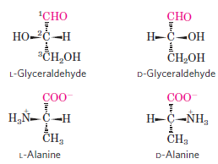
L- and D-isomer of amino acid depend on the configuration of the four different substituents around the asymmetric carbon atom.
Example:

Slide 24
-Nearly all biologically occurring compounds containing asymmetric carbon atom are found in nature in only one stereoisomers form either D or L.
-Except for glycine, the amino acids present in protein molecules are L-stereoisomers.
-When a compound has two or more asymmetric carbon atom, it has 2^{n} possible stereoisomers
(n = number of asymmetric carbon atoms).

Slide 25
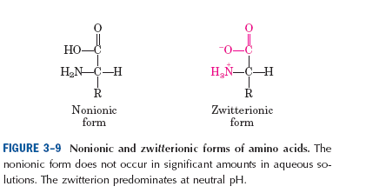
2) All amino acids contain α-carboxyl group and
α-amino group.(and functional groups in the side chain of some amino acids)
All these groups determine the physical and chemical properties of amino acids.
3) Amino acids are ionized in water solution and form dipolar ion or zwitterion.

Slide 26
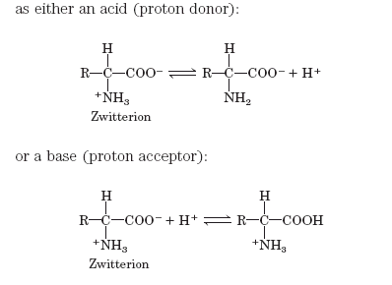
4) Amino acids are soluble in polar solvent (e.g., water).
5) Amino acids can act as acids and bases:
- Amino acids in aqueous solution are ionized and can act as acid or base:

Slide 27
- Substances having two-way property are amphoteric.
In an electric field:
The amino acid in acidic media will move towards cathode
The amino acid in basic media will move towards anode

Slide 28
6) Isoelectric point or isoelectric pH (pI):
is the pH at which the net electric charge on amino acid is equal to zero.
an amino acid will not move in an electric field.
-Each amino acid has its specific pI.
e.g., glycine has pI = 5.97

Slide 29
7) Titration curve of amino acids:
Titration curve:
is a plot of the pH versus the equivalents of base added during titration of an acid.
Titration curve of glycine:
- Glycine is non-polar amino acid.
- It has one carboxyl group (α-carboxyl group) and one amino group (α-amino group).
- Its titration curve consist of two stages.

Slide 30
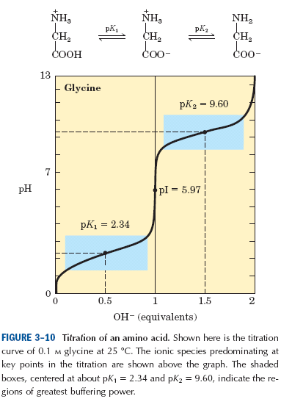

Slide 31
Titration curve of aspartic acid:
- Aspartic acid is a negatively charged amino acid (acidic amino acid)
- It contains two carboxyl groups and one amino group.
- Its titration curve consist of three stages.

Slide 33
Titration curve of lysine:
- Lysine is a positively charged amino acid (basic amino acid).
- It contains one carboxyl group and two amino groups.
- Its titration curve consist of three stages.

Slide 35
8) Absorption spectra:
-Three amino acids (tyrosine, tryptophan, and phenylalanine), absorb light significantly in the ultraviolet.
- Since most proteins contain tyrosine residues, measurement of light absorption at 280 nm in a spectrophotometer is an extremely rapid and convenient means of estimating the protein content of a solution.

Slide 36
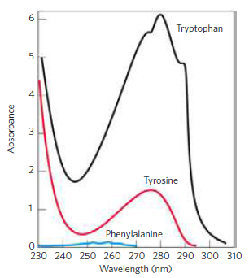
FIGURE 3–6 Absorption of ultraviolet light by aromatic amino acids.
Comparison of the light absorption spectra of the aromatic amino acids
tryptophan, tyrosine, and phenylalanine at pH 6.0.
The measured absorbance of tryptophan is more than four times that of tyrosine at a wavelength of 280 nm.

Slide 37
The chemical reactions of amino acids:
As for all organic compounds, the chemical reactions of amino acids are those characteristic of their functional group. i.e.,
- α-carboxyl group
- α-amino group
- and the functional present in the different side chains.

Slide 38
1) Reaction of carboxyl group:
a) Formation of ester:
b) Formation of amide:

Slide 39
c) Reduction of the α-COOH of amino acid with reducing agent lithium borohydride (LiBH₄) to yield the corresponding primary alcohol.
COOH CH₂OH
H₂N - C – H LiBH₄ H₂N - C – H
R R
d) Decarboxylation

Slide 40
2) Reactions of amino group:
a) Acylated amino acid:
This is by treatment with acid halids.
e.g., formation of the benzyloxy carbomyl (carbobenzoxy) derivative of amino acids.

Slide 42
b) Ninhydrine reaction:
- can be utilized to estimate amino acids quantitatively in very small amounts.
On heating, an α-amino acid reacts with two molecules of ninhydrine to yield an intensly coloured product.
- A purple colour is given in the ninhydrin reaction by all amino acids and peptides having a free α-amino group, whereas proline and hydroxyproline, in which the α-amino group is substituted, yield derivatives with a characteristic yellow colour.

Slide 43
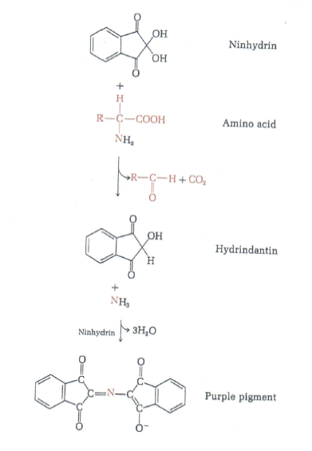

Slide 44
c) Formation of a Schiff′s base:
- The α-amino groups of amino acids react reversibly with aldehydes to form compounds called Schiff′s base.
- Schiff′s bases appear to be intermediates in a number of enzymatic reaction.

Slide 45
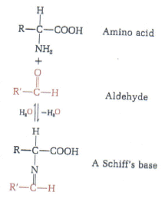

Slide 46
d) Reaction with cyanate:

Slide 47
e) Reaction of α-amino acid with reagent 1-fluoro
2,4 dinitrobenzen (FDNB):
In mild alkaline solution, FDNB reacts with α-amino acids to yield 2,4 dinitrophenyl derivatives.
Useful in identification of individual amino acids.

Slide 48
3) Reaction of the R-groups:
Amino acids show qualitative colour reaction typical of certain functions present in their R-groups.
e.g., - The thiol group of cysteine
- The phenolic hydroxyl group of tyrosine
- The guanidinium group of arginine

Slide 49
A) Reaction of thiol group:
i) Oxidation of cysteine to cystine:
- Oxidation by atmospheric oxygen in the presence of iron salts or by other mild oxidizing agents.
- The oxidation product is cystine, in which the disulfide bond constitute a covalent bridge between two residues of cysteine.

Slide 50
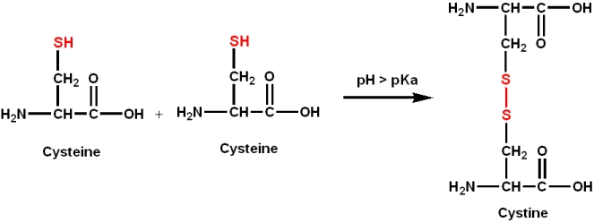

Slide 51
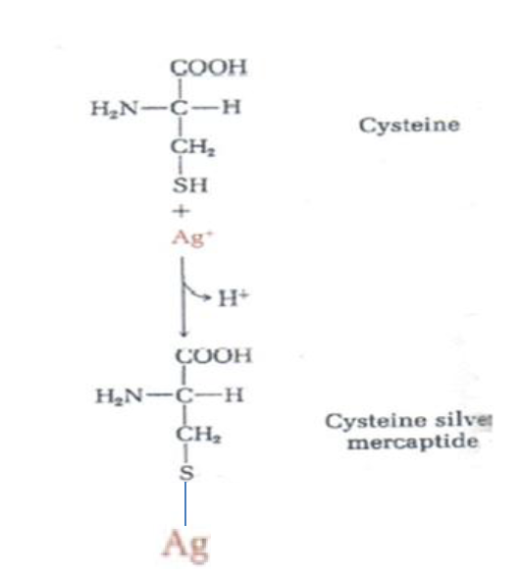
ii) Reaction of cysteine with Ag⁺:
-This is another reaction of thiol group of cysteine with heavy metals such as Hg⁺² and Ag+ which form mercaptides.

Slide 52
iii) Reaction of cysteine with Elman′s reagent:
- The thiol groups of cysteine and cysteine residues in peptides and proteins can be measured by a quantitative reaction with Elman′s reagent, yielding a product that can be measured colorimetrically.

Slide 54
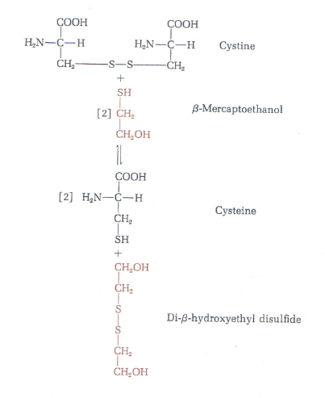
iv) Reduction of cystine to cysteine:

Slide 55
B) Reaction of phenolic hydroxyl group of tyrosine:
i) Millon reaction:
When tyrosine is heated with millon solution (HgSO₄ in H₂SO₄), a red colour is produced.
C) Reaction of guanidinium group of arginine:
i) Sakaguchie test:
The guanidinium group of arginine, react with α-naphthol and sodium hypochlorite to a red colour.

Slide 56
Separation/Purification of amino acids:
Complex mixtures of amino acids can be separated, identified and estimated based on a property such as size or charge by:
● Electrophoresis
● column chromatography:
Fractionation (dialysis)
Ion-exchange chromatography
Affinity chromatography

Slide 57
Paper electrophoresis:
- Its the simplest method for separating amino acids.
● A drop of an aqueous solution of the amino acid mixture is placed on a filter-paper strip moistered with a buffer at a given pH.
● A high-voltage electric field is applied to the strip.
● Because of their different pK values, the amino acids migrate in different directions and at different rates along the strip, depending on the :
• pH of the buffer system
• Voltage applied.

Slide 58
Example:
● At pH 1.0 , histidine, arginine, and lysine have a charge
of +2 and move more rapidly to the negatively charged
cathod than the other amino acids, which have a charge
of +1 .
● At pH 6.0 , the positively charged amino acids (lysine, arginine, histidine) move to the cathode and the negatively charged amino acids (aspartic acid and glutamic acid) to
the anode.
● All the other amino acids will remain at or near the origin, since they have no ionizing groups other than their α-amino and α-carboxyl group and thus have about the same isoelectric point.

Slide 59
● To locate the amino acids on the paper, it is dried, sprayed with ninhydrin and heated.
● Blue or purple spots, each indicating the presence of an amino acid, will appear on the paper.

Slide 60
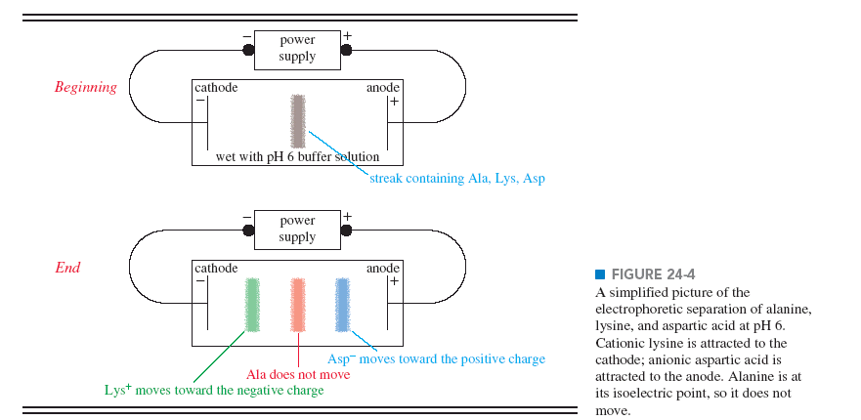

Slide 61
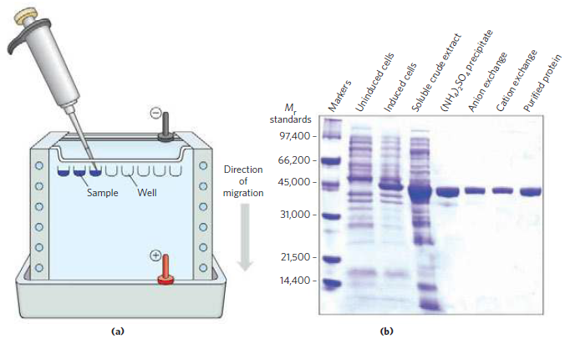

Slide 62
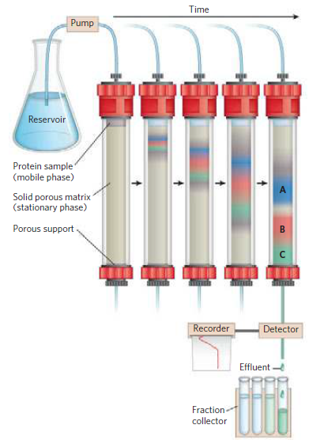

Slide 63
column chromatography
A porous solid material with appropriate chemical properties (the stationary phase) is held in a column
and a buffered solution (the mobile phase) migrates through it

Slide 64
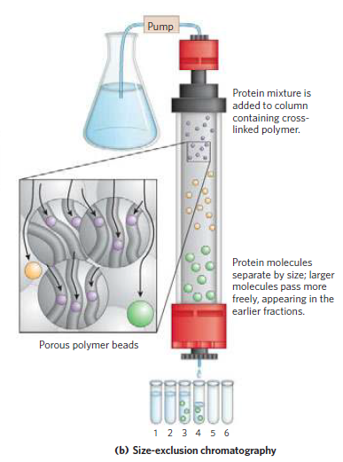

Slide 65
Ion exchange chromatography:
It is the most widely used method for separating, identifying, and quantitating the amounts of each amino acid in a mixture.
- The chromatographic column consists of a long tube filled with the granules of a synthetic resin containing fixed charged groups.
- Resins with fixed anionic groups are called cation exchange resins.
- Resins with fixed cationic groups are anion exchange resins.

Slide 66
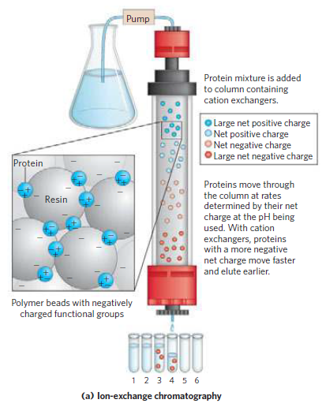

Slide 67
- In the simplest form of ion-exchange chromatography, amino acids can be separated on columns of cation-exchange resins, in which the fixed anionic groups, e.g sulfonic acid groups (-SO₃⁻), are first charged with Na⁺.
●an acid solution (pH 3) of the amino acid mixture to be analyzed is then poured on the column and allowed to percolate through slowly.
-At pH 3 , the amino acids are largely cations with net positive charges.

Slide 68
● As the mixture passes down the column, the positively charged amino acids will displace the bound Na⁺ ions from the fixed (-SO₃⁻) groups of the resin particles.
Example:
• At pH 3.0 , the amino acids with the largest positive charge (lysine, arginine, and histidine) will displace Na+ from the resin first and will be bound to the resin most tightly.
• The amino acids with the least amount of positive charge at pH 3 (glutamic acid and aspartic acid) will be bound
least.
• All the other amino acids will have intermediate amounts of positive charge.

Slide 69
- The different amino acids will therefore move down the resin column at different rates, which depend largely on their pK values.
• glutamic acid and aspartic acid will move down the column at the highest rates, since they bound least at pH 3.0
• whereas lysine, arginine, and histidine will move most slowly.
● small fractions of a few millilitres each collected from the bottom of the column and analyzed quantitatively.

Slide 70
Affinity chromatography
The beads in the column have a covalently attached chemical group called a ligand
For example, if the biological function of a protein involves binding to ATP, then attaching a molecule that resembles ATP to the beads in the column creates an affinity matrix
Chromatographic methods are typically enhanced by the use of HPLC, or high-performance liquid chromatography.
HPLC makes use of high-pressure pumps that speed the movement of the protein molecules down the column

Slide 71
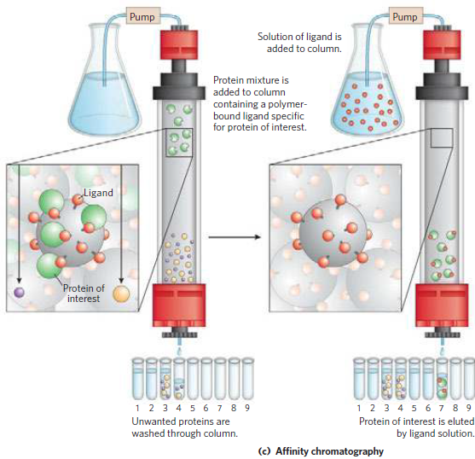

Slide 72
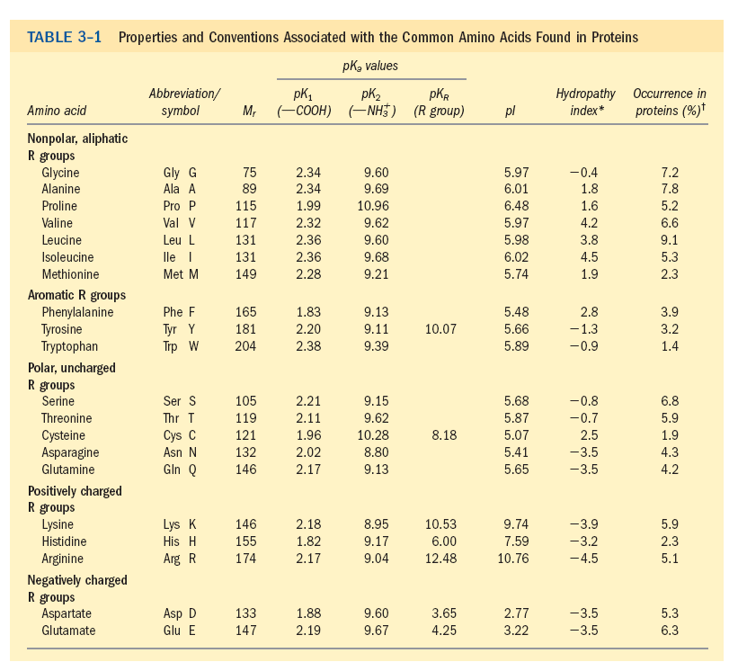

Slide 73
References
Lehninger, A.L., Nelson,D.L., Cox,M.M, Principles of Biochemistry,Worth publishers,Inc.,NewYork .

