Slide 1
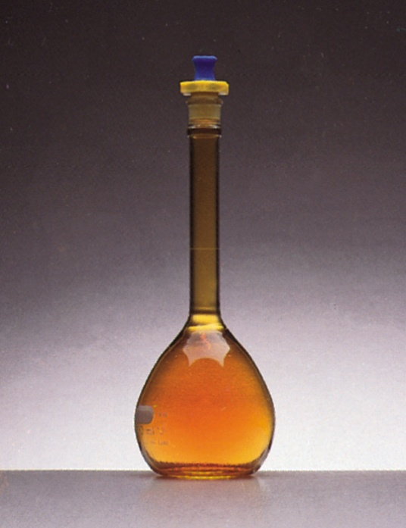
The properties of gases
The perfect gas
Physical Characteristics of Gases
Gases assume the volume and shape of their containers.
Gases are the most compressible state of matter.
Gases will mix evenly and completely when confined to the same container.
Gases have much lower densities than liquids and solids.
NO₂ gas

Slide 2
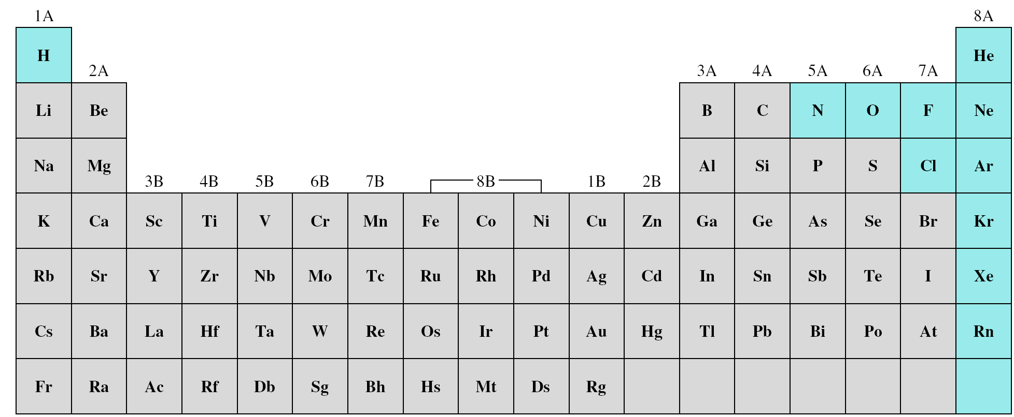
Elements that exist as gases at 25⁰C and 1 atmosphere
Ionic compounds can not be gases at 25 ⁰C and 1 atm because of its strong ionic forces.
Molecular compounds at 25 ⁰C and 1 atm varies; some are gases CO, HCl and others are liquid or solid CH₃OH(l), NaCl (s)
No simple rule to help determine if substance is g or l or s
It depends on magnitude of the intermolecular forces among molecules

Slide 3
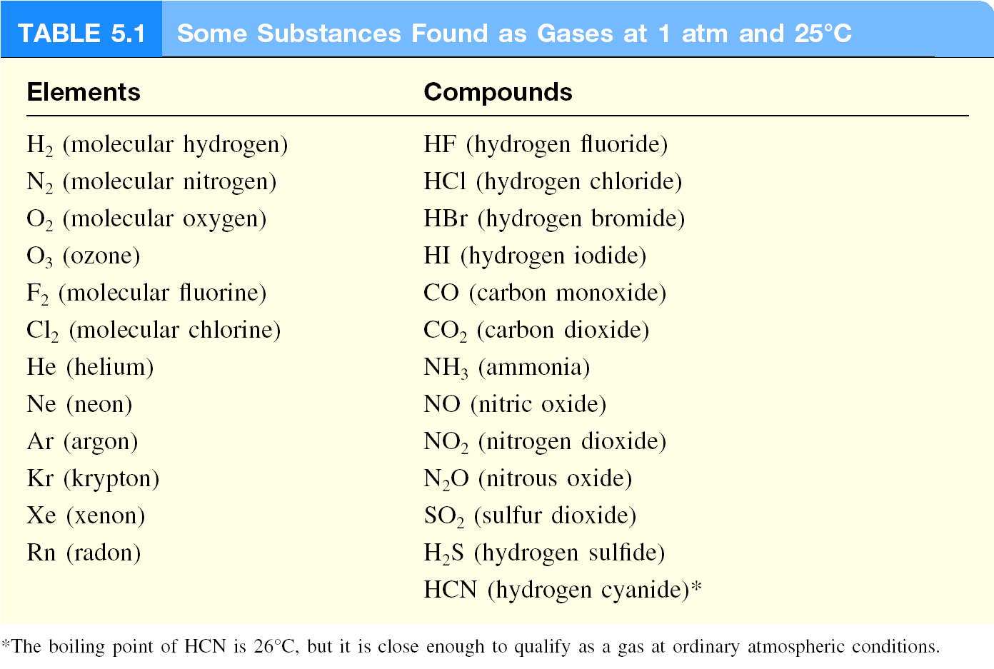

Slide 4
Variables of state
The physical state of a sample of a substance, its physical condition, is defined by its physical properties
The variables needed to specify the state of a system are:
the amount of substance it contains, n.
the volume it occupies, V.
the pressure, p.
the temperature, T.

Slide 5
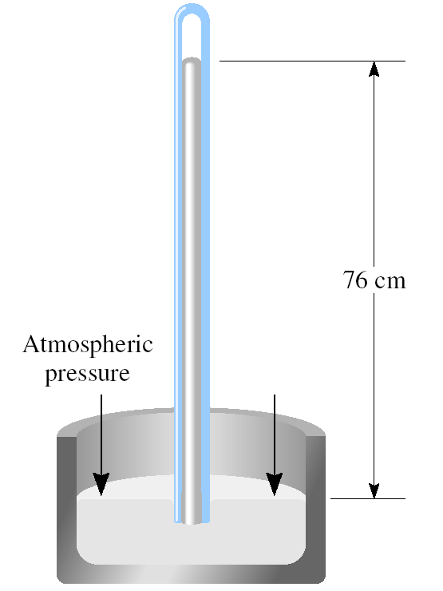
Pressure
Force
Pressure =
Area
(force = mass x acceleration)
Pressure units (Values in bold are exact)
Name | Symbol | Value
pascal | Pa | 1 Pa = 1 N m⁻², 1 kg m⁻¹ s⁻²
bar | bar | 1 bar = 10⁵ Pa
atmosphere | atm | 1 atm = 101.325 kPa
torr | Torr | 1 Torr = (101 325/760) Pa = 133.32… Pa
millimeters of mercury | mmHg | 1 mmHg = 133.322… Pa
pounds per square inch | psi | 1 psi = 6.894 757… kPa
(
a
)
High
Movable
Low
pressure
wall
pressure
Equal pressures
Equal pressures
(
c
)
Low
High
pressure
pressure
When a region of high pressure is separated from a region of low pressure by a movable wall, the wall will be pushed into one region or the other, as in (a) and (c). However, if the two pressures are identical, the wall will not move (b). The latter condition is one of mechanical equilibrium between the two
regions.
A pressure of 1 bar is the standard pressure for reporting data; it is denoted p⦵.

Slide 6
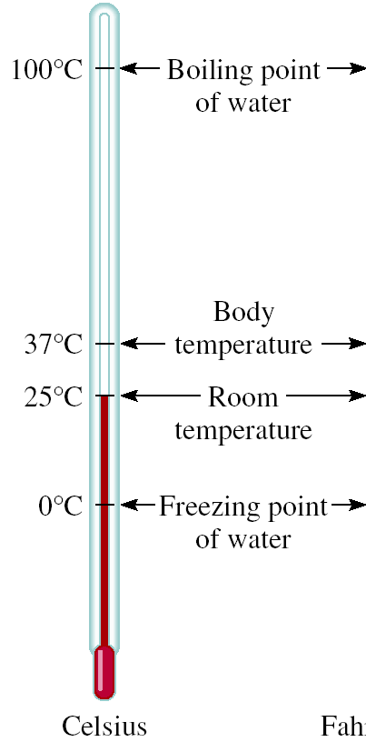
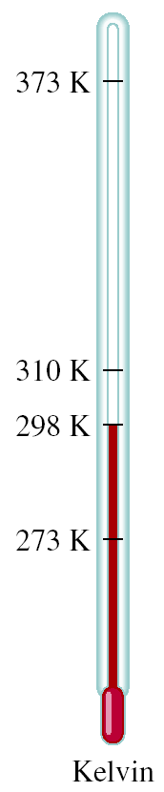
Temperature
T/K = θ /ºC + 273.15
273 K = 0 ⁰C
373 K = 100 ⁰C
The Kelvin Scale is known as the perfect-gas temperature scale
Or more commonly
The thermodynamic temperature scale
Note that T is reported in K and not in ºK

Slide 7
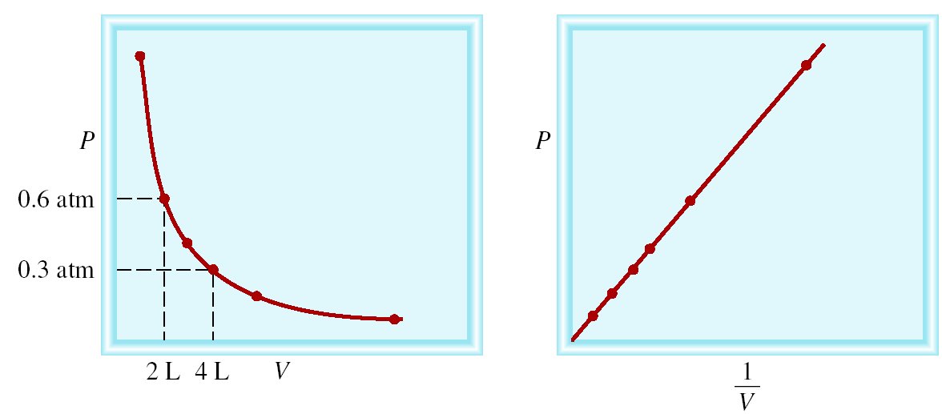
Equations of state
It is an experimental fact that each substance is described by an equation of state, an equation that interrelates the four variables n, V, p, and T.
The general form of an equation of state is
p = f (T,V,n)
The equation of state of a perfect gas was established by combining a series of empirical laws.
1) Boyle’s law
p
Pressure,
Increasing
temperature,
T
Extrapolation
0
0
1
/Volume,
P α 1/V
1
/
V
P x V = constant
Constant T and n
P₁ x V₁ = P₂ x V₂

Slide 8
Example: A sample of chlorine gas occupies a volume of 946 mL at a pressure of 726 mmHg. What is the pressure of the gas (in mmHg) if the volume is reduced at constant temperature to 154 mL?
Soln:
P x V = constant
P₁ x V₁ = P₂ x V₂
P₁ = 726 mmHg
P₂ = ?
V₁ = 946 mL
V₂ = 154 mL
P₁ x V₁
726 mmHg x 946 mL
P₂ =
=
= 4460 mmHg
V₂
154 mL

Slide 9
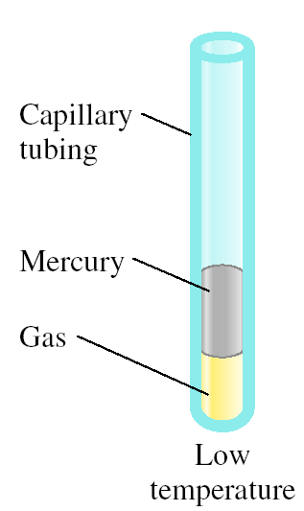
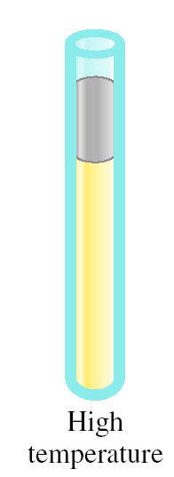
2) Charles’ Law
Variation in V with T at p & n
As T increases
V increases

Slide 10
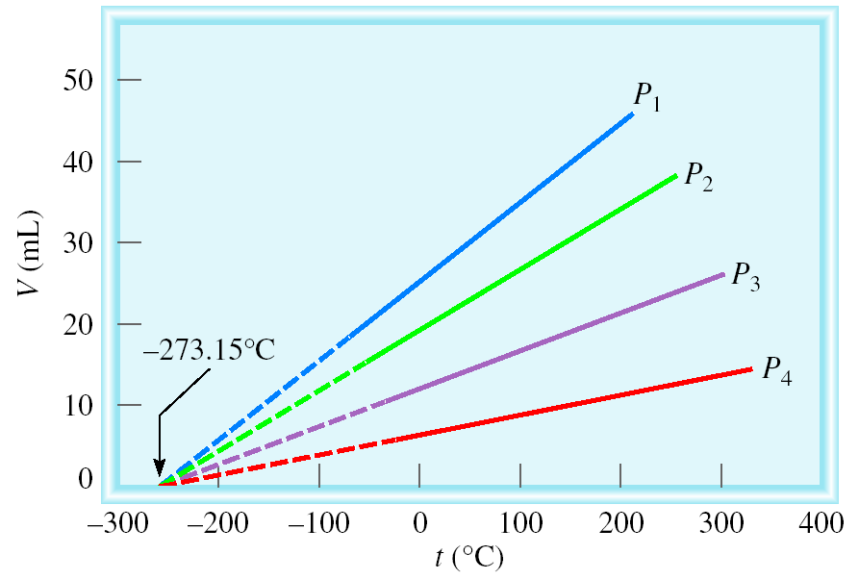
Charles’ Law
p
Pressure,
Decreasing
volume,
V
Extrapolation
0
0
Temperature,
T
V α T
At constant p and n
p α T
V = constant x T
At constant V and n
p = constant x T
V₁/T₁ = V₂ /T₂
p₁/T₁ = p₂ /T₂
Temperature must be in Kelvin
T (K) = θ (⁰C) + 273.15

Slide 11
Example: A sample of carbon monoxide gas occupies 3.20 L at 125 ⁰C. At what temperature will the gas occupy a volume of 1.54 L if the pressure remains constant?
Soln:
V₁ /T₁ = V₂ /T₂
V₁ = 3.20 L
V₂ = 1.54 L
T₁ = 398.15 K
T₂ = ?
T₁ = 125 (⁰C) + 273.15 (K) = 398.15 K
V₂ x T₁
1.54 L x 398.15 K
T₂ =
=
= 192 K
V₁
3.20 L

Slide 12
3) Avogadro’s Law
V α number of moles (n)
Constant temperature
Constant pressure
V = constant x n
V₁ / n₁ = V₂ / n₂
4) Ideal Gas Equation of state
When we combine the empirical observations:
Boyle’s law: pV = constant, at constant n, T
Charles’s law: V = constant × T, at constant n, p
p = constant × T, at constant n, V (1A.3c)
Avogadro’s principle:
V = constant × n at constant p, T (1A.3d)
we get the single expression:
pV = constant × nT
Or
pV = nRT
This expression is the perfect gas law (or perfect gas equation of state)
R is called the (molar) gas constant, one of the most important universal constants
R =
8.314 47 | J K⁻¹ mol⁻¹
8.205 74 × 10⁻² | dm³ atm K⁻¹ mol⁻¹
8.314 47 × 10⁻² | dm³ bar K⁻¹ mol^{–1}
8.314 47 | Pa m3 K−1 mol–1
62.364 | dm³ Torr K⁻¹ mol^{–1}
1.987 21 | cal K⁻¹ mol⁻¹
The gas constant is now defined as R = N_{A}k, where N_{A} is Avogadro’s constant and k is Boltzmann’s constant.

Slide 13
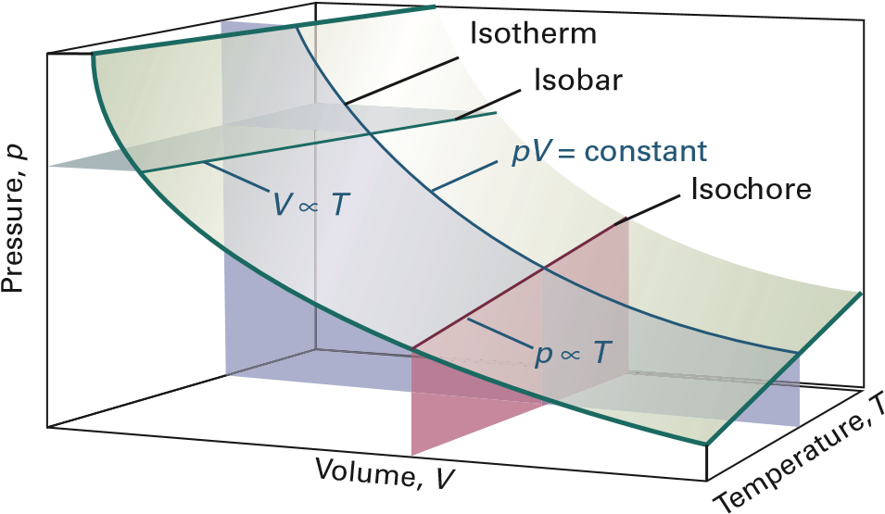
For a given amount of perfect gas:
Sections at constant temperature show the pressure–volume dependence of a perfect gas at different temperatures. Each curve is a hyperbola (pV = constant) and is called an isotherm.
Sections at constant pressure give the variation of the volume of a gas with the temperature at constant pressure which are called Isobars.
Sections at constant volume give the pressure of a perfect gas linear variation with the temperature at constant volume which are called isochores.

Slide 14


Example: In an industrial process, nitrogen gas is introduced into a vessel of constant volume at a pressure of 100 atm and a temperature of 300 K. The gas is then heated to 500 K. What pressure would the gas then exert, assuming that it behaved as a perfect gas?
Soln:
P₁V₁
P₂V₂
pV = nRT
pV/nT = R
=
n₁T₁
n₂T₂
summarize the known and unknown data as follows:
n p V T
Initial Same 100 atm Same 300 K
Final Same ? Same 500 K
Cancellation of the volumes (because V1 = V2) and amounts (because n1 = n2) on each side of the combined gas law results in
P₁
P₂
p₂$=\frac{T2}{T1}\text{p}\text{1}$
=
T₁
T₂
p₂$=\frac{500 K}{300 K} \text{x}\text{ (}\text{100 }\text{atm}\text{)}$ = 167 atm

Slide 15



5) Mixtures of gases
When dealing with gaseous mixtures, it is often necessary to know the contribution that each component makes to the total pressure of the sample.
The partial pressure, p_{J}, of a gas J in a mixture (any gas, not just a perfect gas), is defined as
$$pJ=xJp$$
Where x_{J} is the mole fraction of gas J and defined as
$$xJ=\frac{nJ}{n} where n=nA+nB+ …$$
It should be noted that by the definition of x_{J},
$$xA+xB+ …=1$$
And
$$p=pA+pB+ …=xAp+xBp+ …=\left(xA+xB+ …\right)p$$
This identification was the basis of the original formulation of Dalton’s law:
“The pressure exerted by a mixture of gases is the sum of the pressures that each one would exert if it occupied the container alone.”

Slide 16



Example: The mass percentage composition of dry air at sea level is approximately N2: 75.5; O2: 23.2; Ar: 1.3. What is the partial pressure of each component when the total pressure is 1.20 atm?
Soln:
Assume 100 g of air then the amounts of each type of atom or molecule present in 100 g of air are N₂, O₂, and Ar are 75.5 g, 23.2 g, and 1.3 g, respectively.
Now, find the number of moles for each gas:
$n\left(N2\right)=\frac{75.5 g}{28.02 g /mol}=$ 2.69 mol
$n\left(O2\right)=\frac{23.2 g}{32.00 g /mol}=$ 0.725 mol
$n\left(Ar\right)=\frac{1.3 g}{39.95 g /mol}=$ 0.033 mol
$$n=n\left(N2\right)+n\left(O2\right)+n\left(Ar\right)=2.69+0.725+0.033=3.45 mol$$
 | N₂ | O₂ | Ar
Mole fraction: | 0.780 | 0.210 | 0.0096
Partial pressure/atm: | 0.936 | 0.252 | 0.012

Slide 17
The kinetic model
One of the most remarkable models in physical chemistry, from a set of very slender assumptions, powerful quantitative conclusions can be reached.
The kinetic model is based on three assumptions:
1. The gas consists of molecules of mass m in ceaseless random motion obeying the laws of classical mechanics.
2. The size of the molecules is negligible, in the sense that their diameters are much smaller than the average distance travelled between collisions; they are ‘point-like’.
3. The molecules interact only through brief elastic collisions.
An elastic collision is a collision in which the total translational kinetic energy of the molecules is conserved.

Slide 18




(a) Pressure and molecular speeds
From the very economical assumptions of the kinetic model, it is possible to derive an expression that relates the pressure and volume of a gas.
HOW
Step 1 Set up the calculation of the change in momentum
mv
Before
x
The pressure of a gas arises from the impact of its molecules on the walls.
collision
The x-component of momentum changes by 2mvx on each collision
Many molecules collide with the wall in an interval Δt
–mv
x
After
The total change of momentum is the product of the change in momentum of each molecule multiplied by the number of molecules that reach the wall during the interval.
collision
x
Step 2 Calculate the change in momentum
|
v
Δ
t
x
|
A molecule will reach the wall on the right within an interval of time Δt if it is within a distance vx Δt of the wall and travelling to the right
Area,
A
Won’t
Will
the number of molecules in the volume AvxΔt is (nNA/V ) × Avx Δt.
Momentum change $=\frac{nNAAvxΔt}{2V} x$ 2m$vx$ = $\frac{nmNAAv2x Δt}{V}$ = $\frac{nMAv2x Δt}{V}$
x
Δ
Volume = |
v
x
t
|
A

Slide 19







Step 3 Calculate the force
Rate of change of momentum
= $\frac{nMAv2x }{V}$
According to Newton’s second law of motion this rate of change of momentum is equal to the force.
Step 4 Calculate the pressure
The pressure is this force (nMAv ²x /V ) divided by the area (A) on which the impacts occur
Pressure = $\frac{nMv_{x}^{2} }{V}$
Not all the molecules travel with the same velocity, so the detected pressure, p, is the average (denoted 〈…〉)
p = $\frac{nM<v2x > }{V}$
$v2=v_{x}^{2}$+$v_{y}^{2}$+$v_{z}^{2}$
$\left\langle v_{x}^{2}\right\rangle$= $\frac{1}{3}\left\langle v2\right\rangle$
At this stage it is useful to define the root-mean-square speed, vrms, as the square root of the mean of the squares of the speeds, v, of the molecules
$vrms$= $\left\langle v2\right\rangle 1l2$
$pV$=$\frac{1}{3}nMv_{\text{rms}}^{2}$
This equation is one of the key results of the kinetic model
If the root-mean-square speed of the molecules depends only on the temperature, then at constant temperature
pV = constant

Slide 20







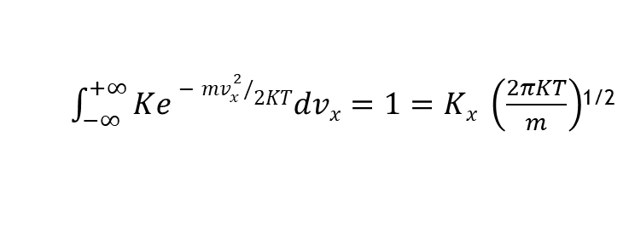

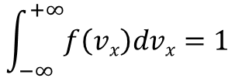
(b) The Maxwell–Boltzmann distribution of speeds
The fraction of molecules that have speeds in the range v to v + dv is proportional to the width of the range, and is written f (v)dv, where f (v) is called the distribution of speeds
The energy of the molecules is entirely kinetic, and we can use the Boltzmann distribution to describe how this energy is distributed over the molecules
HOW
Step 1 Write an expression for the distribution of the kinetic energy
f(v) = Ke^{−ε/kT}
Boltzmann distribution
$∈ ={\frac{1}{2}mv}_{x}^{2}$ + ${\frac{1}{2}mv}_{y}^{2}$ + ${\frac{1}{2}mv}_{z}^{2}$
$f\left(v\right)=Ke−({mv}_{x}^{2}$ ⁺ ${mv}_{y}^{2}$ ⁺ ${mv}_{z}^{2})/2KT$ = $Ke−{mv}_{x}^{2}/2KT$e $−{mv}_{y}^{2}/2KT$ e $−{mv}_{z}^{2}/2KT$
$$f \left(v\right)=f\left(vx\right)f\left(vy\right)f(vz)$$
and
$$K=Kx Ky Kz$$
$$f\left(vx\right)=Kxe−{mv}_{x}^{2}/2KT$$
$$f\left(vy\right)=Kye−{mv}_{y}^{2}/2KT$$
$$f\left(vz\right)=Kze−{mv}_{z}^{2}/2KT$$
Step 2 Determine the constants Kx, Ky, and Kz
To determine the constant Kx, note that a molecule must have a velocity component somewhere in the range −∞ < vx < ∞, so integration over the full range of possible values of vx must give a total probability of 1:
$$\int_{−∞}^{+∞}{f\left(vx\right)dvx=1}$$
$\int_{−∞}^{+∞}{Ke−{mv}_{x}^{2}/2KTdvx=1}=Kx \left(\frac{2πKT}{m}\right)$^{1/2}
$Kx=\left(\frac{m}{2πKT}\right)$^{1/2}
$$f\left(vx\right)=\left(\frac{m}{2πKT}\right)\text{1}\text{/}\text{2}e−{mv}_{x}^{2}/2KT$$
With similar expressions for the y and z components

Slide 21




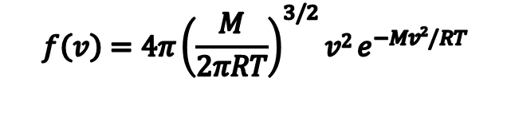
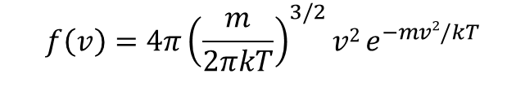
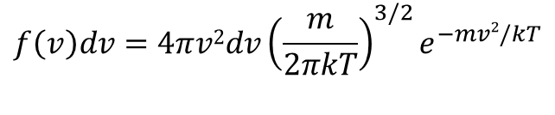
Step 3 Calculate the probability that a molecule has a speed in the range v to v + dv
v
To evaluate the probability that a molecule has a speed in the range v to v + dv, evaluate the total probability that the molecule will have a speed that is anywhere in a thin shell of radius v = (v ²_{x} + v ²_{y} + v ²_{z})^{1/2} and thickness dv.
Surface area, 4πv²
z
Thickness, dv
v
$$f\left(v\right)dv=4πv2dv{\left(\frac{m}{2πkT}\right)}^{3/2}e^{−mv2/kT}$$
v
y
v
x
$$f\left(v\right)=4π{\left(\frac{m}{2πkT}\right)}^{3/2}{v2 e}^{−mv2/kT}$$
Because R = N_{A}k , m/k = mN_{A}/R = M /R, it follows that
$$f\left(v\right)=4π{\left(\frac{M}{2πRT}\right)}^{3/2}{v2 e}^{−Mv2/RT}$$
The function f (v) is called the Maxwell–Boltzmann distribution of speeds.
Note that, in common with other distribution functions, f (v) acquires physical significance only after it is multiplied by the range of speeds of interest.

Slide 22
Low temperature
)
or high molecular mass
v
(
f
Intermediate temperature or
Distributiion function,
molecular mass
High temperature or
low molecular mass
0
0
Speed,
v
Decaying exponential function (more specifically, a Gaussian function). Its presence implies that the fraction of molecules with very high speeds is very small because e−x2 becomes very small when x is large.
The factor M/2RT multiplying v2 in the exponent is large when the molar mass, M, is large, so the exponential factor goes most rapidly towards zero when M is large. That is, heavy molecules are unlikely to be found with very high speeds.
The opposite is true when the temperature, T, is high: then the factor M/2RT in the exponent is small, so the exponential factor falls towards zero relatively slowly as v increases. In other words, a greater fraction of the molecules can be expected to have high speeds at high temperatures than at low temperatures.
A factor v ² (the term before the e) multiplies the exponential. This factor goes to zero as v goes to zero, so the fraction of molecules with very low speeds will also be very small whatever their mass.
The remaining factors (the term in parentheses in eqn 1B.4 and the 4π) simply ensure that, when the fractions are summed over the entire range of speeds from zero to infinity, the result is 1.

Slide 23



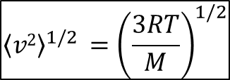

(c) Mean values
With the Maxwell–Boltzmann distribution in hand, it is possible to calculate the mean value of any power of the speed by evaluating the appropriate integral.
For example, to calculate the fraction, F, of molecules with speeds in the range v1 tov2 evaluate the integral
$$F\left(v1,v2\right)=\int_{v1}^{v2}{f\left(v\right)dv}$$
The average value of v ^{n} is calculated as
$$\left\langle vn\right\rangle =\int_{0}^{∞}{vn f\left(v\right)dv}$$
In particular, integration with n = 2 results in the mean square speed, 〈v ² 〉, of the molecules at a temperature T:
$$\left\langle v2\right\rangle =\frac{3RT}{M}$$
Mean square speed [KMT]
$${\left\langle v2\right\rangle }^{1/2} ={\left(\frac{3RT}{M}\right)}^{1/2}$$
Root-mean-square speed [KMT]
To calculate the mean speed vmean , we need to evaluate the integral
$vmean=4π{\left(\frac{M}{2πRT}\right)}^{3/2}\int_{0}^{∞}{v f\left(v\right)e^{−Mv2/2RT} dv}$= $4π{\left(\frac{M}{2πRT}\right)}^{3/2}$x $\frac{1}{2}$ ${\left(\frac{2RT}{M}\right)}^{2}$
= ${\left(\frac{8RT}{πM}\right)}^{1/2}={\left(\frac{8}{3π}\right)}^{1/2}vrms$
Mean speed [KMT]

Slide 24


The most probable speed, v_{mp} , can be identified from the location of the peak of the distribution by differentiating f (v) with respect to v and looking for the value of v at which the derivative is zero
$v$_{mp}= ${\left(\frac{2RT}{M}\right)}^{1/2}={\left(\frac{2}{3}\right)}^{1/2}vrms$
Most probable speed [KMT]
The mean relative speed, v _{rel} , the mean speed with which one molecule approaches another of the same kind, can also be calculated from the distribution:
$v$_{rel}=${\left(2\right)}^{1/2}vmean$
Mean relative speed [KMT, identical molecules]
v
= (2
RT
1
/
2
/
M
mp
)
2
v
=
(8
RT
π
1
/
2
/
M
/
)
3
)
mean
RT
v
= (3
RT
1
/
2
/
M
π
rms
)
/2
M
(
π
4
/
)
v
(
f
1
1
/
2
v
/(2
RT
1
/
2
/
M
(3
)
(4
π
1
/
2
/
2)
/
)

Slide 25
Example: Calculate v_{rms} , v_{mean}, v_{mp} and v_{rel} of N₂ molecules at 25 °C.
Soln:
$vrms={\left(\frac{3RT}{M}\right)}^{1/2}$= ${\left(\frac{3 x 8.3145 J {mol}^{−1}K^{−1}x 298 K}{0.028 kg{ mol}^{−1}}\right)}^{1/2}$= 515 ms⁻¹
$vmean={\left(\frac{8RT}{πM}\right)}^{1/2}$= ${\left(\frac{8 x 8.3145 J {mol}^{−1}K^{−1}x 298 K}{3.14 x 0.028 kg{ mol}^{−1}}\right)}^{1/2}$= 475 ms⁻¹
$vmp={\left(\frac{2RT}{M}\right)}^{1/2}$= ${\left(\frac{2 x 8.3145 J {mol}^{−1}K^{−1}x 298 K}{ 0.028 kg{ mol}^{−1}}\right)}^{1/2}$= 420.7 ms⁻¹
$vrel={\left(2\right)}^{1/2}vmean$=${\left(2\right)}^{1/2} x 475$= 671.8 ms⁻¹

Slide 26
Maxwell distribution of speeds

Slide 27
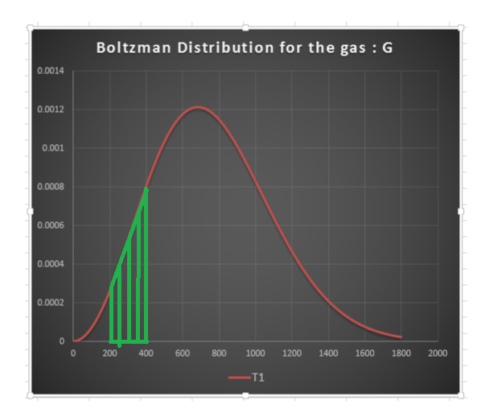
Maxwell distribution of speeds
v₁ = 200 m s⁻¹ ; v₂ = 400 m s⁻¹

Slide 28
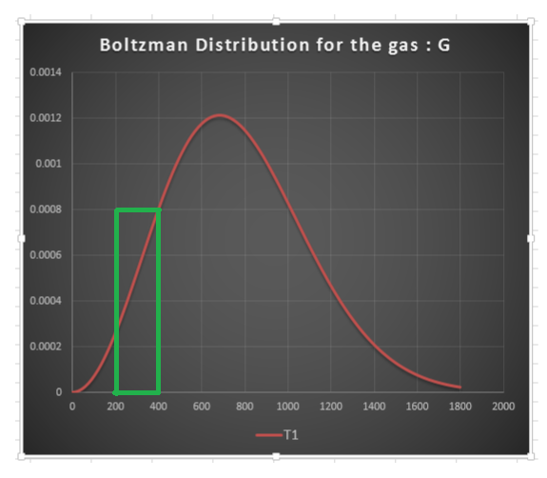
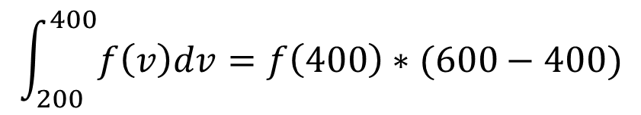
Maxwell distribution of speeds
v₁ = 200 m s⁻¹ ; v₂ = 400 m s⁻¹
$$\int_{200}^{400}{f\left(v\right)dv=f\left(400\right)∗(600−400)}$$

Slide 29
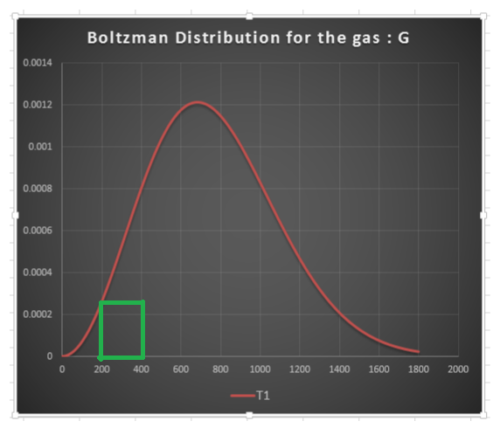
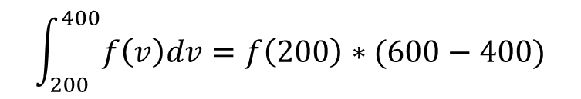
Maxwell distribution of speeds
v₁ = 200 m s⁻¹ ; v₂ = 400 m s⁻¹
$$\int_{200}^{400}{f\left(v\right)dv=f\left(200\right)∗(600−400)}$$

Slide 30
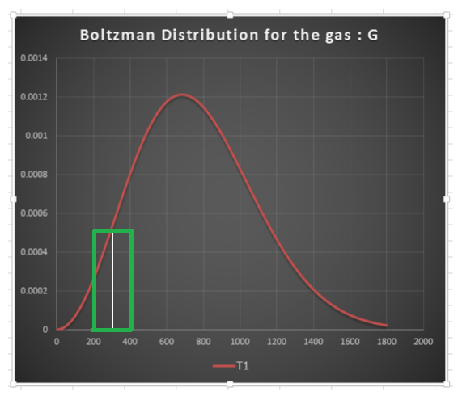

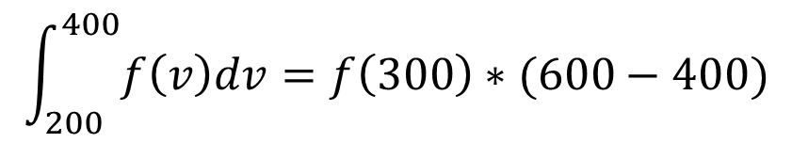
Maxwell distribution of speeds
v₁ = 200 m s⁻¹ ; v₂ = 400 m s⁻¹
$$\int_{200}^{400}{f\left(v\right)dv=f\left(300\right)∗(600−400)}$$
$$=0.0005∗200=0.1=10\%$$

Slide 31








Collisions
(a) The collision frequency
Miss
z = σ vrel N
Collision frequency [KMT]
Δ
v
rel
t
N= $\frac{N}{V}=\frac{nNA}{V}=\frac{nNA}{nRT/p}=\frac{pNA}{RT}= \frac{p}{kT}$
z = $\frac{\text{σ} \text{v}\text{rel} p}{kT}$
Collision frequency [KMT]
d
Hit
d
Collision cross-sections of some molecules
 | σ/nm²
C₆H₆ | 0.88
CO₂ | 0.52
He | 0.21
N₂ | 0.43
σ
Area,
Example: Calculate the collision frequency of N₂ molecules at 25 °C and 1 atm.
Soln:
v_{rel} from the previous example is 671 m s⁻¹ and 1atm equals 1.01 x 10⁵ pa
z = $\frac{\text{σ} \text{v}\text{rel} p}{kT}= \frac{\left(0.43 x {10}^{−18} m^{2}\right)x 671 ms^{−1} x (1.01 x {10}^{5} pa)}{\left(1.381 x {10}^{−23} JK^{−1}\right)x 298 K}=7.4 x{10}^{9} s^{−1}$

Slide 32


(b) The mean free path
The mean free path, λ (lambda), is the average distance a molecule travels between collisions.
$λ$ = $\frac{vrel}{z}=\frac{kT}{σp}$
Mean free path [KMT]
Example: Calculate the mean free path for N₂ molecules at 25 °C and 1 atm.
Soln:
From previous examples, we found that v_{rel} = 671 ms⁻¹ and z = 7.4 x 10⁹ s⁻¹ for N₂ molecules at the same conditions.
$λ$ = $\frac{vrel}{z}=\frac{671 {ms}^{−1}}{7.4 x {10}^{9} s^{−1}}=9.1 x {10}^{−8} m$ = 91 nm

Slide 33
Real gases
Deviations from perfect behaviour
Real gases do not obey the perfect gas law exactly except in the limit of p → 0. Deviations from the law are particularly important at high pressures and low temperatures, especially when a gas is on the point of condensing to liquid
molecules interact with one another
The dependence of the potential energy of two molecules on their internuclear separation. High positive
potential energy (at very small separations) indicates that the interactions between them are strongly repulsive at these distances. At intermediate separations, attractive interactions dominate. At large separations (far to the right) the potential energy is zero and there is no interaction between the molecules.
p
E
Potential energy,
Repulsion dominant
0
Attraction dominant
Internuclear separation

Slide 34

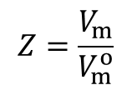
The compression factor Z
The compression factor, Z, is the ratio of the measured molar volume of a gas, V_{m} = V/n, to the molar volume of a perfect gas, V_{m}°, at the same pressure and temperature:
$$Z=\frac{V_{m}}{V_{m}^{o}}$$
Because the molar volume of a perfect gas is equal to RT/p
$pV_{m}$=RTZ
For a perfect gas Z = 1 under all conditions
Deviation of Z from 1 is a measure of departure from perfect behavior.
C
H
2
4
Z
CH
4
The variation of the compression factor, Z, with pressure for several gases at 0 °C. A perfect gas has Z = 1 at all pressures. Notice that, although the curves approach 1 as p → 0, they do so with different slopes.
H
2
Compression factor,
Perfect
1
H
Z
2
p
/atm
10
0.98
CH
4
NH
0.96
NH
C
H
3
3
2
4
0
200
400
600
800
p
/atm

Slide 35
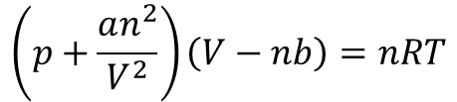

The van der Waals equation
The equation introduced by J.D. van der Waals in 1873 is an excellent example of an expression that can be obtained by thinking scientifically about a mathematically complicated but physically simple problem; that is, it is a good example of ‘model building’.
Two corrections have to be made to the perfect gas equation
First, the volume has to be corrected by taking into account the part of the volume that is occupied by the molecules by subtracting the physical molar volume of the molecules them selves (nb) from the volume of the container.
$$V_{perfect gas}=V_{container}−nb$$
Where n is the number of moles and b is the physical volume of one mole of the molecules. It is constant for each gas.
Second, the pressure of the perfect gas has to be corrected by adding the pressure lost by ignoring the repulsive and attractive forces between molecules. This pressure is directly proportional to n ²/V ² or equals to an ²/V ² where a is the proportionality constant that is a characteristic for each gas.
Introducing these two corrections into the perfect gas law, we get the van der Waals equation
$$\left(p+\frac{an^{2}}{V^{2}}\right)\left(V−nb\right)=nRT$$
The van der Waals equation of state
van der Waals coefficients
 | a/(atm dm⁶ mol⁻²) | b/(10⁻² dm³ mol⁻)
Ar | 1.337 | 3.20
CO₂ | 3.610 | 4.29
He | 0.0341 | 2.38
Xe | 4.137 | 5.16

