Slide 2
Chapter 8 Equilibrium
Section 8.1 Torque and Static Equilibrium
Section 8.2 Stability and Balance

Slide 3
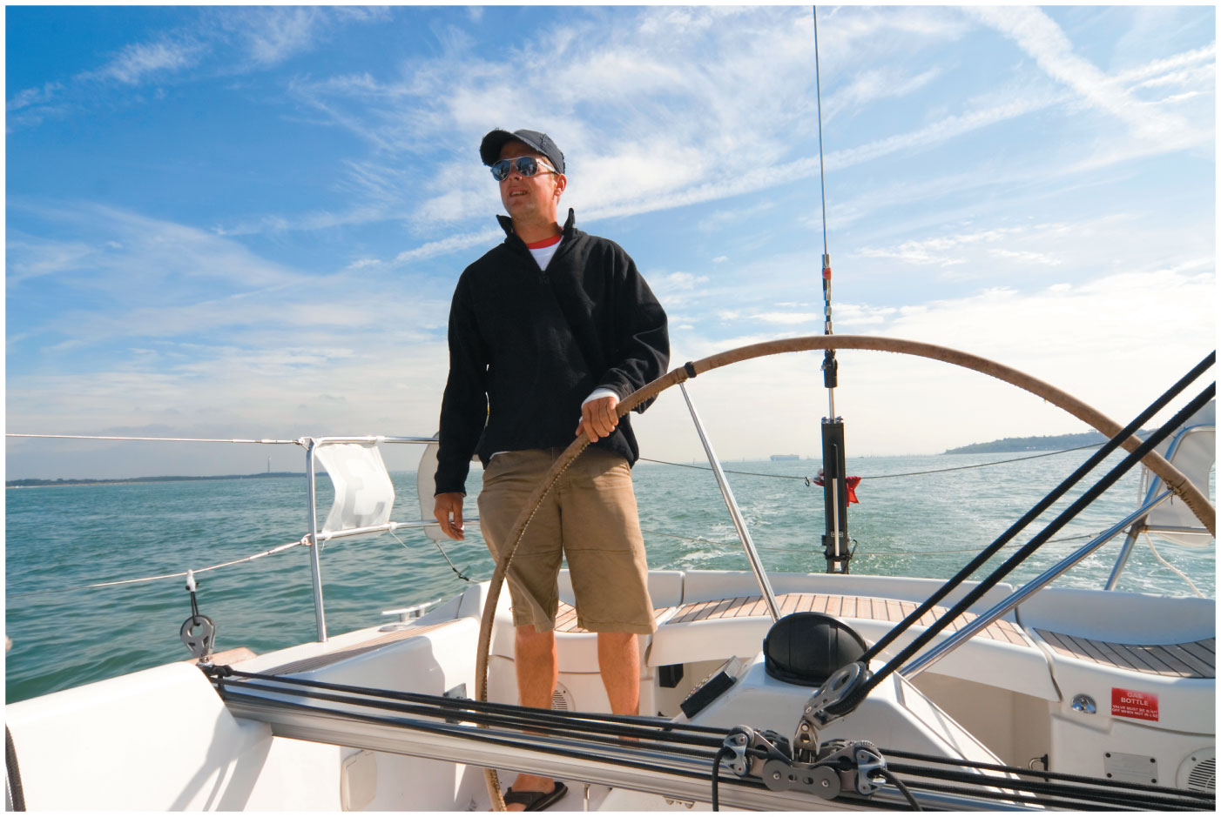
Introduction to the torque
To start something moving, apply a force. To start something rotating, apply a torque, as the sailor is doing to the wheel.
You’ll see that torque depends on how hard you push and also on where you push. A push far from the axle gives a large torque.

Slide 4
Section 8.1 Torque and Static Equilibrium

Slide 5
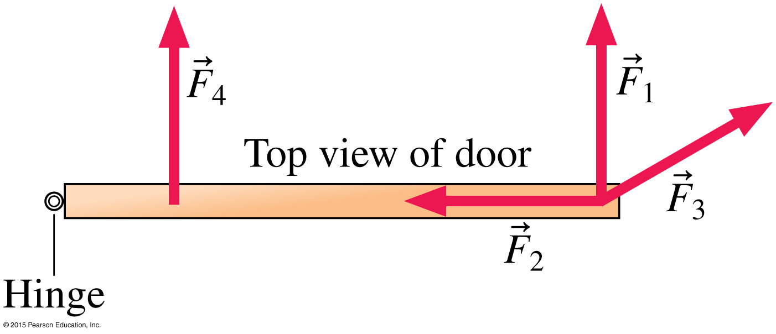
Torque
Forces with equal strength will have different effects on a swinging door.
The ability of a force to cause rotation depends on
The magnitude F of the force.
The distance r from the pivot—the axis about which the object can rotate—to the point at which force is applied.
The angle at which force is applied.

Slide 6
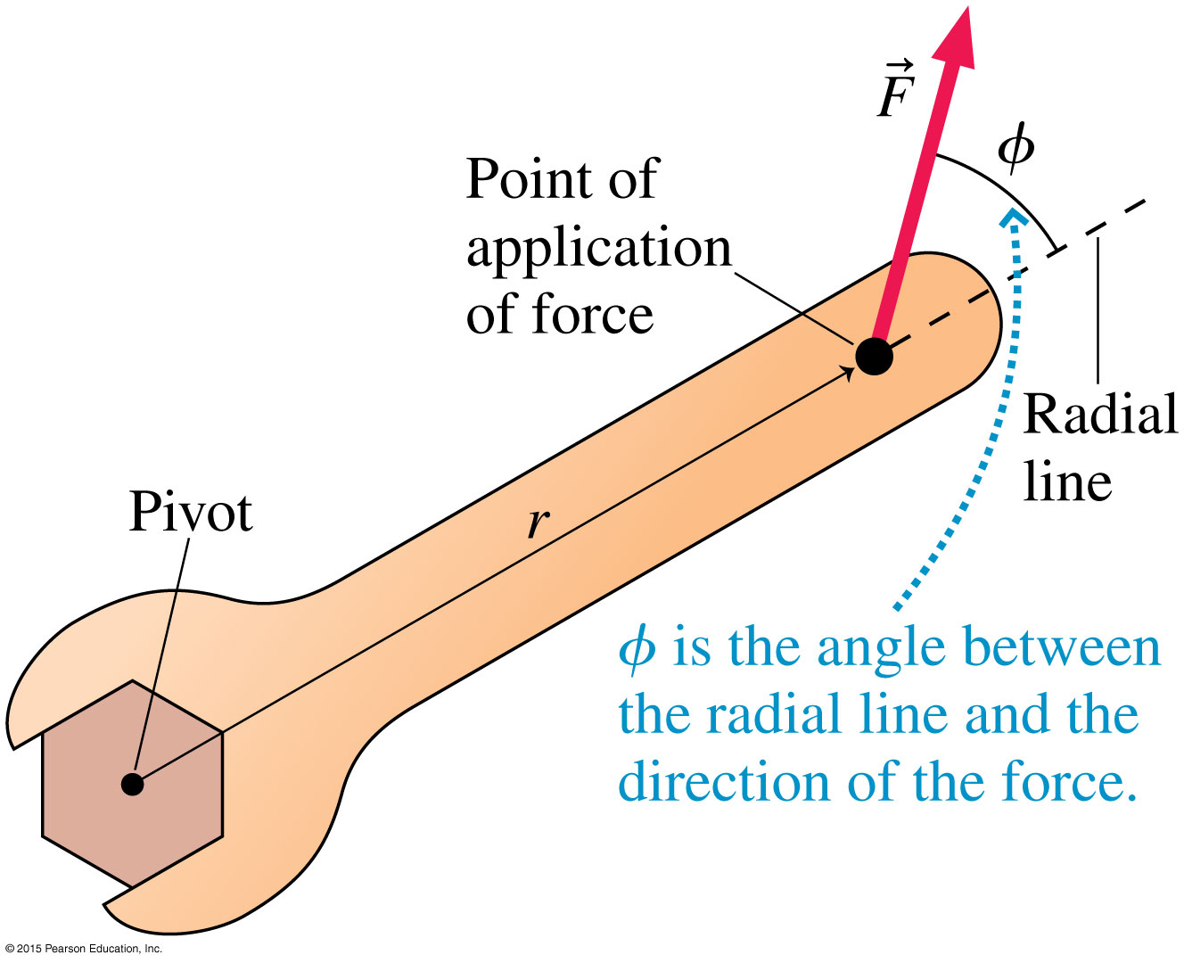
Torque
The radial line is the line starting at the pivot and extending through the point where force is applied.
The angle ϕ is measured from the radial line to the direction of the force.

Slide 7
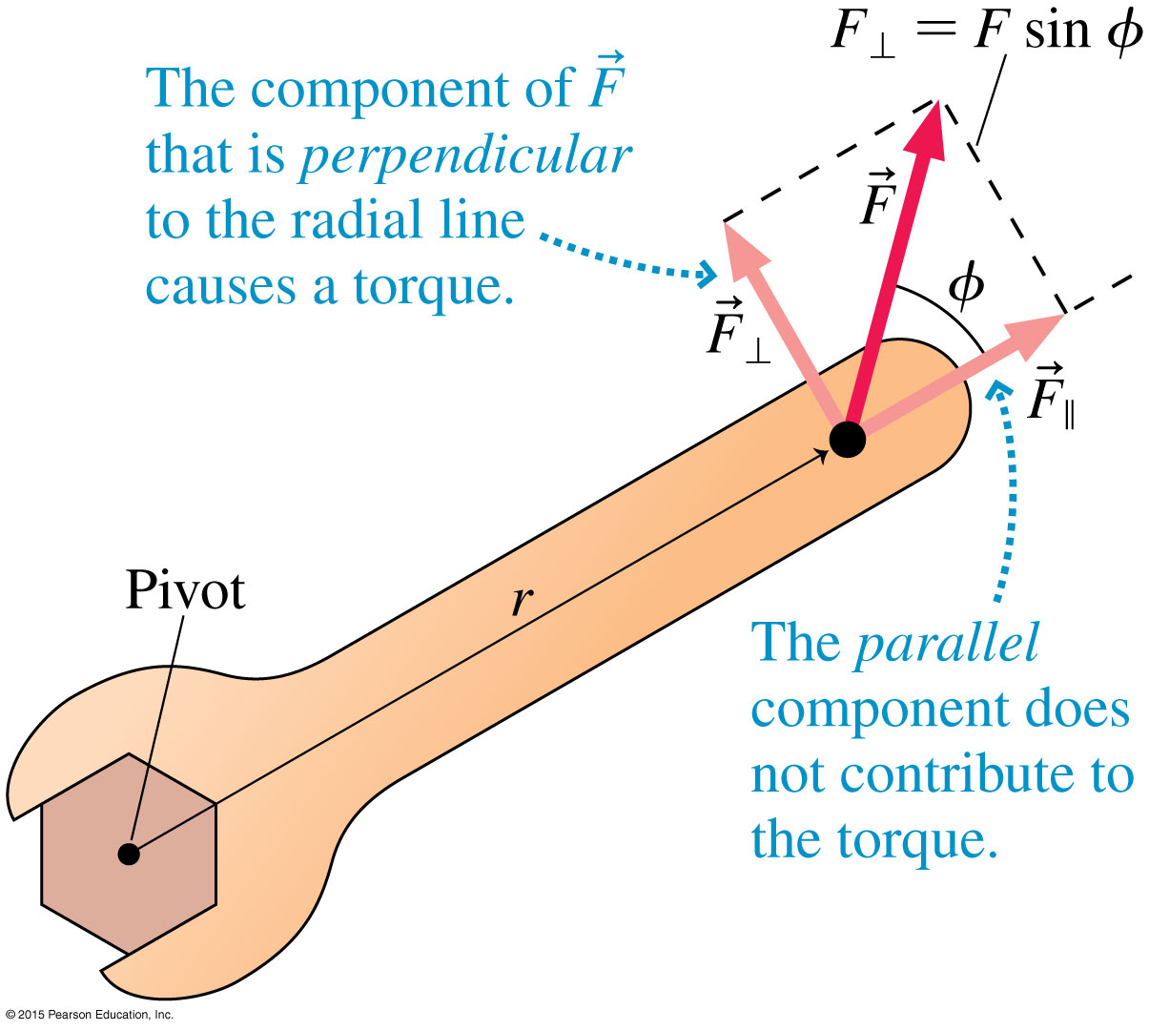
Torque
The radial line is the line starting at the pivot and extending through the point where force is applied.
The angle ϕ is measured from the radial line to the direction of the force.
Torque is dependent on the perpendicular component of the force being applied.

Slide 8
Torque
Torque (τ) is the rotational equivalent of force.
Torque units are newton-meters, abbreviated N ⋅ m.

Slide 9
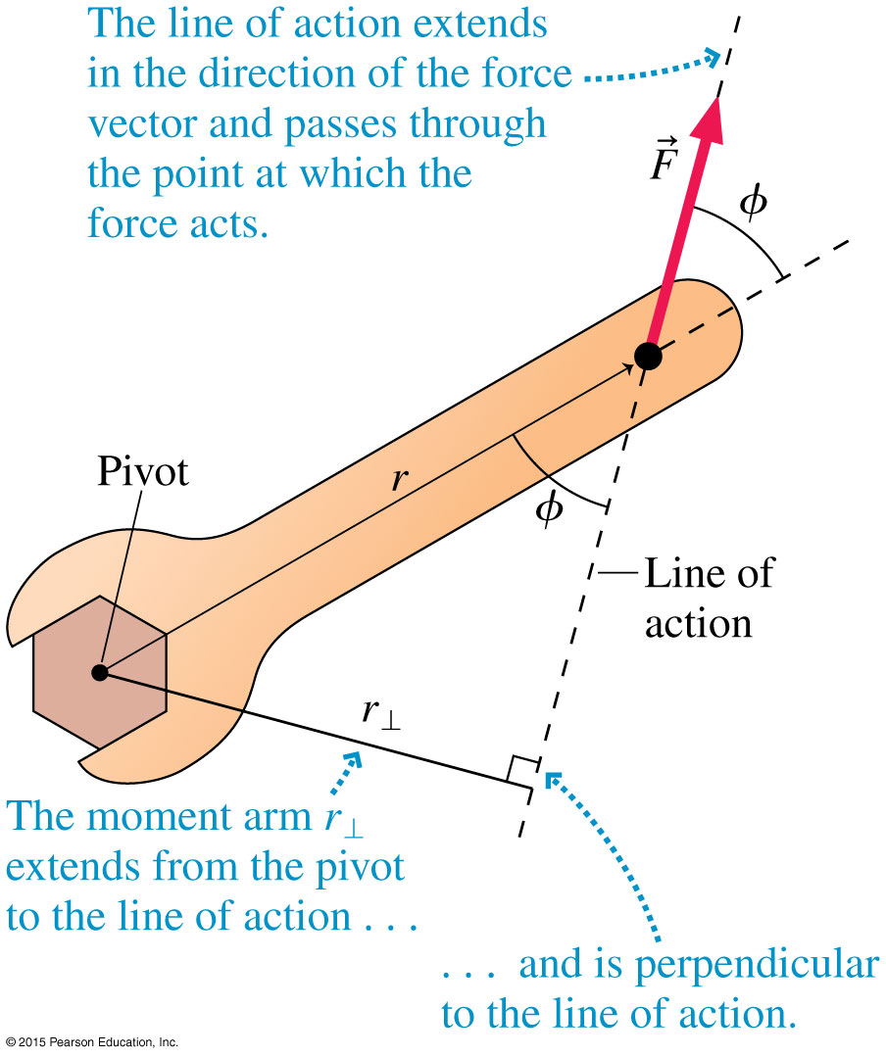
Torque
An alternate way to calculate torque is in terms of the moment arm.
The moment arm (or lever arm) is the perpendicular distance from the line of action to the pivot.
The line of action is the line that is in the direction of the force and passes through the point at which the force acts.

Slide 10
Torque
The equivalent expression for torque is
For both methods for calculating torque, the resulting expression is the same:

Slide 11
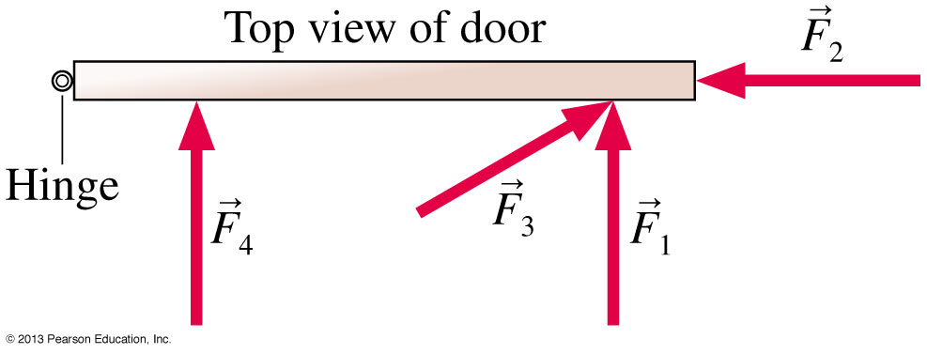
QuickCheck
The four forces shown have the same strength. Which force would be most effective in opening the door?
Force F₁
Force F₂
Force F₃
Force F₄
Either F₁ or F₃
Your intuition likely led you to choose F₁. The reason is that F₁ exerts the largest torque about the hinge.
Notes:
11

Slide 12
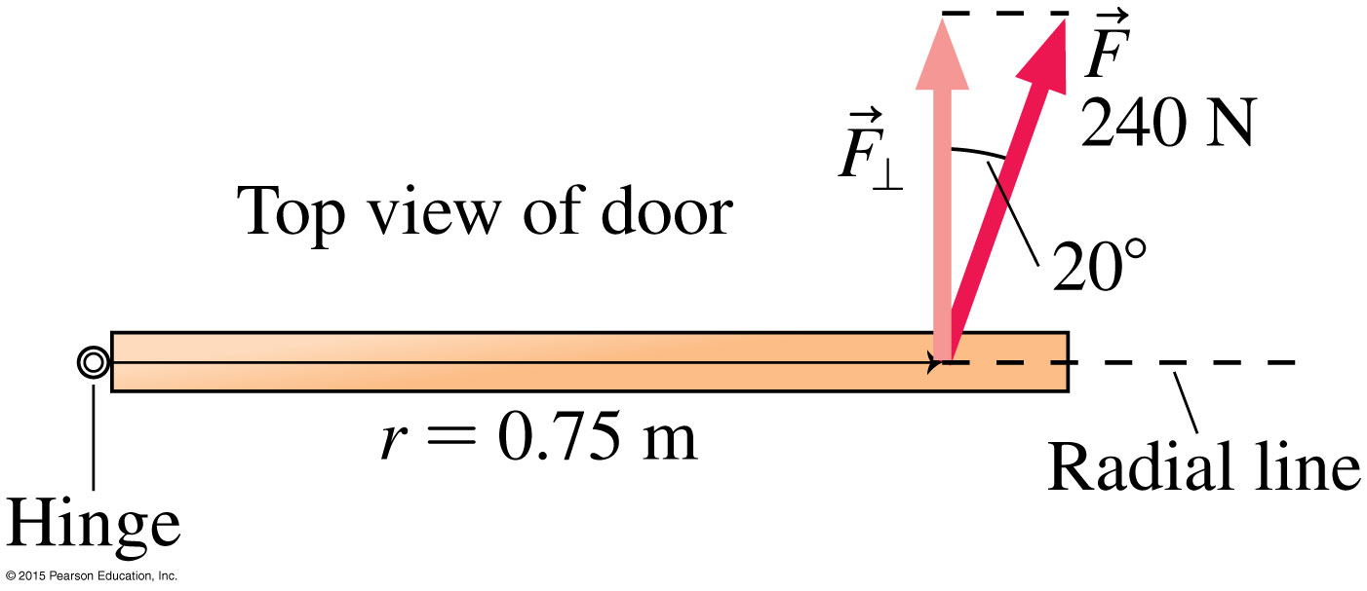
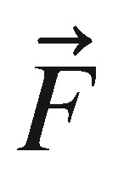
Example: Torque in opening a door
Ryan is trying to open a stuck door. He pushes it at a point 0.75 m from the hinges with a 240 N force directed 20° away from being perpendicular to the door. There’s a natural pivot point, the hinges. What torque does Ryan exert? How could he exert more torque?
prepare In the figure, the radial line is shown drawn from the pivot—the hinge—through the point at which the force is applied. We see that the component of that is perpendicular to the radial line is F⊥ = F cos 20° = 226 N. The distance from the hinge to the point at which the force is applied is r = 0.75 m.

Slide 13
Example: Torque in opening a door (cont.)
solve We can find the torque on the door from Equation 7.10:
The torque depends on how hard Ryan pushes, where he pushes, and at what angle. If he wants to exert more torque, he could push at a point a bit farther out from the hinge, or he could push exactly perpendicular to the door. Or he could simply push harder!
assess As you’ll see by doing more problems, 170 N ⋅ m is a significant torque, but this makes sense if you are trying to free a stuck door.

Slide 14
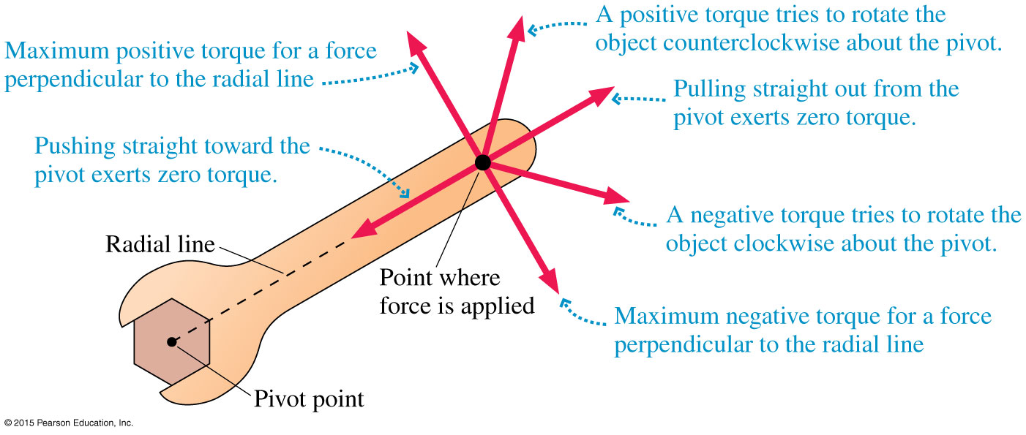
Torque
A torque that tends to rotate the object in a counter-clockwise direction is positive, while a torque that tends to rotate the object in a clockwise direction is negative.

Slide 15
Net Torque
The net torque is the sum of the torques due to the applied forces:
[Insert Figure 7.23]

Slide 16
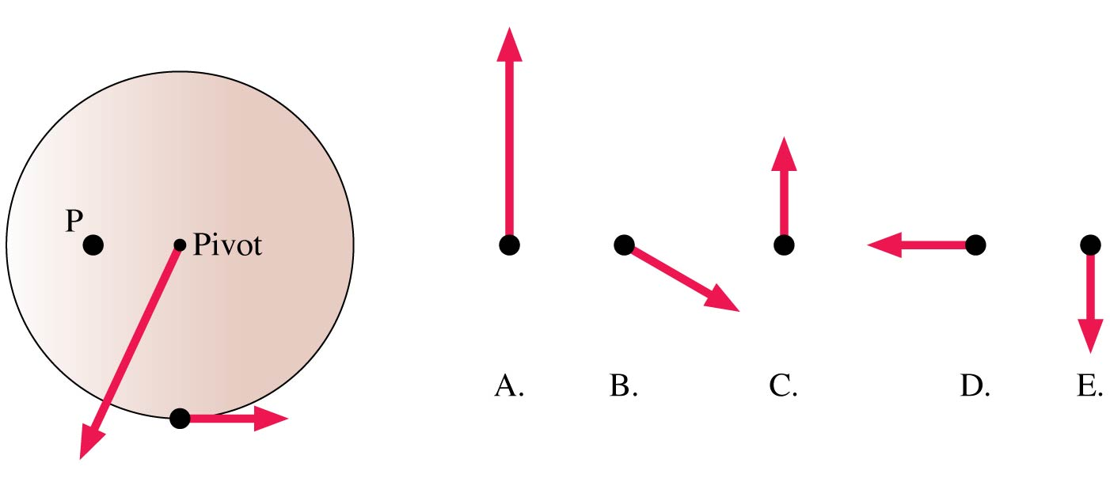
QuickCheck
Which third force on the wheel, applied at point P, will make the net torque zero?
Notes:
16
Answer: A

Slide 17
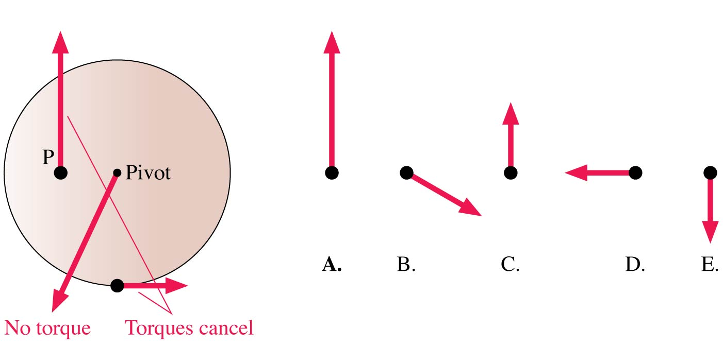
QuickCheck
Which third force on the wheel, applied at point P, will make the net torque zero?
A.
Notes:
17

Slide 18
Torque and Static Equilibrium
An object at rest is in static equilibrium.
As long as the object can be modeled as a particle, static equilibrium is achieved when the net force on the particle is zero.

Slide 19
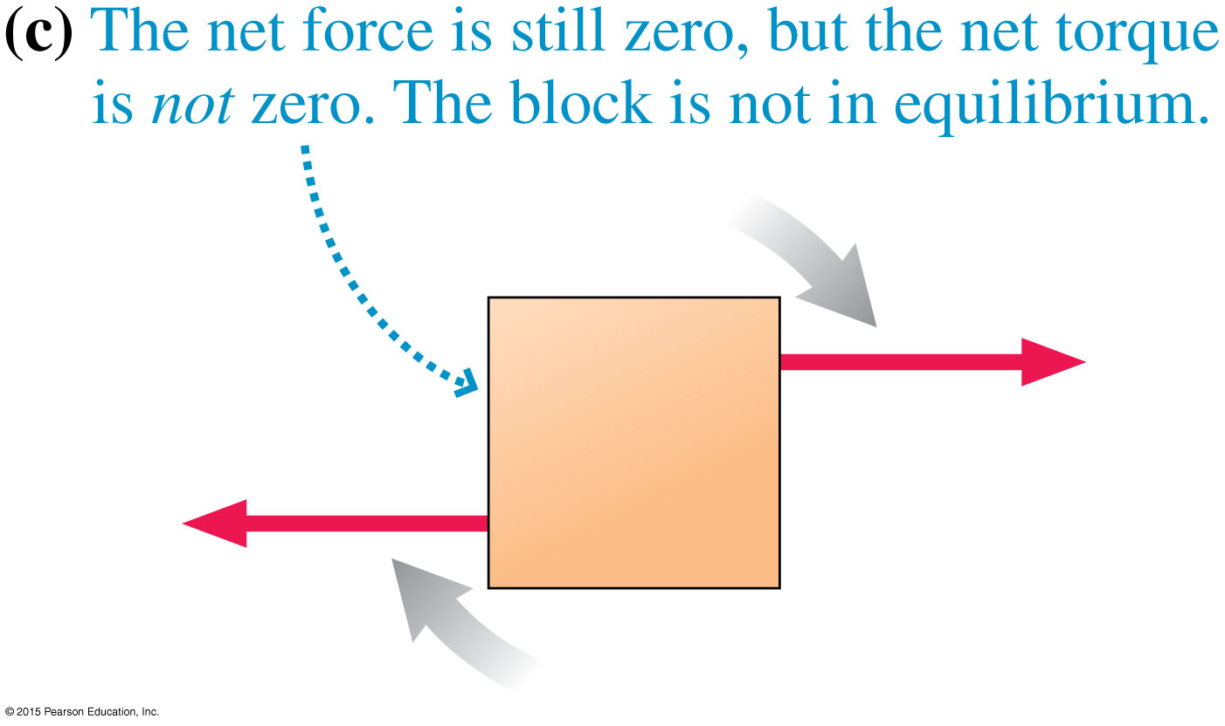
Torque and Static Equilibrium
For extended objects that can rotate, we must consider the net torque, too.
When the net force and the net torque are zero, the block is in static equilibrium.
When the net force is zero, but the net torque is not zero, the object is not in static equilibrium.

Slide 20
Torque and Static Equilibrium
There are two conditions for static equilibrium on an extended object:
The net force on the object must be zero.
The net torque on the object must be zero.

Slide 21
QuickCheck 8.1
Which object is in static equilibrium?
Notes:
21
Answer: D

Slide 22
Choosing the Pivot Point
For an object in static equilibrium, the net torque about every point must be zero.
You can choose any point you wish as a pivot point for calculating torque.

Slide 23
Choosing the Pivot Point
Any pivot point will work, but some pivot points can simplify calculations.
There is a “natural” axis of rotation for many situations. A natural axis is an axis about which rotation would occur if the object were not in static equilibrium.

Slide 24
Choosing the Pivot Point

Slide 25
QuickCheck 8.2
What does the scale read?
500 N
1000 N
2000 N
4000 N
Answering this requires reasoning, not calculating.
Notes:
25
Answer: C

Slide 26
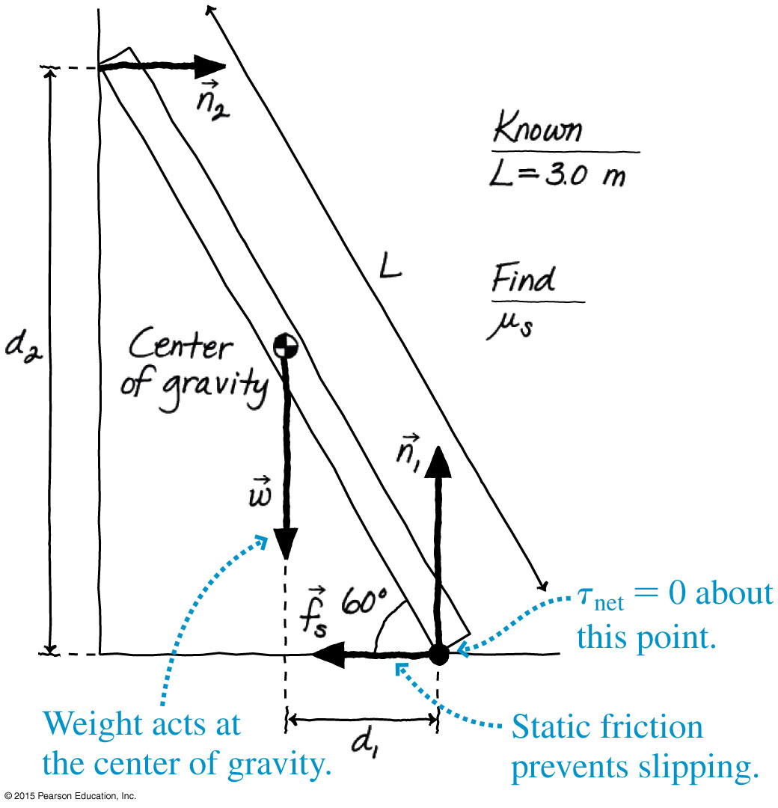
Example 8.4 Will the ladder slip?
A 3.0-m-long ladder leans against a wall at an angle of 60° with respect to the floor. What is the minimum value of μ_{s} , the coefficient of static friction with the ground, that will prevent the ladder from slipping? Assume that friction between the ladder and the wall is negligible.

Slide 27
Example 8.4 Will the ladder slip? (cont.)
prepare The ladder is a rigid rod of length L. To not slip, both the net force and net torque on the ladder must be zero. The figure shows the ladder and the forces acting on it.
We are asked to find the necessary
coefficient of static friction.

Slide 28
Example 8.4 Will the ladder slip? (cont.)
First, we’ll solve for the magnitudes of the static friction force and the normal force. Then we can use these values to determine the necessary value of the coefficient of friction. These forces both act at the bottom corner of the ladder, so even though we are interested in these forces, this is a good choice for the pivot point because two of the forces that act provide no torque, which simplifies the solution.

Slide 29
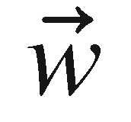
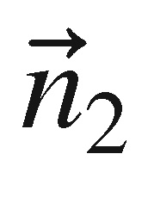
Example 8.4 Will the ladder slip? (cont.)
With this choice of pivot, the weight of the ladder, acting at the center of gravity, exerts torque d₁w and the force of the wall exerts torque −d₂n₂. The signs are based on the observation that would cause the ladder to rotate counterclockwise, while would cause it to rotate clockwise.

Slide 30
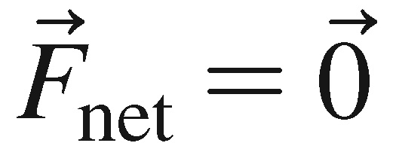
Example 8.4 Will the ladder slip? (cont.)
solve The x- and y-components of are
The torque about the bottom corner is

Slide 31
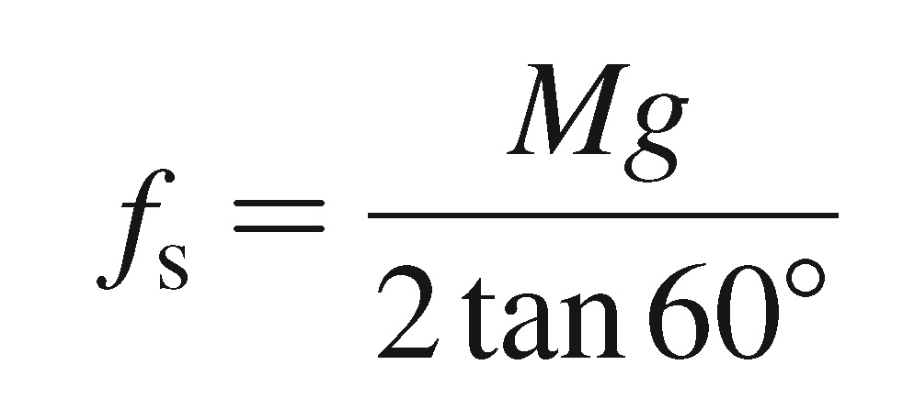
Example 8.4 Will the ladder slip? (cont.)
Altogether, we have three equations with the three unknowns n₁, n₂, and f_{s}. If we solve the third equation for n₂,
we can then substitute this into the first equation to find

Slide 32
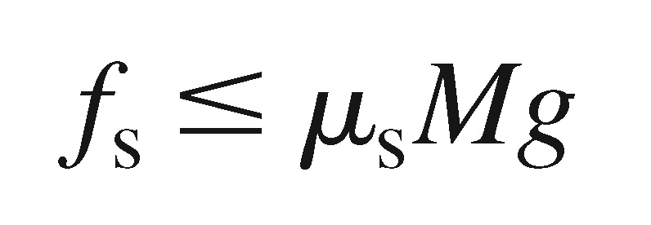
Example 8.4 Will the ladder slip? (cont.)
Our model of static friction is f_{s} ≤ f_{s max} = μ_{s}n₁. We can find n₁from the second equation: n₁ = Mg. From this, the model of friction tells us that
Comparing these two expressions for f_{s}, we see that μ_{s} must obey
Thus the minimum value of the coefficient of static friction is 0.29.

Slide 33
Example 8.4 Will the ladder slip? (cont.)
assess You know from experience that you can lean a ladder or other object against a wall if the ground is “rough,” but it slips if the surface is too smooth. 0.29 is a “medium” value for the coefficient of static friction, which is reasonable.

Slide 34
Section 8.2 Stability and Balance

Slide 35
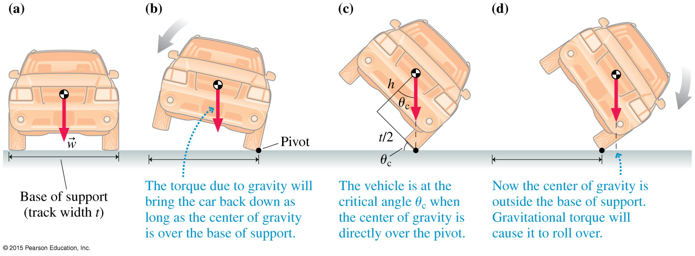
Stability and Balance
An extended object has a base of support on which it rests when in static equilibrium.
A wider base of support and/or a lower center of gravity improves stability.

Slide 36
Stability and Balance
As long as the object’s center of gravity remains over the base of support, torque due to gravity will rotate the object back toward its stable equilibrium position. The object is stable.
If the object’s center of gravity moves outside the base of support, the object is unstable.

Slide 37
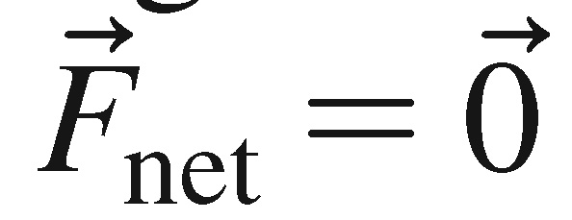
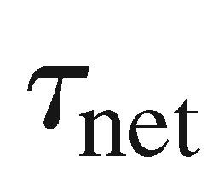
Reading Question 8.1
An object is in equilibrium if
= 0
Either A or B
Both A and B

Slide 38
Reading Question 8.3
An object will be stable if
Its center of gravity is below its highest point.
Its center of gravity lies over its base of support.
Its center of gravity lies outside its base of support.
The height of its center of gravity is less than 1/2 its total height.

Slide 39
Summary: Important Concepts

Slide 40
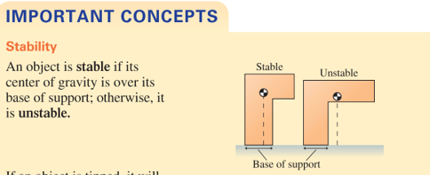
Summary

Slide 41
Problems on chapter 8

Slide 42
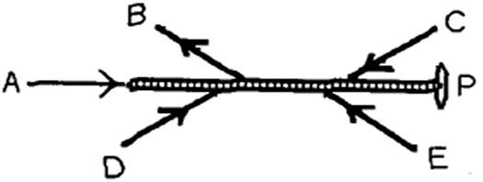
P1:
Five forces act on a rod that is free to pivot at point P, as shown in the figure. Which of these forces is producing a counter-clockwise torque about point P?
Answer: C

Slide 43
P2:
A man in a gym is holding an 8.0-kg weight at arm's length, a distance of 0.55 m from his shoulder joint.
What is the torque about his shoulder joint due to the weight if his arm is horizontal?
Solution:

Slide 44
P3:
A force of 17 N is applied to the end of a 0.63-m long torque wrench at an angle 45° from a line joining the pivot point to the handle. What is the magnitude of the torque about the pivot point produced by this force?
Solution:

Slide 45
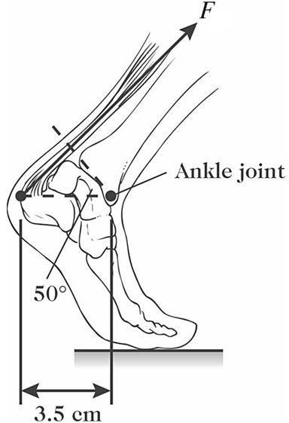
P4:
The figure shows a person's foot. In that figure, the Achilles tendon exerts a force of magnitude F = 720 N.
What is the magnitude of the torque that this force produces about the ankle joint?
Solution:

Slide 46
P5:
A 15-kg child is sitting on a playground teeter-totter, 1.5 m from the pivot.
What is the magnitude of the minimum force, applied 0.30 m on the other side of the pivot, that is needed to make the child lift off the ground?
Solution:

Slide 47
P6:
A 15-kg child is sitting on a playground teeter-totter, 1.5 m from the pivot.
What is the minimum distance, on the other side of the pivot, such that a 220-N force will make the child lift off the ground?
Solution:

Slide 48
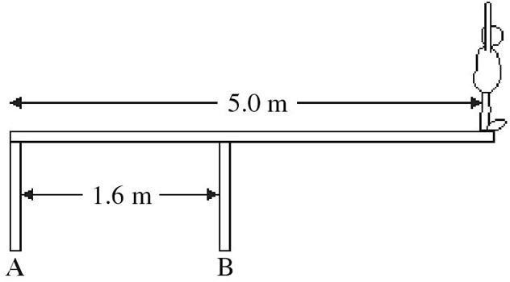
P7:
An 82-kg diver stands at the edge of a light 5.0-m diving board, which is supported by two vertical pillars that are 1.6 m apart, as shown in the figure.
Find the magnitude and direction of the force exerted by each pillar.
Solution:

Slide 49
P8:
A meter stick balances at the 50.0-cm mark. If a mass of 50.0 g is placed at the 90.0-cm mark, the stick balances at the 61-cm mark.
What is the mass of the meter stick?
Solution:

Slide 50
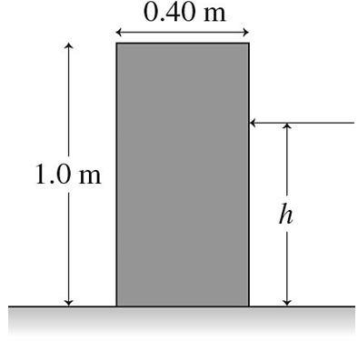
P9:
As shown in the figure, a uniform rectangular crate 0.40 m wide and 1.0 m tall sits on a horizontal surface. The crate weighs 460 N, and its center of gravity is at its geometric center. A horizontal force of magnitude F is applied at a distance h above the floor. Friction at the floor is great enough to prevent the crate from sliding. If h = 0.69 m, what minimum value of F is required to make the crate start to tip over?
Solution:

Slide 51
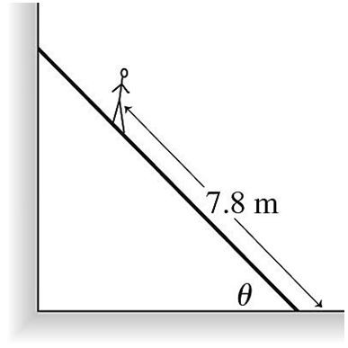
P10:
A uniform ladder 12 meters long rests against a vertical frictionless wall, as shown in the figure. The ladder weighs 400 N and makes an angle
θ = 51° with the floor. A man weighing 874 N climbs slowly up the ladder. When he is 78 m from the bottom of the ladder, it just starts to slip. What is the coefficient of static friction between the floor and the ladder?
Solution:

