Slide 2
Chapter 5 Appling Newton’s Laws
Section 5.1 Equilibrium
Section 5.2 Dynamics and Newton’s Second Law
Section 5.3 Mass and Weight
Section 5.4 Normal Forces
Section 5.5 Friction
Section 5.7 Interacting Objects
Section 5.8 Ropes and Pulleys

Slide 3
Chapter 5 Preview
Looking Ahead: Working with Forces
Goal: To use Newton’s laws to solve equilibrium and dynamics problems.
In this chapter, you’ll learn expressions for the different forces we’ve seen, and you’ll learn how to use them to solve problems.
You’ll learn to solve equilibrium problems by using the fact that there is no net force.
Newton’s laws allow us to relate the forces acting on an object to its motion, and so to solve a wide range of dynamics problems.

Slide 4
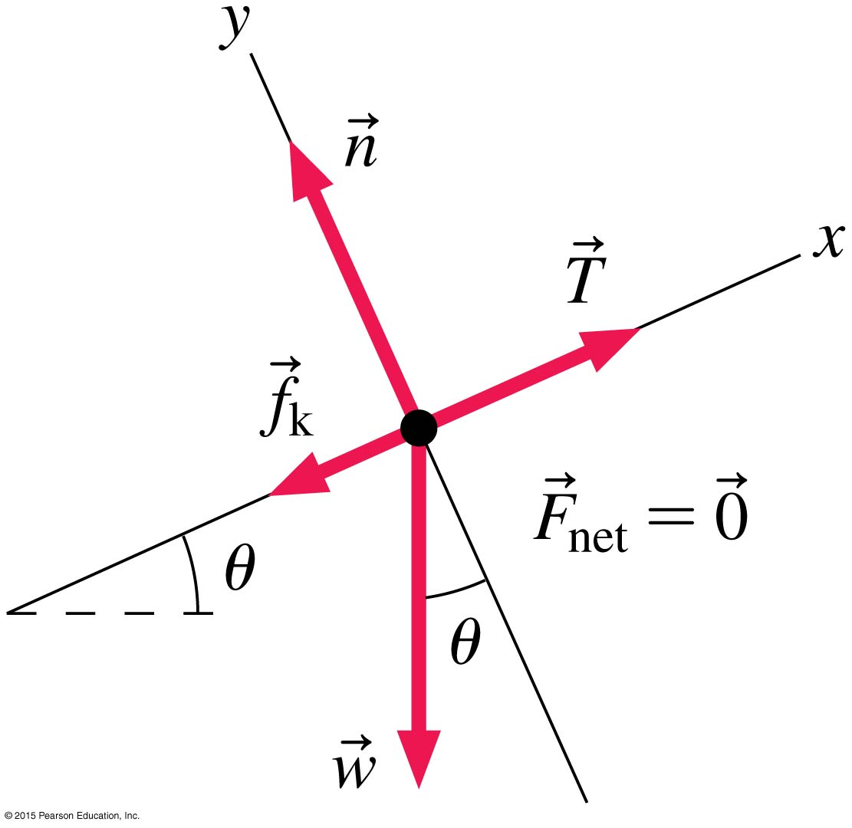
Chapter 5 Preview
Looking Back: Free-Body Diagrams
In chapter 4 you learned to draw a free-body diagram showing the magnitudes and directions of the forces acting on an object.
In this chapter, you’ll use free-body diagrams as an essential problem-solving tool for single objects and interacting objects.

Slide 5
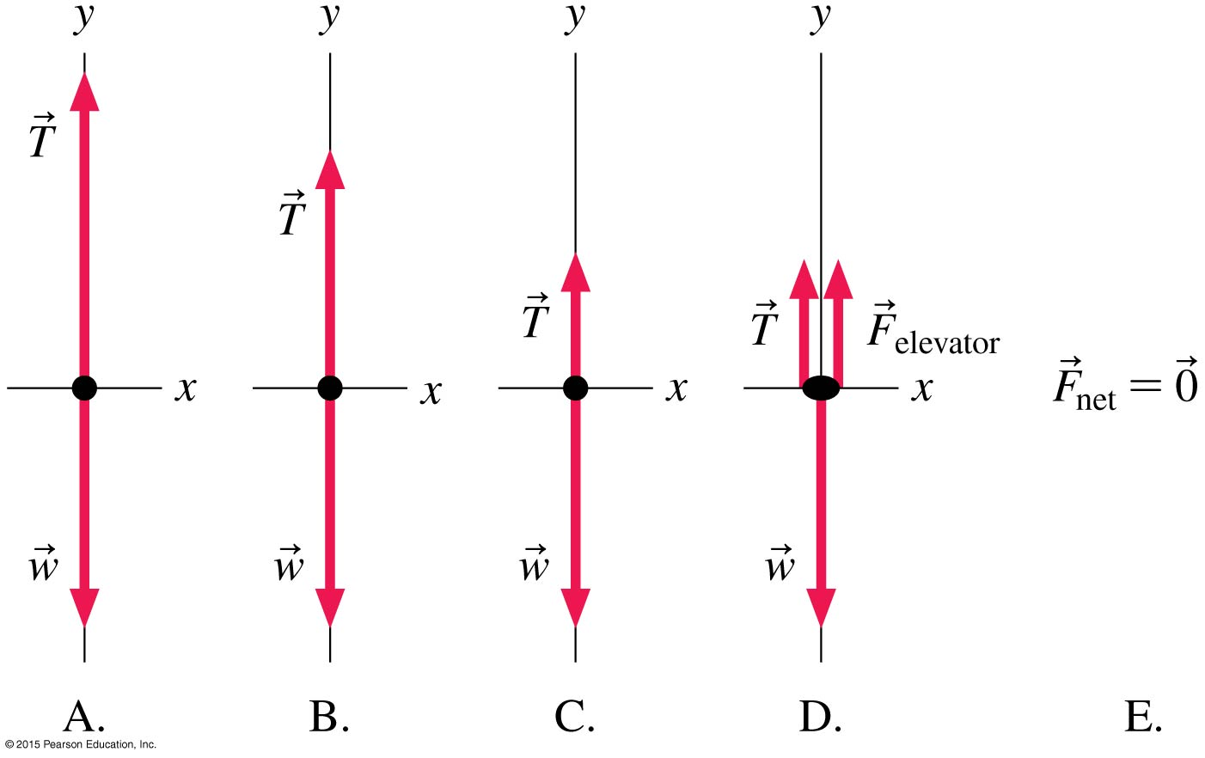
Chapter 5 Preview
Stop to Think
An elevator is suspended from a cable. It is moving upward at a steady speed. Which is the correct free-body diagram for this situation?
Notes:
Stop to Think Answer: B

Slide 6
Chapter 5 Preview
Stop to Think
An elevator is suspended from a cable. It is moving upward at a steady speed. Which is the correct free-body diagram for this situation?
Notes:
Stop to Think Answer: B

Slide 7
Section 5.1 Equilibrium

Slide 8

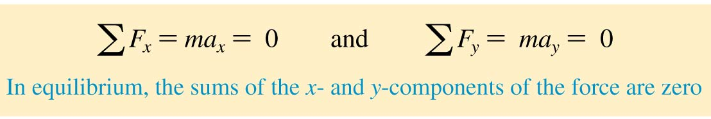
Equilibrium
We say that an object at rest is in static equilibrium.
An object moving in a straight line at a constant speed
is in dynamic equilibrium.
In both types of equilibrium there is no net force acting on the object:

Slide 9
Reading Question 5.1
Which of these objects is in equilibrium?
  A car driving down the road at a constant speed
  A block sitting at rest on a table
  A skydiver falling at a constant speed
  All of the above
Notes:
Answer: D

Slide 10
Reading Question 5.1
Which of these objects is in equilibrium?
  A car driving down the road at a constant speed
  A block sitting at rest on a table
  A skydiver falling at a constant speed
  All of the above
Notes:
Answer: D

Slide 11
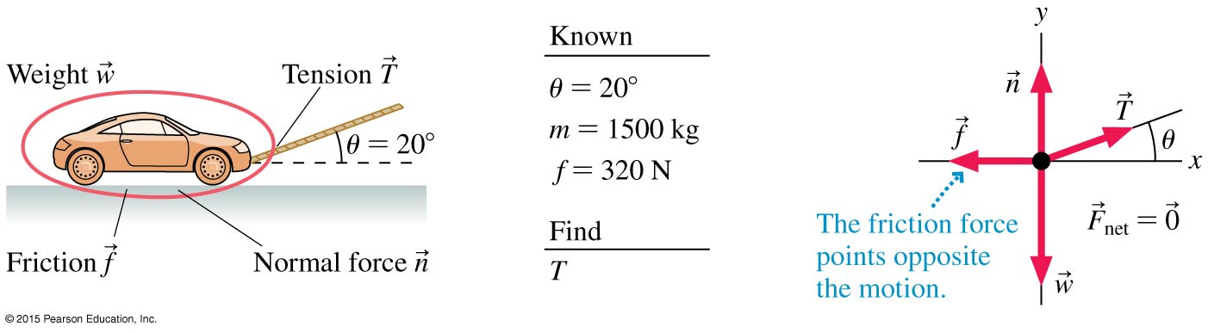
Example 5.4 Tension in towing a car
A car with a mass of 1500 kg is being towed at a steady speed by a rope held at a 20° angle from the horizontal.
A friction force of 320 N opposes the car’s motion.
What is the tension in the rope?

Slide 12
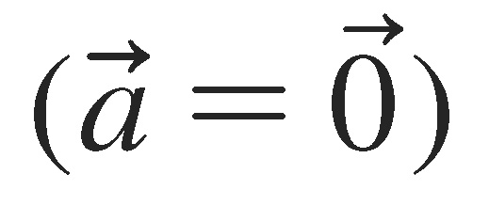
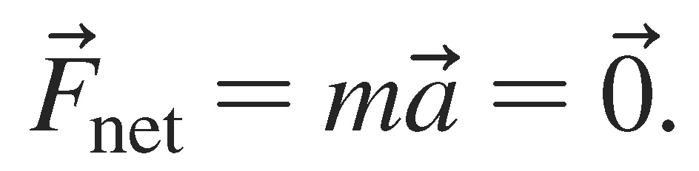




Example 5.4 Tension in towing a car (cont.)
prepare The car is moving in a straight line at a constant speed so it is in dynamic equilibrium and must have The figure shows three contact forces acting on the car—the tension force , friction , and the normal force —and the long-range force of gravity .
These four forces are shown on the free-body diagram.

Slide 13
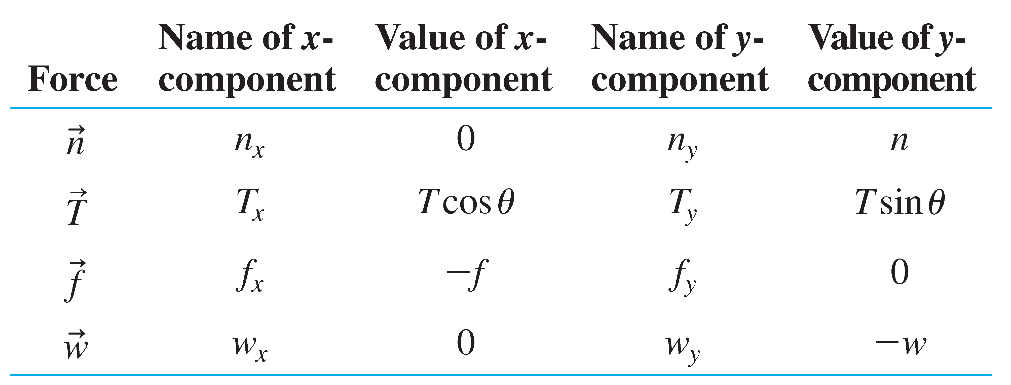
Example 5.4 Tension in towing a car (cont.)
solve This is still an equilibrium problem, even though the car is moving, so our problem-solving procedure is unchanged. With four forces, the requirement of equilibrium is
Σ F_{x} = n_{x} + T_{x} + f_{x} + w_{x} = ma_{x} = 0
Σ F_{y} = n_{y} + T_{y} + f_{y} + w_{y} = ma_{y} = 0
We can again determine the horizontal and vertical components of the forces by “reading” the free-body diagram. The results are shown in the table.

Slide 14
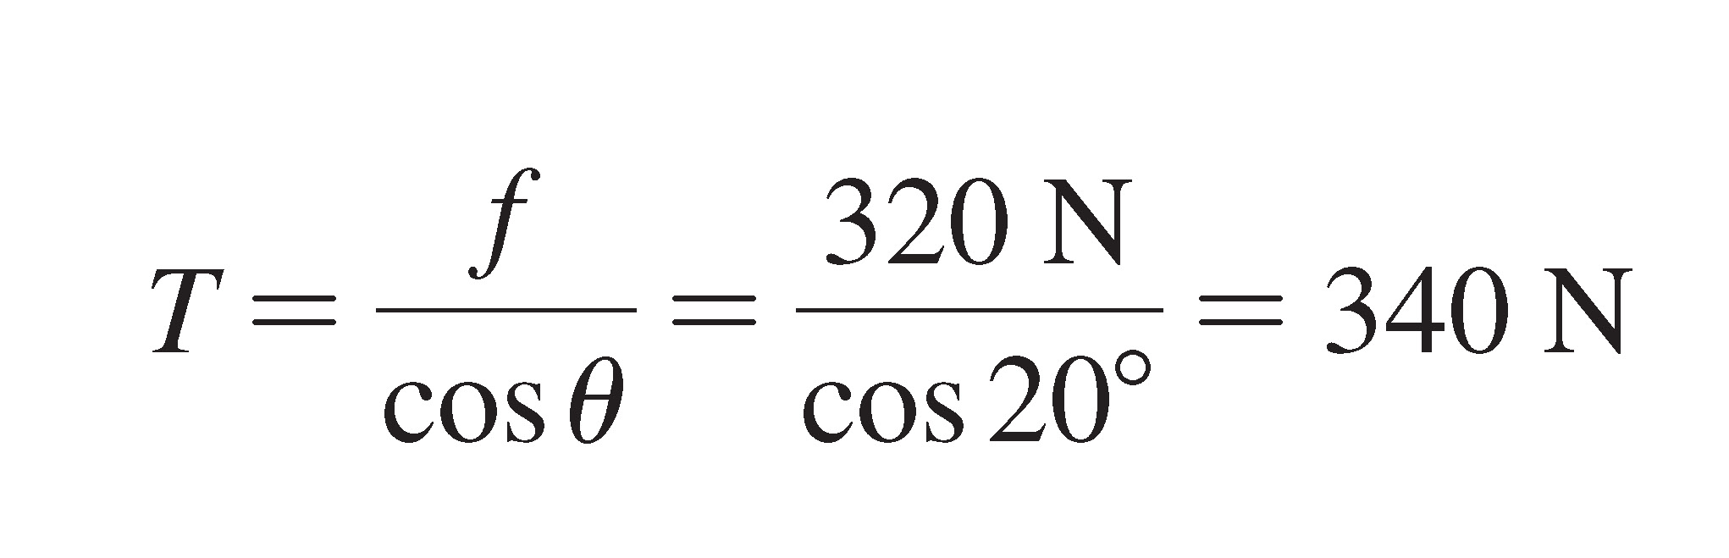
Example 5.4 Tension in towing a car (cont.)
With these components, Newton’s second law becomes
T cosθ − f = 0
n + T sinθ − w = 0
The first equation can be used to solve for the tension in the rope:
It turned out that we did not need the y-component equation in this problem. We would need it if we wanted to find the normal force

Slide 15
Example 5.4 Tension in towing a car (cont.)
assess Had we pulled the car with a horizontal rope, the tension would need to exactly balance the friction force of 320 N. Because we are pulling at an angle, however, part of the tension in the rope pulls up on the car instead of in the forward direction. Thus, we need a little more tension in the rope when it’s at an angle, so our result seems reasonable.

Slide 16
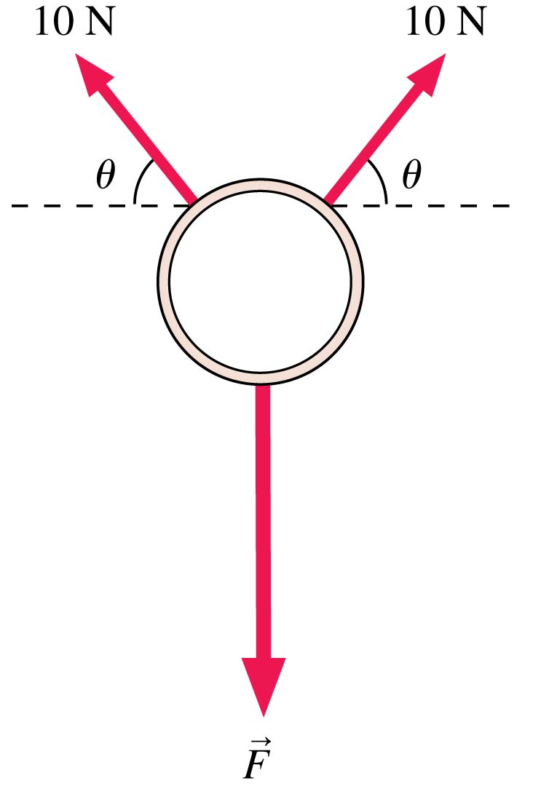
QuickCheck 5.1
A ring, seen from above, is pulled on by three forces. The ring is not moving. How big is the force F?
  20 N
  10 cosθ N
  10 sinθ N
  20 cosθ N
  20 sinθ N
Notes:
Answer: E

Slide 17
QuickCheck 5.1
A ring, seen from above, is pulled on by three forces. The ring is not moving. How big is the force F?
  20 N
  10 cosθ N
  10 sinθ N
  20 cosθ N
  20 sinθ N
Notes:
Answer: E

Slide 18
Example Problem
A 100-kg block with a weight of 980 N hangs on a rope. Find the tension in the rope if the block is stationary, then if it’s moving upward at a steady speed of 5 m/s.
The block is in static equilibrium if it is stationary and in dynamic equilibrium if it’s moving at a steady speed. In both cases the tension in the rope must equal the weight: 980 N.
Notes:
Answer: The block is in static equilibrium if it is stationary and in dynamic equilibrium if it’s moving at a steady speed. In both cases the tension in the rope must equal the weight: 980 N.

Slide 19
Section 5.2 Dynamics and
Newton’s Second Law

Slide 20




Dynamics and Newton’s Second Law
The essence of Newtonian mechanics can be expressed in two steps:
  The forces acting on an object determine its acceleration
  The object’s motion can be found by using in the equations of kinematics.
Thus, Newton’s second law, , is

Slide 21
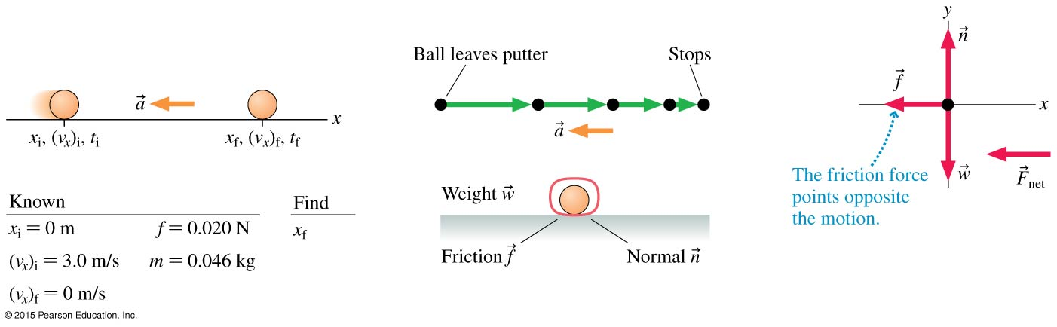
Example 5.5 Putting a golf ball
A golfer putts a 46 g ball with a speed of 3.0 m/s. Friction exerts a 0.020 N retarding force on the ball, slowing it down. Will her putt reach the hole, 10 m away?
prepare The figure is a visual overview of the problem. We’ve collected the known information, drawn a sketch, and identified what we want to find.

Slide 22
Example 5.5 Putting a golf ball (cont.)
The motion diagram shows that the ball is slowing down as it rolls to the right, so the acceleration vector points to the left. Next, we identify the forces acting on the ball and show them on a free-body diagram. Note that the net force points to the left, as it must because the acceleration points to the left.

Slide 23
Example 5.5 Putting a golf ball (cont.)
solve Newton’s second law in component form is
ΣF_{x} = n_{x} + f_{x} + w_{x} = 0 − f + 0 = ma_{x}
ΣF_{y} = n_{y} + f_{y} + w_{y} = n + 0 − w = ma_{y} = 0
We’ve written the equations as sums, as we did with equilibrium problems, then “read” the values of the force components from the free-body diagram.
It is important to notice that a_{y} = 0 in the second equation. This is because the ball does not move in the y-direction, so it does not have an acceleration in the y-direction.

Slide 24
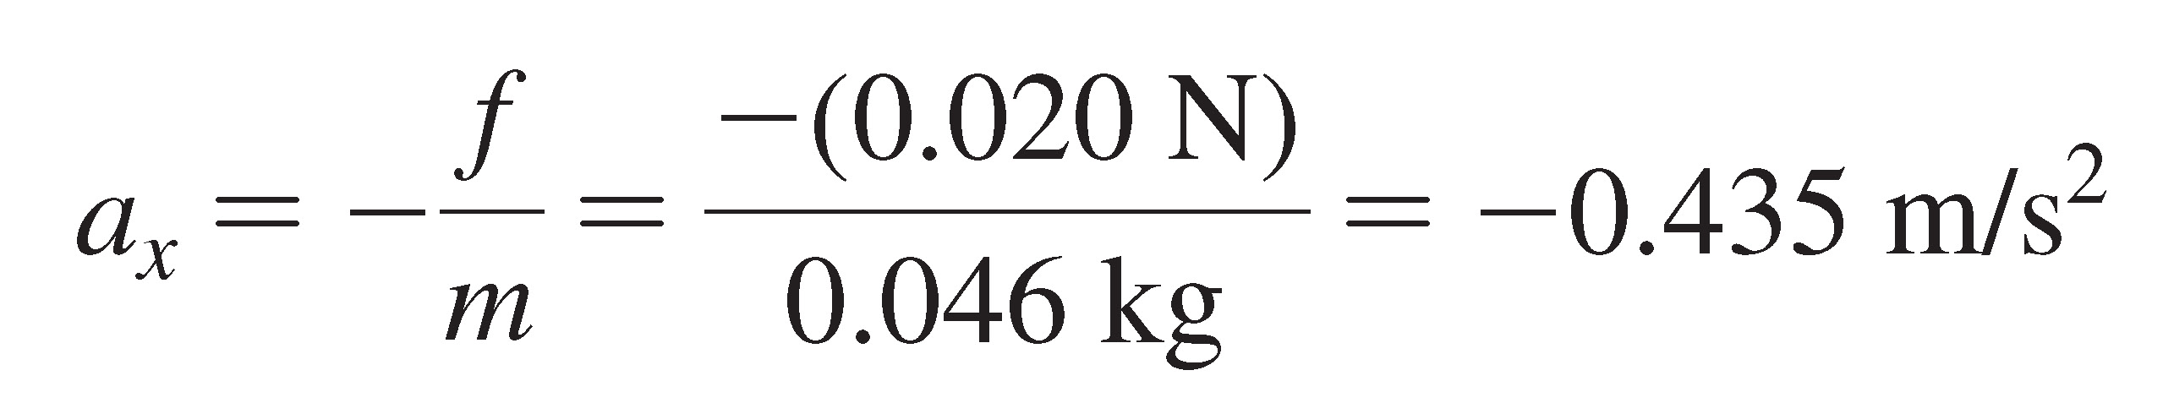
Example 5.5 Putting a golf ball (cont.)
The first equation is −f = ma_{x} , from which we find
To avoid rounding errors we keep an extra digit in this intermediate step in the calculation. The negative sign shows that the acceleration is directed to the left, as expected.

Slide 25
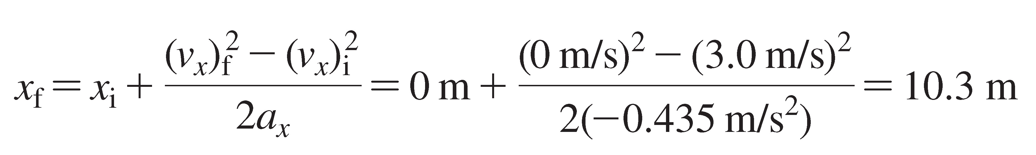
Example 5.5 Putting a golf ball (cont.)
Now that we know the acceleration, we can use kinematics to find how far the ball will roll before stopping. We don’t have any information about the time it takes for the ball to stop, so we’ll use the kinematic equation
(v_{x})_{f}² = (v_{x})_{i}² + 2a_{x} (x_{f} − x_{i}). This gives
If her aim is true, the ball will just make it into the hole.

Slide 26
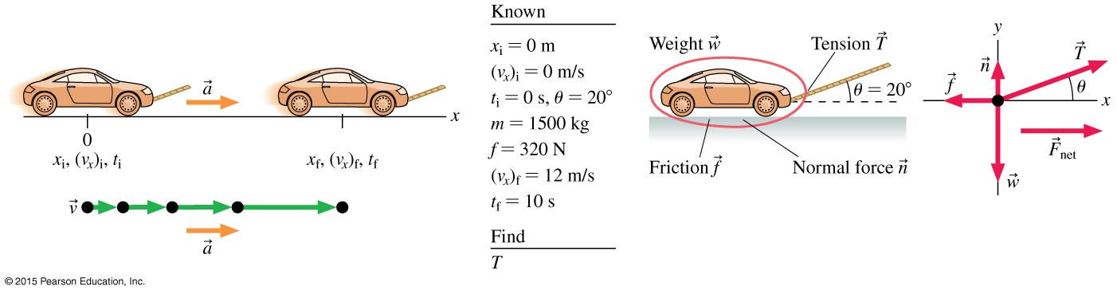
Example 5.6 Towing a car with acceleration
A car with a mass of 1500 kg is being towed by a rope held
at a 20° angle to the horizontal. A friction force of 320 N
opposes the car’s motion. What is the tension in the rope if the car goes from rest to 12 m/s in 10 s?

Slide 27
Example 5.6 Towing a car with acceleration (cont.)
prepare You should recognize that this problem is almost identical to Example 5.4. The difference is that the car is now accelerating, so it is no longer in equilibrium. This means, as shown in the figure, that the net force is not zero.

Slide 28
Example 5.6 Towing a car with acceleration (cont.)

Slide 29
Example 5.6 Towing a car with acceleration (cont.)
solve Newton’s second law in component form is
ΣF_{x} = n_{x} + T_{x} + f_{x} + w_{x} = ma_{x}
ΣF_{y} = n_{y} + T_{y} + f_{y} + w_{y} = ma_{y} = 0
We’ve again used the fact that a_{y} = 0 for motion that is purely along the x-axis.
The Newton’s second law in component form is:
T cosθ − f = ma_{x}
n + T sinθ − w = 0

Slide 30
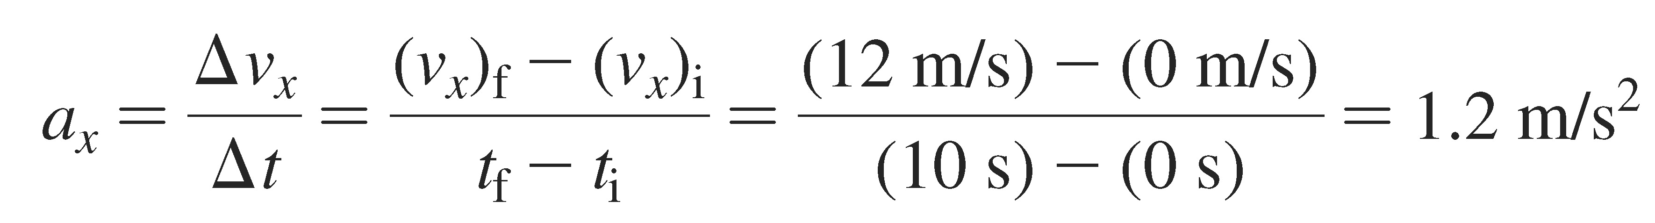
Example 5.6 Towing a car with acceleration (cont.)
Because the car speeds up from rest to 12 m/s in 10 s, we can use kinematics to find the acceleration:

Slide 31
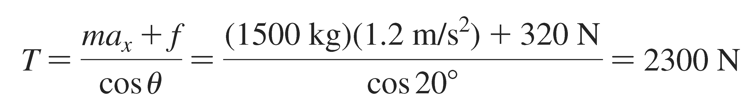
Example 5.6 Towing a car with acceleration (cont.)
We can now use the first Newton’s-law equation above to solve for the tension. We have
assess The tension is substantially greater than the 340 N found in Example 5.4. It takes much more force to accelerate the car than to keep it rolling at a constant speed.

Slide 32
Example Problem
A 100-kg block with a weight of 980 N hangs on a rope. Find the tension in the rope if the block is accelerating upwards at 5 m/s².
The block is not in equilibrium; it is accelerating. Newton’s second law gives m × a = T − 980 or T = 1480 N.
Notes:
Answer: The block is not in equilibrium; it is accelerating. Newton’s second law gives m × a + = T − 980 or T = 1480 N.

Slide 33
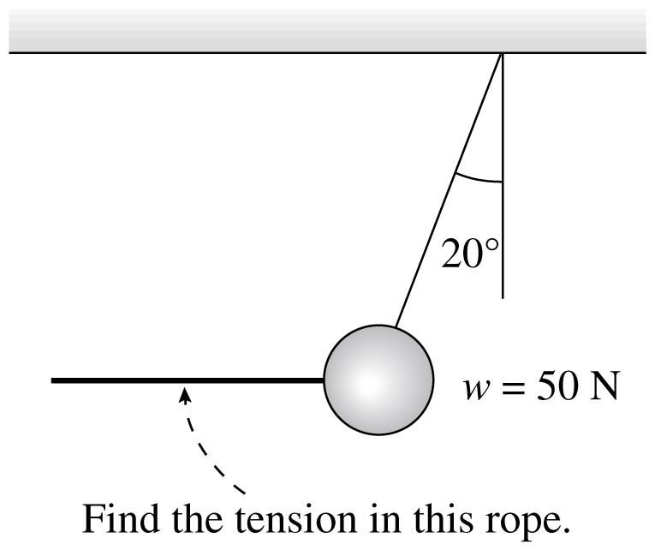
Example Problem
A ball weighing 50 N is pulled back by a rope by an angle of 20°. What is the tension in the pulling rope?
Notes:
Answer: The ball is in static equilibrium. The tension in the upper rope is 53 N and the tension in the horizontal rope is 18 N.

Slide 34

Example Problem
The ball is in static equilibrium.
The tension in the upper rope is 53 N and the tension in the horizontal rope is 18 N.
Notes:
Answer: The ball is in static equilibrium. The tension in the upper rope is 53 N and the tension in the horizontal rope is 18 N.

Slide 35
Example Problem
A sled with a mass of 20 kg slides along frictionless ice at 4.5 m/s. It then crosses a rough patch of snow that exerts a friction force of 12 N. How far does it slide on the snow before coming to rest?
The acceleration is -0.6 m/s².
The initial velocity is 4.5 m/s and the final velocity is 0.
The distance traveled before stopping is 17 m.
Notes:
Answer: The acceleration is -0.6 m/s². The initial velocity is 4.5 m/s and the final velocity is 0. The distance traveled before stopping is 17 m.

Slide 36
Section 5.3 Mass and Weight

Slide 37
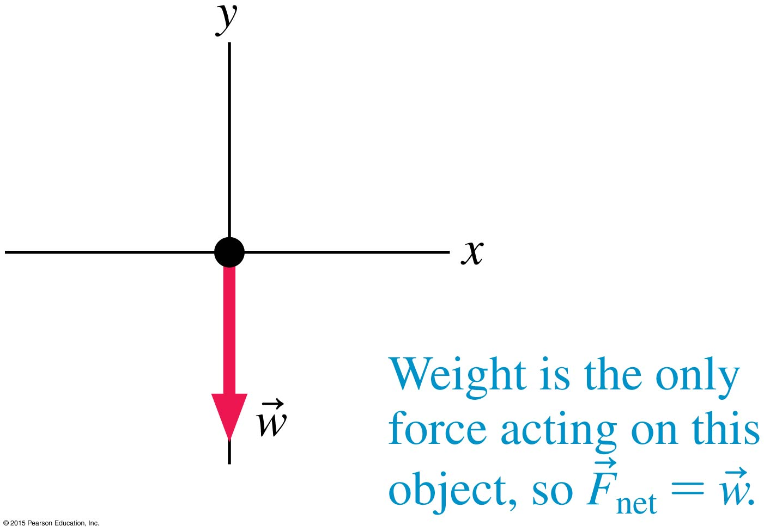
Mass, Weight and Apparent Weight
Mass and weight are not the
same thing.
Mass is a quantity that
describes an object’s inertia,
its tendency to resist being
accelerated.
Weight is the gravitational force exerted on an object by a planet:
w = –mg

Slide 38
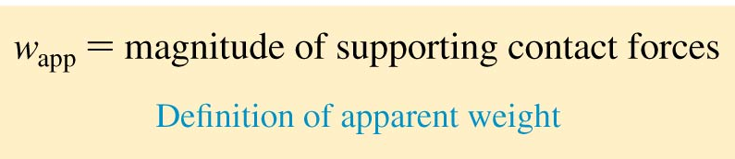
Apparent Weight
The weight of an object is the force of gravity on that object.
Your sensation of weight is due to contact forces supporting you.
Let’s define your apparent weight w_{app} in terms of the force you feel:

Slide 39
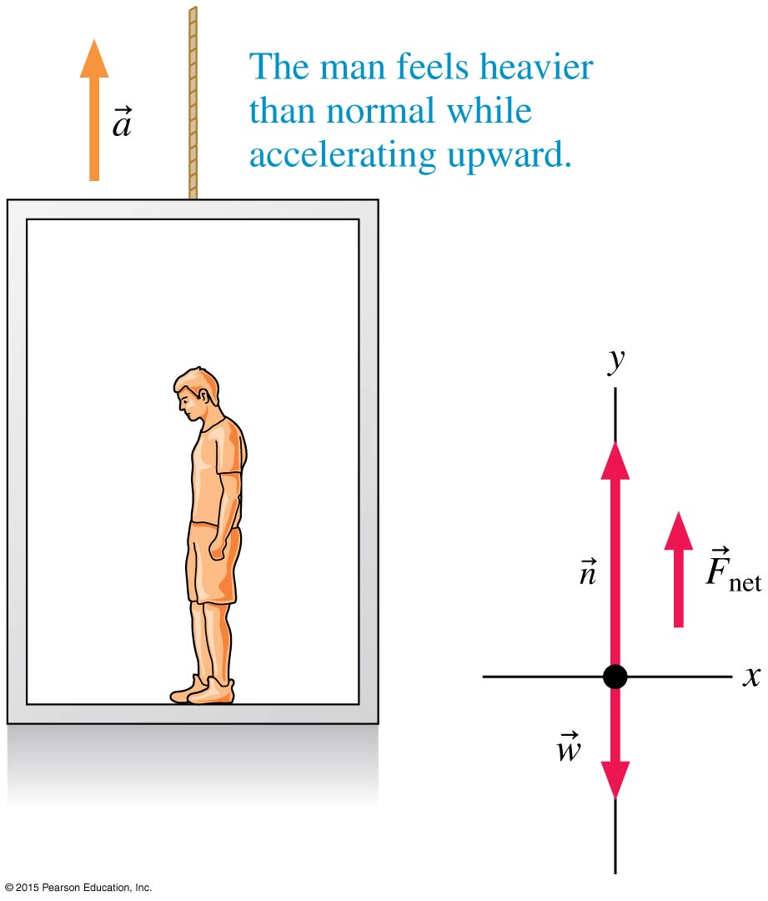
Apparent Weight
The only forces acting on the man are the upward normal force of the floor and the downward weight force:
n = w + ma
w_{app} = w + ma
Thus w_{app} > w and the man feels heavier than normal.

Slide 40
Example 5.8 Apparent weight in an elevator
Anis’s mass is 70 kg. He is standing on a scale in an elevator that is moving at 5.0 m/s. As the elevator stops, the scale reads 750 N. Before it stopped, was the elevator moving up or down? How long did the elevator take to come to rest?
prepare The scale reading as the elevator comes to rest, 750 N, is Anis’s apparent weight.
Anis’s actual weight is:
w = mg = (70 kg)(9.80 m/s²) = 686 N

Slide 41
Example 5.8 Apparent weight in an elevator (cont.)
This is an intermediate step in the calculation, so we are keeping an extra significant figure. Anis’s apparent weight, which is the upward force of the scale on him, is greater than his actual weight, so there is a net upward force on Anis. His acceleration must be upward as well, so we can use this figure as the free-body diagram for this problem. We can find the net force on Anis, and then we can use this net force to determine his acceleration. Once we know the acceleration, we can use kinematics to determine the time it takes for the elevator to stop.

Slide 42
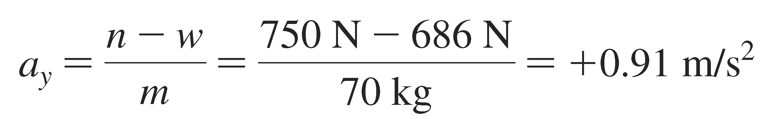
Example 5.8 Apparent weight in an elevator (cont.)
solve We can read components of vectors from the figure. The vertical component of Newton’s second law for Anis’s motion is
ΣF_{y} = n − w = ma_{y}
n is the normal force, which is the scale force on Anis,
750 N. w is his weight, 686 N.
We can thus solve for a_{y}:

Slide 43
Example 5.8 Apparent weight in an elevator (cont.)
The acceleration is positive and so is directed upward, exactly as we assumed—a good check on our work. The elevator is slowing down, but the acceleration is directed upward. This means that the elevator was moving downward, with a negative velocity, before it stopped.

Slide 44
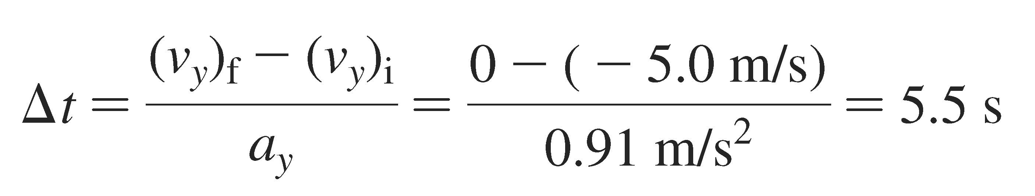
Example 5.8 Apparent weight in an elevator (cont.)
To find the stopping time, we can use the kinematic equation
(v_{y})_{f} = (v_{y})_{i} + a_{y} Δt
The elevator is initially moving downward, so (v_{y})_{i} = − 5.0 m/s, and it then comes to a halt, so (v_{y})_{f} = 0. We know the acceleration, so the time interval is

Slide 45
Example 5.8 Apparent weight in an elevator (cont.)
assess Think back to your experiences riding elevators. If the elevator is moving downward and then comes to rest, you “feel heavy.” This gives us confidence that our analysis of the motion is correct. And 5.0 m/s is a pretty fast elevator: At this speed, the elevator will be passing more than one floor per second. If you’ve been in a fast elevator in a tall building, you know that 5.5 s is reasonable for the time it takes for the elevator to slow to a stop.

Slide 46
Reading Question 5.2
You are riding in an elevator that is accelerating upward. Suppose you stand on a scale. The reading on the scale is
  Greater than your true weight.
  Equal to your true weight.
  Less than your true weight.
Notes:
Answer: A

Slide 47
Reading Question 5.2
You are riding in an elevator that is accelerating upward. Suppose you stand on a scale. The reading on the scale is
  Greater than your true weight.
  Equal to your true weight.
  Less than your true weight.
Notes:
Answer: A

Slide 48
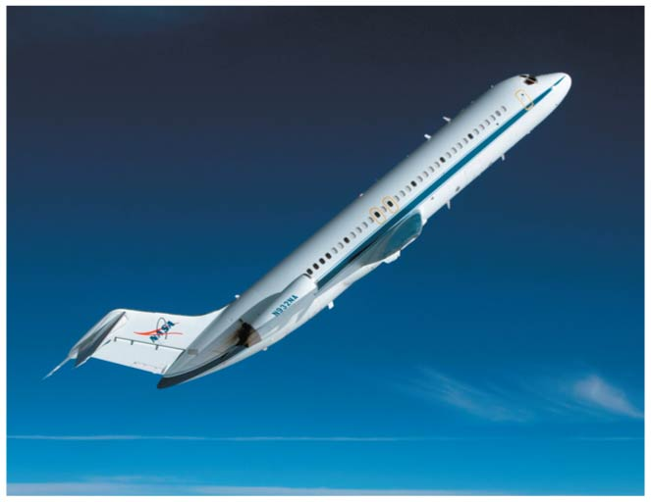
Weightlessness
A person in free fall has zero apparent weight.
“Weightless” does not mean “no weight.”
An object that is weightless has no apparent weight.

Slide 49
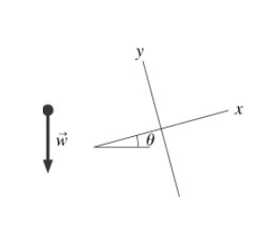
QuickCheck 5.4
What are the components of in the coordinate system shown?
Notes:
Answer: D

Slide 50
QuickCheck 5.4
What are the components of in the coordinate system shown?
Notes:
Answer: D

Slide 51
QuickCheck 5.5
A 50-kg student (mg = 490 N) gets in a 1000-kg elevator at rest and stands on a metric bathroom scale. As the elevator accelerates upward, the scale reads
  > 490 N
  490 N
  < 490 N but not 0 N
  0 N
Notes:
51
Answer: A

Slide 52
QuickCheck 5.5
A 50-kg student (mg = 490 N) gets in a 1000-kg elevator at rest and stands on a metric bathroom scale. As the elevator accelerates upward, the scale reads
  > 490 N
  490 N
  < 490 N but not 0 N
  0 N
Notes:
52
Answer: A

Slide 53
QuickCheck 5.6
A 50-kg student (mg = 490 N) gets in a 1000-kg elevator at rest and stands on a metric bathroom scale. Sadly, the elevator cable breaks. What is the reading on the scale during the few seconds it takes the student to plunge to his doom?
  > 490 N
  490 N
  < 490 N but not 0 N
  0 N
Notes:
53
Answer: D

Slide 54

QuickCheck 5.6
A 50-kg student (mg = 490 N) gets in a 1000-kg elevator at rest and stands on a metric bathroom scale. Sadly, the elevator cable breaks. What is the reading on the scale during the few seconds it takes the student to plunge to his doom?
  > 490 N
  490 N
  < 490 N but not 0 N
  0 N
The bathroom scale would read 0 N. Weight is reading of a scale on which the object is stationary relative to the scale.
Notes:
54

Slide 55
Example Problem
A 50-kg student gets in a 1000-kg elevator at rest. As the elevator begins to move, she has an apparent weight of 600 N for the first 3 s. How far has the elevator moved, and in which direction, at the end of 3 s?
Notes:
Answer: The mass of the elevator is irrelevant. The apparent weight is the normal force which is 600 N. This equals her true weight plus m × a where m is the student’s mass. The acceleration is then 2.2 m/s². The initial velocity is 0. The time is 3 s. V_{f} = a × t = 6.6 m/s.

Slide 56
Section 5.4 Normal Forces

Slide 57
Normal Forces
An object at rest on a table is subject to an upward force due to the table.
This force is called the normal force because it is always directed normal, or perpendicular, to the surface of contact.
The normal force adjusts itself so that the object stays on the surface without penetrating it.

Slide 58
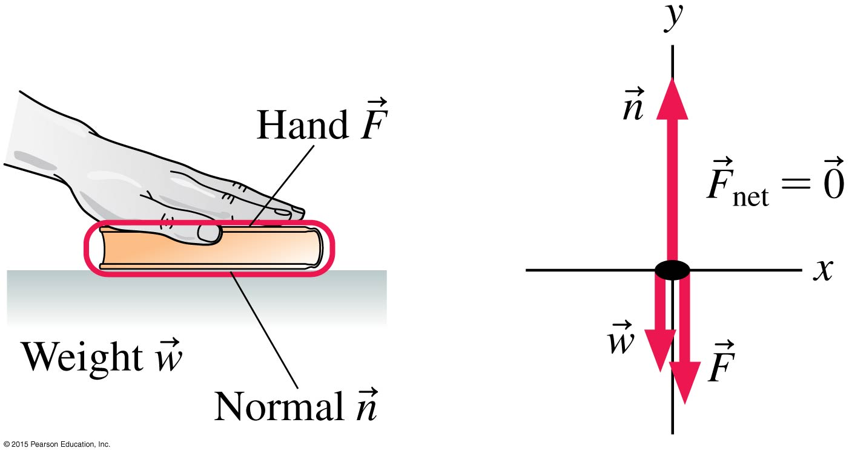
Example 5.9 Normal force on a pressed book
A 1.2 kg book lies on a table. The book is pressed down from above with a force of 15 N. What is the normal force acting on the book from the table below?
prepare The book is not moving and is thus in static equilibrium. We need to identify the forces acting on the book and prepare a free-body diagram showing these forces.

Slide 59
Example 5.9 Normal force on a pressed book (cont.)
solve Because the book is in static equilibrium, the net force on it must be zero. The only forces acting are in the
y-direction, so Newton’s second law is
ΣF_{y} = n_{y} + w_{y} + F_{y} = n − w − F = ma_{y} = 0
We learned in the last section that the weight force is
w = mg. The weight of the book is thus
w = mg = (1.2 kg)(9.8 m/s²) = 12 N
With this information, we see that the normal force exerted by the table is
n = F + w = 15 N + 12 N = 27 N

Slide 60
Example 5.9 Normal force on a pressed book (cont.)
assess The magnitude of the normal force is larger than the weight of the book. From the table’s perspective, the extra force from the hand pushes the book further into the atomic springs of the table. These springs then push back harder, giving a normal force that is greater than the weight of the book.

Slide 61
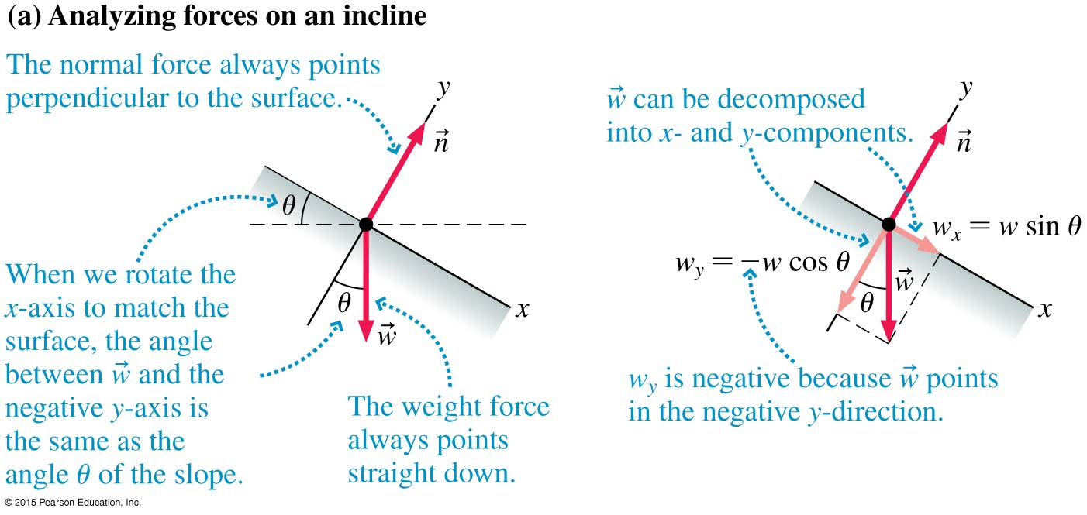
Normal Forces

Slide 62
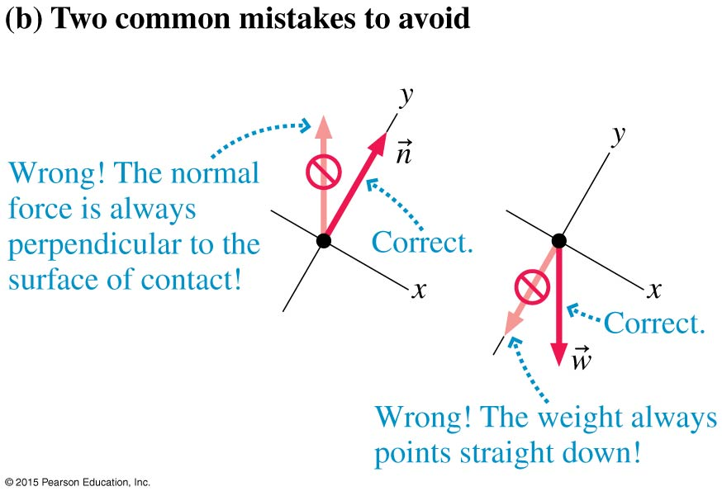
Normal Forces

Slide 63
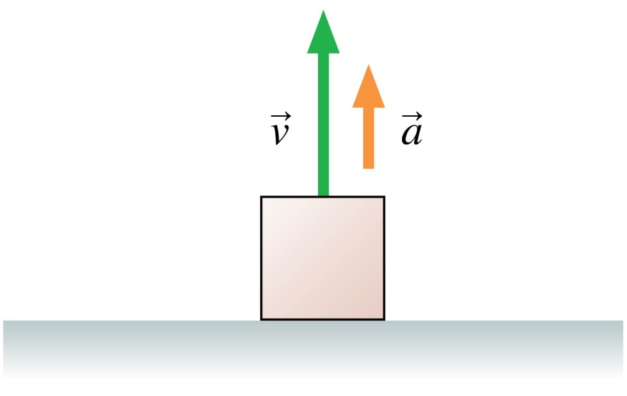
QuickCheck 5.2
The box is sitting on the floor of an elevator. The elevator is accelerating upward. The magnitude of the normal
force on the box is
  n > mg
  n = mg
  n < mg
  n = 0
  Not enough information to tell
Notes:
63
Answer: A

Slide 64
QuickCheck 5.2
The box is sitting on the floor of an elevator. The elevator is accelerating upward. The magnitude of the normal
force on the box is
  n > mg
  n = mg
  n < mg
  n = 0
  Not enough information to tell
Notes:
64
Answer: A

Slide 65
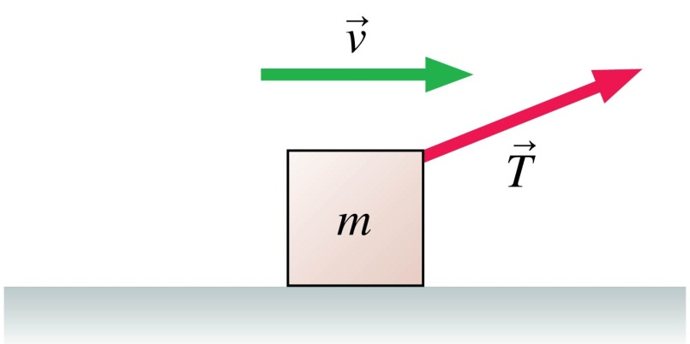
QuickCheck 5.3
A box is being pulled to the right at steady speed by a rope that angles upward. In this situation:
  n > mg
  n = mg
  n < mg
  n = 0
  Not enough information
  to judge the size of the
  normal force
Notes:
65
Answer: C

Slide 66
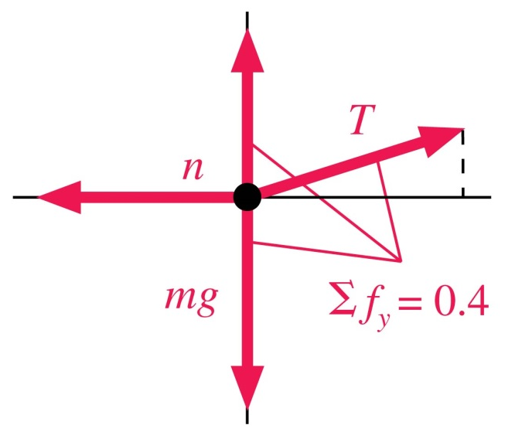
QuickCheck 5.3
A box is being pulled to the right at steady speed by a rope that angles upward. In this situation:
  n > mg
  n = mg
  n < mg
  n = 0
  Not enough information
  to judge the size of the
  normal force
Notes:
66

Slide 67
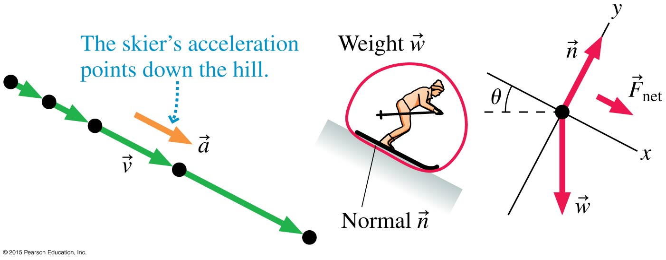
Example 5.10 Acceleration of a downhill skier
A skier slides down a steep 27° slope. On a slope this steep, friction is much smaller than the other forces at work and can be ignored. What is the skier’s acceleration?

Slide 68
Example 5.10 Acceleration of a downhill skier (cont.)
prepare We choose a coordinate system tilted so that the x-axis points down the slope.
This greatly simplifies the analysis because with this choice
a_{y} = 0 (the skier does not move in the y-direction at all). The free-body diagram is based on the information in the figure.

Slide 69
Example 5.10 Acceleration of a downhill skier (cont.)
solve We can now use Newton’s second law in component form to find the skier’s acceleration:
ΣF_{x} = w_{x} + n_{x} = ma_{x}
ΣF_{y} = w_{y} + n_{y} = ma_{y}
Because points directly in the positive y-direction, n_{y} = n and
n_{x} = 0. The figure showed the important fact that the angle between
and the negative y-axis is the same as the slope angle θ. With this information, the components of are w_{x} = w sinθ = mg sinθ and
w_{y} = −w cosθ = −mg cosθ, where we used the fact that w = mg. With these components in hand, Newton’s second law becomes
ΣF_{x} = w_{x} + n_{x} = m_{x} g sinθ = ma_{x}
ΣF_{y} = w_{y} + n_{y} = −mg cosθ + n = ma_{y} = 0

Slide 70
Example 5.10 Acceleration of a downhill skier (cont.)
In the second equation we used the fact that a_{y} = 0. The m cancels in the first of these equations, leaving us with
a_{x} = g sinθ
This is the expression for acceleration on a frictionless surface that we presented, without proof, in Chapter 3. Now we’ve justified our earlier assertion. We can use this to calculate the skier’s acceleration:
a_{x} = g sinθ = (9.8 m/s²) sin 27° = 4.4 m/s²

Slide 71
Example 5.10 Acceleration of a downhill skier (cont.)
assess Our result shows that when θ = 0, so that the slope is horizontal, the skier’s acceleration is zero, as it should be. Further, when θ = 90° (a vertical slope), his acceleration is g, which makes sense because he’s in free fall when θ = 90°. Notice that the mass canceled out, so we didn’t need to know the skier’s mass. We first saw the formula for the acceleration, but now we see the physical reasons behind it.

Slide 72
Section 5.5 Friction

Slide 73
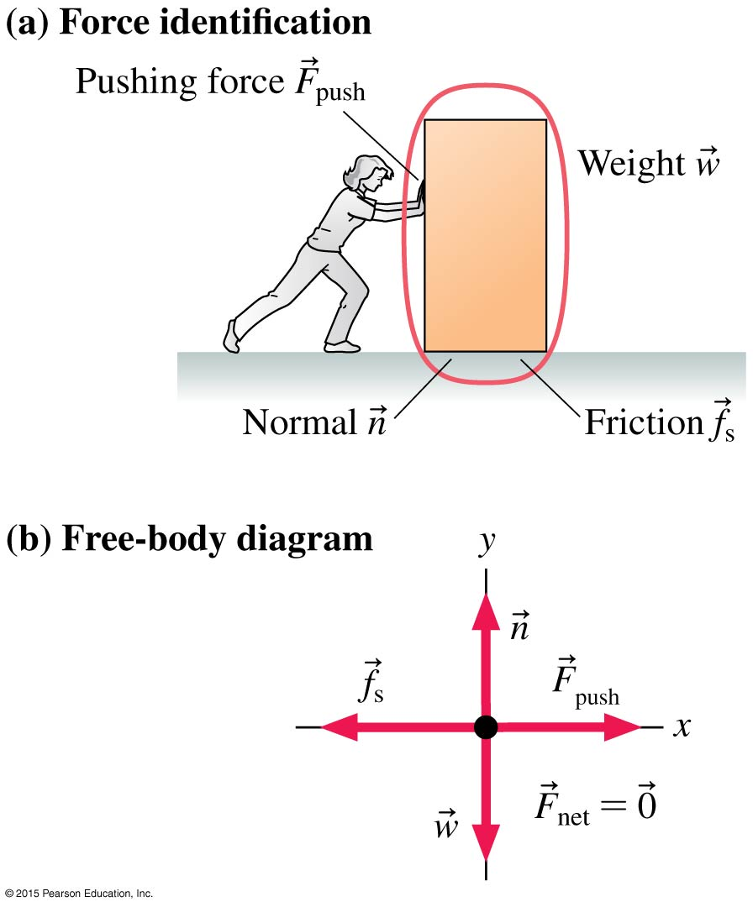

Static Friction
Static friction is the force that a surface exerts on an object to keep it from slipping across the surface.
To find the direction of , decide which way the object would move if there were no friction. The static friction force then points in the opposite direction.

Slide 74
Static Friction
The box is in static equilibrium.
The static friction force must exactly balance the pushing force.

Slide 75
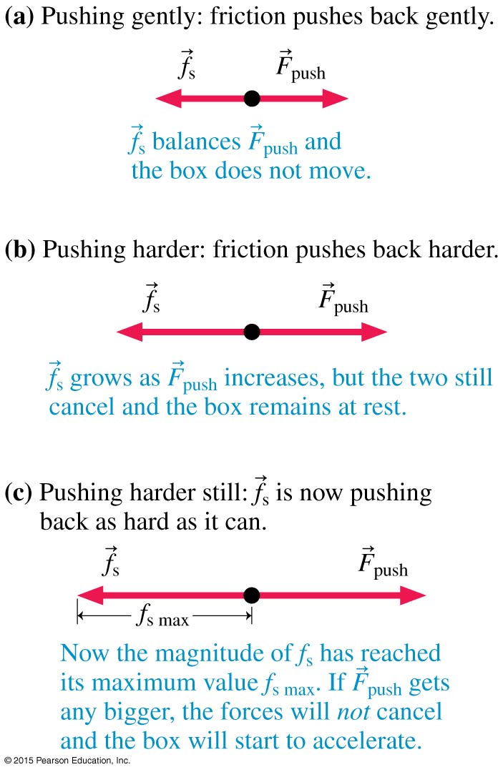
Static Friction
The harder the woman pushes, the harder the friction force from the floor pushes back.
If the woman pushes hard enough, the box will slip and start to move.
The static friction force has a maximum possible magnitude:
f_{s max} = µ_{s}n
where µ_{s} is called the coefficient of static friction.

Slide 76
Static Friction
The direction of static friction is such as to oppose motion.
The magnitude f_{s} of static friction adjusts itself so that the net force is zero and the object doesn’t move.
The magnitude of static friction cannot exceed the maximum value f_{s max} . If the friction force needed to keep the object stationary is greater than
f_{s max}, the object slips and starts to move.

Slide 77
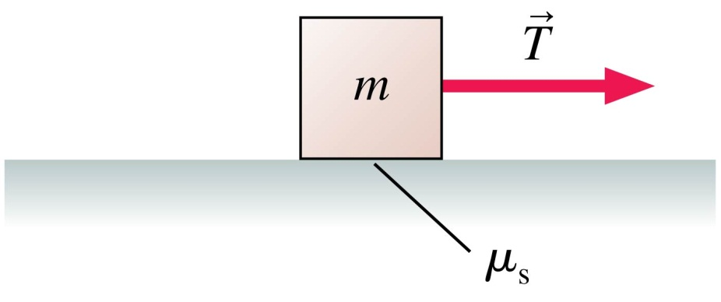
QuickCheck 5.7
A box on a rough surface is pulled by a horizontal rope with tension T. The box is not moving. In this situation:
  f_{s} > T
  f_{s} = T
  f_{s} < T
  f_{s} = μ_{s} mg
  f_{s} = 0
Notes:
77
Answer: B

Slide 78
QuickCheck 5.7
A box on a rough surface is pulled by a horizontal rope with tension T. The box is not moving. In this situation:
  f_{s} > T
  f_{s} = T
  f_{s} < T
  f_{s} = μ_{s} mg
  f_{s} = 0
Notes:
78
Answer: B

Slide 79
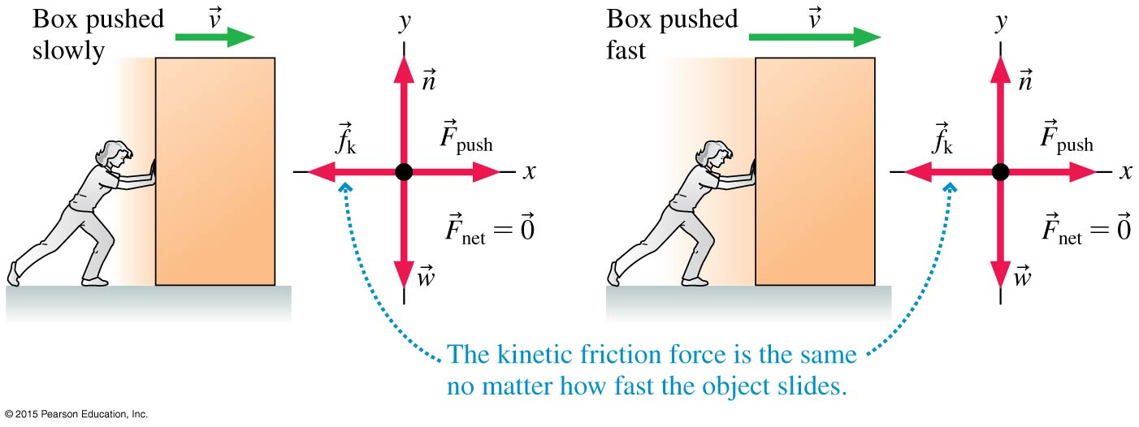
Kinetic Friction
Kinetic friction, unlike static friction, has a nearly constant magnitude given by
f_{k} = µ_{k}n
where µ_{k} is called the coefficient of kinetic friction.

Slide 80
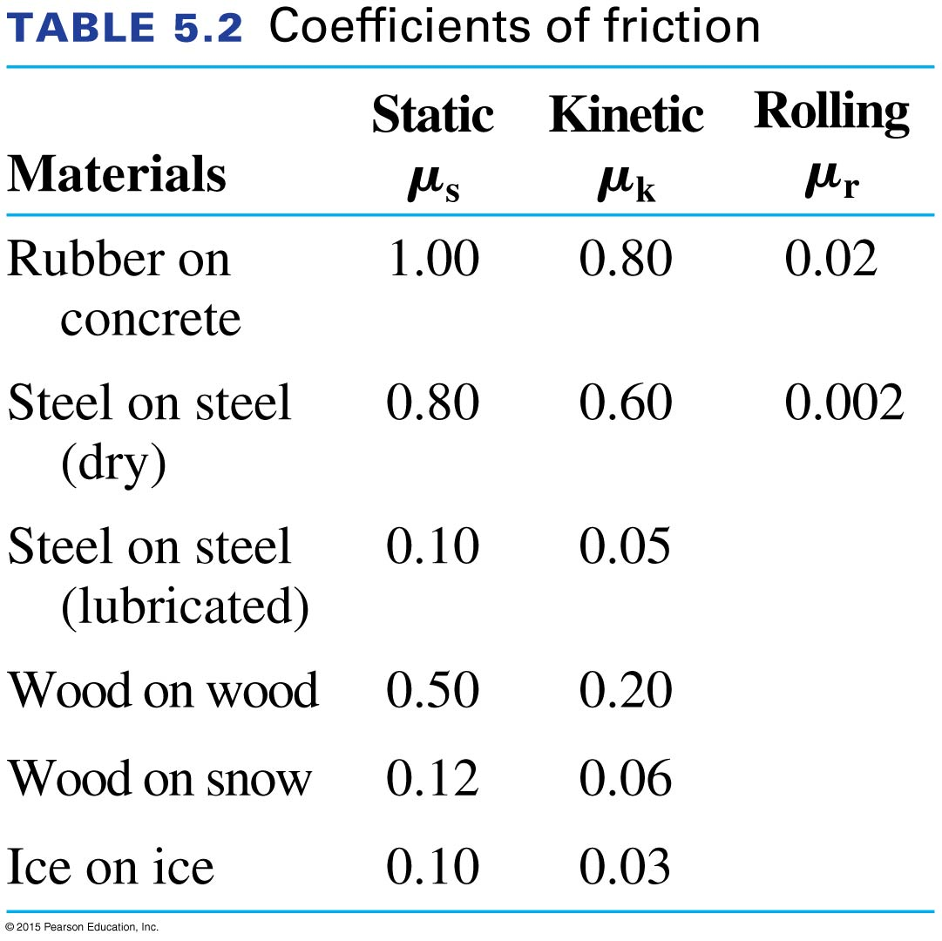
Friction Forces

Slide 81
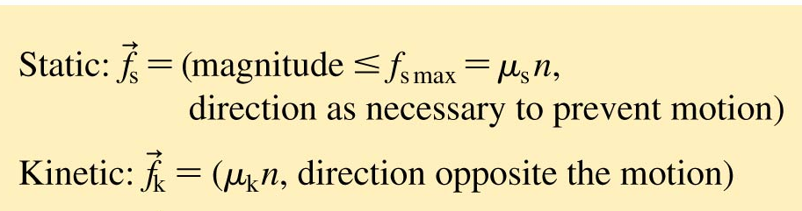
Working with Friction Forces

Slide 82
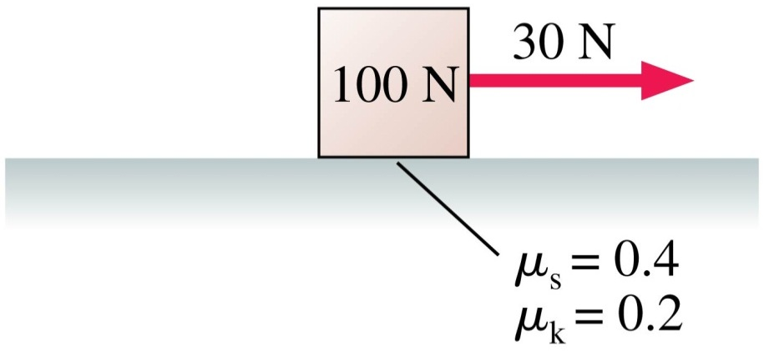
QuickCheck 5.8
A box with a weight of 100 N is at rest. It is then pulled by a 30 N horizontal force.
Does the box move?
  Yes
  No
  Not enough information to say
Notes:
82
Answer: B

Slide 83
QuickCheck 5.8
A box with a weight of 100 N is at rest. It is then pulled by a 30 N horizontal force.
Does the box move?
  Yes
  No
  Not enough information to say
Notes:
83
Answer: B

Slide 84
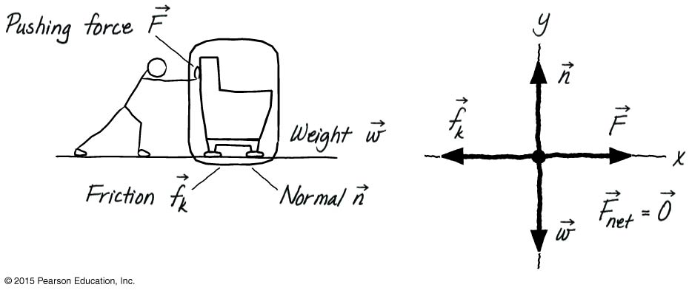
Example 5.11 Finding the force to slide a sofa
Sarah wants to move her 32 kg sofa to a different room in the house. She places “sofa sliders,” slippery disks with
μ_{k} = 0.080, on the carpet, under the feet of the sofa. She then pushes the sofa at a steady 0.40 m/s across the floor. How much force does she apply to the sofa?

Slide 85

Example 5.11 Finding the force to slide a sofa (cont.)
prepare Let’s assume the sofa slides to the right. In this case, a kinetic friction force , opposes the motion by pointing to the left. In the figure, we identify the forces acting on the sofa and construct a free-body diagram.

Slide 86
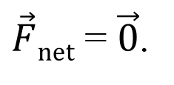
Example 5.11 Finding the force to slide a sofa (cont.)
solve The sofa is moving at a constant speed, so it is in dynamic equilibrium with This means that the x- and y-components of the net force must be zero:
ΣF_{x} = n_{x} + w_{x} + F_{x} + ( f_{k})_{x} = 0 + 0 + F − f_{k} = 0
ΣF_{y} = n_{y} + w_{y} + F_{y} + ( f_{k})_{y} = n − w + 0 + 0 = 0
In the first equation, the x -component of is equal to −f_{k} because is directed to the left. Similarly, w_{y} = −w because the weight force points down.
From the first equation, we see that Sarah’s pushing force is
F = f_{k}. To evaluate this, we need f_{k}. Here we can use our model for kinetic friction:
f_{k} = μ_{k}n

Slide 87
Example 5.11 Finding the force to slide a sofa (cont.)
Let’s look at the vertical motion first. The second equation ultimately reduces to
n − w = 0
The weight force w = mg, so we can write
n = mg
This is a common result we’ll see again. The force that Sarah pushes with is equal to the friction force, and this depends on the normal force and the coefficient of kinetic friction, μ_{k} = 0.080:
F = f_{k} = μ_{k}n = μ_{k}mg
= (0.080)(32 kg)(9.80 m/s²) = 25 N

Slide 88
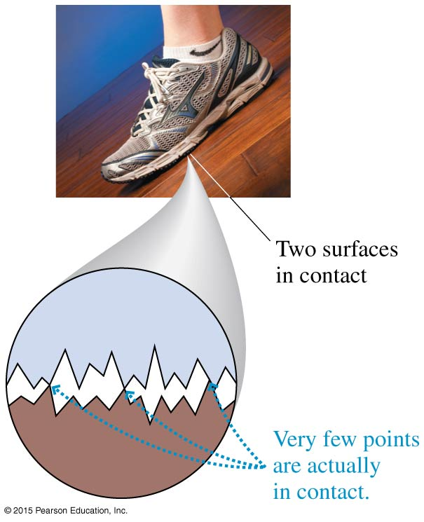
Causes of Friction
All surfaces are very rough on a microscopic scale.
When two objects are placed in contact, the high points on one surface become jammed against the high points on the other surface.
The amount of contact depends on how hard the surfaces are pushed together.
[Insert Figure 5.21.]

Slide 89
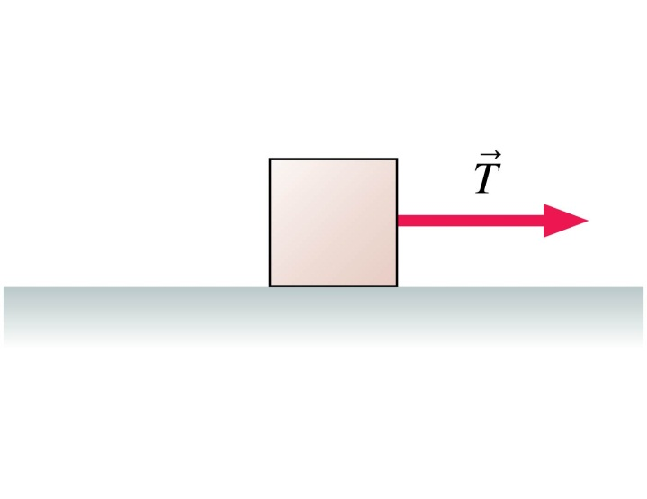
QuickCheck 5.9
A box is being pulled to the right over a rough surface.
T > f_{k}, so the box is speeding up. Suddenly the rope breaks.
What happens? The box
  Stops immediately.
  Continues with the speed it had when the rope broke.
  Continues speeding up for a short while, then slows
  and stops.
  Keeps its speed for a short while, then slows and stops.
  Slows steadily until it stops.
Notes:
89
Answer: E

Slide 90
QuickCheck 5.9
A box is being pulled to the right over a rough surface.
T > f_{k}, so the box is speeding up. Suddenly the rope breaks.
What happens? The box
  Stops immediately.
  Continues with the speed it had when the rope broke.
  Continues speeding up for a short while, then slows
  and stops.
  Keeps its speed for a short while, then slows and stops.
  Slows steadily until it stops.
Notes:
90
Answer: E

Slide 91
Reading Question 5.3
In general, the coefficient of static friction is
  Smaller than the coefficient of kinetic friction.
  Equal to the coefficient of kinetic friction.
  Greater than the coefficient of kinetic friction.
Notes:
Answer: C

Slide 92
Reading Question 5.3
In general, the coefficient of static friction is
  Smaller than the coefficient of kinetic friction.
  Equal to the coefficient of kinetic friction.
  Greater than the coefficient of kinetic friction.
Notes:
Answer: C

Slide 93





Example Problem
A wooden box, with a mass of 22 kg, is pulled at a constant speed with a rope that makes an angle of 25° with the wooden floor (μ_{s}=μ_{s(wood-wood)} = 0.5).
What is the tension in the rope?
Notes:
Answer: The box is in dynamic equilibrium. The tension can be determined from the vertical forces. T = 510 N.

Slide 94
Section 5.7 Interacting Objects

Slide 95
Interacting Objects
Newton’s third law states:
  Every force occurs as one member of an action/reaction pair of forces. The two members of the pair always act on different objects.
  The two members of an action/reaction pair point in opposite directions and are equal in magnitude.

Slide 96
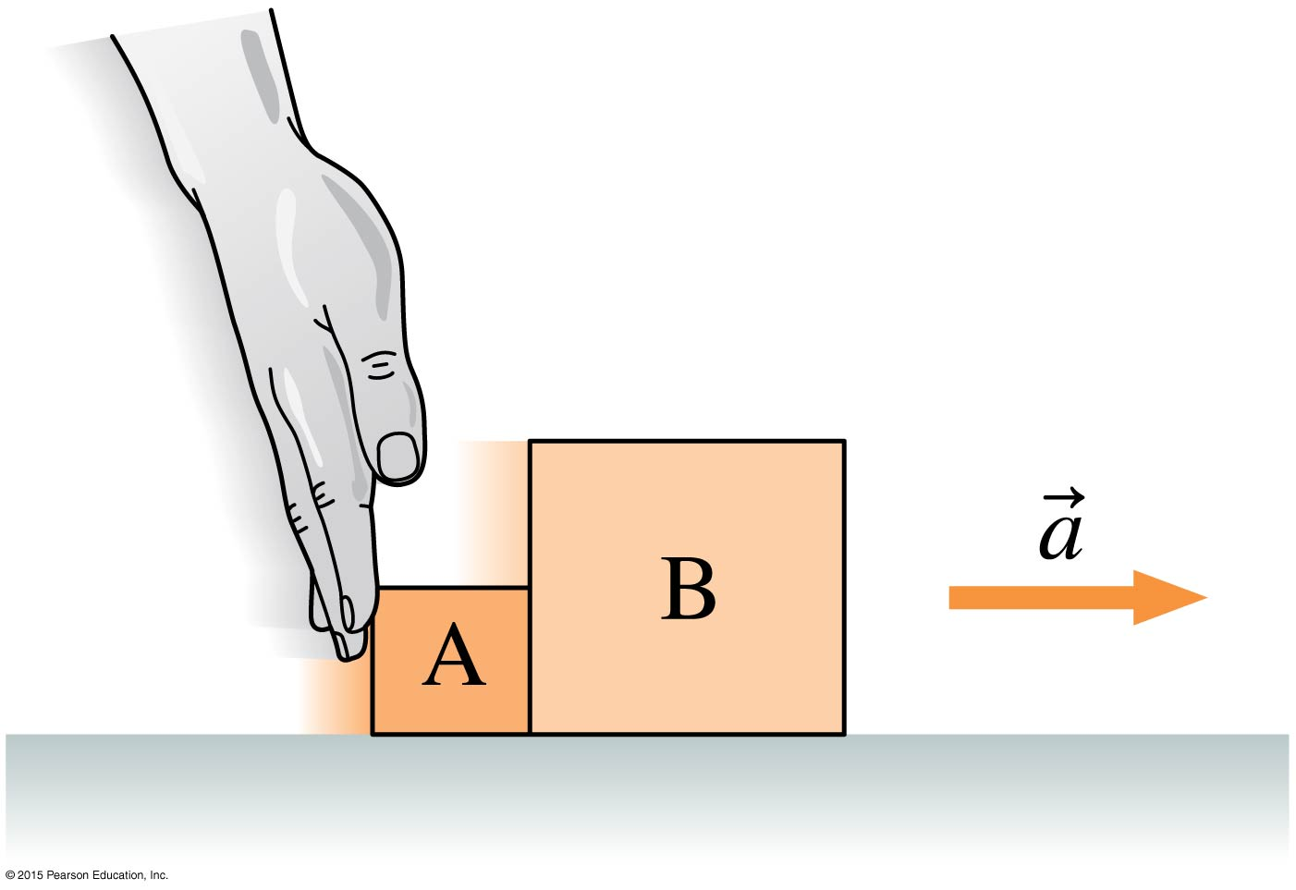


Objects in Contact
To analyze block A’s motion, we
need to identify all the forces acting
on it and then draw its free-body
diagram.
We repeat the same steps to analyze
the motion of block B.
However, the forces on A and B are
not independent: Forces acting on block A and acting on block B are an action/reaction pair and thus have the same magnitude.
Because the two blocks are in contact, their accelerations must be the same: a_{Ax} = a_{Bx} = a_{x}.
We can’t solve for the motion of one block without considering the motion of the other block.

Slide 97
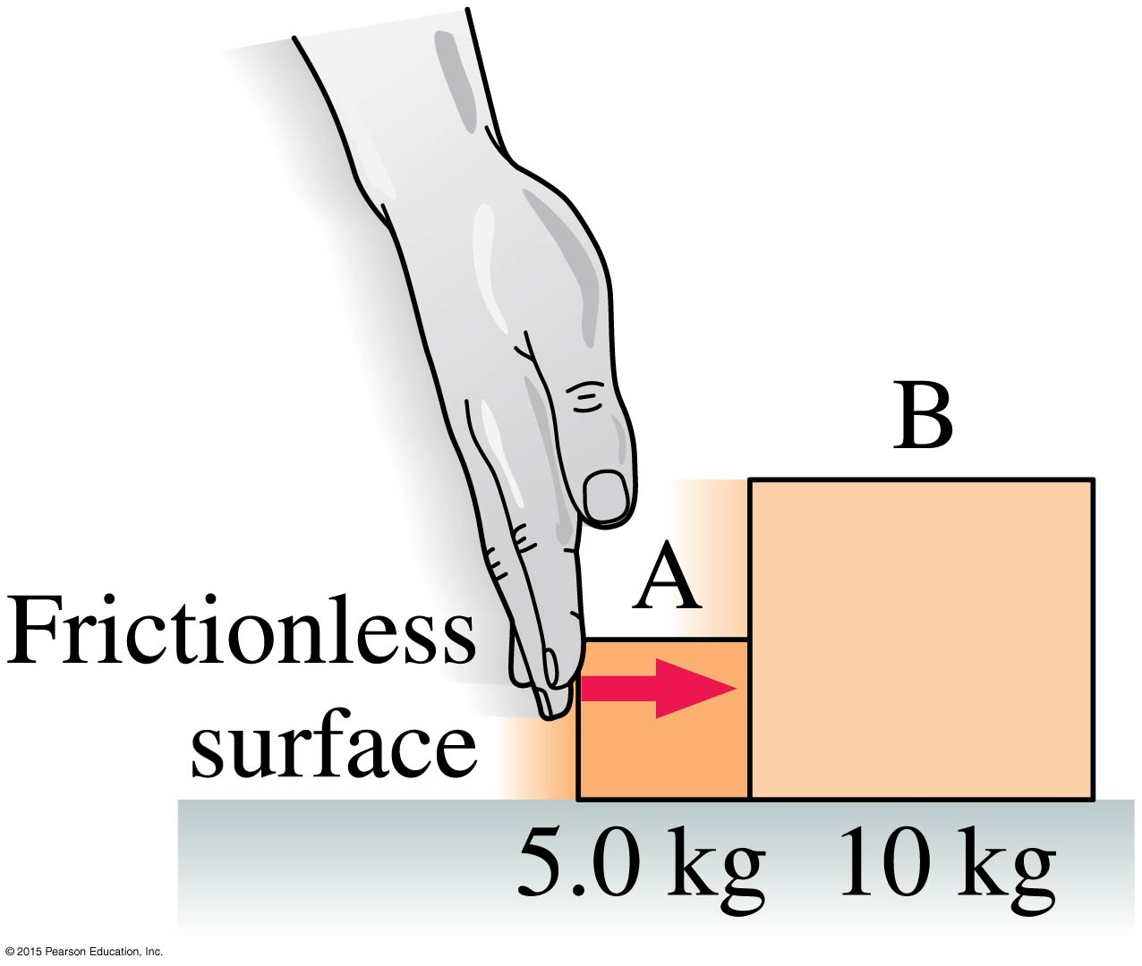
Example 5.15 Pushing two blocks
The figure shows a 5.0 kg block A being pushed with a 3.0 N force. In front of this block is a 10 kg block B; the two blocks move together. What force does block A exert on block B?

Slide 98
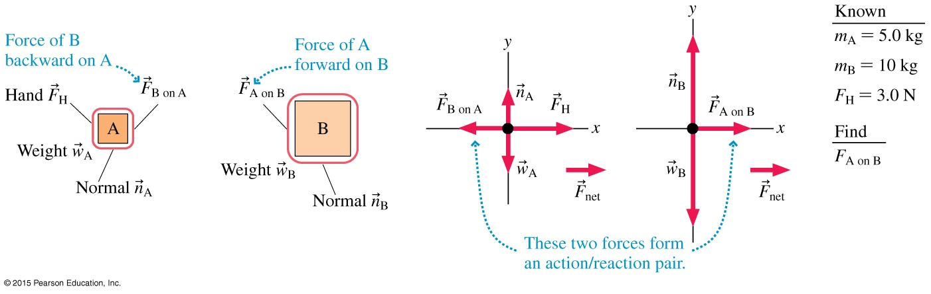
Example 5.15 Pushing two blocks (cont.)
prepare The visual overview of the figure lists the known information and identifies F_{A on B} as what we’re trying to find. Then, we’ve drawn separate force identification diagrams and separate free-body diagrams for the two blocks. Both blocks have a weight force and a normal force, so we’ve used subscripts A and B to distinguish between them.

Slide 99
Example 5.15 Pushing two blocks (cont.)
The force is the contact
force that block A exerts on B;
it forms an action/reaction
pair with the force that
block B exerts on A. Notice
that force is drawn acting
on block B; it is the force of A
on B. Force vectors are always drawn on the free-body
diagram of the object that experiences the force, not the object exerting the force. Because action/reaction pairs act in opposite directions, force pushes backward on block A and appears on A’s free-body diagram.

Slide 100
Example 5.15 Pushing two blocks (cont.)
solve We begin by writing Newton’s second
law in component form for each block. Because
the motion is only in the x-direction, we need
only the x-component of the second law. For
block A,
ΣF_{x} = (F_{H})_{x} + (F_{B on A})_{x} = m_{A}a_{Ax}
The force components can be “read” from the free-body diagram, where we see pointing to the right and
pointing to the left. Thus
F_{H} − F_{B} _{on A} = m_{A}a_{Ax}

Slide 101
Example 5.15 Pushing two blocks (cont.)
For B, we have
ΣF_{x} = (F_{A on B})_{x} = F_{A on B} = m_{B}a_{Bx}
We have two additional pieces of information:
First, Newton’s third law tells us that F_{B on A} = F_{A on B}. Second, the boxes are in contact and must have the same acceleration a_{x}; that is, a_{Ax} = a_{Bx} = a_{x}. With this information, the two x-component equations become
F_{H} - F_{A on B} = m_{A}a_{x}
F_{A on B} = m_{B}a_{x}

Slide 102
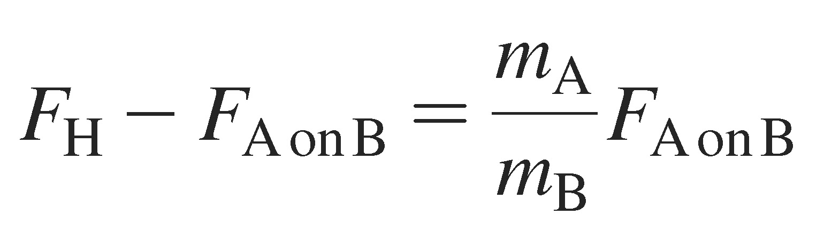
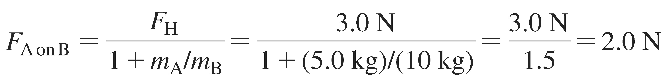
Example 5.15 Pushing two blocks (cont.)
F_{H} − F_{A on B} = m_{A}a_{x}
F_{A on B} = m_{B}a_{x}
Our goal is to find F_{A on B}, so we need to eliminate the unknown acceleration a_{x}. From the second equation,
a_{x} = F_{A on B}/m_{B}. Substituting this into the first equation gives
This can be solved for the force of block A on block B, giving

Slide 103
Example 5.15 Pushing two blocks (cont.)
assess Force F_{H} accelerates both blocks, a total mass of 15 kg, but force F_{A on B} accelerates only block B, with a mass of 10 kg. Thus it makes sense that F_{A on B} < F_{H}.

Slide 104
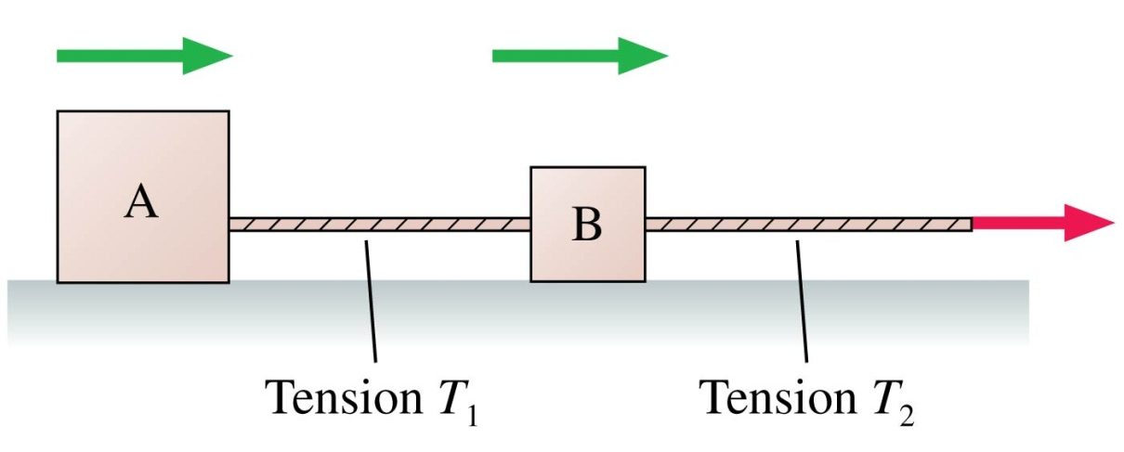
QuickCheck 5.12
Boxes A and B are being pulled to the right on a frictionless surface; the boxes are speeding up. Box A has a larger mass than Box B. How do the two tension forces compare?
  T₁ > T₂
  T₁ = T₂
  T₁ < T₂
  Not enough information to tell
Notes:
104
Answer: C

Slide 105
QuickCheck 5.12
Boxes A and B are being pulled to the right on a frictionless surface; the boxes are speeding up. Box A has a larger mass than Box B. How do the two tension forces compare?
  T₁ > T₂
  T₁ = T₂
  T₁ < T₂
  Not enough information to tell
Notes:
105
Answer: C

Slide 106
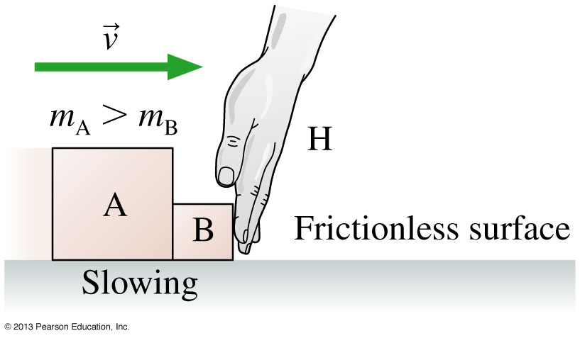
QuickCheck 5.13
Boxes A and B are sliding to the right on a frictionless surface. Hand H is slowing them. Box A has a larger mass than Box B. Considering only the horizontal forces:
  F_{B on H} = F_{H on B} = F_{A on B} = F_{B on A}
  F_{B on H} = F_{H on B} > F_{A on B} = F_{B on A}
  F_{B on H} = F_{H on B} < F_{A on B} = F_{B on A}
  F_{H on B} = F_{H on A} > F_{A on B}
Notes:
106
Answer: B

Slide 107
QuickCheck 5.13
Boxes A and B are sliding to the right on a frictionless surface. Hand H is slowing them. Box A has a larger mass than Box B. Considering only the horizontal forces:
  F_{B on H} = F_{H on B} = F_{A on B} = F_{B on A}
  F_{B on H} = F_{H on B} > F_{A on B} = F_{B on A}
  F_{B on H} = F_{H on B} < F_{A on B} = F_{B on A}
  F_{H on B} = F_{H on A} > F_{A on B}
Notes:
107
Answer: B

Slide 108
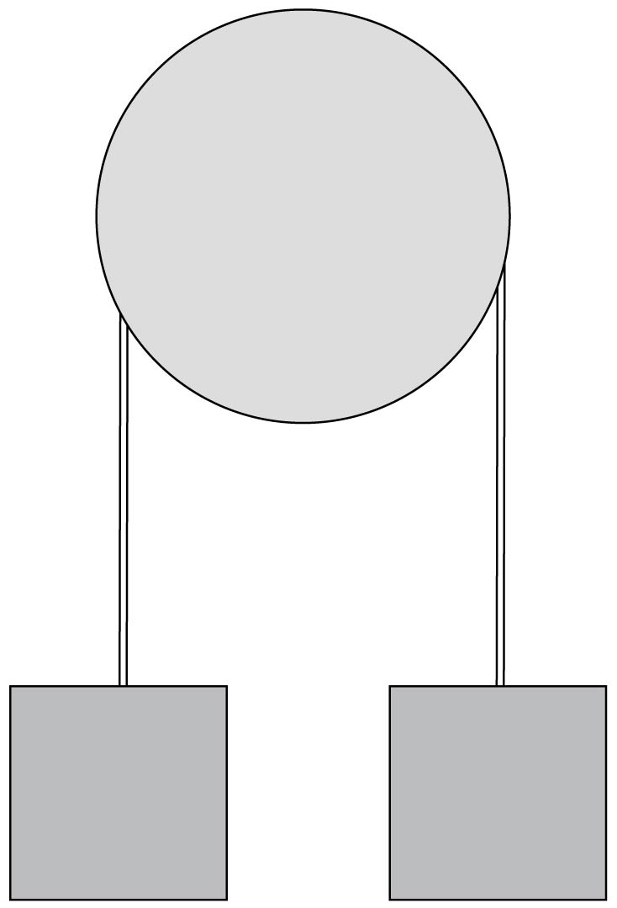
Reading Question 5.5
Two boxes are suspended from a rope over a pulley. Each box has weight 50 N. What is the tension in the rope?
  25 N
  50 N
  100 N
  200 N
Notes:
Answer: B

Slide 109
Reading Question 5.5
Two boxes are suspended from a rope over a pulley. Each box has weight 50 N. What is the tension in the rope?
  25 N
  50 N
  100 N
  200 N
Notes:
Answer: B

Slide 110
Section 5.8 Ropes and Pulleys

Slide 111
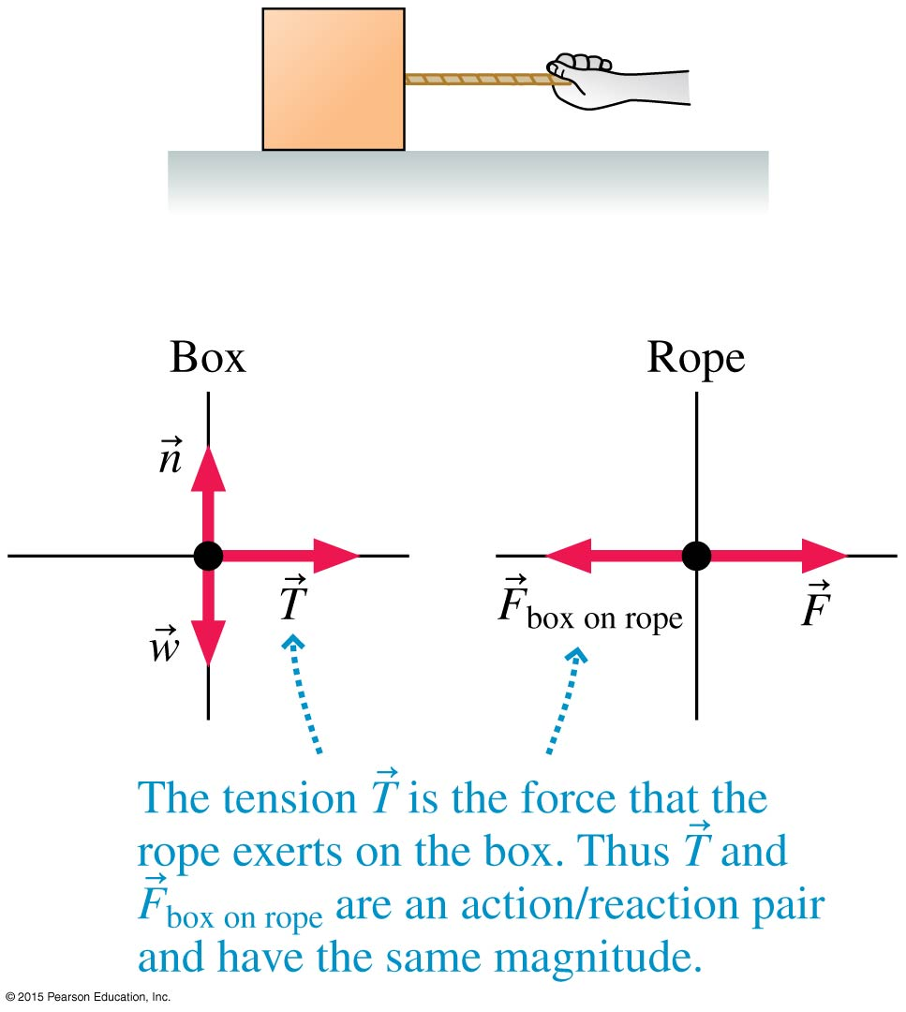

Ropes
The box is pulled by the
rope, so the box’s free-body
diagram shows a tension
force .
We make the massless
string approximation that
m_{rope} = 0.
Newton’s second law for the
rope is thus
ΣF_{x} = F-F_{box on rope} = F – T = m_{rope}a_{x} = 0

Slide 112
Ropes
Generally, the tension in a massless string or rope equals the magnitude of the force pulling on the end of the string or rope. As a result:
  A massless string or rope “transmits” a force undiminished from one end to the other: If you pull on one end of a rope with force F, the other end of the rope pulls on what it’s attached to with a force of the same magnitude F.
  The tension in a massless string or rope is the same from one end to the other.

Slide 113

QuickCheck 5.10
All three 50-kg blocks are at rest. The tension in rope 2 is
  Greater than the tension in rope 1.
  Equal to the tension in rope 1.
  Less than the tension in rope 1.
Notes:
113
Answer: B

Slide 114


QuickCheck 5.10
All three 50-kg blocks are at rest. The tension in rope 2 is
  Greater than the tension in rope 1.
  Equal to the tension in rope 1.
  Less than the tension in rope 1.
Each block is in static equilibrium, with .
Notes:
114

Slide 115

Pulleys
The tension in a massless string is unchanged by passing over a massless, frictionless pulley.
We’ll assume such an ideal pulley for problems in this chapter.

Slide 116

QuickCheck 5.15
The top block is accelerated across a frictionless table by the falling mass m. The string is massless, and the pulley is both massless and frictionless. The tension in the string is
  T < mg
  T = mg
  T > mg
Notes:
116
Answer: A

Slide 117
QuickCheck 5.15
The top block is accelerated across a frictionless table by the falling mass m. The string is massless, and the pulley is both massless and frictionless. The tension in the string is
  T < mg
  T = mg
  T > mg
Notes:
117
Answer: A

Slide 118

Example 5.18 Lifting a stage set
A 200 kg set used in a play is
stored in the loft above the
stage. The rope holding
the set passes up and
over a pulley, then
is tied backstage. The
director tells a 100 kg
stagehand to lower the set.
When he unties the rope, the
set falls and the unfortunate man is hoisted into the loft. What is the stagehand’s acceleration?

Slide 119


Example 5.18 Lifting a stage set (cont.)
prepare The figure shows
the visual overview. The
objects of interest are
the stagehand M and
the set S, for which
we’ve drawn separate
free-body diagrams.
Assume a massless rope
and a massless, frictionless
pulley. Tension forces and are due to a massless rope going over an ideal pulley, so their magnitudes are the same.

Slide 120
Example 5.18 Lifting a stage set (cont.)
solve From the two free-body diagrams, we can write Newton’s second law in component form. For the man we have
ΣF_{My} = T_{M} − w_{M} = T_{M} − m_{M}g = m_{M}a_{My}
For the set we have
ΣFS_{y} = T_{S} − w_{S} = T_{S} − m_{S}g = m_{S}a_{Sy}

Slide 121
Example 5.18 Lifting a stage set (cont.)
Only the y-equations are needed. Because the stagehand and the set are connected by a rope, the upward distance traveled by one is the same as the downward distance traveled by the other. Thus, the magnitudes of their accelerations must be the same, but, as the figure shows, their directions are opposite.

Slide 122
Example 5.18 Lifting a stage set (cont.)
We can express this mathematically as
a_{Sy} = −a_{My}. We also know that the two
tension forces have equal magnitudes,
which we’ll call T. Inserting this
information into the above equations
gives
T − m_{M}g = m_{M}a_{My}
T − m_{S}g = −m_{S}a_{My}

Slide 123
Example 5.18 Lifting a stage set (cont.)
These are simultaneous equations in the two unknowns T and a_{My}. We can solve for T in the first equation to get
T = m_{M}a_{My} + m_{M}g
Inserting this value of T into the second equation then gives
m_{M}a_{My} + m_{M}g − m_{S}g = −m_{S}a_{My}
which we can rewrite as
(m_{S} − m_{M})g = (m_{S} + m_{M})a_{My}

Slide 124

Example 5.18 Lifting a stage set (cont.)
Finally, we can solve for the hapless stagehand’s acceleration:
This is also the acceleration with which the set falls. If the rope’s tension was needed, we could now find it from
T = m_{M}a_{My}+ m_{M}g.
assess If the stagehand weren’t holding on, the set would fall with free-fall acceleration g. The stagehand acts as a counterweight to reduce the acceleration.

Slide 125

Summary: General Strategy

Slide 126

Summary: General Strategy

Slide 127

Summary: Important Concepts

Slide 128

Summary: Important Concepts

Slide 129

Summary: Applications

Slide 130

Summary: Important Concepts

Slide 131
Problems on chapter 5

Slide 132
1- What is the minimum downward force on the box that will keep it from slipping? The coefficients of static and kinetic friction between the box and the floor are 0.35 and 0.25, respectively.
Answer: 63 N

Slide 133
2- The figure shows the velocity graph of a 75 kg passenger in an elevator. What is the passenger’s apparent weight at: t = 1.0 s?
t = 5.0 s?
t = 9.0 s?
Answers:
1.0 kN
0.74 kN
0.59 kN

Slide 134
3- Two blocks are at rest on a frictionless incline, as shown in the figure. What are the tensions in the two strings?
Answer:
T₁ = 17 N
T₂ = 27 N

Slide 135
4-A 10 kg crate is placed on a horizontal conveyor belt. The materials are such that µ_{s} = 0.50 and µ_{k} = 0.30. What is the maximum acceleration the belt can have without the crate slipping?
Answer: 4.9 m/s²

Slide 136
5- The ramp in figure is frictionless. If the blocks are released from rest, which way does the 10 kg block slide, and what is the magnitude of its acceleration?
Answer:
Down at 0.93 m/s²

Slide 137
6- A 1.0 kg wood block is pressed against a vertical wood wall (µ_{s} = 0.50) by a 12 N force as shown in the figure. If the block is initially at rest, will it move upward, move downward, or stay at rest?
Answer:
Stay at rest

Slide 138
7- A person is using a rope to lower a 5.0-N bucket into a well with a constant speed of 2.0 m/s. What is the magnitude of the force exerted by the rope on the bucket?
Answer: 5 N

Slide 139
8- A 2.0 kg ball is suspended by two light strings as shown
in the figure. What is the tension T in the angled string?
Answer: 26 N

Slide 140
9- A crate pushed along the floor with velocity v_{i} slides a distance d after the pushing force is removed.
a. If the mass of the crate is doubled, but the initial velocity is not changed, what distance does the crate slide before stopping?
b. If the initial velocity of the crate is doubled to 2v, but the
mass is not changed, what distance does the crate slide before stopping?
Answers:
d
4d

Slide 141
10- A 50 kg box hangs from a rope. What is the tension in the rope if the box has v_{y} = 5.0 m/s and is speeding up at 5.0 m/s²?
Answers:
740 N

