Slide 1
Implications of Ethics in Practice

Slide 3
CONFIDENTIALITY and INFORMED CONSENT IN BIOETHICS

Slide 4
CONFIDENTIALITY
is one of the core and fundamental tenets at medical practice. It requires health care providers to maintain a patient’s personal health information private unless consent to release the information is provided by the patient.

Slide 5
THE CORE OF THE CONFIDENTIALITY IS BASED ON:
Respect the patient privacy – the patient expect doctors to maintain confidentiality
Confidentiality promotes trust in physician-patient relationship
Confidentiality heartens patients to seek medical attention
Confidentiality encourages patients to share information that can be important for the decision on the treatment
Prevention of harmful consequences to patients – discrimination based on ill health
Notes:
–patients have the right to control the access to their personal information

Slide 6
VIOLATION OF CONFIDENTIALITY, LEVELS
Unauthorized release of confidential information, disclosure of confidential information
Levels of breaching confidentiality:
0 – no breach of confidentiality:
between the members of the medical team or required by law
1 – trivial breach of confidentiality:
the information is shared to third person without names
Notes:
medical information is disclosed to non-medical person with patient being identified and some social and physiological information has been revealed that can discredit patient to the society and their family and friends

Slide 7
Levels of breaching confidentiality cont.
2 – significant breach of confidentiality:
medical information is discussed with non-medical person and identifies the patient; damages to the patients could follow
3 – severe breach of confidentiality:
shared with non-medical; patient is identified and too much compromised in the society

Slide 8
WHEN CAN CONFIDENTIALITY BE BREACHED?
Overriding concerns can lead to the need to breach confidentiality in certain circumstances.
Exception 1: Concern for the safety of other specific persons
Examples:
 homicidal ideation, when the patient shares a specific plan with a physician;
 psychotherapist to harm a particular individual;
 the man, just tested positive for HIV…
In many countries State Law requires the report of certain communicable/infectious diseases to the public health authorities. That’s why, the duty to protect public health outweighs the duty to maintain a patient's confidence.
Exception 2: Legal requirements to report certain conditions or circumstances
Examples:
Measles (الحصبه), rabies(داء الكلب), anthrax)الجمره الخبيثه), botulism(التسمم الوشيقي)
sexually transmitted diseases, and tuberculosis;
suspected cases of child, dependent adult, and elder abuse are reportable;
gunshot wounds.

Slide 9
CONCEPT OF INFORMED CONSENT
 Medical advances should not require some people to sacrifice their health and rights for the good of all.
 Informed consent is a process which is designed to empower the individual to make a voluntary informed decision regarding participation in the research.
 Voluntary consent means that the participants were able to consent, were not being coerced to do the study and understood the risks and benefit involved.

Slide 10
INFORMED CONSENT
Definition: A patient’s willing acceptance of a medical intervention after adequate disclosure from their physician of the nature of the intervention, risks, benefits and alternative treatment options.
What constitutes informed consent?
  Disclosure: information to allow reasonable person to make a decision
  Understanding: comprehension of the information given
  Voluntary: no coercion or incentive to accept or deny a treatment
  Agreement: verbal or written (preferred) to discussed intervention

Slide 11
˚ Why get informed consent?
Respect for person
Autonomy
Justice
Notes:
To maintain careful records copies of the shipment forms, return drug forms, documentation of drug disposal. No white out can EVER be used on the Drug Accountability Record Form (DARF).

Slide 12
INFORMED CONSENT
Importance of Informed Consent
Informed Consent is the first and longest of the 10 principles in the Nuremberg code.
Informed Consent is included in every guidelines on Research Ethics.
Informed Consent is one of the 8 requirements for clinical research.
Notes:
To maintain careful records copies of the shipment forms, return drug forms, documentation of drug disposal. No white out can EVER be used on the Drug Accountability Record Form (DARF).

Slide 13
WHAT ARE THE ELEMENTS OF INFORMED CONSENT?
 The nature of the decision/procedure
 Reasonable alternatives to the proposed intervention
 The relevant risks, benefits, and uncertainties related to each alternative
 Assessment of patient understanding
 The acceptance of the intervention by the patient

Slide 14
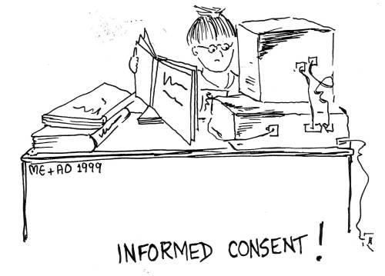



Slide 15
Conflict of Interest (COI)
A conflict of interest is a set of conditions in which professional judgment concerning a primary interest (such as a patient’s welfare or the validity of the research) tends to be unduly influenced by a secondary interest (such as financial gain)

Slide 16
Relevance of COI to Research
Potential for COI to produce different results
Potential for COI to affect the publication process
Sources of funding for academic research – public to private sources
University – Private research institution relationships
Risk the erosion of public trust
Not a behavior of an individual or institution but a condition that prevails

Slide 17
Conflict of Interest (COI)
To be continued

