Slide 1
Regional Anesthesia

Slide 2
What is Regional Anesthesia?

Slide 3
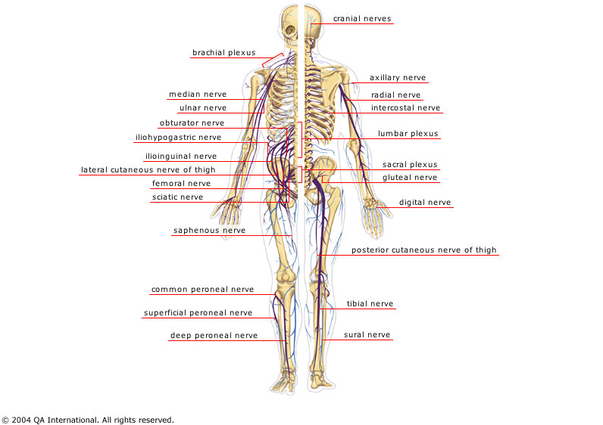

Slide 4
Nerve Sensitivity
Autonomic >> Sensory >> Motor

Slide 5
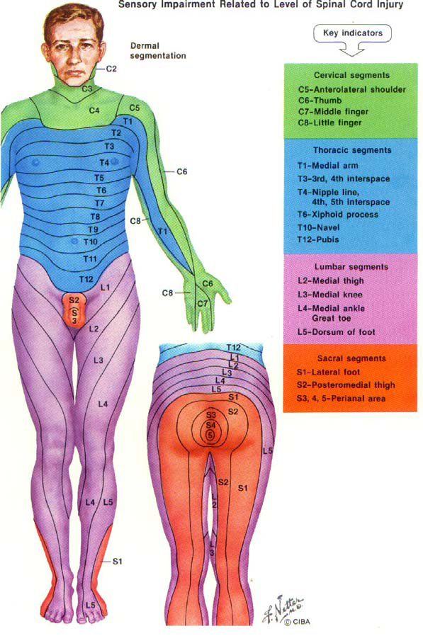

Slide 6
Neuraxial
Spinal
Epidural
Caudal
Peripheral Nerve Block
IV Regional ( Bier block )

Slide 7
Spinal Anesthesia

Slide 8
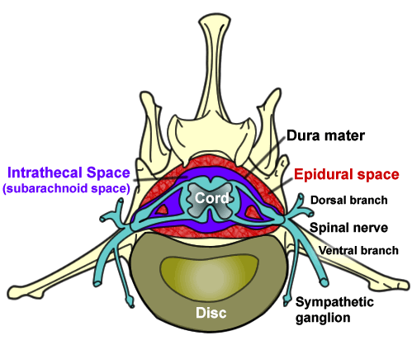

Slide 9
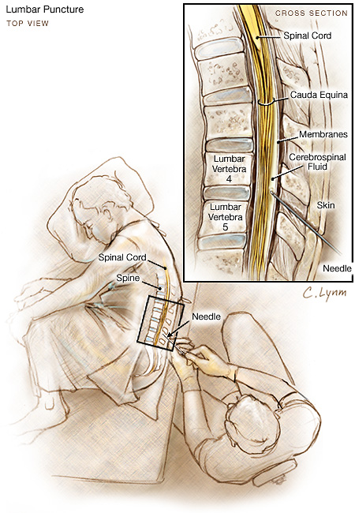

Slide 10
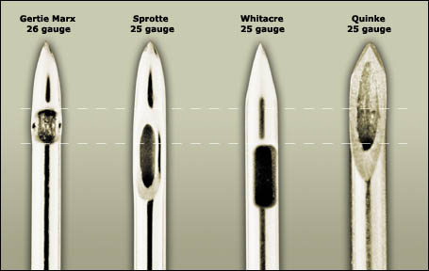

Slide 11
Local Anesthetic Physiology
Hyperbaric
(Dextrose)
Isobaric
Hypobaric

Slide 12
Spread of Local Anesthesia
• Baricity of Local Anesthetic
• Position of Patient
• Concentration of Local Anesthetic
• Volume Injected
• Level of Injection
• Speed of Injection

Slide 13
Advantages
• Cheap
• High Patient Satisfaction
• Well Tolerated in Pulmonary Disease
• Maintain Patent Airway
• Selective Muscle Relaxation
• Decreased Blood Loss
• Decreased Incidence of DVT and PE

Slide 14
Disadvantages
• Difficult Placement in Elderly
• Hypotension
• Patient Can Talk
• Patient Anxiety
• Not Reliable for Surgery > 2 hours

Slide 15
Complications
• Bleeding
• Post-Dural Puncture Headache
• Transient Neurological Syndrome
• Total Spinal

Slide 16
Total Spinal
• Hypotension
• Bradycardia
• Arm involvement
• Shortness of Breath
• Patient Anxiety
• Loss of Consciousness

Slide 17
Contra-Indications
• Inadequate equipment for GA
• Bleeding Dyscrasia’s
• Hypovolemia
• Patient Refusal
• Sepsis/Bactermia
• Anatomic Deformities of the Spine
• Neurological Disease
• Increased ICP
• Fixed Cardiac Output States

Slide 18
Epidural Anesthesia

Slide 19
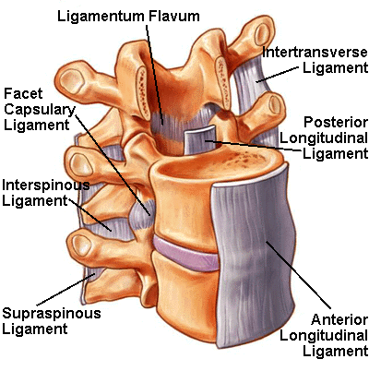

Slide 20
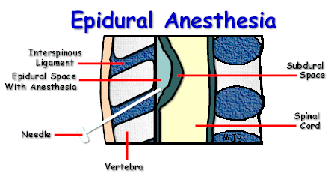

Slide 21
Uses
• Hip and Knee Surgery
• Lower Extremity Vascular Surgery
• Lower Extremity Amputation
• Obstetrical – Labor & C/S
• Thoracic Surgery – Post-Op Pain Control
• Thoracic Trauma
• Abdominal Surgery – Post-Op Pain
Control

Slide 22
Advantages
• Cheap
• High Patient Satisfaction
• Well Tolerated in Pulmonary Disease
• Maintain Patent Airway
• Selective Muscle Relaxation
• Decreased Blood Loss
• Decreased Incidence of DVT and PE

Slide 23
Disadvantages
• Difficult Placement in Elderly
• Hypotension
• Patient Can Talk
• Patient Anxiety

Slide 24
Complications
• High Epidural
• Local Anesthetic Toxicity
• Total Spinal
• Accidental Dural Puncture

Slide 25
Contra-Indications
• Patient Refusal
• Coagulopathy
• Localized Skin Infection
• Elevated ICP
• Hypovolemia
• Uncooperative Patient
• Pre-Existing Neurological Disease
• Spinal Column Abnormalities
• Fixed Cardiac Output States

Slide 26
Peripheral Nerve Blocks

Slide 27
• Brachial Plexus
• Psoas Compartment Block
• Femoral Nerve Block
• Popliteal Fossa Block
• Ankle Block

Slide 28
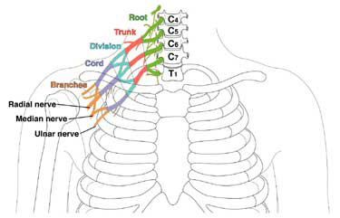

Slide 29
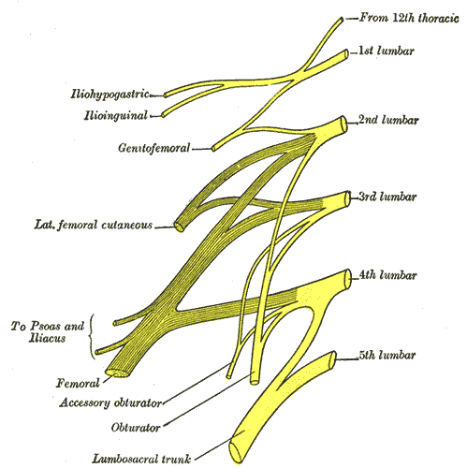

Slide 30
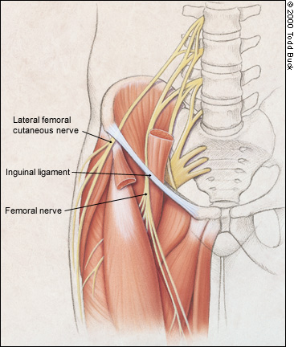

Slide 31
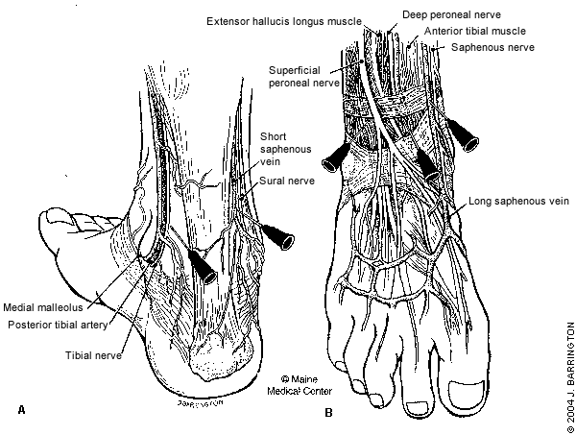

Slide 32
Intravenous Regional Anesthesia
( Bier block )

Slide 33
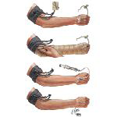

Slide 34
Applications
• Distal Arm Surgery
• Useful for Short Procedures

Slide 35
Contra-Indications
• Sickle Cell Disease
• Crush Injury to the Limb
• Very Young may need additional

Slide 36
Complications
• Local Anesthetic Toxicity

Slide 37
THANK YOU

