Slide 1

Fundamentals of Digital Image
Gray level & Resolution

Slide 2
Gray level
Each pixel can have only one value and the value of the pixel at any point denotes the intensity of image at that location, and that is also known as gray level.
The value of the minimum gray level is 0.
The value 0 means absence of light. It means that 0 denotes dark, and it further means that when ever a pixel has a value of 0, it means at that point, black color would be formed.

Slide 3
Bits per Pixel
A bit also known as a binary digit is the smallest unit of data in a computer. A bit has 0 or 1.
BPP or bits per pixel denotes the number of bits per pixel.
The number of different colors in an image depends on the depth of color or bits per pixel.
How many numbers can be represented by one bit.
0 and 1
How many two bits combinations can be made.
00 01 10 11

Slide 4
Bits per Pixel
If we devise a formula for the calculation of total number of combinations that can be made from bit, it would be
2^{bpp}
where bpp denotes bits per pixel.
Put 1 in the formula you get 2¹ = 2
Put 2 in the formula you get 2² = 4
It grows exponentially.

Slide 5
How many colors
The number of different colors depend on the number of bits per pixel.
The table for some of the bits and their color is given below:
Bits per pixel | Number of different colors
1 | 2¹ = 2 colors
2 | 2² = 4 colors
3 | 2³ = 8 colors
4 | 2⁴ = 16 colors
5 | 2⁵ = 32 colors
6 | 2⁶ = 64 colors

Slide 6
Shades
The famous gray scale image is of 8 bpp, means it has 2⁸ = 256 different colors in it or 256 shades.
Shades can be represented as: Shades = Number of colors = 2^{bpp}
Color images are usually of the 24 bpp format, or 16 bpp.
0 pixel value always denotes black color.
But there is no fixed value that denotes white color.
The value that denotes white color can be calculated as: 2^{bpp} - 1
In case of 8 bpp, 0 denotes black, and 255 denotes white.

Slide 7
Resolution
Digital images are made up of dots called pixels.
The resolution of an image tells us how close together those dots are (the dots per inch — referred to as the “dpi” of an image).
Images with dots that are close together are said to have a “high” resolution (a high number of dots per inch).
Images with dots that are far apart are said to have a “low” resolution.

Slide 8
Resolution
Resolution refers to the
    number of dots-per-inch (if you’re printing) or
    pixels-per inch (if you’re looking at the computer screen).
The resolution of an image, to a great degree, determines the apparent quality of the image.
High-resolution images tend to look clear and sharp — more like photographs.
Low-resolution images tend to look grainy, speckled, and blurry.

Slide 9
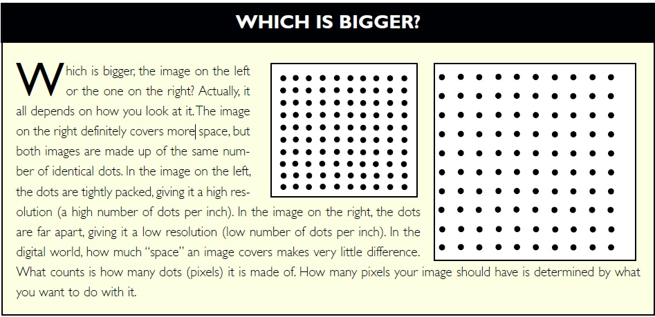
Resolution

Slide 10
Resolution
Does this mean you should always create the highest-resolution image you can? Well, no.
The more dots in an image, the more the computer has to remember and move around every time you ask it to do something with those dots.
This means it will take longer for the image to open, and performing operations on it will be slower.
Because it is bigger, you’ll also need more space on your hard drive to store each high-resolution image.

Slide 11
Resolution
Higher resolution gives you a better quality image but uses more memory.
Computer’s monitor have a resolution 72 dpi — or dots-per-inch.
Most images that you see in print have a resolution of 150 dpi to 300 dpi — or dots-per-inch.

Slide 12
Which Resolution is Right?
So what should the resolution be? The answer is: only as high as it has to be.
The precise number will be determined by what you want to do with the image.
    If you want to use it on your web page, you’ll select a relatively low resolution — probably 72dpi.
      This is all that is needed to create an acceptably sharp, clear image on a monitor. Anything more wouldn’t make the image look any better and would increase the time the image takes to load.
    If you want to generate a photo quality print on your inkjet printer, you may want to create a file as large as 700dpi.

Slide 13
Which Resolution is Right?
If you’re not sure what resolution you need to create the product you have in mind, find out before you create your file.
If you’ll be using your image in multiple applications (say you want to make a print but also plan to e-mail the photo to someone), create your image at the largest size you’ll need.
Make any needed corrections to this large file, then reduce its size and save multiple copies of the image for other uses.

