Slide 1

Fundamentals of Digital Image
Digital Image Processing

Slide 2
Digital Image Processing (DIP)
Digital image processing deals with manipulation of digital images through a digital computer.
DIP focuses on developing a computer system that is able to perform processing on an image.
The input of that system is a digital image and the system process that image using efficient algorithms, and gives an image as an output.
The most common example is Adobe Photoshop. It is one of the widely used application for processing digital images.

Slide 3
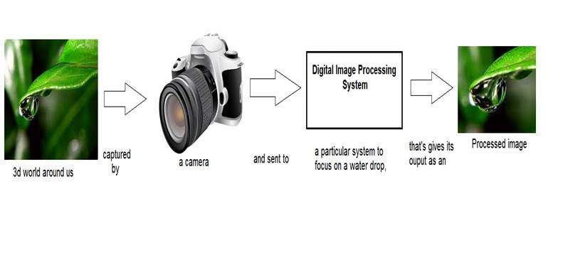
How it works?
In the above figure, an image has been captured by a camera and has been sent to a digital system to remove all the other details, and just focus on the water drop by zooming it in such a way that the quality of the image remains the same

Slide 4
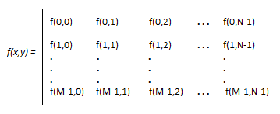
Digital Image
An image may be defined as a two-dimensional function, f (x, y), where x and y are spatial (plane) coordinates, and the amplitude (some value) of f at any pair of coordinates (x, y) is called the intensity or gray level of the image at that point.
In other words, an image can be defined by a two-dimensional array specifically arranged in rows and columns.

Slide 5
Digital Image
When x, y, and the intensity values of f are all finite, discrete quantities, we call the image a digital image.
Note that a digital image is composed of a finite number of elements, each of which has a particular location and value. These elements are called picture elements, image elements, pels, and pixels.
200 120 0 25 12
78 90 56 30 50
90 35 150 55 90
Location = (0,4)
Value = 12
Pixel

Slide 6
Pixel
The full form of the pixel is "Picture Element." It is also known as "PEL."
Pixel is the smallest element of an image on a computer display, whether they are LCD or CRT monitors.
A screen is made up of a matrix of thousands or millions of pixels.
A pixel is represented with a dot or a square on a computer screen.
Each pixel correspond to any one value.
The value of a pixel at any point correspond to the intensity of the light photons striking at that point.

Slide 7
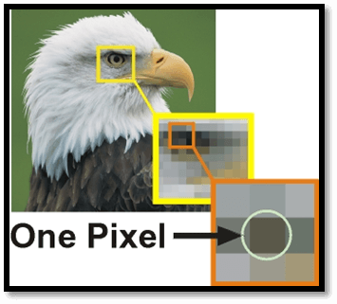
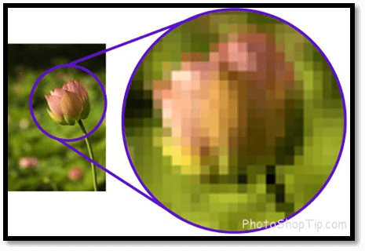
Pixel
As we know that an image is build up of thousands and millions of pixels.
In the above images, if we zoom in the image, we will be able to see some of the pixels.

Slide 8
Pixel
The good thing is that a pixel cannot be seen as they are very small which result in a smooth and clear image rather than "pixelated."
Each pixel can have only one color at a time.
Color of a pixel is determined by the number of bits which is used to represent it.
A resolution of a computer screen depends upon graphics card and display monitor, the quantity, size and color combination of pixels.

Slide 9
Pixel
The more the count of pixel, more detailed and clear image is generated.
We have define an image as a two dimensional matrix. Then in that case the number of pixels would be equal to
number of rows X number of columns
For example:
let rows = 300 & columns = 200
Total number of pixels = 300 X 200 = 60000

Slide 10
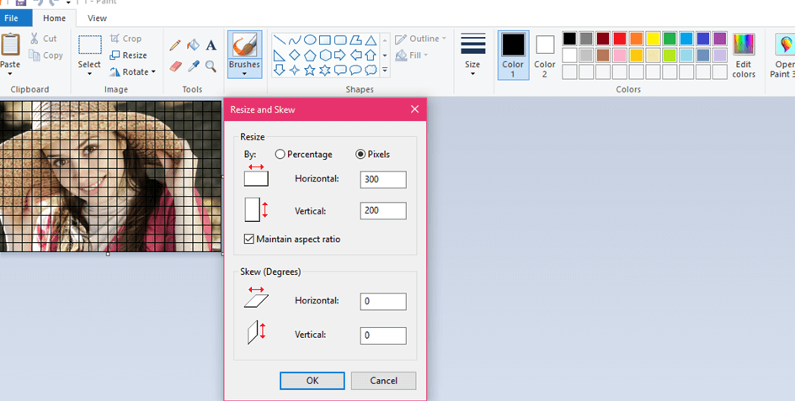
Pixel

