Slide 1
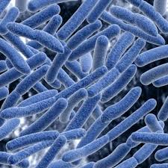
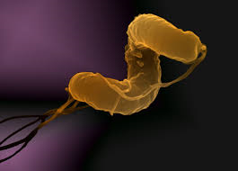
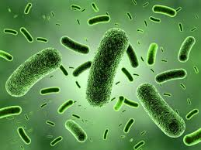
BACTEREIA
SAHAR ALHOGAIL

Slide 2
Bacteria are prokaryotes . Prokaryotic cells possess simpler structures than eukaryotic cells , since they do not have a nucleus , other membrane bound organelles , or a cytoskeleton .
There are two major types of prokaryotes:
bacteria and
archaea. Archaea (also called archaebacteria) are often found in extreme environments, and while they are clearly prokaryotic, they have evolved separately from bacteria.

Slide 3
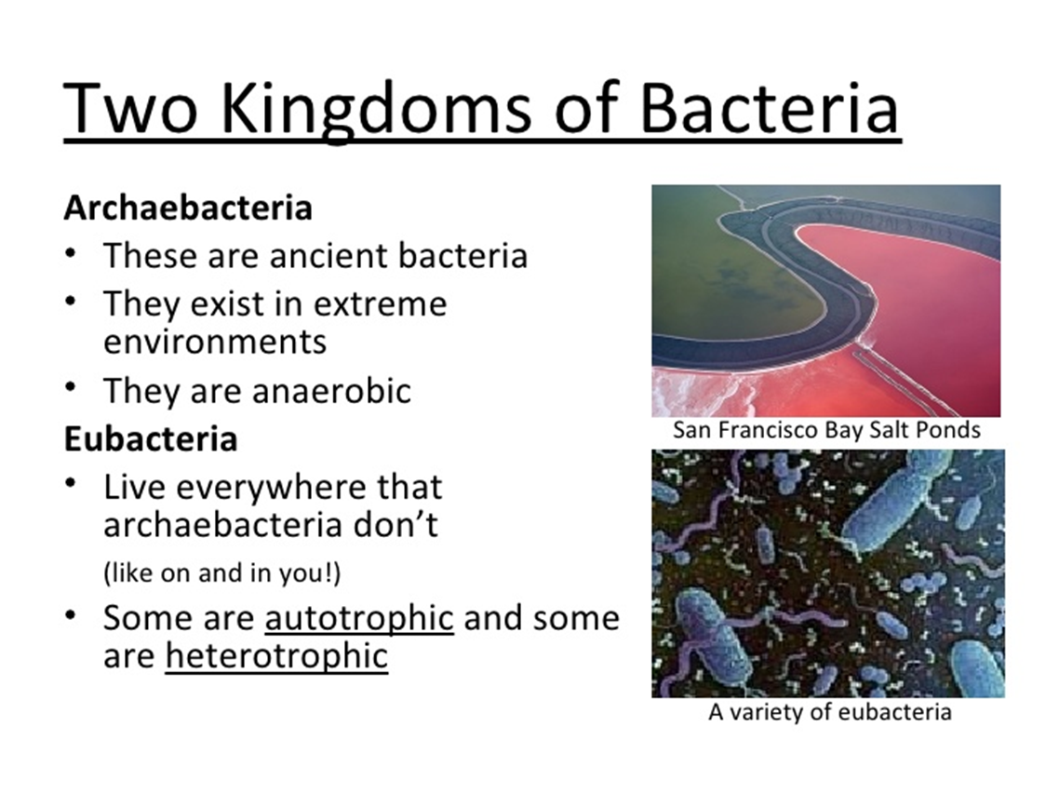

Slide 4
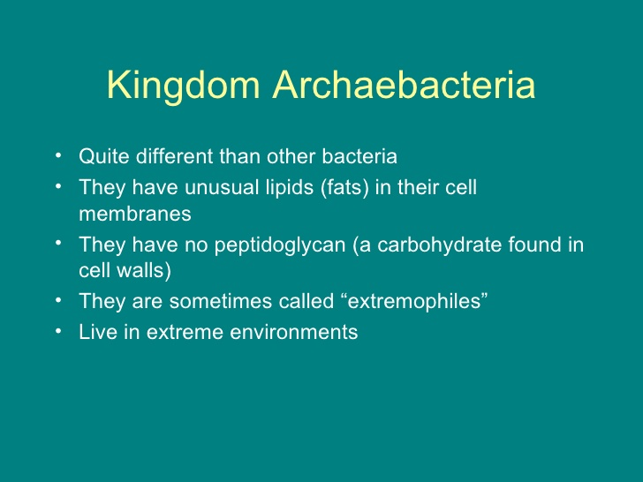

Slide 5
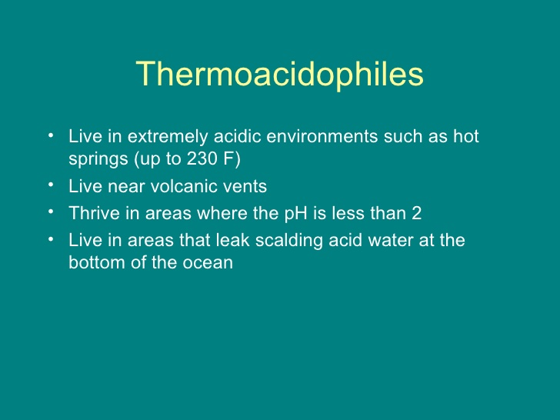

Slide 6
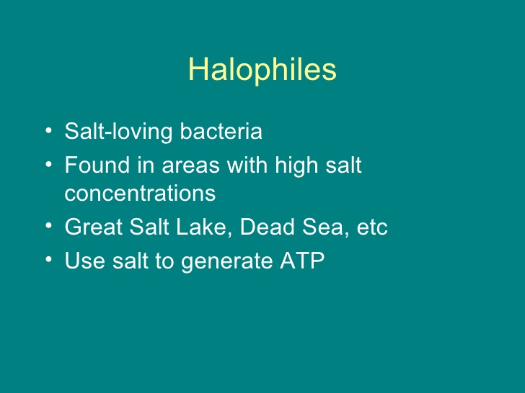

Slide 7
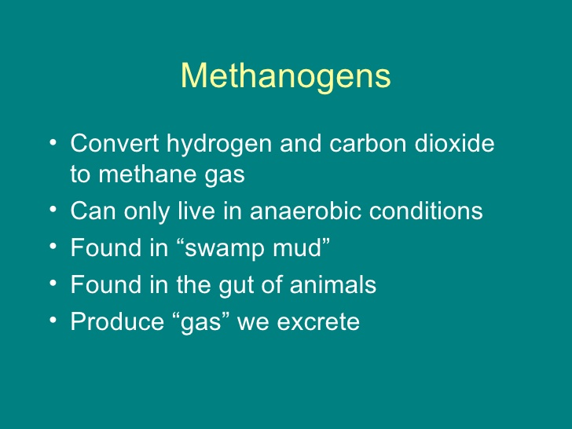

Slide 8
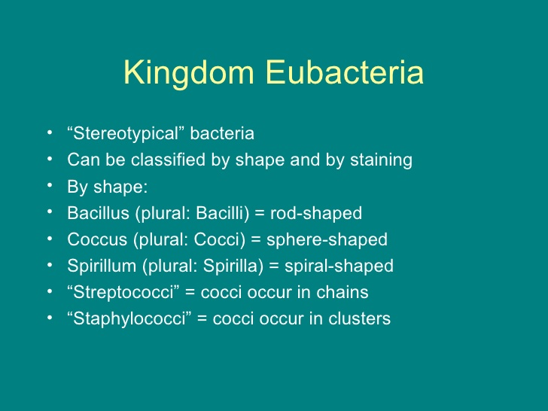

Slide 9
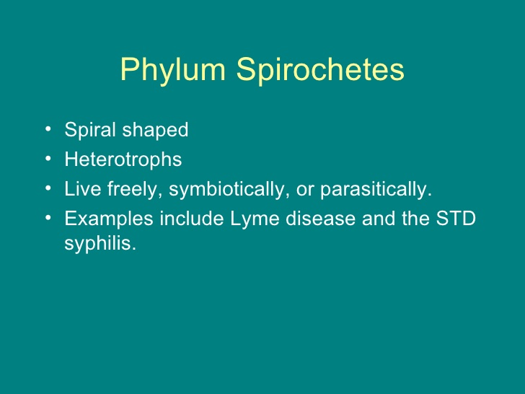

Slide 10
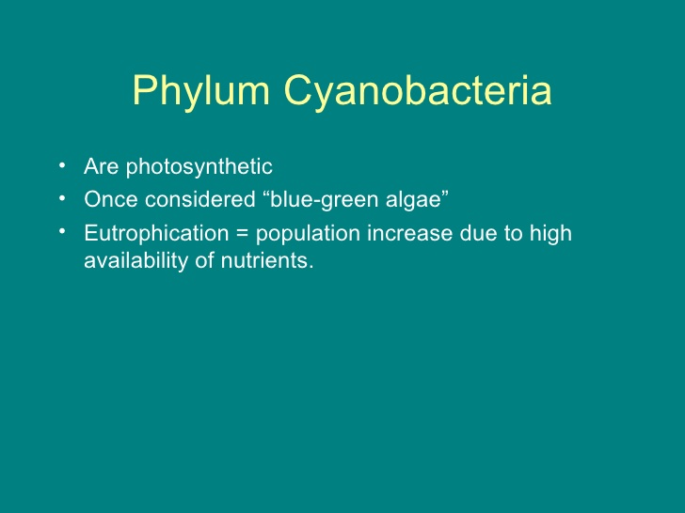

Slide 11
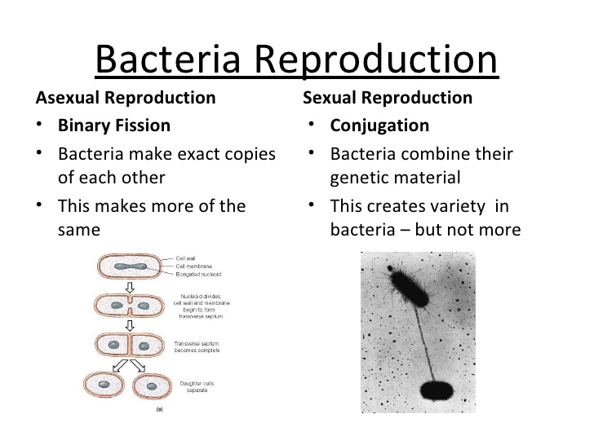

Slide 12

Bacterial cells grow by a process called binary fission:
One cell doubles in size and splits in half to produce two identical daughter cells. These daughter cells can then double in size again to produce four sibling cells and these to produce eight, and so on. The time it takes for a bacterial cell to grow and divide in two is called the doubling time. When nutrients are plentiful, the doubling time of some bacterial species can be as short as twenty minutes. However, most bacterial species show a doubling time between one and four hours.

Slide 13
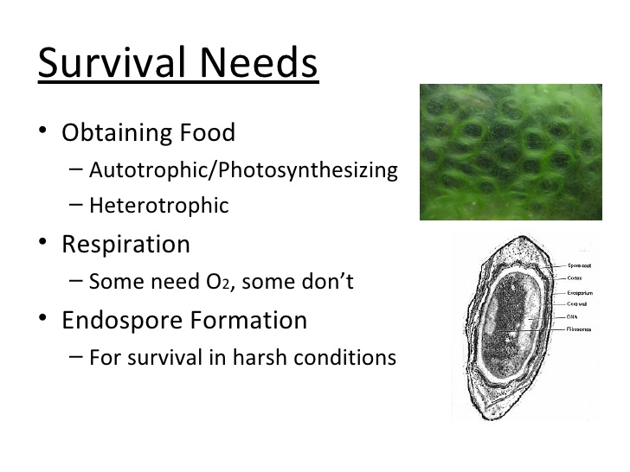

Slide 14
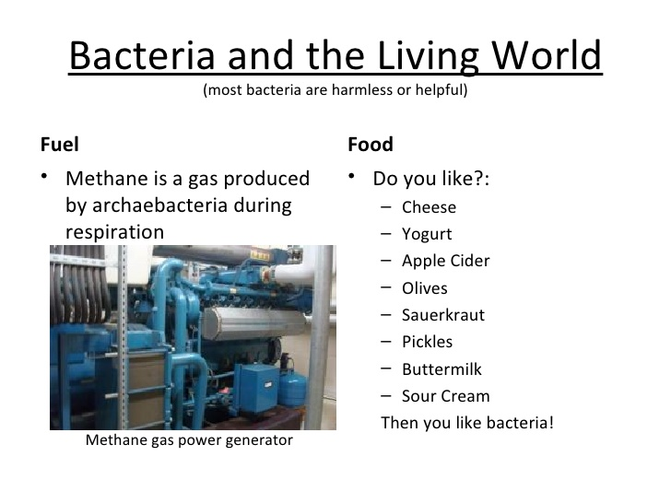

Slide 15
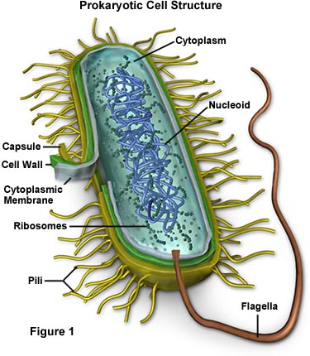

Slide 16
Structure of bacterial cell
Cell Envelope - The cell envelope is made up of two to three layers: the interior cytoplasmic membrane, the cell wall, and -- in some species of bacteria -- an outer capsule.
Capsule - Some species of bacteria have a third protective covering, a capsule made up of polysaccharides (complex carbohydrates) glycogalex. Capsules play a number of roles, but the most important are adhere to specific surfaces, to keep the bacterium from drying out and to protect it from phagocytosis (engulfing) by larger microorganisms. The capsule is a major virulence factor in the major disease-causing bacteria, such as Escherichia coli and Streptococcus pneumoniae. Nonencapsulated mutants of these organisms are a virulent, i.e. they don't cause disease.
Cell Wall - Each bacterium is enclosed by a rigid cell wall composed of peptidoglycan, a protein-sugar (polysaccharide) molecule..

Slide 17
cell wall provides structural integrity to the cell.
The strength of the wall is responsible for keeping the cell from bursting when there are large differences in osmotic pressure between the cytoplasm and the environment.
several antibiotics ( penicillins and cephalosporins) stop bacterial infections by interfering with cell wall synthesis, while having no effects on human cells.
lysozyme break the bound bet NAG- NAM
It also helps to anchor appendages like the pili and flagella, which originate in the cytoplasm membrane and protrude through the wall to the outside.

Slide 18
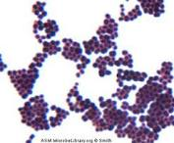
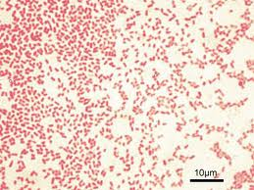
The type of cell wall distinguishes two main group of bacteria –
Gram positive bacteria – Gram negative bacteria

Slide 19
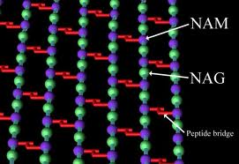
The bacterial cell made up of peptidoglycan a macromolecule found only in bacteria. It is an alternating series of two major subunits (poly-N-acetylglucosamine NAG and N-acetylmuramic acid NAM), which is located immediately outside of the cytoplasmic membrane. Attach to each NAM molecule is string of four amino acid (tetrapeptide chain) Peptidoglycan is responsible for the rigidity of the bacterial cell wall and for the determination of cell shape. While all bacterial cell walls contain peptidoglycan, not all cell walls have the same overall structures.

Slide 20
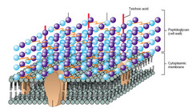
GRAM POSITIVE CELL WALL :
This type of bacteria have thick layer of peptidoglycan . It is fully permeable to many substance include sugar and amino acid it has a molecule called TITONIC ACID embedded
It is attached to the peptidoglycan through a covalent bond to
N -acetylmuramic acid
Transport protein

Slide 21
GRAM NEGATIVE BACTERIA :
it is more complicated than gram positive bacteria
It contain thin layer of peptidoglycan.
It has outer-membrane layer .
The peptidoglycan layer (periplasm) sandwiched between the cytoplasmic membrane and outer membrane.
Periplasm : it is the area between the cytoplasmic membrane and the outer membrane of gram negative bacteria is filled with gel like fluid.

Slide 22
This outer membrane serve as barrier to the passage of the most molecules (protective barrier) include certain antimicrobial medications.(less sensitive)
the outer membrane made of lipid bilayer inner part ,lipopolysaccride outer part unique for gram negative bacteria .

Slide 23
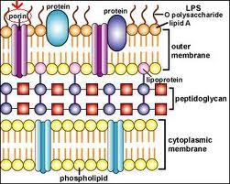
The LPS endotoxins inherited part of the cell wall that cause disease.
It is made of lipopolysaccharides with two part :
Lipid A
O- specific polysaccharide : it is made of chain of sugar molecules that gives the difference in the species .
It has PORINS special channel for passing the small molecules .

Slide 24
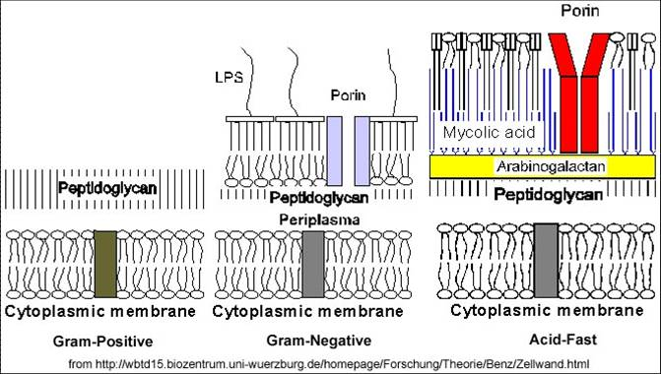

Slide 25
There are two main types of bacterial cell walls, Gram positive and Gram negative, which are differentiated by their Gram staining characteristics.
Gram stain :
Crystal violt
Iodine
Alcohole
Saffranine

Slide 26
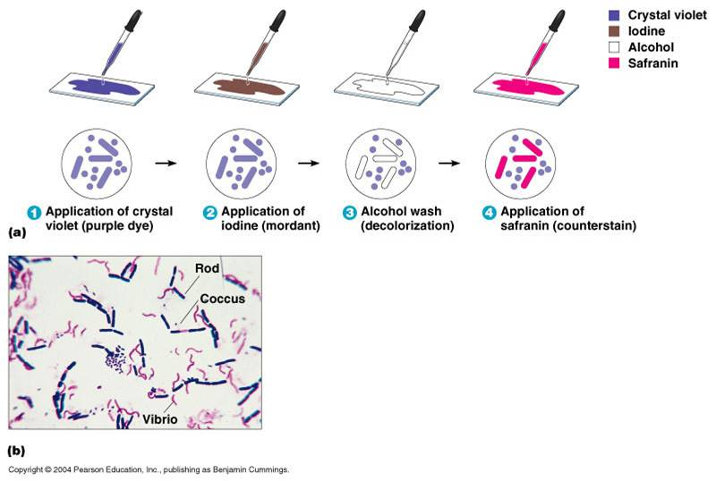
Gram stain

Slide 27
The Gram positive cell wall is characterized by the presence of a very thick peptidoglycan layer, which is responsible for the retention of the crystal violet dyes during the Gram staining procedure.
The Gram negative cell wall
Unlike the Gram positive cell wall, the Gram negative cell wall contains a thin peptidoglycan layer adjacent to the cytoplasmic membrane. This is responsible for the cell wall's inability to retain the crystal violet stain upon decolourisation with ethanol during Gram staining.
The Gram positive cell wall

Slide 28
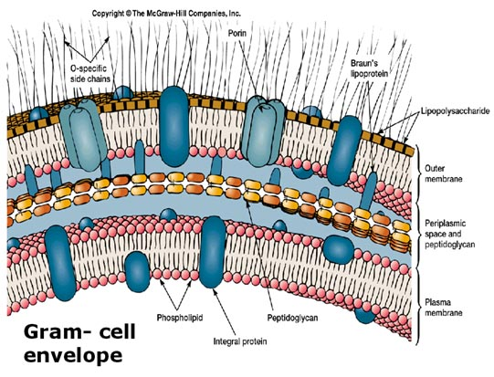
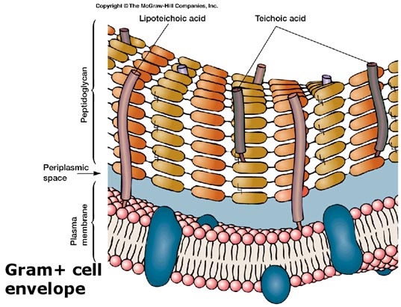

Slide 29
Some bacteria as mycoplasma lack the cell wall so it has variable shape it has sterols in the cytoplasm membrane .

Slide 30
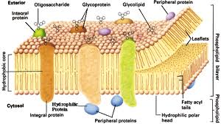
Cytoplasmic Membrane
membrane, encloses the interior of the bacterium, regulating the flow of materials in and out of the cell with specific proteins.
structure of the cytoplasma membrane :
Consist of lipid bilayer embedded with proteins.
Lipid bilayer consist of two opposing layers of phospholipid

Slide 31
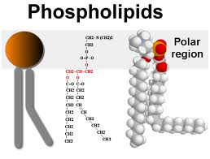
At one end of each phospholipid molecules are two fatty acid chain (hydrophobic tails ) water insoluble .
Other end that contain phosphate group +glycerol (hydrophillic head ) interact freely aqueous solution .
Hydrophillic face
Outward
and the hydrophobic face
outward.

Slide 32
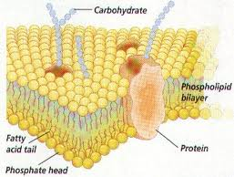

Slide 33
Permeability of the cytoplasmic membrane :
Few types of molecules can pass through it freely by a process called simple diffusion
Simple diffusion :
Is the process by which some molecules move freely into and out of the cells.[water-gases(Co2-O2)] .
the speed and the direction depend on the difference in the concn in and out the cells.
difference speed and vis versa
Movement usually from higher concentration to the lower concentration

Slide 34
The cytoplasm : (inorganic salts –sugar –amino acids-various other molecules).
Environment have lower salts other molecule. (solute).
Equalize the concen inside and outside the cells=osmosis
If the concen of the solute out side the cell is higher than the solute concen in side the cell the cell will shrink
If the concen of the solute out side the cell is less than the solute concen in side the cell the cell will swallow lyse

Slide 35
Movement of molecules across cytoplasm
1.transport system: 2. secretion
it is protein serve as selective gate for entrance of molecules . and it use to expel waist , antibiotics, disinfection .transport protein,permease,or carrier.
This protein as permease transports lactose a long with protons to inside the cell.
This protein are embedded in the cytoplasmic membrane one end inside the cell – other outside the cell.
Single carrier generally transport specific molecules.

Slide 36
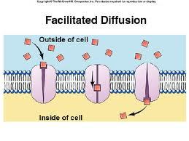
Transport mechanisms
Passive transports: rarely used by prokaryotic no energy used.
Simple diffusion
high concentration to low concentration
no carrier protein
passive
vary small(o2) and lipid soluble molecule (steroid)
Facilitated diffusion
high concentration to low concentration
carrier protein
passive
Large charged molecule.

Slide 37
Transport mechanisms
Active transports
move compounds against concon gradient this require energy :
Transport system that use(proton motive force) can transport small molecules and ions using this energy .
ABC transporter ( ATP Binding Cassette) that use ATP as energy source it use the binding protein to deliver specific molecule to the transport protein to the cell .
Lower concentration to high concentration.
Carrier protein .
Large and charged molecules.

Slide 38
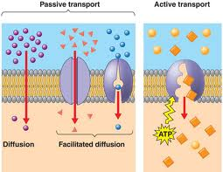
Transport mechanisms

Slide 39
Transport mechanisms
Secretion : move cretin proteins that the cell synthesis.

Slide 40
Flagella
- Flagella (singular, flagellum) are hair like structures that provide a means of locomotion for those bacteria that have them.
They can be found at either or both ends of a bacterium or all over its surface.
The flagella beat in a propeller-like motion to help the bacterium move toward nutrients; away from toxic chemicals; (chemotaxis) or, in the case of the photosynthetic cyanobacteria; toward the light.(phototaxis)-(aerotaxis)

Slide 41
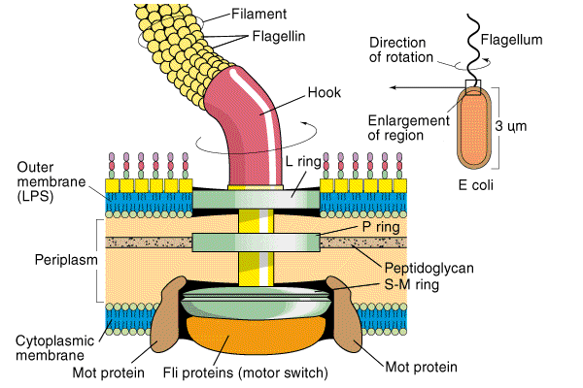
Structure and arrangment of flagella:
Filament part composed of identical subunits of protein
Hook: curved structure that connect the filament to the cell surface
Basal body that anchore the flagellum to the cell wall and
cytoplasmic membrane.

Slide 42
Pili - Many species of bacteria have pili (singular, pilus), small hairlike projections emerging from the outside cell surface.
These outgrowths assist the bacteria in attaching to other cells and surfaces, such as teeth, intestines, and rocks. Without pili, many disease-causing bacteria lose their ability to infect because they're unable to attach to host tissue.
Specialized pili (sex pili) are used for conjugation, during which two bacteria exchange fragments of plasmid DNA.

Slide 43
Cytoplasm
The cytoplasm, or protoplasm, of bacterial cells
cell growth, metabolism, and replication are carried out.
It is a gel-like matrix composed of water, enzymes, nutrients, wastes, and gases.
contains cell structures such as ribosomes, a chromosome, and plasmids.
The cell envelope encases the cytoplasm and all its components.
Unlike the eukaryotic (true) cells, bacteria do not have a membrane enclosed nucleus.

Slide 44
The chromosome
It is a single, circular double -stranded DNA, is localized, but not contained, in a region of the cell called the nucleoid. All the other cellular components are scattered throughout the cytoplasm.

Slide 45
Plasmids
it is a small, extra-chromosomal genetic structures carried by many strains of bacteria.
It is circular piece of DNA
Unlike the chromosome, they are not involved in reproduction. Only the chromosome has the genetic instructions for initiating and carrying out cell division, or binary fission, the primary means of reproduction in bacteria.
Plasmids replicate independently of the chromosome and, while not essential for survival.
appear to give bacteria a selective advantage.
Plasmids are passed on to other bacteria through two means. For most plasmid types, copies in the cytoplasm are passed on to daughter cells during binary fission.
Other types of plasmids, however, form a tube-like structure at the surface called a pilus that passes copies of the plasmid to other bacteria during conjugation, a process by which bacteria exchange genetic information.
Plasmids have been shown to be instrumental in the transmission of special properties, such as antibiotic drug resistance, resistance to heavy metals, and virulence factors necessary for infection of animal or plant hosts.
The ability to insert specific genes into plasmids have made them extremely useful tools in the fields of molecular biology and genetics, specifically in the area of genetic engineering

Slide 46
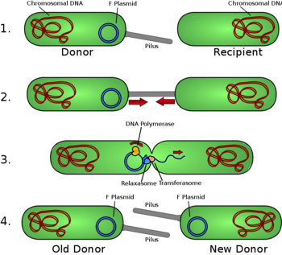
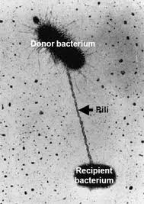

Slide 47
Nucleoid - The nucleoid is a region of cytoplasm where the chromosomal DNA is located. It is not a membrane bound nucleus, but simply an area of the cytoplasm where the strands of DNA are found. Most bacteria have a single, circular chromosome that is responsible for replication, although a few species do have two or more.

Slide 48
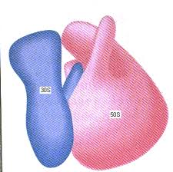
9. Ribosomes
They translate the genetic code from the molecular language of nucleic acid to that of amino acids—the building blocks of proteins.
Proteins are the molecules that perform all the functions of cells and living organisms.
Bacterial ribosomes are similar to those of eukaryotes, but are smaller (70 S) and have a slightly different composition and molecular structure.
Bacterial ribosomes are never bound to other organelles as they sometimes are (bound to the endoplasmic reticulum) in eukaryotes, but are free-standing structures distributed throughout the cytoplasm.
There are sufficient differences between bacterial ribosomes and eukaryotic ribosomes that some antibiotics will inhibit the functioning of bacterial ribosomes, but not a eukaryote's, thus killing bacteria
but not the eukaryotic
organisms they are infecting.

Slide 49
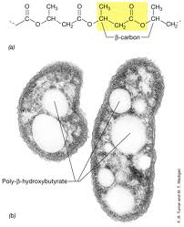
Storage granules : are accumulations of a high molecular weigh polymers synthesized from a nutrient and in excess in the cell .
Example: E.coli carbon and energy sources are plentiful such as glucose but it cannot multiply because it lack the nitrogen and phosphorus so it storage it as glycogen ( glucose polymers).
Other bacteria store the energy in form of poly- β- hydroxybutyrate .

Slide 50
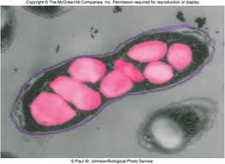
Some granules can be detected by light microscope volutin appear red when stained with MB stain .called ( meta-chromatic granules)
Beneficial in waste water treatment
Involve with energy storage and PH balance.

Slide 51
Gas vesicles:
Some aquatic bacteria produce gas vesicles
It is small , rigid , protein compartment filled with gas that help bacteria to float at the surface of the water to use the sun light as source of energy.

Slide 52
Bacteria cell morphology & arrangment (shape):
coccus (spherical) strepto-staph
Bacillus- Rod ( cylindrical-like) strepto
Coccobacillus a rod shap bacteria so short
Vibrio a short curved rod
spirillum (spiralla) long curve rod long enough to form spirals.
Spirochete: long helical cell with flexible cell wall and unique mechanism of motility.

Slide 53
Endospores are bacterial survival structures that are highly resistant to many different types of chemical and environmental stresses and therefore enable the survival of bacteria in environments that would be lethal for these cells in their normal vegetative form.

Slide 54
when Spore-forming bacteria are grown in low amount of nitrogen or carbon
Starvation condition 8 hours stage .
After vegetative growth stops, DNA is duplicated .
A septum formed between two cores dividing the cell asymmetrically
The large compartment engulfs the smaller compartment forming forespore within mother cells
The forespore inclosed by two membrane core and peptidoglycan layer between these two membrane forming core wall and cortex.
Meanwhile the mother cell will make a protein that will form the spore coat.
Mother cell will degraded and endospore will released .

Slide 55
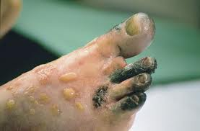
Several species of endospore-formers can cause a disease :
clostridium botulinum botulism
Clostridium tetani tetanus
Clostridiun prefrenges gas gangren

Slide 56
