Slide 1
Digestion of DNA with Restriction Enzyme

Slide 2
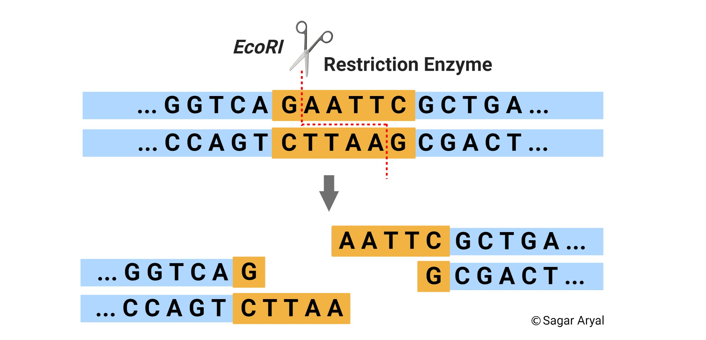
Restriction endonucleases (RE) are enzymes, produced by bacterial cells that have the ability to cleave the sugar phosphate backbones in double stranded DNA at specific restriction sites.
Each RE recognizes a specific sequence of 4-6 nucleotides in length.
Defense strategy
https://microbenotes.com/restriction-enzyme-restriction-endonuclease/

Slide 4
The restriction enzymes generate two different types of cuts:
1- Blunt ends are produced when they cut the DNA at the center of the recognition sequence
2- Sticky ends produce an overhang.
https://www.nagwa.com/en/explainers/947179145028/
Notes:
https://www.nagwa.com/en/explainers/947179145028/

Slide 5
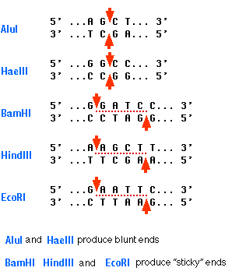
https://www.biology-pages.info/R/RestrictionEnzymes.html

Slide 6
مراجعة

Slide 7
Primers: Two synthetic oligonucleotides are synthesized, called primers each complementary to a stretch of DNA to the 3’ side of the target DNA, one oligonucleotide for each of the two DNA strands (DNA polymerase can add a nucleotide only onto a preexisting 3'-OH group).

Slide 8
Primer length: long enough for adequate specificity and short enough for primers to bind easily to the template at the annealing temperature. It prefers that the two primers have a similar length.
GC content:GC% = [(G + C) / (G + C + A + T)] x 100
Melting temperature (Tm):Tm = [(G + C) x 4] + [(A + T) x 2]

Slide 9
5’-CTCCTTCCCCTAGTCCCCAGAAACAGGAGGTCCCTACTCCCGCCCGAGATCCCGACCCGGACCCCTAGGT GGGGGACGCTTTCTTTCCTTTCGCGCTCTGCGGGGTCACGTGTCGCAGAGGAGCCCCTCCCCCACGGCCT CCGGCACCGCAGGCCCCGGGATGCTAGTGCGCAGCGGGTGCATCCCTGTCCGGATGCTGCGCCTGCGGTA GAGCGGCCGCCATGTTGCAACCGGGAAGGAAATGAATGGGCAGCCGTTAGGAAAGCCTGCCGGTGACTAA CCCTGCGCTCCTGCCTCGATGGGTGGAGTCGCGTGTGGCGGGGAAGTCAGGTGGAGCGAGGCTAGCTGGC CCGATTTCTCCTCCGGGTGATGCTTTTCCTAGATTATTCTCTGGTAAATCAAAGAAGTGGGTTTATGGAG GTCCTCTTGTGTCCCCTCCCCGCAGAGGTGTGGTGGCTGTGGCATGGTGCCAAGCCGGGAGAAGCTGAGT-3’

Slide 10
Example:
You want to study a mutation in a DLG3 gene and how it relate to memory:
Find the sequence of the gene from any website, eg.Ensebmle.
Determine your target region.
The segment that you want to amplified is in the red square
5’
3’
3’
5’

Slide 11
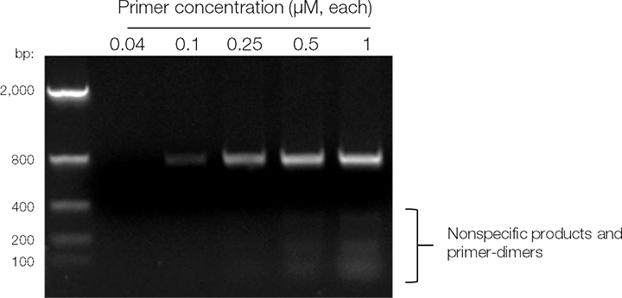
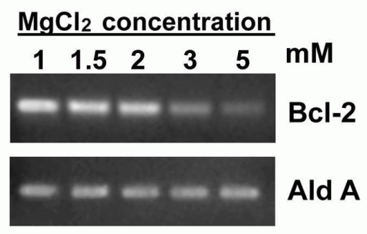
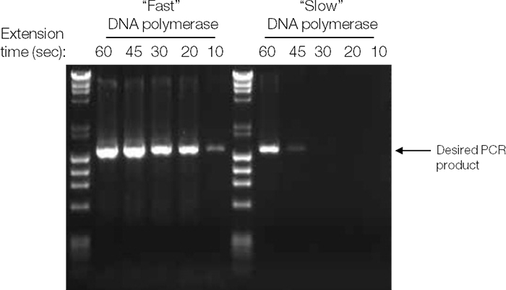
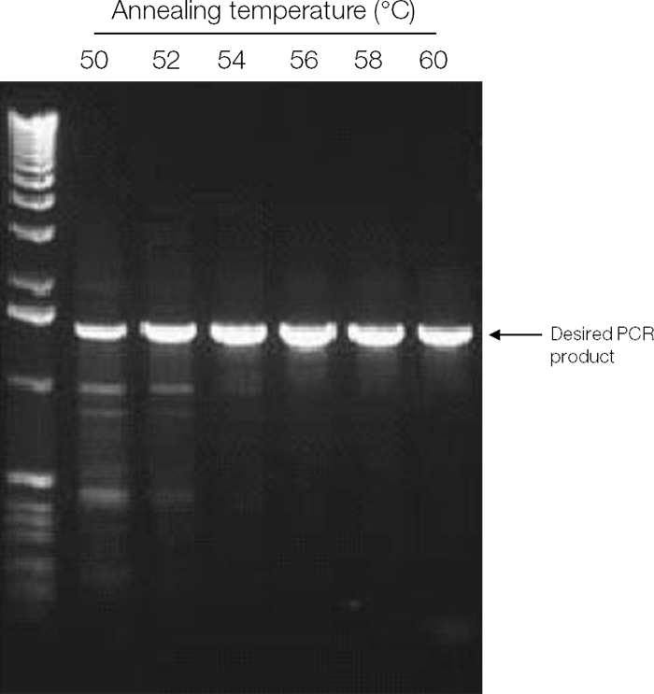
How will you know that you reached to the optimum conditions?

