Slide 1
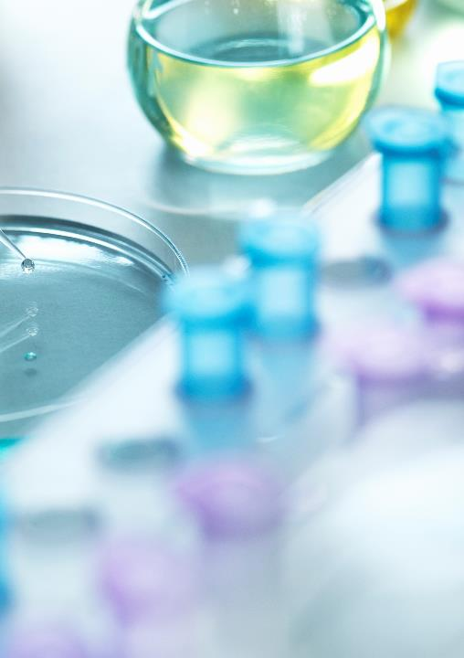
melatonin
Heterocyclic compounds
Student’s name: majed matar Alharbi
Dr:sultan: saad almadhhi
Outline:
Introduction to Melatonin
Compound name (IUPAC, Commercial)
Chemical structure
Physical Properties
Preparation Methods
Applications and uses
Environmental and Health impacts
Literature review

Slide 2
Introduction to melatonin
Melatonin is a hormone that your brain makes in response to darkness. It helps control your sleep cycle. Think of it as your body's way of knowing when it's time to sleep and wake up.

Slide 3
Compound nmae
commercial
iupac
Circadin,
Natrol Melatonin,
Sleepwell,
Melatonex.
N-[2-(5-Methoxy-1H-indol-3-yl)etheyl]acetamide

Slide 4
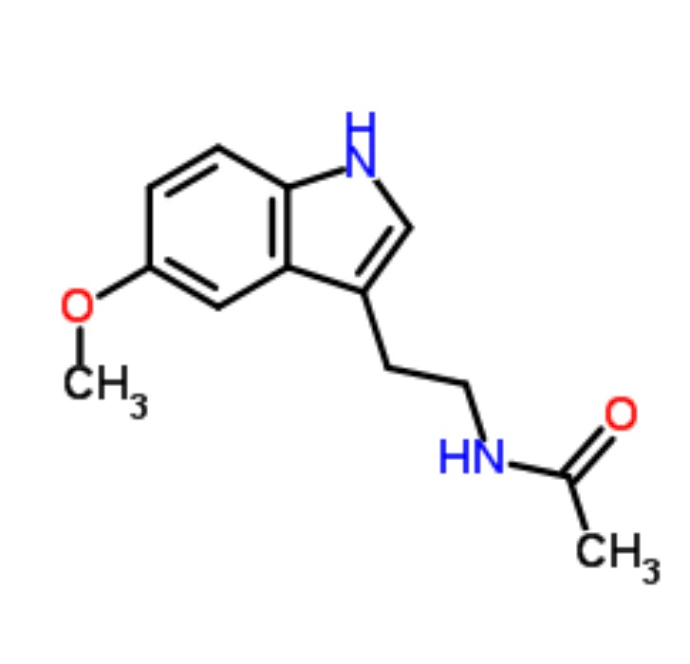
Physical properties
Chemical structure
Physical state | Solid
Melting point | 118°C
Boling point | 512.8°C

Slide 5
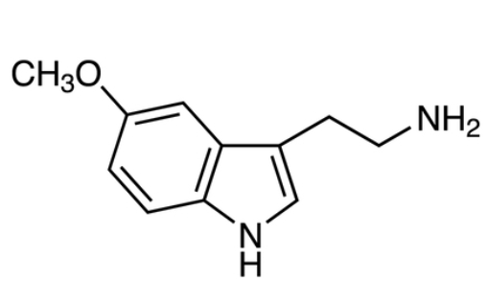
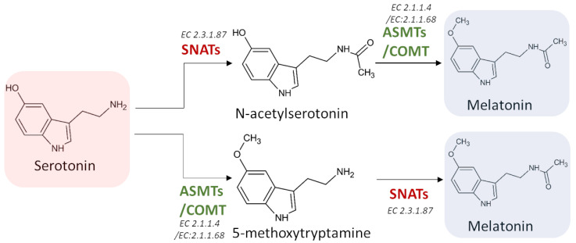
Preparation methods
From serotonin;
1-Acetylation: add an acetyl group (-COCH3)to serotonin.
2-Methylation:add a Methyl group to the resulting compound.
From 5-Methoxytryptamin
1-Aacetylation: add an acetyl group (-COCH3)to 5-Methoxytryptamin

Slide 6
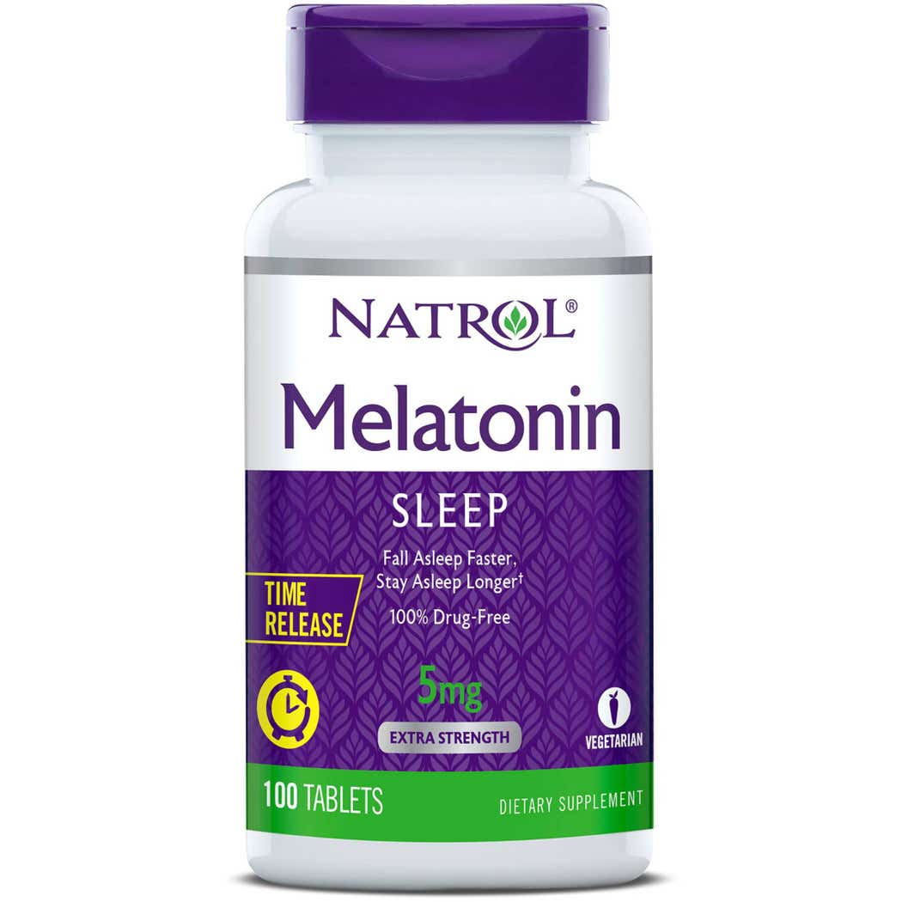
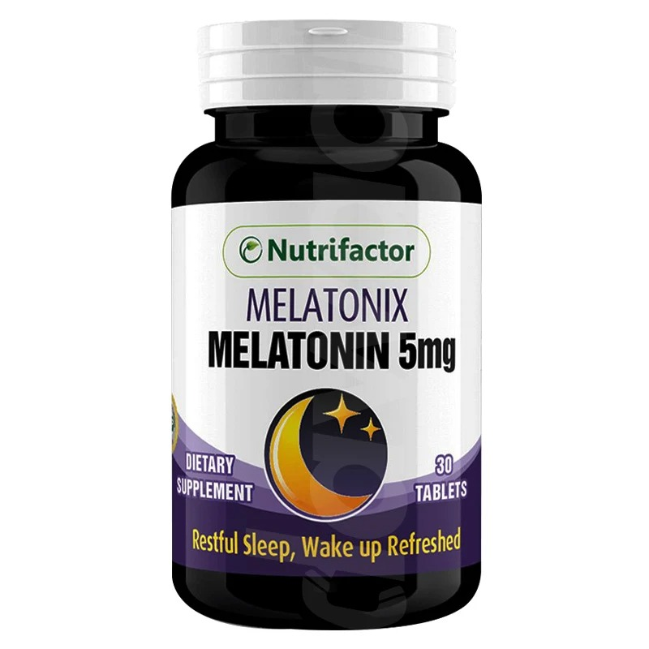
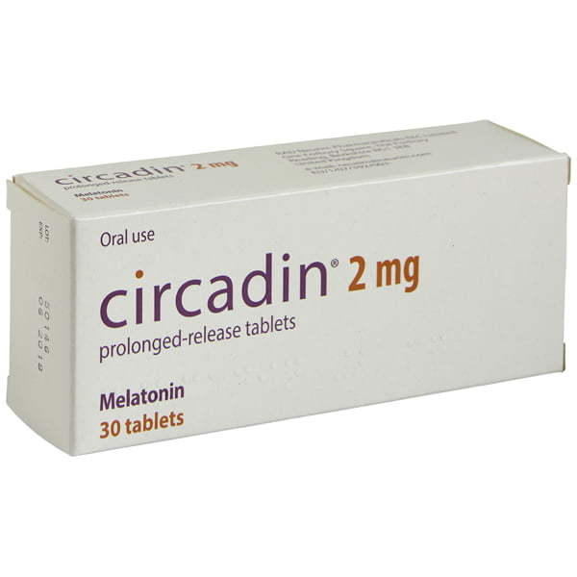
Application and uses
💤 1. Sleep Regulation
Melatonin signals the body that it’s time to sleep. Used to treat insomnia and jet lag.
2. Antioxidant
Melatonin protects cells from oxidative stress. Stronger than vitamin C and E in some cases.
3. Circadian Rhythm Disorders
Helps reset the body’s internal clock. Used for sleep phase delays, night shifts, and jet lag.

Slide 7
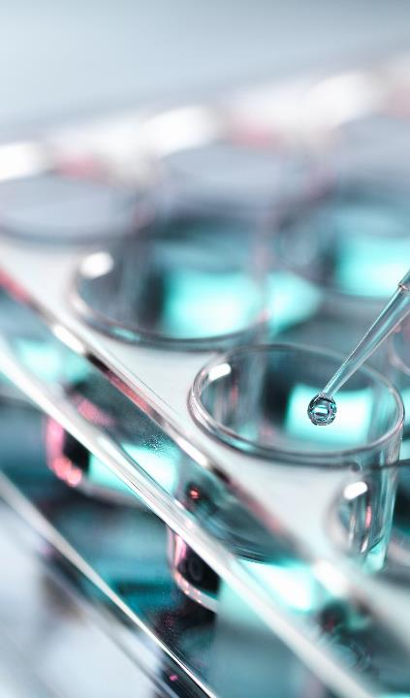
Environmental and health impacts
Environmental Impact: biodegradable , low toxicity
Health impact: safe at normal doses ,
High does may affect hormones or cause drowsiness

Slide 8
Melatonin-literature Review Discovered in 1958 from the pineal gland. Regulates sleep and circadian rhythm. Studied for insomnia ,jet lag , antioxidant effects.
Sources
https://pmc.ncbi.nlm.nih.gov/articles/PMC8469784/
https://chem.libretexts.org/Bookshelves
https://www.acs.org/molecule-of-the-
week/archive/m/melatonin.html

