Slide 1
vidagliptin
اسم الطالب : فيحان مبارك القحطاني الدكنور المشرف : سلطان المضحي

Slide 2
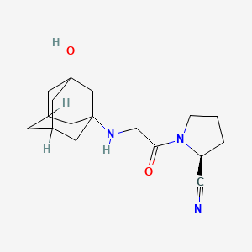
vidagliptin
IUPAC:1-[2-[(3-hydroxy-1-adamantyl)amino]acetyl]pyrrolidine-2-carbonitrile
Chemical Structure:

Slide 3
Physical Properties AND Preparation Methods OF vidagliptin
Physical State :Solid
Melting Point : 148.22 ̊C
Boiling Point: 50.0 °C
Preparation Methods :

Slide 4
Applications and Uses
It is used together with a healthy diet and regular exercise to control blood sugar levels
works by causing the pancreas to release more insulin and decreasing the hormones that cause blood sugar levels to rise

Slide 5
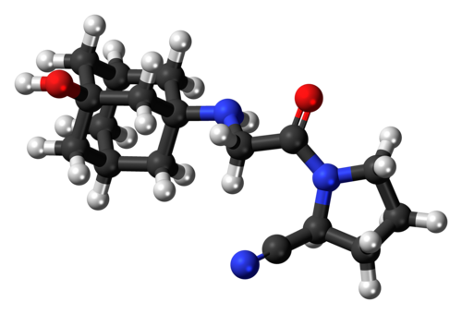
Literature Review
Vildagliptin is a DPP-4 inhibitor. Previous research has established that after treatment with vildagliptin, a time-dependent improvement in memory retention and a dose-dependent attenuation of Aβ, tau phosphorylation, and inflammatory markers were demonstrated in the AD mouse model [82] .

Slide 6
Environmental and Health Impacts
Hypertension is the most important modifiable risk factor for all-cause morbidity.
risk factor for all-cause morbidity and mortality worldwide and is associated with an increased risk of coronary heart disease, arrythmias, heart failure, cerebrovascular disease, peripheral artery disease, and renal failure [109,110].

Slide 7
Any question

