Slide 1
Student name:ABDULLAH ALKAHTANI Student ID:444101452 CHEM:341 Dr:Sultan Almadhhi 2025 May
_{Quinine}

Slide 2
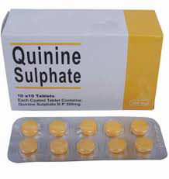
Introduction
2
Quinine is a white, crystalline alkaloid with numerous properties, including antipyretic, antimalarial, analgesic, anti-inflammatory, and a bitter taste. It is a stereoisomer of quinidine, which is used to treat cardiac arrhythmias, a property not found in quinine.

Slide 3
General Information: • Compound Name: Quinine • Systematic (IUPAC) Name: (R)-[(1S,2S,4S,5R)-5-ethenyl-1-azabicyclo[2,2,2]octan-2-yl](6-methoxyquinolin-4-yl)methanol • Trade Name: Quinine, Qualaquin, Quinamm • Molecular Formula: C20H24N2O2 • Molar Mass: 324.42 g/mol
3

Slide 4
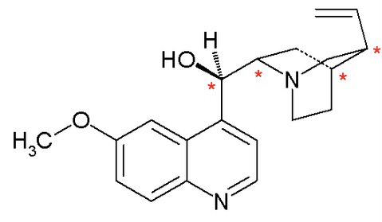
Chemical Structure: • Quinine's structure consists of a quinoline ring linked to a trigonal ring structure containing a nitrogen atom. • The structure contains: • An alcohol group (-OH) • A methoxy group (-OCH3) • A phenyl group (C=C)
4

Slide 5
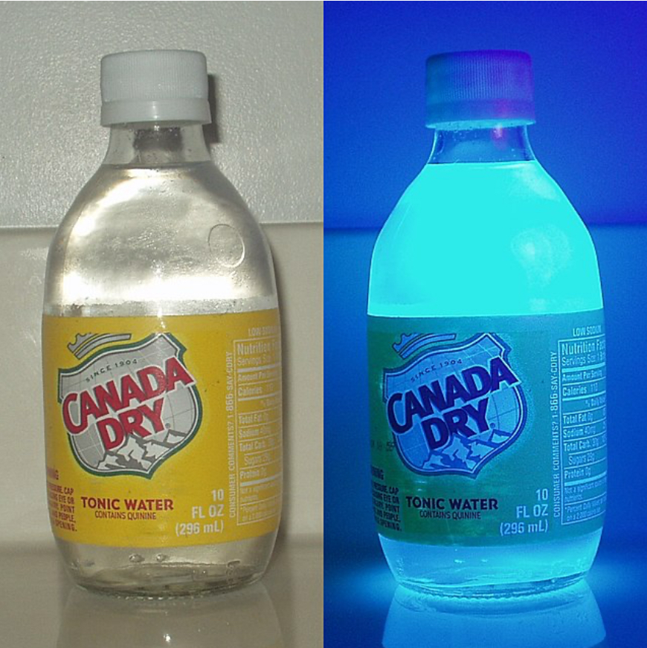
Physical Properties: • Physical State: White or transparent crystalline solid • Melting Point: 177–180°C •Boiling point:It does not boil easily, but it decomposes before boiling, have a boiling point.(57°C) • Solubility: Soluble in alcohol and organic solvents• Taste: Very bitter • Optical Properties: Quinine exhibits blue fluorescence under ultraviolet light
5

Slide 6
Preparation Methods: * (Natural Extraction) 1. Grind the bark of the cinchona tree. 2. Treat the bark with a basic solution (Ca(OH)₂). 3. Extract the alkaloids with an organic solvent (such as kerosene). 4. Precipitate the quinine using dilute acid (H2SO4). 5. Purify the quinine sulfate crystals. •This method is the most widely used industrially.
6
*(Artificial Synthesis)
• The first complete synthesis of quinine was performed in 1944 by Woodward and Doering:
•- Formation of the quinoline ring via condensation.
•- Multi-step hydrogenation to create saturated structures.
•- Oxidation/reduction reactions and ring-closing.
•- Raab-Kindler reaction to convert quinotoxin to quinine.
• This method is complex and industrially impractical.

Slide 7
Applications and Uses: 1. An effective antimalarial. 2. A treatment for nocturnal muscle cramps. 3. An ingredient in tonic drinks to impart a bitter flavor. 4. Used in scientific research to study nerve receptors. 5. It has fluorescence activity, making it useful in some biological tests. Environmental and Health Effects: Environmental Effects: • It is not considered a serious pollutant, but it is extracted from natural sources that may be affected. Health Effects: * Positive: Effective against malaria. ​​* Negative: May cause headaches, tinnitus, nausea, or cardiac effects. • Dosages should be monitored to avoid cinchonism.
7

Slide 8
Literature Review and Conclusion: • Key Studies: 1 Quinine's effectiveness against Plasmodium parasites. 2 Its toxicity and side effects. 3 Methods for developing safer synthetic alternatives. References: 1. WHO Guidelines 2. PubChem (CID: 8549) 3. Journal of Medicinal Chemistry
8

