Slide 1
Isatin: Heterocyclic Compound
Abdulaziz alrasheed

Slide 2
Basic Information
• Compound Name: Isatin
• IUPAC Name:
1H-Indole-2,3-dione
• Commercial Names: Isatin, 2,3-Indolinedione
• Available from: Sigma-Aldrich, TCI Chemicals

Slide 3
isatin
Originally isolated by oxidation of indigo dye.
Can be synthesized via several laboratory methods (e.g., Sandmeyer isonitrosoacetanilide synthesis).
Found in some plants and microbes as a natural metabolite

Slide 4
Isatis tinctoria (Woad)
A well-known source of indigo dye, from which isatin was originally isolated.
While isatin is not a major component, it can form as a byproduct of indigo oxidation.

Slide 5
History of Isatin
Isatin was first discovered in 1841 by chemists Erdmann and Laurent.
It was originally isolated from the oxidation of indigo dye.
The name “isatin” is derived from “indigo” and the suffix “-atin”.
It has since become an important compound in organic and medicinal chemistry.
Historically, isatin has been used in the synthesis of dyes and pharmaceuticals.
Modern research continues to explore its potential for antimicrobial, antiviral, and anticancer applications.

Slide 6
Physical Properties
• Physical State: Solid
• Melting Point: 197–200 °C
• Boiling Point: Decomposes before boiling

Slide 7
Scientific Preparation Method
• Reaction Name: Sandmeyer Isatin Synthesis
• Step 1: Aniline reacts with chloral hydrate and hydroxylamine HCl to form isonitrosoacetanilide.
• Step 2: Heated with conc. H2SO4 to cyclize and yield Isatin.
• Yield: 40–70%
• Reference: Sandmeyer, T. (1882). Ber. Dtsch. Chem. Ges. 15, 1496.

Slide 8
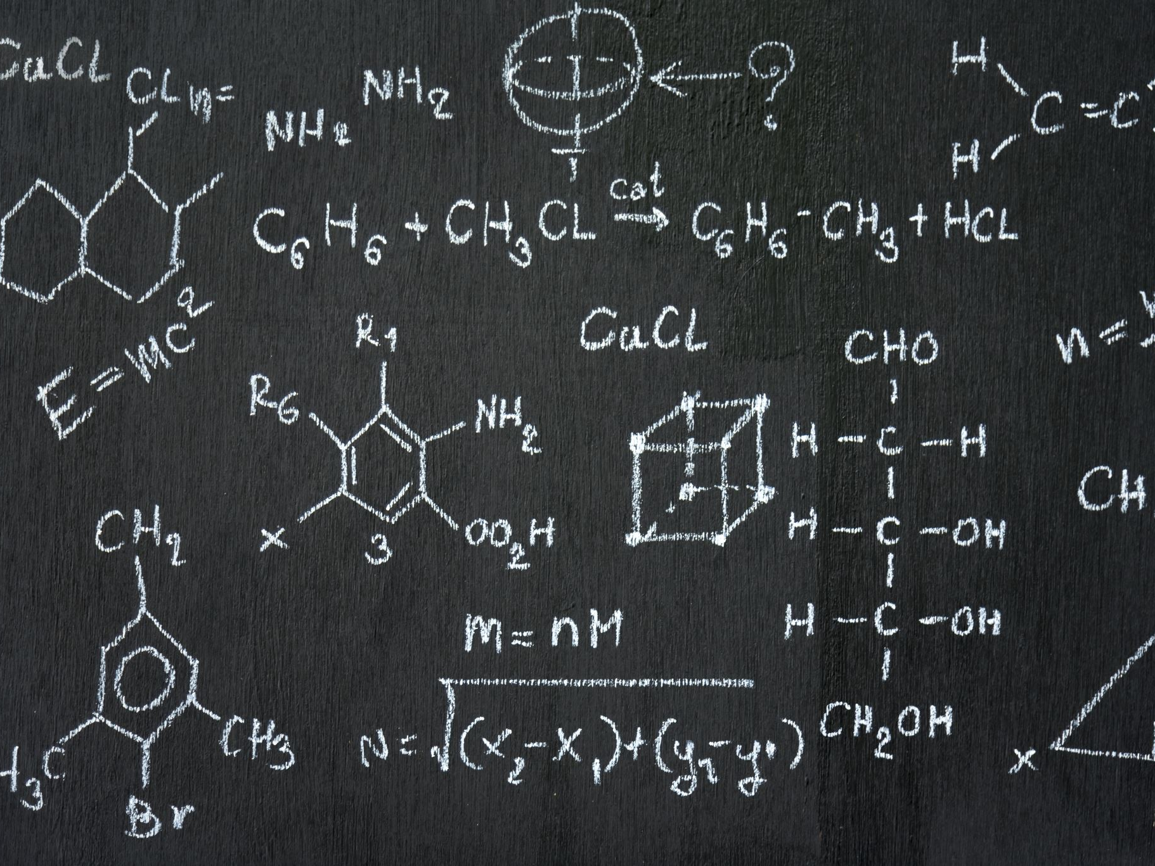
Latest finds
1. Anticancer Activity:
• Isatin-oxime ether derivatives (e.g., 6a, 6c, 6r) show potent cytotoxicity against A549 lung cancer cells (IC₅₀ ~14 nM).
2. Antifungal Properties:
• Natural isatin derivatives effective against Candida albicans and Cryptococcus neoformans.
3. Anti-Toxoplasma Activity:
• Isatin-1,2,3-triazole derivatives show in vivo efficacy against Toxoplasma gondii.
4. SARS-CoV-2 Inhibition:
• Moderate inhibition of viral Nsp15 endoribonuclease by isatin-based compounds.

Slide 9
Applications and Uses
• Anticancer: Apoptosis induction in leukemia and prostate cancer cells
• Antibacterial: Effective against Gram-positive and Gram-negative strains
• Neurological: Inhibits FAAH and MAGL enzymes
• Other uses: Dyes, reagents, pharmaceutical synthesis

Slide 10
Environmental and Health Impact
• Low toxicity in small quantities
• Potential irritant upon inhalation or ingestion
• Derivatives may have cytotoxic effects
• Requires safe lab handling and proper disposal

Slide 11
Literature Review
• Apoptosis in HL60 leukemia cells
• VEGFR-2 and STAT-3 inhibitors
• Schiff base derivatives as antibacterials
• Dual inhibition of FAAH and MAGL

Slide 12
References
Erdmann, O. L. & Laurent, A. (1841). Annalen der Chemie und Pharmacie, 39, 100–116.
Lee, H. J., et al. (2013). Current Medicinal Chemistry, 20(13), 1677–1693. PMID: 23448443
Padmini, E., et al. (2012). Pharmacognosy Magazine, 8(29), 45–50. PMCID: PMC3573604
de la Mare, P. B. D., & Ridd, J. H. (1970). Aromatic Substitution. Wiley.
Kumar, D., & Sharma, P. (2021). Bioorganic Chemistry, 107, 104635. PMID: 33839380
Trease and Evans' Pharmacognosy (16th Edition). Saunders Elsevier.

