Slide 1
Chapter 4
Thermochemistry

Slide 2
Thermochemistry is the study of heat changes in chemical reactions, where the exchange of heat between system and surroundings occurs.
Exothermic process is any process that gives off heat – transfers thermal energy from the system to the surroundings
2H₂ (g) + O₂ (g) 2H₂O (l) + energy
H₂O (g) H₂O (l) + energy

Slide 3
Endothermic process is any process in which heat has to be supplied to the system from the surroundings.
Energy + 2HgO (s) 2Hg (l) + O₂ (g)
Energy + H₂O (s) H₂O (g)

Slide 4
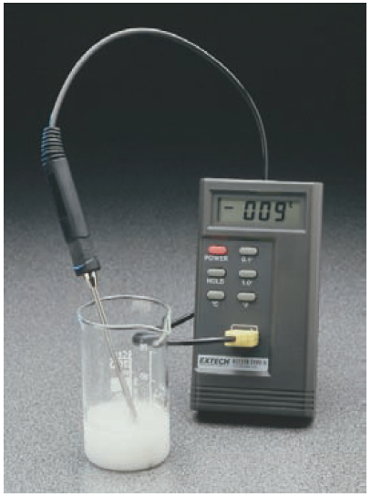
Examples of endothermic and exothermic reactions
2NH₄SCN (s) + Ba(OH)₂•8H₂O (s) Ba(SCN)₂ (aq) + 2NH₃ (aq) + 10H₂O (l)
As a results, the temperature of the system drops from about 20 ºC to -9 ºC.

Slide 5
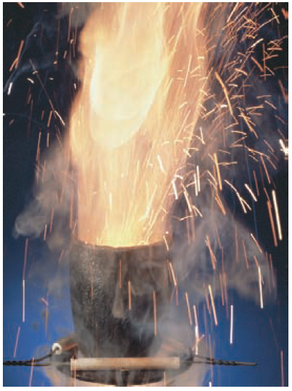
2) 2Al (s) + Fe₂O₃ (s) Al₂O₃ (s) + 2Fe (l)
The reaction of powdered aluminum with Fe₂O₃ is highly exothermic. The reaction proceeds vigorously to form Al₂O₃ and molten iron.

Slide 6
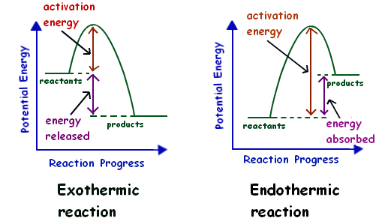
Exothermic and Endothermic Reactions
The change in enthalpy can be calculated by
∆H_{reaction} = ∑∆H_{products} - ∑∆H_{reactants}
If ∆H_{reaction} is negative, then the reaction is exothermic reaction.
If ∆H_{reaction} is positive, then the reaction is endothermic reaction.

Slide 7
Exothermic Reaction | Endothermic Reaction
Heat is given out to the surrounding. | Heat is absorbed from the surrounding.
Enthalpy of the reactant is more. | Enthalpy of the reactant is less.
Reactants are less stable | Reactants are more stable
Enthalpy of the product is less | Enthalpy of product is more
Products are more stable | Product are less stable
∆H is negative | ∆H is positive
Reaction is likely to be spontaneous in forward direction. | Reaction is unlikely to be spontaneous in forward direction

Slide 8
Thermochemical Equation
To write thermochemical equation, first, the reaction conditions and states must be written; e.g. C₆H₆ (l, 1 atm, 273 K) + O₂ (g, 1 atm, 273)
or state that the reaction condition is standard (1 atm, 298 K)
The thermochemical reaction equation must be balanced:
C₂H₆ (g) + 7/2 O₂ (g) 2CO₂ (g) + 3H₂O (g)

Slide 9
∆H for a reaction in the forward direction is equal in value, but opposite in sign to ∆H for reverse reaction.
H₂O (s) H₂O (l) ∆H = 6.01 kJ
H₂O (l) H₂O (s) ∆H = -6.01 kJ
Also, The rational number coefficients can be used in balancing the thermochemical equation

Slide 10
Factors that affect the reaction heat:
1- Physical state of materials
ΔH_{reaction} depends on the state of the reactants and the state of the products. This factor can be divided into:
A- Crystalline of the reactants
C (graphite) + O₂ (g) CO₂ (g) ∆H₁
C (diamond) + O₂ (g) CO₂ (g) ∆H₂
∆H₁ ≠ ∆H₂

Slide 11
B- State of matter
H₂ (g) + I₂ (s) 2HI (g) ∆H₁
H₂ (g) + I₂ (g) 2HI (g) ∆H₂
∆H₁ ≠ ∆H₂
H₂ (g) + ½ O₂ (g) H₂O (l) ∆H₁
H₂ (g) + ½ O₂ (g) H₂O (g) ∆H₂
∆H₁ ≠ ∆H₂

Slide 12
2- Number of moles ( amount of materials)
If a chemical equation multiplied by a factor n, then both sides of equation will be multiplied by it as well as the reaction enthalpy ∆H
For example:
H₂ (g) + ½ O₂ (g) H₂O (l) ∆H
If this chemical equation multiplied by factor of 4,
4 × the chemical equation:
4H₂ (g) + 2O₂ (g) 4H₂O 4 × ∆H

Slide 13
3- Reaction conditions (P, V, T)

Slide 14
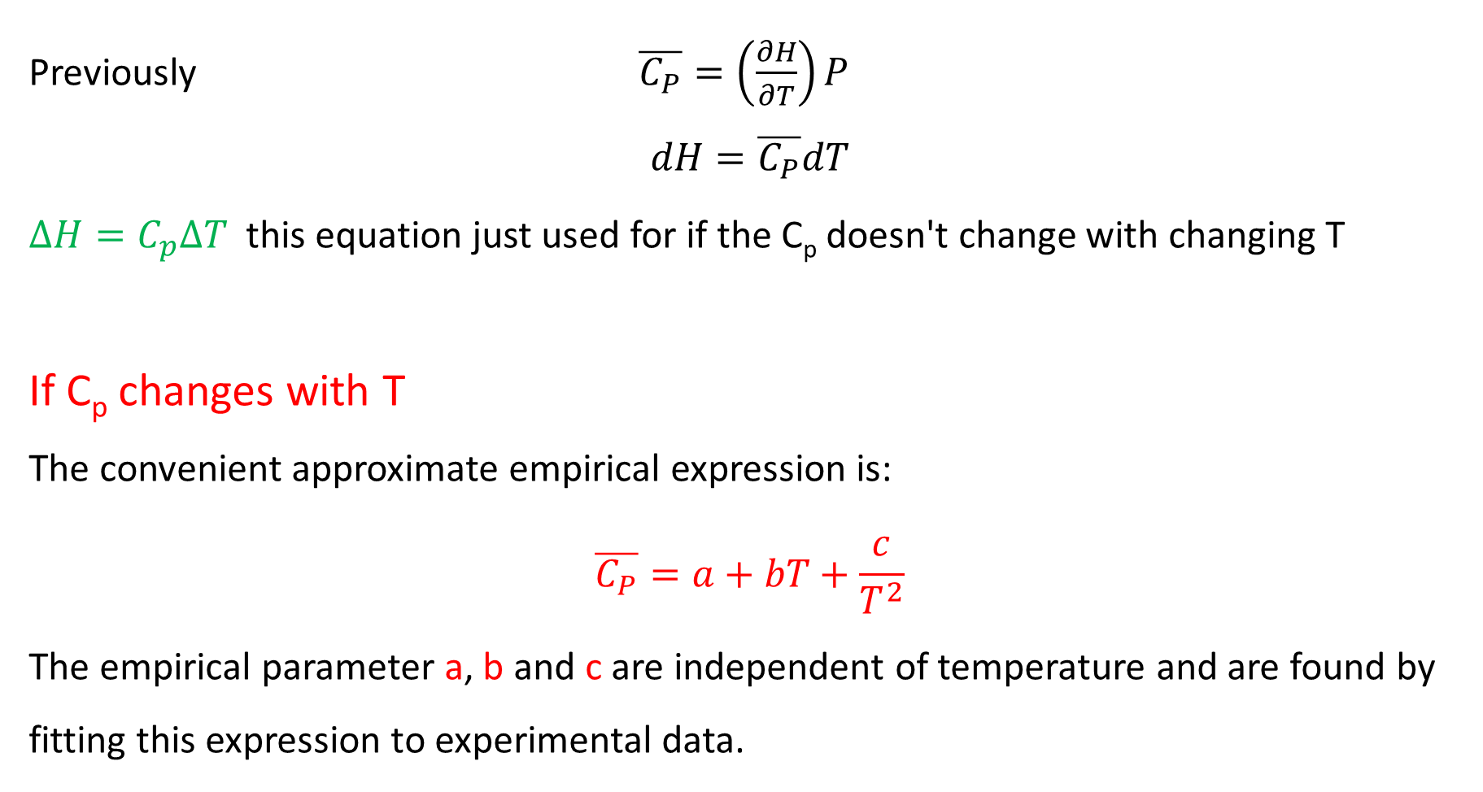
Previously $\overline{C_{P}}=\left(\frac{∂H}{∂T}\right)P$
$$dH=\overline{C_{P}}dT$$
$∆H=C_{p}∆T$this equation just used for if the C_{p} doesn't change with changing T
If C_{p} changes with T
The convenient approximate empirical expression is:
$$\overline{C_{P}}=a+bT+\frac{c}{T^{2}}$$
The empirical parameter a, b and c are independent of temperature and are found by fitting this expression to experimental data.

Slide 15
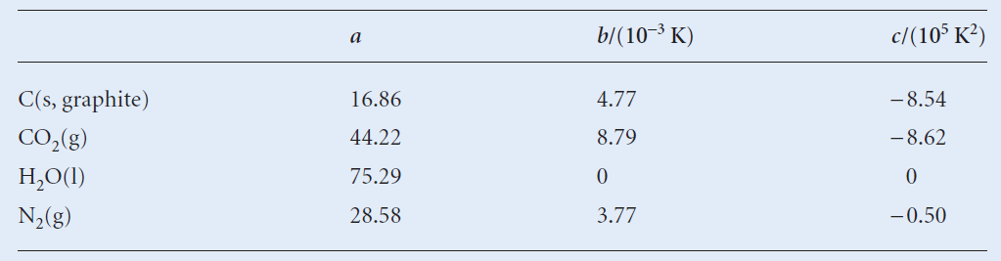

Slide 16
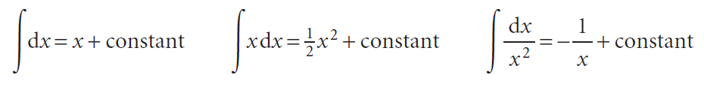
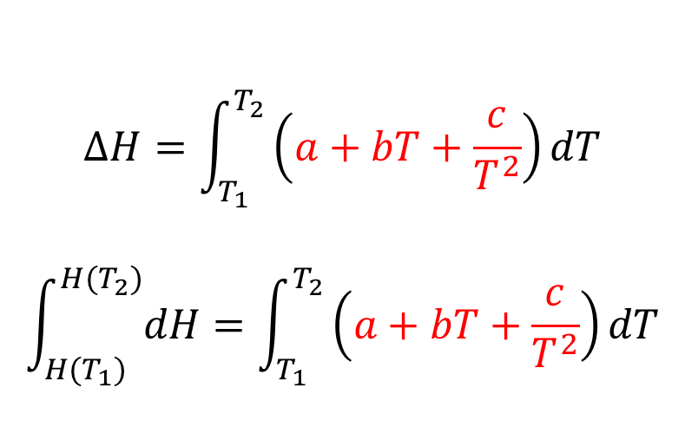
$$∆H=\int_{T_{1}}^{T_{2}}{\left(a+bT+\frac{c}{T^{2}}\right)dT}$$
$$\int_{H(T_{1})}^{H(T_{2})}{dH}=\int_{T_{1}}^{T_{2}}{\left(a+bT+\frac{c}{T^{2}}\right)dT}$$
$$∆H=H\left(T_{2}\right)−H\left(T_{1}\right)=a\left(T_{2}−T_{1}\right)+\frac{1}{2}b\left(T_{2}^{2}−T_{1}^{2}\right)−c\left(\frac{1}{T_{2}}−\frac{1}{T_{1}}\right)$$

Slide 17
Examples
1- Olive oiles is completely burned in oxygen at 100 ºC according to:
C₅₇H₁₀₄O₆ (l) + 80O₂ (g) → 57CO₂ (g) + 52H₂O (g) ∆H = -31150 kJ
Calculate the change in the internal energy ∆U (in kJ) for this combustion process.
2- The internal energy change when 1.0 mol CaCO₃ in the form calcite converts to aragonite is +0.21 kJ. Calculate the difference between the enthalpy change and the change in internal energy when the pressure is 1.0 bar given that the densities of the solids are 2.71 g cm⁻³ and 2.93 g cm⁻³ respectively.

Slide 18
Enthalpy (∆H)
Hess’s law
ΔH is well known for many reactions, and it is inconvenient to measure ΔH for every reaction in which we are interested.
Hess’s law states that “If a reaction is carried out in a series of steps, ΔH for the overall reaction will be equal to the sum of the enthalpy changes for the individual steps.”
- The total enthalpy change depends only on the initial state of the reactants and the final state of the products.

Slide 19
∆H
The change in enthalpy for the reaction is the same whether the reaction takes place in one step or series of steps
A
D
∆H₁
∆H₃
B
C
∆H₂
Conversion of A to D
Step 1 A → B ∆H = ∆H₁
Step 2 B → C ∆H = ∆H₂
Step 3 C → D ∆H = ∆H₃
Overall A → D ∆H = ∆H₁+ ∆H₂ + ∆H₃

Slide 23
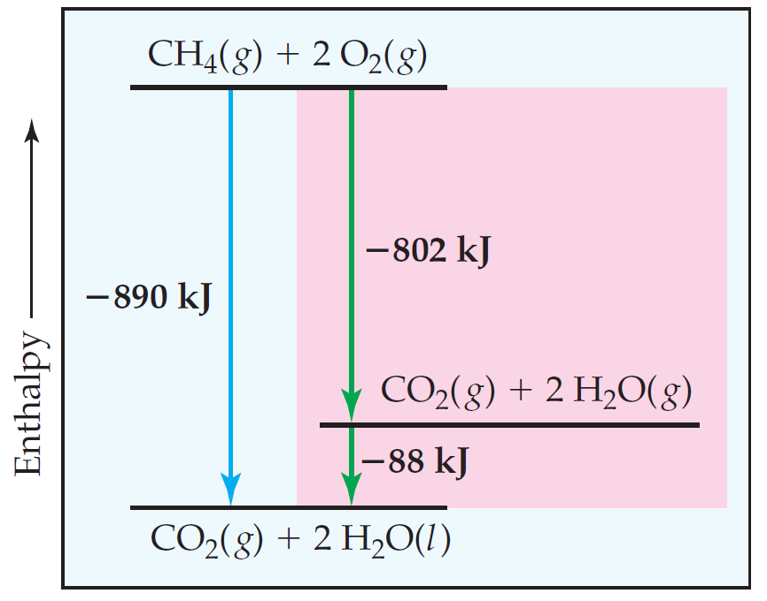

Slide 24
Example
3- Find the enthalpy of the reaction:
2B (s) + 3/2O₂ (g) → B₂O₃ (s)
If you this information:
B₂H₆ (g) + 3O₂ (g) → B₂O₃ (s) + 3H₂O (g) ∆H₁ = -2035 kJ
H₂O (l) → H₂O (g) ∆H₂ = +44 kJ
2H₂ (g) + O₂ (g) → 2H₂O (l) ∆H₃ = -572 kJ
2B (s) + 3H₂ (g) → B₂H₆ (g) ∆H₄ = +36 kJ

Slide 25
4- The enthalpy of reaction for the combustion of C to CO₂ is –393.5 kJ/mol C, and the enthalpy for the combustion of CO to CO₂ is - 283.0 kJ/mol CO:
(1) C (s) + O₂ (g) → CO2 (g) ΔH₁ = -393.5 kJ
(2) CO (g) + 0.5 O₂ (g) → CO₂ (g) ΔH₂ = -283.0 kJ
Using these data, calculate the enthalpy for combustion of C to CO:
(3) C (s) + 0.5 O₂ (g) → CO (g) ΔH₃ = ? kJ

Slide 26
5- Given the following data
2ClF (g) + O₂ (g) → Cl₂O (g) + F₂O (g) ΔH₁ = 167.4 kJ
2ClF₃ (g) + 2O₂ (g) → Cl₂O (g) + 3F₂O (g) ΔH₂ = 341.4 kJ
2F₂ (g) + O₂ (g) → 2F₂O (g) ΔH₃ = -43.4 kJ
Calculate ΔH for the reaction
ClF (g) + F₂ (g) → ClF₃ (g)

Slide 27
Kirchhoff’s Law
The object is to calculate the enthalpy of reaction when the temperature is changed
Propose the following set of reaction
1 A reaction to form B at temperature T₁
2 A is transformed from T₁ to T₂
3 A reacts to form B at T₂
4 B is transformed from T₂ to T₁
∆H₁ = ∆H₂ + ∆H₃ + ∆H₄
3
At T₂
A
B
2
4
At T₁
A
B
1

Slide 28
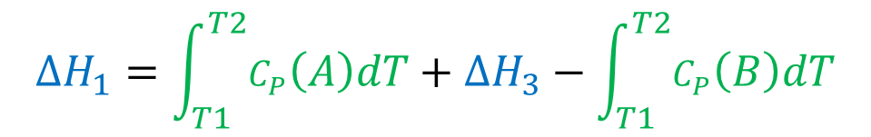
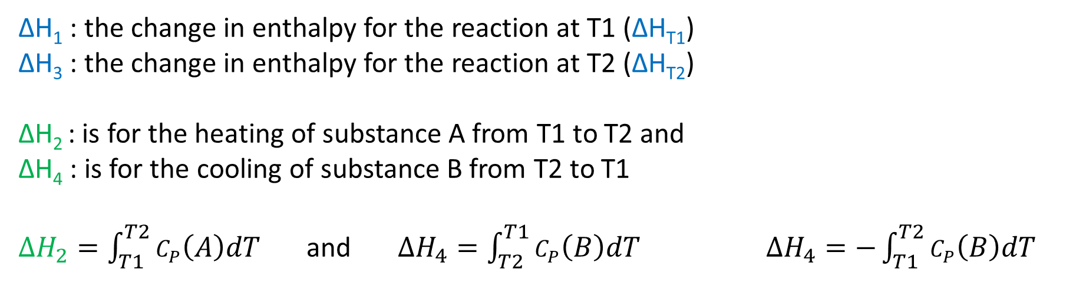
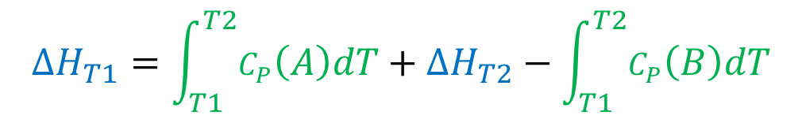
∆H₁ : the change in enthalpy for the reaction at T1 (∆H_{T1})
∆H₃ : the change in enthalpy for the reaction at T2 (∆H_{T2})
∆H₂ : is for the heating of substance A from T1 to T2 and
∆H₄ : is for the cooling of substance B from T2 to T1
$∆H_{2}=\int_{T1}^{T2}{C_{P}\left(A\right)dT}$ and $∆H_{4}=\int_{T2}^{T1}{C_{P}\left(B\right)dT}$ $∆H_{4}=−\int_{T1}^{T2}{C_{P}\left(B\right)dT}$
∆H₁ = ∆H₂ + ∆H₃ + ∆H₄
∆H_{T1} = ∆H₂ + ∆H_{T2} + ∆H₄
$$∆H_{1}=\int_{T1}^{T2}{C_{P}\left(A\right)dT}+∆H_{3}−\int_{T1}^{T2}{C_{P}\left(B\right)dT}$$
$$∆H_{T1}=\int_{T1}^{T2}{C_{P}\left(A\right)dT}+∆H_{T2}−\int_{T1}^{T2}{C_{P}\left(B\right)dT}$$

Slide 29
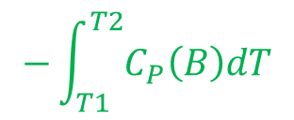
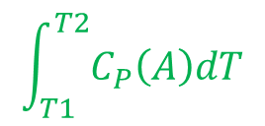
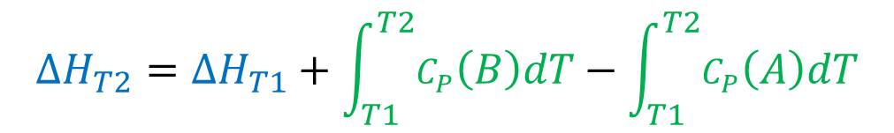
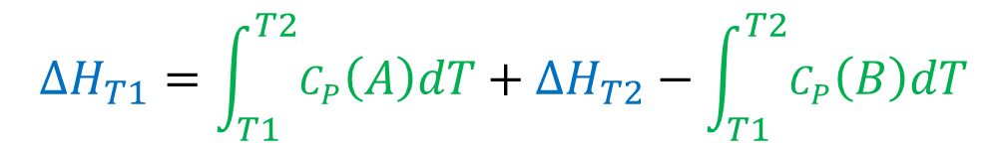
∆H_{T2}
A
B
$$\int_{T1}^{T2}{C_{P}\left(A\right)dT}$$
$$−\int_{T1}^{T2}{C_{P}\left(B\right)dT}$$
A
B
∆H_{T1}
$$∆H_{T1}=\int_{T1}^{T2}{C_{P}\left(A\right)dT}+∆H_{T2}−\int_{T1}^{T2}{C_{P}\left(B\right)dT}$$
$$∆H_{T2}=∆H_{T1}+\int_{T1}^{T2}{C_{P}\left(B\right)dT}−\int_{T1}^{T2}{C_{P}\left(A\right)dT}$$

Slide 30
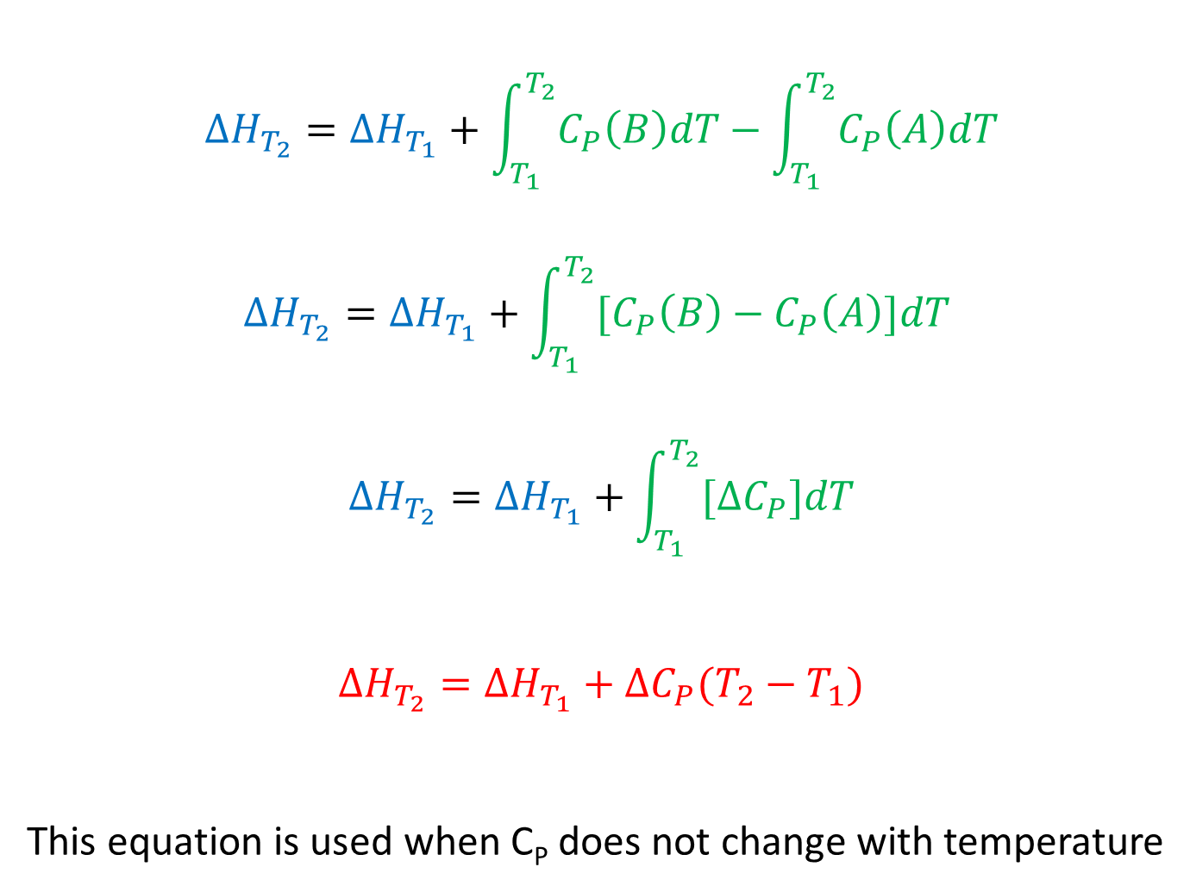
$$∆H_{T_{2}}=∆H_{T_{1}}+\int_{T_{1}}^{T_{2}}{C_{P}\left(B\right)dT}−\int_{T_{1}}^{T_{2}}{C_{P}\left(A\right)dT}$$
$$∆H_{T_{2}}=∆H_{T_{1}}+\int_{T_{1}}^{T_{2}}{[C_{P}\left(B\right)−C_{P}\left(A\right)]dT}$$
$$∆H_{T_{2}}=∆H_{T_{1}}+\int_{T_{1}}^{T_{2}}{[∆C_{P}]dT}$$
$$∆H_{T_{2}}=∆H_{T_{1}}+∆C_{P}(T_{2}−T_{1})$$
This equation is used when C_{P} does not change with temperature

Slide 31
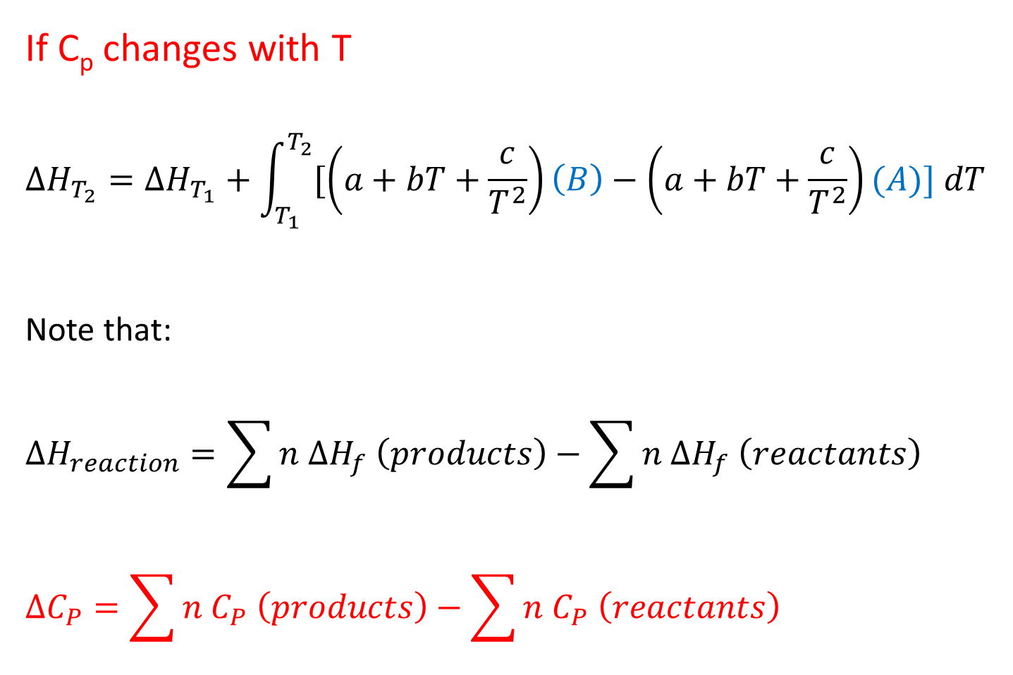
If C_{p} changes with T
$$∆H_{T_{2}}=∆H_{T_{1}}+\int_{T_{1}}^{T_{2}}{[\left(a+bT+\frac{c}{T^{2}}\right)\left(B\right)−\left(a+bT+\frac{c}{T^{2}}\right)(A)] dT}$$
Note that:
$$∆H_{reaction}=\sum{n ∆H_{f} \left(products\right)−\sum{n ∆H_{f} \left(reactants\right)}}$$
$$∆C_{P}=\sum{n C_{P} \left(products\right)−\sum{n C_{P} \left(reactants\right)}}$$

Slide 32
Solved example
The reduction of Fe₂O₃:
Fe₂O₃ (s) + 3H₂ (g) → 2Fe (s) + 3H₂O (l) ∆H at 298 K = -33.29 kJ
What is the enthalpy change at 358 K?
If you know the heat capacities at constant pressure C_{P} (J mol⁻¹ K⁻¹) of the reaction components :
Fe₂O₃ (s): 103.8; H₂ (g): 28.8; Fe (s): 25.1; H₂O (l): 75.3.

Slide 33
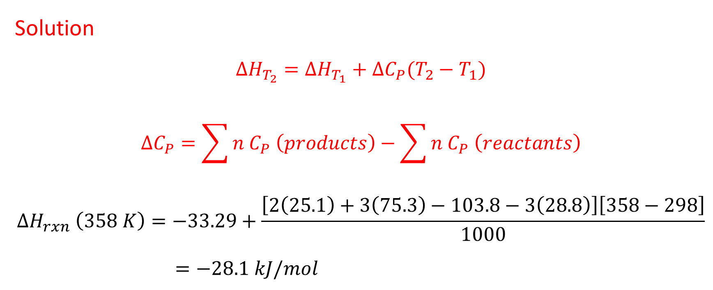
Solution
$$∆H_{T_{2}}=∆H_{T_{1}}+∆C_{P}(T_{2}−T_{1})$$
$$∆C_{P}=\sum{n C_{P} \left(products\right)−\sum{n C_{P} \left(reactants\right)}}$$
$$∆H_{rxn} \left(358 K\right)=−33.29+\frac{\left[2\left(25.1\right)+3\left(75.3\right)−103.8−3\left(28.8\right)\right]\left[358−298\right]}{1000}$$
$=−28.1 kJ/mol$

Slide 34
Example
6- The standard enthalpy of formation of H₂O (g) at 298 K is -241.82 kJ mol⁻¹. Estimate its value at 100 ºC, given the following value of the molar heat capacities at constant pressure:
H₂O (g): 33.58 J K⁻¹ mol⁻¹; H₂ (g): 28.84 J K⁻¹ mol⁻¹; O₂ (g): 29.37 J K⁻¹ mol⁻¹.
Assume heat capacities are independent of temperature.

Slide 35
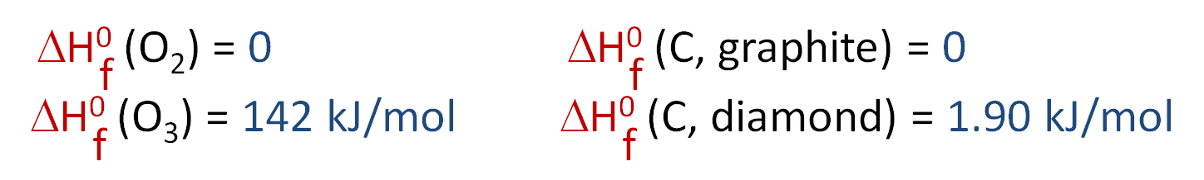
Standard Enthalpies of Formation ( ΔH_{f}º )
- An enthalpy of formation, ΔH_{f}, is defined as the enthalpy change for the reaction in which a compound is made from its constituent elements in their elemental forms.
- Standard of enthalpies formation (ΔH_{f}º) is the heat change that results when one mole of a compound is formed from its elements at a pressure of 1 atm.
- The superscript zero indicates that the corresponding process has been carried out under standard conditions.
- The standard enthalpy of formation of any element in its most stable form (allotrope) is zero.

Slide 36
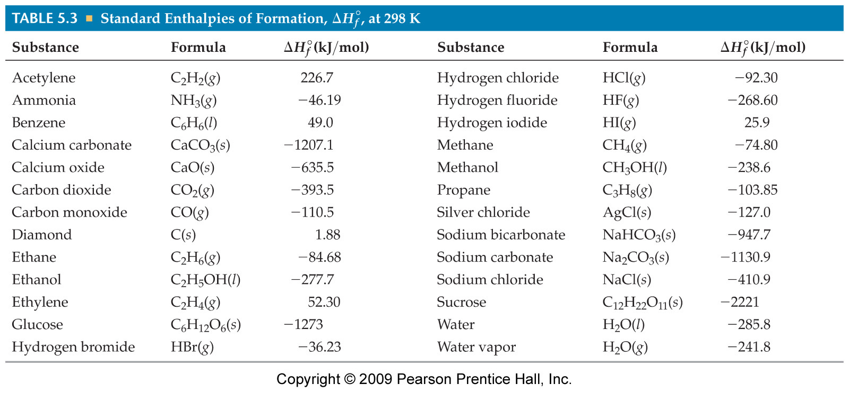
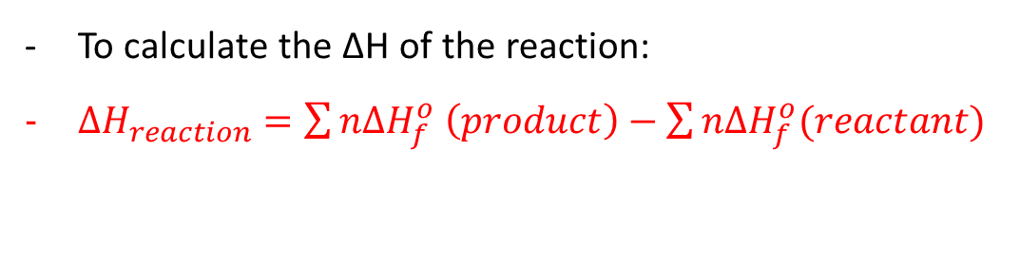
Standard enthalpies of formation, ΔH_{f}°, are measured under standard conditions (25 °C and 1.00 atm pressure).
To calculate the ΔH of the reaction:
$∆H_{reaction}=\sum{n{∆H}_{f}^{o} \left(product\right)−\sum{n{∆H}_{f}^{o}(reactant)}}$

Slide 37
Determination of ΔH_{f}º
There are a number of ways in which to measure the enthalpy of formation of a compound; here are two. The most obvious is to simply carry out the formation reaction from the constituent elements in their standard states in a constant pressure calorimeter (will be explained later). For example, consider the combustion of graphite to form carbon dioxide
The heat released in this reaction is -ΔH_{f}º (CO₂), since the standard enthalpy of formation of the reactants is zero. For this method to work, two conditions must be met:
1) the reaction goes to completion.
2) only one product is formed.

Slide 38
However, the reaction:
C (grapite) + 2H₂ (g) → CH₄ (g) at 25 ºC, 1 atm
is not suitable for this method since it doesn’t readily go to completion and we get a complicated mixture of hydrocarbons. In order to get around this, note that it is often possible to burn something to completion (and measure ΔH_{combustion}, the heat released). Thus consider:
CH₄ (g) + 2O₂ (g) → CO₂ (g) + 2H₂O at 25 ºC, 1 atm
Using the equation:
ΔH_{combustion} = ΔHº_{f} (CO₂(g)) + 2ΔHº_{f} (H₂O(l)) - ΔHº_{f} (CH₄(g)).

Slide 39
The standard enthalpies of formation of carbon dioxide and water can be measured using the first method; hence, once we measure the heat of combustion, the only unknown is the standard enthalpy of formation of methane (CH₄) and a little algebra gives:
ΔHº_{f} (CH₄(g)) = ΔHº_{f} (CO₂(g)) + 2ΔHº_{f} (H₂O(l)) - ΔH_{combustion}
= [-398. 51 + 2(-285. 83) - (-890. 36)]kJ/mole
= -74. 81kJ/mole

Slide 40
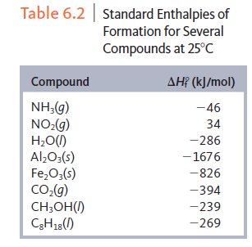
Standard Enthalpy of formation

Slide 41
Example
7- Calculate (in J) the standard change in the internal energy ∆Uº for the following reaction:
C₂H₄ (g) + H₂O (g) → C₂H₅OH (l)
Knowing that:
ΔHº_{f} [C₂H₅OH (l)] = -277.7 kJ
ΔHº_{f} [C₂H₄ (g) ] = +52.3 kJ
ΔHº_{f} [H₂O (g)] = -241.8 kJ

Slide 42
8- Find (in kJ) the standard enthalpy of formation of NO gas ΔHº_{f} [NO (g)], given the following data:
N₂ (g) + 2O₂ (g) → 2NO₂ (g) ΔHº = +68 kJ
2NO (g) + O₂ (g) → 2NO₂ (g) ΔHº = -114 kJ

Slide 43
Bond Enthalpy (Bond Energy)
A useful way to calculate enthalpy changes in chemical reactions is through the concept of bond energies. Bond energy is defined as the energy required to break a chemical bond. It is usually measured at 273K.
Enthalpy can be measured by
ΔH_{reaction} = Ʃ nΔH_{(bonds broken)} - Ʃ nΔH_{(bonds formed)}

Slide 44
Consider the following reactions
CH₄ (g) → CH₃ (g) + H (g) ΔHº₁ = 426.36 kJ mol⁻¹
CH₃ (g) → CH₂ (g) + H (g) ΔHº₂ = 465.94 kJ mol⁻¹
CH₂ (g) → CH (g) + H (g) ΔHº₃ = 421.7 kJ mol⁻¹
CH (g) → C (g) + H (g) ΔHº₁ = 338.8 kJ mol⁻¹
CH₄ (g) → C (g) + 4H (g) ΔHº = 1652.80 kJ mol⁻¹
ΔHº (C - H) = 1652.80 ÷ 4 = 413.20 kJ mol⁻¹
one C-H bond is broken. Experimentally, ΔH for this reaction is 413 kJ/mole

Slide 45
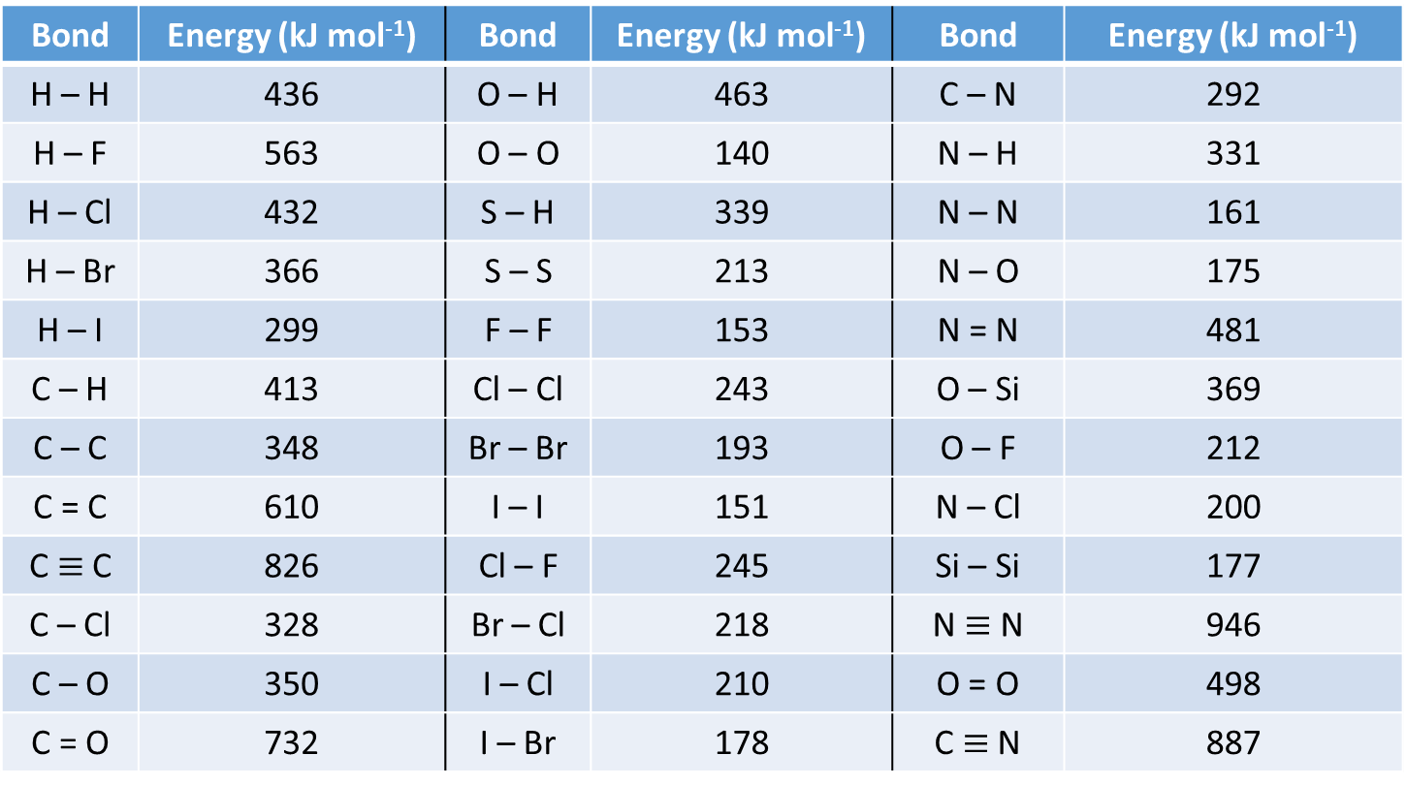
Average Energies for Common bonds
Bond | Energy (kJ mol⁻¹) | Bond | Energy (kJ mol⁻¹) | Bond | Energy (kJ mol⁻¹)
H – H | 436 | O – H | 463 | C – N | 292
H – F | 563 | O – O | 140 | N – H | 331
H – Cl | 432 | S – H | 339 | N – N | 161
H – Br | 366 | S – S | 213 | N – O | 175
H – I | 299 | F – F | 153 | N = N | 481
C – H | 413 | Cl – Cl | 243 | O – Si | 369
C – C | 348 | Br – Br | 193 | O – F | 212
C = C | 610 | I – I | 151 | N – Cl | 200
C $≡$ C | 826 | Cl – F | 245 | Si – Si | 177
C – Cl | 328 | Br – Cl | 218 | N $≡$ N | 946
C – O | 350 | I – Cl | 210 | O = O | 498
C = O | 732 | I – Br | 178 | C $≡$ N | 887

Slide 46
How can this be used? Consider the hydrogenation of ethylene:
H₂C = CH₂ + H – H → H₃C – CH₃
At the molecular level, we break one H-H and one C=C bond, and form one C-C and two C-H bonds. The energy change is just the net energy left in the molecule in such a process. From the table, the bond breaking steps take 610 + 436 = 1046 kJ/mole. The bond formation will give off 348 + 2(413) = 1174 kJ/mole. Hence the net energy change in the system is 1046 -1174 = -128 kJ/mol.

Slide 47
Example
9- Hydrogen and chlorine react to form hydrogen chloride gas:
H₂ (g) + Cl₂ (g) → 2HCl (g)
The bond energies in kJ mol⁻¹: [H – H : 436], [Cl – Cl: 243] and [H – Cl: 432]
What is the enthalpy of this reaction?
10- Hydrogen bromide decomposes to form hydrogen and bromine:
2HBr (g) → H₂ (g) + Br₂ (g)
The bond energies in kJ mol⁻¹: [H – H : 436], [Br – Br: 193] and [H – Br: 366]
What is the enthalpy of this reaction?

Slide 48
Factors Affecting Enthalpy Of Chemical Changes
1- The physical state of the reactants and products
2- Pressure exerted on reactants and products (gaseous form)
3- Temperature of the reaction
4- Whether the reaction takes place at constant temperature or at constant volume

Slide 49
Enthalpy (Heat) of Physical Changes ∆H
In phase transition one phase of substance is converted in bulk into another, at constant temperature and pressure.
Phase Transition
1- Fusion (melting)
2- Vaporization
3- Sublimation
4- condensation
5- freezing
Atomic / Molecular Changes
1- Atomization
2- Ionization
3- Solution
4- electron affinity
Dilution

Slide 50
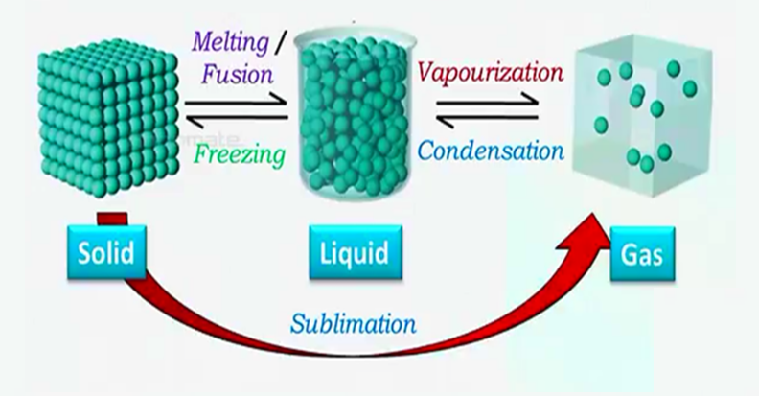

Slide 51
Enthalpy of solution (∆H_{soln})
∆H_{soln} can be calculated using: ∆H_{soln} = ∆H₁ + ∆H₂ + ∆H₃
∆H₁ or ∆H_{solute} is the separation of solute molecules
∆H₂ or ∆H_{solvent} is the separation of solvent molecules
∆H₃ or ∆H_{mix} is the formation of solute-solvent interaction

Slide 52
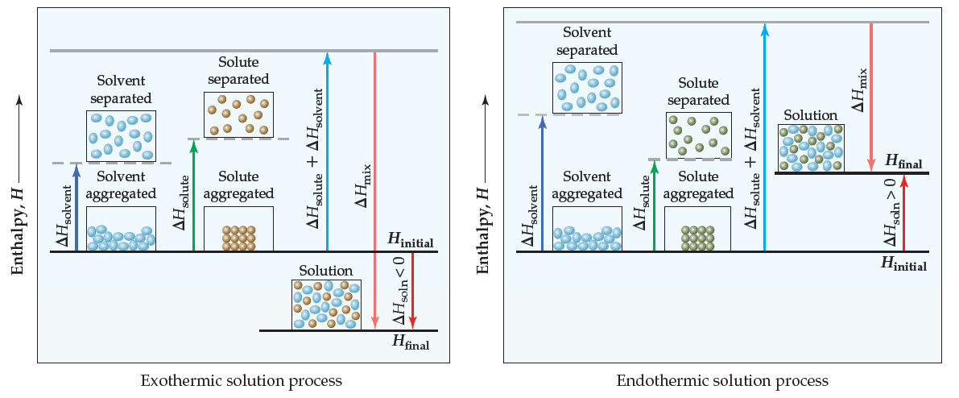

Slide 53
Enthalpy of dilution (∆H_{dil})
The enthalpy of dilution is defined as the enthalpy change that occurs when a solution of one concentration is diluted further to form solution of another concentration
∆H_{dil} = (∆H_{soln})_{diluted} – (∆H_{soln})_{concentrated}
HCl (g) + 5H₂O (l) → HCl.5H₂O ∆H_{soln} = -64 kJ
HCl (g) + 25H₂O (l) → HCl.25H₂O ∆H_{soln} = -72.2 kJ
HCl.5H₂O + 20H₂O → → HCl.25H₂O ∆H_{dil} = -72.2 – (-64) = -8.2 kJ

Slide 54
Enthalpy of fusion (melting) (∆_{fus}H)
The enthalpy change that is accompanied during fusion of 1 mole of a solid without change in temperature at constant pressure
H₂O (s) → H₂O (l) ∆_{fus}H = +6.01 kJ/mole at 0 ºC
Enthalpy of freezing (∆_{freez}H)
The reverse of fusion is freezing of liquid
H₂O (l) → H₂O (s) ∆_{freez}H = -6.01 kJ/mole at 0 ºC

Slide 55
Enthalpy of vaporization (∆_{vap}H)
The enthalpy change that is accompanied during vaporization of 1 mole of a liquid without change in temperature at constant pressure
H₂O (l) → H₂O (g) ∆_{vap}H = +45.07 kJ/mole at 100 ºC
Enthalpy of condensation (∆_{con}H)
The reverse of vaporization is condensation of gases
H₂O (g) → H₂O (l) ∆_{con}H = -45.07 kJ/mole at 100 ºC

Slide 56
Enthalpy of sublimation (∆_{sub}H)
The enthalpy change that is accompanied during conversion of 1 mole of a solid directly into its vapor at constant temperature and pressure
H₂O (s) → H₂O (g) ∆_{sub}H = +51.08 kJ/mole at 0 ºC
And the liquid state comes during the conversion:
H₂O (s) → H₂O (l) ∆_{fus}H = +6.01 kJ/mole at 0 ºC
H₂O (l) → H₂O (g) ∆_{vap}H = +45.07 kJ/mole at 0 ºC
H₂O (s) → H₂O (g) ∆_{sub}H = +51.08 kJ/mole at 0 ºC
Another example: Ag (s) → Ag (g) ∆_{sub}H = 284 kJ

Slide 57
Enthalpy of atomization (dissociation) (∆_{atom}H or ∆_{a}H)
The enthalpy change that is accompanied by dissociation of all molecules in one mole of gaseous phase into gaseous atoms
Molecules (g) → atoms (g)
Cl₂ (g) → Cl (g) + Cl (g) ∆_{a}H or ∆_{d}H = +242 kJ mol⁻¹

Slide 58
Enthalpy of ionization (∆_{ion}H)
The enthalpy change that accompanies the removal of an electron from each atom or ion in one mole of gaseous atoms or ions.
Ca (g) → Ca⁺ (g) + e⁻ ∆_{ion}H = +590 kJ mol⁻¹
Ca⁺ (g) → Ca²⁺ (g) + e⁻ ∆_{ion}H = +1150 kJ mol⁻¹ 1st IE < 2nd IE
Enthalpy of electron affinity (electron attachment) (∆_{aff}H)
The electron affinity is the energy released when 1 mole of gaseous atoms each acquire an electron to form 1 mole of gaseous 1- ions
O (g) + e⁻ → O⁻ (g) ∆_{aff}H = -142 kJ mol⁻¹
O⁻ (g) + e⁻ → O²⁻ (g) ∆_{aff}H = +844 kJ mol⁻¹ 1st EA < 2nd EA

Slide 59
The Born-Haber cycle for finding lattice enthalpy ∆H_{L}
Born–Haber cycles are used primarily as a means of calculating lattice energy (enthalpy) ∆H_{L}, which cannot otherwise be measured directly. The lattice enthalpy is the enthalpy change involved in the formation of an ionic compound from gaseous ions (an exothermic process), or sometimes defined as the energy to break the ionic compound into gaseous ions (an endothermic process).
K⁺ (g) + Cl⁻ (g) → KCl (s) ∆H_{L} = -717 kJ mol⁻¹
KCl (s) → K⁺ (g) + Cl⁻ (g) ∆H_{L} = +717 kJ mol⁻¹

Slide 60
Calculating lattice enthalpy of AgCl (s)
1- Formation of AgCl (s) from Ag (s) and Cl₂ (g): ∆H_{f} = -127 kJ / mol
2- Sublimation of Ag (s) : ∆H_{sub} = 284 kJ / mol
3- Ionization of Ag (g) to Ag⁺ (g): ∆H_{ion} = 731 kJ / mol
3- Dissociation (atomization) of Cl₂: ∆H_{diss} = 244 kJ / mol
4- Electron attachment (affinity) to Cl (g): ∆H_{aff} = -349 kJ / mol

Slide 61
∆H_{f} = -127
Ag (s) + ½ Cl₂ (g)
AgCl (s)
∆H_{L}
½ ∆H_{diss} = 122
∆H_{sub} = 284
+ e⁻
∆H_{aff} = -349
Cl (g)
Cl⁻ (g)
+
- e⁻
∆H_{ion} = 731
Ag (g)
Ag⁺ (g)

Slide 62
Ag⁺ (g) + Cl (g) + e⁻
½ ∆H_{diss} = 122
Ag⁺ (g) + ½ Cl₂ (g) + e⁻
Ag⁺ (g) + Cl⁻ (g)
∆H_{aff} = -349
∆H_{ion} = 731
Ag (g) + ½ Cl₂ (g)
∆H_{L}
∆H_{sub} = 284
Ag (s) + ½ Cl₂ (g)
∆H_{f} = -127
AgCl (s)
AgCl (s)

Slide 63
Lattice enthalpy of AgCl:
∆H_{L} = ∆H_{f} - ∆H_{sub} – ½ ∆H_{diss} - ∆H_{ion} - ∆H_{aff}
= -127 – 284 – 731 – 122 – ( - 349) = - 915 kJ mol⁻¹
Note:
Ag⁺ (g) + Cl⁻ (g) → AgCl (s) ∆H_{L} = - 915 kJ mol⁻¹
AgCl (s) → Ag⁺ (g) + Cl⁻ (g) ∆H_{L} = + 915 kJ mol⁻¹
How can the lattice enthalpy be calculated by Hess’s Law?

Slide 64
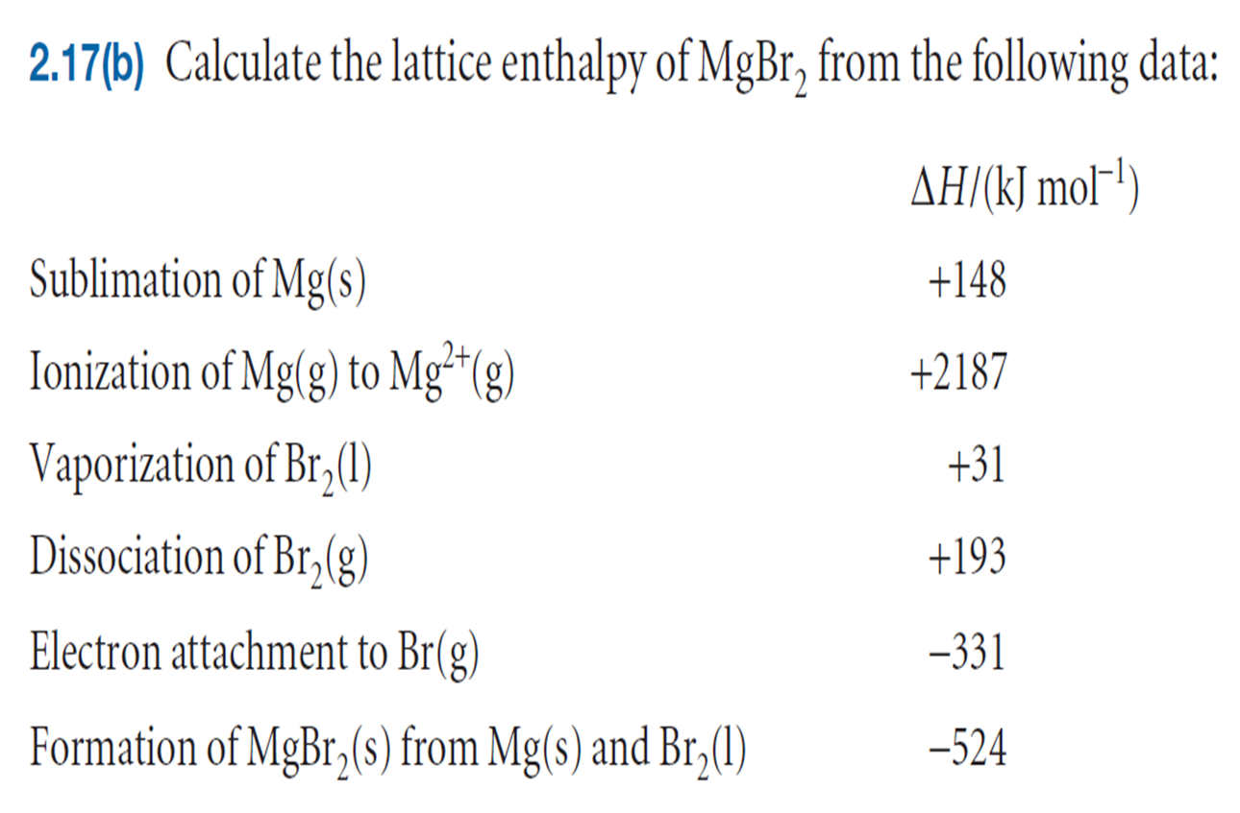
Practice!

Slide 65
Various Types of Heat Changes
Heat of Combustion
The enthalpy or energy change when one mole of a substance is burnt in oxygen, is defined as the heat of combustion ∆H_{c}, the product being water and carbon dioxide (usually): C₂H₆ (g) + 7/5 O₂ (g) → 2CO₂ (g) + 3H₂O (l) ∆H_{c} = - 1560.1 kJ
Heat of Hydrogenation
The enthalpy change accompanying the conversion of one mole of unsaturated organic into corresponding saturated compound by reducing the former with hydrogen, e. g. when benzene is hydrogenated to cyclohexane, the change in enthalpy is represented by the following equation: C₆H₆ (l) + 3H₂ (g) → C₆H₁₂ (l) ∆H = -205 kJ

Slide 66
Heat of transition
The amount of heat absorbed or evolved when one mole of a substance is transform from one allotropic form (state) to another allotropic form, e. g., when graphite form of carbon is converted to diamond form, 1.89 kJ of heat is absorbed
C (graphite) → C (diamond) ∆H = 1.89 kJ
Heat of neutralization
The enthalpy change accompanying the conversion of one mole of acid and base to salt and water. For strong acid and base:
H⁺ (aq) + OH⁻ (aq) → H₂O (l) ∆H_{n} = -57.36 kJ

Slide 67
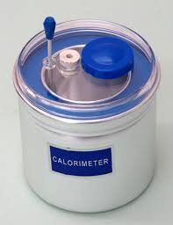
Determination the heat of chemical reaction
Since we cannot know the exact enthalpy of the reactants and products, we measure ΔH through calorimetry, the measurement of heat flow. Two calorimetry can be used:
1- Constant-pressure calorimetry
2- Constant-volume calorimetry

Slide 68
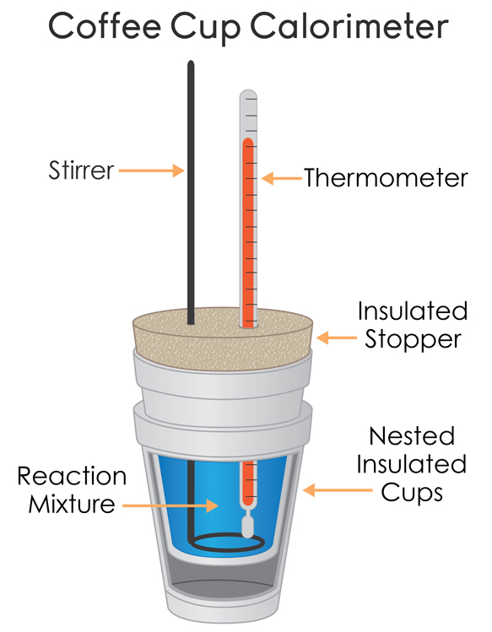
1- Constant-pressure calorimetry
A constant-pressure calorimetry is used in determining the change in enthalpy equals the heat (∆H = q_{p} = q_{reaction} = q_{rxn} ). By carrying out a reaction in aqueous solution in a simple calorimeter
q_{reaction}= − q_{calorimeter}
which can indirectly measure the heat change for the system by measuring the heat change for the water in the calorimeter. Because the specific heat for water is well known (4.184 J/g.K), we can measure ΔH for the reaction with this equation:
q_{P} = m × C_{S} × ∆T

Slide 69
Example
Physical change:
11- A 155 g piece of a certain metal was heated to 120 ºC and then plunged in a constant pressure coffee-cup calorimeter, containing 250 g of water at 22 ºC. The temperature of the system became 28 ºC. Assuming that there was no heat energy transferred to the surrounding and knowing that the specific heat of water is 4.184 J/g.ºC. Calculate (in J/g.ºC) the specific heat of this metal?

Slide 70
Chemical change
12- When 1.00 L of 1.00 M Ba(NO₃)₂ solution at 25.0 ºC is mixed with 1.00 L of 1.00 M Na₂SO₄ solution at 25 ºC in a calorimeter, the white solid BaSO₄ forms and the temperature of the mixture increases to 28.1 ºC. Assuming that the calorimeter absorbs only a negligible quantity of heat, that the specific heat capacity of the solution is 4.18 J/g.K and that the density of the final solution is 1.0 g/mL, calculate the enthalpy change per mole of BaSO₄ formed

Slide 71
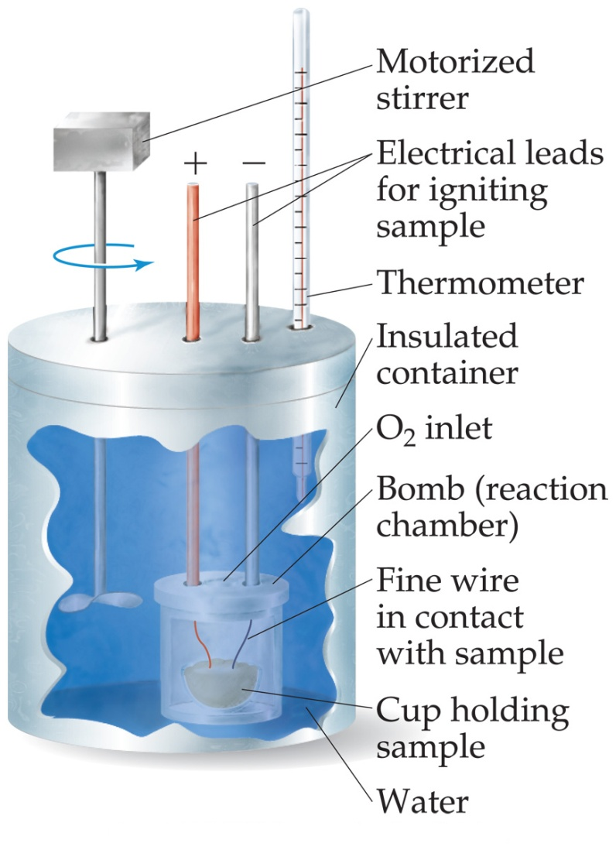
Constant-Volume Calorimetry (Bomb Calorimetry)
The heat absorbed (or released) by the water is a very good approximation of the energy change for the reaction. Once the sample is completely combusted, the heat released in the reaction transfers to the water and the calorimeter. The temperature change of the water is measured with a thermometer. Because water and calorimetry absorb heat, then the total heat given off in the reaction will be equal to the heat gained by the water and the calorimeter:
q_{v} = q_{rxn} = - q_{cal}

Slide 72
If the given heat capacity of the calorimeter is including the water inside it, then the following equation can be used to find the q_{rxn}:
q_{rxn} = -q_{cal}
q_{rxn} = - C_{cal}∆T
Where C_{cal} is the heat capacity of the used calorimeter in kJ/K or J/K units

Slide 73
But, if the given heat capacity of the calorimeter is excluding the water inside it, then the following equation can be used to find the q_{rxn}:
q_{rxn} = -(q_{water} + q_{cal})
q_{rxn} = - [(m_{water} × Cs_{water} × ΔT) + (C_{cal} × ΔT)]
q_{rxn} = - ∆T [(m_{water} × Cs_{water}) + C_{cal}]
where m_{water} is the water mass in g, Cs_{water} denotes the specific heat capacity of the water, and C_{cal} is the heat capacity of the calorimeter.

Slide 74
A bomb calorimeter is used to measure the heat of reaction at constant volume (q_{v}) which is equal to the change in internal energy, ΔU , of a reaction. Thus, the total heat given off by the reaction is related to the change in internal energy (ΔU), not the change in enthalpy (ΔH) which is measured under conditions of constant pressure.
The enthalpy change (ΔH) can be calculated according to the formula:
ΔH = q_{v} + Δn_{g}RT
which Δn_{g} is the change in the number of moles of gases in the reaction.

Slide 75
Example
13- 1.150 g of sucrose goes through combustion in a bomb calorimeter. If the temperature rose from 23.42°C to 27.64°C and the heat capacity of the calorimeter is 4.90 kJ/°C, then determine the heat of combustion of sucrose, (C₁₂H₂₂O₁₁), in kJ per mole of (C₁₂H₂₂O₁₁).

Slide 76
14- To compare the energies of combustion of methane and hydrogen, the following experiment was carried out using a bomb calorimeter with a heat capacity of 11.3 kJ/ºC. When a 1.50 g sample of methane gas was burned with excess oxygen in the calorimeter, the temperature increased by 7.3ºC. When a 1.15 g sample of hydrogen gas was burned with excess oxygen, the temperature increase was 14.3 ºC. Calculate the energy of combustion (per mole) for hydrogen and methane.

Slide 77
Solved Example
15- A piece of 0.865 g of magnesium metal “Mg” is completely combusted in a constant-volume bomb calorimeter containing 1000 g of water.
The heat capacity of the calorimeter alone (excluding the water) is 1.5 kJ / °C.
The molar heat of combustion of magnesium metal is -602.0 kJ / mol
Calculate the temperature rise (in °C) of the calorimeter and its water.

Slide 78
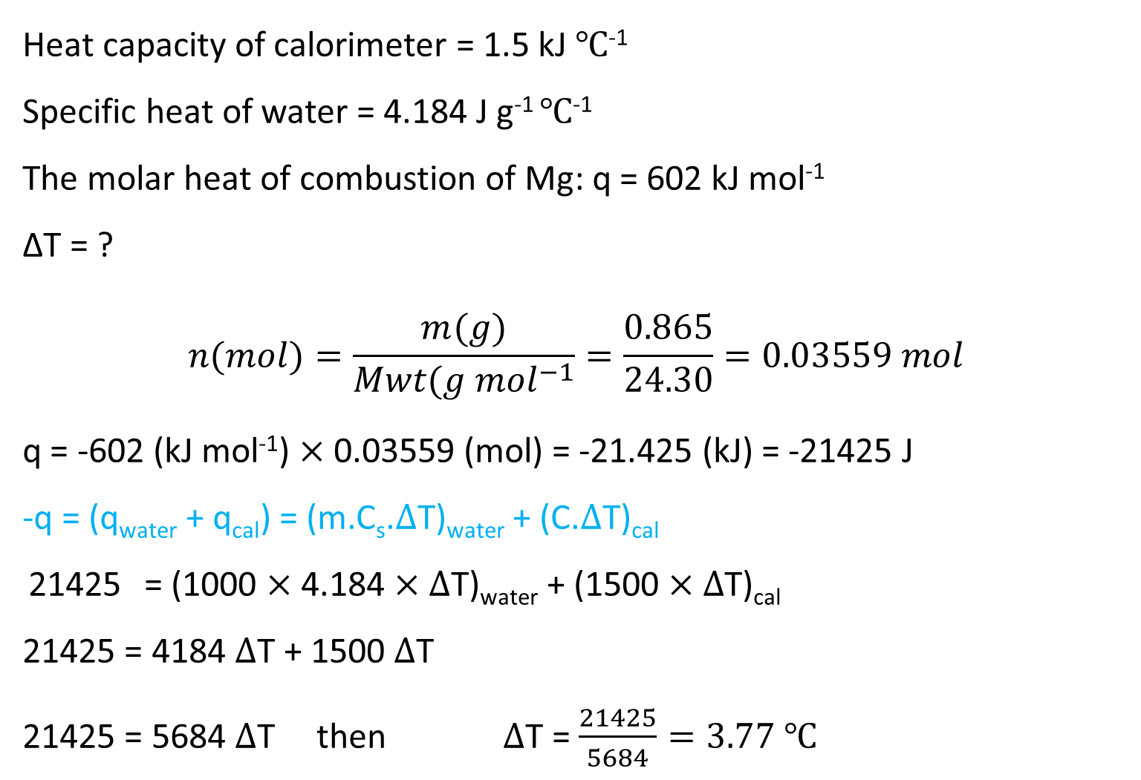
Heat capacity of calorimeter = 1.5 kJ ℃⁻¹
Specific heat of water = 4.184 J g⁻¹ ℃⁻¹
The molar heat of combustion of Mg: q = 602 kJ mol⁻¹
∆T = ?
$$n(mol)=\frac{m(g)}{Mwt(g {mol}^{−1}}=\frac{0.865}{24.30}=0.03559 mol$$
q = -602 (kJ mol⁻¹) $×$0.03559 (mol) = -21.425 (kJ) = -21425 J
-q = (q_{water} + q_{cal}) = (m.C_{s}.$∆$T)_{water} + (C.$∆$T)_{cal}
21425 = (1000 $×$ 4.184 $×$ $∆$T)_{water} + (1500 $×∆$T)_{cal}
21425 = 4184 $∆$T + 1500 $∆$T
21425 = 5684 $∆$T then $∆$T = $\frac{21425}{5684}=3.77 ℃$

