Slide 1
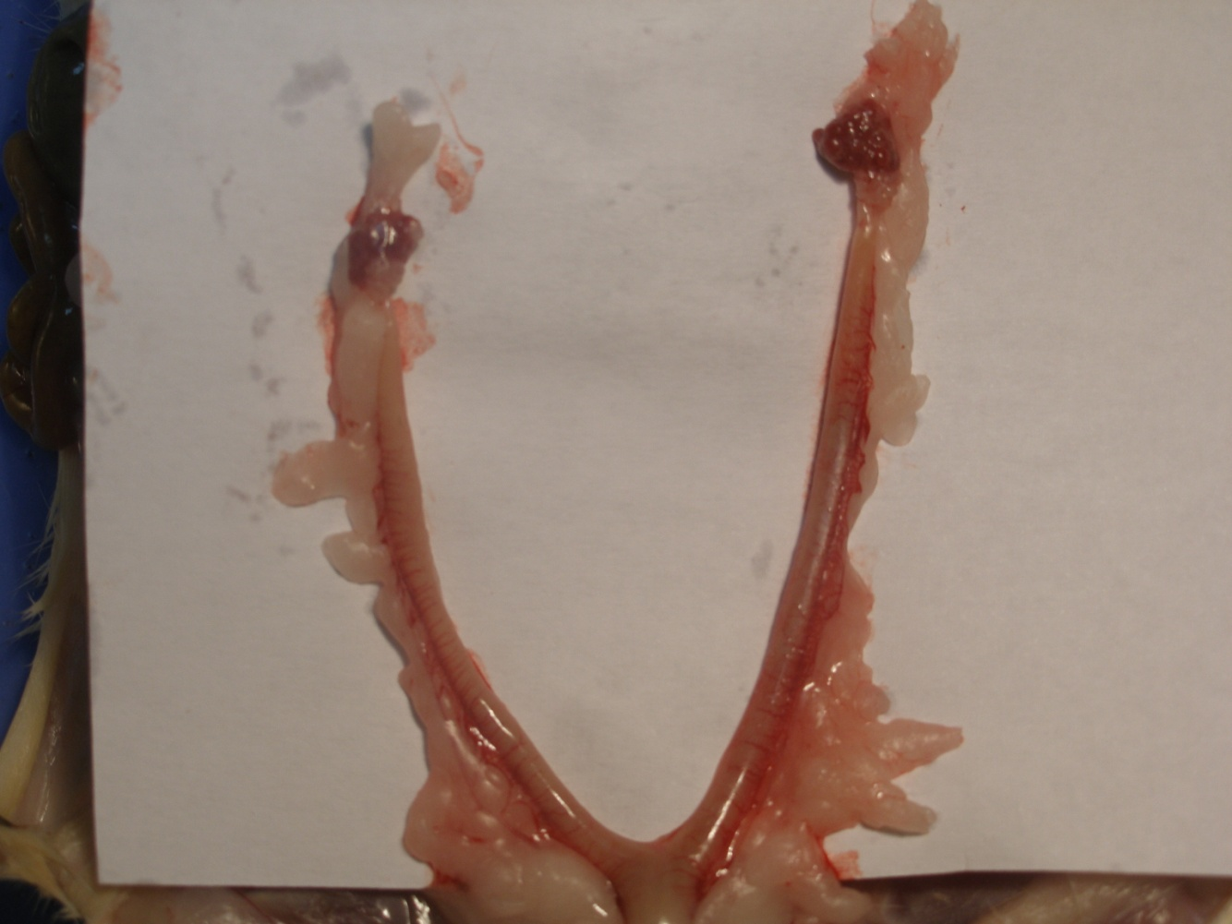
THE female GENITAL SYSTEM OF THE RAT

Slide 2
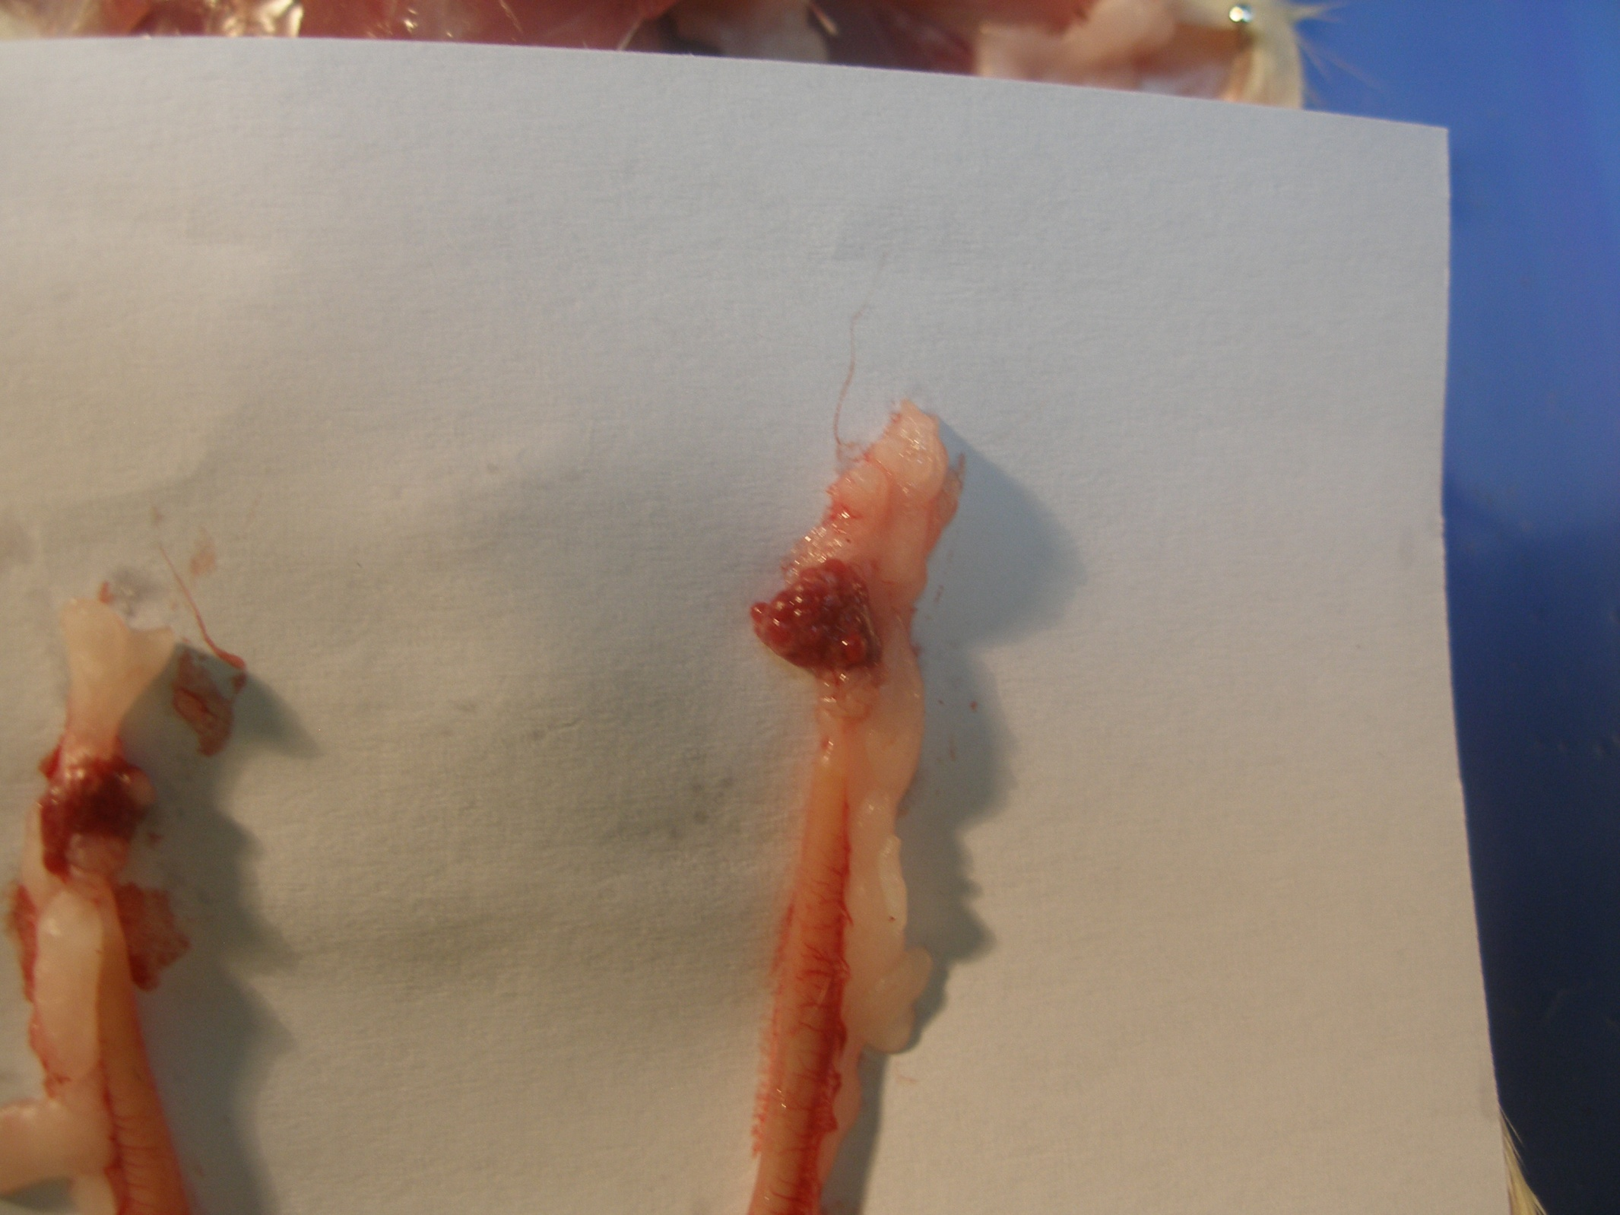
Ovary
Fat

Slide 3
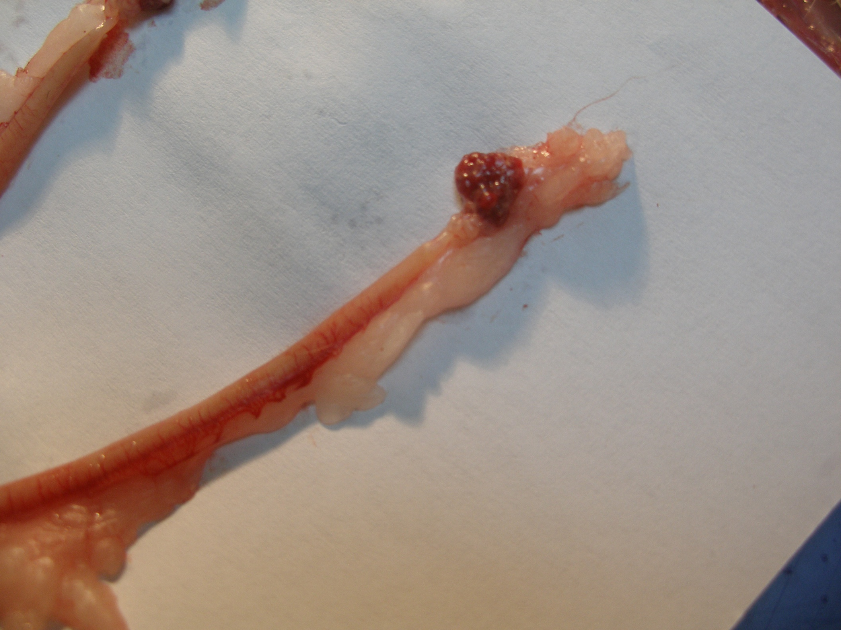
Ovary
Oviduct
Left horn of uterus

Slide 4
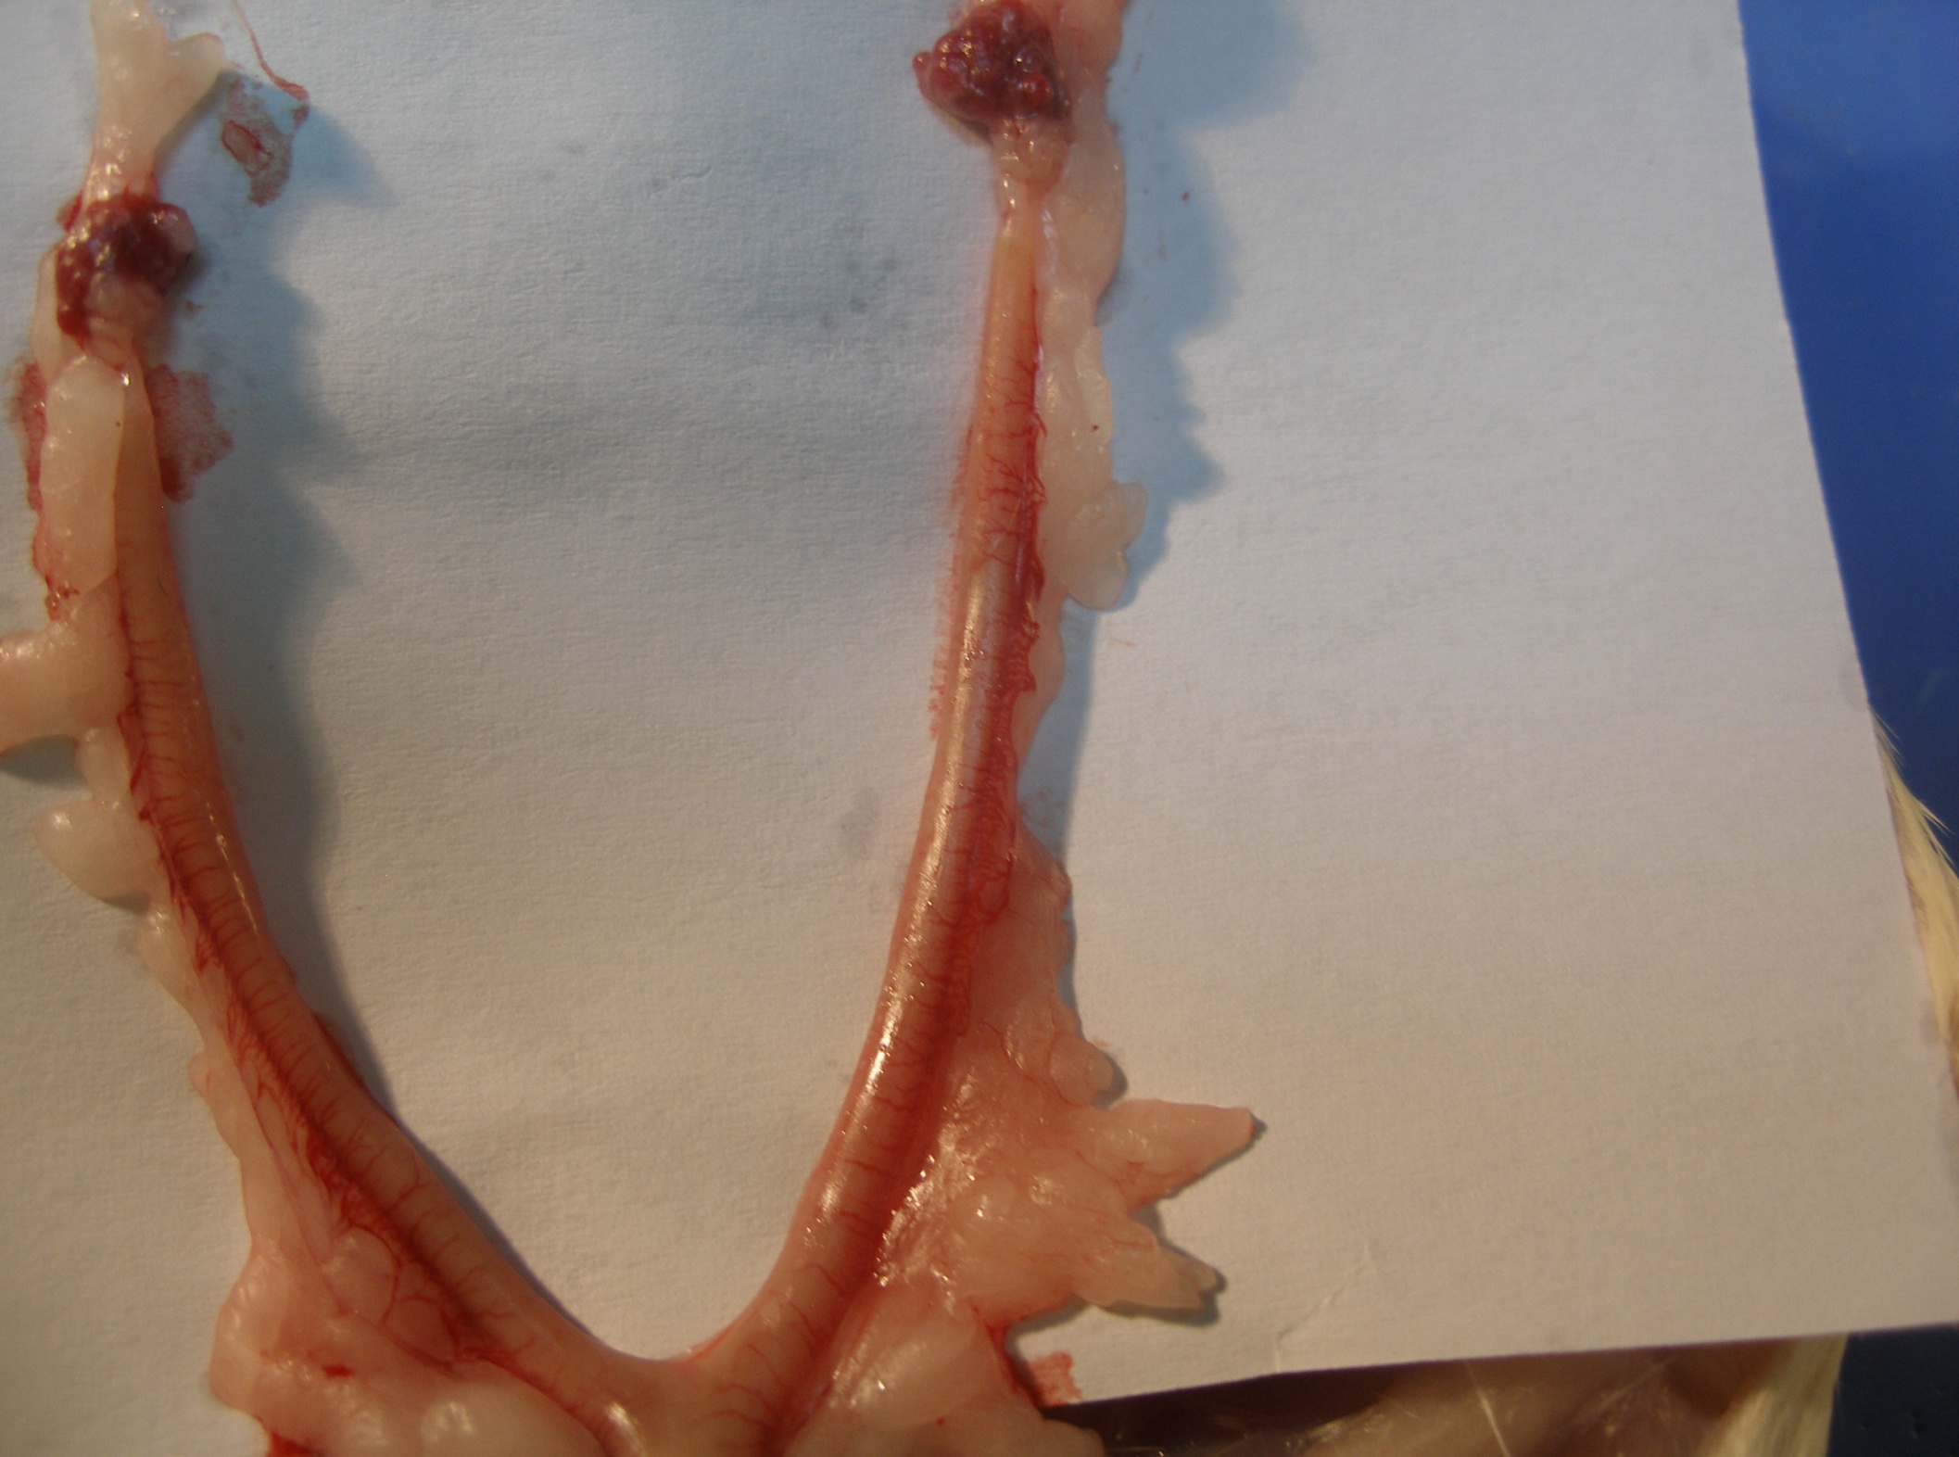
Right Ovary
Left Ovary
Right Oviduct
Left Oviduct
Right horn of uterus
Left horn of uterus

Slide 5
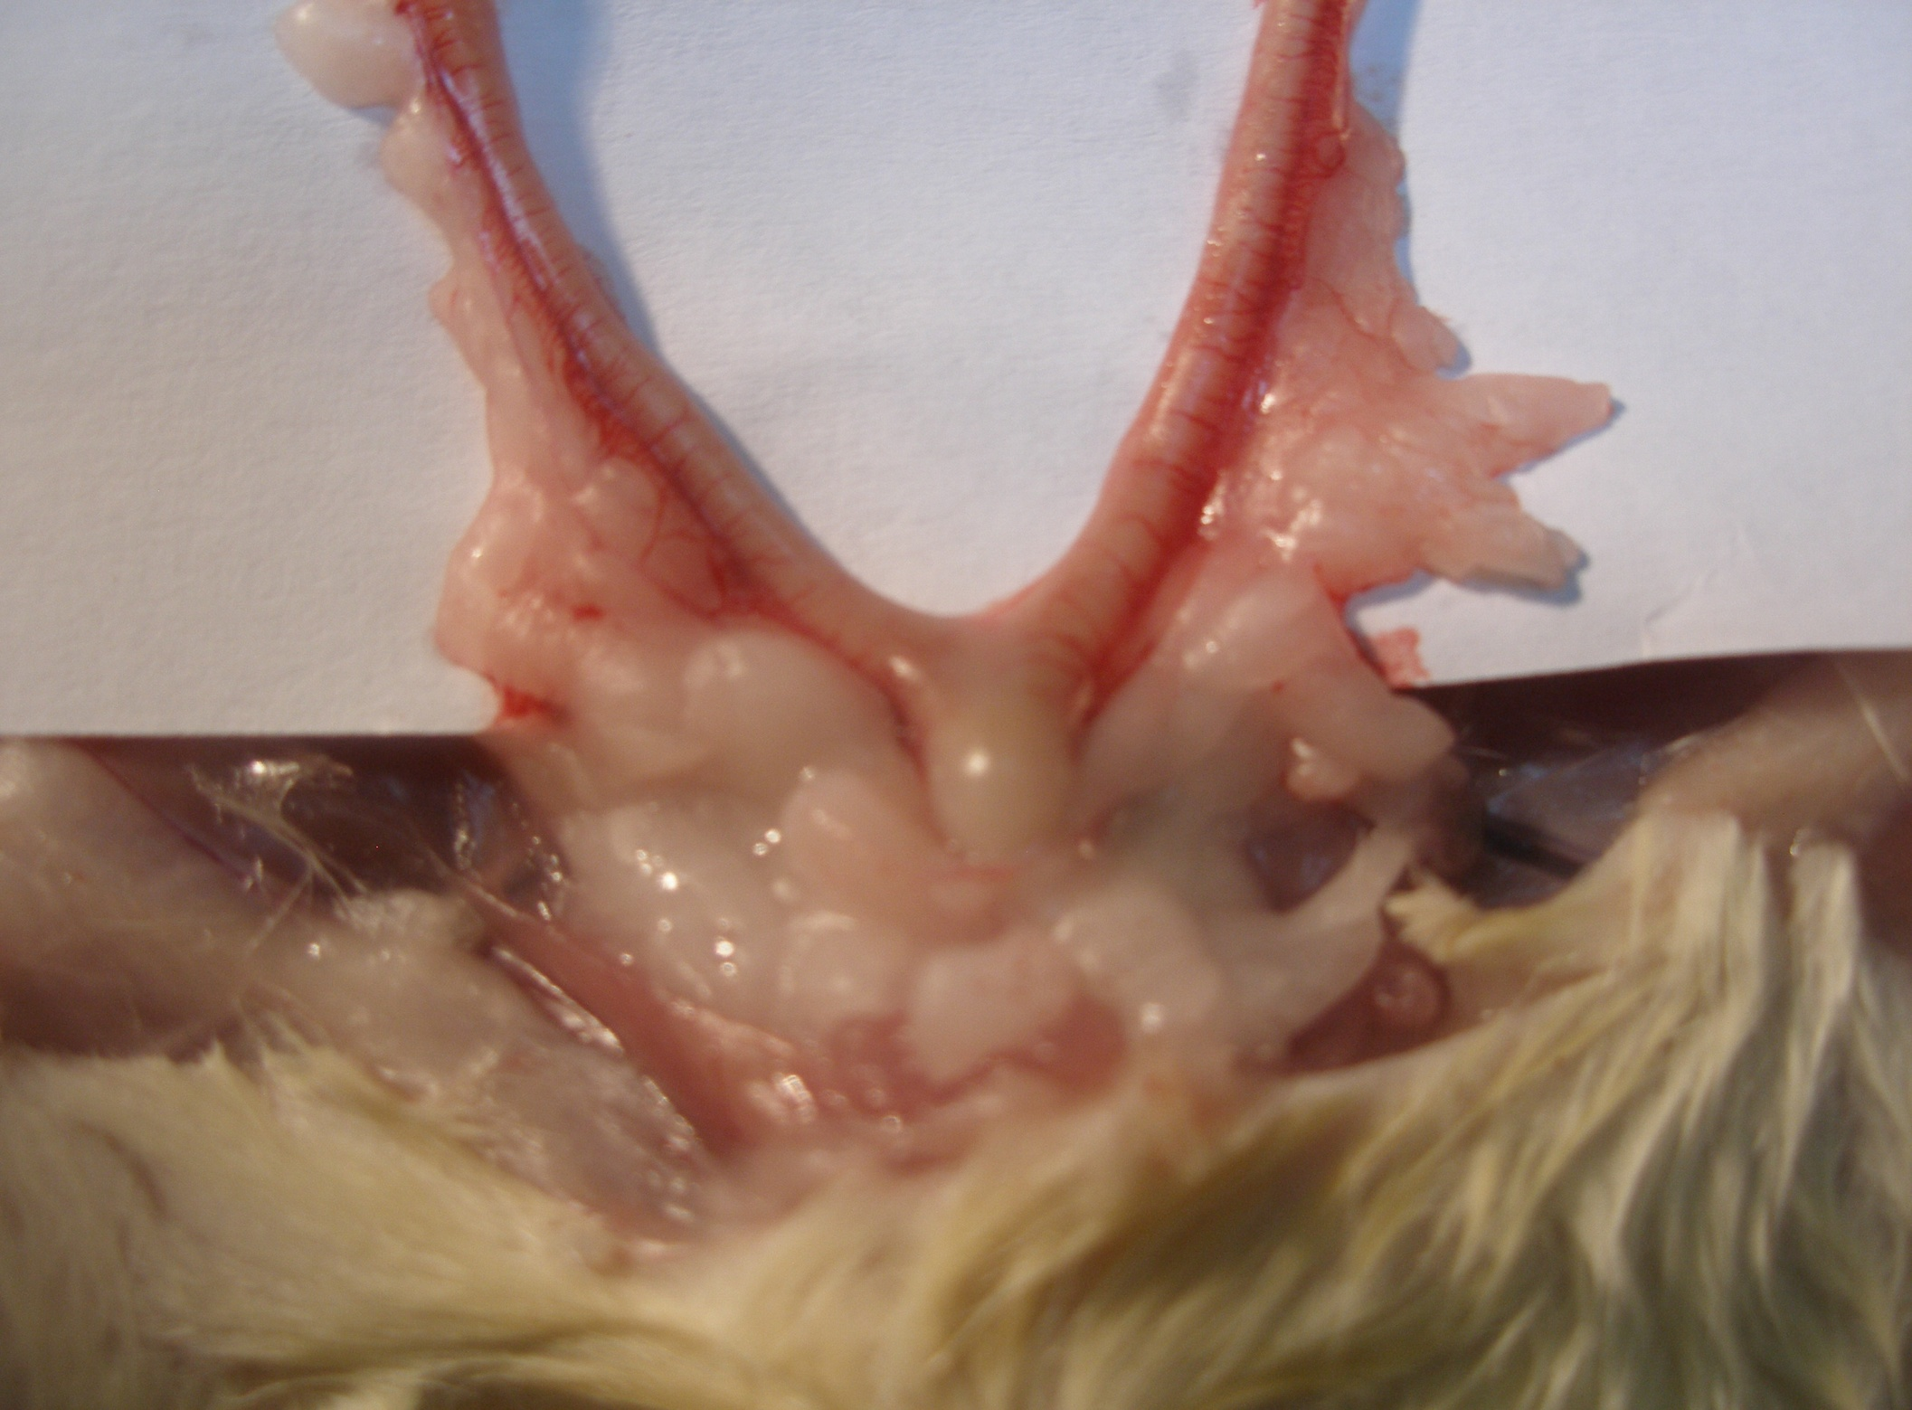
Vagina

Slide 6
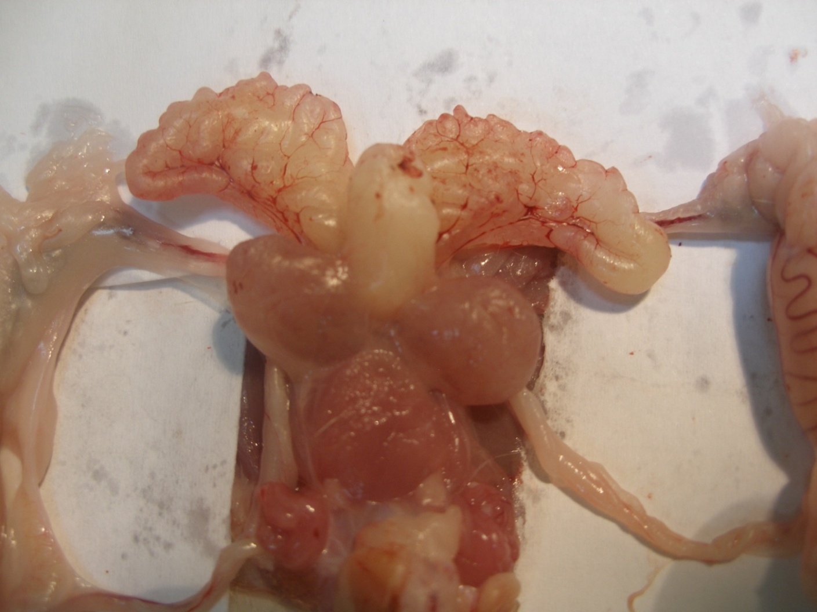
THE MALE UROGENITAL SYSTEM OF THE RAT

Slide 7
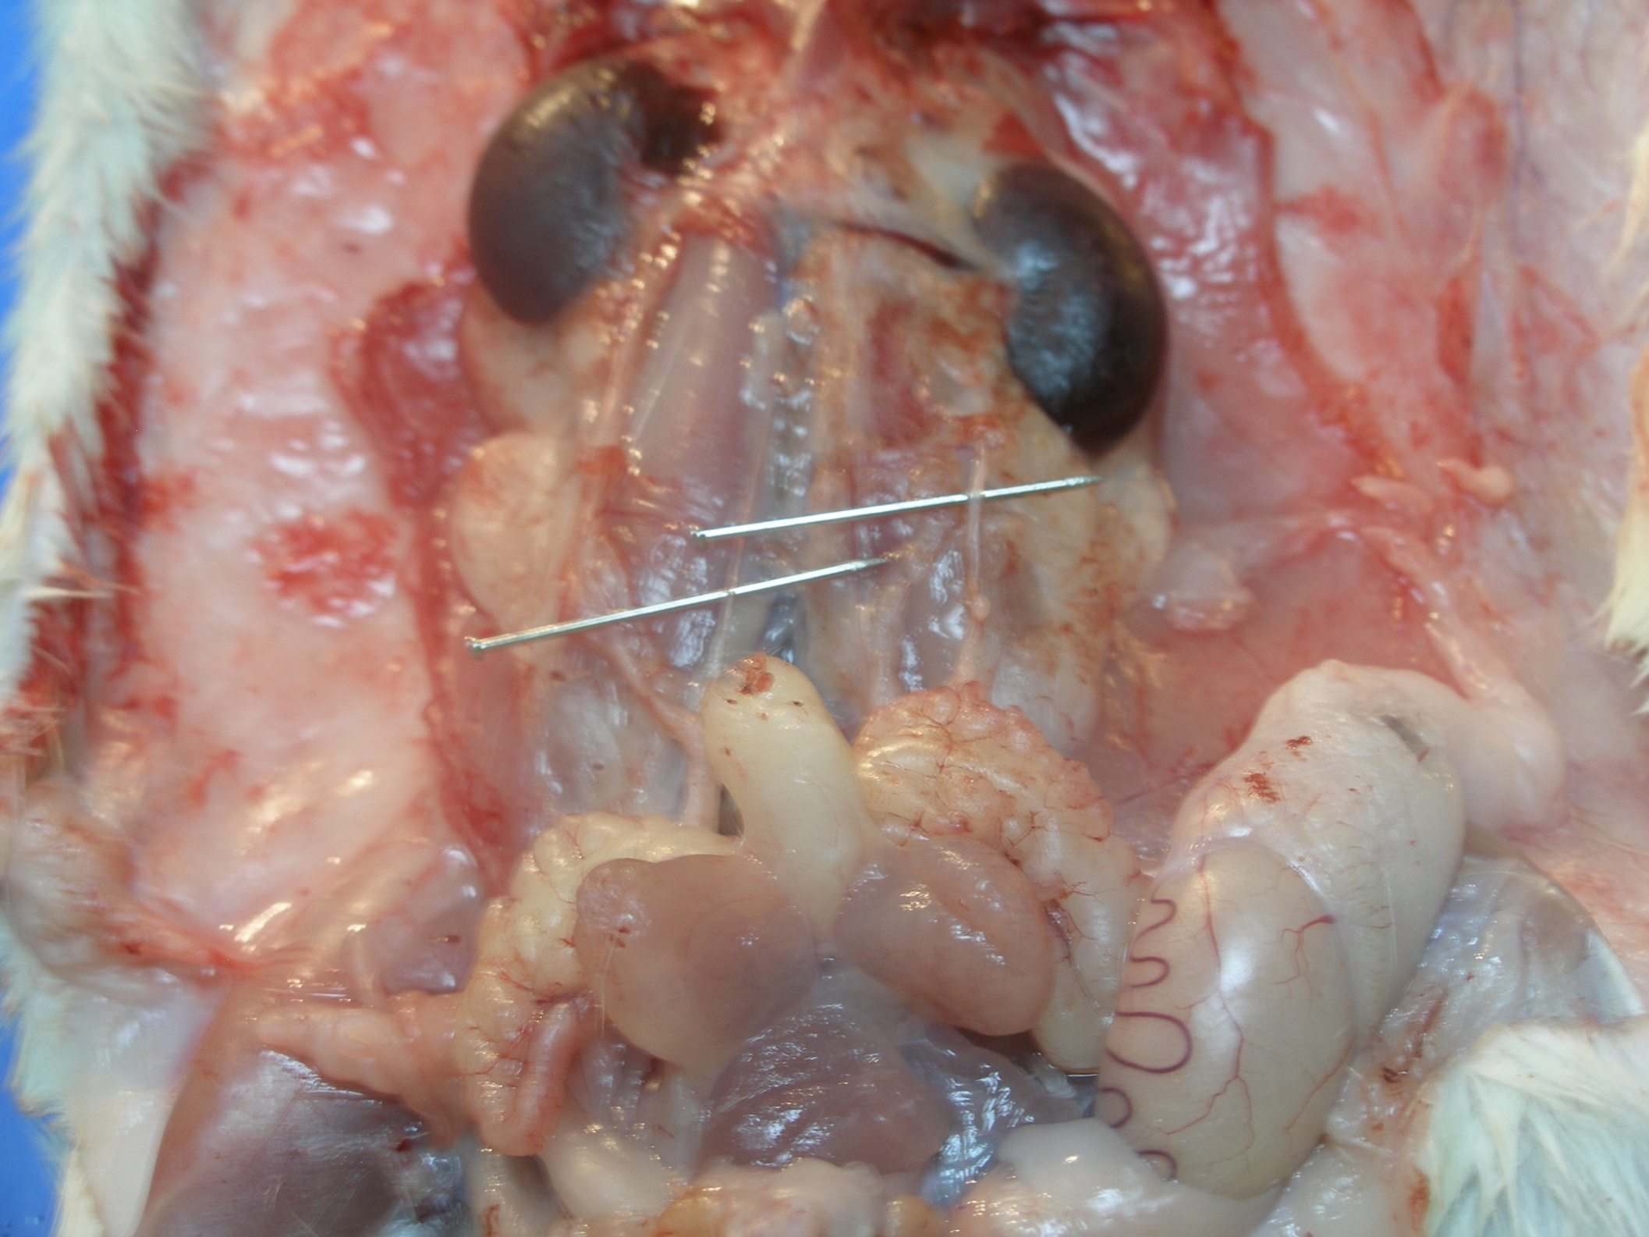
Right kidney
Left Kidney
Right ureter
Left ureter
Urinary bladder

Slide 8
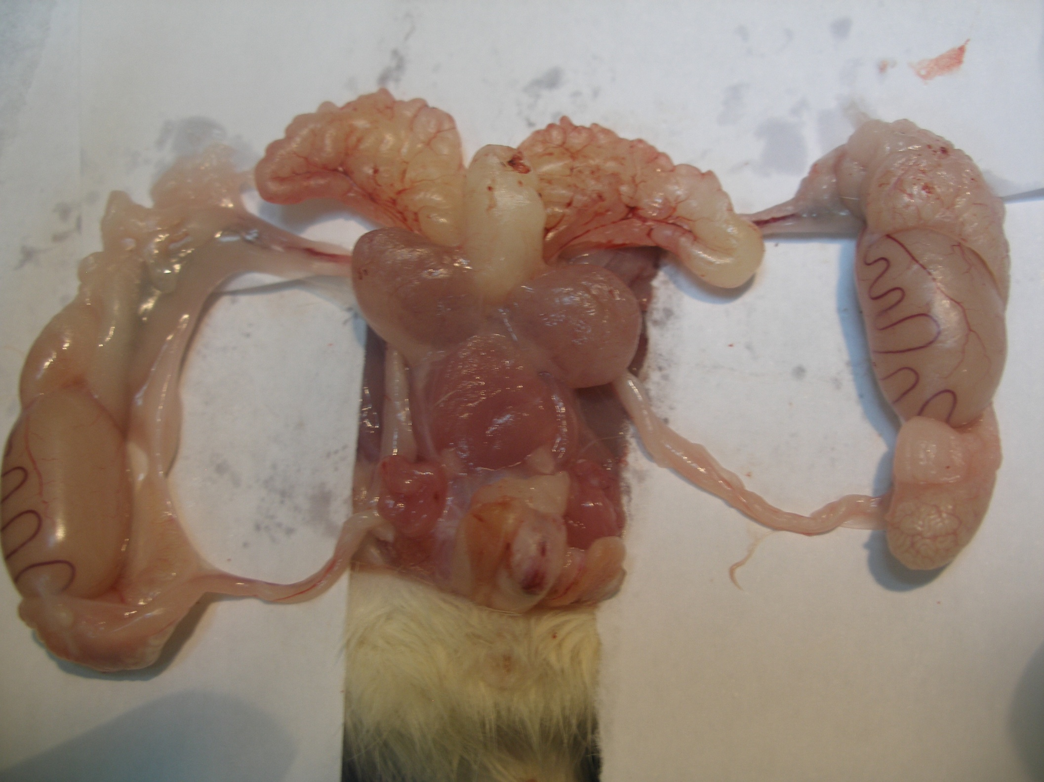
Vesicula seminalis
Caput epididymis
Coagulating gland
Prostate gland
Left Testis
Spermatic cord
cauda epididymis
corpus
Vas deferens

Slide 9
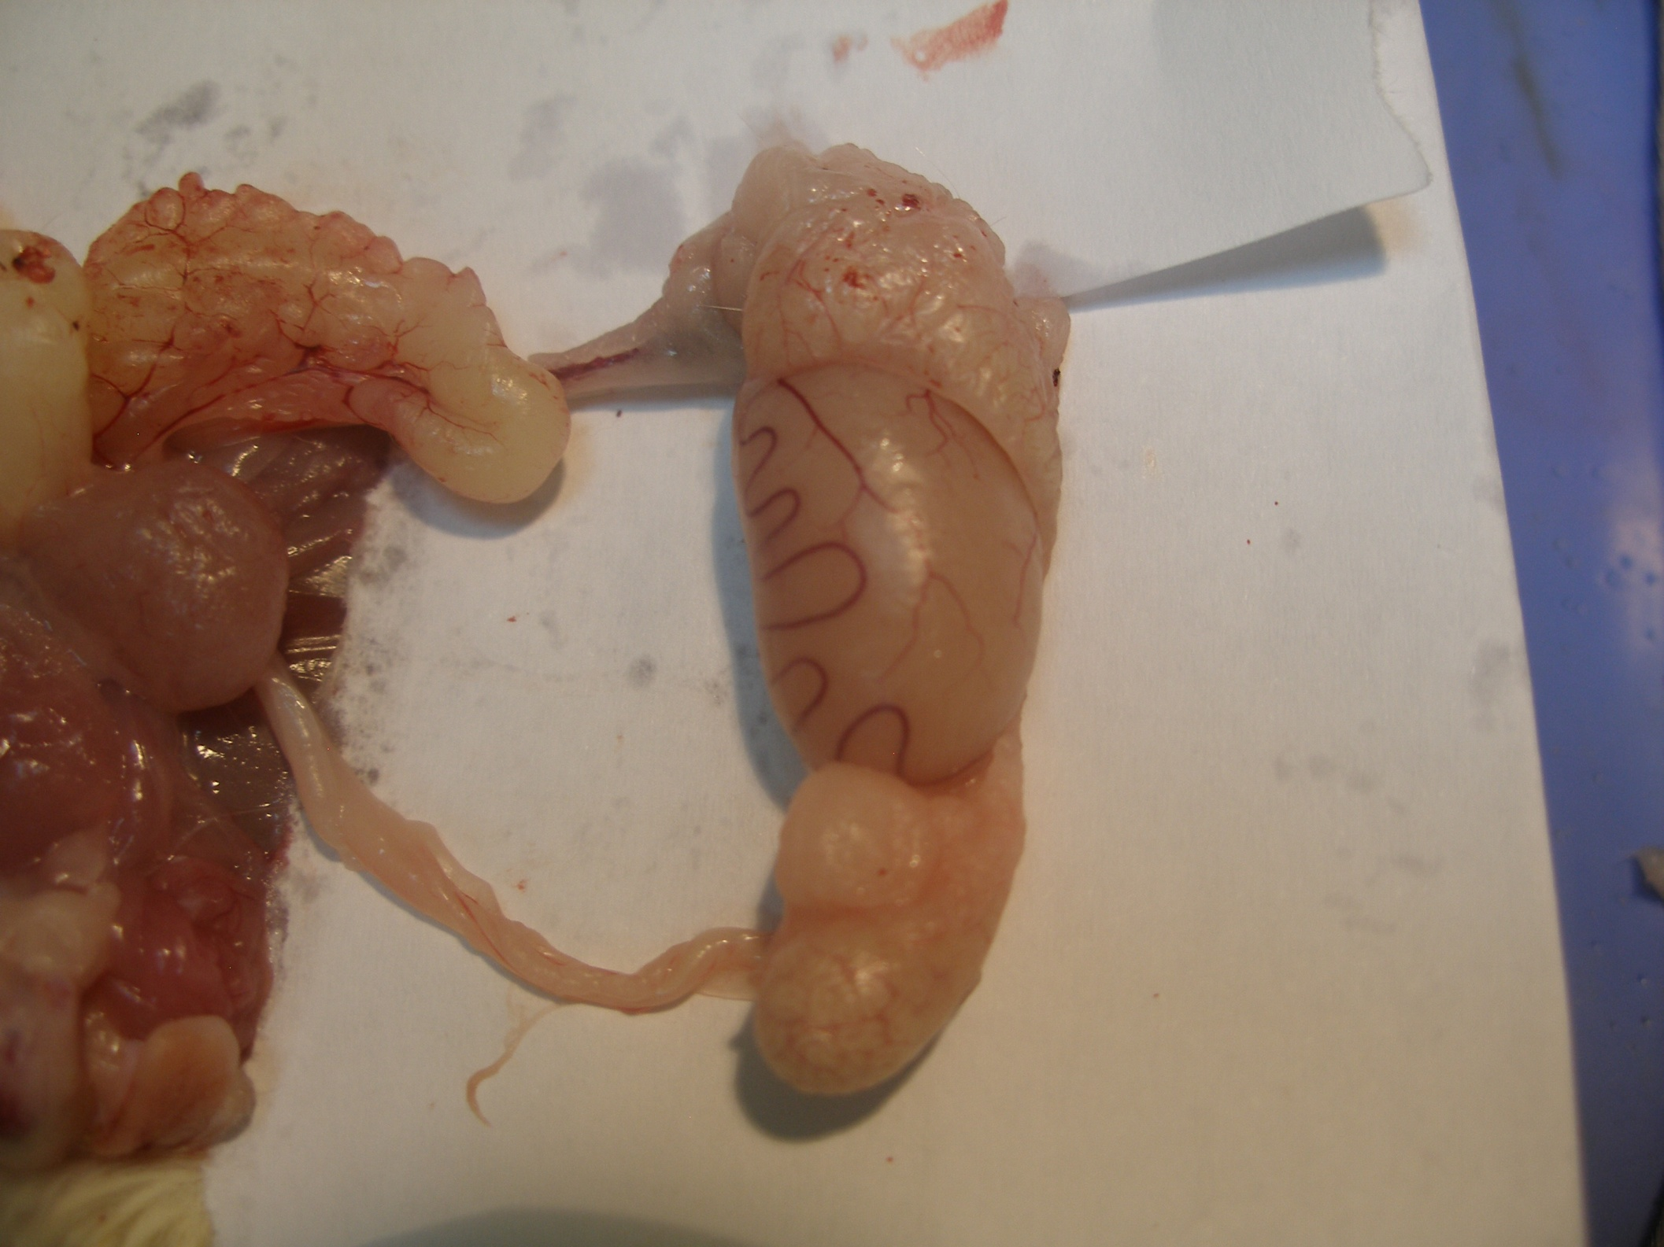
Vesicula seminalis
Spermatic cord
Caput epididymis
corpus
cauda epididymis
Vas deferens

Slide 10
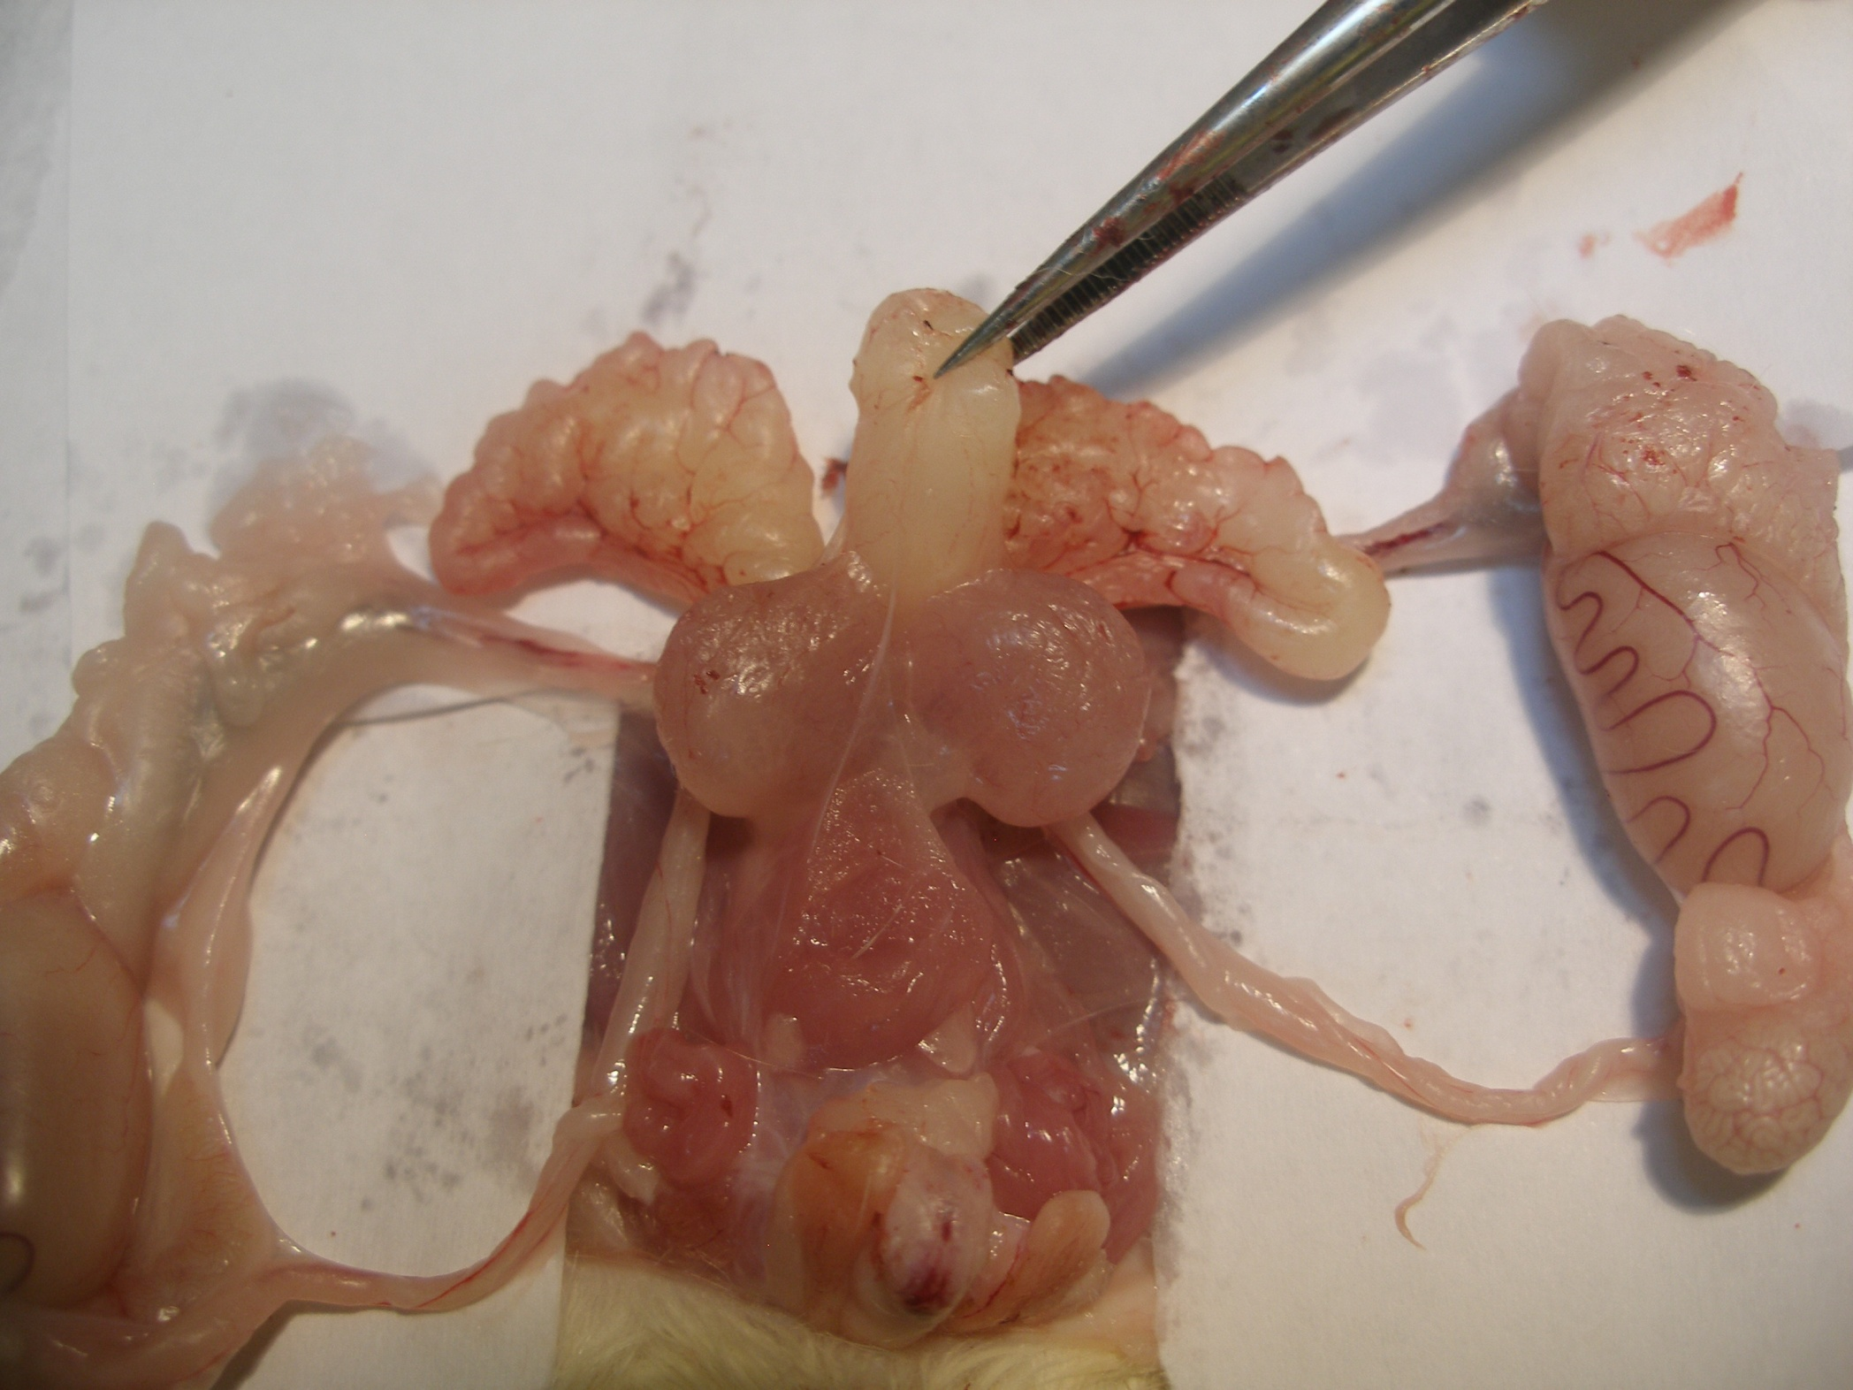
Urinary bladder
Spermatic cord

Slide 11



مع تمنياتنا للجميع بالتوفيق
أ. غادة البشر
أ. جميلة الشمري

