Slide 1

CALVIN CYCLE

Slide 2
1- Riblous 1,5 bisphate carboxylase/oxygenase
2(3-phosphoglycerate ) + 2H+ riblous-1,5-bisphosphate + CO2 + H2O
Reaction of the calvin cycly
CH2OPO3 C O H C OH H C OH CH2OPO3
CH2OPO3 C H HO COO
2- 3-Phosphoglycerate Kinase
3-Phsphoglycerate + ATP 1,3 bisphosphoglycerate + ADP
CH2OPO3 HO C H COO
CH2OPO3 H O C H C OPO3 O
3- NADP:Glyceraldehyde-3-phosphate dehydrogenase
Glyceraldehye-3-phosphate NADP + HOPO3 1,3Bisphosphoglycerate + NADPH + H
CH2OPO3 H O C H C OPO3 O
CH2OPO3 H O C H C H O

Slide 3
4- Triose phosphate isomerase dihydroxyacetone-3-phosphate Glyceraldehyde-3-phosphate
CH2OPO3 HO C H C O H
CH2OPO3 C O CH2OH
5- Aldolase
dihydroxyacetone-3-phosphate fructose-1,6-bisphosphate Glyceraldehyde-3-phosphate
CH2OPO3 HO C H C O H
CH2OPO3 C O CH2OH
O3POH2C O OH H H HO CH2OPO3 H OH
6- Fructose-1,6-bisphosphate phosphate
HOPO3+fructose-1,6-bisphosphate Fructose-1,6-bisphosphate + H2O
O3POH2C O OH H H HO CH2OPO3 H OH
O3POH2C O OH H H HO CH2OH H OH
7- Trensketolase
Fructose-1,6-bisphosphate + Glyceraldehye-3-phosphate erythrose-4-phosphate + xylulose-5-phosphate

Slide 4
O3POH2C O OH H H HO CH2OH H OH
CH2OPO3 OH C H C O H
H O C H C OH OH H C CH2OPO3
CH2OH O C H O C H OH H C CH2OPO3
+
+
8- Aldolase
Erythrose-4-phosphate + dihydoxycetone-3-phosphate sedoheptulose-1,7-bisphosphate
H O C H C OH OH H C CH2OPO3
CH2OPO3 C O CH2OH
CH2OPO3 H O OH H H HO HO CH2OH H HO
+
9- Sedoheptulosee-1,7,bisphosphate phosphate
Sedoheptulosee-1,7,bisphosphate + H2O sedoheptulose-7-phosphate + HOPO3
CH2OPO3 H O OH H H HO HO CH2OPO3 H HO
CH2OPO3 H O OH H H HO HO CH2OH H HO
10- Transketolase
Sedoheptulosee-1,7,bisphosphate + glyceraldehyd-3-phosphate riblulose-5-phosphate + xylulose-5-phosphate

Slide 5
CH2OPO3
H O OH
H
H HO
HO CH2OH
H H
CH2OPO3 H O OH H H HO HO CH2OH H HO
CH2OPO3 HO C H C O H
O3POH2C O H H H H OH OH OH
CH2OH C O H O C H H C OH CH2OPO3
+
+
11- Ribluse5-phosphate epimerase
Xylulose-5-phosphate riblulose-5-phosphate
CH2OH C O H O C H H C OH CH2OPO3
CH2OH C O H C OH H C OH CH2OPO3
12- Ribose-5-phosphate isomerase
Ribose-5-phosphate riblulose-5-phosphate
O3POH2C O OH H H H CH2OPO3 OH OH
CH2OH C O H C OH H C OH CH2OPO3

Slide 6
13- Ribluse5-phosphate KINASE
riblulose-5-phosphate + ATP riblulose-5-phosphate + ATP + H
CH2OH C O H C OH H C OH CH2OPO3
CH2OPO3 C O H C OH H C OH CH2OPO3

Slide 7
The Photorespiratory Carbon Oxidation Cycle

Slide 8
CLOROPLAT
Ribulose-1 5-bisphosphate
3-phosphoglycerate
ADP
O2
(2-1)
(2-10)
ATP
2-phosphoglycolate
Glycerate
H2O
(2-2)
Pi
PEROXISOME
Glycerate
Glycolate
O2
NAD+
(2-3)
(2-9)
H2O2
NADH
Glyoxylate
H4-FOLATE
Hydroxypyruvate
(2-5)
H4-FOLATE
(2-8)
Glycine
MITOCHODRION
Serine
NAD+
(2-6)
H4-FOLATE
H2O
NADH
(2-7)
+
CO2
+
Methylene H4- folate
Glycine
NH3

Slide 9
chloroplast )) 1- Riblous 1,5 bisphate carboxylase/oxygenase
2-phosphoglyceraten+ 3-phosphoglyceraten + 2H+ riblous-1,5-bisphosphate + O2
CH2OPO3
C O
H C OH
H C OH
CH2OPO3
CH2OPO3 C O H C OH H C OH CH2OPO3
CH2OPO3 COO
CH2OPO3 C H HO COO
+
2- 3-Phosphoglycolate phosphatase ( chloroplast )
3-Phsphoglycolate + H2O glycolate + HOPO3
CH2OPO3 COO
CH2OH COO
3- glycolate oxidase ( peroxisome )
glycolate + O2 glyoxylate + H2O2
CH2OH COO
H O C COO

Slide 10
4- Catalas ( peroxisome )
O2 + 2 H2O2 2 H2O
5- glyoxalate : glutamat aminotrasferase ( peroxisome )
α-ketoglutrarate glycoxalate + glytomate glycine +
H O C COO
COO C C H C NH2 COO
NH2 H2C COO
COO CH2 C H2 C O COO
+
+
6- glycine decarboxylas ( mitachondrion )
4-folate-H + CO2 + NH3 + methylen glycine + NAD + H4-folate NADH +
NH2 H2C COO
-CH2 – H4 – folate
7- serine hydroxymethyltransferase ( mitachondrion )
merhylene-H4-folate + H2O + glycine serine + H4-folate
-CH2 – H4 – folate
+
NH2 H2C COO
CH2OH H C NH2 COO

Slide 11
8- serine aminotransferase ( peroxisome )
serine + α-ketoglutarate hydroxypyruvate + glutamate
CH2OH H C NH2 COO
COO CH2 C H2 C O COO
CH2OH C O COO
COO CH2 C H2 O C NH2 COO
+
+
9- Hydroxypyruvate reductase( peroxisome )
NADH + H Glycerate + NAD + hydroxypyruvate
CH2OH C O COO
CH2OH H C H COO
10- Glycerate kinase ( Chloroplast)
ATP 3-Phosphoglycerate +ADP + H + Glycerate
CH2OH HO C H COO
CH2OPO3 HO C H COO

Slide 12
Photosynthetic carbon cycle C4

Slide 13
MESOPHELL CELL
BUNDLE SHESTH CELL
NADP malic enzyme type
oxlaoacetate
(3-2)
malate
malate
(3-4)
HCO3 CO2
(3-1)
CO2
Clavin cycle
Phosohoenol pyruvate
peruvate
peruvate
(3-7)
NADP malic enzyme type
(3-3)
Aspartat
oxlaoacetate
oxlaoacetate
(3-3)
Aspartat
(3-2)
Malate
HCO3 CO2
(3-1)
(3-4)
CO2
Clavin cycle
Phosohoenol pyruvate
Pyruvate
Alanine
Alanine
Pyruvate
(3-7)
(3-6)
(3-6)
Phosphoenopyruvate carboxykinase type
(3-3)
(3-3)
Aspartat
Aspartat
oxlaoacetate
oxlaoacetate
(3-6)
Pyruvate
CO2
HCO3 CO2
(3-1)
Alanine
Pyruvate
Alanine
Clavin cycle
Phosohoenol pyruvate
Phosohoenol pyruvate
(3-6)

Slide 14
1- Phosphoenolpyruvate carboxylase
oxaloacetat + HOPO3 Phosphoenolpyruvate + HCO3
CH2 C O PO3 COO
COO CH2 C O COO
2- NAD : malak dehydrogonase
Malate + NADP oxaloactate + NADPH + H
COO CH2 C O COO
COO C H2 H C OH COO
3- Aspartate aminotransferas
aspartat + Oxalocate + Glutamate
α-ketoglutarate
COO CH2 C O COO
COO CH2 C H2 H C NH2 COO
COO CH2 H C NH2 COO
COO CH2 C H2 C O COO
+
+

Slide 15
4- NAD(p) : malak dehydrogonase
Pyruvate + CO2 + NAPDP + H malate + NADP
COO CH2 H C OH COO
CH2 C O COO
5- phosphoenolpyruvate carboxykinase
Phospoenolpyruvate + CO2 + ADP oxaloacetate + ATP
COO C H2 C O COO
CH2 C O PO3 COO
6- Alanine aminotransferase
alanine + pyruvate + glutamate
α-ketoglutarate
CH3 C O COO
COO CH2 C H2 H C NH2 COO
CH2 H C NH2 COO
COO CH2 C H2 C O COO
+
+

Slide 16
7- Pyruvate-orthophosphate di kinase
PHOSPHOENOLPYRUVATE + AMP + NAPDP + H2P2O7 peruvate + HOPO3 + ATP
CH3 C O COO
CH2 C O PO3 COO

Slide 17
Crassulacean acid metabolism ( CAM )

Slide 18
Darkness
Light
Decarboxylation of stored malate and refixation of intrnal CO2 : deacidication
CO2 uptake and fixtion : leaf acidification
co2
Open stoma permits entry of CO2 and loss of H2O
Closed stoma prevents H2O loss and CO2 uptake
Leaf
epidermis
Leaf
epidermis
HCO3
PI
(3-1)
(3-4)
co2
malate
Phosoenol pyruvate
oxaloacetate
NADPH
(3-2)
vacuole
Calvin cycle
Malic acid
Trios phosphate
NADP
Pyruver
malate
Malic acid
vacuole
starch
starch

Slide 19
chloroplast
ADP Glucose
(5-5)
Glucose-1-phosphate
(5-4)
Glucose-6-phosphate
ATP
PPi
(5-3)
(5-7)
Fructose-6-phosphate
(5-6)
Starch
Calvin cycle
H2O
Pi
(5-2)
Pi
Triose
phsphate
Fructose1,6 bisphosphate
(5-2)
CYTOSOL
(6-1)
Triose
phsphate
(6-3)
Metabolism via glycolysis
Pi
Sucrose
(6-9)
Pi
Fructose1,6 bisphosphate
Sucrose phosphate
Pi
(6-4)
PPi
UTP
(6-8)
UDP Glucose
Glucose-1-phosphate
Glucose-6-phosphate
Fructose-6-phosphate
(6-7)
(6-6)
(6-5)

Slide 20
1- Fructos-1,6-bisphosphate aldolase
Dihydroxyaceton-3-phosphate + glyceraldhyde-3-phosphate fructose1,6bisphosphate
CH2OH C O CH2OPO3
CH2OPO3 HO C H C O H
O3POH2C O H H H HO OH H HO
+
2- Fuctos-1,6-bisphosphate phosphate
Fructose-1,6-bisphosphate + H2O fructose-6-bisphosphate + HOPO3
O3POH2C O OH H H HO CH2OPO3 H HO
O3POH2C O OH H H HO CH2OH H HO
3- Hexose phosphate ispmerase
Fructose-6-bisphosphate + H2O glucose-6-bisphosphate
O3POH2C O OH H H HO CH2OH H HO
CH2OPO3 H O H H OH H HO OH OH H

Slide 21
4- Phosphoglucomutase
glucose-6-phosphate glucose-1-bisphosphate
CH2OPO3 H O H H OH H HO OH OH H
CH2OH H O H H OH H HO OPO3 HO H
5- ADP-glucose pyrophosphophorylase
glucose-1-phosphate + ATP ADP-glucose + H2P2O7
CH2OH H O H H OH H HO OPO3 HO H
CH2OH H O H O O H OH H Adenosine O P P O HO O H HO O - - O
6- Pyrophosphatase
H2P2O7 +H2O 2 HOPO3 + 2 H
7- Starch synthase
ADP-glucose
CH2OH H O H O O H OH H Adenosine O P P O HO O H HO O - - O
CH2OH H O H H OH H OH O HO H
CH2OH H O H H OH H O O HO H
CH2OH H O H H OH H O O HO H

Slide 22
1- Phosphateltriose bisphosphate translocator
Triose phosphate (chloroplast) + HOPO3 (cytosol) triose phosphate (cytosol) + HOPO3 ( chloroplast)
2- triose phosphate ispmerase
Dihydrexyaton-3-phosphate glyceraldehy-3-phosphate
CH2OPO3 HO C H C O H
CH2OH C O CH2OPO3
3- Frouctose 1,6 bisphosphate aldolase
Dihydrexyaton-3-phosphate + glyceraldehy-3-phosphate Frouctose 1,6 bisphosphate
CH2OH C O CH2OPO3
CH2OPO3 HO C H C O H
O3POH2C O H H H HO CH2OPO3 H HO
+
4- Frouctose 1,6 bisphosphate phosphatase
Frouctose 1,6 bisphosphate + H2O Frouctose 1,6 bisphosphate + HOPO3

Slide 23
O3POH2C O H H H HO CH2OPO3 H HO
O3POH2C O H H H HO CH2OH H HO
4a-Ppi-linked phosphoructokinase
Frouctose 1,6 bisphosphate + H2P2O7 Frouctose 1,6 bisphosphate + HOPO3
O3POH2C O H H H HO CH2OH H HO
O3POH2C O H H H HO CH2OPO3 H HO
5- Hexose-phospjate isomerase
Frouctose-6-phosphate glucose-6-phosphate
O3POH2C O H H H HO CH2OH H HO
CH2OPO3 H O H H OH H HO OH OH H

Slide 24
6- phosphoglucomutase
Glucose-6-phosphate glucose-6-phosphate
CH2OPO3 H O H H OH H HO OH OH H
CH2OH H O H H OH H HO OPO3 HO H
7- UDP glucose pyrophosphorylase
Glucose-1-phosphate + ATP UDP-glucose + H2P2O7
CH2OH H O H H OH H HO OPO3 HO H
O O O O Uridine P O P P O O O- O - -O
+
CH2OH H O H O O H OH H Uridine O P P O HO O H OH O - - O

Slide 25
8- Sucrose phosphate synthase
UDP-Glucose + Fuctose-6-phosphate UDP-sucrose6-6phosphate
CH2OH H O H O O H OH H Adenosine O P P O HO O H HO O - - O
O3PO – CH2 O H H H HO CH2OH H HO
CH2OH H O H H OH H HO HO H
+
O3PO – CH2 O O H H HO CH2OH H HO
phosphatase 9- Sucrose phosphate
sucrose6-6phosphate + H2O sucrose6 + HOPO3
CH2OH H O H H OH H HO HO H
CH2OH H O H H OH H HO HO H
O3PO – CH2 O O H H HO CH2OH H HO
O3PO – CH2 O O H H HO CH2OH H HO

Slide 26
Fat synthesis

Slide 30
Proten synthesis

Slide 31
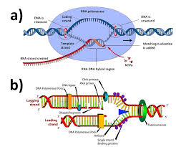
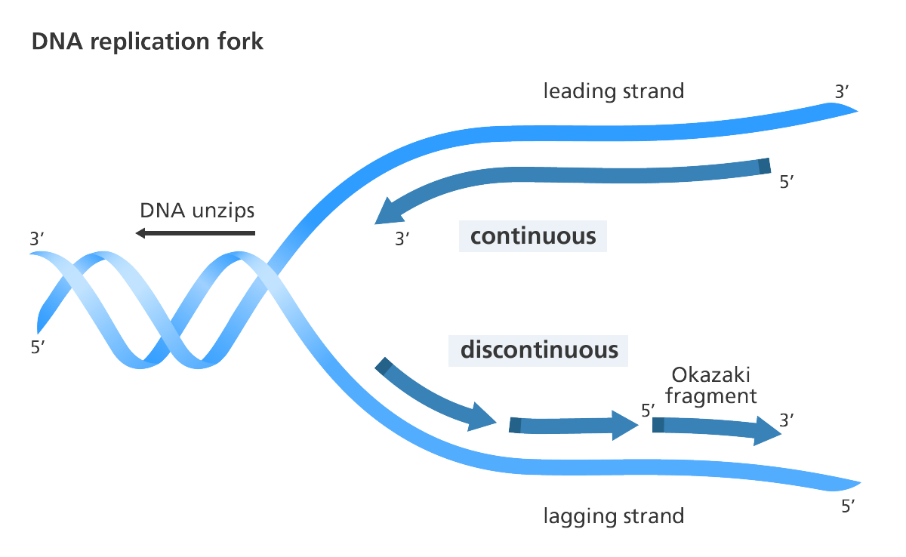
DNA to Proten
تحدث عملية ترجمة الجين إلى بروتين خلال مرحلتين :
1- النسخ Transcreaption (تحدث في النواة وتنتج mRNA ) هي نقل المعلومات الوراثية من أحد شريطي ال DNA إلى شريط RNA
2- يلتحم أنزيم ” بلمره RNA polymerase مع حمض DNA ينفصل شريطا حمض DNA وتنكشف القواعد النيتروجينية

Slide 32
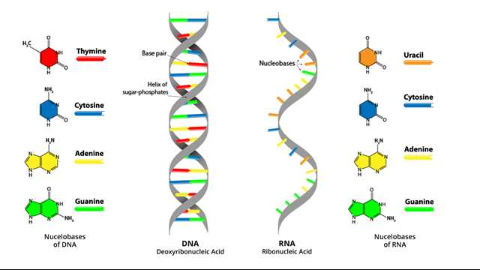
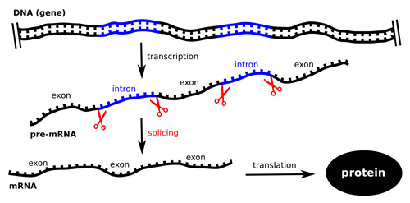
3- يضيف أنزيم RNA polymerase نيوكليوتيدات للقواعد المكشوفة تتبع عملية النسخ نظام ” ازدواج القواعد” U مع A وال C مع G
4- بعد اكتمال عملية النسخ ينفصل الانزيم عن شريط ال DNA تحدث عملية المعالجة ويسمى هنا mRNA حيث انزيمات بازالة Intron وربط Exon مع بعض

Slide 33
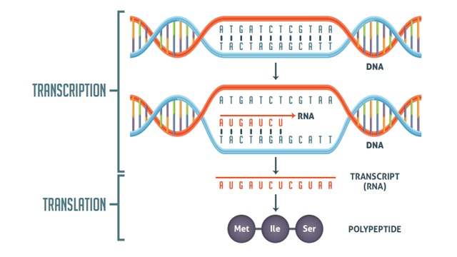
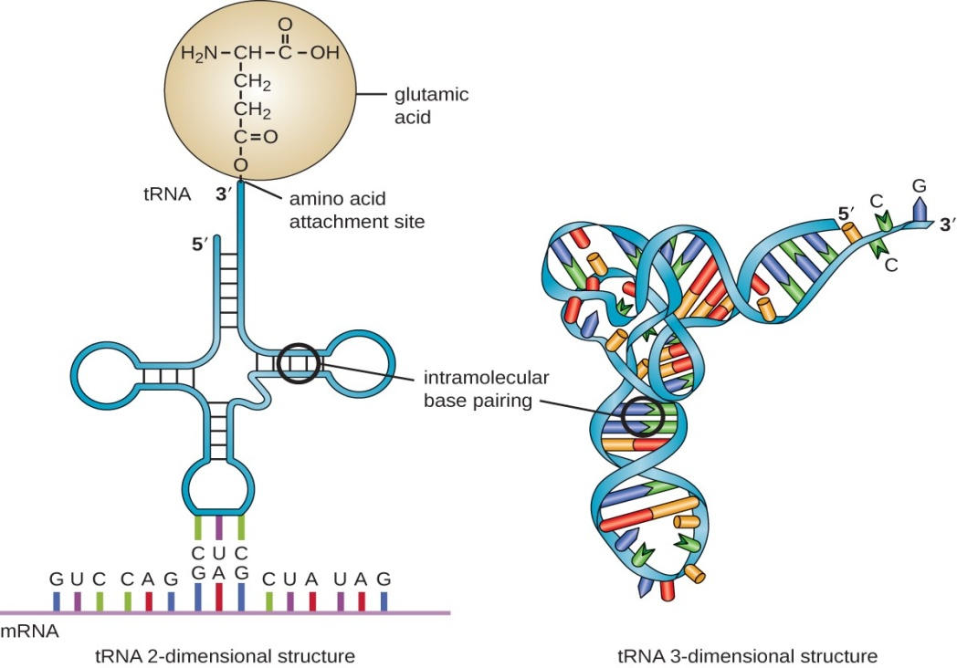
5- الترجمة Translation ( تحدث في السيتوبلازم وتنتج بروتين )
6- يرتبط mRNA بالوحدة الريبوسومية الصغرى عند كودون البدء . يحمل tRNA على احد طرفية الحمض الاميني codon والطرف الاخر مقابل الكودون anticodon يرتبط أول tRNA مع كودون البدء ثم ترتبط الوحدة الريبوسومية الكبرى مع الصغري

Slide 34
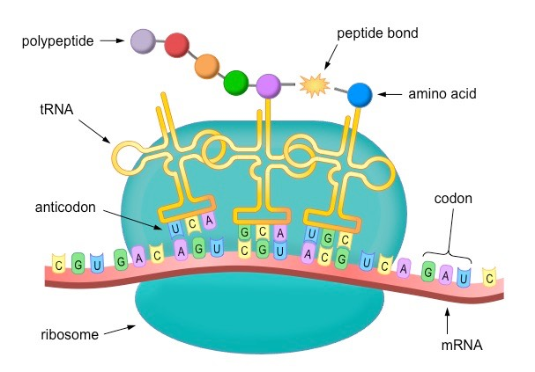
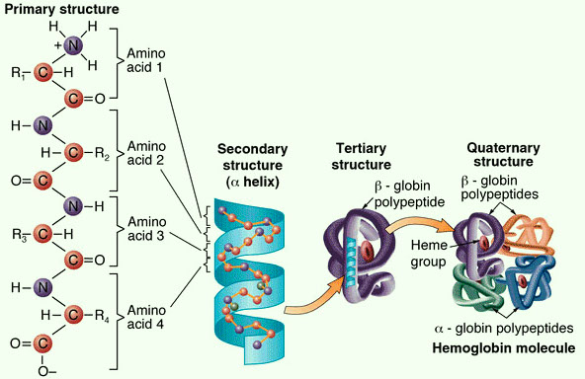
7- يوجد على الريبوسوم موقعين لارتباط ا tRNA ” موقع A وموقع P ” ترتبط الاحماض الامينية ببعضها البعض بروابط ببتيدية تضيف الريبوسومات حمض أميني واحد في وقت واحد إلى سلسلة الببتيد المتنامية. يدفع tRNA الموجود في A إلى P وتستمر العملية إلى أن يصل كودون التوقف إلى الموقع A
8- تنطلق الريبوسومات من الحمض الريبي النووي النقال والببتيد على شكل بروتين . كودون التوقف ليس له مقابل كودون ولا يترجم إلى أي حمض اميني ثم تنفصل الريبوسومات عن بعضها البعض

