Slide 1
Effect of various factors on polyphenol oxidase activity
BCH303 [Practical]

Slide 2
Catalyst:
A substance that speeds up a chemical reaction.
Not consumed in the reaction.
The catalysts for biochemical reactions that occur in the living organisms are called enzymes.

Slide 3
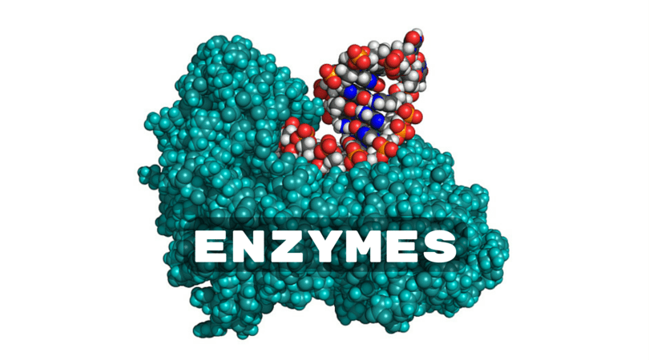
Enzymes:
Highly specialized proteins.
Protein and RNA.
-ase.
Accelerate chemical reactions (INCREASE RATE OF REACTION).
➔ HOW ?

Slide 4
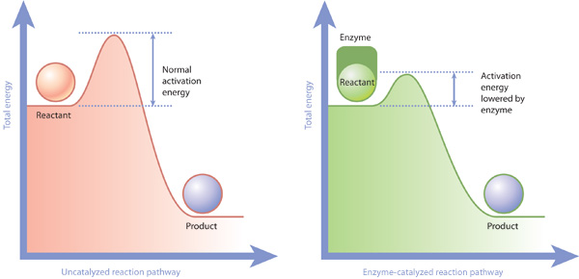
How can enzyme increase the rate of a biochemical reactions ?
Enzymes perform the critical task of lowering a reaction's activation energy.

Slide 5
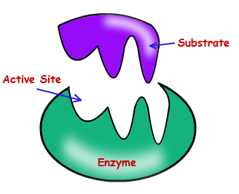
Enzyme active site and substrate:
To catalyse a reaction, an enzyme will bind to one or more reactant molecules. These molecules are the enzyme's substrates.
The distinguishing feature of an enzyme-catalyzed reaction is that it takes place within the confines of a pocket on the enzyme called the active site.

Slide 6
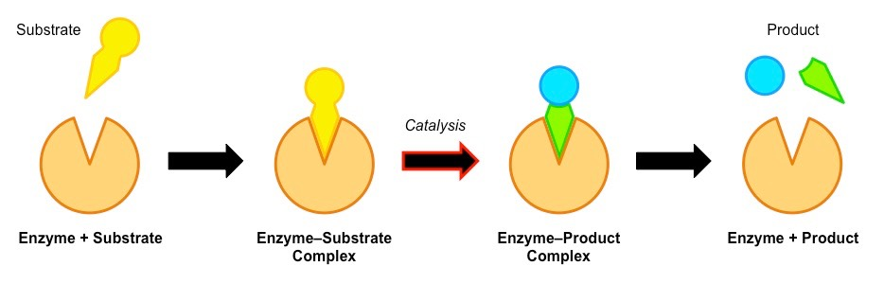
Enzymatic reaction :

Slide 7
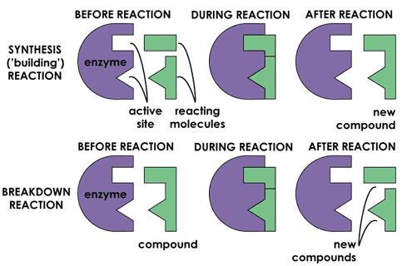

Slide 8
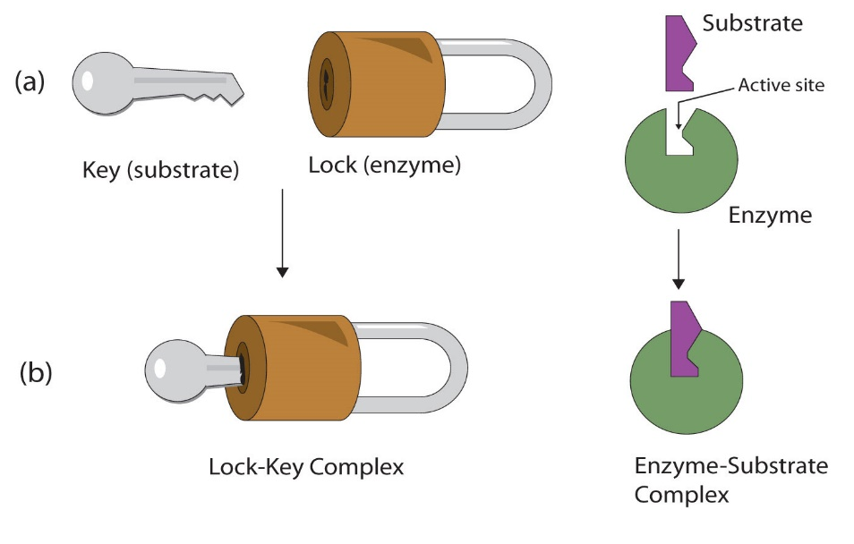
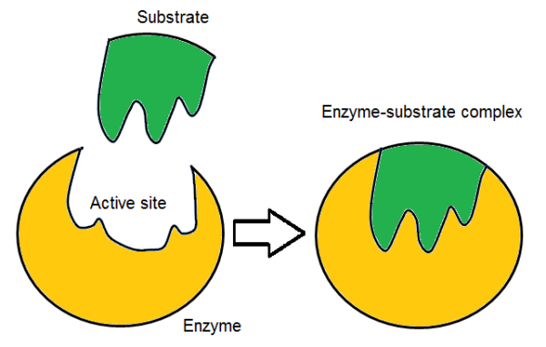
How can substrate bind to the Enzyme?
(1)
(2)

Slide 9
Importance of studying enzymes:
Diseases.
Food.
Agriculture.
Chemical industry.
..etc

Slide 10
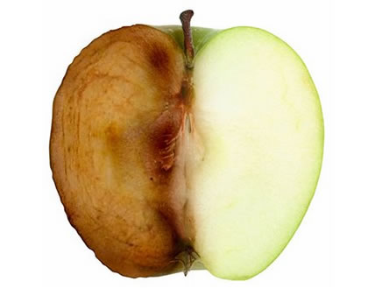
Enzyme browning :
This occurs when the phenolic compounds present in them react with polyphenol oxidase.

Slide 11
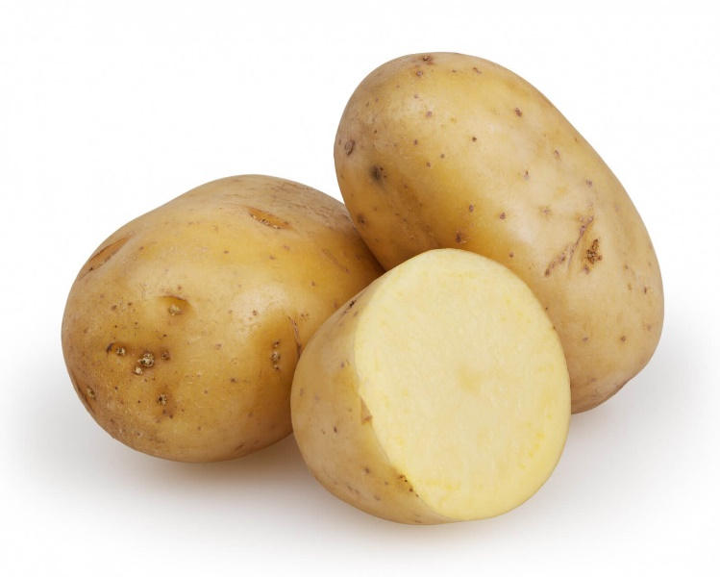
Polyphenol oxidase (PPO):
Is a copper-containing enzyme that catalyse the oxidation of dihydroxy-and trihydroxy phenol to corresponding quinone which has a brown color.
In this lab, activity of polyphenol oxidase extracted from potato will be examined qualitatively.

Slide 12
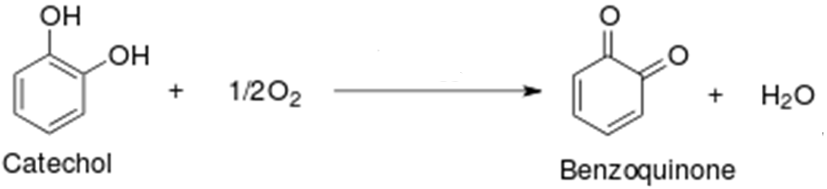
Polyphenol oxidase
بولي فينول أكسيديز
ثنائي هيدروكسي فينول
كينون
لون بني

Slide 13
Practical part

Slide 14
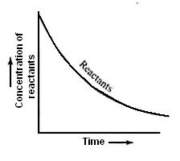
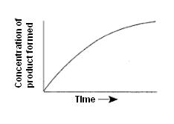
The principle of studying the activity of enzymes in a practical way:
تركيز المواد المتفاعلة
تركيز المواد الناتجة

Slide 15
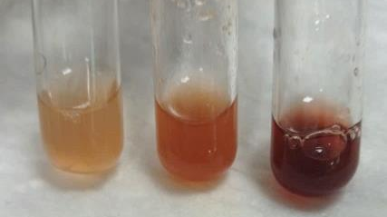
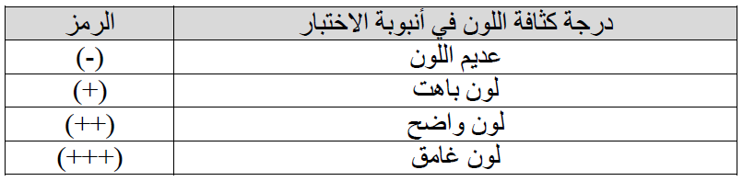

Slide 16
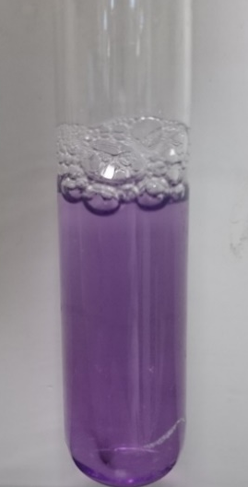
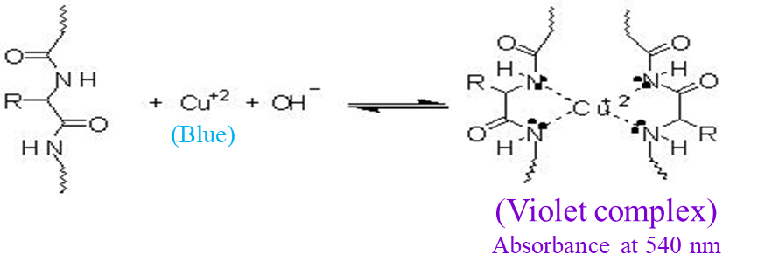
Experiment (1): Examine the protein nature of polyphenol oxidase
Aim:
Examine the protein nature of polyphenol oxidase by biuret test.
Principle:
Notes:
Heating only can’t brake the glycosidic bond, there is should be an acid to act on.
Sucrose is non-reducing :
http://upload.wikimedia.org/wikipedia/commons/1/1c/Reducing_or_non_reducing_sugar.jpg

Slide 17
Experiment (2): Test the activity of polyphenol oxidase
Aim:
To demonstrate activity of the enzyme.
To investigate the effect of incubation time on enzyme activity.
Principle:
Polyphenol oxidase
بولي فينول أكسيديز
Notes:
Heating only can’t brake the glycosidic bond, there is should be an acid to act on.
Sucrose is non-reducing :
http://upload.wikimedia.org/wikipedia/commons/1/1c/Reducing_or_non_reducing_sugar.jpg

Slide 18
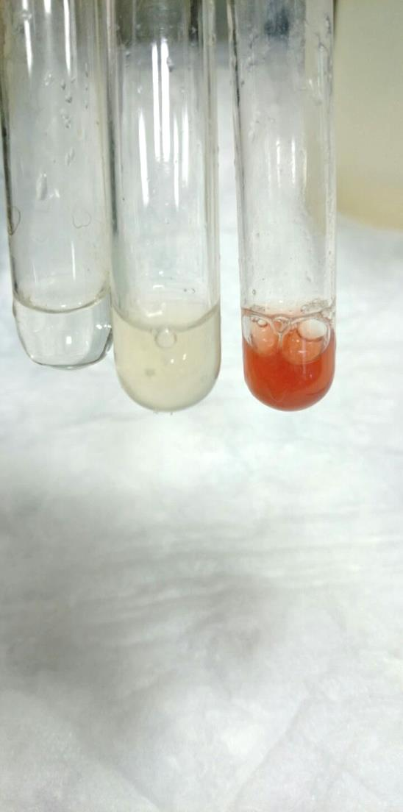
ج
ب
أ

Slide 19
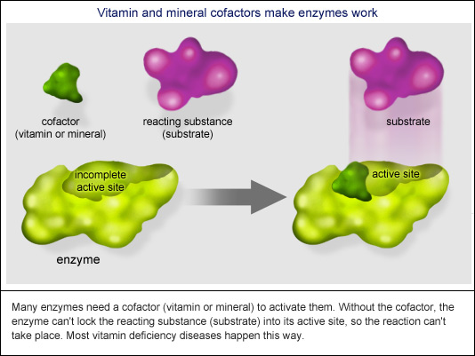
Experiment (3): Demonstrate the chemical nature of polyphenol oxidase
Aim:
To examine the chemical nature of polyphenol oxidase.
Principle:
pH.
Cofactor.
Notes:
Heating only can’t brake the glycosidic bond, there is should be an acid to act on.
Sucrose is non-reducing :
http://upload.wikimedia.org/wikipedia/commons/1/1c/Reducing_or_non_reducing_sugar.jpg

Slide 20
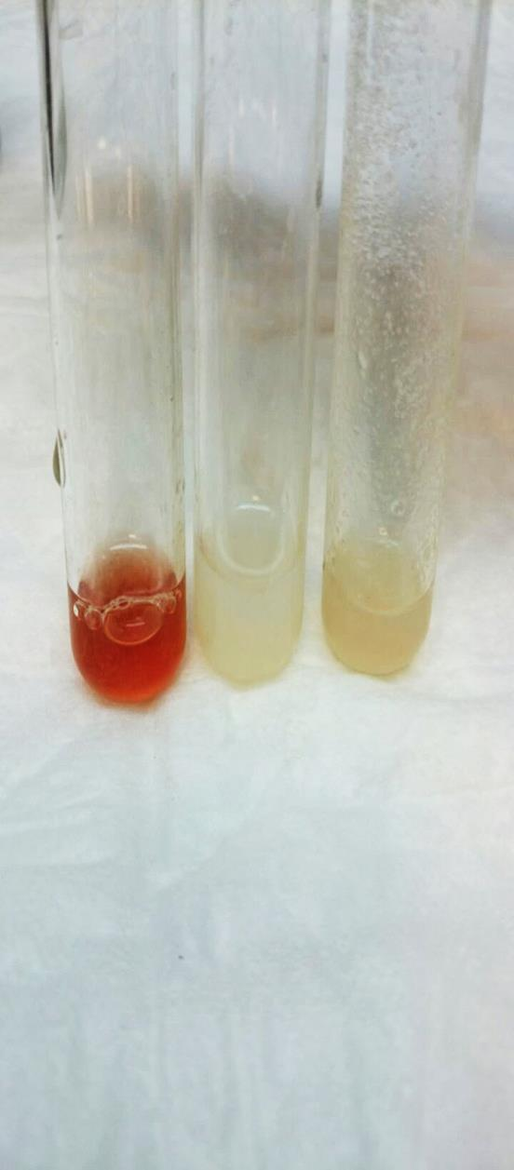
A
B
C

Slide 21
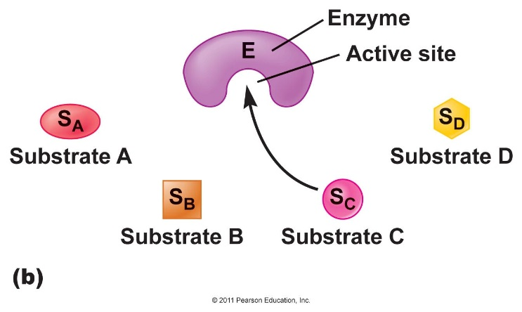
Experiment (4): Investigating the substrate specificity of polyphenol oxidase
Aim:
To investigate the substrate specificity of the enzyme using structurally related chemicals.
Principle:
Notes:
Heating only can’t brake the glycosidic bond, there is should be an acid to act on.
Sucrose is non-reducing :
http://upload.wikimedia.org/wikipedia/commons/1/1c/Reducing_or_non_reducing_sugar.jpg

Slide 22
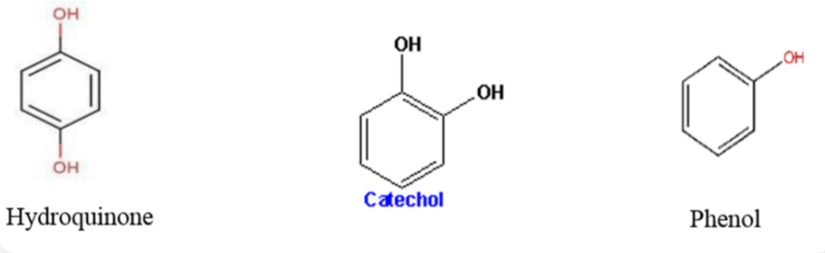
The three compounds (mono-and di-hydroxyl phenol) will be used to find out which one of them is a substrate for PPO.

Slide 24
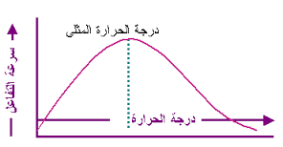
Experiment (5): Investigating the effect of temperature on polyphenol oxidase activity
Aim:
To investigate the effects of temperature on the enzyme activity.
Principle:
37°C
Notes:
Heating only can’t brake the glycosidic bond, there is should be an acid to act on.
Sucrose is non-reducing :
http://upload.wikimedia.org/wikipedia/commons/1/1c/Reducing_or_non_reducing_sugar.jpg

Slide 25
