Slide 1
Lipids-II
BCH202 [Practical]

Slide 2
Classification of Fatty Acids:
Saturated Fatty Acids:
There are no double bonds between carbon atoms in the fatty acid chain.
a) Short chain:
From 4 to 10 Carbon atoms ,and present as liquid in room temperature e.g butyric acid.
b) Long chain:
More than 10 Carbone atoms, present in solid at room temp. e.g. Palmatic (16) acid and Stearic (18) acid.
Single bond only

Slide 3
Classification of Fatty Acids cont’:
Unsaturated Fatty Acids:
Have one or more double bonds between carbon atoms (side chain has at least one double bond).

Slide 4
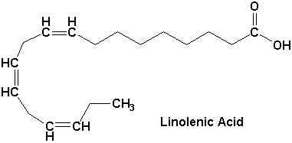
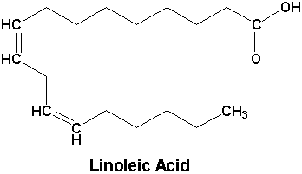
a) Essential Fatty acids:
linolenic acid18-C, 3 double bond (ω-3).
Linoleic acid 18-C, 2 double bond (ω-6).
b) Non-essential Fatty acids:
Can be synthesized in the body: Oleic acid.
2
ω
3
1

Slide 5
Omega-3 fatty acids :
Also called ω-3 fatty acids or n-3 fatty acids.
Are polyunsaturated fatty acids (PUFAs) with a double bond(C=C) at the third carbon atom from the end of the carbon chain.
The fatty acids have two ends, the carboxylic acid (-COOH) end, which is considered the beginning of the chain, thus "alpha", and the methyl (CH₃) end, which is considered the "tail" of the chain, thus "omega."
The way in which a fatty acid is named is determined by the location of the first double bond, counted from the methyl end, that is, the omega (ω-) or the n- end.
2
ω
3
1
Notes:
Polyunsaturated fatty acids are fatty acids that contain more than one double bond in their backbone

Slide 6
Practical Part

Slide 7
Test of lipids:
Copper acetate test: For fatty acids.
Liebermann - Burchard Test: For cholesterol.
Unsaturation Test.
Acrolein test: for glycerol or fats.
1
2
3
4

Slide 8
Experiment 1: Copper acetate test
Objective:
This test is used to distinguish between oil [neutral fat] and fatty acid [saturated and unsaturated].
Principle:
The copper acetate solution does not react with the oils (or fats), while fatty acids [saturated and unsaturated ] react with copper acetate to form copper salt.
Copper salt formed in the case of fatty acids can only be extracted by petroleum ether.
Notes:
Therefore, the key difference between ether and petroleum ether is that ether is an organic compound with a –O- ether linkage, while petroleum ether is a mixture of hydrocarbon compounds.

Slide 9
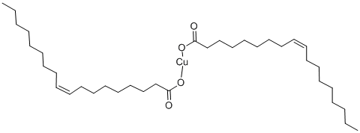
Olive oil: notice that petroleum ether upper lay containing the dissolved oil and appears colorless, aqueous solution remains blue in the bottom.
Oleic acid: the upper layer of petroleum ether becomes green as a result of copper oleate (cupper salt). The lower layer becomes less in blue (become less concentrated).
copper oleate

Slide 11
Experiment 2 : Qualitative estimation of Cholesterol by Liebermann - Burchard Test
Objective:
To detect the presence of cholesterol.
Principle:
Liebermann - Burchard test , is a chemical estimation of cholesterol, the cholesterol is react as a typical alcohol with a strong concentrated acids and the product are colored substances.
Acetic anhydride are used as solvent and dehydrating agents.
Sulfuric acid is used as dehydrating and oxidizing agent.
A positive result is observed when the solution becomes red or pink , then purple , blue, and finally bluish –green color.

Slide 12
Experiment 2 : Qualitative estimation of Cholesterol by Liebermann - Burchard Test
Method:
Dissolve a few crystals of cholesterol in 2 ml of chloroform in a dry test tube.
Now add 10 drops of acetic anhydride.
Add 2 to 3 drops of conc. sulfuric acid.
Repeat the reaction with olive oil.
Results:
Tube | Observation
Olive oil
Cholesterol
Olive oil
(-)
Cholesterol
(+)

Slide 13
Experiment 3: Unsaturation Test
Objective:
Determine the degree of saturation of different types oils.
Principle:
These unsaturated fatty acids become saturated by taking up iodine ➔ If the fat contains more unsaturated fatty acids, it will take up more iodine.
Halogens ( I, Br ) will add across the double bonds and thus the decolorization of an iodine or bromine solution will indicate the presence of unsaturated fatty acids.

Slide 14
Experiment 3: Unsaturation Test
Method:
Equally into 2 flask Add 10 ml of Chloroform then 10 drops of iodine reagent ,the chloroform shows pink color due to presence of iodine.
To one test flask add the oil sample drop by drop shaking the tube vigorously for about 30 seconds after addition of each until the pink color is discharged and count the number of drops. (The pink color is discharged owing to the taking up of iodine by the unsaturated fatty acids of the oil).
Repeat the experiment using butter.
Results:
Tube | Observation
Olive oil
Butter
pink color formed
pink color discharged

Slide 15
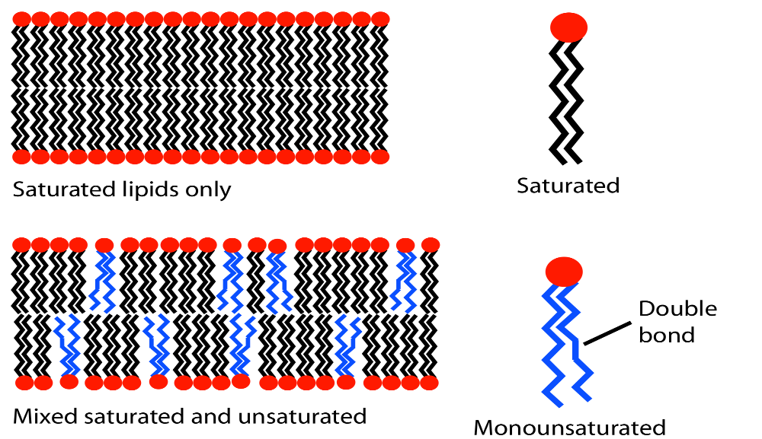
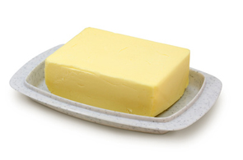
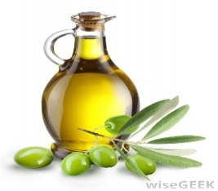
Compare unsaturation , it should be remembered that more the number of drops of the sample (fat) required to discharge the pink color, the less the unsaturation (it is more saturated), because fat contains less unsaturated fatty acids (less double bonds) , it will take up less iodine per drop due to low number of double bonds (so it will need more drops of fat sample to take up all iodine and decolorize the pink color) and vice versa.
There is an inverse relationship between number of fat drops required and number of double bonds.

Slide 16
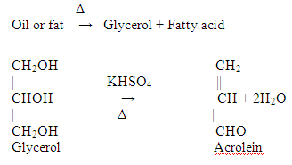
Experiment 4: Acrolein test
Objective:
To detect glycrol or fats (Most lipid are found in the form of triglycerides, an ester formed from glycerol and fatty acids).
Principle:
When a fat is heated strongly in the presence of a dehydrating agent such as KHSO₄ [potassium bisulphate], the glycerol portion of the molecule is dehydrated to form the unsaturated aldehyde, acrolein CH2=CH-CHO.
Which can be distinguished by its irritating acrid smell and as burnt grease.

Slide 17
Another way to detect lipids :
Other way to detect lipids is by dye Sudan IV (general dye for lipid ), which produce red color with lipid.
Its is fat soluble dyes used for biochemical staining of triglycerides, fatty acids, and lipoproteins.
Sudan IV (general dye for lipid )

