Slide 1
Detection and quantitative estimation of proteins by different methods
BCH303 [Practical]

Slide 2
Protein quantification:
The accurate quantitation of protein content is a critical step in protein analysis.
Importance of protein quantification ?
Depending on the accuracy required and the amount and purity of the protein available:
➔ different methods are appropriate for determining protein concentration.

Slide 3
Different methods of protein quantification:
Methods:
Direct assay: measure the absorbance at 280 nm.
e.g. The Warburg–Christian method
2. Colorimetric/fluorescent and reagent-based protein assay: Protein is added to the reagent, producing a color change or increased fluorescence in proportion to the amount added.
The most commonly used reagent-based techniques involve (Colorimetric):
Biuret test.
Bradford test.
Bicinchoninic acid assay (BCA assay).
Lowry test.

Slide 4
Choosing the compatible method:
Best or ideal method ? WHY?
Each method has its advantages and disadvantages.
How to choose the appropriate method?
Compatibility with the sample.
Availability.
Interfering substances .
Accuracy.
Sensitivity.
Time.
….

Slide 5
Choosing the compatible method:

Slide 6


Slide 7
Criteria for choosing an assay:
Therefore, successful use of protein assays involves selecting the method that is:
Most compatible with the samples to be analysed, choosing an appropriate assay standard, and understanding and controlling the particular assumptions and limitations that remain.

Slide 8
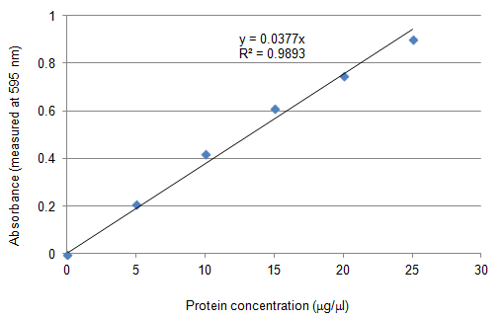
Determination of protein concentration:
Protein concentration is determined by reference to a standard curve consisting of known concentrations of a purified reference protein.
Next lab.
Typically, standard curves of concentration are constructed using at least two replicates for each point on the curve.

Slide 9
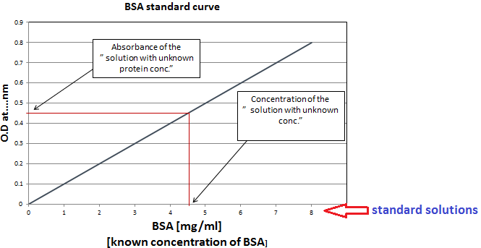
Determination of unknown concentration by standard curve:

Slide 10
Practical part

Slide 11
Experiment 1 : Qualitative detection of proteins by biuret test.
Objective:
To detect the presence of a protein or peptides using biuret test.
Principle:
In this reaction, peptide bonds in the proteins and peptides treated with an alkaline solution of dilute copper sulphate CuSO₄ (biuret reagent) forming a purple coloured complex.
The colour density is proportional to the amount of proteins present.
Two or more peptide bonds.
Name?
Notes:
O || H2N - C - NH - C - NH2 | NH
Description:
Functional Groups: The biuret molecule contains two amine groups (–NH2) and one carbonyl group (C=O).
Peptide Bonds: The connections between the nitrogen and carbon atoms represent the peptide bonds.

Slide 12
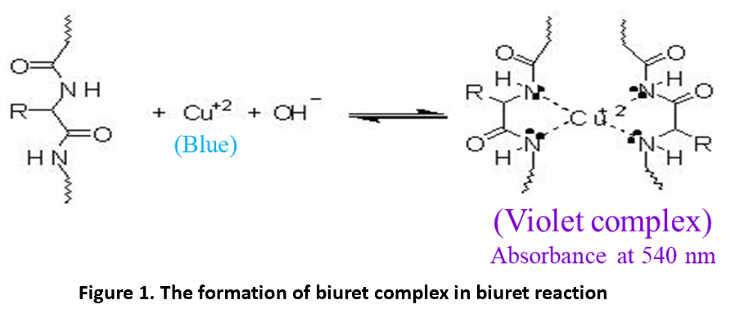

Slide 13
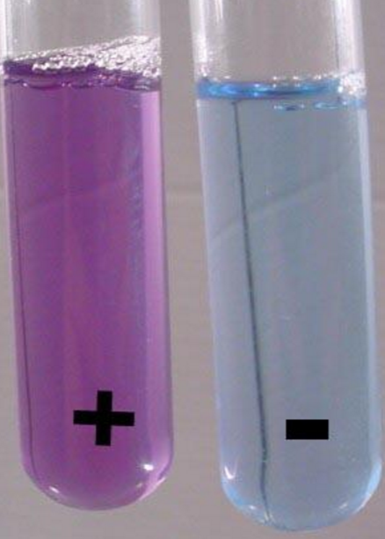
Experiment 1 : Qualitative detection of proteins by biuret test.
Method:
1. Label three test tubes as A and B.
2. In tube A: add 1 ml of animal crude extract.
3. In tube B: add 1 ml of water.
4. Add 1 ml of biuret reagent to all tubes and mix well.
Results:
Blue color is the biuret reagent color
13

Slide 14
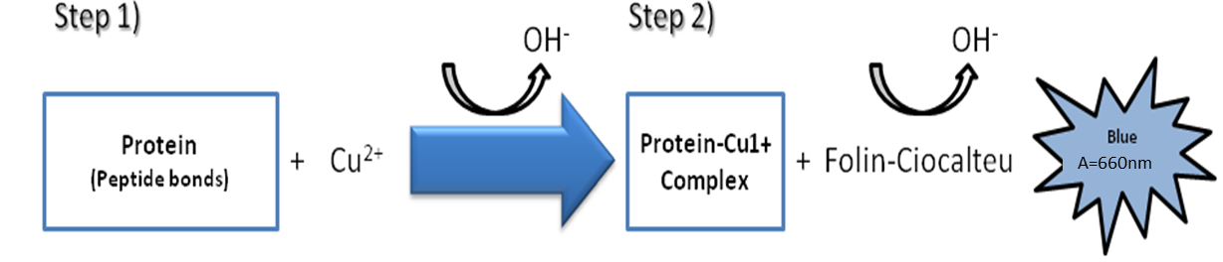
Experiment 2 : Quantitative estimation of proteins by Lowry assay.
Objective:
To determine the concentration of extracted protein by Lowry assay.
Principle:
Replaced by the more sensitive methods.
The method is based on two chemical reactions.
The resultant strong blue colour is partly dependent on the tyrosine and tryptophan content of the protein sample.
Figure 1. Series of reaction on Lowry method.

Slide 15
Experiment 3 : Quantitative estimation of proteins by biuret assay.
Objective:
To determine the concentration of extracted protein by biuret assay.
Principle:
Biuret method is based on copper ions Cu2+ binding to peptide bonds of protein under alkaline condition to give a violet colour that have a maximum absorbance at 540 nm.
The intensity of the color, and hence the absorption at 540 nm, is directly proportional to the protein concentration, according to the Beer–Lambert law.

Slide 17
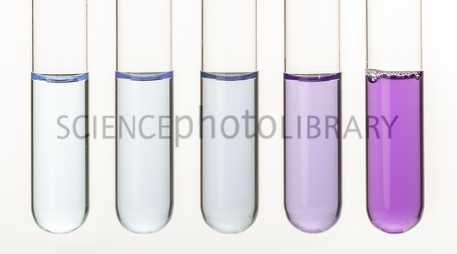
From lower to higher concentration
There is a linear relationship between purple color developed and concentration.

Slide 18
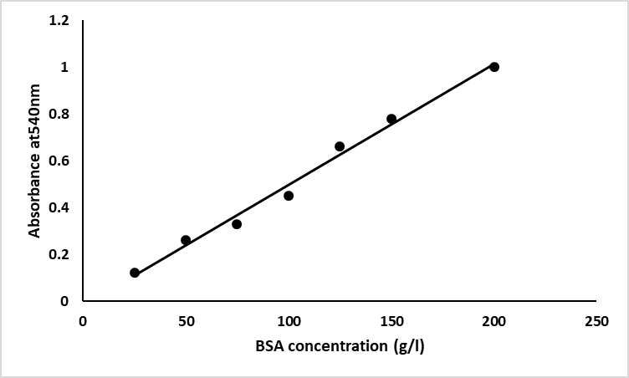
Experiment 3: Quantitative estimation of proteins by biuret assay.
Results:
Table 1. Concentration of standard BSA solution and their absorbance at 540 nm.
Figure 1. Standard curve of BSA using biuret method.
18

