Slide 1
Protein extraction from animal and plant source
BCH303 [Practical]

Slide 2
Cell lysis and disruption:
Cell lysis is the first step in cell fractionation, organelle isolation and protein extraction and purification.
Many techniques ???

Slide 3
Cell lysis and disruption methods:
Mechanical and non-mechanical methods.
Traditional Methods for Cell Lysis - Thermo Fisher Scientific

Slide 4
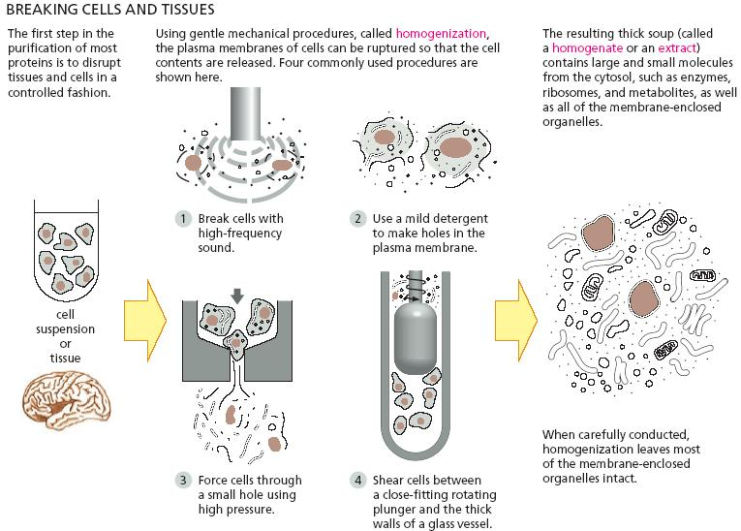
Cell disruption by different mechanical and non-mechanical methods:
"Homogenization." Biology Forums Gallery, 4 Mar. 2014, https://biology-forums.com/index.php?action=gallery;sa=view;id=15348. Accessed 29 Sep. 2024.
Notes:
Heating only can’t brake the glycosidic bond, there is should be an acid to act on.
Sucrose is non-reducing :
http://upload.wikimedia.org/wikipedia/commons/1/1c/Reducing_or_non_reducing_sugar.jpg
"Homogenization." Biology Forums Gallery, 4 Mar. 2014, https://biology-forums.com/index.php?action=gallery;sa=view;id=15348. Accessed 29 Sep. 2024.

Slide 5
Protein extraction/isolation:
There is no universal protocol for protein sample preparation. (WHY?)
Factors affecting:
Sample.
Structure of protein.
Location.
Yield.

Slide 6
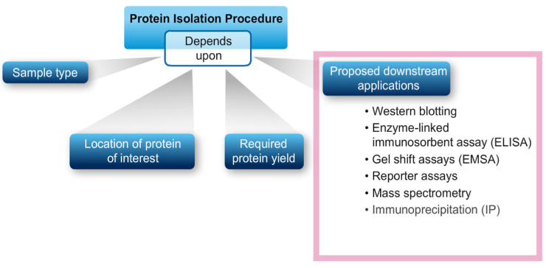
Protein extraction/isolation method:
5 Steps to Fundamental Protein Preparation - Thermo Fisher Scientific

Slide 7
Practical part

Slide 8
Principle:
The initial step of any purification procedure must, of course, be to disrupt the starting tissue to release proteins from within the cell.
Depend on the cell type.
Animal and plant cell ?
Cell disrupting will be achieved using both mechanical and non-mechanical methods.
After extraction, protein concentration determination is a routine requirement during protein purification, which can be achieved by different method (coming labs).
Notes:
Heating only can’t brake the glycosidic bond, there is should be an acid to act on.
Sucrose is non-reducing :
http://upload.wikimedia.org/wikipedia/commons/1/1c/Reducing_or_non_reducing_sugar.jpg

Slide 9
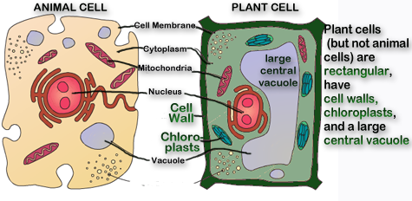
Animal cell vs Plant cell:
Notes:
Heating only can’t brake the glycosidic bond, there is should be an acid to act on.
Sucrose is non-reducing :
http://upload.wikimedia.org/wikipedia/commons/1/1c/Reducing_or_non_reducing_sugar.jpg

Slide 10
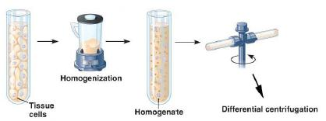
Shear forces using blenders:
Notes:
Heating only can’t brake the glycosidic bond, there is should be an acid to act on.
Sucrose is non-reducing :
http://upload.wikimedia.org/wikipedia/commons/1/1c/Reducing_or_non_reducing_sugar.jpg
https://study.com/academy/lesson/cell-fractionation-definition-steps-methods.html

Slide 11
Experiment 1 : Protease inhibitor extraction from plant source
Aim:
To prepare crude extract from plant source.
Method:
1. Weight 12 g of the sample and place it in the blender with 200 ml of the extraction buffer (phosphate buffer 0.1 M, pH 7.0)
2. Incubate the homogenate at room temperature on a rotary shaker for 30 min at 150 rpm.
3. Filter the slurry through cheesecloth and then transfer to centrifuge tube.
4. Centrifuge the filtrate at 10,000 rpm for 10 min at 4 ◦C for the removal of any cell debris that remained in the preparation.
5. Measure the volume of the supernatant.
Notes:
Heating only can’t brake the glycosidic bond, there is should be an acid to act on.
Sucrose is non-reducing :
http://upload.wikimedia.org/wikipedia/commons/1/1c/Reducing_or_non_reducing_sugar.jpg

Slide 12
Experiment 2 : Lactate dehydrogenase extraction from animal source
Aim:
To prepare crude extract from animal source.
Method:
1. Cut ~7.5 g of muscle tissue from the tissue source. Record the exact weight of tissue used.
2. Cut the tissue into small pieces. Discard the connective tissue and fat.
3. Add 38 ml of cold extraction buffer (0.1 M Tris-HCl, pH 7.4) in a blender with the sample.
4. Transfer the homogenized tissue/buffer mixture into centrifuge tubes.
5. Centrifuge your homogenate for 10 minutes at 7000 rpm.
6. Measure the volume of the supernatant.
Notes:
Heating only can’t brake the glycosidic bond, there is should be an acid to act on.
Sucrose is non-reducing :
http://upload.wikimedia.org/wikipedia/commons/1/1c/Reducing_or_non_reducing_sugar.jpg

