Slide 1
Quantitative amino acids estimation by Ninhydrin method
BCH303 [Practical]

Slide 2
Amino acid quantitation :
Free amino acids, as well as amino acids released from macromolecules such as peptides, proteins or glycoproteins. Are usually being analysed. When and Why?
a.a analysis mean? .
Importance ?

Slide 3
Ninhydrin reaction:
Sensitive in detecting of total free alpha-amino acids.
Microgram amounts.
Non-selective ?
Other convenient reagents are available which can react with the alpha amino group to form colored or fluorescent derivatives. These include fluorescamine, dansyl chloride, etc., used in the detection of trace amounts of amino acids at the nanogram level.

Slide 4
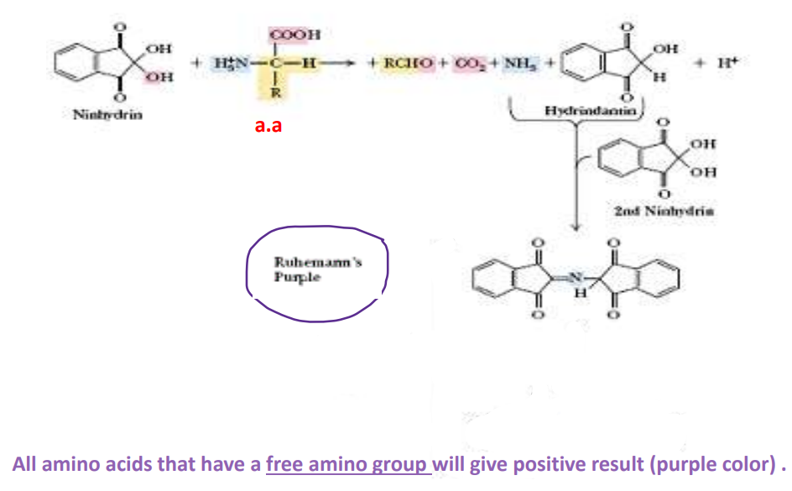
Ruhemann's purple formed by the reaction at 570 nm is measured, whereas for imino acids, the absorption happens at 440 nm.
The color intensity produced is proportional to the amino acid concentration.
So ?

Slide 5
“Standard ” Curve of concentration :
-Knowing the direct relationship between known concentrations and their absorbance values is beneficial for draw Calibration “Standard ” Curve of concentration.
- Establishing a Standard curve allows for the determination of unknown concentrations by measuring absorbance and applying the linear relationship.

Slide 6
How to determine unknown concentration
of a solution with known absorbance value using Standard curve of concentration ?

Slide 7
Absorbance of the
” solution with unknown concentration” the sample
Concentration of the
the sample

Slide 8
Standard curve of concentration:
Direct relationship between color and concentration ➔ direct relationship between concentration and absorbance.
So , to draw the curve we must prepare the standard solutions.
standard solution is a solution containing a precisely known concentration of an element or a substance .

Slide 9
Practical part

Slide 10
Aim:
Determination of amino acids quantity using ninhydrin reaction.
Notes:
Heating only can’t brake the glycosidic bond, there is should be an acid to act on.
Sucrose is non-reducing :
http://upload.wikimedia.org/wikipedia/commons/1/1c/Reducing_or_non_reducing_sugar.jpg

Slide 11
Principle:
At nuetral pH, ninhydrin destroys each primary α-amino acid to form Ruhemann's purple.
Maximum absorption at about 570 nm.
The intensity of the color resulted is linearly proportional to the concentration of the amino acids present in the solution.
Notes:
Heating only can’t brake the glycosidic bond, there is should be an acid to act on.
Sucrose is non-reducing :
http://upload.wikimedia.org/wikipedia/commons/1/1c/Reducing_or_non_reducing_sugar.jpg

Slide 12
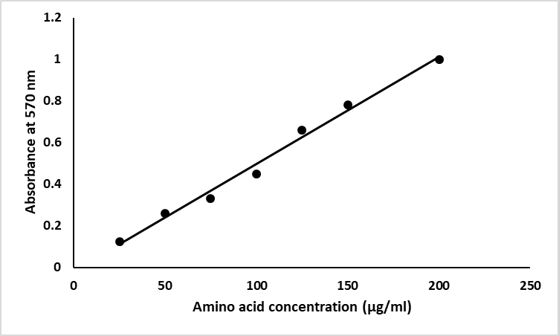
Results:
Table 1. Concentration of standard amino acid solution (alanine) and their absorbance at 570 nm.
Figure 1. standard curve of amino acid using ninhydrin method.
Notes:
Heating only can’t brake the glycosidic bond, there is should be an acid to act on.
Sucrose is non-reducing :
http://upload.wikimedia.org/wikipedia/commons/1/1c/Reducing_or_non_reducing_sugar.jpg

