Slide 1
Qualitative Tests of Carbohydrates
(Part I)
BCH202 [Practical]

Slide 2
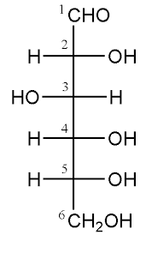
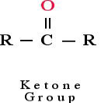
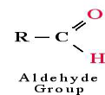
Introduction:
Carbohydrates, are defined as the polyhydroxy aldehydes or polyhydroxy ketones.
Most , but not all carbohydrate have a formula (CH2O)n (hence the name hydrate of carbon).
In human body, the D-glucose is used.
Simple sugars ends with –ose.

Slide 3
Biological role:
Carbohydrates are the key source of energy used by living things.
Also serve as extracellular structural elements as in cell wall of bacteria and plant.
Carbohydrates are essential macromolecules that support energy production, provide structural support, facilitate cell communication, and contribute to various metabolic processes. Their diverse roles are crucial for maintaining cellular function and overall organism health.

Slide 4
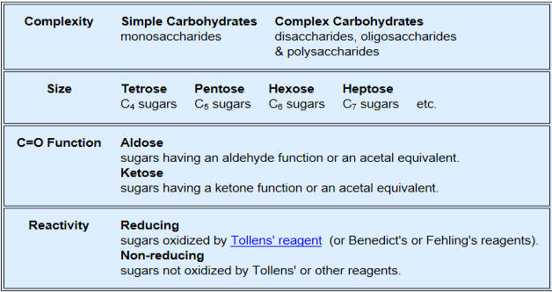
Classification of carbohydrates:
Several classifications of carbohydrates have proven useful, and are outlined in the following table:
Notes:
A ketose contains a carbonyl group attached to two R groups having one or more hydroxyl groups).
An aldose contains terminal aldehyde group in addition to R group containing -OH.

Slide 5
Classification based on complexity:
Simple sugar (one unit) :
Monosaccharides contain one monosaccharide unit.
Complex sugar (more than one) :
Disaccharides contain two monosaccharide units.
Oligosaccharides contain 3-9 monosaccharide units.
Polysaccharides can contain more than 9 monosaccharide units.
Complex carbohydrates can be broken down into smaller sugar units through a process known as hydrolysis.

Slide 6
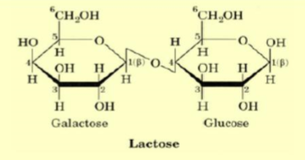
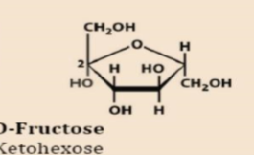
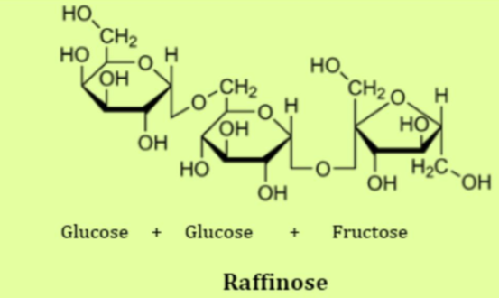
Classification based on complexity:
Disaccharides
Monosaccharides
Polysaccharides
Oligosaccharides

Slide 7
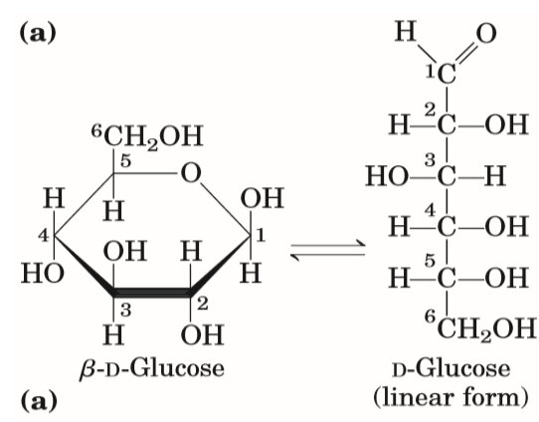
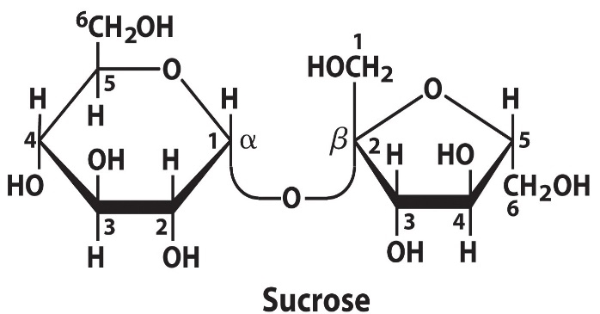
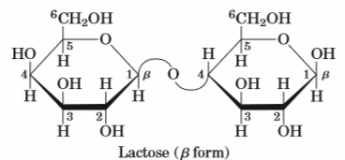
Classification based on reactivity:
Reducing and non Reducing sugar :
If the oxygen on the anomeric carbon of a sugar is not attached to any other structure, that sugar can act as a reducing agent and is termed a reducing sugar.
attached anomeric carbon
Non-Reducing sugar
FREE anomeric carbon
Reducing sugar
FREE anomeric carbon
Reducing sugar

Slide 8
Classification based on reactivity cont’:
All monosaccharides are reducing sugars; they all have a free reactive carbonyl (C=O) group.
Some disaccharides have exposed carbonyl groups and are also reducing sugars like lactose. While other disaccharides such as sucrose are non-reducing sugars and will not react with Benedict's solution.
Large polymers of glucose, such as starch, are not reducing sugars. In starch, the glucose units are linked together, and there are no free aldehyde or ketone groups available for reduction reactions.

Slide 9
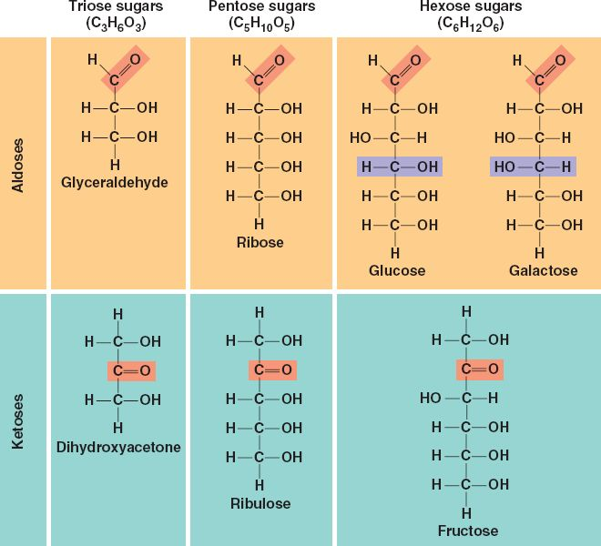

Slide 10
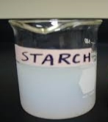
Solubility of sugars [physical property]:
Monosaccharide and disaccharide can be dissolved freely in water because water is a polar.
Polysaccharide cannot be dissolved easily in water, because, it has high molecular weight, which give colloidal solutions in water.(e.g. starch)

Slide 11
Practical Part

Slide 12
Chemical properties of carbohydrates:
Molisch's Test: To identify the carbohydrate from other macromolecules.
Benedict test: For the presence of reducing sugars.
Barfoed’s Test: To identify the presence of reducing sugars, specifically distinguishing between monosaccharides (which react quickly) and disaccharides (which react more slowly).
Seliwanoff's Test: To distinguish between aldoses and ketoses (to detect ketoses).
Bial’s Test: To distinguish between pentose monosaccharide and hexose monosaccharide (to detect pentoses).
1
2
3
4
5

Slide 13
Experiment 1 : Molisch test
Objective:
To identify the carbohydrate from other macromolecules lipids and proteins (this test is specific for all carbohydrates).
Principle:
Two solutions are used : (H₂SO₄ and α-naphthol )
The sulfuric acid (H₂SO₄) will dehydrates the sugar (pentose to form furfural and dehydrates hexoses to form 5-hydroxymethyl furfural).
The dehydrated sugars will further react with α-naphthol present in the test reagent to produce a purple product.

Slide 14
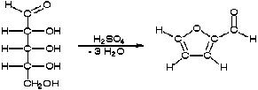
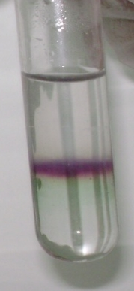
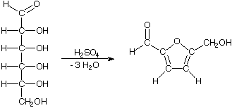
(1)
(2)
α-naphthol
[Present in the reagent ]
Furfural
Pentose sugar
α-naphthol
[Present in the reagent ]
5- hydroxymethyl furfural
Hexose sugar

Slide 15
Experiment 1 : Molisch test
Method:
Two ml of a sample solution is placed in a test tube.
0.5 ml of the Molisch reagent (which α-napthol in 95% ethanol) is added.
The solution is then poured slowly into a tube containing two ml of concentrated sulfuric acid so that two layers form, producing violet ring appear as liaison between the surface separations.
Results:
Concentrated sulfuric acid is extremely corrosive and can cause serious burns when not handled properly.
Observation | Tube
 | Glucose
 | Lactose
 | Starch

Slide 16
Experiment 2 : Benedict's test
Objective:
To distinguish between the reducing and non-reducing sugars (to detect the presence of reducing sugar).
Principle:
The copper sulfate (CuSO₄) present in Benedict's solution reacts with electrons from the aldehyde or ketone group of the reducing sugar in alkaline medium.
Reducing sugars are oxidized by the copper ion in solution to form a carboxylic acid and a reddish precipitate of copper oxide.
The non-reducing sugars give negative result.
reddish precipitate
reducing sugar
carboxylic acid

Slide 17
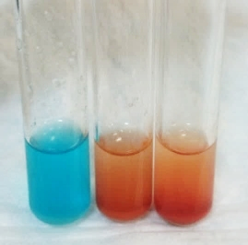
Experiment 2 : Benedict's test
Method:
One ml of a sample solution is placed in a test tube.
Two ml of Benedict's reagent is added.
The solution is then heated in a boiling water bath for five minutes.
A positive test is indicated by: The formation of a reddish precipitate.
Results:
Sucrose (-)
Glucose (+)
Lactose (+)
Observation | Tube
 | Glucose
 | Lactose
 | Sucrose

Slide 18
Experiment 3 : Barfoed’s test
Objective:
To identify the presence of reducing sugars, specifically distinguishing between monosaccharides (which react quickly) and disaccharides (which react more slowly).
Principle:
Barfoed’s test used copper (II) ions in a slightly acidic medium.
Reducing saccharides are oxidized by the copper ion in solution to form a carboxylic acid and a reddish precipitate of copper (I) oxide.
Different types of reducing sugars react at different rates ➔ Reducing monosaccharides react quickly with Barfoed’s reagent (acidic condition), but reducing disaccharides react very slowly.
The non-reducing sugars give negative result.
reddish precipitate
reducing sugar
carboxylic acid

Slide 19
Experiment 3 : Barfoed’s test
Method:
Place one ml of a sample solution in a test tube.
Add 3 ml of Barfoed's reagent (a solution of cupric acetate and acetic acid).
Heat the solution in a boiling water bath for 6 minutes (after the 3 min check the tubes).
Results:
Observation | Tube
 | Glucose
 | Lactose
 | Starch
No Reduction
Reduction

Slide 20
Experiment 4 : Bial’s test
Objective:
To distinguish between pentose monosaccharide and hexose monosaccharide (to detect pentoses).
Principle:
Bial's reagent (orcinol, concentrated HCl as a dehydrating acid and ferric chloride as condensation reagent).
The test reagent dehydrates pentoses to form furfural, furfural further reacts with orcinol and the iron ion present in the test reagent to produce a bluish or green product.
Notes:
Heating only can’t brake the glycosidic bond, there is should be an acid to act on.
Sucrose is non-reducing :
http://upload.wikimedia.org/wikipedia/commons/1/1c/Reducing_or_non_reducing_sugar.jpg

Slide 21
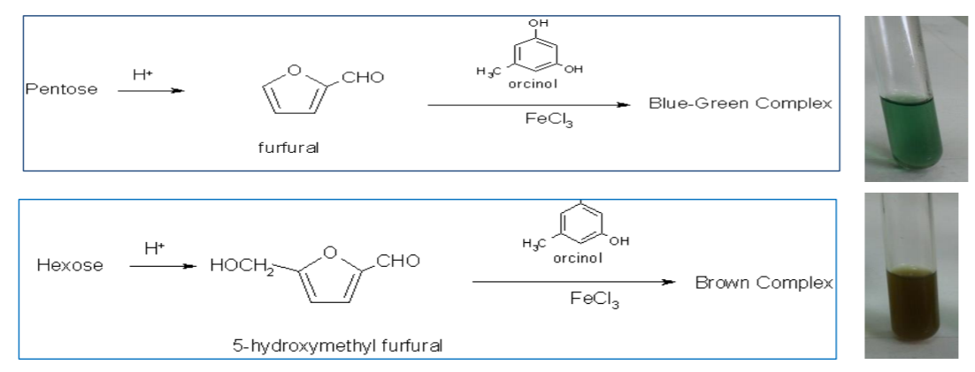

Slide 22
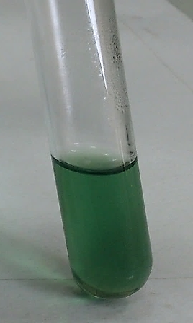
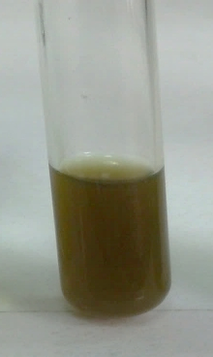
Experiment 4 : Bial’s test
Method:
Put 2 ml of a sample solution in a test tube.
Add 2 ml of Bial's reagent to each tube.
Heat the tubes gently in hot water bath.
If the color is not obvious, more water can be added to the tube.
Results:
Observation | Tube
 | Glucose
 | Ribose
Ribose
(+)
Glucose
(-)

Slide 23
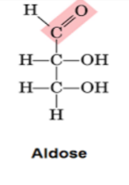
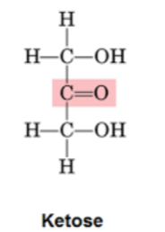
Experiment 5 : Seliwanoff's test
Objective:
To distinguish between aldoses and ketoses (to detect ketoses).
Principle:
Seliwanoff’s test uses 6M HCl as dehydrating agent and resoncinol as condensation reagent.
The test reagent dehydrates ketohexoses to form 5-hydroxymethylfurfural ➔ 5-hydroxymethylfurfural further condenses with resorcinol present in the test reagent to produce a cherry red product within two minutes.
Aldohexoses react to form the same product. But do so more slowly giving yellow to faint pink color.
Notes:
Heating only can’t brake the glycosidic bond, there is should be an acid to act on.
Sucrose is non-reducing :
http://upload.wikimedia.org/wikipedia/commons/1/1c/Reducing_or_non_reducing_sugar.jpg

Slide 24
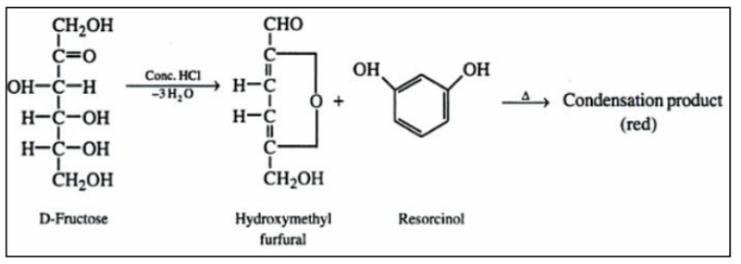

Slide 25
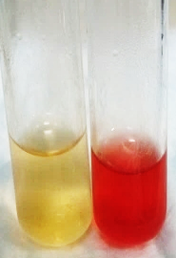
Experiment 5 : Seliwanoff's test
Method:
One half ml of a sample solution is placed in a test tube.
Two ml of Seliwanoff's reagent (a solution of resorcinol and HCl) is added.
The solution is then heated in a boiling water bath for two minutes.
Results:
Glucose
Fructose
Observation | Tube
 | Glucose
 | fructose

