Slide 1
Characterization of The DNA by Spectrophotometric Assay and Melting Temperature (TM)
BCH361- Practical

Slide 2
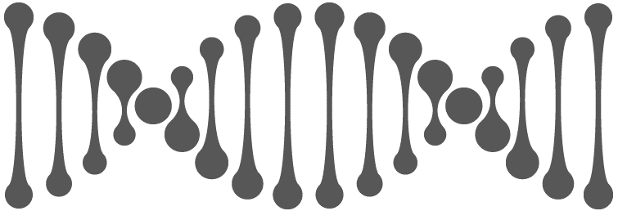
What NEXT, After DNA Extraction…
DNA characterization
Quantitative analysis, using
spectrophotometer
Qualitative analysis, using Agarose gel electrophoresis
DNA purity and concentration
DNA integrity and its size.
GC content
Determine Tm

Slide 3
1. Determination of DNA concentration
Is determined by measuring absorbance at 260 nm. Why?
At 260 nm double-stranded DNA has specific absorption coefficient of 0.02 (μg/ml)⁻¹cm⁻¹.
So:
➔ Concentration of DNA= (A260 / ε L) x Dilution Factor (DF).
Beer‐Lambert Law:
A = ɛcl

Slide 4
2. DNA purity:
1. To detect nucleic acid purity from proteins contamination:
➔ Calculate A₂₆₀/A₂₈₀
Highly purified DNA samples have a A₂₆₀/A₂₈₀ nm ratio of (1.8-1.9).
What if the ration is below 1.8? What that means?
A high ratio (typically around 1.8-2.0) indicates relatively pure nucleic acid, while lower ratios suggest the presence of contaminants.
2. To detect nucleic acid purity from carbohydrates, salts, peptides, ethanol or any organic compounds:
➔ Calculate A₂₆₀/A₂₃₀
Purified DNA samples have a A₂₆₀/A₂₃₀ nm ratio of (2-2.2).

Slide 5
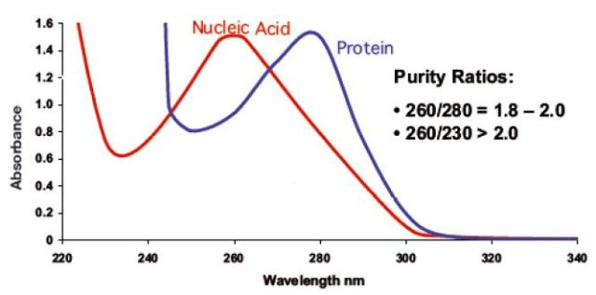
DNA and protein absorption spectrum:

Slide 6
Denaturation or melting of a DNA: is when the double-stranded DNA (dsDNA) unwinds {dissociated "melted"} and separates into single-stranded (ssDNA) by heat or altered pH, which breaks the hydrogen bonds between complementary bases (A＝T and G≡C).
If we cooldown the separated DNA solution? DNA strands can re-anneal or reassociate to form double-stranded DNA again.
But>>>

Slide 7
3. GC content and melting temperature ™:
The melting temperature (Tm) is the temperature at which 50% of the DNA strand is unpaired (denatured).
Note: The Tm is depending on both length of DNA molecule and its GC content.
Hyperchromic and hypochromic effect.
GC content: what does it mean? And how to calculate it
GC content can be calculated by generating Tm profile (DNA melting curve).
%(G+C) = 2.44 (Tm - 69.3)

Slide 8
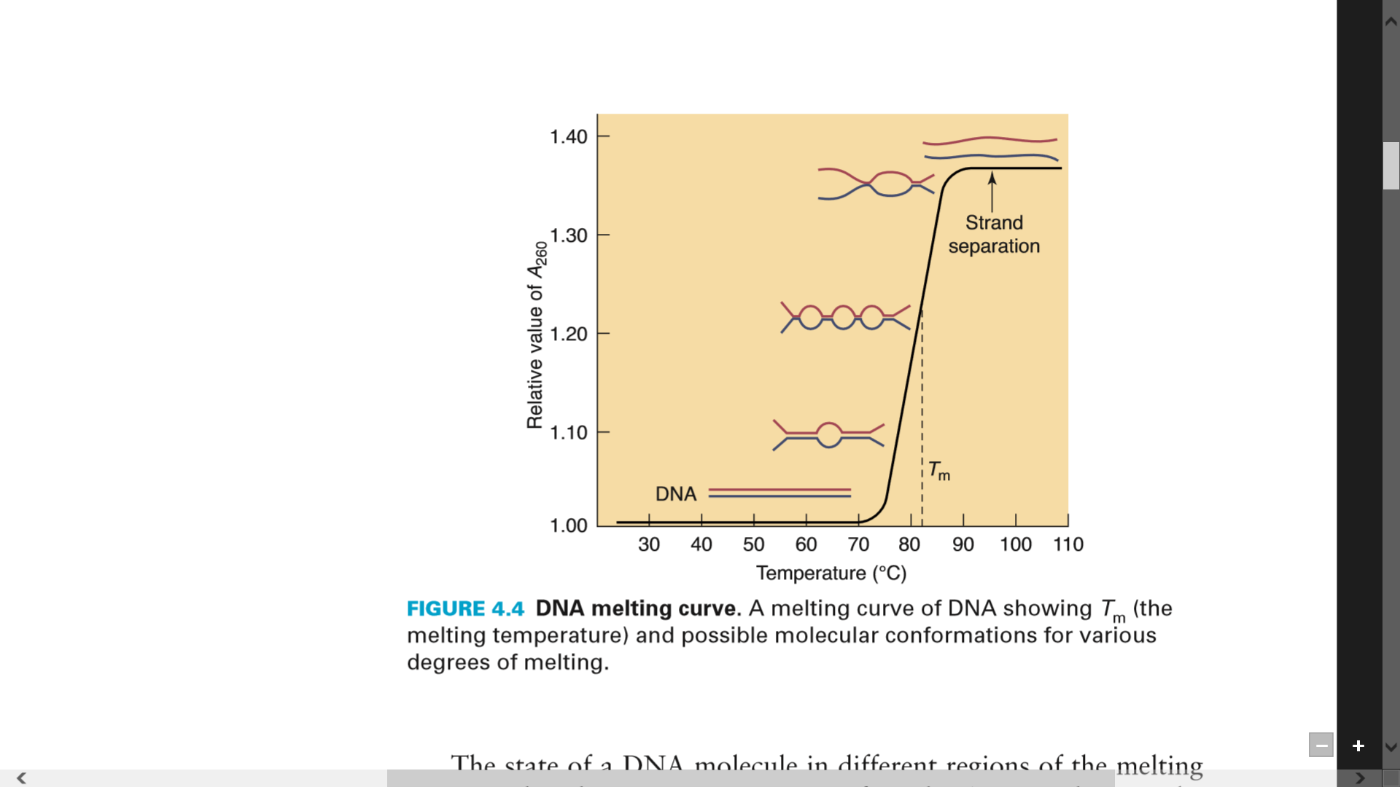
DNA melting curve:

Slide 9
Relationship between Tm and GC%:
What do you notice in the relation between GC content and Tm?

Slide 10
Practical Part

Slide 11
Aim:
Determination the concentration and purity of extracted DNA using spectrophotometer.
Determination of DNA melting temperature and GC content percentage.
Principle:
dsDNA will be separated to ssDNA by heat (denaturation).
O.D at 260 nm will increase during denaturation... Why?
Temperature for midpoint of denaturation gives Tm. Why it is important to know Tm of DNA?
The DNA of each species has a specific denaturation curve.. Why?

Slide 12
Results:
As in the lab sheet

