Slide 1
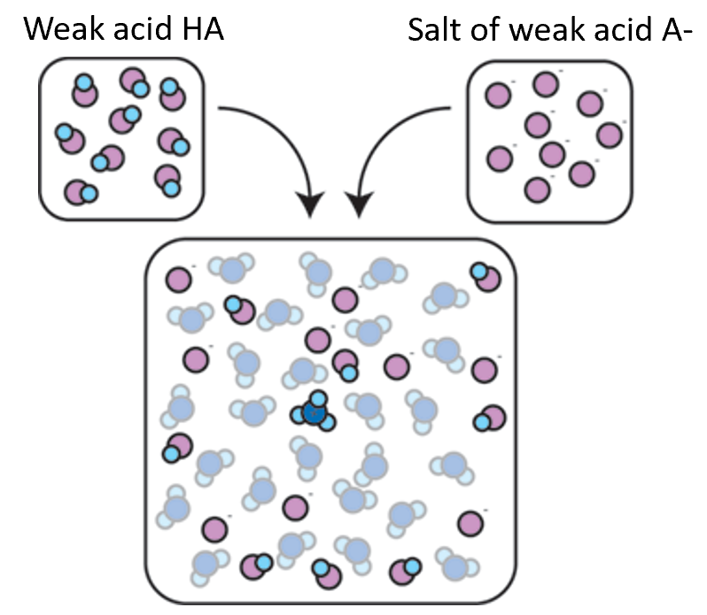
Preparation of Buffer Solutions
BCH202 [Practical]

Slide 2
Hydrogen number (pH) :
The acidity and basicity of certain solutions can be determined by measuring hydrogen number (pH).
pH defined as: The negative logarithm of the hydrogen ion concentration.
pH= - Log [H⁺]
When the pH value is high, it mean the concentration of hydrogen ion is low and vice versa.

Slide 3
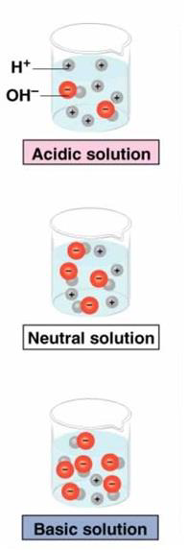
Acidic medium: The hydrogen ion is present in a very large amount (or high concentration), exceeding that of hydroxide.
Neutral medium: The hydrogen and hydroxide ions are present in equal amounts (or equal concentrations).
Basic medium: The hydrogen ion is present in very low amounts (or low concentration), less than that of hydroxide

Slide 4
Measuring of hydrogen number:
To measure the hydrogen number in certain solution in very accurate way, we use a special instrument called pH meter.
It’s consisted of glass electrode which contain a very thin bulb, blown onto a hard glass tube which is sensitive to pH.
The bulb contains a solution of hydrochloric acid and is connected to a platinum lead via silver -silver chloride electrode which is reversible with respect to hydrogen ions.

Slide 5
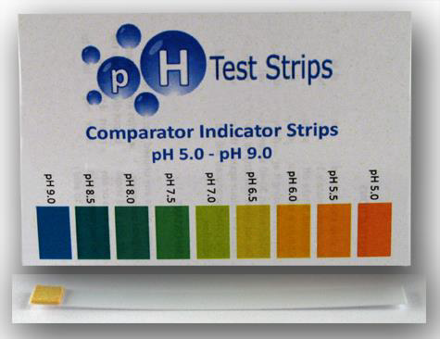
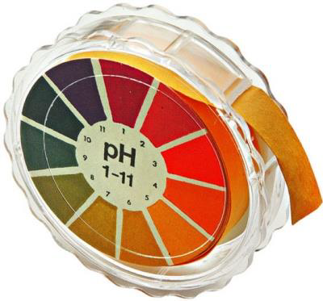
Other method to know the pH of the medium is by using Test strips.
Supporting materials:
How pH meter works: https://youtu.be/P1wRXTl2L3I
How to use the pH meter: https://youtu.be/vwY-xWMam7o

Slide 6
pH and biological system:
All biochemical reactions occur under strict conditions of the concentration of hydrogen ion.
So how to resist changes in pH ? Buffers.

Slide 7
Buffers:
So, buffers defines as: the solutions that have the ability to resist changes in pH upon the addition of limited amounts of acid or base.
A buffer is made up of :
1- a weak acid and its conjugate base (salt of the weak acid).
Or
2- a weak base and its conjugate acid (salt of the weak base).
So, the buffers are tow types.

Slide 8
Two types of Buffers
Acidic Buffer
Basic Buffer
Are made from weak acid and its conjugated base[ its salt].
Example:
[CH₃COOH / CH₃COONa] buffer made of:
➔ CH3COOH (Weak acid)
➔ CH3COONa (conjugated base –its salt-)
Are made from weak base and its conjugated acid [ its salt].
Example:
[NH₃ / NH₄Cl ] buffer made of:
➔ NH₃ (Weak base)
➔NH₄Cl (conjugated acid –its salt-)

Slide 9
Mechanism of action: (How buffers can resist the change in pH?)
-Example using [HA/A⁻] buffer:Where: HA is Weak acid and A- is conjugated base [its salt].
States A:
If H⁺ (acid) is added to this buffer system → H⁺ will react with conjugated base (or the salt of weak acid “A⁻ ”)→ to give conjugate acid [HA].
H⁺
A⁻ ⇌ HA

Slide 10
If OH⁻ (base) is added to this buffer system → OH⁻ will react with conjugated acid ➔to give conjugate base and H₂O.
OH-
HA ⇌ A- + H2O

Slide 11
NOTE: the buffer resists pH changes, when it’s two components are present in specific proportions.
Thus, a buffer can protect against pH changes from added H+ or OH- ion as long as there is sufficient basic and acidic forms respectively ➔As soon as you run out of one of the forms you no longer have a buffer .

Slide 12
Mechanism of Action cont’ Example:
Buffer system: CH3COOH / CH3COO- , (CH3COOH :acid - CH3COO-: conjugated base )
When acid [H+] added: ➔ CH3COO- + H+ ➔ CH3COOH
When base [OH] added: ➔ CH3COOH + OH - ➔ CH3COO- + H2O

Slide 13
Henderson-Hasselbalch equation:
The Henderson-Hasselbalch equation is an equation that is often used to:
1- To calculate the pH of the Buffer.
2-To prepare Buffer.
Where:
- **pH**: is the hydrogen number.
- **pKa**: is the acid dissociation constant.
- **[A⁻]**: is the concentration of the conjugate base (salt).
- **[HA]**: is the concentration of the acid."
Notes:
Note: Ka is weak acid dissociation constant
What is ka dissociation constant?*** read about معامل تفكك الحمض

Slide 14
Buffer capacity:
It expresses the efficiency of the buffer solution in resisting changes in pH.
Buffer capacity can be defined in many ways, it can be defined as:
The number of moles of H+/OH- ions that must be added to one liter of the buffer in order to decrease /increase the pH by one unit respectively.
Buffer capacity is directly proportional to the buffer concentration. How?

Slide 15
Practical Part

Slide 16
Objectives:
To learn how to prepare buffers:
“A. Preparation of phosphate buffer:”
To understand the behaviour of buffers solutions.

Slide 17
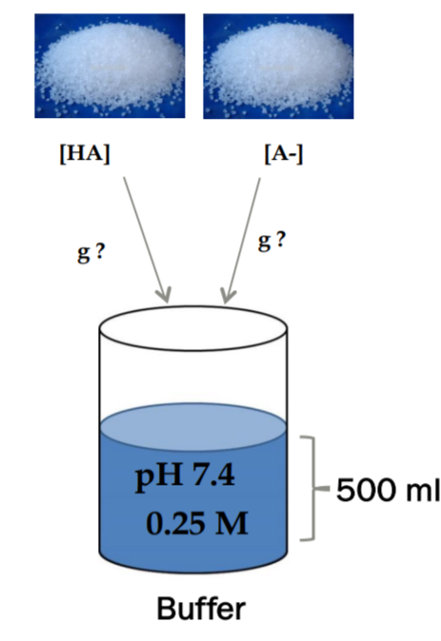
A. Preparation of phosphate buffer:
Prepare 50 ml from phosphate buffer with concentration 0.25M and pH=7.4, if you know that (pKa=7.2).
You are provided with buffer solution content:
(Monosodium dihydrogen phosphate NaH2PO4 )and (Disodium hydrogen phosphate Na2HPO4.)
Solution:
■ Provided:
Pka = 7.2
pH=7.4
Final volume of buffer =50 ml
Concentration of buffer = 0.25 M ➔ [HA] + [A⁻]
■ Required:
Weight in grams (g) of NaH2PO4 (as HA) and Na2HPO4 (as A-).
50 ml

Slide 18
Calculations:
-To prepare a buffer Henderson-Hasselbalch equation is used:
pH = pka + log [A-] \[HA]
First: calculate the concentration of the weak acid and its conjugated base that make up the buffer with 0.25 M:
Assume [A-] = y and [HA] = 0.25 – y

Slide 19
So:
7.4 = 7.2 + log $\frac{\left[y\right]}{\left[0.25 −y\right]}$
0.2=log $\frac{\left[y\right]}{\left[0.25 −y\right]}$
By taking the “Anti log for both sides” :
1.58 = $\frac{\left[y\right]}{\left[0.25 −y\right]}$
y=0.395 – 1.58 y
1.58 y + y = 0.395
y= 0.15 M
[which is the concentration of [A⁻] in the buffer ]
0.15+ 0.1 = 0.25M
Which is the targeted concentration
So, [HA] = 0.25 – 0.15 = 0.1 M [which is the concentration of [HA] in the buffer ]

Slide 20
Second: Calculate the weight in grams (g) needed from [A-] and [HA] using Molarity:
Calculate the weight in (g) needed from [A-] to prepare the buffer, so number of mole of [A- ] should be calculated first :
➔ Calculate moles of A- in buffer:
No. of mole (of A-) = molarity [A-] X volume in Liter (volume of the buffer)
= 0.15 M x 0.05 L = 0.0075 mole
➔ Calculate weight of [A-] needed:
Weight in (g) of [A-] = No. of moles x M.W. (g/mole)
= 0.0075 x 142 = 1.065 g
--------------------------------------------------------------------------------------------------------------------------------------
B. Calculate the weight in (g) needed from [HA] to prepare the buffer, so number of mole of [HA] should be calculated first :
➔ Calculate moles of HA in buffer:
No. of mole (of HA) = molarity [HA] X volume L (volume of the buffer)
= 0.1 M x 0.05 L = 0.005 mole
➔ Calculate weight of [HA] needed:
Weight in (g) of [HA] = No. of moles x M.W. (g/mole)
= 0.005 x 120 = 0.6 g

Slide 21
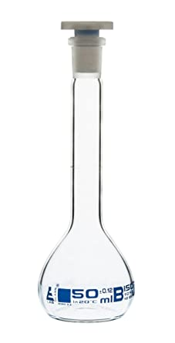
Method:
Now take 0.6 g from NaH2PO4 and 1.065 g from Na2HPO4 dissolve them in a volume of a distal water (less than 50 ml).
Check the pH, then complete the volume up to 50 ml by addition of distal water using a volumetric flask.

Slide 22
B. Testing for buffering behavior:
Method:
In one beaker add 10 ml of 0.25M phosphate buffer that you have prepared, and in another beaker add 10 ml of KCl.
Measure the pH.
Add 0.1 ml from 2 M HCl to both solutions.
Measure the pH after the addition.
Record your observation. And discuss the result.
Measured pH | Add 2M HCl | Measured pH | Solution
 | 0.1 ml |  | 0.25M Phosphate buffer
 | 0.1 ml |  | o.2M KCl

Slide 23
Homework:
You are provided with 0.15 M acetic acid and sodium acetate.
Prepare 100 ml of a 0.2M acetate buffer, pH =5.2 if you know that pKa =4.76.
Hint: you will calculate ml of acetic acid and g of sodium acetate.
Notes:
A ➔0.15 M ➔1.23 g
HA ➔ 0.05 M ➔ 33.34 ml

