Slide 2
What is Molecular Biology ?

Slide 3
Understanding Molecular Biology…. Why it is important?

Slide 4
Things you need to Know :

Slide 6
Types of Hazards:

Slide 7
Conducting a Successful Molecular Biology Experiment

Slide 8
Searching the scientific literature:

Slide 9
Types of scientific articles:

Slide 10
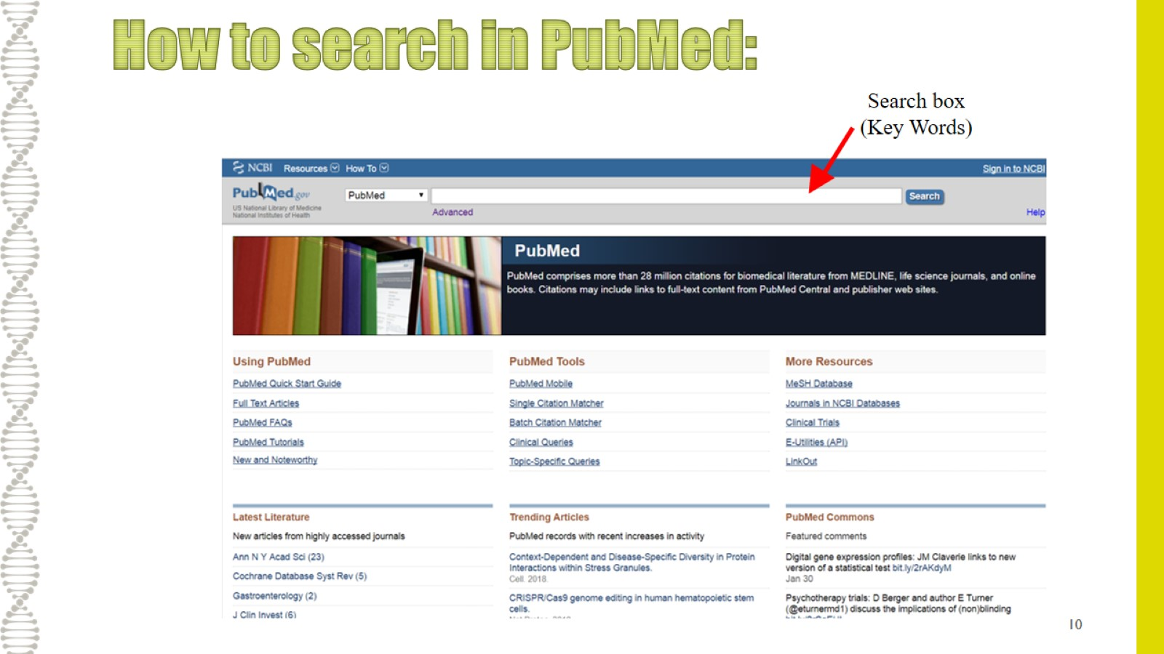
How to search in PubMed:

Slide 11
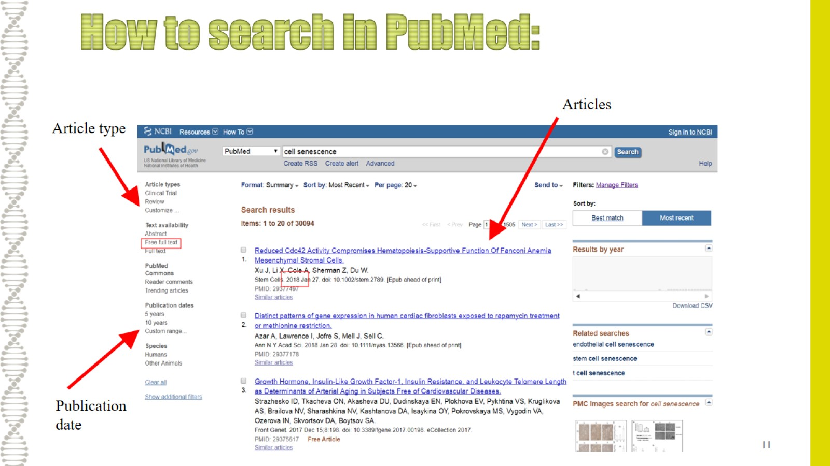
How to search in PubMed:

