Slide 1

Introduction to Molecular Biology
BCH361- Practical

Slide 2


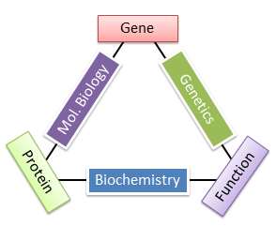
What is Molecular Biology ?
"Molecular Biology" is the study of biology at the molecular level.
Molecular biology is the study of essential cellular macromolecules, including DNA, RNA, and proteins, and the biological pathways between them (replication, transcription, translation).
Researchers in Molecular Biology field, design and perform experiments to gain insight into how these components operate, organization and communicate.
The techniques used for these studies are referred to as:
"Techniques of Molecular Biology".

Slide 3
The first step is to isolate DNA or RNA, for these techniques to be carried out. The DNA or RNA can be obtained either from the cells (e.g. plasmid DNA, genomic DNA, mRNA) or can be prepared [complimentary DNA (cDNA)].

Slide 4
Understanding Molecular Biology…. Why it is important?
Understanding the molecular basis of process and diseases.
Improves diagnostic tests for genetic diseases, forensic DNA analysis, medicine, modern agriculture…etc
Find more effective treatment.

Slide 5




Things you need to Know :
Molecular Biologist
Or any dep.
Basic molecular biology background
Techniques
Lab safety
Website Sources of information

Slide 6
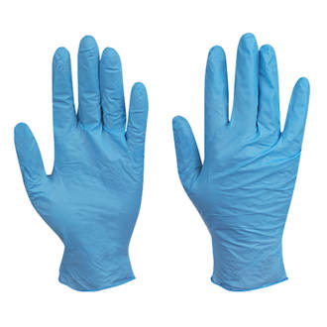
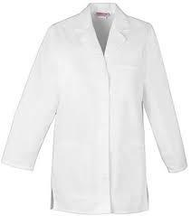




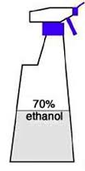



Safety
Before Start Working
While Working
After Working

Slide 7

Types of Hazards:
Biological hazards.
Chemical hazards:
-Ethidium bromide (EtBr).
Phenol: cause severe burns
Physical, Electrical and Mechanical hazards:
-Ultraviolet (UV) light.
-Electricity.
-Centrifugation.

Slide 8
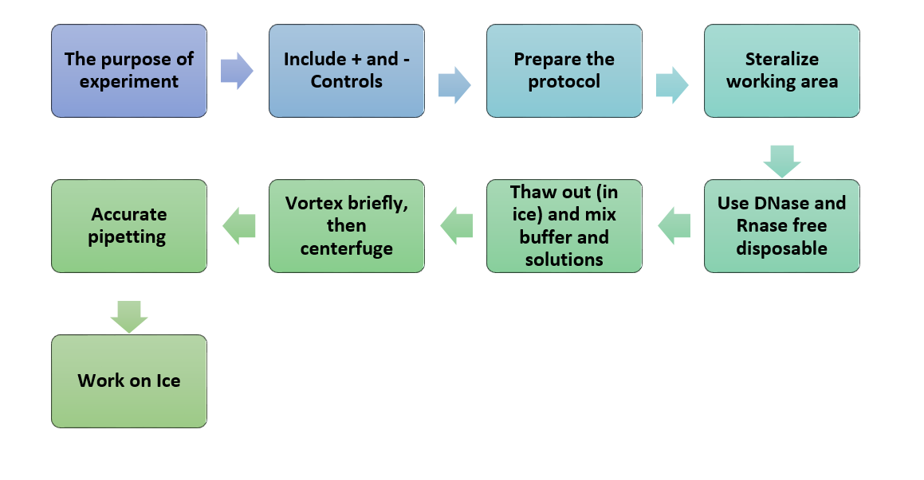
Conducting a Successful Molecular Biology Experiment

Slide 9
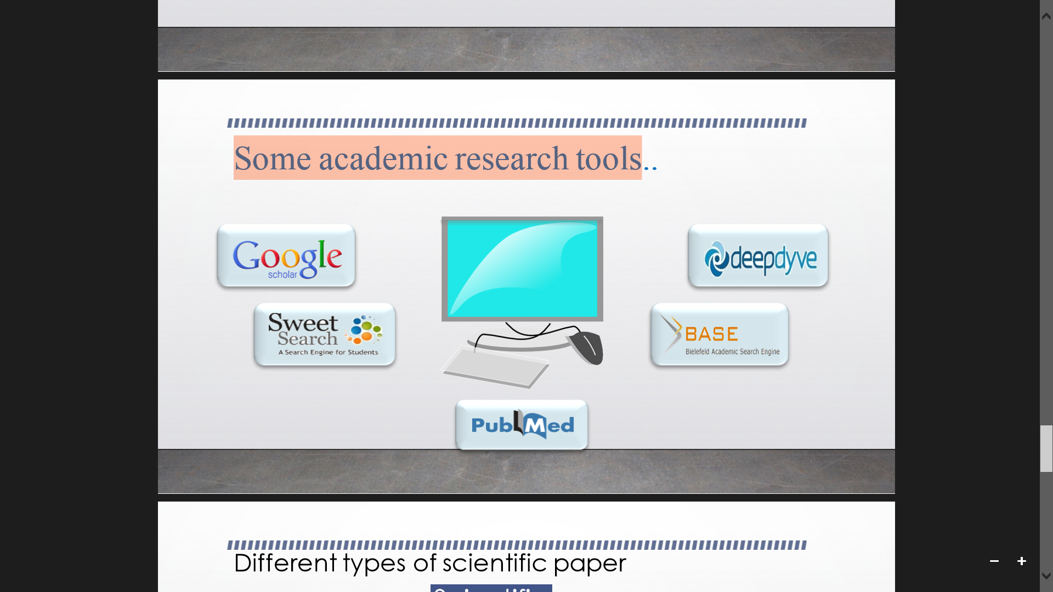
Searching the scientific literature:
The most fundamental skill in bioinformatics is the ability to carry out an efficient and comprehensive search of the scientific literature to find out what is known about a specific subject.
Sources of information:
Books, Articles, Websites.
Some academic research tools:

Slide 10
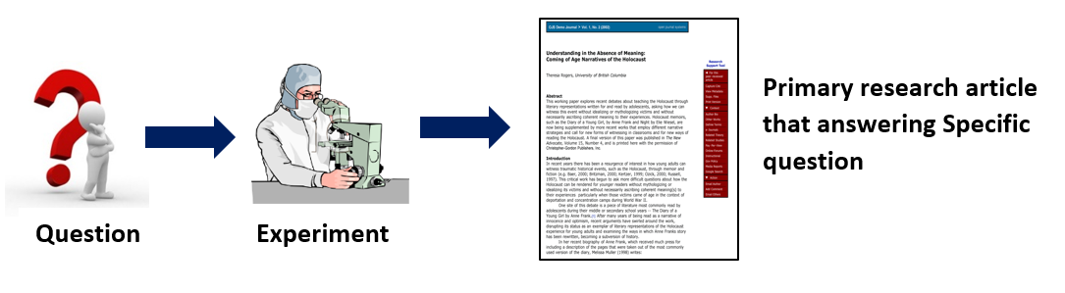
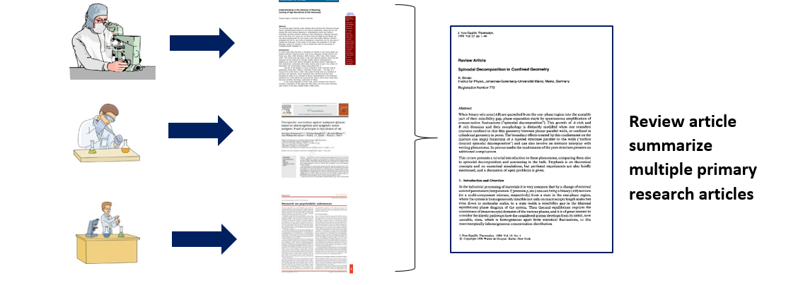
Types of scientific articles:
1. Primary research article:
➔ Peer-reviewed.
➔ New research.
➔ Answer a question.
2. Review article:
➔ Peer-reviewed.
➔No new information.
➔ Good to start with.

Slide 11
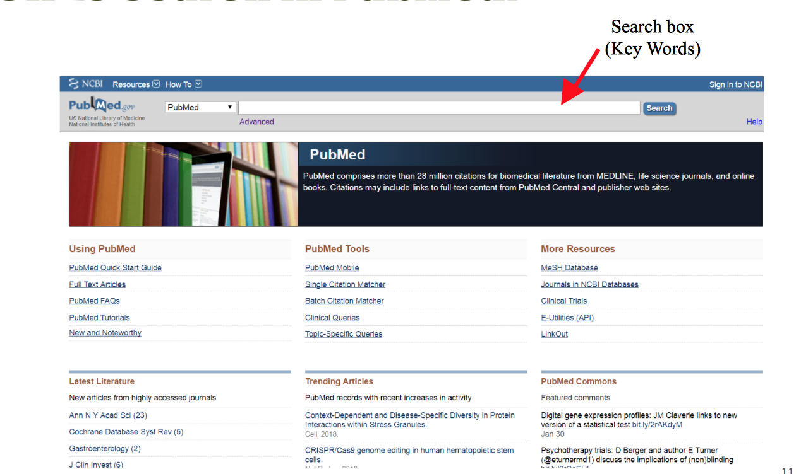
How to search in PubMed

Slide 12
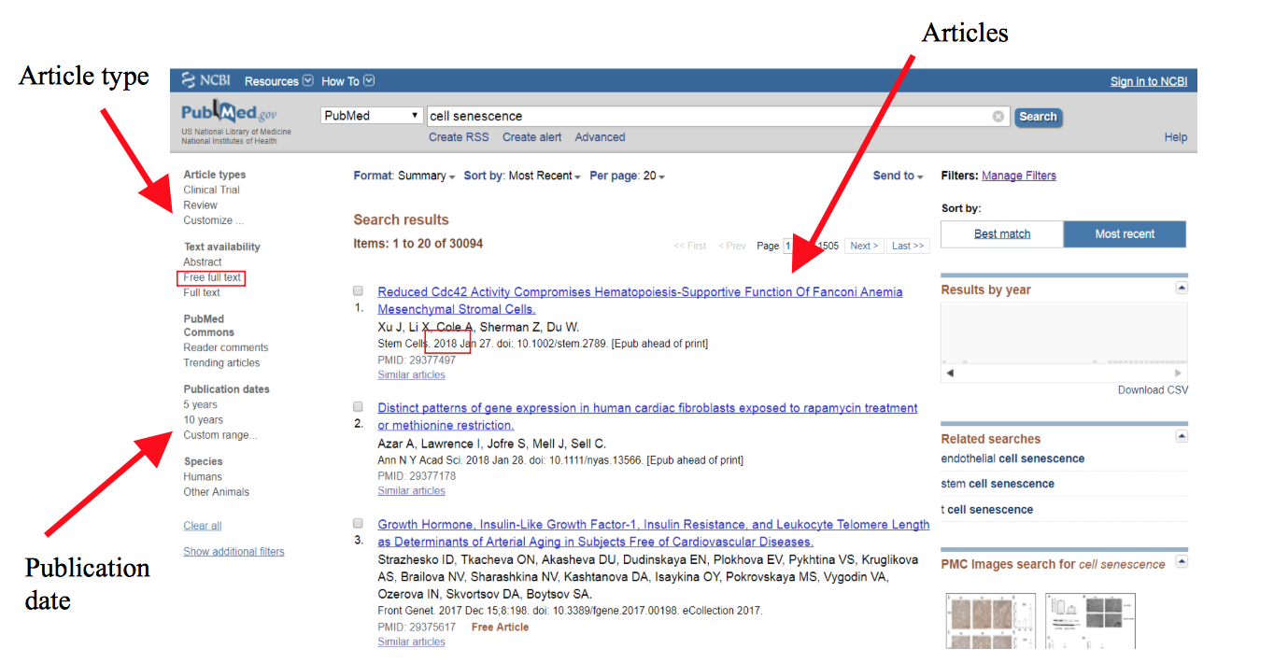
How to search in PubMed

Slide 13
Marks Distribution
Total = 30
Quiz = 7
Report = 5
Final =15
Performance=3

