Slide 1
Chapter 15
Testing for Differences Between Groups and for Predictive Relationships

Slide 2
LEARNING OUTCOMES
Choose an appropriate statistic based on data characteristics
Compute a 𝜒2 statistic for cross-tab results
Use a t-test to compare a difference between two means
Conduct a one-way analysis of variance test (ANOVA)
Appreciate the practicality of modern statistical software packages
Understand how the General Linear Model (GLM) can predict a key dependent variable

Slide 3
Introduction
A surprising number of inferences involve two variables
The automated search for relationships between two variables provides the backbone for automated big data searchers
Sometimes, the marketing analyst reduces a more complex analysis involving multiple variables to a series of two-variable comparison because presenting the results becomes very simple

Slide 4
What Is the Appropriate Test Statistic?
Researchers commonly test hypotheses stating that two groups differ
Such tests are bivariate tests of differences when they involve only two variables
Both the type of measurement and the number of groups to be compared influence the type of bivariate statistical analysis

Slide 5
What Is the Appropriate Test Statistic? (cont’d.)
Two questions help determine the analytical approach
How many independent variables (IV) and dependent variables (DV) are involved in the analysis?
What is the scale level of the independent and dependent variables involved in the analysis?

Slide 6
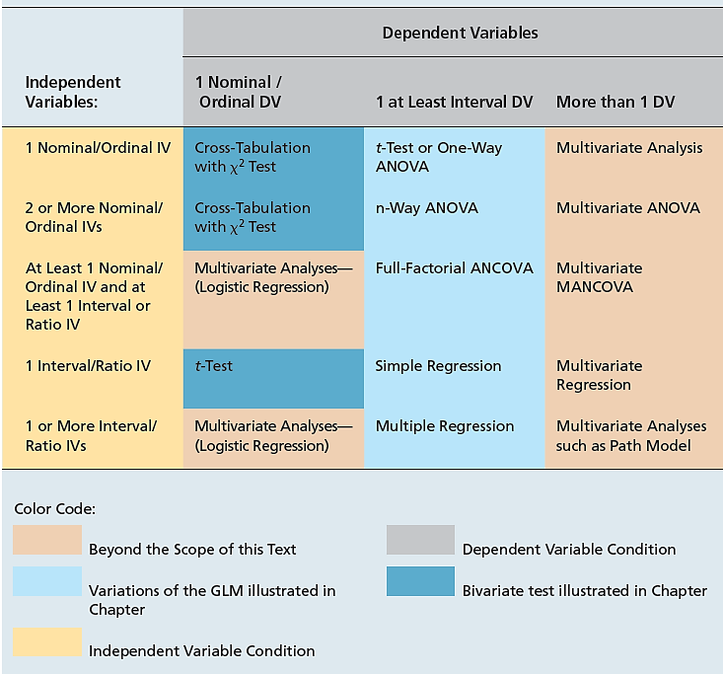
EXHIBIT 15.2 Choosing the Right Statistic

Slide 7
Cross-Tabulation Tables: The $χ^{2}$ Test for Goodness-of-Fit
One of the most widely used and simplest techniques for describing sets of relationships is the cross-tabulation
A cross-tabulation, or contingency table, is a joint frequency distribution of observations on two or more nominal or ordinal variables
The χ² distribution provides a means for testing the statistical significance of contingency tables
The test involves comparing the observed frequencies ($O_{i}$) with the expected frequencies ($E_{i}$) in each cell of the table

Slide 8
Cross-Tabulation Tables: The $χ^{2}$ Test For Goodness-Of-Fit (cont’d.)
The goodness- (or closeness-) of-fit of the observed distribution with the expected distribution is captured by this statistic
The test allows us to conduct tests for significance in the analysis of the R x C contingency table (R = row and C = column)
Formula: $E_{ij}= \frac{R_{i}C_{j}}{n}$
where $R_{i}$ = total observed frequency count in the ith row $C_{j}$ = total observed frequency count in the jth column n = sample size

Slide 9
Computing $χ^{2}$ and Hypothesis Testing
To compute a chi-square, the same formula as before is used, except that we calculate degrees of freedom as the number of rows minus one, times the number of columns minus one
Testing the hypothesis involves two key steps
Examine the statistical significance of the observed contingency table
Examine whether the differences between the observed and expected values are consistent with the hypothesized prediction
Proper use of the chi-square test requires that each expected cell frequency (E) have a value of at least 5

Slide 10
The t-Test for Comparing Two Means
Independent samples t-test
A t-test is appropriate when a researcher needs to compare means for a variable grouped into two categories based on some less-than interval variable
One way to think about this is as testing the way a dichotomous (two levels) independent variable is associated with changes in a continuous dependent variable
Most typically, the researcher will apply the independent samples t-test which tests the differences between means taken from two independent samples or groups
This test assumes the two samples are drawn from normal distributions and that the variances of the two populations are approximately equal (homoscedasticity)

Slide 11
Independent Samples t-Test Calculation
The t-test actually tests whether or not the differences between two means is zero
The null hypothesis is normally stated as $μ_{1}=μ_{2}$ or $μ_{1}−μ_{2}=0$
However, since this is inferential statistics, we test the idea by comparing two sample means (${\overline{X}}_{1}−{\overline{X}}_{2}$)
Thus, the t-value is a ratio with information about the differences between means (provided by the sample) in the numerator and the standard error in the denominator
The question is whether the observed differences have occurred by chance alone

Slide 12
Independent Samples t-Test Calculation (cont’d.)
A pooled estimate of the standard error is a better estimate of the standard error than one based on the variance from either sample
A higher t-value is associated with a lower p-value, and as the t gets higher and the p-value gets lower, the researcher has more confidence that the means are truly different
In a test of two means, the degrees of freedom are calculated as follows:
df = n – k (where n = ${\text{n}}_{1}$ + ${\text{n}}_{2}$ and k = number of groups)

Slide 13
Practically Speaking
In practice, computer software is used
Interpretation of the t-test is made by focusing on either the p-value or the confidence interval and the group means
Basic steps
Examine the difference in means to find the “direction” of any difference
Compute or locate the computed t-test value
Find the p-value associated with this t and the corresponding degrees of freedom

Slide 14
Practically Speaking (cont’d.)
Note that the means may be the same due to the variance
The t-statistic is a function of the standard error, which is a function of the standard deviation
Check for outliers
Consider increasing the sample size and test again
As samples get larger, the t-test and Z-test will tend to yield the same result
A t-test can be used with large samples
A Z-test should not be used with small samples
A Z-test can be used in instances where the population variance is known ahead of time

Slide 15
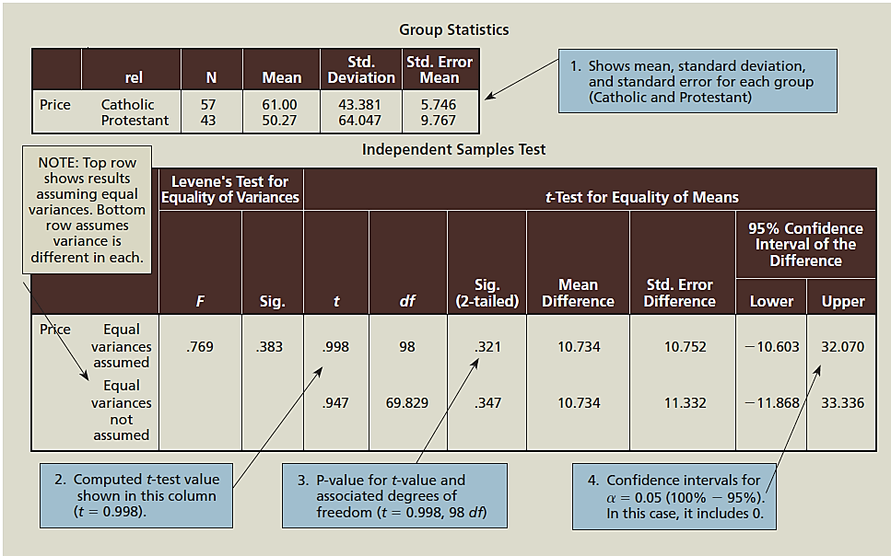
EXHIBIT 15.3 Independent Samples t-Test Results
Please insert image when available

Slide 16
Paired Samples t-Test
A paired samples t-test is appropriate when means that need to be compared are not from independent samples (i.e., the same respondent is measured twice)
When a paired samples t-test is appropriate, the two numbers being compared are usually scored as separate variables

Slide 17
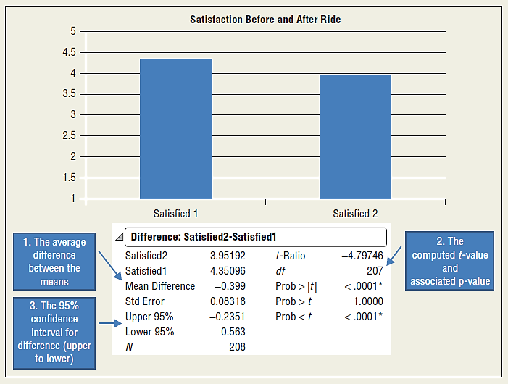
EXHIBIT 15.4 Illustration of Paired-Samples t-Test Results

Slide 18
The Z-Test For Comparing Two Proportions
The Z-test for differences of proportions is used to test the hypothesis that the two proportions will be significantly different for two independent samples or groups
Requires a sample size greater than 30
Appropriate for a hypothesis of this form:
$H_{0}$: $π_{1}≠π_{2}$ or $H_{0}$: $π_{1}−π_{2}=0$
The comparison of the observed sample proportions $p_{1}$and $p_{2}$ allows the researcher to ask whether the differences from two large random samples occurred due to chance alone

Slide 19
The Z-Test Formula
$Z=\frac{\left(p_{1}−p_{2}\right)−(π_{1}−π_{2})}{S_{p1−p2}}$
where
$p_{1}$ = sample proportion of successes in group 1
$p_{2}$ = sample proportion of successes in group 2
$π_{1}−π_{2}$ = hypothesized population proportion 1 minus hypothesized population proportion 2
$S_{p1−p2}$ = pooled estimate of the standard error of differences in proportions
The statistic works on the assumption that the value of $π_{1}−π_{2}$ is zero
Note the similarity between this and the paired-samples t-test

Slide 20
Standard Error of Differences in Proportions Formula
$S_{p1−p2}=\sqrt{\overline{p}\overline{q}(\frac{1}{n_{1}}+\frac{1}{n_{2}})}$
where
$\overline{p}$ = pooled estimate of proportion of successes in a sample
$\overline{q}$ = 1 $−\overline{p}$, or pooled estimate of proportion of failures in a sample
$n_{1}$ = sample size for group 1
$n_{2}$ = sample size for group 2
To calculate the pooled estimator, $\overline{p}$:
$\overline{p}= \frac{n_{1}p_{1}+n_{2}p_{2}}{n_{1}+n_{2}}$

Slide 21
One-Way Analysis of Variance (ANOVA)
When the means of more than two groups or populations are to be compared, one-way analysis of variance (ANOVA) is the appropriate statistical tool
ANOVA involving only one grouping variable is often referred to as one-way ANOVA because only one independent variable is involved
Another way to define ANOVA: the appropriate statistical technique to examine the effect of a less than interval independent variable on an at least interval dependent variable

Slide 22
One-Way Analysis of Variance (ANOVA) (cont’d.)
An independent samples t-test can be thought of as a special case of ANOVA in which the independent variable has only two levels
When more levels exist, the t-test alone cannot handle the problem
The null hypothesis in such a test is that all the means are equal
The substantive hypothesis tests in ANOVA is: at least one group mean is not equal to another group mean
As the term analysis of variance suggests, the problem requires comparing variances to make inferences about the means

Slide 23
Simple Illustration of ANOVA
Data are given describing how much coffee respondents report drinking each day based on which shift they work (i.e., day, night, graveyard)
A table displaying the means for each group and the overall mean is given, and Exhibit 15.5 plots each observation with a bar and lines corresponding to the variances

Slide 24
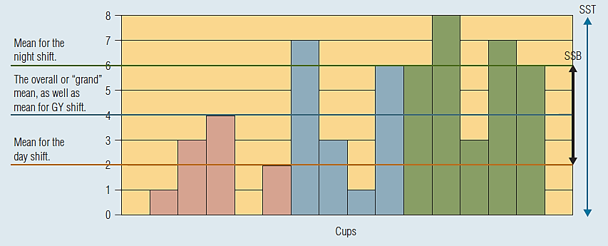
EXHIBIT 15.5 Illustration of ANOVA Logic

Slide 25
Partitioning Variance in ANOVA
Total variability
An implicit question with the use of ANOVA is “How can the dependent variable best be predicted?”
Absent any additional information, the error in predicting an observation is minimized by choosing the central tendency, or mean, for an interval variable
The total error (or variability) that would result from using the grand mean, meaning the mean over all observations, can be thought of as:
SST = Total of (observed value – grand mean)²
Although the term error is used, this really represents how much total variation exists among the measures

Slide 26
Between-Groups Variance
ANOVA tests whether “grouping” observations explains variance in the dependent variable
The between groups variance can be found by taking the total sum of the weighted difference between group means and the overall mean:
SSB = Total of n_{group}(group mean – grand mean)²
The weighting factor (n_{group}) is the specific group sample size
The total SSB represents the variation explained by the experimental or independent variable

Slide 27
Within-Group Error
While the group means explain the variation between the total mean and the group mean, the distance from the group mean and each individual observation remains unexplained, and this distance is called within-group error or variance
The values for each observation can be found by:
$SSE=Total of {(Observed Mean −Group Mean)}^{2}$
The term total error variance is sometimes used to refer to SSE since it is variability not accounted for by the group means

Slide 28
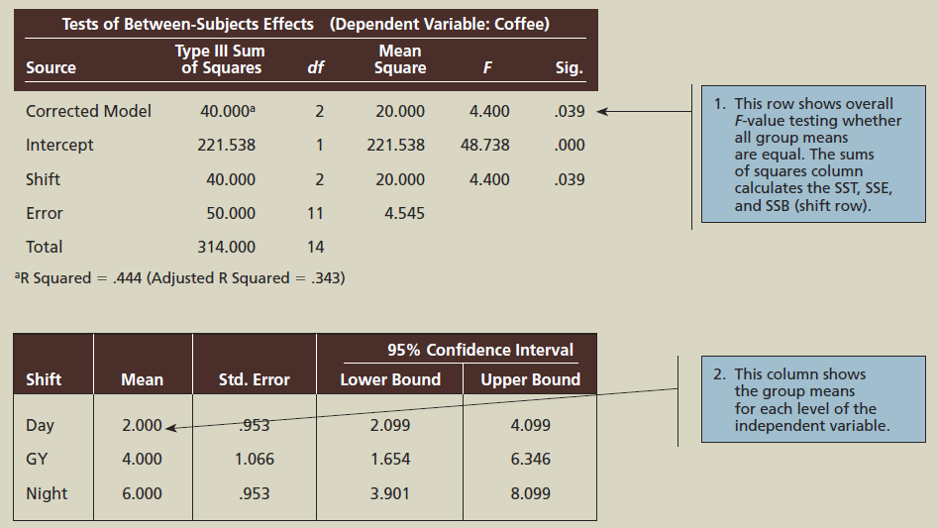
EXHIBIT 15.6 Interpreting ANOVA

Slide 29
The F-Test
The F-Test is the key statistical test for an ANOVA model
Determines whether there is more variability in the scores of one sample than in another sample
The key question is whether the two sample variances are different from each other or whether they are from the same population
The F-statistic (of F-ratio) can be obtained by taking the larger sample variance and dividing by the smaller sample variance
Degrees of freedom must be specified

Slide 30
Using Variance Components to Compute F-Ratios
Three forms of variation
SSE – variation of scores due to random error or within-group variation due to individual differences from the group mean
SSB – systematic variation of scores between groups due to manipulation of an experimental variable or group classifications of a measured independent variable or between-group variance
SST – the total observed variation across all groups and individual observations

Slide 31
Using Variance Components to Compute F-Ratios (cont’d.)
The F-distribution is a function of the ratio of these two sources of variance:
$F=f\left(\frac{SSB}{SSE}\right)$
A larger ratio of variance between groups to variance within groups implies a greater value of F
If the F-value is large, the results are likely to be statistically significant

Slide 32
A Different But Equivalent Representation
F also can be thoughts of as a function of the between group variance and total variance
$F=f\left(\frac{SSB}{SST−SSB}\right)$

Slide 33
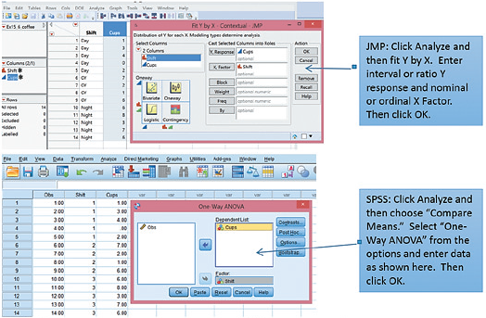
EXHIBIT 15.7 How to Do One-Way ANOVA using SAS JMP, SPSS, and EXCEL

Slide 34
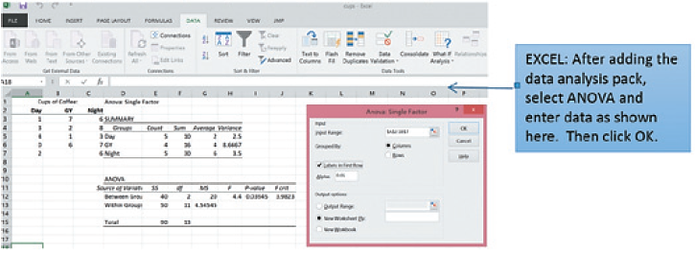
EXHIBIT 15.7 How to Do One-Way ANOVA using SAS JMP, SPSS, and EXCEL (cont’d.)

Slide 35
Practically Speaking
The first thing to check is whether or not the overall model F is significant
Second, the researcher must examine the actual means from each group to properly interpret the result

Slide 36
Statistical Software
The marketing research analyst has access to statistical software that facilitates statistical analysis by quickly and easily providing results for t-tests, cross-tabulations, ANOVA, GLM, and more
Some data mining routines even automate some of this analysis
Some of the most common statistical software packages are SPSS, now owned by IBM, SAS, and its new user friendly product called JMP

Slide 37
Statistical Software (cont’d.)
Excel includes basic data analysis functions and an add-in data analysis function that contains procedures like ANOVA
However, for marketing researchers, packages like SPSS and JMP offer an easy to use interface and a standardized approach to statistics

Slide 38
General Linear Model
Multivariate dependence techniques are variants of the general linear model (GLM)
The GLM is a way of modeling some process based on how different variables cause fluctuations from the average dependent variable
Fluctuations can come in the form of group means that differ from the overall mean as is in ANOVA or in the form of a significant slope coefficient as in regression

Slide 39
GLM Equation
${\hat{Y}}_{i} = \overline{Y} + ΔX + ΔF + ΔXF$
Here, $\overline{Y}$represents a constant, which can be thought of as the overall mean of the dependent variable, ΔX and ΔF represent changes due to main effect independent variables (such as experimental variables) and blocking independent variables (such as covariates or grouping variables), respectively, and ΔXF represents the change due to the combination (interaction effect) of those variables
Y_{i} in this case could represent multiple dependent variables, just as X and F could represent multiple independent variables
This form is an ANOVA representation

Slide 40
ANCOVA
An ANCOVA representation would add a continuous covariate (Xc):
${\hat{Y}}_{i} = \overline{Y} + ΔX + ΔF + ΔXF+BX_{C}$
B is a regression coefficient

Slide 41
Regression Analysis
Simple regression investigates a straight-line relationship of the type:
Y = α + βX
Where Y is a continuous dependent variable and X is an independent variable that is usually continuous (although a dichotomous nominal or ordinal variables can be included in the form of a dummy variable)
Alpha (α) and beta (β) are two parameters that must be estimated so that the equation best represents a given set of data
These two parameters determine the height of the regression line and the angle of the line relative to horizontal
When these parameters change, the line changes

Slide 42
Interpreting Multiple Regression Analysis
Multiple regression analysis allows one dependent variable to be explained by more than one independent variable
When trying to explain sales, plausible independent variables include prices, economic factors, advertising intensity, and consumers’ incomes in the area
A simple regression equation can be expanded to represent multiple regression analysis:
Y_{i} = b₀ + b₁X₁ + b₂X₂ + b₃X₃ + … + b_{n}X_{n} + e_{i}

Slide 43
Parameter Estimate Choices
The estimates for α and β are the key to regression analysis
In most business research, the estimate of β is most important
The explanatory power of regression rests with β because this is where the direction and strength of the relationship between the independent and dependent variable is explained
A Y-intercept term is sometimes referred to as a constant because α represents a fixed point
An estimated slope coefficient is sometimes referred to as a regression weight, regression coefficient, parameter estimate, or sometimes even as a path estimate

Slide 44
Parameter Estimate Choices (cont’d.)
Researchers often explain regression results by referring to a standardized regression coefficient (β)
A standardized regression coefficient, like a correlation coefficient, provides a common metric allowing regression results to be compared to one another no matter what the original scale range may have been
Due to the mathematics involved in standardization, the standardized Y-intercept term is always 0

Slide 45
Using Shorthand Regression Coefficients as Either “Raw” or “Standardized”
The most common shorthand is as follows:
B₀ or b₀—raw (unstandardized) Y-intercept term; an estimate of what was referred to as α in the previous slide
B₁ or b₁—raw regression coefficient or estimate
β₁—standardized regression coefficients
The bottom line is that when the actual units of measurement are the focus of analysis, such as might be the case in trying to forecast sales during some period, raw (unstandardized) coefficients are most appropriate
Use standardized regression when the size of the relationship for each IV can be compared directly

Slide 46
Steps in Interpreting A Multiple Regression Model
Examine the model F-test
If the result is not significant, the model should be dismissed
Examine the individual statistical tests for each parameter estimate
Independent variables with significant results can be considered a significant explanatory variable

Slide 47
Steps in Interpreting A Multiple Regression Model (cont’d.)
Examine the model $R^{2}$
No cutoff values exist that can distinguish an acceptable amount of explained variation across all regression models
However, the absolute value of $R^{2}$ is more important when the researcher is more interested in prediction than explanation
A next step would be to diagnose multicollinearity
This is the extent to which the independent variables are redundant

Slide 48
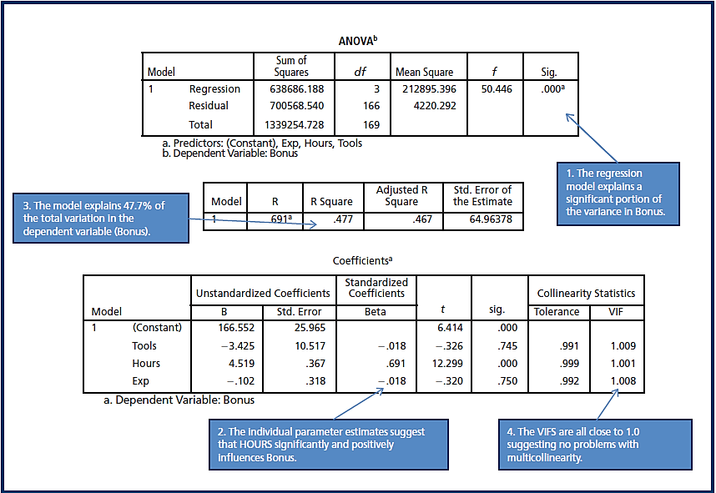
EXHIBIT 15.8 Illustration of Steps for Interpreting a Multiple Regression Model

