Slide 1
Chapter 10
Measurement and Attitude Scaling

Slide 2
LEARNING OUTCOMES
Determine what things need to be measured to address a research question
Distinguish levels of scale measurement
Create an index or composite measure
Assess scale reliability and validity
Understand why the concept of attitude is so important in marketing research
Design a scale that measures an attitudinal concept
Implement a multi-attribute model

Slide 3
Introduction
Anyone who has ever followed a recipe knows the importance of good measurement
Just as in the culinary arts, researchers can measure business and marketing in more than one way
Researchers often may have to use imperfect measurement devices
Measure a concept poorly and the “recipe” is a likely disaster
Only in this case, the “recipe” is usually an important business decision poorly made instead of a ruined dish

Slide 4
What Needs to Be Measured?
Business and marketing concepts can often be measured in more than one way
Before the measurement process can be defined, researchers have to decide exactly what it is that needs to be produced
The decision statement, corresponding research questions, and research hypotheses can be used to decide what concepts need to be measured

Slide 5
What Needs to Be Measured? (cont’d.)
Measurement is the process of describing some property of a phenomenon of interest usually by assigning numbers in a reliable and valid way
When numbers are used, the researcher must have a rule for assigning a number to an observation in a way that provides an accurate description
All measurement systems present the potential for error

Slide 6
Concepts
Generalized ideas that represent something of meaning
Concepts such as age, sex, and number of children are relatively concrete properties and present few problems in either definition or measurement
Concepts such as brand loyalty, personality, and so on, are more abstract and are more difficult to both define and measure

Slide 7
Operational Definitions
Researchers measure concepts through a process known as operationalization
A process that involves identifying scales that correspond to variance in the concept
Scales provide:
A range of values that correspond to different values in the concept being measured
Correspondence rules that indicate that a certain value on a scale corresponds to some true value of a concept, hopefully in a truthful way

Slide 8
Variables
Researchers use variance in concepts to make diagnoses
Variables capture different concept values
Scales capture variance in concepts and as such, the scales provide the researcher’s variables
Once a research project is underway, there is little difference between a concept and a variable

Slide 9
Constructs
A term used for concepts that are measured with multiple variables
Sometimes a single variable cannot capture a concept alone
Using multiple variables to measure one concept can provide a more complete account of some concept than could any single variable
Operational definitions translate conceptual definitions into measurement scales

Slide 10
Levels of Scale Measurement
Important because it determines the mathematical comparisons that are allowed
The four levels of scale measurement
Nominal
Ordinal
Interval
Ratio

Slide 11
Nominal Scales
Represent the simplest type of scale and assign a value to an object for identification or classification purposes
The value can be but does not have to be a number since no quantities are being represented
A qualitative scale
Useful even though they can be considered elementary
Marketing researchers use nominal scales quite often

Slide 12
Nominal Scales (cont’d.)
Arbitrary in the sense that each label can be assigned to any of the categories without introducing error
Examples
Uniform numbers
Airport terminals
School bus numbers

Slide 13
Ordinal Scales
Have nominal properties
Allow things to be arranged based on how much of some concept they possess
Include ranking scales
Are somewhat arbitrary
Example: “win,” “place,” and “show” in a horse race tells which horse was first, second, and third, but does not tell by how much a horse won

Slide 14
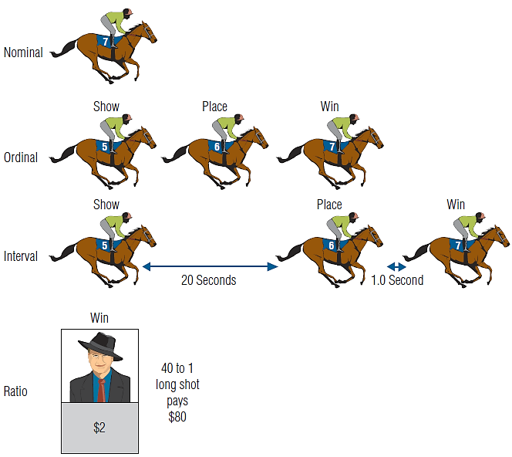
EXHIBIT 10.2 Nominal, Ordinal, Interval, and Ratio Scales Provide Different Information

Slide 15
Interval Scales
Have both nominal and ordinal properties
Capture information about differences in quantities of a concept
Classic example: Fahrenheit temperature scale:
80 degrees is hotter than 40 degrees
One cannot conclude that the 40° is twice as cold as 80°
Illustration: convert the temperatures to the Celsius scale 80° F = 26.7° C and 40° F = 4.4° C.
Do not exactly represent some phenomenon

Slide 16
Ratio Scales
Represents the highest form of measurement
Have all the properties of interval scales with the additional attribute of representing absolute quantities
Represent absolute meaning
Provide iconic measurement

Slide 17
Ratio Scales (cont’d.)
Zero, therefore, has meaning in that it represents an absence of some concept
An absolute zero is a defining characteristic in determining between ratio and interval scales
For example, money is a way to measure economic value

Slide 18
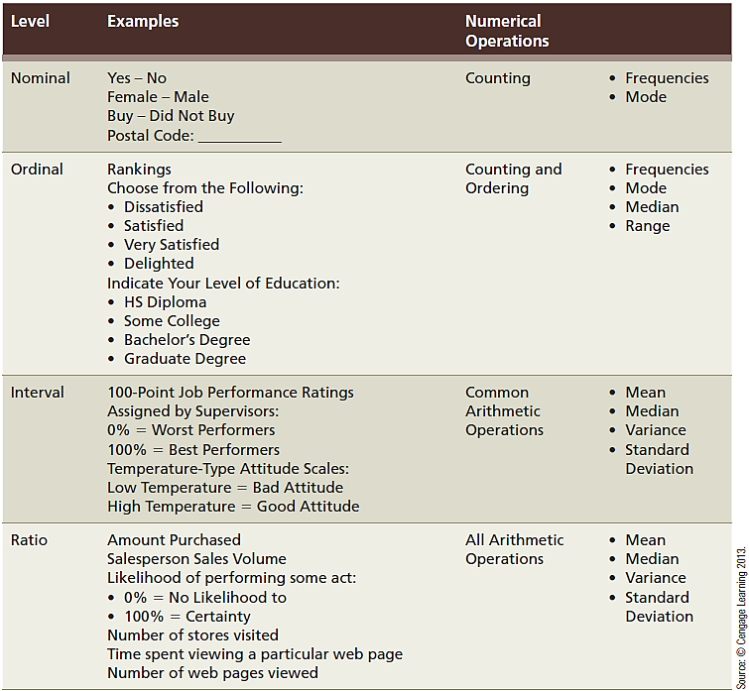
EXHIBIT 10.3 Facts About the Four Levels of Scales

Slide 19
EXHIBIT 10.3 Facts About the Four Levels of Scales (cont’d.)

Slide 20
Mathematical and Statistical Analysis of Scales
A researcher must know the meaning behind the numbers before useful conclusions can be drawn
Example: averaging the numbers used to identify school busses is meaningless

Slide 21
Discrete Measures
Take on only one of a finite number of values
Most often used to represent a classificatory variable
Do not represent intensity of measures
Common discrete scales include any yes-no response, matching, etc.
Can possess ordinal properties and nominal properties
The central tendency of a nominal or ordinal discrete measure is best captured by the mode

Slide 22
Continuous Measures
Assign values anywhere along some scale range in a place that corresponds to the intensity of some concept
Ratio measures are continuous measures
Marketing researchers generally treat interval scales with five or more categories as continuous

Slide 23
Continuous Measures (cont’d.)
Researchers should keep in mind the distinction between ratio and interval measures
Errors in judgment can be made when interval measures are treated as ratio
An attitude of 0 means nothing as attitude only has meaning in a relative sense
The means and standard deviation may be calculated from continuous data
Using the actual quantities from arithmetic operations is permissible with ratio scales

Slide 24
Reliable and Valid Measures
An attribute is a single characteristic or fundamental feature of an object, person, situation, or issue
Attribute assessment is common in marketing research
The measures of attributes are often combined to represent some less concrete concept

Slide 25
Indexes and Composites
Multi-item instruments for measuring a construct are called index measures, or composite measures
An index measure assigns a value based on how much of the concept being measured is associated with an observation
An index is often formed by putting several variables together
Composite scales also assign a value based on a mathematical derivation of multiple variables

Slide 26
Computing Scale Values
A summated scale is created by summing the response to each item making up the composite measure
A researcher may sometimes choose to average the scores rather than summing them because the composite measure is expressed on the same scale as is the items that make it up
Reverse coding means that the value assigned for a response is treated oppositely from the other items

Slide 27
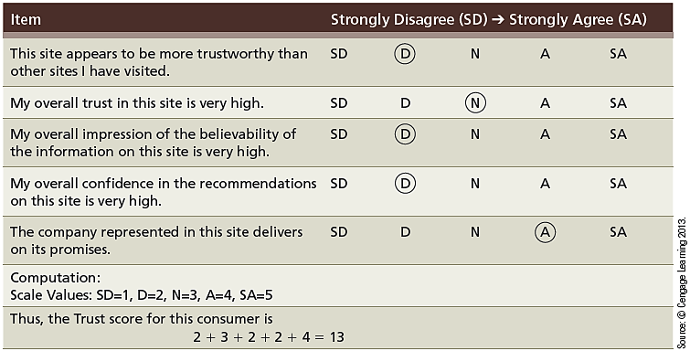
EXHIBIT 10.4 Computing a Composite Scale

Slide 28
Reliability
An indicator of a measure’s internal consistency
A measure is reliable when different attempts at measuring something converge on the same result
When the measuring process provides reproducible results, the measuring instrument is reliable

Slide 29
Internal Consistency
Represents a measure’s homogeneity
Internal consistency of a multiple-item measure can be measured by correlating scores on subsets of items making up a scale
The split-half method of checking reliability
Take half the items from the scale and checking them against the results from the other half
The two scale halves should:
Correlate highly
Produce similar scores

Slide 30
Coefficient Alpha (α)
Represents internal consistency by computing the average of all possible split-half reliabilities for a multiple item scale
The coefficient demonstrates whether or not the different items converge
Ranges in value from 0 (no consistency) to 1 (complete consistency)
0.80 - 0.96: very good reliability
0.70 - 0.80: good reliability
0.60 - 0.70: fair reliability
Below 0.60: poor reliability

Slide 31
Test-Retest Reliability
The test-retest method of determining reliability involves administering the same scale or measure to the same respondents at two separate times to test for stability
If the measure is stable over time, the test, administered under the same conditions each time, should obtain similar results
Represents a measure’s repeatability

Slide 32
Test-Retest Reliability (cont’d.)
Reliability is a necessary but insufficient condition for validity
A reliable scale may not be valid
A reliable but invalid instrument will yield consistently inaccurate results

Slide 33
Validity
Good measures should be both precise (i.e., reliable) and accurate (i.e., valid).
Validity is the accuracy of a measure or the extent to which a score truthfully represents a concept
Achieving validity is not a simple matter
Addresses the problem of whether a measure indeed measures what it is supposed to measure
When a measure lacks validity, any conclusions based on that measure are also likely to be faulty

Slide 34
Establishing Validity
The three approaches to establishing validity
Face (content) validity refers to the subjective agreement among professionals that a scale logically reflects the concept being measured
Criterion validity addresses the question: “Does my measure correlate with measures of similar concepts or known quantities?”
May be classified as either concurrent validity or predictive validity
Construct validity

Slide 35
Construct Validity
Exists when a measure reliably measures and truthfully represents a unique concept and consists of several components:
Face validity
Criterion validity
Convergent validity
Discriminant validity
Fit validity

Slide 36
Reliability versus Validity
The differences between the two are illustrated with rifle targets (see Exhibit 10.5)
A: The shots from the older gun are scattered ► low reliability
B: The shots from the newer gun are closely clustered and on target ► high reliability and validity
C: The shots from a newer gun are closely clustered but off target ► high reliability but low validity

Slide 37
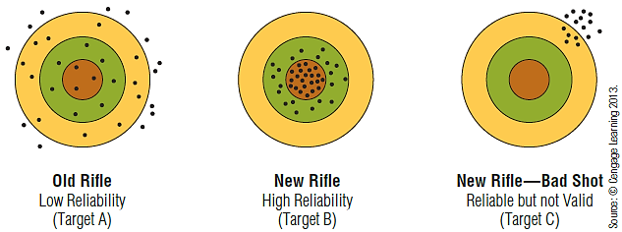
EXHIBIT 10.5 Computing a Composite Scale

Slide 38
What Is an Attitude?
An enduring disposition to respond consistently in a given manner to various aspects of the world, including persons, events, and objects
There are three components of attitude:
Affective component – expresses how much affinity someone has toward the relevant matter
Cognitive component – represents an individual’s awareness of the relevant matter
Behavioral component – represents the action that corresponds to a certain type of attitude

Slide 39
Attitude Measures and Scaling
A remarkable variety of techniques has been devised to measure attitudes, stemming in part from lack of consensus about the exact definition of the concept
The affective, cognitive, and behavioral components of an attitude may be measured by different means, i.e., direct to indirect, physiological to verbal, etc.

Slide 40
Physiological Measures
Research may assess the affective (emotional) components of attitudes through physiological measures
Examples: galvanic skin response (GSR), blood pressure, magnetic resonance imaging (MRI), and pupil dilation
These measures provide:
A means of assessing affect without verbally questioning the respondent
A gross measure of likes or dislikes; they are not extremely sensitive to the different gradients of an attitude

Slide 41
Self-Report Scales
Involve gaining a respondent’s structured response to some specific query or stimulus
Researchers can ask respondents to rank, rate, sort, or choose one of multiple responses
A ranking task requires the respondent to rank order a small number of stores, brands, feelings, or objects based on overall preference or of some characteristic of the stimulus
Rankings provide ordinal measurement

Slide 42
Self-Report Scales (cont’d.)
Rating requires the respondent to estimate the magnitude or the extent to which some characteristic exists or some choice is preferred
A sorting task presents the respondent with several product concepts to classify the concepts
Another type of attitude measurement requires a choice between two or more alternatives

Slide 43
Measuring the Affect Component
Exhibit 10.6 displays an approach to ask respondents to rate their affect toward an object
Respondents are asked to choose a “manikin” from each or three rows to show: 1) their general affective state (like or dislike); 2) the degree to which they get emotionally aroused; and 3) how much the thing being rated makes them feel small (unimportant) or important

Slide 44
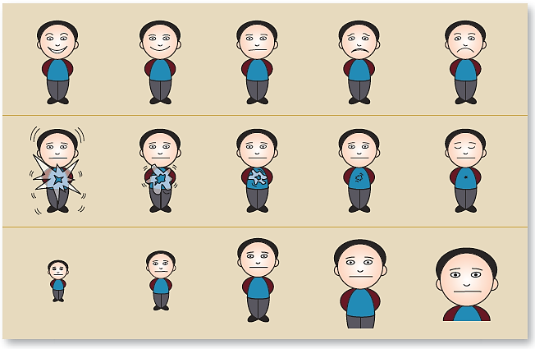
EXHIBIT 10.6 Novel Approach to Rating Affect
Notes:
Sources: Morris, J. D. (1995), “Observations: SAM: The Self-Assessment Manikin: An Efficient Cross-Cultural Measurement of Emotional Response,” Journal of Advertising Research, 35, 63–68. Morris, J. D., C. Woo and A. J. Singh (2005), “Elaboration Likelihood Model: A Missing Intrinsic Emotional Implication,” Journal of Targeting, Measurement and Analysis for Marketing, 14 (October), 79–98.

Slide 45
Category Scales
Rating scales that consist of several response categories, often providing respondents with alternatives to indicate positions on a continuum
Ordered categories based on a particular descriptive or evaluative dimension can provide further information
Measure attitude with greater sensitivity than a two-point response scale
Question wording is an extremely important factor in the usefulness of these scales

Slide 46
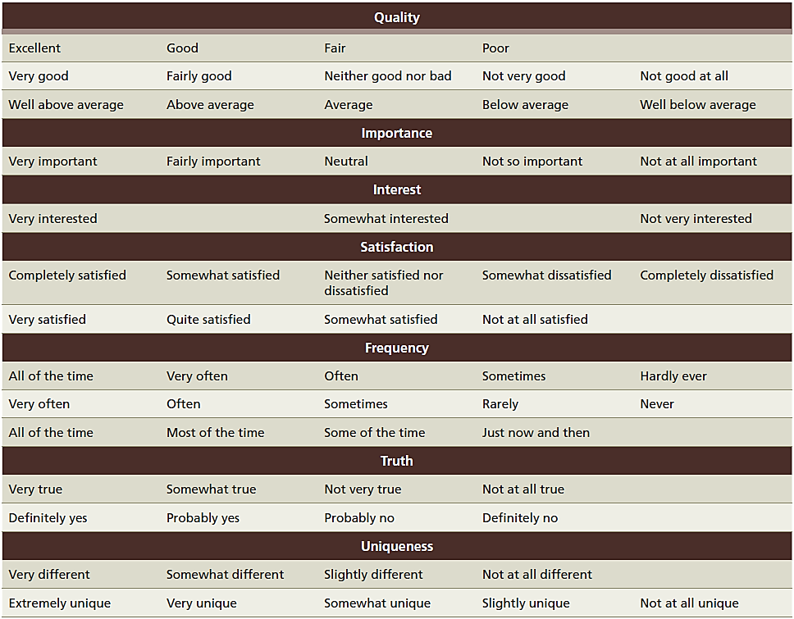
EXHIBIT 10.7 Commonly Applied Category Scale Descriptions

Slide 47
EXHIBIT 10.7 Commonly Applied Category Scale Descriptions (cont’d.)

Slide 48
The Likert Scale
Respondents indicate their attitudes by checking how strongly they agree or disagree with carefully constructed statements, ranging from very positive to very negative attitudes
Individuals generally choose from approximately five, e.g., “strongly agree,” “agree,” “uncertain,” “disagree,” and “strongly disagree”
Researchers assign scores to each possible response (e.g., 1, 2, 3, 4, and 5, respectively)
Attitude scores are at best interval and not ratio

Slide 49
Selecting Items for a Likert Scale
A researcher may use multiple items to represent a single attitudinal concept and generate a large number of statements before putting together the final questionnaire
A pretest may be conducted using these items, allowing for an item analysis to be performed
Allows for selecting items that evoke a wide response

Slide 50
Semantic Differential
A scale type that has respondents describe their attitude using a series of bipolar rating scales
Bipolar adjectives—such as “good” and “bad,” “modern” and “old-fashioned,” or “clean” and “dirty”—anchor both ends (or poles) of the scale
Semantic differentials and meaning
The validity of the semantic differential depends on finding scale anchors that are semantic opposites

Slide 51
EXHIBIT 10.8 An Example of a Semantic Differential Scale

Slide 52
Scoring Semantic Differentials
For scoring purposes, a numerical score is assigned to each position on the rating scale (i.e., 1, 2, 3, 4, 5, 6, 7 or -3, -2, -1, 0, +1, +2, +3).
Researchers generally assume that the semantic differential provides interval data
Critics argue that the data have only ordinal properties because the numerical scores are arbitrary
Practically, marketing researchers treat them as metric (at least interval) because the amount of error introduced by assuming the intervals between choices are equal is fairly small

Slide 53
Constant-Sum Scale
With a constant-sum scale, respondents are asked to divide a fixed number of points among several attributes to indicate their relative importance
If respondents follow the instructions correctly, the results will approximate interval measures
The scale is flawed because the last response is completely determined by the way the respondent has scored the other choices

Slide 54
Graphic Rating Scales
Present respondents with a graphic continuum
Respondents are allowed to choose any point on the continuum to indicate their attitude
Ways to determine a respondent’s score
Measure the length (in millimeters) from one end of the continuum to the point marked by the respondent
Divide the line into predetermined scoring categories (lengths) and record respondents’ marks accordingly
Advantage
Allows the researcher to choose any interval desired for purposes of scoring

Slide 55
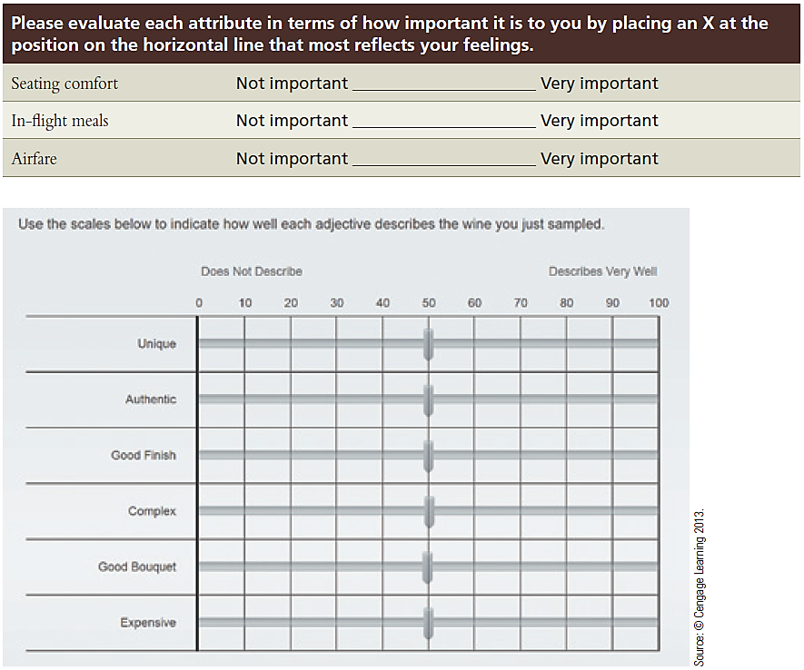
EXHIBIT 10.9 Graphic Rating Scale

Slide 56
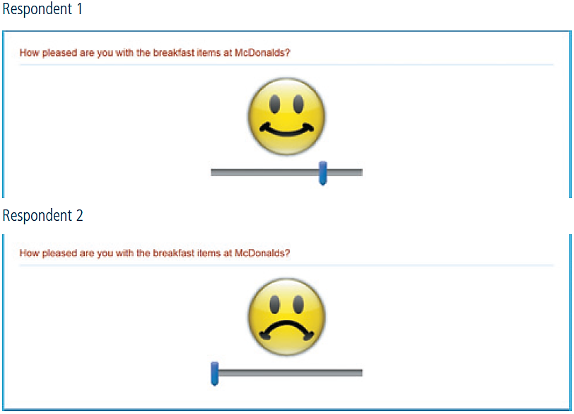
EXHIBIT 10.10 Using Face Scales to Assess Attitudes

Slide 57
Ranking
Consumers often rank order their preferences
An ordinal scale may be developed by asking respondents to rank order (from most preferred to least preferred) a set of objects or attributes
The ranking scale suffers from inflexibility in that if we know how someone ranked five out of six alternatives, we know the answer to the sixth

Slide 58
Paired Comparisons
In paired comparisons, the respondents are presented with two objects at a time and asked to pick the one they prefer
Ranking objects with respect to one attribute is not difficult if only a few products are compared, but as the number of items increases, the number of comparisons increases geometrically [(n)(n - 1)/2]
If the number of comparisons is too large
Respondents may fatigue and no longer carefully discriminate among them

Slide 59
Direct Assessment of Consumer Attitudes
Attitudes, as hypothetical constructs, cannot be observed directly
One’s attitude can be inferred by the way he or she responds to multiple attitude indicators
The decision whether to use ranking, sorting, rating, or a choice technique is determined by:
The problem definition
The type of statistical analysis desired

Slide 60
How Many Scale Categories or Response Positions?
A matter of sensitivity
More categories are better than fewer
Be careful that the number category responses does not become taxing to respondents

Slide 61
Balanced or Unbalanced Rating Scale?
The fixed-alternative format may be balanced or unbalanced
A balanced scale has an equal number of positive and negative categories and a neutral point
Unbalanced rating scales have more response categories at one end than the other
The choice generally depends on the concept or the researcher’s knowledge about attitudes toward the stimulus to be measured

Slide 62
Forced-Choice Scales?
In many situations, a respondent has not formed an attitude towards a concept
If a forced-choice rating scale compels the respondent to answer, the response is merely a function of the question
If answers are not forced, the midpoint of the scale may be used by the respondent to indicate unawareness as well as indifference
If many respondents are expected to be unaware of the attitudinal object, this problem may be eliminated by using a “no opinion” category

Slide 63
Single or Multiple Items?
Depends on:
The complexity of the issue to be investigated
The number of dimensions the issue contains
The level of abstraction of the phenomenon
The researcher’s conceptual definition will be helpful in making this choice

Slide 64
Attitudes and Intentions
Attitudes are considered a function of a person’s beliefs about some activity weighted by their evaluations of those characteristics
Research in this area is sometimes referred to as a multi-attribute model or reasoned action approach

Slide 65
Multi-Attribute Attitude Score
Attitudes are modeled with a multi-attribute approach
Take belief scores assessed with some type of rating scale
Multiply each belief score by an evaluation also supplied using some type of rating scale
Sum each resulting product
Advantages
Results can provide management with feedback on the relative attitude scores and identify characteristics that are most in need of being improved

Slide 66
Behavioral Intention
Intentions represent the behavioral expectations of an individual toward an attitudinal object
The component of interest to marketers is buying intention, a tendency to seek additional information, or plans to visit a showroom
Category scales for measuring the behavioral component of an attitude ask about a respondent’s likelihood of purchase or intention to perform some future action, e.g., “How likely is it that you will purchase…?”

