Slide 1
Chapter 5
Qualitative Research Tools

Slide 2
LEARNING OUTCOMES
Contrast qualitative research with quantitative research
Know the role of qualitative research in exploratory research designs
Describe the basic orientations of qualitative research
Recognize common qualitative research tools and know the advantages and limitations of their use
Prepare a focus group interview outline
Recognize ways social networking and the blogosphere provide opportunities for qualitative research

Slide 3
Describing Qualitative Research
Qualitative marketing research
  Addresses marketing objectives through techniques allowing the researcher to provide elaborate interpretations of market phenomena without depending on numerical measurement
  Focuses on discovering true inner meanings and new insights
Researcher-dependent
  Researcher must extract meaning from unstructured responses, e.g., text from a recorded interview or a collage representing the meaning of some experience

Slide 4
Uses of Qualitative Research
Qualitative research is useful when:
  It is difficult to develop specific and actionable decision statements or research objectives
  The research objective is to develop a detailed and in-depth understanding of some phenomena
  The research objective is to learn how consumers use a product in its natural setting or to learn how to express some concept in colloquial terms
  The behavior the researcher is studying is particularly context-dependent
  A fresh approach to studying the problem is needed

Slide 5
Qualitative “Versus” Quantitative Research
Qualitative research can accomplish research objectives that quantitative research cannot and vice versa
  The key to successfully using either is to match the right approach to the right research context
Quantitative marketing research
  Addresses research objectives through empirical assessments that involve numerical measurement and statistical analysis

Slide 6
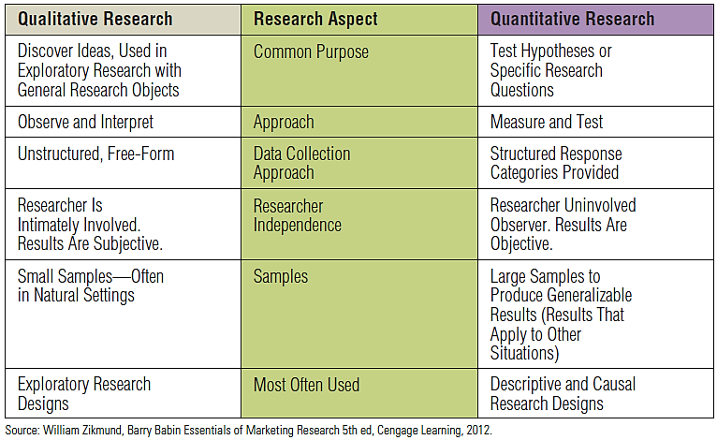
EXHIBIT 5.1 Comparing Qualitative and Quantitative Research

Slide 7
Contrasting Qualitative with Quantitative Methods
Qualitative research results are researcher-dependent, or subjective
  Different researchers may reach different conclusions based on the same data
Qualitative research usually involves smaller samples than the typical quantitative study
  Acceptable in discovery-oriented research
  Smaller sample sizes do not necessarily equate to cost savings

Slide 8
Qualitative Research and Exploratory Research Designs
Qualitative data
  Data that are not characterized by numbers but rather, are textual, visual, or oral
  Focus on stories, visual portrayals, meaningful characterizations, interpretations, and other expressive descriptions
Quantitative data
  Represent phenomena by assigning numbers in an ordered and meaningful way

Slide 9
Idea Generation
Qualitative research can generate ideas for new products, advertising copy, promotional ideas, and product improvements in numerous ways
Checklist for a creative mindset
  Quantity leads to quality
  Wilder is better
  Do not judge
  Question assumptions

Slide 10
Probing
An interview technique that tries to draw deeper and more elaborate explanations from a respondent
Useful for the following reasons:
  Clarification
  Free-form thinking
  Pause
  Contrast
  Meaning
  Change

Slide 11
Qualitative Research Orientations
Major categories of qualitative research
  Phenomenology—originating in philosophy and psychology
  Ethnography—originating in anthropology
  Grounded theory—originating in sociology
  Case studies—originating in psychology and in business research

Slide 12
Case Studies
What are case studies?
  The documented history of a particular person, group, organization, or event
  Themes are identified by the frequency with which the same term (or a synonym) arises in the narrative description
How are case studies used?
  Commonly applied to business
  Primary advantage is the ability to study an entire organization in depth with meticulous attention to detail

Slide 13
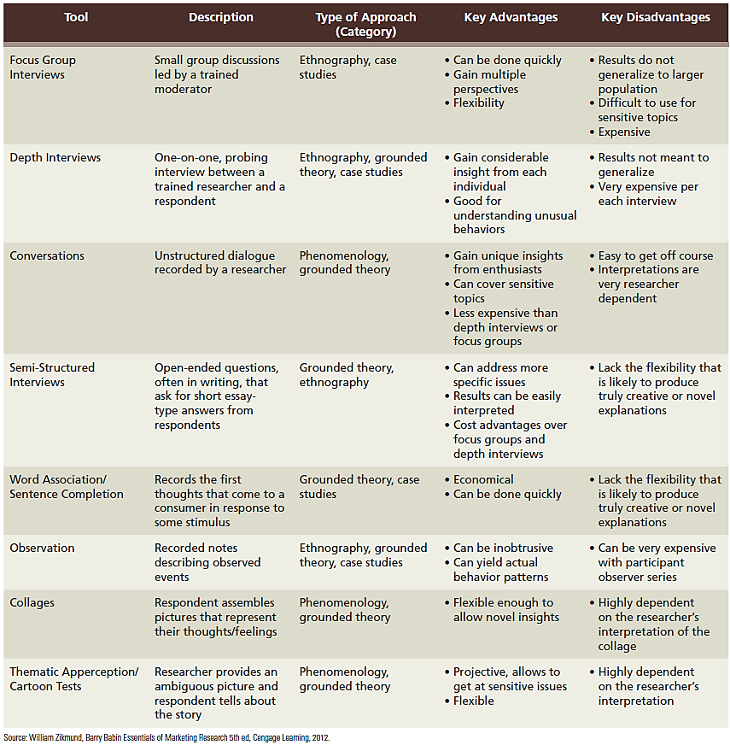
EXHIBIT 5.4 Common Qualitative Research Tools

Slide 14
EXHIBIT 1.1 Common Qualitative Research Methods (cont’d.)

Slide 15
Focus Group Interview
An unstructured, free-flowing interview with a small group (6-10 people) led by a moderator who encourages dialogue among respondents
Advantages
  Relatively fast
  Easy to execute
  Allow respondents to piggyback off each other’s ideas
  Provide multiple perspectives
  Flexibility to allow more detailed descriptions
  High degree of scrutiny

Slide 16
Focus Group Respondents
Group composition
  Six to ten people
  Relatively homogeneous
  Similar lifestyles and experiences

Slide 17
The Focus Group Moderator
Moderator
  A person who leads a focus group interview and ensures that everyone gets a chance to speak and contribute to the discussion
Qualities of a good moderator:
  Develops rapport with the group
  Good listener
  Tries not to interject his/her own opinions
  Controls the discussion without being overbearing

Slide 18
Focus Groups as Diagnostic Tools
Can supply diagnostic help to other research studies
Excellent tools for spotting problems with ideas as an idea screening technique
Mature products can also be “focused-grouped” for improvements

Slide 19
Depth Interviews
Depth interview
  A one-on-one interview between a professional researcher and a research respondent conducted about some relevant business or social topic
Laddering
  A particular approach to probing that asks respondents to compare differences between brands at different levels
  Produces distinctions at the attribute level, benefit level, and the value or motivation level

Slide 20
Depth Interview Procedure
May last more than an hour
Produces the same amount of text as a focus group
Interviewer must be aware of what is happening
  Records both surface reactions and subconscious motivations of the respondent
Analysis and interpretation is highly subjective
Particularly advantageous when the focus is on some unique or unusual behavior

Slide 21
Conversations and Semi-Structured Interviews
Conversations
  An informal qualitative data-gathering approach in which the researcher engages a respondent in a discussion of the relevant subject matter
Semi-structured interviews
  Written form that asks respondents for short essay responses to specific open-ended questions
  Advantages
    Can address more specific issues
    Responses are easier to interpret
    Can be relatively cost effective without the presence of an interviewer

Slide 22
Observation and Collages
Observation
  Field notes: the researcher’s descriptions of what actually happens in the field
  Become the text from which meaning is extracted
  Advantageous for gaining insight into things that respondents cannot or will not verbalize
Collages
  Respondents prepare a collage to represent their experience with some good, service, or brand
  Analyzed for meaning

Slide 23
Preparing a Focus Group Outline
Discussion guide
  Includes written introductory comments informing the group about the focus group purpose and rules
  Outlines topics or questions to be addressed in the group session

Slide 24
Steps for an Effective Focus Group Discussion Guide
Conduct welcome and introductions first
Begin the interview with a broad icebreaker that does not reveal too many specifics about the interview
Make questions increasingly more specific as the interview proceeds

Slide 25
Steps for an Effective Focus Group Discussion Guide (cont’d.)
If there is a very specific objective to be accomplished, that question should probably be saved for last
A debriefing statement should provide respondents with the actual focus group objectives and answering any questions they may have

Slide 26
Disadvantages of Focus Groups
Focus groups:
  Require objective, sensitive, and effective moderators
  May have unique sampling problems
  May not be useful for discussing sensitive topics in face-to-face situations
  Cost a considerable amount of money
    Particularly when they are not conducted by someone employed by the company requesting the focus group

Slide 27
Modern Technology and Qualitative Research
Facilitating interviewing
  Videoconferencing technologies
  Interactive media and online focus groups
  Focus blogs
Social networking
Software development

Slide 28
Online Versus Face-to-Face Focus Group Techniques
Advantages
  Fast
  Inexpensive
  Bring together many participants from wide-spread geographical areas
  Respondent anonymity
  Transcript automatically recorded
Disadvantages
  Less control over who participates
  Participants cannot touch or taste something
  Facial expression and body language cannot be seen
  Reduced ability of moderator to probe and ask questions

Slide 29
Social Networking
One of the most impactful trends in recent times
  For many, social networking sites have become the primary tool for communicating with friends both far and near and known and unknown
  Well-known sites: Facebook, tmblr, and Twitter
A large portion of social networking information discusses marketing and consumer-related information
  Companies monitor these sites for information related to their brands

Slide 30
Exploratory Research in Science and in Practice
Misuses of exploratory and qualitative research
  Interpretation
    Qualitative research cannot draw conclusive references
  Replicability
    When the same conclusion is reached based on another researcher’s interpretation
  Motivational research era
    Too few researchers engaged in too much interpretation of too few respondents

