Slide 1
Introduction to XHTML
Cont:

Slide 2
Images
The img element’s src attribute specifies an image’s location
Every img element must have an alt attribute, which contains text that is displayed if the client cannot render the image
The alt attribute makes web pages more accessible to users with disabilities, especially vision impairments
Width and height are optional attributes but recommended
If omitted, the browser uses the image’s actual width and height
Images are measured in pixels

Slide 3
Images (Cont.)
Some XHTML elements are empty elements that contain only attributes and do not mark up text
Empty elements (e.g., img) must be terminated, either by using the forward slash character (/) inside the closing right angle bracket or by explicitly writing an end tag

Slide 4
Specifies the image file’s location
Specifies the image’s width
Specifies the image’s height
Specifies text to display if the image is unavailable

Slide 5
Creates a hyperlinked image

Slide 6
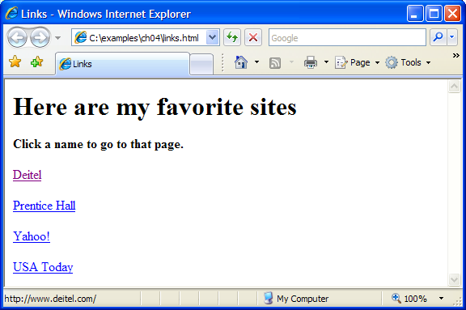
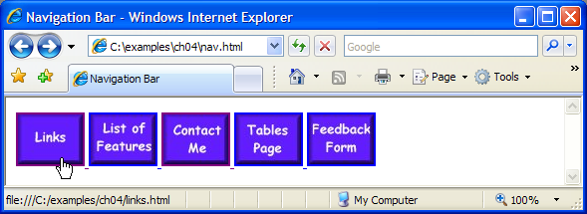

Slide 7
Special Characters and Horizontal Rules
XHTML provides special characters or entity references (in the form &code;) for representing characters that cannot be rendered otherwise
The code can be:
Word abbreviations
Numbers
Decimal
Hexadecimal
Example: & character represented by:
&amp
&#38 (decimal)
&#x26 (hexadecimal)

Slide 8
Special Characters and Horizontal Rules Cont.
Most browsers render a horizontal rule, indicated by the <hr /> tag, as a horizontal line
The hr element also inserts a line break above and below the horizontal line

Slide 9
Inserts a horizontal rule, with a line break before and after
Inserts the special characters © and &

Slide 10
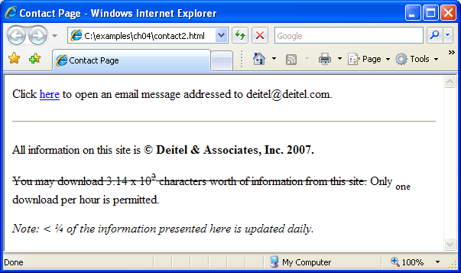
Creates a strikethrough effect
Makes the 1 subscript
Makes the 2 superscript
Inserts the special symbols < and ¼
Emphasizes text

Slide 11
Lists
Unordered list element ul
creates a list in which each item in the list begins with a bullet symbol (called a disc)
Each entry is an li (list item) element. Most web browsers render these elements with a line break and a bullet symbol at the beginning of the line

Slide 12
Creates an unordered list
Makes hyperlinked elements into individual list items

Slide 13
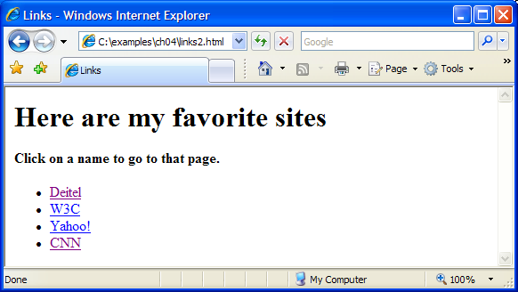

Slide 14
Lists (Cont.)
The ordered list element ol creates a list in which each item begins with a number
Lists may be nested to represent hierarchical data relationships

Slide 15
A single list element

Slide 16
Creates an ordered list within a list element
Ends nested list
Ends the list element
Another single unordered list element
Creates an ordered list within this list element

Slide 18
Tables
table element
defines an XHTML table
Attribute summary summarizes the table’s contents and is used by speech devices to make the table more accessible to users with visual impairments
Element caption describes the table’s content
The text inside the <caption> tag is rendered above the table in most browsers

Slide 19
Tables Cont.
A table can be split into three distinct sections:
Head (thead element)
Table titles
Column headers
Body (tbody element)
Primary table data
Foot (tfoot element)
Calculation results
Footnotes
Above body section in the code, but displays at the bottom in the page

Slide 20
Tables Cont.
Element tr
Defines individual table rows
Element th
Defines a header cell
Element td
Contains table data elements

Slide 21
Begins a new XHTML table
Sets the table’s border to be one pixel wide
Sets the table’s width to 40% of the screen
Describes the table’s contents in the summary attribute
Sets the text above the table
Creates a head element
Creates a table heading cell in the new table row
Makes a new table row
Creates the next cell in the row

Slide 22
Creates a foot section
Creates table header cells at the bottom of the table
Creates a body section
Inserts a cell in the body of the table
Ends the table

Slide 23
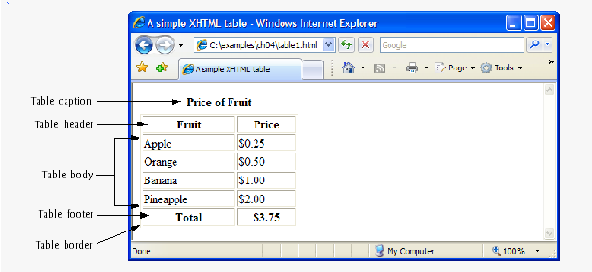

Slide 24
Tables Cont.
You can merge data cells with the rowspan and colspan attributes
The values of these attributes specify the number of rows or columns occupied by the cell
Can be placed inside any data cell or table header cell

Slide 25
Makes the header cell span 2 rows

Slide 26
Makes the header cell span 4 columns

Slide 27
