Slide 1
Introduction to XHTML

Slide 2
OBJECTIVES
In this chapter you will learn:
To understand important components of XHTML documents.
To use XHTML to create web pages.
To add images to web pages.
To create and use hyperlinks to navigate web pages.
To mark up lists of information.
To create tables with rows and columns of data and control table formatting.
To create and use forms to get user input.
To make web pages accessible to search engines using <meta> tags.

Slide 3
HTML vs XHTML
HTML or HyperText Markup Language is the main markup language for creating web pages and other information that can be displayed in a web browser.
XHTML (Extensible HyperText Markup Language) is a family of XML markup languages that mirror or extend versions of the widely used Hypertext Markup Language (HTML), the language in which web pages are written.

Slide 4
HTML | XHTML
Filename extension | .html, .htm | .xhtml, .xht, .xml, .html, .htm
Internet media type | text/html | application/xhtml+xml
Developed by | W3C & WHATWG | World Wide Web Consortium
Type of format | Document file format | Markup language
Extended from | SGML | XML, HTML
Stands for | HyperText Markup Language | Extensible HyperText Markup Language
Application | Application of Standard Generalized Markup Language (SGML). | Application of XML
Function | Web pages are written in HTML. | Extended version of HTML that is stricter and XML-based.
Nature | Flexible framework requiring lenient HTML specific parser. | Restrictive subset of XML and needs to be parsed with standard XML parsers.
Origin | Proposed by Tim Berners-Lee in 1987. | World Wide Web Consortium Recommendation in 2000.
Versions | HTML 2, HTML 3.2, HTML 4.0, HTML 5. | XHTML 1, XHTML 1.1, XHTML 2, XHTML 5.

Slide 5
Introduction
XHTML (Extensible HyperText Markup Language)
markup language for creating web pages
Based on HTML (HyperText Markup Language)
legacy technology of the World Wide Web Consortium (W3C)
XHTML 1.0
Allows only a document’s content and structure to appear in a valid XHTML document, and not its formatting
Formatting is specified with Cascading Style Sheets

Slide 6
Editing XHTML
A machine that runs a specialized piece of software called a web server stores XHTML documents

Slide 7
First XHTML Example
In XHTML, text is marked up with elements delimited by tags that are names contained in pairs of angle brackets
Every XHTML document contains a start <html> tag and an end </html> tag
Some elements may contain attributes that provide additional information about the element
Comments in XHTML always begin with <!-- and end with -->. The browser ignores all text inside a comment

Slide 8
First XHTML Example (Cont.)
Every XHTML document contains a head element which generally contains:
A title
A body element
head element
generally is not rendered in the display window

Slide 9
First XHTML Example (Cont.)
The title element:
Names a web page
Usually appears in the colored bar (called the title bar) at the top of the browser window
Is the text identifying a page when users add your page to their list of Favorites or Bookmarks
The body element:
Contains the document’s content, which may include text and tags

Slide 10
First XHTML Example (Cont.)
All text placed between the <p> and </p> tags forms one paragraph
XHTML documents delimit an element with start and end tags
A start tag consists of the element name in angle brackets (e.g., <html>)
An end tag consists of the element name preceded by a forward slash (/) in angle brackets (e.g., </html>)
Many start tags have attributes that provide additional information about an element
Each attribute has a name and a value separated by an equals sign (=)

Slide 11
First XHTML example.
XHTML comments, not interpreted by the browser
Creates a head element
Creates a title element, which contains the text Welcome
Creates a p element within the body, which displays welcome text

Slide 12
Common Programming Error
XHTML does not permit tags to overlap—a nested element’s end tag must appear in the document before the enclosing element’s end tag.
For example, the nested XHTML tags
<head><title>hello</head></title>
cause a syntax error, because the enclosing head element’s ending </head> tag appears before the nested title element’s ending </title> tag.

Slide 13
W3C XHTML Validation Service
XHTML documents that are syntactically correct are guaranteed to render properly
XHTML documents that contain syntax errors may not display properly
Validation services (e.g., validator.w3.org) ensure that an XHTML document is syntactically correct

Slide 14
Headings
XHTML provides six headings (h1 through h6) for specifying the relative importance of information
Heading element h1 is considered the most significant heading and is rendered in the largest font
Each successive heading element (i.e., h2, h3, etc.) is rendered in a progressively smaller font

Slide 15
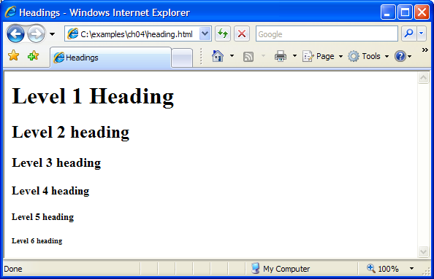
Heading elements h1 through h6
Creates six headings, each with decreasing significance

Slide 16
Linking
A hyperlink references or links to other resources, such as XHTML documents and images
Web browsers typically underline text hyperlinks and color them blue by default

Slide 17
Linking (Cont.)
Users can insert links with the a (anchor) element.
The href attribute specifies the resource (e.g., page, file, e-mail address) being linked
Anchors can link to an e-mail address using a mailto: URL
When a user clicks this type of anchored link, most browsers launch the default e-mail program (e.g., Outlook Express) to initiate an e-mail message addressed to the linked address.
The strong element typically causes the browser to render text in a bold font

Slide 18
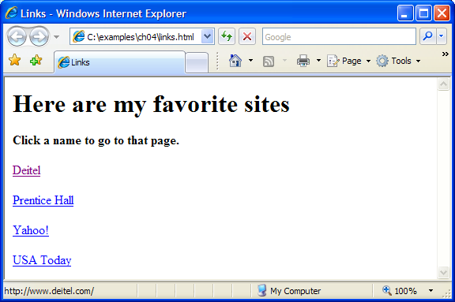
Linking to other web pages.
Creates anchor elements that link to the URL specified in the href attribute

Slide 19
Linking to an e-mail address
Hyperlink that creates a message to the address deitel@deitel.com with the computer’s default e-mail program

Slide 20
