Slide 1
Microscopes & Stains

تقنية الأجهزة الكيموحيوية

Slide 2
What is the Microscope ?
The microscope magnifies the images of objects that are invisible to the unaided human eye.

Slide 3
History of microscope

Slide 4
Simple Glass Magnifiers
More than 500 years ago.
In 1600s, this “simple microscope” allowed scientists to see cells and bacteria
Problem: not enough magnification

Slide 5
Types of Microscope
Light microscopy
Bright field microscopy
Dark field microscopy
Phase-contrast microscopy
Fluorescence microscopy
Electron microscopy

Slide 6
Light Microscope
Simple – uses a single lens
Compound – uses a set of lenses or lens systems

Slide 7
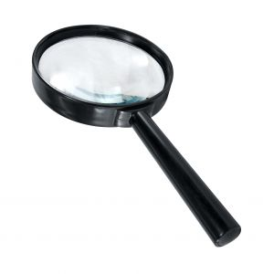
Simple Light Microscope

Slide 8
First Compound Microscope
Developed at the beginning of the 1600's, by the Janssen brothers and Galileo
Problem: images were blurred and had colored halos

Slide 9
Light Compound Microscope
1900s, started using iron instead of brass (cheaper)
1st type of microscope, most widely used
light passes through 2 lenses
a compound light microscope may have a single eye piece (monocular) or two eye pieces (binocular).
Only one eyepiece (monocular)
Oil immersion lens increases resolution because light does not refract
1 ocular/eyepiece ( 10x magnification ).
3 objectives(4x,10x and 40x magnification )
Total magnification = magnification of objective lens X magnification of ocular lens
Still used today

Slide 11
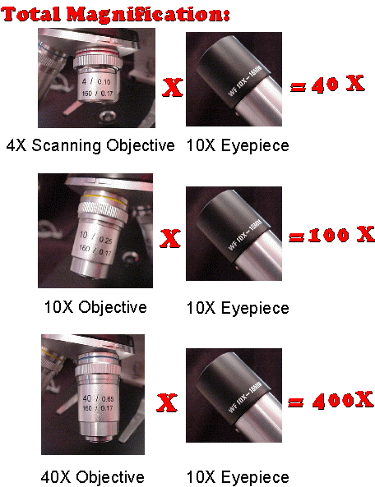

Slide 12
Bright-Field Microscopy
Simplest optical microscopy illumination technique
Uses visible light as source of illumination.
The field of view is brightly lit so that organism and other structures are visible against it because of their different densities.
Single stain or differential staining may be used depending on the properties of different structure and organism.
Contrast comes from absorbance of light in the sample, or from staining.
When the diaphragm is wide open the image is brighter and contrast is low.
Total Magnification: (if 10x ocular magnification is used) Range: 10x-1000x
Widely used in histology , pathology , botany

Slide 13
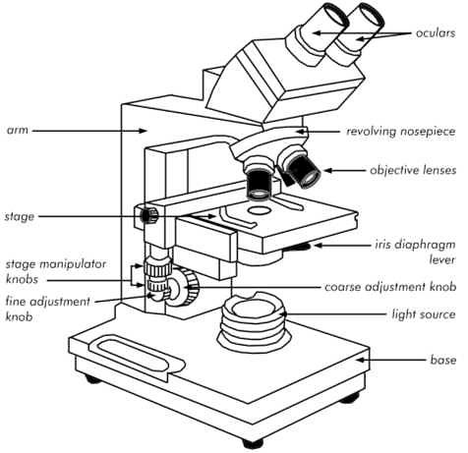
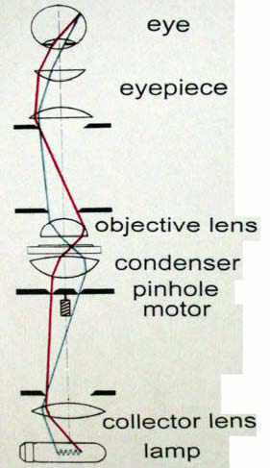
Source: http://www.austincc.edu/biocr/1406/labm/ex3/prelab_3_8.htm

Slide 15
Dark-Field Microscopy
Best for observing pale objects
Specimen appears light against dark background
Increases contrast and enables observation of more details
Good for watching bacterial motion.
A special condenser is used which cause light to reflect from the specimen at an angle.
Total Magnification: Can range from those of compound microscopes (10x to 1000x)
Used to observe living ,unstained preparations.

Slide 16
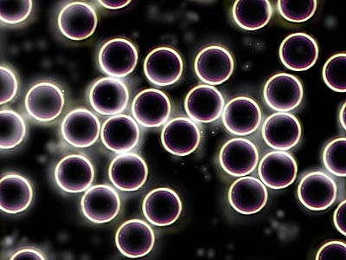

Slide 17
Comparison of bright and darkfield
Brightfield Microscopy
Darkfield Microscopy
Contrast is reversed in these modalities

Slide 18
Phase-Contrast Microscopy
Type of light microscope
Enhances contrast in micrographs by converting phase shifts of light waves into brightness
Offers more contrast than brightfield microscopy
Does not require the use of staining procedures which usually kill cells.
Total magnification for phase contrast microscopes range from 40x to 400x
Especially useful for examining living, unpigmented cells

Slide 19
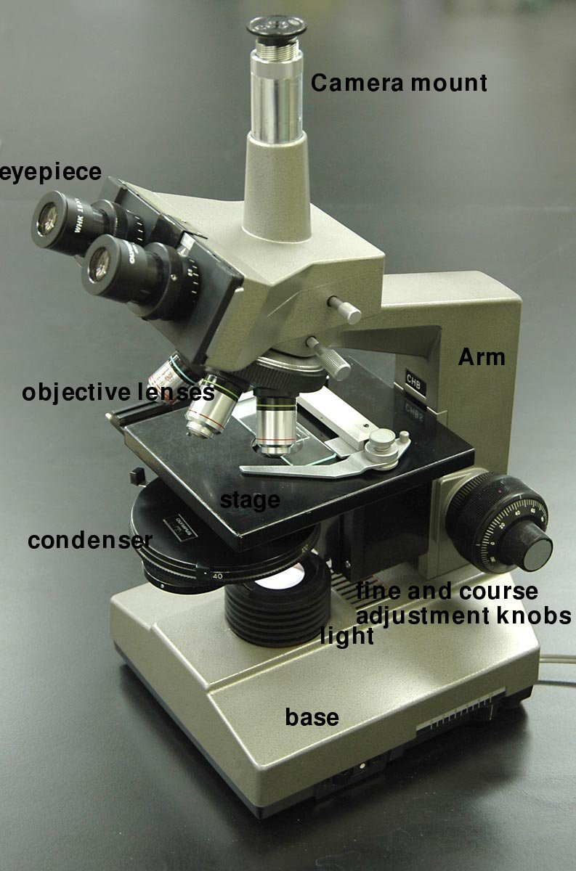
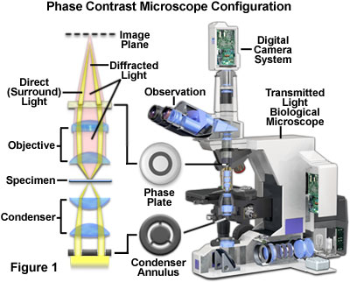
Phase-contrast microscope

Slide 20
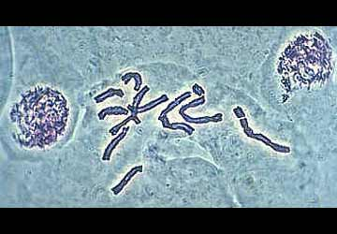
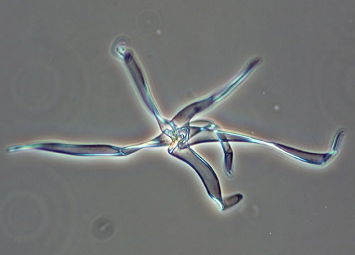
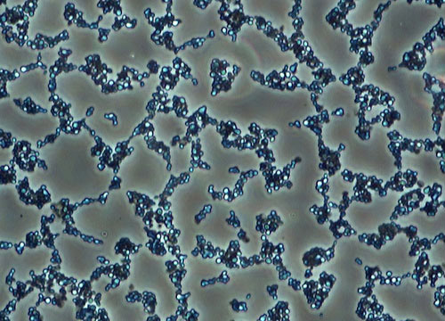

Slide 21
Fluorescence microscopy
A fluorescence microscope is an optical microscope.
Uses fluorescence and phosphorescence instead of, or in addition to, reflectionand absorption to study properties of organic or inorganic substances.
Fluorescent-designed to detect fluorescent light, specimen must be dyed, ultraviolet light used

Slide 22
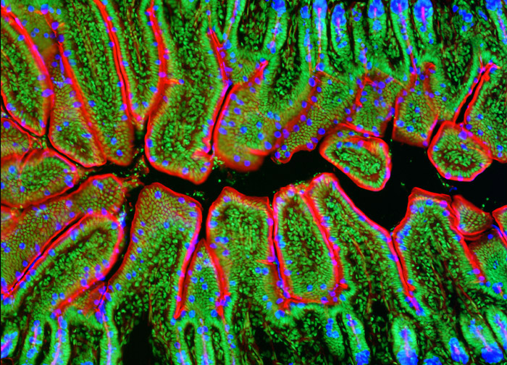

Slide 23
Electron Microscope
Invented by Ernst Ruska in year 1933 .
An electron microscope (EM) is a type of microscope that uses an electron beam to illuminate a specimen and produce a magnified image.
An electron microscope has greater resolving power than a light microscope .
The have two types of EM : ( SEM ) … (TEM)
Magnification can be done upto 2 million times

Slide 24
First Electron Microscope
Invented by Ernst Ruska
Year-1933
He was awarded the Nobel Prize for physics for his invention in 1986

Slide 25
Types of Electron Microscope
Scanning electron microscope . ( SEM )
Transmission electron microscope. (TEM )

Slide 26
SEM AND TEM PHOTOS
SEM
TEM

Slide 27
E.coli

Slide 28
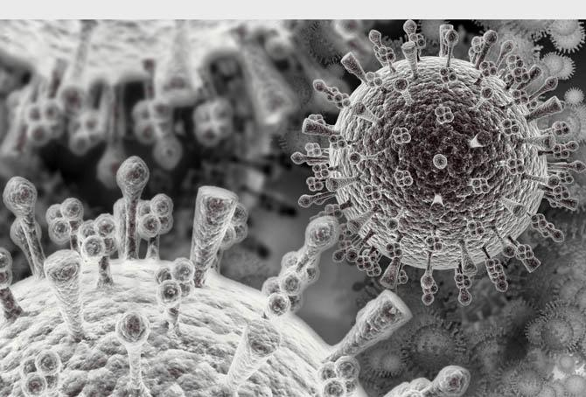
HIV Virus

Slide 29
Microscope Vocabulary
Magnification: increase of an object’s apparent size
Resolution: power to show details clearly
Both are needed to see a clear image

Slide 30
Types of stain
Simple staining – only one dye - Eg. Methylene blue , crystal violet.
2. Differential staining- more than one dye is used- Eg. Gram’s staining, Acid-fast staining.
3. Special staining – more than one dye used -Special structures are seen.
Eg. Capsule staining, Spore staining.

Slide 31
Simple Stain
Methylene blue - stains animal cells to make nuclei more visible.
Crystal violet - stains cell walls purple when combined with a mordant. This stain is used in Gram staining
Malachite green - a blue-green counterstain to safranin in Gimenez staining for bacteria. This stain can also be used to stain spores.
Iodine - used as a starch indicator. When in solution, starch and iodine turn a dark blue color.
Bismarck Brown - colors acid mucins, a type of protein, yellow and may be used to stain live cells
Fuchsin - this stain is used to stain collagen, smooth muscle, or mitochondria
. Safranin - a nuclear stain used as a counterstain or to color collagen yellow.

Slide 32
Gram Stain
DANISH BACTERIOLOGIST HANS CHRISTIAN GRAM (1880)
Gram Stain- 1884 crystal violet (+) and iodine and ethanol decolorizer, and counterstained with safranin (-)
Gram +=purple
Gram - = red
Gram non reactive= no stain
Gram Variable= stain unevenly

Slide 33
Time Frame
1) 1 minute
2) 1 minute
3) 15 seconds
4) 1 minute
Rinse with water between each step

Slide 35
Acid-Fast Stain
Type of differential stain
Used to detect organisms with a waxy substance in the cell wall
Useful for detecting Mycobacterium
Mycobacterium tuberculosis.
Mycobacterium leprae.

Slide 36
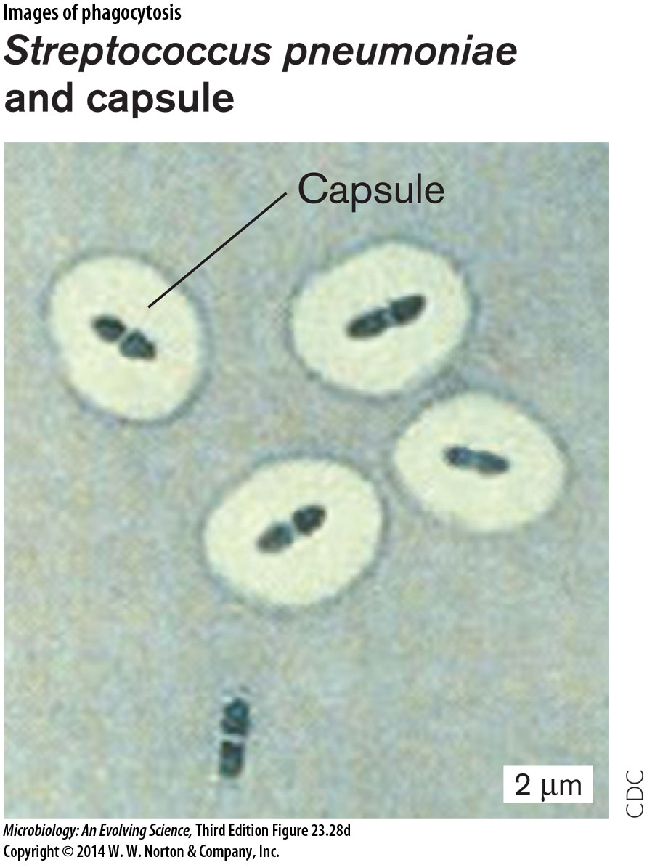
Special Stains
1-Negative (capsule) stain:
( Nigrosin ink+ indian ink)

Slide 37
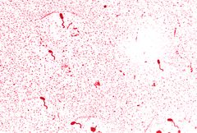
FLAGELLAR STAIN – SILVER STAIN:
This stain increases the thickness of flagella – thus easy to see under light microscope.

Slide 38
References
Different types of microscopes. (n.d.). Retrieved April 4, 2015, from http://www.slideshare.net/UTTAMKUMARDAS/different-types-of-microscopes.
Electron Microscope Shanthakumar. (n.d.). Retrieved April 4, 2015, from http://www.slideshare.net/guestcd4662/electron-microscope-shanthakumarjpg.
Microscope types and use. (n.d.). Retrieved April 4, 2015, from http://www.slideshare.net/MsAllenBio/microscope-types-and-use?related=1
Electron microscopy. (n.d.). Retrieved April 4, 2015, from http://www.slideshare.net/suniu/electron-microscopy
Microscope. (n.d.). Retrieved April 4, 2015, from http://www.slideshare.net/sarathy4/microscope-10905635?related=3
Fluorescence microscope. (n.d.). Retrieved April 4, 2015, from http://en.wikipedia.org/wiki/Fluorescence_microscope

Slide 39
References
Bacterial staining. (n.d.). Retrieved April 4, 2015, from http://www.slideshare.net/sasiprasad/bacterial-staining
Fluorescent Microscopy. (n.d.). Retrieved April 4, 2015, from http://serc.carleton.edu/microbelife/research_methods/microscopy/fluromic.html

