Slide 1
Input/ output
Scanf & printf

Slide 2
2.3 Display information
input data
output data
Keyboard
mouse
Processing
Screen
printer
We use printf() which is an inbuilt library functions in C that is available in C library by default.
this function is declared and defined in “stdio.h”.
We have to include “stdio.h” file to make use of t printf() library functions.

Slide 3
2.3 Display information
Note:
C language is case sensitive. For example, printf() is different from Printf(). All characters in printf() must be in lower case.
printf() is used in two cases:
Prompting Messages
Formatted output
Dr. Soha S. Zaghloul 3 Copyright © Pearson, Inc. 2013. All Rights Reserved.

Slide 4
2.3.1 pROMPT MESSAGES
Prompting Messages
They are messages that tells the user to take a specific action.
Write any message you want to display on the screen between the parentheses in printf using “”
EX:
printf( "Enter first integer" );
The characters normally print exactly as they appear between the double quotes in the printf statement. The example displays the literal “Enter first integer” and positions the cursor at the end of the statement.
Dr. Soha S. Zaghloul 4 Copyright © Pearson, Inc. 2013. All Rights Reserved.

Slide 5
2.3.1 prompt MESSAGES
Escape Sequences
EX:
printf( "Enter first integer\n" );
Notice that the characters \n were not printed on the screen.
The backslash (\) is called an escape character.
It indicates that printf is supposed to do something out of the ordinary.
When encountering a backslash in a string, the compiler looks ahead at the next character and combines it with the backslash to form an escape sequence.
The escape sequence \n means newline.
When a newline appears in the string output by a printf, the newline causes the cursor to position to the beginning of the next line on the screen.
Dr. Soha S. Zaghloul 5 Copyright © Pearson, Inc. 2013. All Rights Reserved.

Slide 6
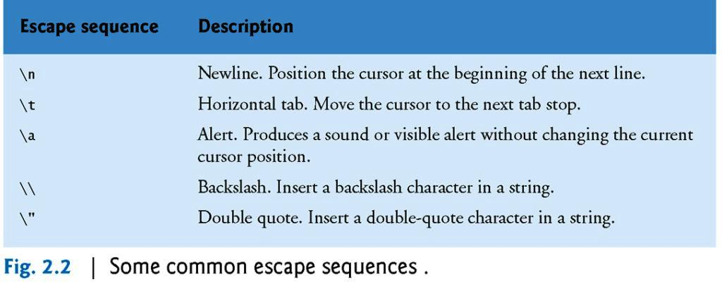
The Escape Sequence…
Dr. Soha S. Zaghloul 6 Copyright © Pearson, Inc. 2013. All Rights Reserved.

Slide 7
2.3.1 prompt MESSAGES (Cont.)
The Escape Sequence…
Because the backslash has special meaning in a string, i.e., the compiler recognizes it as an escape character, we use a double backslash (\\) to place a single backslash in a string.
Printing a double quote also presents a problem because double quotes mark the boundaries of a string—such quotes are not printed.
By using the escape sequence \" in a string to be output by printf, we indicate that printf should display a double quote.
Dr. Soha S. Zaghloul 7 Copyright © Pearson, Inc. 2013. All Rights Reserved.

Slide 8
2.7 The printf STATEMENT
Printing with a Format Control String
We use printf() function with % format specifier to display the value of variable.
%d got replaced by value of an integer variable (no),
%c got replaced by value of a character variable (ch),
%f got replaced by value of a float variable (flt),
Dr. Soha S. Zaghloul 8 Copyright © Pearson, Inc. 2013. All Rights Reserved.

Slide 9
2.7 The printf STATEMENT (cont)
EX
printf( "Sum is %d\n", sum );
calls function printf to print the literal Sum is followed by the numerical value of variable sum on the screen.
This printf has two arguments, "Sum is %d\n" and sum.
The first argument is the format control string.
It contains some literal characters to be displayed, and it contains the conversion specifier %d indicating that an integer will be printed.
The second argument specifies the value to be printed.
Notice that the conversion specifier for an integer is the same in both printf and scanf.
We will discuss scanf later
Dr. Soha S. Zaghloul 9 Copyright © Pearson, Inc. 2013. All Rights Reserved.

Slide 10
2.7 The printf STATEMENT (cont’d)
Formatting int in Program Output
The field width is the number of columns to use for the display of the value.
Add a number between % and d in the printf format string to specify the field width.
A minus sign before the field width justifies the output to the left.
Example:
printf(“Results: %3d meters = %4d ft. %2d in. \n”, meters, feet, inches);
Outputs:
Results:~~21~meters~=~~~68~ft.~11~in.
~ denotes a space. The spaces specified by the field width are in red (~). Blue spaces are caused by the format string of printf.
For negative numbers, the minus sign is included in the count of the digits displayed.
Dr. Soha S. Zaghloul 10 Copyright © Pearson, Inc. 2013. All Rights Reserved.

Slide 11
2.7 The printf STATEMENT (cont’d)
Formatting int in Program Output
The following table displays numbers with different placeholders:
Value | Format | Output
234 | %4d | ~234
-234 | %4d | -234
234 | %5d | ~~234
-234 | %5d | ~-234
234 | %1d | 234
-234 | %1d | -234
234 | %-5d | 234~~
-234 | %-5d | -234~
Dr. Soha S. Zaghloul 11 Copyright © Pearson, Inc. 2013. All Rights Reserved.

Slide 12
2.7 The printf STATEMENT (cont’d)
Formatting double in Program Output
For double numbers, we need to specify the field width and the number of decimal places desired.
The field width should be large enough to accommodate all digits before and after the decimal point.
So, the form of the format placeholder is %n.mf where n is a number representing the total field width, and m is the desired number of decimal places.
For example, if x is a variable of type double, whose value is between -99.99 and 999.99; then, we could use the placeholder %6.2f to display an accuracy of x of two decimal places.
Dr. Soha S. Zaghloul 12 Copyright © Pearson, Inc. 2013. All Rights Reserved.

Slide 13
2.7 The printf STATEMENT (cont’d)
Formatting double in Program Output
The following table displays x using format string placeholder %6.2f for different values of x:
Value of X | Displayed Output
-99.42 | -99.42
.123 | ~~0.12
-9.536 | ~-9.54
-25.554 | -25.55
99.999 | 100.00
999.4 | 999.40
Dr. Soha S. Zaghloul 13 Copyright © Pearson, Inc. 2013. All Rights Reserved.

Slide 14
2.4 the scanf FUNCTION
it is used to read values from user.
scanf() function is used to read character, string, numeric data from keyboard.
SYNTAX
scanf( "%format specifier", &variable );
Each data type have different format specifier to be used in reading it.
Dr. Soha S. Zaghloul 14 Copyright © Pearson, Inc. 2013. All Rights Reserved.

Slide 15
2.4 the scanf FUNCTION (cont’d)
EX:
scanf( "%d", &integer1 );
This scanf has two arguments, "%d" and &integer1.
The first, the format control string, indicates the type of data that should be input by the user.
The %d conversion specifier indicates that the data should be an integer (the letter d stands for “decimal integer”).
The % in this context is treated by scanf (and printf as we’ll see) as a special character that begins a conversion specifier.
The second argument of scanf begins with an ampersand (&)—called the address operator in C—followed by the variable name.
Dr. Soha S. Zaghloul 15 Copyright © Pearson, Inc. 2013. All Rights Reserved.

Slide 16
2.4 the scanf FUNCTION (cont’d)
The &, when combined with the variable name, tells scanf the location (or address) in memory at which the variable integer1 is stored.
The computer then stores the value that the user enters for integer1 at that location.
Therefore, remember to precede each variable in every call to scanf with an ampersand.
Dr. Soha S. Zaghloul 16 Copyright © Pearson, Inc. 2013. All Rights Reserved.

Slide 17
2.4 the scanf FUNCTION (cont’d)
When the computer executes the preceding scanf, it waits for the user to enter a value for variable integer1.
The user responds by typing an integer, then pressing the Enter key to send the number to the computer.
The computer then assigns this number, or value, to the variable integer1.
Any subsequent references to integer1 in this program will use this same value.
Functions printf and scanf facilitate interaction between the user and the computer.
Because this interaction resembles a dialogue, it’s often called interactive computing.
Dr. Soha S. Zaghloul 17 Copyright © Pearson, Inc. 2013. All Rights Reserved.

Slide 18
2.4 the scanf FUNCTION (cont’d)
Dr. Soha S. Zaghloul 18 Copyright © Pearson, Inc. 2013. All Rights Reserved.

