Slide 1
ARITHMETIC IN C
Operators

Slide 2
Program
Next step to focus on is the process (operations)
input data
output data
Keyboard
Processing
Screen

Slide 3
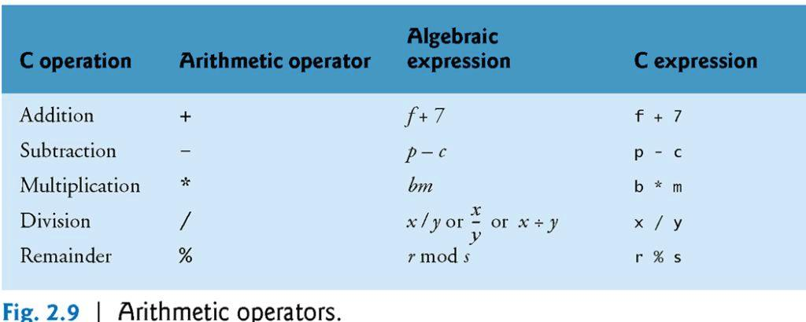
1 Arithmetic in C

Slide 4
1 Arithmetic in C (Cont.)
Most C programs perform calculations using the C arithmetic operators (Fig. 2.9).
Note the use of various special symbols not used in algebra.
The asterisk (*) indicates multiplication and the percent sign (%) denotes the remainder operator, which is introduced below.
In algebra, to multiply a times b, we simply place these single-letter variable names side by side as in ab.
In C, however, if we were to do this, ab would be interpreted as a single, two-letter name (or identifier).
Therefore, C requires that multiplication be explicitly denoted by using the * operator as in a * b.
The arithmetic operators are all binary operators.
For example, the expression 3 + 7 contains the binary operator + and the operands 3 and 7.

Slide 5
1.1 Arithmetic in C (Cont.)
Integer Division and the Remainder Operator
Integer division yields an integer result.
For example, the expression 7 / 4 evaluates to 1 and the expression 17 / 5 evaluates to 3.
C provides the remainder operator, %, which yields the remainder after integer division.
The remainder operator is an integer operator that can be used only with integer operands.
The expression x % y yields the remainder after x is divided by y.
Thus, 7 % 4 yields 3 and 17 % 5 yields 2.

Slide 6
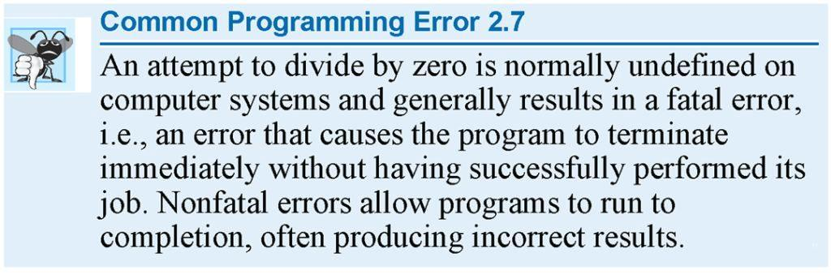

Slide 7
1.2 Arithmetic in C (Cont.)
Parentheses for Grouping Subexpressions
Parentheses are used in C expressions in the same manner as in algebraic expressions.
For example, to multiply a times the quantity b + c we write
a * ( b + c )

Slide 8
1.3 Arithmetic in C (Cont.)
Rules of Operator Precedence
C applies the operators in arithmetic expressions in a precise sequence determined by the following rules of operator precedence, which are generally the same as those in algebra:
Operators in expressions contained within pairs of parentheses are evaluated first. Parentheses are said to be at the “highest level of precedence.” In cases of nested, or embedded, parentheses, such as
( ( a + b ) + c )
the operators in the innermost pair of parentheses are applied first.

Slide 9
1.3 Arithmetic in C (Cont.)
Multiplication, division and remainder operations are applied next. If an expression contains several multiplication, division and remainder operations, evaluation proceeds from left to right. Multiplication, division and remainder are said to be on the same level of precedence.
Addition and subtraction operations are evaluated next. If an expression contains several addition and subtraction operations, evaluation proceeds from left to right. Addition and subtraction also have the same level of precedence, which is lower than the precedence of the multiplication, division and remainder operations.
The assignment operator (=) is evaluated last.

Slide 10
1.3 Arithmetic in C (Cont.)
The rules of operator precedence specify the order C uses to evaluate expressions. When we say evaluation proceeds from left to right, we’re referring to the associativity of the operators.
Figure 2.10 summarizes these rules of operator precedence for the operators we’ve seen so far.

Slide 11
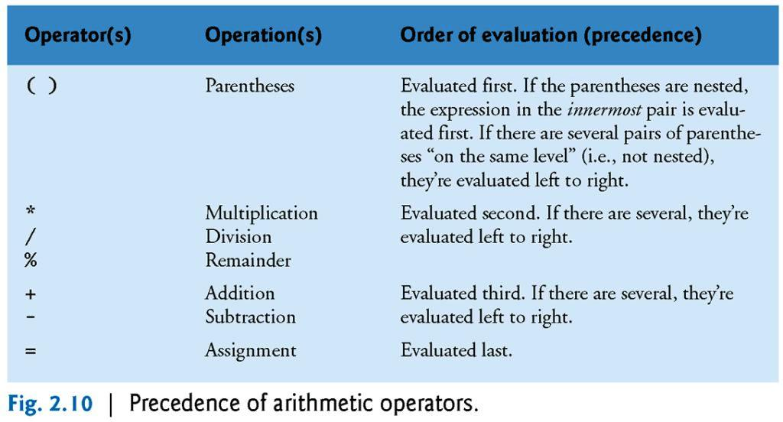

Slide 12
1.3 Arithmetic in C (Cont.)
EX:
What is the result of the following expression?
In c , the expression is:
2 * 5 * 5 + 3 * 5 + 7
Figure 2.11 illustrates the order in which the operators are applied.

Slide 14
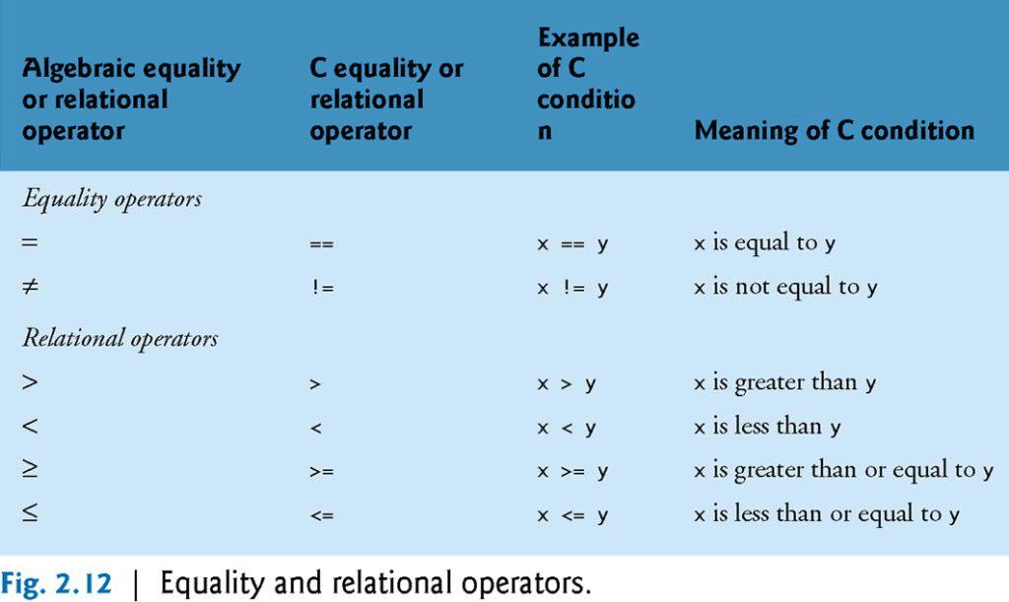
2. Relational and equality operators
LOWER
HIGHER

Slide 15
2. Relational and equality operators (cont.)
The relational operators used in the C language are shown in Fig. 2.12.
The relational operators all have the same level of precedence and they associate left to right.
The equality operators have a lower level of precedence than the relational operators and they also associate left to right.
In C, a condition may actually be any expression that generates a zero (false) or nonzero (true) value.

Slide 18
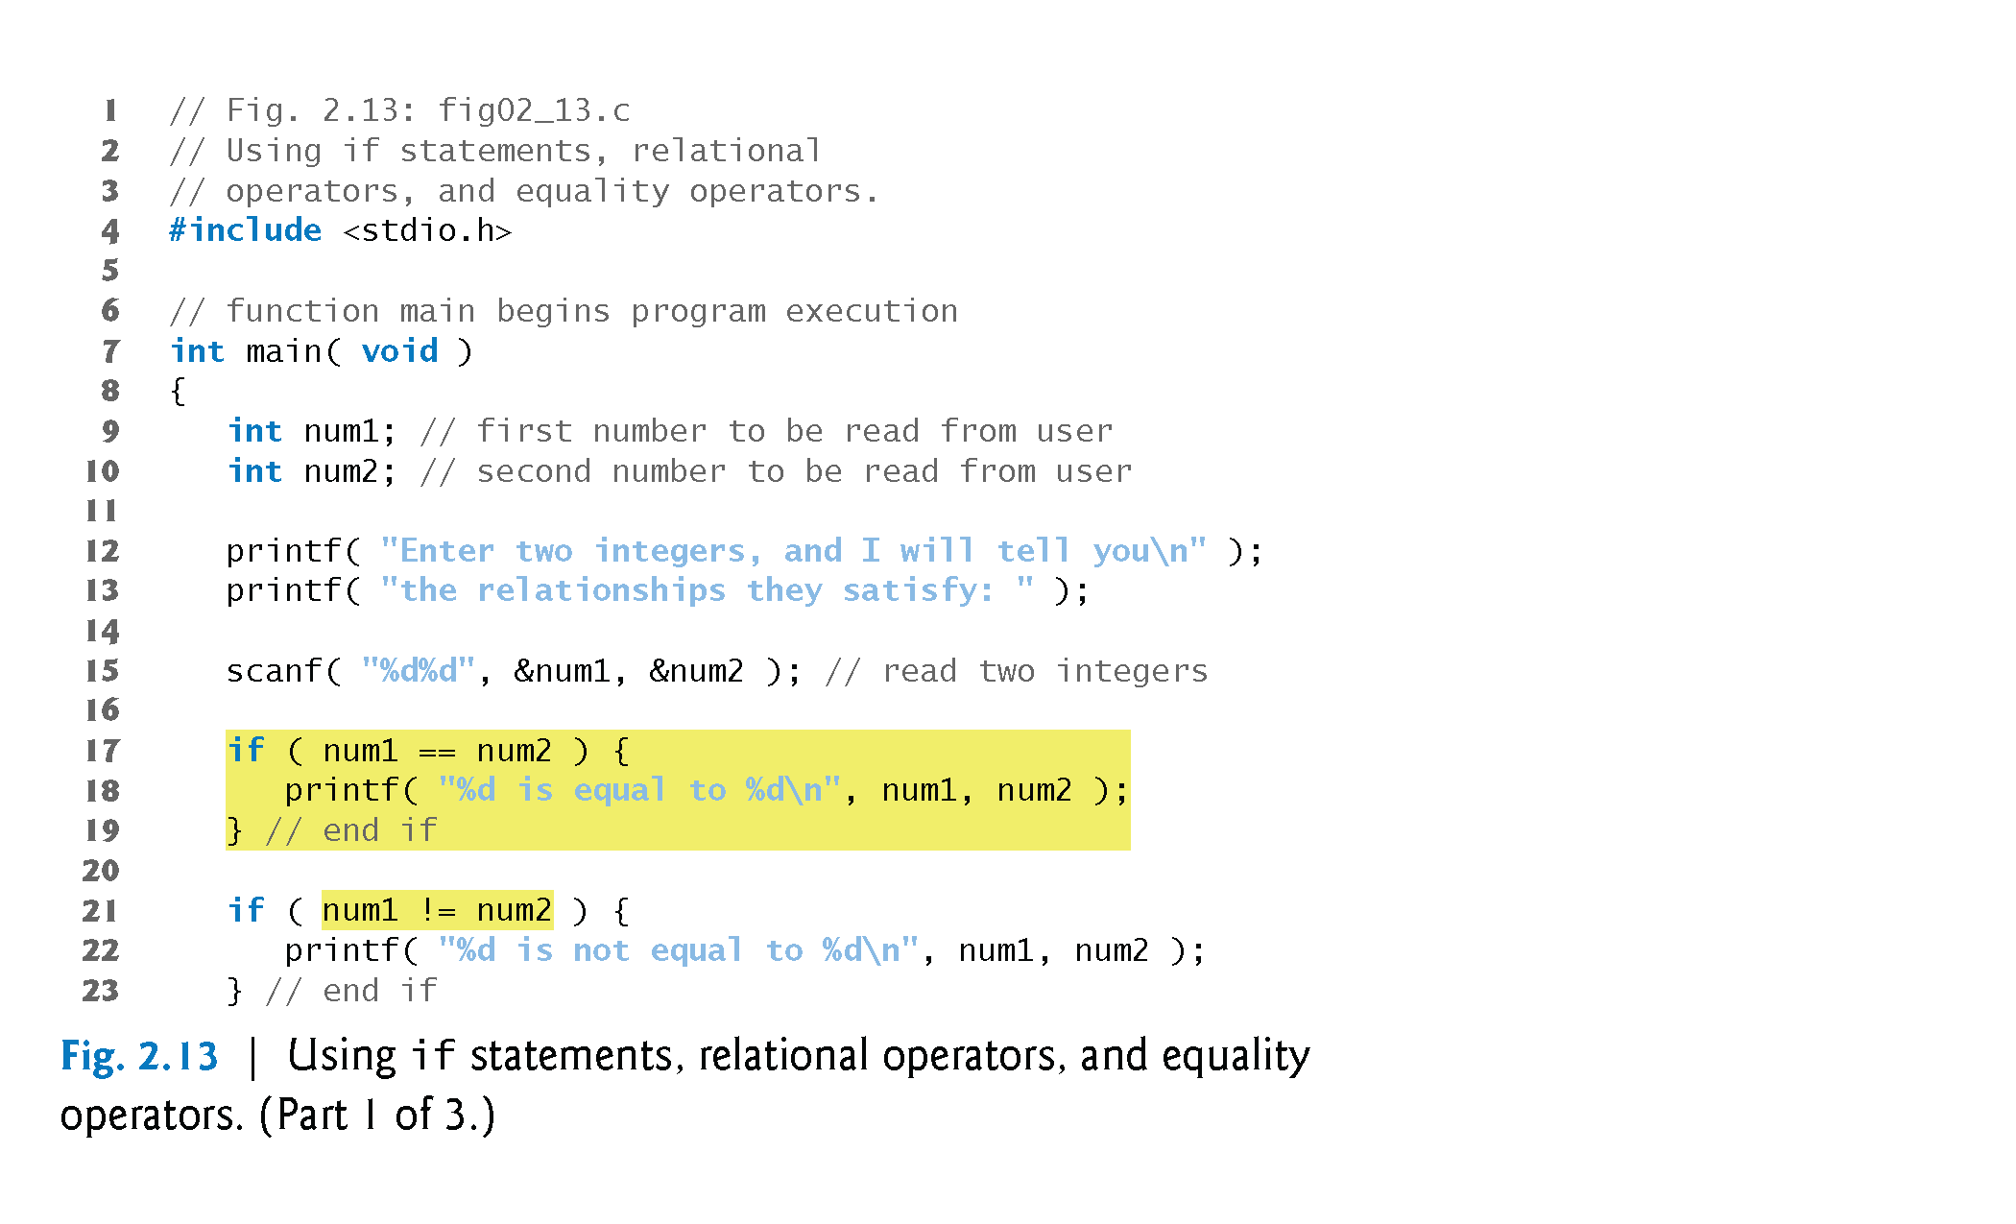
3. A SAMPLE PROGRAM

Slide 19
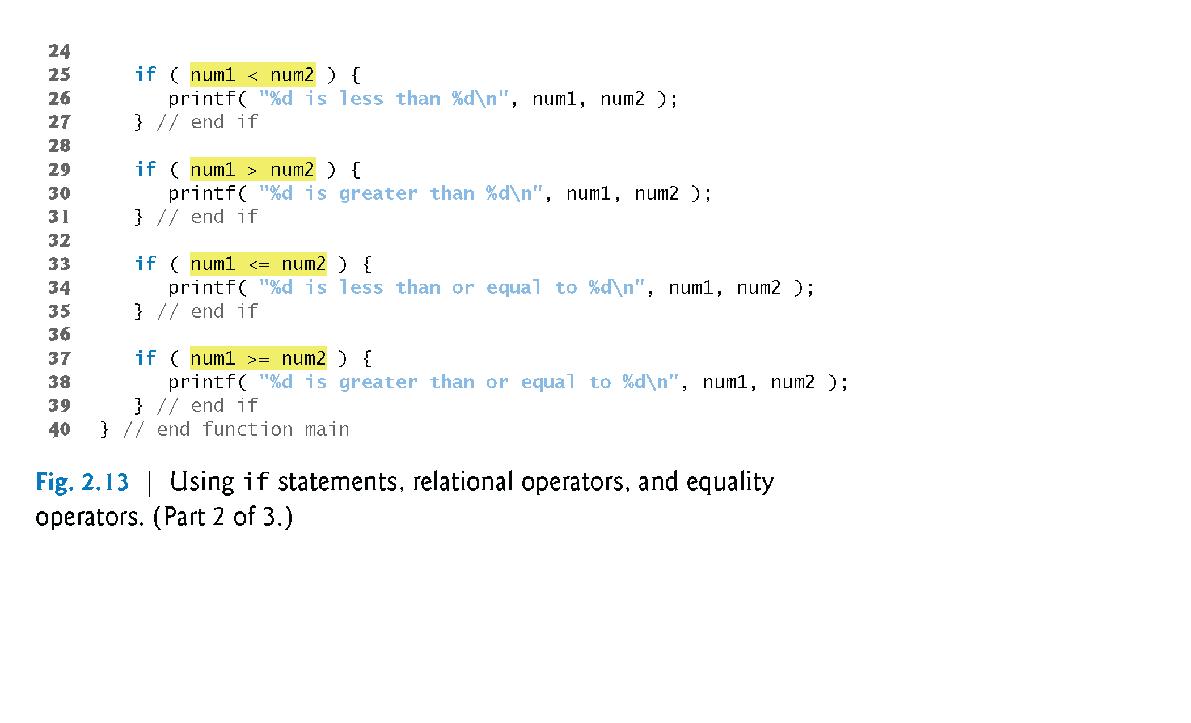
3. A SAMPLE PROGRAM (Cont’d)

Slide 20
3. A SAMPLE PROGRAM (Cont’d)
The program uses scanf (line 15) to input two numbers.
Each conversion specifier has a corresponding argument in which a value will be stored.
The first %d converts a value to be stored in the variable num1, and the second %d converts a value to be stored in variable num2.

Slide 22
4. rules of precedence - revisited
Figure 2.14 lists from highest to lowest the precedence of the operators introduced in this chapter.
Operators are shown top to bottom in decreasing order of precedence.
The equals sign is also an operator.

Slide 25
the assignment Operator
Assignment is used to assign the values for the variables in C programs.
Assignment operator stores a value in memory.
The syntax is
leftSide = rightSide ;
Examples:
i = 1;
first = i;
sum = firstNumber + secondNumber;
Allways it is a variable identifier.
It is either a literal | a variable identifier | an expression.

Slide 26
2.6 the assignment statement
Integer1 + integer2 = sum
Dr. Soha S. Zaghloul 26 Copyright © Pearson, Inc. 2013. All Rights Reserved.

Slide 27
2.8 Memory Concepts
Remember in previous example:
int integer1 , integer 2 , sum;
Variable names such as integer1, integer2 and sum actually correspond to locations in the computer’s memory.
EX:
integer1 = 45 ;
integer 2 = 72;
sum = 0;
is executed, the value is placed into a memory location to which the name integer1 , integer2 , sum , has been assigned.
Dr. Soha S. Zaghloul 27 Copyright © Pearson, Inc. 2013. All Rights Reserved.

Slide 28
sum
0
Dr. Soha S. Zaghloul 28 Copyright © Pearson, Inc. 2013. All Rights Reserved.

Slide 29
2.8 Memory Concepts (Cont.)
Whenever a value is placed in a memory location, the value replaces the previous value in that location; thus, this process is said to be destructive.
These locations are not necessarily adjacent in memory.
EX:
sum = integer1 + integer2; /* assign total to sum */
that performs the addition also replaces whatever value was stored in sum.
Dr. Soha S. Zaghloul 29 Copyright © Pearson, Inc. 2013. All Rights Reserved.

Slide 30
2.8 Memory Concepts (Cont.)
This occurs when the calculated total of integer1 and integer2 is placed into location sum (destroying the value already in sum).
After sum is calculated, memory appears as in Fig. 2.8.
The values of integer1 and integer2 appear exactly as they did before they were used in the calculation.
Dr. Soha S. Zaghloul 30 Copyright © Pearson, Inc. 2013. All Rights Reserved.

Slide 31
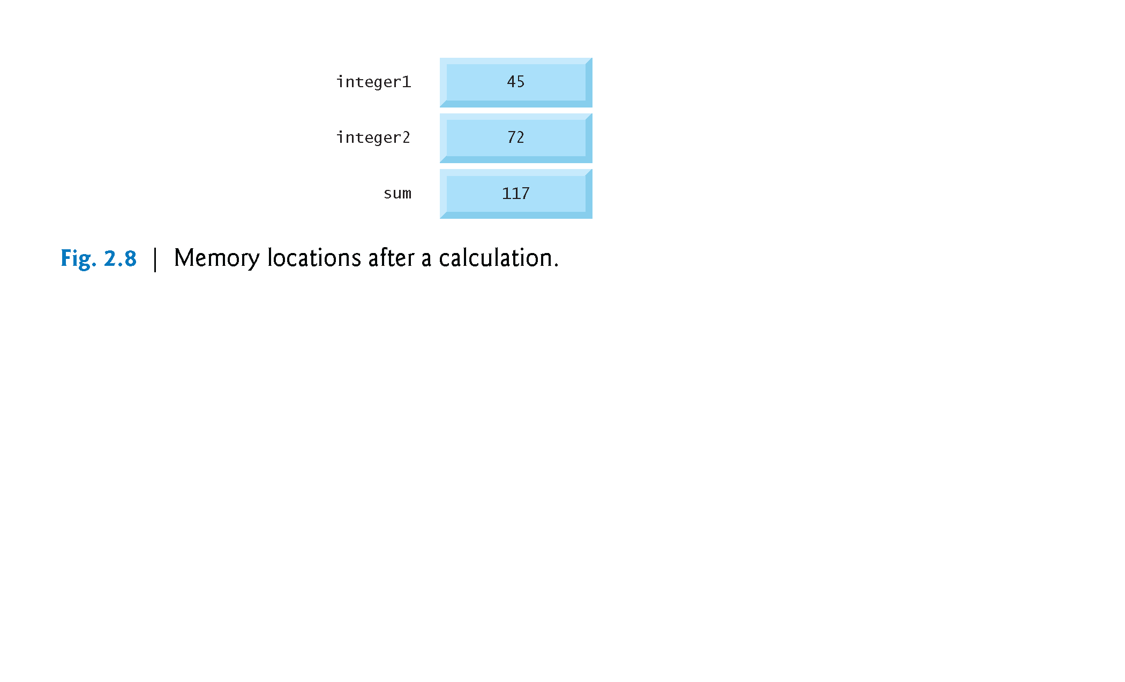
Value of sum has changed after assignment
Dr. Soha S. Zaghloul 31 Copyright © Pearson, Inc. 2013. All Rights Reserved.

Slide 32
2.8 Memory Concepts (Cont.)
They were used, but not destroyed, as the computer performed the calculation.
Thus, when a value is read from a memory location, the process is said to be nondestructive.
Dr. Soha S. Zaghloul 32 Copyright © Pearson, Inc. 2013. All Rights Reserved.

