Slide 1
C fundamentals
Variables and Data type

Slide 2
Program and Data
input data
output data
Keyboard
mouse
Processing
Screen
printer
In every program there are three main elements we need to idintify.
Input: Data to be processed.
Output: The expected result.
Look for nouns in the problem statement that suggest output and input.
and processing: The statements to achieve.
Look for verbs to suggest processing steps.

Slide 3
EX
Write a program to read 2 numbers and print their sum.
Input
2 numbers
First number , second number.
Process
Sum of two numbers (+).
Output
Sum of two numbers

Slide 4
2. Another Simple C Program: Adding Two Integers
Lets check the code of a program that add two numbers and print their sum.
Dr. Soha S. Zaghloul 4 Copyright © Pearson, Inc. 2013. All Rights Reserved.

Slide 5
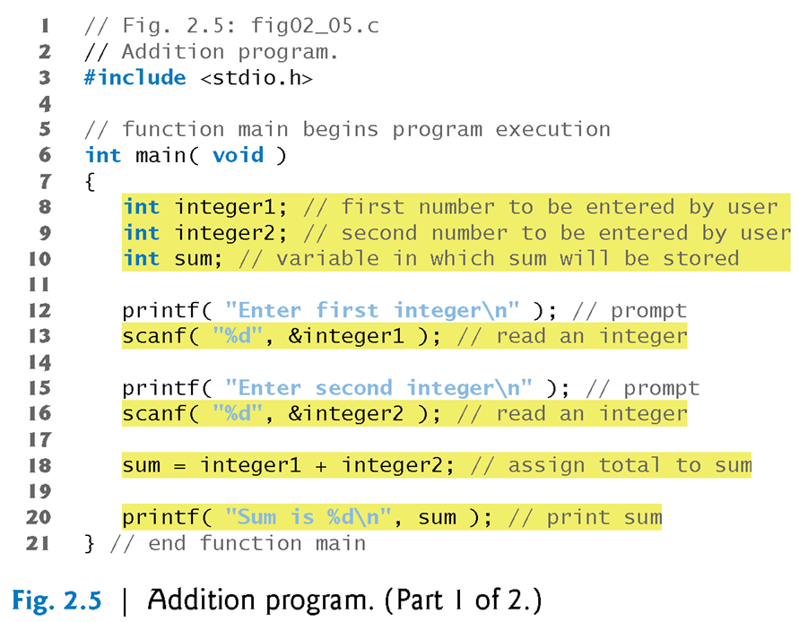
2. Another Simple C Program: Adding Two Integers (Cont’d)
Dr. Soha S. Zaghloul 5 Copyright © Pearson, Inc. 2013. All Rights Reserved.

Slide 6
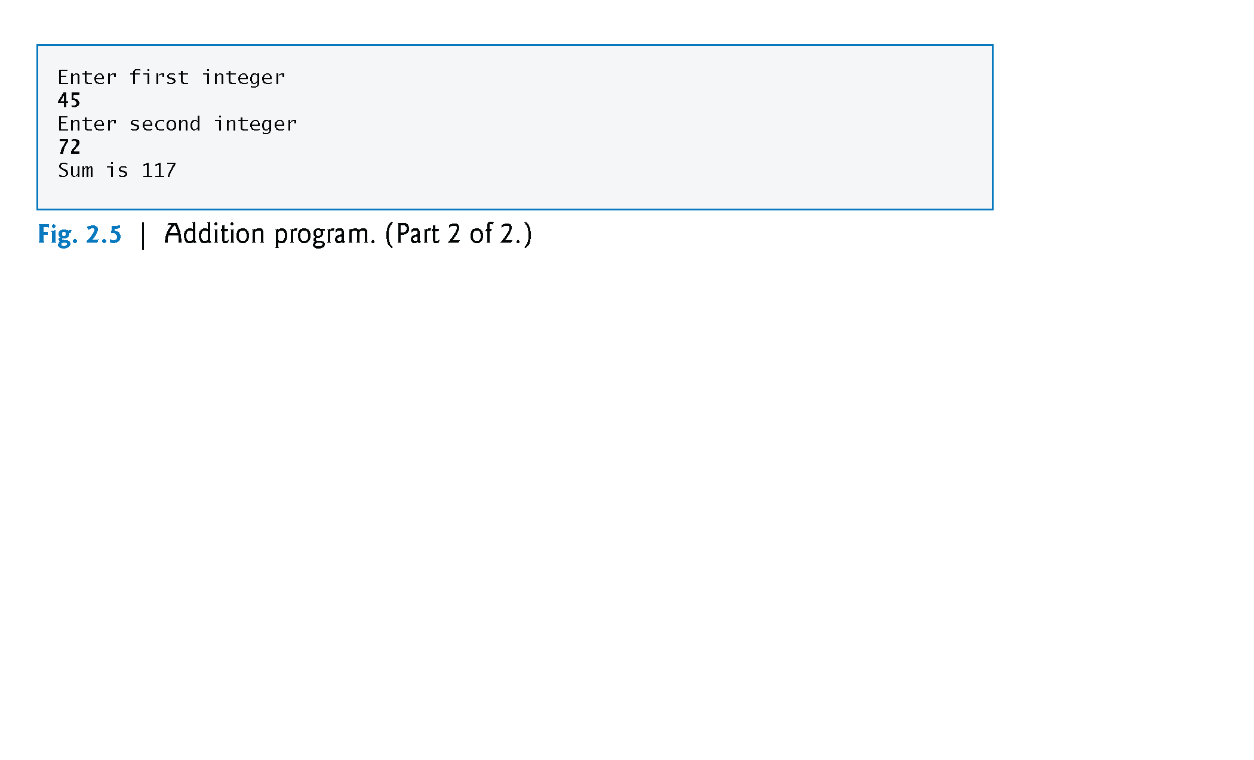
2.1 Another Simple C Program: Adding Two Integers – PROGRAM OUTPUT
The numbers emphasized in bold are entered by the user
Dr. Soha S. Zaghloul 6 Copyright © Pearson, Inc. 2013. All Rights Reserved.

Slide 7
2. Data Type and variables
input data
output data
Keyboard
mouse
Processing
Screen
printer
Dr. Soha S. Zaghloul 7 Copyright © Pearson, Inc. 2013. All Rights Reserved.

Slide 8
2.2 VARIABLES
Variables and Variable Definitions
Any data need to be saved in memory before we can use it.
To save this data we need to define it’s type (what kind of data) and where it should be stored..
This is called variable declaration.
The steps are:
Name identifier
Select data type
Assign value
Use variable
Dr. Soha S. Zaghloul 8 Copyright © Pearson, Inc. 2013. All Rights Reserved.

Slide 9
2.2.1 VARIABLES - Identifiers
Identifiers and Case Sensitivity
A variable name in C is any valid identifier.
Rules for specifying an identifier are:
1) Consist of only letters (A-Z and a-z), digits (0 – 9) and underscore (_)
2) Should start with a letter
3) Should not be a reserved word (key word)
Important : C is case sensitive—uppercase and lowercase letters are different in C, so a1 and A1 are different identifiers.
Dr. Soha S. Zaghloul 9 Copyright © Pearson, Inc. 2013. All Rights Reserved.

Slide 10
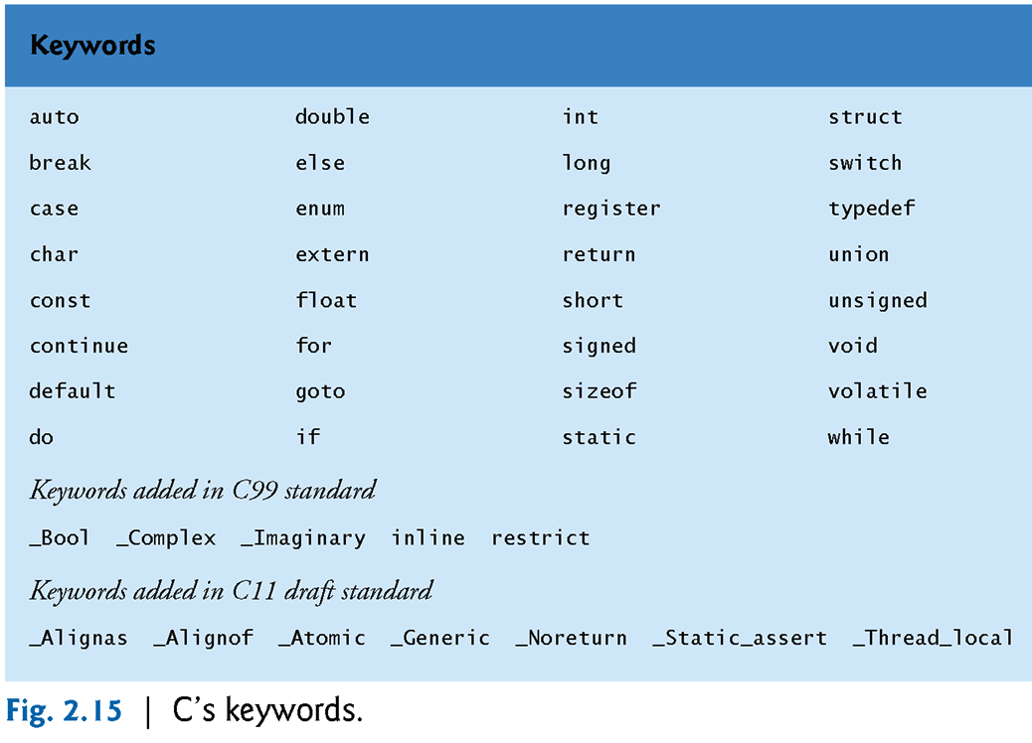
2.2.1 C KEYWORDS
Dr. Soha S. Zaghloul 10 Copyright © Pearson, Inc. 2013. All Rights Reserved.

Slide 11
2.2.1 variables – Identifiers (cont’d)
Dr. Soha S. Zaghloul 11 Copyright © Pearson, Inc. 2013. All Rights Reserved.

Slide 12
2.2.1 variables – Identifiers (cont’d)
Examples of valid identifiers:
letter_1, CENT_PER_INCH, Hello, variable
Examples of invalid identifiers:
Invalid Identifier | Reason Invalid
1Letter | Starts with a digit
double | Reserved word
int | Reserved word
TWO*FOUR | Character * not allowed
joe’s | Character ‘ not allowed

Slide 13
2.2.2 variables – Standard Data Types
Data Type | Represents | Operations | Examples
int | Integer values in the range -32,767 through 32767 | Add, Subtract, Multiply, Divide and Compare | -10500 435 +15 -25 32767
double | Real numbers that include a decimal point or an exponent (scientific notation) | Add, Subtract, Multiply, Divide and Compare | 3.14159 0.005 123.0 15.0e-4 2.245e2 1.15e-3 12e+5
char | An individual character value. These are enclosed in single quotes inside the code. Do not enclose them when entering them as data while run-time. | Compare | ‘A’ ‘z’ ‘2’ ‘9’ ‘*’ ‘:’ ‘”’ ‘ ‘

Slide 14
2.2.2 variables – Standard Data Types
Data Type | Invalid Example | Reason
int | 15.0 -32,768 +30,000 | Contains a decimal point Out of range Comma is not allowed
double | 150 0.1234e 15e-0.3 34,500.99 | No decimal point Missing exponent Non-integer exponent Comma is not allowed
char | ’20’ D | Not a single character Not enclosed between single quotes. However, it is valid as data input while execution.

Slide 15
2.2.3 variables Declaration
How to declare a variable..
Data type Identifier
EX:
int x ;
Remember , each line in c should end with ;
double one;
char id;

Slide 16
2.2 VARIABLES (cont’d)
If we need to declare several variables of the same type we separate them using ,
Ex:
int i;
int y;
Can be written :
int i , y;
Dr. Soha S. Zaghloul 16 Copyright © Pearson, Inc. 2013. All Rights Reserved.

Slide 17
2.2 VARIABLES (cont’d)
A variable can’t be used until a value is assigned to it.
If we use a variable without a value this will cause a syntax error.
How to assign a value to a variable
variable name = value
The value should be compatible with the data type.
The value can be in the code or from the user.
Dr. Soha S. Zaghloul 17 Copyright © Pearson, Inc. 2013. All Rights Reserved.

Slide 18
Assign value to variable in code
Ex:
int age = 20;
The previous statement is correct , it declared variable age of type int and assigned value 20 to it.
We will learn assign value from user later..

Slide 19
2.2 Constant
There are two types of data that we use in a program.
Data that can be changed : variable
Data that Can’t be chanced : constant
You can define constants of any type by using the #define compiler directive.
#define identifier value
EX:
#define ANGLE_MIN 0
#define ANGLE_MAX 360
would define ANGLE_MIN with value 0 and ANGLE_MAX with value 360.
C distinguishes between lowercase and uppercase letters in variable names. It is customary to use capital letters in defining constants.

