Slide 1
Acids and bases

Slide 2
Acids and bases
Acid:
It is defined as a substance that donate a proton (it is a
proton donor).
Base:
it is a substance that accept a proton (it is proton
acceptor).
- Acid: a) strong acid
b) weak acid

Slide 3
Strong acid:
It is completely ionized in the solution.
example: HCl , H₂SO₄
Strong base:
It is completely ionized in the solution.
example: NaOH, KOH
Weak acids and weak bases are not completely ionized when dissolved in water.
- Example of weak acid: acetic acid (CH₃COOH)
- Example of weak base: ammonia (NH₃)

Slide 4
-Weak acids and bases are common in biological systems and
play important roles in metabolism and its regulation.
Conjugate acid – base pair:
It is consist of a proton donor and its corresponding proton acceptor.
Example:
(CH₃COOH/CH₃COO⁻)
CH₃COOH H⁺ + CH₃COO⁻
● Acetic acid (CH₃COOH) is a proton donor
● Acetate anion (CH₃COO⁻) is the corresponding proton
acceptor.

Slide 5
-Each acid has a characteristic tendency to lose its proton in an aqueous solution.
-The stronger the acid, the greater the tendency to lose its proton.
-The tendency of any acid HA to lose a proton and form the conjugate base A⁻ is defined by the equilibrium constant K′ for the reversible reaction
HA H⁺ + A⁻
Which is
[H⁺] [A⁻]
K′ =
[HA]
https://www.youtube.com/watch?v=vxAmLPtrQDI

Slide 6
-Equilibrium constants for ionization reactions are more usually called ionization or dissociation constants.
- The dissociation constants for acid often designated K′_{a}
PK′ :
1
PK′ = log = - log K′
K′
- The symbol P denotes “negative logarithm of” in both PH and PK′.
(The more strongly dissociated the acid, the lower its PK′.

Slide 7
PH:
- The H⁺ concentration of a solution is usually indicated in PH units on a PH scale that runs from 0 to 14.
PH: It is the negative logarithm of the hydrogen ion
concentration of an aqueous solution.
PH = -log [H⁺]
1
- This can also expressed as PH = log
[H⁺]
where [H⁺] is molar H⁺ concentration.

Slide 8
- Pure water has a H⁺ concentration of 10⁻⁷ molar and thus has a PH of 7 neutral
A solution with a higher H⁺ concentration has a lower PH value, and one with a lower H⁺ concentration has a higher PH value.
Example:
A strong acid with a high H⁺ concentration of 10⁻² molar
has a PH of 2, whereas a solution with only 10⁻¹⁰ molar H⁺
has a PH of 10.
- Acidic solutions have a PH of less than 7
- Basic (alkaline) solutions have a PH more than 7

Slide 9
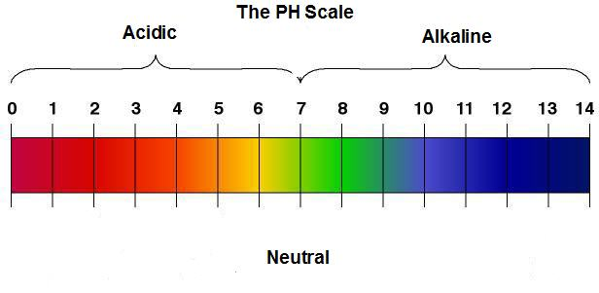

Slide 10
Buffers
Buffer:
is a chemical system that tends to resist large changes in PH
upon the addition of small amounts of H⁺ or OH⁻ ions.
-Common buffer mixtures contain two substances, a conjugate
acid and a conjugate base.

Slide 11
Types of buffer
a) acidic buffer: b) a basic buffer:
-contains a weak acid and a salt - contains a weak base and a salt
of the weak acid (conjugate base). of the weak base (conjugate acid).
-Together the two species (conjugate acid plus conjugate base)
resist large changes in PH by partially absorbing additions of [H⁺] or [OH⁻] ions to the system.

Slide 12
●If H⁺ ions are added to the buffered solution, they react partially with the conjugate base present to form the conjugate acid. Thus some H⁺ ions are taken out of circulation .
●If OH⁻ ions are added to the buffered solution, they react partially with the conjugate acid present to form water and the conjugate base. Thus, some OH⁻ are taken out of circulation.
example of acidic buffer:
●(CH₃COOH/CH₃COO⁻)
●(H₂CO₃/ HCO₃⁻)

Slide 13
Example:
How can this acidic buffer (H₂CO₃/ HCO₃⁻) resist change in PH.
H⁺
● HCO₃⁻ H₂CO₃
OH⁻
● H₂CO₃ HCO₃⁻

Slide 14
-The buffer working range is determined by the PKa of the conjugate acid.
-The best buffering region is one PH unit on either side of the PKa value
PH = PKa ±1

Slide 15
Titration curve:
It is a plot of PH against the amount of NaOH added.
- A measured volume of the acid is titrated with a base solution, usually sodium hydroxide (NaOH) of known concentration.
- The NaOH is added in small increments until the acid is consumed (neutralized).

Slide 16
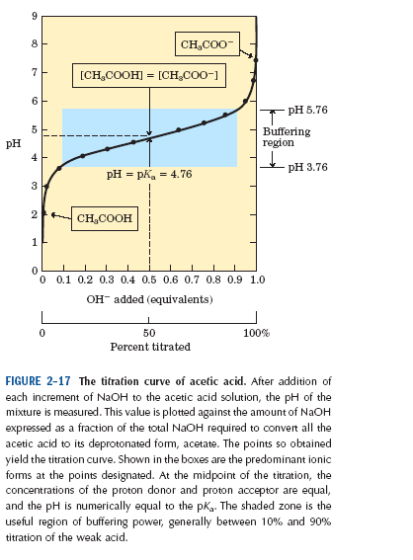
Example:
Titration curve of acetic acid

