Slide 1
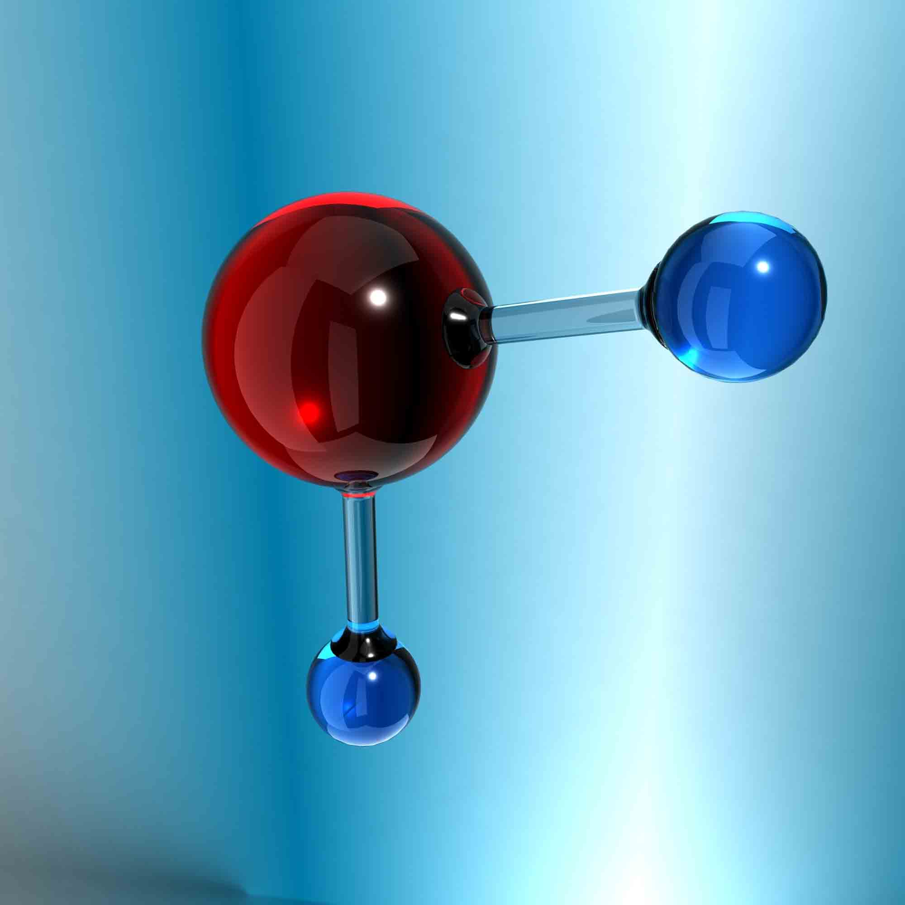
Water
-Water accounts for about 70% of a cell′s weight, and most
intracellular reactions occur in an aqueous environment.
Water (H₂O) is a chemical compound consisting of two
hydrogen atoms and one oxygen.
H₂O

Slide 2
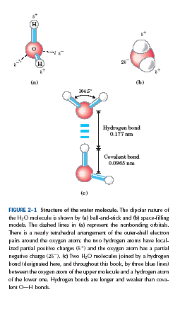
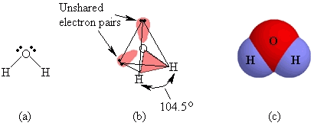

Slide 3
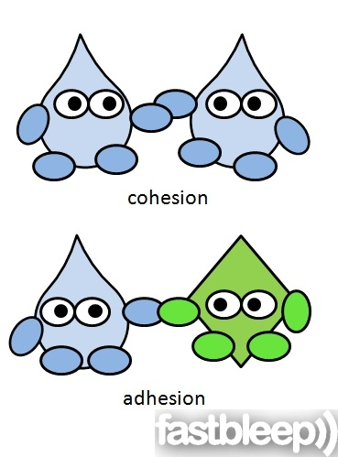
properties of water:
Polar molecule
Cohesion
adhesion
Density:
greatest at 4ºC (Expand when freeze)
Universal solvent of life

Slide 4
-1) Polar molecule:
The unusual physical properties of water are due to hydrogen bonding ( water has a higher melting point , boiling point (100°C) , and heat of vaporization than most other liquids).
Water is held together by hydrogen bonds:
-In each molecule of water (H₂O), the two H atoms are linked to the oxygen atom by covalent bonds.
-The two bonds are highly polar because the oxygen is strongly attractive for electrons, whereas the H is only weakly attractive. (Electronegativity)
Consequently, there is unequal distribution of electrons in a water molecule so partial positive charge on the two H atoms and partial negative charge on the O Water is therefore called a polar molecule (dipole molecule).

Slide 5
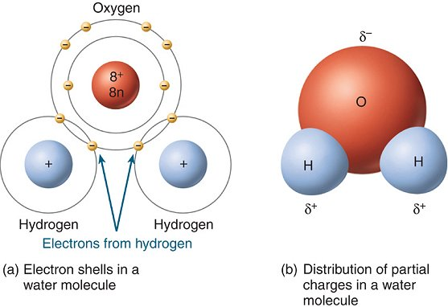
- A water molecule is a polar molecule with opposite ends of the molecule with opposite charges.

Slide 6
- When a positively charged region of one water molecule (that is, one of its hydrogen atoms) comes close to
a negatively charged region (that is, the O) of a second water molecule, the electrical attraction between them can establish a weak bond called a hydrogen bond.
Hydrogen bonds are much weaker than covalent bonds and are easily broken by heat.
Each water molecule can form hydrogen bonds through its two hydrogen atoms to two other water molecules, producing a network in which hydrogen bonds are being continually broken and formed.
-Each water molecule can form hydrogen bonds with up to four other water molecules.

Slide 7
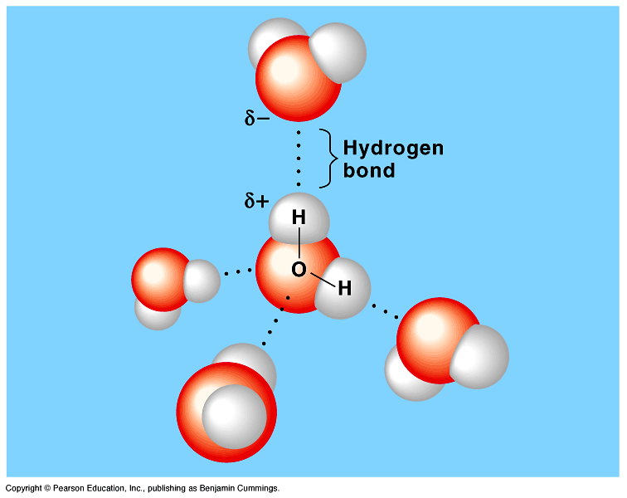
It is because of these interlocking hydrogen bonds
that water at room temperature is a liquid (with a high boiling
point and high surface tension).

Slide 8
2. Cohesion :
is attraction between molecules of the same substance.
-Water has a high Cohesion because of Hydrogen bonding.
-Attraction between particles of the same substance results in Surface tension (a measure of the strength of water’s surface)
- (Surface tension, a measure of the force necessary to stretch or break the surface of a liquid, is related to cohesion).
- Strong intermolecular forces High surface tension

Slide 9
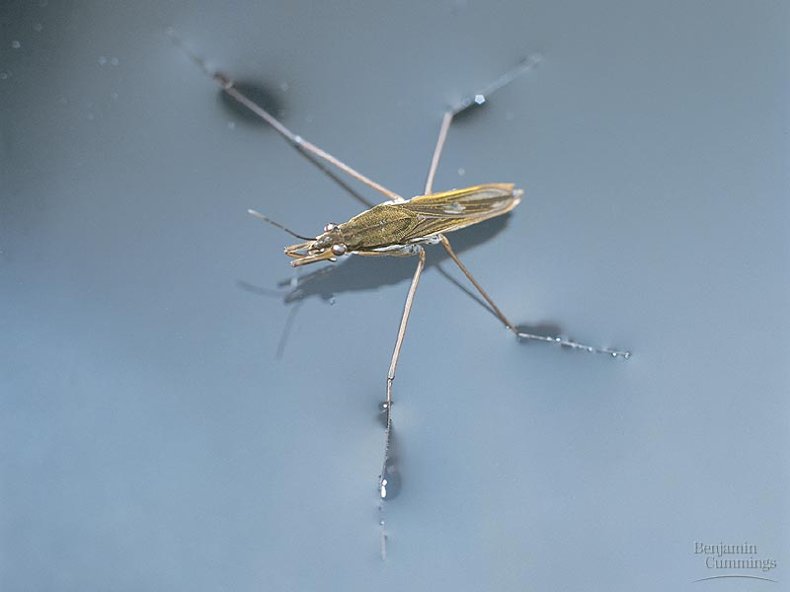
Water has a greater surface tension than most other liquids because hydrogen bonds among surface water molecules resist stretching or breaking the surface.
Water behaves as if covered by an invisible film.
- This surface film on water allows insects to walk on the surface of water.

Slide 10
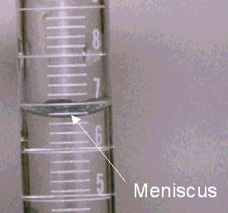
3. Adhesion:
is attraction between molecules of different substances.
- The meniscus shown below forms when water adheres to the sides of the glass container.

Slide 11
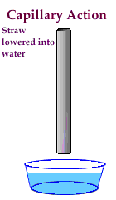
-Adhesion Causes Capillary Action, Which gives water the ability to “climb” structures.

Slide 12
4. Density of water:
- Most dense at 4ºC
- Expands from 4ºC to 0ºC
- water is less dense as a solid (ice) than as a liquid ice floats.
-In liquid water at room temperature, water molecules are disorganized and in continuous motion, so that each molecule forms hydrogen bonds with an average of only 3.4 other molecules (since water molecules are in continuous motion in the liquid, so these hydrogen bonds are constantly and rapidly being broken and reformed).

Slide 13
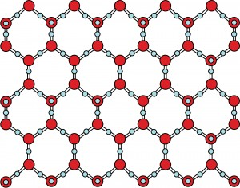
-In ice, on the other hand, each water molecule is fixed in space, and forms hydrogen bonds with a full complement of four other water molecules to yield a regular lattice structure.
this crystal lattice structure makes ice less dense than liquid water and thus ice floats on liquid water.
- Ice forms on the surface first—the freezing of the water releases heat to the water below creating insulation.

Slide 14
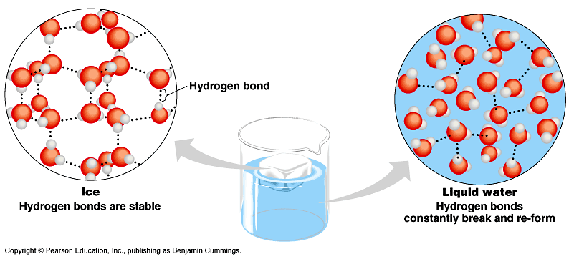

Slide 15
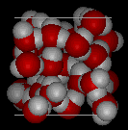
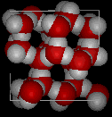
Water is Less Dense as a Solid
Water
Ice
Notes:
1

Slide 16
5. Water has unusual solvent properties:
- Water is a much better solvent than most common liquids.
• Most crystalline salt e.g., sodium chloride (NaCl) readily dissolve in water but are insoluble in non-polar liquids like chloroform or benzene.
- This property is a reflection of the dipolar character of the water molecule.
- The crystal lattice of a salt is held together by very strong electrostatic attraction between alternating positive and negative ions.
When crystalline NaCl is exposed to water, the dipolar water molecules are very strongly attracted to Na⁺ and Cl⁻ ions and pull them away from the lattice to form the hydrated Na⁺ and Cl⁻ ions in solution.

Slide 17
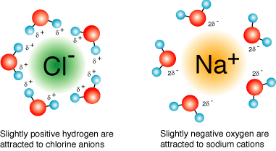
-Water also dissolves many simple organic compounds having carboxyl or amino groups, which tend to ionize by interaction with water.
• A second class of substances readily dissolved by water includes many neutral organic compounds with polar functional groups, such as sugars, alcohols:
- Their solubility is due to the propensity of water molecules to form hydrogen bonds with the hydroxyl groups of sugars and alcohols or the carbonyl groups of aldehydes and ketones.

Slide 19
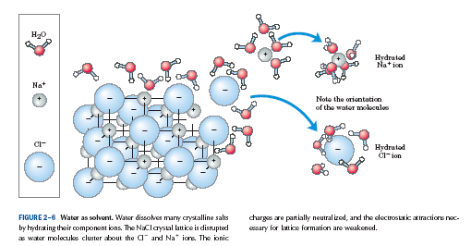

Slide 20
Ionization of water:
- Many reactions that occur in nature are reversible and do not proceed to completion. Instead, they come to equilibrium.
- The position of equilibrium is described by equilibrium constant, K_{eq} .
- Ionization of water is expressed by an equilibrium constant
Equilibrium constant (Keq):
it is a constant characteristic for each chemical reaction, that relates the specific concentrations of all reactants and products at equilibrium at
a given temperature and pressure.
A + B C + D
[C] [D]
K_{eq} =
[A] [B]

Slide 21
- The degree of ionization of water at equilibrium is small.
H₂O H⁺ + OH⁻
- The reversible reaction of water is important in its properties and in its effects on cell function.
Pure water ionizes slightly forming equal numbers of hydrogen ions (hydronium ions, H₃O⁺) and hydroxyl ions.
The extent of ionization is described by an equilibrium constant, K_{eq} .
[H⁺] [OH⁻]
K_{eq} =
[H₂O]

Slide 22
Keq [H2O] = [H⁺] [OH⁻]
[H₂O] = constant
Keq [H2O] = k_{w}
k_{w} = [H⁺] [OH⁻]
k_{w} = dissociation or ionization constant for water
● In pure water [H⁺] = [OH⁻] = 10⁻⁷
k_{w} = 10^{-7 ×} 10⁻⁷
k_{w} = 10⁻¹⁴
[H⁺] [OH⁻] =10⁻¹⁴

