Slide 1
Introduction
CSC 111

Slide 2
Outline
1. Computer Organization
2. Program Solving Cycle
3. Program Components
- Examples
4. Program Compilation
4.1 Java Program Compilation
4.2 Java Virtual Machine (JVM)
5. Program Testing & Debugging

Slide 3
1. Computer Organization
A computer consists of:
Hardware: Physical devices of computer system
Software: Programs that run on computers
A program is a set of instructions written in a high programming language (such as C/C++ or Java) to do a specific task.

Slide 4
1. Computer Organization (cnt’d)
The main components of a computer system are:
1. Input unit (mouse, keyboard)
2. Output unit (printer, monitor, audio speakers)
3. Memory unit (retains input data, calculated data and instructions)
4. Central processing unit (CPU) which consists of:
4.1 Control unit (supervises the operation of other devices)
4.2 Arithmetic and Logic unit (ALU) (performs calculations)
5. Secondary storage (hard drives, floppy drives)

Slide 5
2. Program Solving Cycle
Solving a program goes through the following main steps:
1. Analysis: Outline the solution requirements
2. Design an appropriate algorithm or a flowchart.
3. Code the solution in a high programming language (such as Java)
4. Compile the code into machine language. Verify that the program works:
4.1 If there is an error, correct it by going to step 3.
4.2 If there is no error, proceed to step 5.
5. Run the program. Verify the results:
5.1 If the output does not give the required results, go to step 1.
5.2 If the output matches the required result, you are done.
Refer to figure in Slide 6

Slide 6
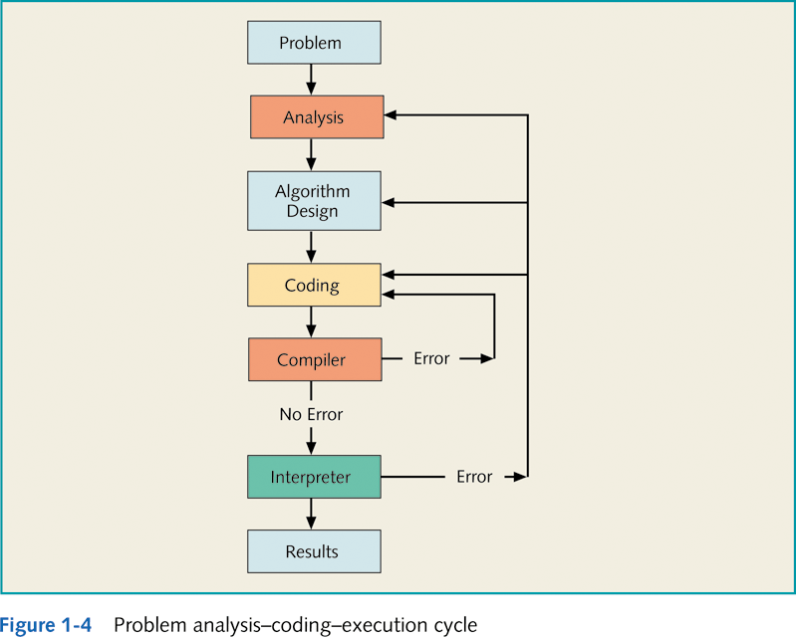
2. Program Solving Cycle (cnt’d)
Syntax Error
Logical or Run-time Error

Slide 7
3. Program Components
A program consists of the following:
Input: Data to begin with to solve the program.
Output: The target of the problem. This is the expected result.
Nouns in the problem statement suggest input and output data.
Processing: This is the set of instructions that drive from the input to the output.
Verbs in the problem suggest the processing steps.
Processing
Input Data
Output Data

Slide 8
Example 1 - Area and Perimeter of a Rectangle
Write a program that calculates the area and the perimeter of a rectangle of width and length 5 cm and 3 cm respectively.
Input
Width = 5 cm
Length = 3 cm
Output
Area = ?
Perimeter = ?
Processing (Input → Output)
Area = length*width = 5 * 3 = 15 cm²
Perimeter = 2*( length + width) = 2*(3 + 5) = 16 cm
If the values of the input data are not given in the problem statement, they may be read from the user through the keyboard.

Slide 9
Example 2 - Area and Perimeter of a Circle
Calculate the area and the perimeter of a circle of radius = 2.5 cm.
Input
Radius = 2.5 cm
PI = 3.14
Output
Area = ?
Perimeter = ?
Processing (Input → Output)
Area = PI * Radius * Radius = 3.14*6.25 = 19.625 cm²
Perimeter = 2 * PI * Radius = 2*3.14*2.5 = 15.7 cm
If the values of the input data are not given in the problem statement, they may be read from the user through the keyboard.

Slide 10
Example 3 - Sum and Average of 5 Numbers
Calculate the sum and the average of the numbers 10, 20, 30, 40 and 50.
Input
Five numbers = x1, x2, x3, x4, x5
Output
Sum = ?
Average = ?
Processing (Input → Output)
Sum = x1+x2+x3+x4+x5 =10+20+30+40+50= 150
Average = Sum/5 = 150/5 = 30
If the values of the input data are not given in the problem statement, they may be read from the user through the keyboard.

Slide 11
4. Program Compilation
Computers do not understand programs written in high programming languages (source code) such as C++ and Java
Therefore, programs must be converted into machine code that the computer can understand and execute
A software that translates a source code from a high-level programming language into machine code is called a compiler
Compiler
Source Code
Machine Code

Slide 12
4.1 What is Java ?
Java is a programming language and computing platform first released by Sun Microsystems in 1995.
The language derives much of its syntax from C and C++ but has a simpler object model and fewer low-level facilities.
The Java language is accompanied by a library of extra software that we can use when developing programs.
The library provides the ability to create graphics, communicate over networks, and interact with databases.
The set of supporting libraries is huge.

Slide 13
4.2 Java applications and applets
Applications – standalone Java programs
Applets – Java programs that run inside web browsers
Java is the first programming language to deliberately embrace
the concept of writing programs that
can be executed on the Web.

Slide 14
4. Program Compilation (cnt’d)
The compiler is a software that checks the correctness of the source code according to the language rules.
If the compiler produces an error, this is called a syntax error.
Translates the source code into a machine code if no errors were found.
Machine code depends on the computer hardware: we say that the compiled version is platform-dependent.
For example, a program compiled on a machine that works under the Windows operating system, cannot run on another machine that works under the MAC operating system.
In this case, the program should be re-compiled under the MAC operating system.
However, Java is characterized by being platform-independent. In other words, a Java program that is compiled under the Windows OS can run under the MAC OS without being re-compiled.
Refer to figure in Slide 13 -16

Slide 15
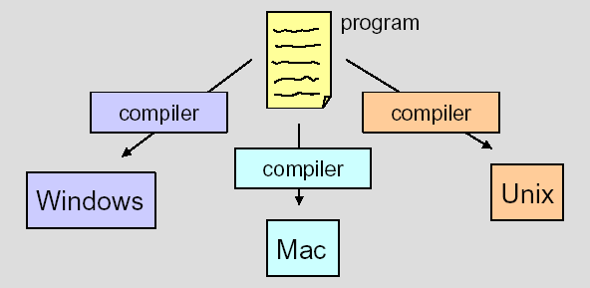
4. Program Compilation (cnt’d)
Platform-Dependent Compilation

Slide 16
4.1 Java Programs Compilation (cnt’d)
The Java compiler translates the source code (with extension “.java”) into a bytecode (with extension “.class”) rather than machine code.
Then, a bytecode is converted into machine code using a Java Interpreter.
Source Code
Bytecode
Java VM or JVM = Java Virtual Machine

Slide 17
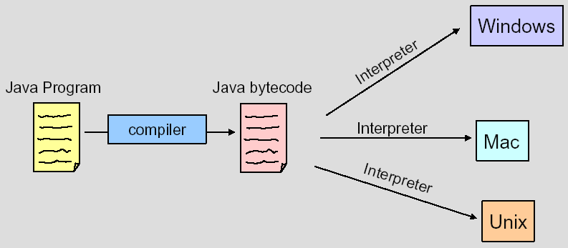
4.1 Java Programs Compilation
The same bytecode is run on any computer installed with a Java Interpreter.
“Hello.java”
“Hello.class”

Slide 18
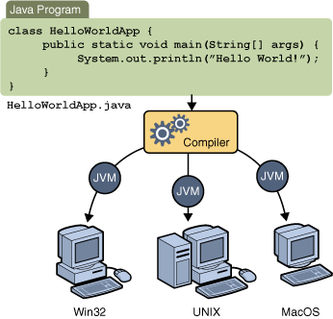
4.1 Java Programs Compilation (cnt’d)
JVM = Java Virtual Machine

Slide 19
Hello world JAVA program
// import section
public class MyFirstprogram {
// main method
public static void main( String args[] ){
System.out.println(“Hello World”);
} // end main
} // end class

Slide 20
Saving a Java program :
A file having a name same as the class name should be used to save the program. The extension of this file is ”.java”.
“MyFirstprogram.java”.
Compiling a Java program : Call the Java compiler javac .
The Java compiler generates a file called
” MyFirstprogram.class” (the bytecode).
Running a Java program
Call the Java Virtual Machine java:
java MyFirstprogram.class

Slide 21
4.2 Java Virtual Machine (JVM)
Java Virtual Machine (JVM): A hypothetical computer developed to make Java programs machine independent (i.e. run on many different types of computer platforms).
A JVM consists of the following components:
The class loader: stores the bytecodes into the computer memory
Bytecode verifier: ensures that the bytecodes do not violate security requirements
Bytecode interpreter: translates the bytecode into machine language
Refer to figure in Slide 18

Slide 22
5. Program Testing and Debugging
Testing
After program compilation, the programmer needs to make sure that the output of the program matches the expected results.
Two types of errors may be encountered
Logical Errors: The program runs but provides wrong output.
Runtime errors: The program stops running suddenly. This happens when the program asks the OS to execute a non-accepted statement (such as division by zero).
Debugging
When an error is encountered, it should be found, understood, and corrected.

