Slide 1
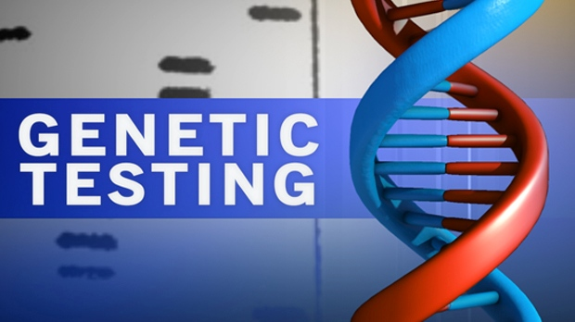

Slide 2
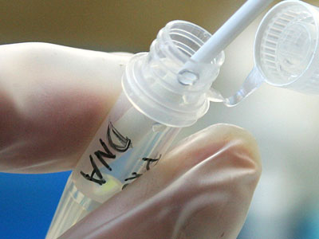
Definition
Genetic Testing
is a type of medical test that identifies changes in chromosomes, genes, or proteins.
The results of a genetic test can confirm or rule out a suspected genetic condition or help determine a person’s chance of developing or passing on a genetic disorder.

Slide 3
Methods used for genetic testing:
Molecular genetic tests (or gene tests)
study single genes or short lengths of DNA to identify variations or mutations that lead to a genetic disorder.
Chromosomal genetic tests
analyze whole chromosomes or long lengths of DNA to see if there are large genetic changes, such as an extra copy of a chromosome, that cause a genetic condition.
Biochemical genetic tests
study the amount or activity level of proteins; abnormalities in either can indicate changes to the DNA that result in a genetic disorder.

Slide 4
Types of genetic testing

Slide 5
Outline
Detection of genetic carriers/ Carrier testing
Prenatal Diagnosis
Screening of Newborn Infant
Predictive testing
Diagnostic testing
Preimplantation testing
Forensic testing (legal purpose)

Slide 6
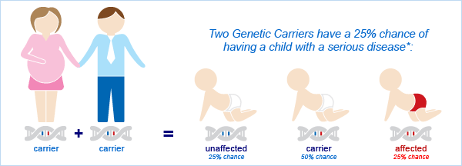
Detection of genetic carriers/ Carrier testing
Testing to identify an asymptomatic adult who is a carrier for autosomal- recessive or X-linked recessive conditions.
Testing is usually initiated on the basis of family history or because the genetic condition is common among individuals of the patient’s ethnicity.
If both parents are tested, the test can provide information about a couple’s risk of having a child with a genetic condition.

Slide 7
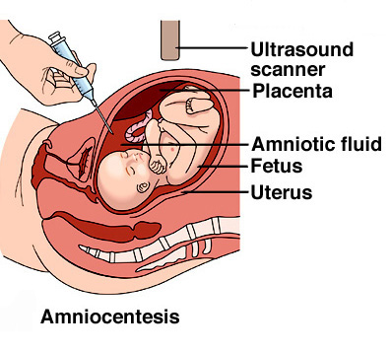
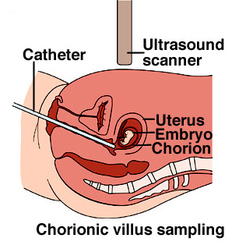
Prenatal Diagnosis
is used to detect changes in a fetus’s genes or chromosomes before birth.
This type of testing is offered during pregnancy if there is an increased risk that the baby will have a genetic or chromosomal disorder.
In some cases, prenatal testing can lessen a couple’s uncertainty or help them make decisions about a pregnancy.
It cannot identify all possible inherited disorders and birth defects.

Slide 8
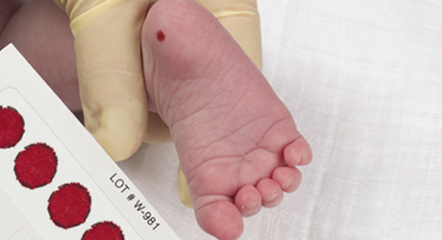
Screening of Newborn Infant (Newborn screening)
Is used just after birth to identify genetic disorders that can be treated early in life.
Millions of babies are tested each year in the United States.
All states currently test infants for
phenylketonuria
a genetic disorder that causes mental retardation if left untreated
congenital hypothyroidism
a disorder of the thyroid gland.
Most states also test for other genetic disorders.

Slide 9
Predictive testing
Definition: Refers to a genetic test performed on a person who has a family history but no symptoms of a specific disorder at the time of testing.
Purpose: to determine whether or not the mutation for that disorder (known to be present in the family) has been inherited.
2 types:
Presymptomatic
Predispositional

Slide 10
Pre-symptomatic Testing
- can determine whether a person will develop a genetic disorder, before any signs or symptoms appear.
Examples:
Huntington disease
myotonic dystrophy

Slide 11
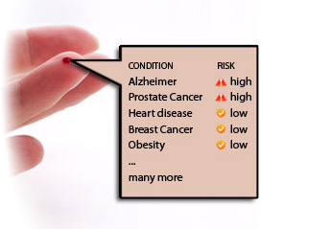
Predispositional testing
High risk to develop a disease

Slide 13
Diagnostic testing
is used to identify or rule out a specific genetic or chromosomal condition.
In many cases, genetic testing is used to confirm a diagnosis when a particular condition is suspected based on physical signs and symptoms.
can be performed before birth or at any time during a person’s life, but is not available for all genes or all genetic conditions.
The results can influence a person’s choices about health care and the management of the disorder.

Slide 14
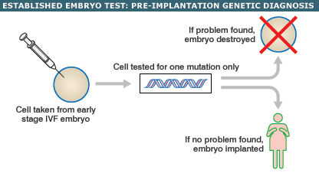
Preimplantation testing
also called preimplantation genetic diagnosis (PGD)
is a specialized technique that can reduce the risk of having a child with a particular genetic or chromosomal disorder.
It is used to detect genetic changes in embryos that were created using assisted reproductive techniques such as in-vitro fertilization.
In-vitro fertilization involves removing egg cells from a woman’s ovaries and fertilizing them with sperm cells outside the body.
To perform preimplantation testing, a small number of cells are taken from these embryos and tested for certain genetic changes.
Only embryos without these changes are implanted in the uterus to initiate a pregnancy.

Slide 15
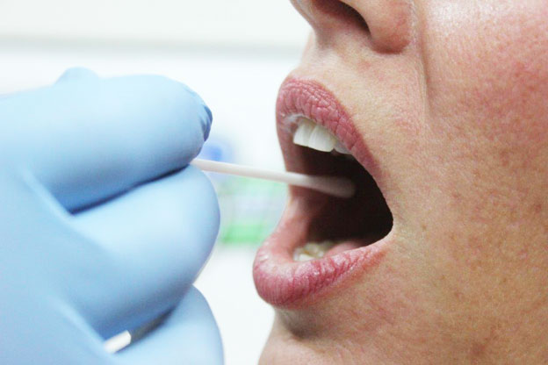
Forensic testing (legal purpose)
uses DNA sequences to identify an individual for legal purposes.
forensic testing is not used to detect gene mutations associated with disease.
This type of testing can identify crime or catastrophe victims, rule out or implicate a crime suspect, or establish biological relationships between people (for example, paternity).

Slide 16
Key considerations for GT

Slide 17
Overview on the process of genetic testing

Slide 18
Informed consent
The process of educating a person about the test and obtaining permission to carry out testing is called informed consent.
“Informed” means that the person has enough information to make an educated decision about testing;
“consent” refers to a person’s voluntary agreement to have the test done.

Slide 19
General rule
informed consent can only be given by adults who are competent to make medical decisions for themselves.
For children and others who are unable to make their own medical decisions (such as people with impaired mental status),
informed consent can be given by a parent, guardian, or other person legally responsible for making decisions on that person’s behalf.

Slide 20
When to obtain an informed consent?
obtained by a doctor or genetic counselor during an office visit.
The healthcare provider will discuss the test and answer any questions.
If the person wishes to have the test, he or she will then usually read and sign a consent form.

Slide 21
factors commonly included on an informed consent form:
A general description of the test, including the purpose of the test and the condition for which the testing is being performed.
How the test will be carried out (for example, a blood sample).
What the test results mean, including positive and negative results, and the potential for uninformative results or incorrect results such as false positives or false negatives.
Any physical or emotional risks associated with the test.

Slide 22
factors commonly included on an informed consent form:
Whether the results can be used for research purposes.
Whether the results might provide information about other family members’ health, including the risk of developing a particular condition or the possibility of having affected children.
How and to whom test results will be reported and under what circumstances results can be disclosed (for example, to health insurance providers).

Slide 23
Risks, limitations and benefits of genetic testing?

Slide 24
risks
emotional, social, or financial consequences of the test results.
may feel angry, depressed, anxious, or guilty about their results.
creates tension within a family because the results can reveal information about other family members in addition to the person who is tested.
The possibility of genetic discrimination in employment or insurance is also a concern.

Slide 25
limitations
Genetic testing can provide only limited information about an inherited condition.
The test often can’t determine if a person will show symptoms of a disorder, how severe the symptoms will be, or whether the disorder will progress over time.
Another major limitation is the lack of treatment strategies for many genetic disorders once they are diagnosed.

Slide 26
Benefits of genetic testing
Test results can provide a sense of relief from uncertainty and help people make informed decisions about managing their health care.
For example, a negative result can eliminate the need for unnecessary checkups and screening tests in some cases.
A positive result can direct a person toward available prevention, monitoring, and treatment options.
Some test results can also help people make decisions about having children.
Newborn screening can identify genetic disorders early in life so treatment can be started as early as possible.

Slide 27
Genetic counseling and role of the nurse in genetic reporting

Slide 28
Genetic Counseling
Is the process by which patients or relatives at risk of an inherited disorder, are advised of the consequences and nature of the disorder, the probability of developing or transmitting it, and the options open to them in management and family planning.
This complex process can be separated into diagnostic (the actual estimation of risk) and supportive aspects.
Genetic counseling is the process by which individuals and families come to learn and understand relevant aspects of genetics; it is also the process for obtaining assistance in clarifying options available for their decision making and coping with the significance of personal and family genetic knowledge in their lives.

Slide 29
Considerations for Genetics Consultation
A personal or family history of a genetic condition, birth defect, chromosomal disorder, or hereditary cancer
Two or more miscarriages
A known inherited disorder, birth defect, mental retardation, or developmental delay in a child
A woman who is pregnant or plans to become pregnancy at or after age 35
Abnormal test results suggesting a potential genetic or chromosomal condition
An increased risk of developing or passing on a particular genetic disorder on the basis of the individual's ethnic background
A consanguineous couple planning to have a child together

Slide 30
Components of genetic counseling
Validation of diagnosis
Obtaining the family risk
Estimation of risk recurrence
Helping the family to reach decisions and take appropriate actions
Follow up

Slide 32
Role of the nurse
Nurse
Advocating
Counseling
Supporting
Educating
Nurses are forefront of patient care and will participate fully in genetic- based and genomic-based practice activities:

Slide 33
Ethical challenges for nurses on genetic information

Slide 34
Genetic information
Defined as heritable, biological information (National Human Genome Research Institute, 2007)
Can be identified at any point throughout a person’s lifespan from preconception until after death.
Sources of information: (Jenkins & Lea, 2005)
Heritable and biological information
Family history
Genetic test results
Medical records

Slide 35
Privacy and confidentiality
Privacy – as defined by the ANA Code of Ethics (2001) involves the right of individual to control their own body, actions, and personal information.
Confidentiality- refers to the nurse’s obligation to protect, and not to disclose, personal information provided in confidence to another.

Slide 36
Privacy and confidentiality
Who should have access to genetic information?
Who owns and control it?
How can families resolve conflicts when some members want to be tested for a genetic disorder and others do not?
What to do as a Nurse?
Need to be familiar with the nature and sources of genetic information so that they can assure privacy and confidentiality.

Slide 37
DISCRIMINATION
Nurses should protect the clients and their families against the misuse of their genetic information.
Nurses must work with healthcare teams and institutions to create practice environments in which their clients can be assured that their genetic information is shared in a professional manner.
Employment
- Qualification for acceptance or renewal of contract
Insurance
- Use to deny or limit insurance coverage

Slide 38
Nursing competencies for ethical issues in genetics and genomic healthcare
Professional Responsibilities
1. Recognize when one’s own attitude and values related to genetic and genomic science may affect care provided to clients.
2. Advocate for the rights of all clients for autonomous, informed genetic-and-genomic related decision making and voluntary action
Practice Domain
1. Identify ethical, ethnic/ancestral, cultural, religious, legal, and societal issues related to genomic information and technologies.
2. Define issues that undermine the rights of all clients for autonomous, informed genetic-and-genomic related decision making and voluntary action
3. Provide clients with accurate, appropriate, and current genetic and genomic information, resources, services, and/or technologies that will support and facilitate decision making.

Slide 39
Strengthening genetic and genomic care around the world
Nurses’ should;
Assurance to meet the health and social needs of the public including technological discrimination in accessing healthcare worldwide.
Equal access to genomic health care around the world – CORE PUBLIC HEALTH.
Collaborate with the governmental agencies to assist them in promoting genetic and genomic healthcare around the world.
Take a lead role working with state, federal, and international agencies to provide guidance to health systems with regard to decisions about utilization of genetics and genomics services.

Slide 40
Future directions
Expand patient record representation
Develop the representation of genetic variation and pharmacogenetics
Investigate animal models for disease and capture treatment outcomes
Find ways with emerging resistance (MRSA)
Genetics and DNA technology improves daily in the scientific community.
Explore integration with i2b2/ transSMART.

Slide 41
Hope you enjoy your journey in human genetics!

