Slide 1
UNIT 3
Groundwater and well hydraulics

Slide 2
Methods for determining aquifer parameters
In Unit 2 we discussed about various lab and field methods for determining the hydraulic conductivity values for the soil/rocks.
Methods included the use of constant head Permeameter, falling head Permeameter and tracer tests for determining the K.
How ever each method had its own demerit.
The best method however for determining the aquifer parameters (K, T and S) are the aquifer tests/pumping tests.

Slide 3
Pumping/Aquifer Test Basics
The term “Pump” is a misnomer.
Groundwater is pumped from an aquifer in order to estimate important aquifer parameters such as hydraulic conductivity (K), transmissivity (T) and the storage coefficient (S). However, it’s the aquifer that is being tested – not the pump doing the work.
Therefore, “aquifer test or aquifer testing” or “pumping test” are more appropriate terms.
An aquifer test is probably the most accurate method that can be used to estimate aquifer parameters.

Slide 4
Pumping/Aquifer Test Basics
An aquifer test consists of a production or pumping well, which discharges groundwater from the aquifer at a constant rate that stresses the aquifer, and observation wells from where the decline in the water level is measured.
Three observation wells at various positions, up and down gradient are considered appropriate for thorough test results.
The specific capacity (Q/s) of a production well can also be used to estimate aquifer parameters.

Slide 5
Observation of groundwater
The occurrence, distribution and movement of groundwater must be detected and analyzed by means of water levels data measured in observation wells and piezometers.
A piezometer: is a well (or narrow tube) from which the pressure head(water level) can be measured at a point in the aquifer.
Observation well: is used to measure water levels during an aquifer test.
Production/Pumping well: is the well from which water is discharged during an aquifer test.
Drawdown: a decline in water level measured from any well during an aquifer test is called drawdown.
Drawdown increases over time and decreases with distance from the production well.

Slide 6
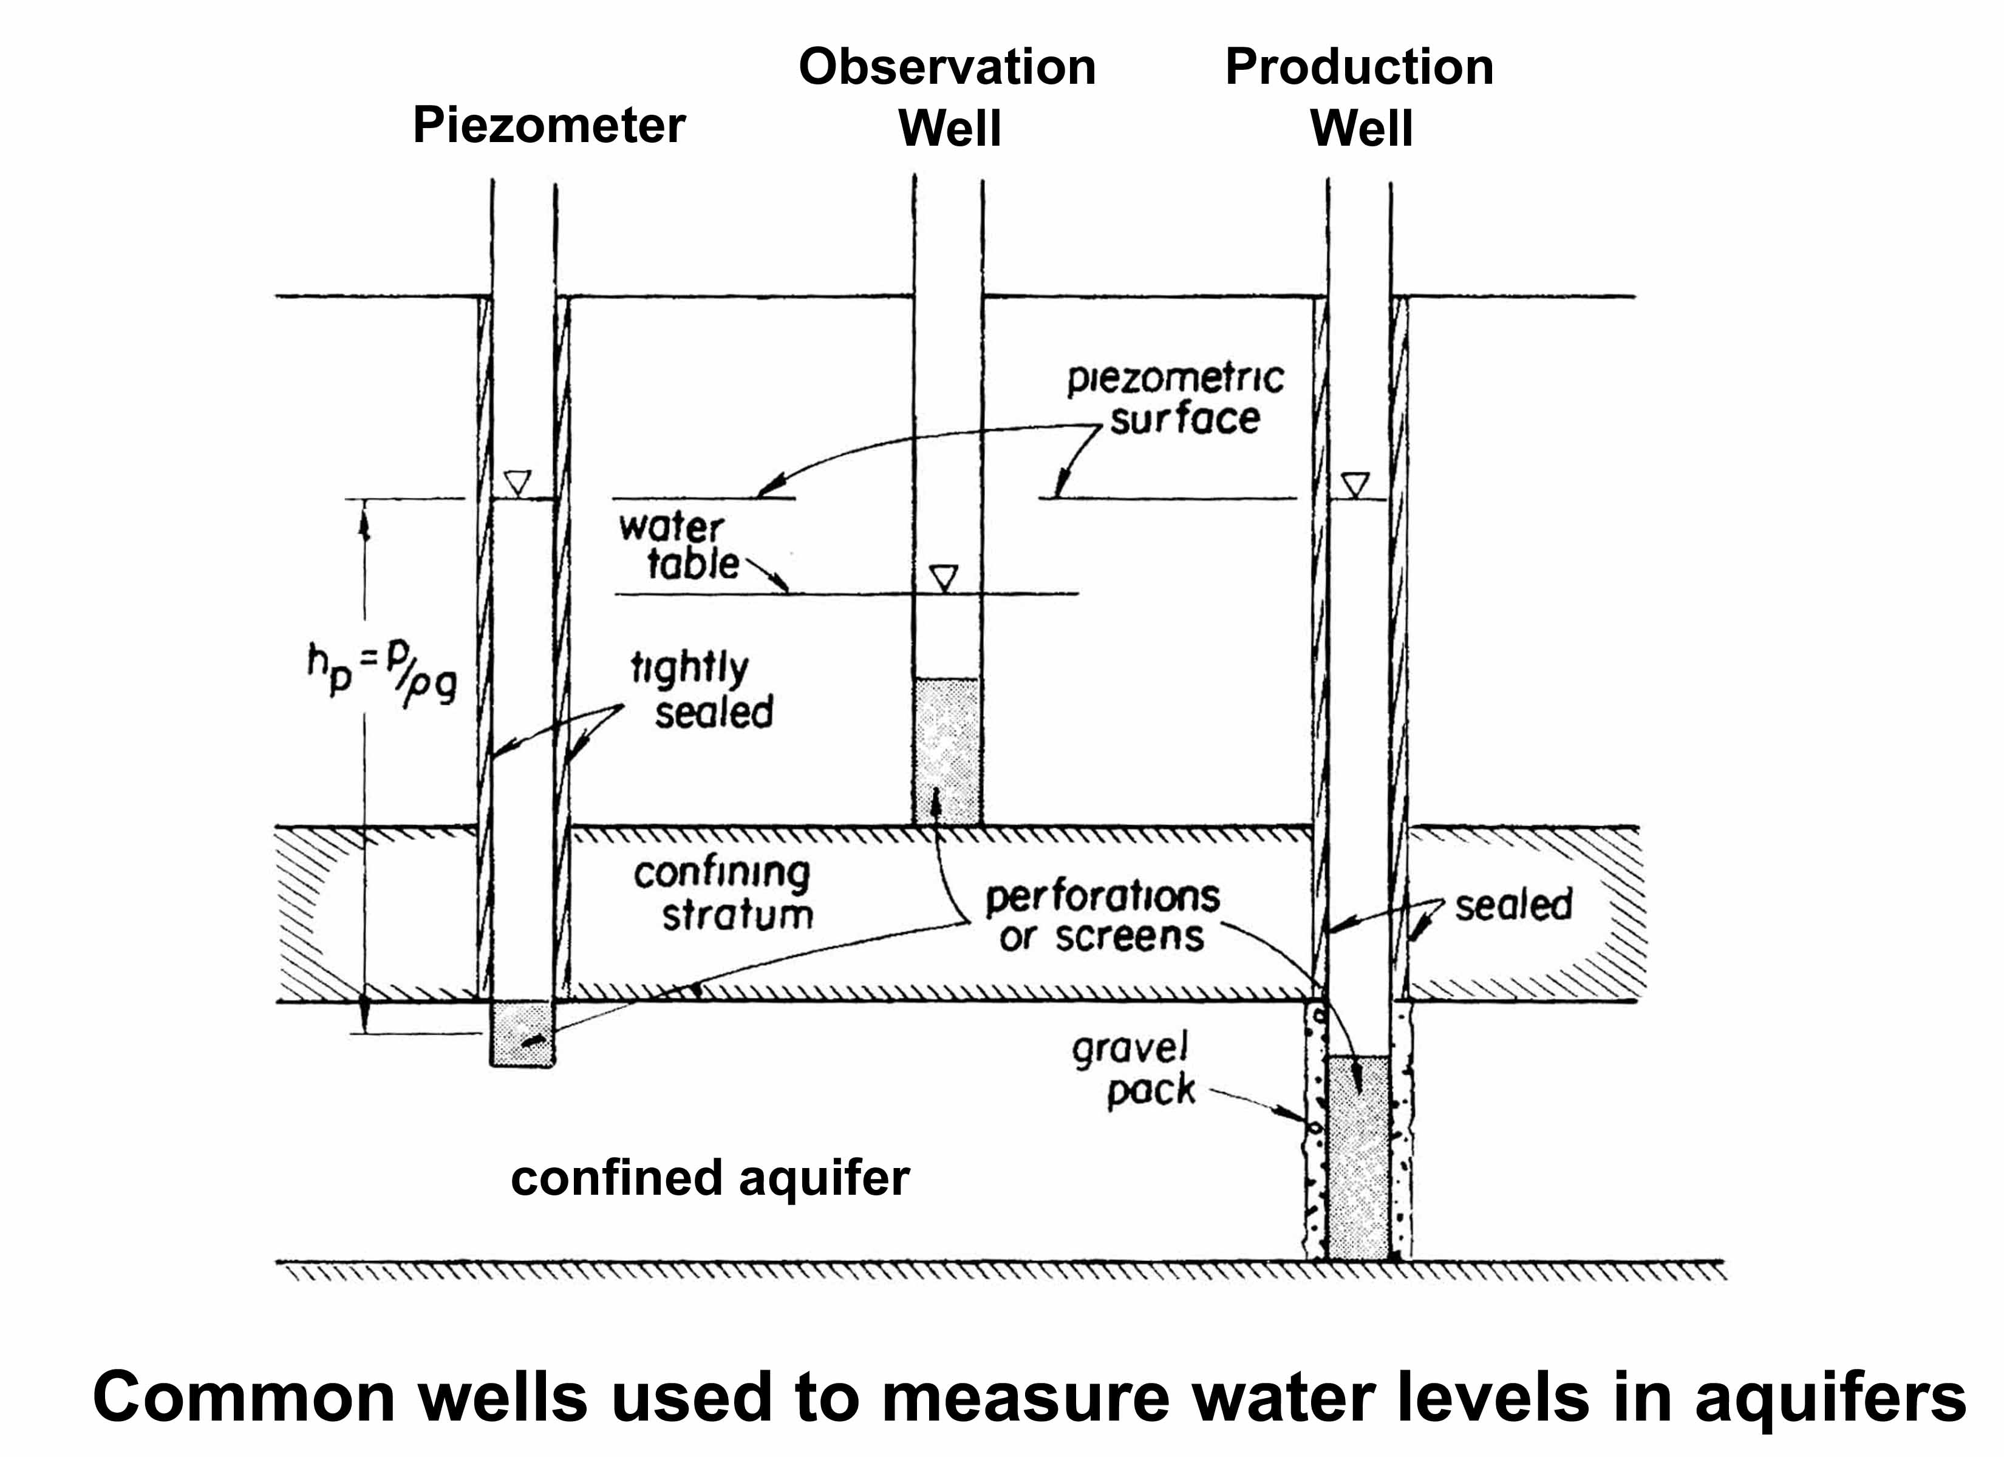
Observation of groundwater

Slide 7
Observation of groundwater
Drawdown and the time of the drawdown are the most important field data collected during an aquifer test.
Change in groundwater level with respect to time in response to pumping is called as drawdown (s)
The most accurate drawdown measurements occur when s = S_{a} ; drawdown due to laminar flow (s_{a})
Drawdown and Groundwater Boundaries
Drawdown (s_{r}) will decrease under the influence of recharge boundary.
Drawdown (s_{b}) will increase under the influence of barrier boundary.
Drawdwon (s_{p}) will increase under the influence of perched aquifer.
Drawdown is additive in case of well interference.

Slide 8
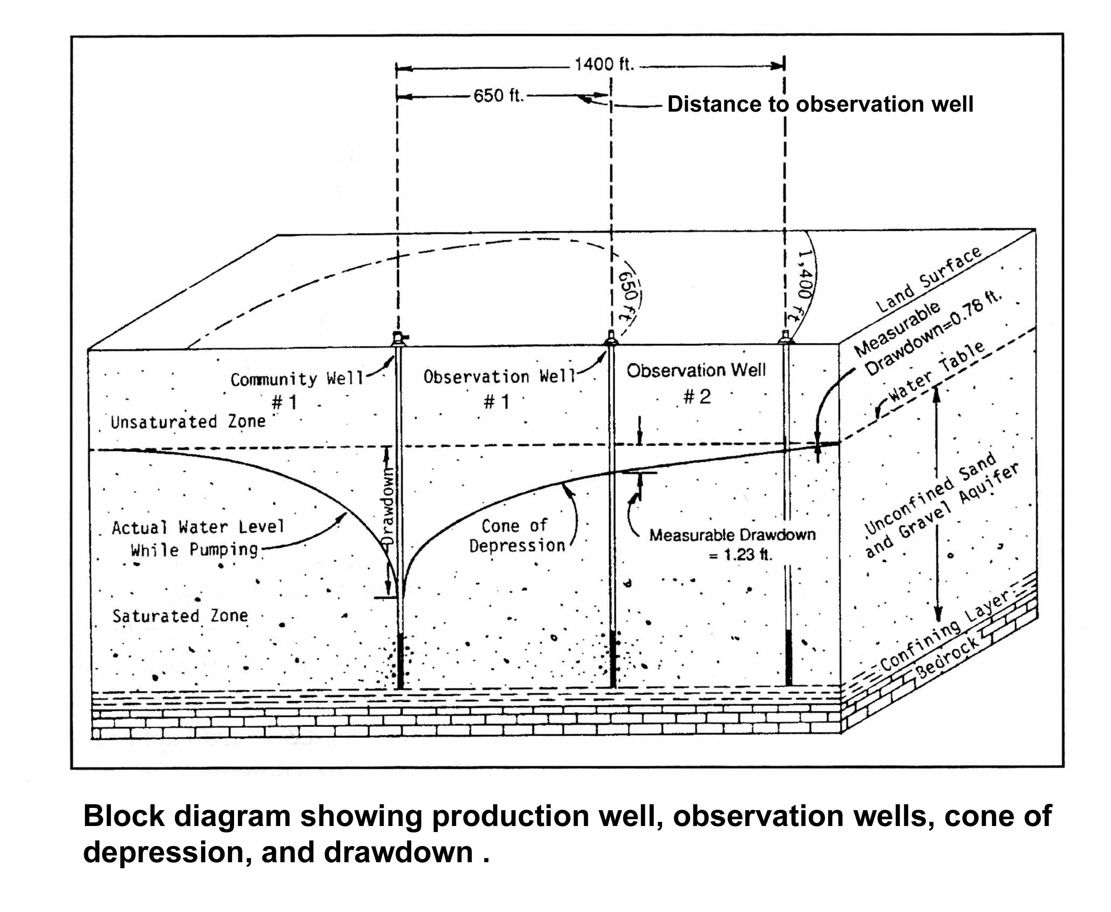
Observation of groundwater

Slide 9
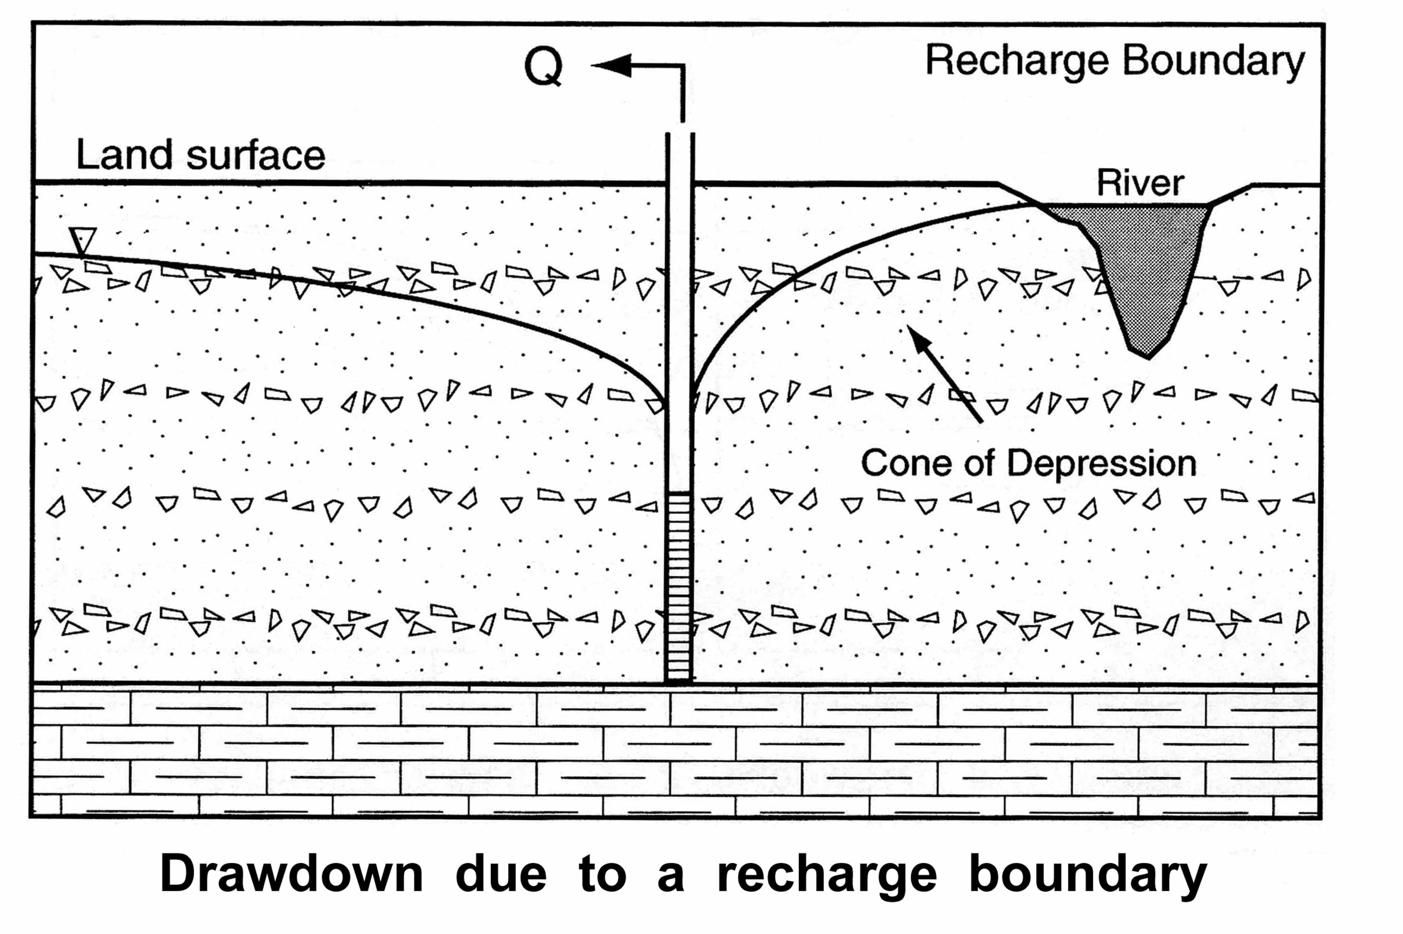
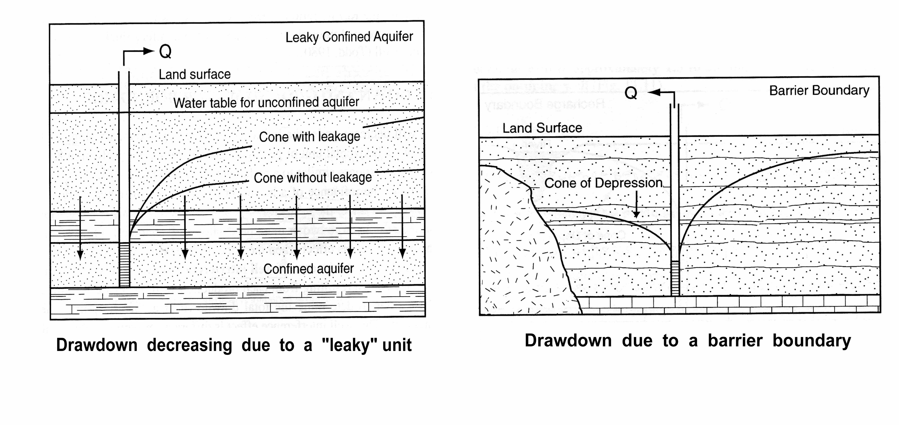
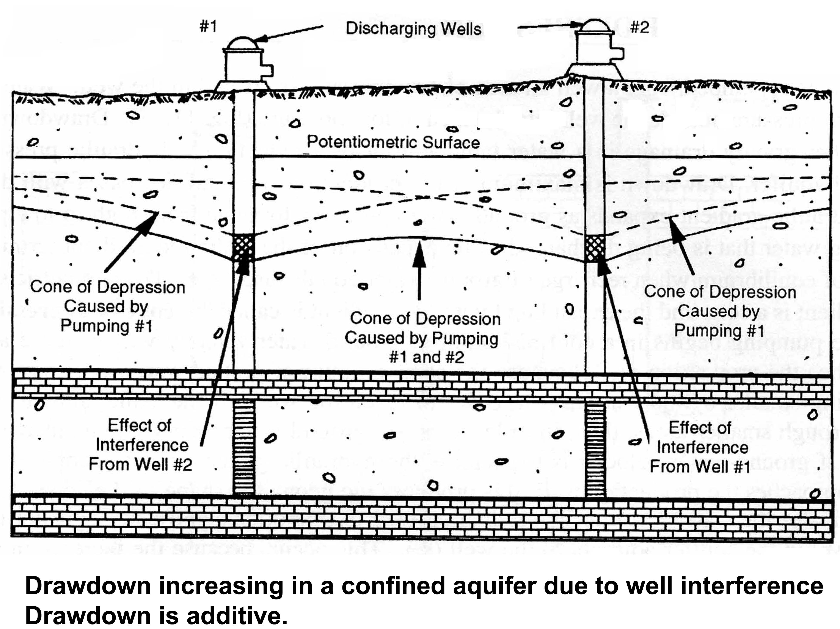
Observation of groundwater

Slide 10
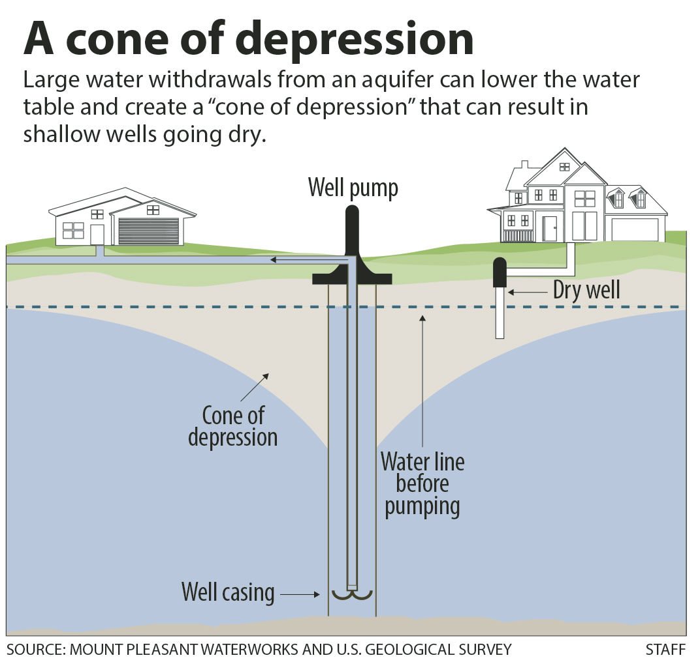
Observation of groundwater

Slide 11
Terms used in Aquifer testing
Static Water Level (S.W.L.): This is a level at which water stands in a well, when no water is being taken from the aquifer, either by pumping or by free flow.
Pumping Level (P.L.): This is the level at which water stands in the well when pumping is in progress.
Drawdown (s): Drawdown in a well means the extent of lowering of the water level when pumping is in progress, or when water is discharged from flow well.
Well Yield/Flow Rate (Q): Yield is the volume of water per unit time, discharged from a well. e.g. m³/day.
Specific Capacity (Q/s): Specific capacity of a well is its yield per unit of drawdown i.e. yield/drawdown.

Slide 12
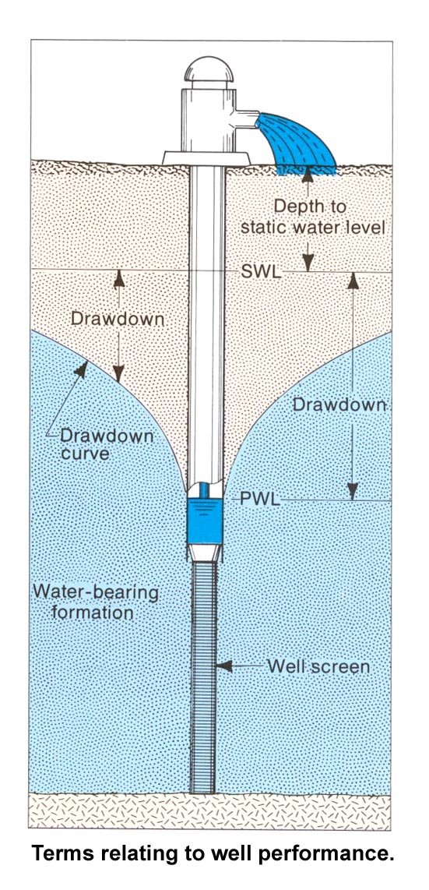
Terms related to well performance
When a well is pumped water is removed from the aquifer surrounding the well and the water table or the piezometric surface depending on the type of aquifer is lowered.
The drawdown at a given point is the distance the water level is lowered.
A drawdown curve (cone) shows the variation of drawdown with distance from the well.
In three dimensions, the drawdown curve describes a conic shape known as the cone of depression.
The outer limit of the cone of depression defines the area of influence of the well.

Slide 13
Types of Pumping Tests
Pumping test
Aquifer test
Well test
Determination of Aquifer types
Determination of Aquifer properties
1. Yield and drawdown
2. Well loss /well efficiency

Slide 14
Principle of aquifer pumping test
Water is pumped during a certain time (t) and at a certain rate (Q). The effect of this pumping on the water table is measured in the pumped well and in some piezometers in the vicinity.
To measure the parameters of groundwater investigations in the field, a well is pumped and changes are observed in the water level in this well and in other wells screened in the same aquifer.
The well is pumped at a constant rate, so that variations in pumping will not mask other trends in the recorded water level data.

Slide 15
Principle of aquifer pumping test
As water is pumped from the well, a cone of depression is forms around the well.
As the pumping continues, the cone of depression becomes deeper and extends further out.
As the water level is lowered in the well, the head difference between the area near the well and the outer edge of the cone of depression is sufficient to overcome frictional resistance of the aquifer and water moves towards the well.
There are various techniques for interpreting these results.

Slide 16
Processing the Pumping test data
At the end of pumping test the following data are to be collected.
Prior to the pumping test, the initial depth to the water table observed in the well itself, and in piezometers.
During the pumping test, depth to water table data as function of the pumping time, and discharge rate (Q).
After the pumping test, depth to water table data as a function of the shut-down time recovery.
Most of the well-flow equations require drawdown data (s).
Therefore, the depth to the water table data should be converted to drawdown data.
i.e. s (drawdown) = depth to water table during the test.- initial depth e.g. S = 96.5m – 96.0m = 0.5 m

Slide 17
Steady and Unsteady State flow
There are two types of well-flow equations
One describing the unsteady-state flow towards a well and the other describing the steady-state flow.
Steady state flow: known as equilibrium flow and is independent of time. i.e. the water level observed in the piezometer, doesn’t change with time.
Unsteady state flow: Known as non-equilibrium flow and is time dependent. i.e. the water level changes with time.
During a pumping test the unsteady-state flow may reach a steady-state flow.

Slide 18
Law of Mass Balance + Darcy’s Law =
Governing Equation for Groundwater Flow
---------------------------------------------------------------
div q = - S_{s} (∂h ⁄∂t) +R* (Law of Mass Balance)
q = - K grad h (Darcy’s Law)
div (K grad h) = S_{s} (∂h ⁄∂t) –R*
Water balance equation

Slide 19
Steady State Water Balance Equation
Inflow = Outflow
Recharge
Discharge
Transient (unsteady) Water Balance Equation
Inflow = Outflow +/- Change in Storage
Outflow - Inflow = Change in Storage

Slide 20
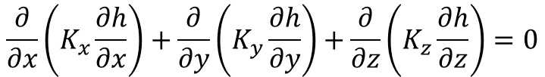
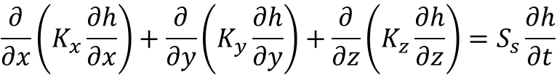
Steady and Unsteady Groundwater flow equation in 3 Dimension
$$\frac{∂}{∂x}\left(K_{x}\frac{∂h}{∂x}\right)+\frac{∂}{∂y}\left(K_{y}\frac{∂h}{∂y}\right)+\frac{∂}{∂z}\left(K_{z}\frac{∂h}{∂z}\right)=0$$
Steady State Groundwater Flow Equation
$$\frac{∂}{∂x}\left(K_{x}\frac{∂h}{∂x}\right)+\frac{∂}{∂y}\left(K_{y}\frac{∂h}{∂y}\right)+\frac{∂}{∂z}\left(K_{z}\frac{∂h}{∂z}\right)=S_{s}\frac{∂h}{∂t}$$
Unsteady State Groundwater Flow Equation

Slide 21
Analysis and Evaluation of Pumping Test Data
Different methods for evaluating pumping test conducted in confined, leaky, and unconfined aquifers are available for steady-state flow and unsteady-state flow.
They are named after the persons who developed them
Aquifer type | Unsteady state | Steady state
Confined aquifer | Thies Jacob | Theim
Leaky aquifer | Walton Hantush | De-Glee Hantush – Jacob
Unconfined aquifer | Boulton Neuman Theis Jacob | Theim

Slide 22
Assumptions Underlying all pumping test methods
The aquifer has a seemingly infinite area extent.
The aquifer is homogeneous, isotropic and of uniform thickness over the area influenced by the pumping test.
Prior to pumping, the piezometric surface and/or phreatic surface are (nearly) horizontal over the area influenced by the pumping test.
The aquifer is pumped at a constant discharge rate.
The pumped well penetrates the entire aquifer and thus receives water from the entire thickness of the aquifer by horizontal flow.
Well diameter is small.

Slide 23
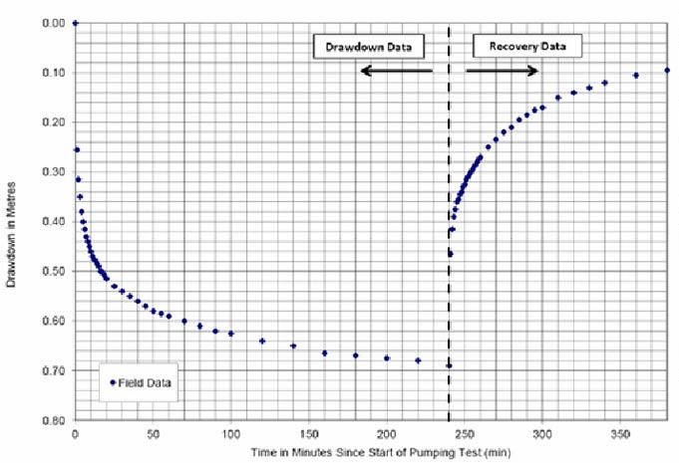
Drawdown and Recovery Plot for Aquifer Test

Slide 24
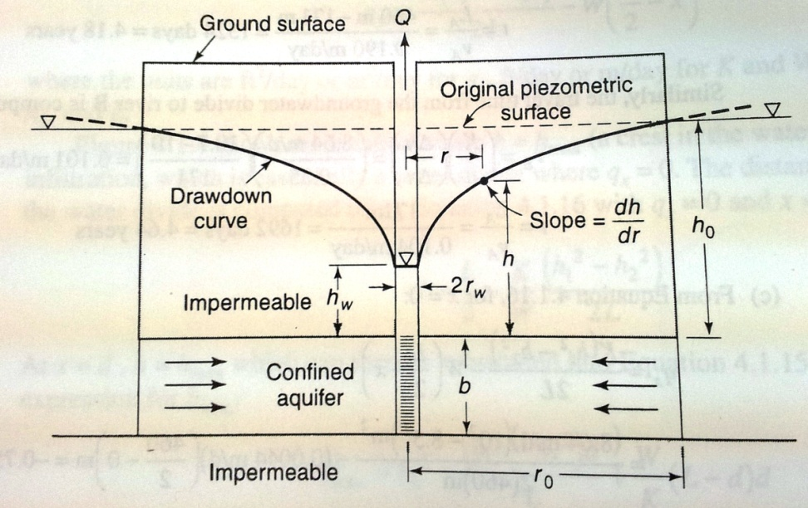
Steady radial flow to a well: Confined Aquifer
To derive the radial flow equation for a well completely penetrating a confined aquifer the figure will prove useful.
The flow is assumed two-dimensional to a well penetrating a homogeneous and isotropic aquifer.
The well discharge at any given point can be given as

Slide 25
Steady radial flow to a well: Confined Aquifer
Rearranging and integrating the equation for the boundary conditions at the well h=h_{w} and r=r_{w} and h=h₀ and r=r₀ some distance away from the well gives the equation
The above equation is known as the Equilibrium or Theim equation which enables the hydraulic conductivity or the transmissivity of a confined aquifer to be determined from a pumped well that fully penetrated the aquifer.

Slide 26
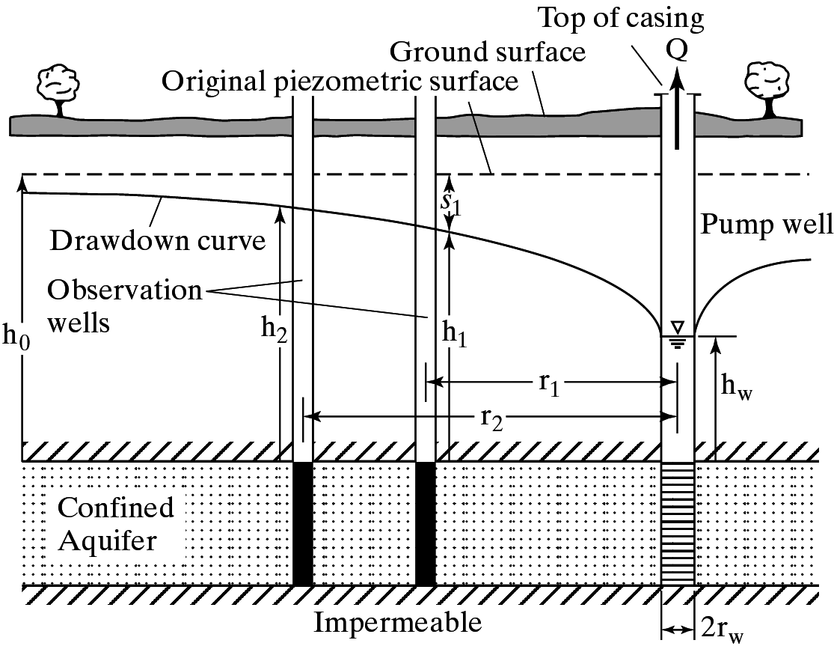
Steady radial flow to a well: Confined Aquifer
If there are two observation wells close to the pumping well and the distance r₁ and r₂ of the observation wells from the pumping well are known, the Q of the pumping well is known and the water level in the two observation wells h₂ and h₁ are known, the Transmissivity of the aquifer can be calculated by applying the following formula

Slide 27
Steady radial flow to a well: Confined Aquifer
The following are the assumptions for applying the Thiem Equation:
  The pumping rate is constant and is pumped for a sufficiently long time to reach the steady state.
  The observation well are close to the pumping well so that the drawdown is appreciable.
  The aquifer is assumed to be homogeneous and isotropic, of uniform thickness and infinite aerial extent.
  The wells penetrate the entire thickness of the aquifer and
  The original piezometeric surface in nearly horizontal.

Slide 28
Limitations of Thiem method
Two observation wells are required at different distances from the pumping well to measure the drawdown at given time after pumping.
Pumping is carried out for a sufficiently long time to approach the steady state condition.
Theoretically h_{w} at the pumped well can be one of the measurement point but the well losses caused by the flow through the well screen inside the well introduces errors so that the water level in the pumping well h_{w} should be avoided.

Slide 29
Steady radial flow to a well: Confined Aquifer
A well penetrates a 25 meter thick confined aquifer. After a long period of pumping at a constant rate of 0.05m³/sec, the drawdown at distances of 50m and 150m from the well were observed to be 3m and 1.2m respectively. Determine the hydraulic conductivity and the transmissivity.

Slide 30
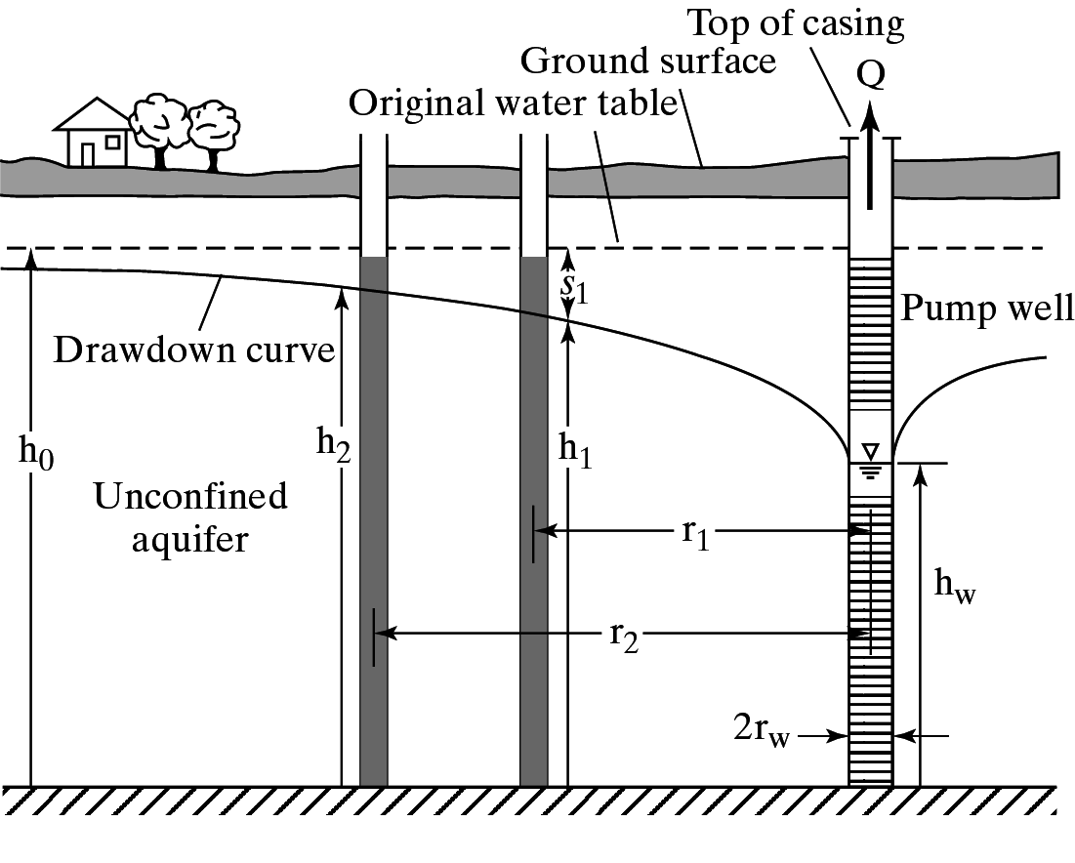
Steady radial flow to a well: Unconfined Aquifer
An equation for steady radial flow in an unconfined aquifer also can be derived with the help of Dupit assumptions.
The figure shows a well completely penetrating an unconfined aquifer.
The well discharge is given as

Slide 31
Steady radial flow to a well: Unconfined Aquifer
The previous equation when integrated between the limits h=h_{w} at r=r_{w} and h=h₀ at r=r₀ yields
Converting heads and radii to two observation wells the above equation becomes

Slide 32
Steady radial flow to a well: Unconfined Aquifer
A well penetrates an unconfined aquifer. Prior to pumping the static water level is 25 meter. After a long period of pumping at a constant rate of 0.05m³/sec, the drawdown at distances of 50m and 150m from the well were observed to be 3m and 1.2m respectively. Determine the hydraulic conductivity and the transmissivity.

Slide 33
Unsteady radial flow in a confined aquifer
When a well penetrating and extensive confined aquifer is pumped at a constant rate, the influence of discharge extends outward with time.
The rate of decline of head multiplied by the storage co-efficient summed over the area of influence equals the discharge.
Since the water comes from the reduction of storage within the aquifer, the head will continue to decline as along as the aquifer is effectively infinite and therefore unsteady or transient flow exists.

Slide 34

Unsteady radial flow in a confined aquifer
The applicable differential equation in plane polar coordinate is
where h is head, r is radial distance from the pumped well, S is the storage co-efficient, T is the transmissivity and t is the time since the beginning of the pumping.
Theis obtained a solution for the above equation based on the analogy between groundwater flow and heat conduction.

Slide 35
Unsteady radial flow in a confined aquifer
By assuming that the well is replaced by a mathematical sink of constant strength and imposing the boundary conditions h=h₀ for t=0, and h → h₀ as r → ∞ for t ≥ 0, the solution
is obtained, where s is drawdown, Q is the constant well discharge, and

Slide 36
Unsteady radial flow in a confined aquifer
The equation below came to be known as the non-equilibrium or Theis equation.
The integral is a function of the lower limit u and is known as the exponential integral.
It can be shown as a convergent series as shown in the equation above and is termed as the well function W(u).
s

Slide 37
Unsteady radial flow in a confined aquifer
The non equilibrium equation permits the determination of the aquifer Storativity (S) and Transmissivity (T) by means of pumping tests of wells.
The equation is widely applied in practice and is preferred over the equilibrium equation (Thiem) because
  The value of S can be determined
  Only one observation well is required
  Shorter period of pumping is generally required and
  No assumption of steady-state flow condition is required.

Slide 38
Unsteady radial flow in a confined aquifer
However the assumptions for the non-equilibrium equation include
  The aquifer is homogeneous, isotropic, of uniform thickness and of infinite areal extent.
  Before pumping, the piezometric surface is horizontal.
  The well is pumped at a constant discharge rate.
  The pumped well penetrates the entire aquifer and the flow is everywhere horizontal within the aquifer to the well.
  The well diameter is infinetesimal so that storage within the well can be neglected.
  Water removed from storage is discharged instantaneously with decline of head.

Slide 39
Theis Method of solution
s
The equation
can be reduced to
Where W(u) is the well function.
The equation can be rearranged as
The relation between W(u) and u is similar to that between s and r²/t because the terms inside the parentheses in the two equations are constants.
Given this similarity Theis suggested and approximate solution of S and T based on the graphic method of superposition.

Slide 40
Theis Method of solution
A plot on a logarithmic paper of W(u) versus u, known as the type curve is prepared.
Values of drawdown (s) are plotted against values of r²/t on logarithmic paper of the same size and scale as the type curve.
The observed time-drawdown data are superimposed on the type curve, keeping the coordinate axes of the two curves parallel and adjusted until a position is found by trial whereby most of the plotted points of the observed data fall on a segment of the type curve.
Any convenient point is then selected and the coordinates of this match point are recorded.
With values of W(u), u , s and r²/t thus determined, S and T can be obtained.

Slide 41
Theis Plot : 1/u vs W(u)

Slide 42
Theis Plot : s vs r²/t
10.0
1.0
Drawdown (m)
0.1
0.0
1.E+01
1.E+02
1.E+03
1.E+04
1.E+05
r²/t

Slide 43
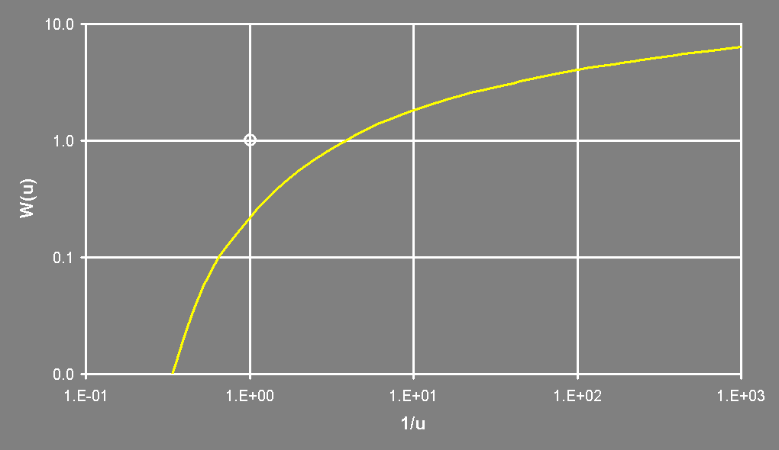
Theis Plot: Matching
s=0.17m
r²/t
[1,1]
Type
Curve
r²/t=51

Slide 44
Cooper-Jacob Straight Line Method
It was noted by Cooper and Jacob that for small values of r and large values of t, u is very small and can be neglected from the equation
And the drawdown can be represented as which can
further be rearranged as
s

Slide 45
Cooper-Jacob Straight Line Method
The Cooper-Jacob simplification expresses drawdown (s) as a linear function of ln(t) or log(t)
The equation in the simplified way can be written as
And

Slide 46
Cooper-Jacob Straight Line Method
Fit straight-line to data (excluding early and late times if necessary):
At early times the Cooper-Jacob approximation may not be valid.
At late times boundaries may significantly influence drawdown.
Determine intercept on the time axis for s=0
Determine drawdown increment (Ds) for one log-cycle.

Slide 47
Cooper-Jacob Straight Line Plot

Slide 48
Cooper-Jacob Straight Line Plot
t_{o} = 84s
Δs =0.39 m

Slide 49
Cooper-Jacob Straight Line Method
Assumptions of the Cooper-Jacob Method remain same as that of Theis method.
  The aquifer is homogeneous, isotropic, of uniform thickness and of infinite areal extent.
  Before pumping, the piezometric surface is horizontal.
  The well is pumped at a constant discharge rate.
  The pumped well penetrates the entire aquifer and the flow is everywhere horizontal within the aquifer to the well.
  The well diameter is infinetesimal so that storage within the well can be neglected.
  Water removed from storage is discharged instantaneously with decline of head.

