Slide 1
Unit 7 Sequential Circuits (Flip Flop)
College of Computer and Information Sciences
Department of Computer Science
CSC 220: Computer Organization

Slide 2
Unit 7: Sequential Circuits
Overview
SR Latch
S′R′ Latch
SR Latch with Control Input
D Latch
Clock and Synchronization
Flip-flops
Positive edge-triggered D Flip-flop
JK &T Flip-flop
Direct Inputs
Chapter-4
M. Morris Mano, Charles R. Kime and Tom Martin, Logic and Computer Design Fundamentals, Global (5th) Edition, Pearson Education Limited, 2016. ISBN: 9781292096124

Slide 3
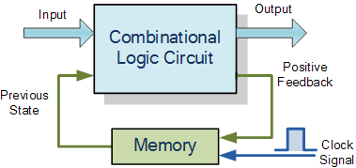

Slide 4
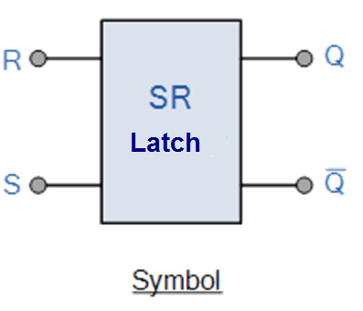
SR Latch
The SR Latch, can be considered as one of the most basic sequential logic circuit possible.
This simple circuit is basically a one-bit memory bistable device.
It has two inputs,
S: will “SET” the device (meaning the output Q = “1”)
R: will “RESET” the device (meaning the output Q = “0”)
Output Q′ is always complement of Q

Slide 8
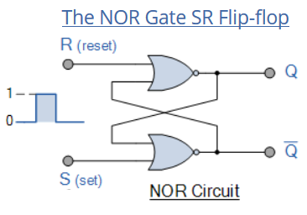

Slide 9
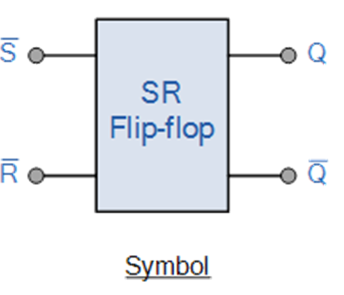
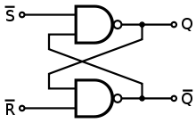
S′R′ Latch
The S′R′ Latch, is build with two cross-coupled NAND gate.
S′ | R′ | Q
0 | 1 | 1
1 | 0 | 0
1 | 1 | No Change
0 | 0 | !

Slide 12
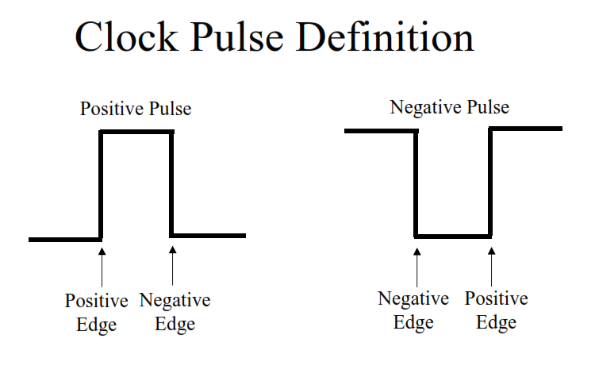
Give Examples

Slide 13
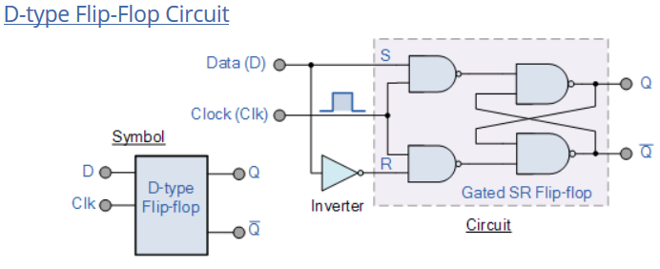
The output of the flip flop would always change on every pulse applied to this data input.
To avoid this an additional input called the “CLOCK” or “ENABLE” input is used to isolate the data input from the flip flop’s latching circuitry after the desired data has been stored. The effect is that D input condition is only copied to the output Q when the clock input is active. This then forms the basis of another sequential device called a D Flip Flop.

Slide 15
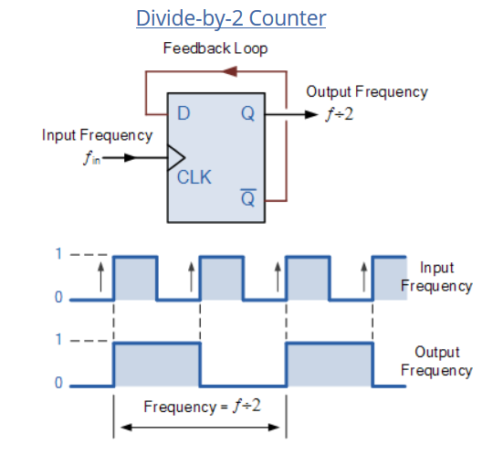
It can be seen from the frequency waveforms above, that by “feeding back” the output from Q to the input terminal D, the output pulses at Q have a frequency that are exactly one half ( ƒ/2 ) that of the input clock frequency, ( ƒ_{IN} ). In other words the circuit produces frequency division as it now divides the input frequency by a factor of two (an octave) as Q = 1 once every two clock cycles.

Slide 16
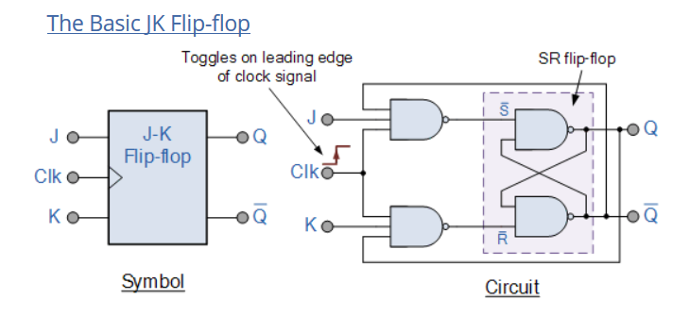

Slide 20
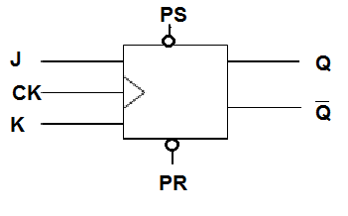
Direct Inputs
Flip-flops often provides special inputs PS, PR for setting and resetting them:
Independent of clock input
Initializes the flip-flop
PS′ | PR′ | CK | J | K | Q(t+1)
1 | 1 | ↑ | 0 | 0 | Q(t)
1 | 1 | ↑ | 0 | 1 | 0
1 | 1 | ↑ | 1 | 0 | 1
1 | 1 | ↑ | 1 | 1 | Q′(t)
0 | 1 | X | X | X | 1
1 | 0 | X | X | X | 0
0 | 0 | X | X | X | Undefined

Slide 21
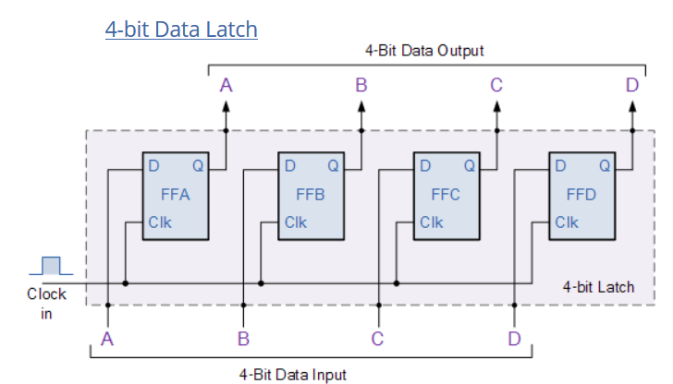
D Flip Flops as Data Latches
A data latch can be used as a device to hold or remember the data present on its data input, thereby acting a bit like a single bit memory device and IC’s such as the TTL 74LS74 or the CMOS 4042 are available in Quad format exactly for this purpose. By connecting together four, 1-bit data latches so that all their clock inputs are connected together and are “clocked” at the same time, a simple “4-bit” Data latch can be made as shown below.

