Slide 1
College of Computer and Information Sciences
Department of Computer Science
CSC 220: Computer Organization
Unit 11
Datapath Design

Slide 2
Unit 11: Datapath Design
Overview
Register file
Function Unit
ALU
Combinational Shifter
Basic Datapaths Design
General Datapath Representation
Accessing RAM
The Control Word
Chapter-8
M. Morris Mano, Charles R. Kime and Tom Martin, Logic and Computer Design Fundamentals, Global (5th) Edition, Pearson Education Limited, 2016. ISBN: 9781292096124

Slide 3
Datapath Design
ALU + Shifter
Registers
A limited set of registers serve as fast temporary storage.
ALU & Shifter perform various operations on the data stored in the registers
A larger, but slower, random-access memory is also available.
The datapath completes a single microoperation each clock cycle.
For given microoperation, we need to specify;
Source registers
Destination register
Operation to perform

Slide 4
Register file
Modern processors contain a number of registers grouped together in a register file.
Much like words stored in a RAM, individual registers are identified by an address.
Here is a block symbol for a
2^{k} x n register file.
There are 2^{k} registers, so register addresses are k bits long.
Each register holds an n-bit word, so the data inputs and outputs are n bits wide.
D
n
D data
WR
Write
DA
k
D address
Register File
AA
k
A address
B address
k
BA
A data
B data
n
n
A
B

Slide 5
Accessing the register file
You can read two registers at once by supplying the AA and BA inputs. The data appears on the A and B outputs.
You can write to a register by using the DA and D inputs, and setting WR = 1.
These are registers so there must be a clock signal, even though we usually don’t show it in diagrams.
We can read from the register file at any time.
Data is written only on the positive edge of the clock.
D
n
D data
WR
Write
DA
k
D address
Register File
AA
k
A address
B address
k
BA
A data
B data
n
n
A
B

Slide 6
What’s inside the register file
Here’s a 4 x n register file. (We’ll assume a 2^{k} x n = 4 x n register file for all our examples.)
n
decoder
DA0 & DA1
Select the register
to write in
The n-bit 4-to-1 muxes select the two register file outputs A and B, based on the inputs AA and BA.
AA0 & AA1
BA0 & BA1
Select the register
to read from
n Mux (4×1)
n Mux (4×1)
n
n

Slide 7
The all-important ALU
The main job of a central processing unit is to “process,” or to perform computations....remember the ALU
We’ll use the following general block symbol for the ALU.
A and B are two n-bit numeric inputs.
FS is an m-bit function select code, which picks one of 2^{m} functions.
The n-bit result is called G.
Several status bits provide more
information about the output G:
V = 1 in case of signed overflow.
C is the carry out.
N = 1 if the result is negative.
Z = 1 if the result is 0.
n
n
A
B
m
FS
V
ALU
C
N
Z
G
n

Slide 8
Combinational Shifter
Bidirectional shift register with parallel load
Disadvantage: 3 clock pulses required
Combinational Shifter
Transfer from a source to destination register
One clock cycle
Operations: Transfer, Shift Left, Shift Right
Filling of vacant positions
Here, will provide input lines or zero fill
Many options depending on instruction set

Slide 9
4-Bit Basic Left/Right Shifter
B
3
B
2
B
1
B
0
Serial
output L
Serial
output R
I
R
I
L
0
1
2
M
0
1
2
M
0
1
2
M
0
1
2
M
S
U
S
U
S
U
S
U
X
X
X
X
S
2
H
3
H
2
H
1
H
0
Serial Inputs:
I_{R} for right shift
I_{L} for left shift
Serial Outputs
R for right shift (Same as MSB input)
L for left shift (Same as LSB input)
Shift Functions: (S1, S0) = 00 Pass B unchanged 01 Right shift 10 Left shift 11 Unused

Slide 10
Function Unit Design
Function Unit = ALU + Shifter
The function select code FS is 4 bits long, but there are only 15 different functions here.
Bus A
Bus B
A
B
n
G select
H select
B
4
A
B
2
S
S
2:0
|| C
in
V
Arithmetic/logic
0
I
R
Shifter
I
L
0
C
unit (ALU)
G
H
N
n
Z
Zero Detect
n
MF select
0
1
Function unit
MUX F
F
n
n
n
A
B
m
FS
V
Function Unit
C
N
Z
F
n

Slide 11
Definition of Function Unit Select (FS) Codes
G
Select,
H
Select,
and
MF
in T
of
FS
Codes
MF
G
H
FS(3:0)
Select
Select(3:0)
Select(3:0)
Micr
ooperation
0000
0
0000
XX
←
Boolean
Equations:
MF = F₃ F₂
G_{i} = F_{i}
H_{i} = F_{i}
F A
0001
0
0001
XX
←
+
F A
1
0010
0
0010
XX
←
+
F A
B
0011
0
0011
XX
←
+
+
F A
B
1
0100
0
0100
XX
←
+
F A
B
0101
0
0101
XX
←
+
+
F A
B
1
0110
0
0110
XX
←
−
F A
1
0111
0
0111
XX
F
←
A
1000
0
1
X
00
XX
F
←
∧
A B
1001
0
1
X
01
XX
F
←
∨
A B
1010
0
1
X
10
XX
F
←
⊕
A B
1011
0
1
X
11
XX
F
←
A
1100
1
XXXX
00
F
←
B
1101
1
XXXX
01
F
←
sr
B
1110
1
XXXX
10
F
←
sl
B

Slide 12
Basic Datapaths Design
Guiding principles for basic datapaths:
The set of registers
A set of registers with common access resources called a register file
Microoperation implementation
One or more shared resources for implementing microoperations
Buses - shared transfer paths
Arithmetic-Logic Unit (ALU) - shared resource for implementing arithmetic and logic microoperations
Shifter - shared resource for implementing shift microoperations

Slide 13
Datapath Example
WR
(Load enable)
A select
B select
Four parallel-load registers (R0-R3)
Two mux-based register selectors
Register destination decoder
Mux B for external constant input
Buses A and B with external address and data outputs
ALU and Shifter with Mux F for output select
Mux D for external data input
Logic for generating status bits V, C, N, Z
D data
n
A address
B address
Load
R0
2
2
n
n
Load
R1
n
0
1
MUX
n
2
0
3
Load
1
MUX
R2
2
n
n
3
Load
R3
n
n
0
1
2
3
n
Register file
Decoder
D address
A data
B data
2
Constant in
n
n
Destination select
MB select
n
1
0
Bus A
MUX B
n
Address
Bus B
n
Out
A
B
Data
G select
H select
n
Out
4
S
A
|| C
B
2
S
B
V
2:0
in
0
I
Shifter
I
0
Arithmetic/logic
R
L
C
unit (ALU)
H
N
G
n
Z
Zero Detect
n
MF select
0
1
Function unit
MUX F
F
n
n
Data In
MD select
0
1
n
Bus D
MUX D

Slide 14
Datapath Example: Performing a Microoperation
Microoperation: R0 ← R1 + R2
Load enable
A select
B select
D data
Write
n
A address
B address
Apply 01 to A select to place contents of R1 onto Bus A
Load
R0
2
2
Apply 10 to B select to place contents of R2 onto B data and apply 0 to MB select to place B data on Bus B
n
n
Load
R1
n
0
1
MUX
n
2
0
3
Load
1
MUX
Apply 0010 to G select to perform addition G = Bus A + Bus B
R2
2
n
n
3
Apply 0 to MF select and 0 to MD select to place the value of G onto BUS D
Load
R3
n
n
0
1
2
3
n
Register file
Decoder
D address
A data
B data
2
Constant in
n
n
Destination select
MB select
n
1
0
Apply 00 to Destination select to enable the Load input to R0
Bus A
MUX B
n
Address
Bus B
n
Out
A
B
Data
G select
H select
n
Out
Apply 1 to Load Enable to force the Load input to R0 to 1 so that R0 is loaded on the clock pulse (not shown)
The overall microoperation requires 1 clock cycle
4
S
A
|| C
B
2
S
B
V
2:0
in
0
I
Shifter
I
0
Arithmetic/logic
R
L
C
unit (ALU)
H
N
G
n
Z
Zero Detect
n
MF select
0
1
Function unit
MUX F
F
n
n
Data In
MD select
0
1
n
Bus D
MUX D

Slide 15
General Datapath Representation
Here we move up one level in the hierarchy from that datapath
The registers, and the multiplexer, decoder, and enable hardware for accessing them become a register file
A register file is an array of fast registers
The ALU, shifter, Mux F and status hardware become a function unit
The remaining muxes and buses which handle data transfers are at the new level of the hierarchy
n
D data
m
Write
D address
2
m
x
n
Register file
m
A address
B address
m
A data
B data
Constant in
n
n
n
MB select
1
0
MUX B
Bus A
n
Address out
Bus B
n
Data out
FS
4
A
B
V
C
Function
N
unit
Z
F
n
n
Data in
MD select
0
1
MUX D

Slide 16
Datapath Representation (continued)
In the register file:
Multiplexer select inputs become A address and B address
Decoder input becomes D address
Multiplexer outputs become A data and B data
Input data to the registers becomes D data
Load enable becomes write
The register file now appears like a memory based on clocked flip-flops (the clock is not shown)
The function unit labeling is quite straightforward except for FS
n
D data
m
Write
D address
2
m
x
n
Register file
m
A address
B address
m
A data
B data
Constant in
n
n
n
MB select
1
0
MUX B
Bus A
n
Address out
Bus B
n
Data out
FS
4
A
B
V
C
Function
N
unit
Z
F
n
n
Data in
MD select
0
1
MUX D

Slide 17
Accessing RAM
Here’s a way to connect RAM into our existing datapath.
Write to RAM: we must give an address and a data value.
These will come from the registers/Constant. We connect A data to the memory’s ADRS input, and B data to the memory’s DATA input.
Set MW = 1 to write to the RAM. (It’s called MW to distinguish it from the WR write signal on the register file.)
D data
WR
Write
DA
D address
Register File
AA
A address
B address
BA
A data
B data
Constant
MB
S D1 D0
Q
RAM
ADRS
DATA
OUT
+5V
CS
A
B
MW
WR
FS
FS
V
C
N
Z
F
D0
Q D1
S
MD
MW = 1
to write to the RAM

Slide 18
Reading from RAM
To read from RAM, A data must supply the address.
Set MW = 0 for reading.
The incoming data will be sent to the register file for storage.
This means that the register file’s D data input could come from either the ALU output or the RAM.
A mux MD selects the source for the register file.
When MD = 0, the ALU output can be stored in the register file.
When MD = 1, the RAM output is sent to the register file instead.
D data
WR
Write
DA
D address
Register File
AA
A address
B address
BA
A data
B data
Constant
MB
S D1 D0
Q
RAM
ADRS
DATA
OUT
+5V
CS
A
B
MW
WR
FS
FS
V
C
N
Z
F
D0
Q D1
S
MD

Slide 19
Notes about this setup
We now have a way to copy data between our register file and the RAM.
Notice that there’s no way for the Function Unit to directly access the memory—RAM contents must go through the register file first.
Here the size of the memory is limited by the size of the registers; with n-bit registers, we can only use a 2^{n} x n RAM.
D data
WR
Write
DA
D address
Register File
AA
A address
B address
BA
A data
B data
Constant
MB
S D1 D0
Q
RAM
ADRS
DATA
OUT
+5V
CS
A
B
MW
WR
FS
FS
V
C
N
Z
F
D0
Q D1
S
MD

Slide 20
Datapath (Summary)
The datapath completes a single microoperation each clock cycle.
For given microoperation, we need to specify;
Source registers
Destination register
Operation to perform
For the datapath, we also need to specify;
External or function data
Data B from register or constant
Whether the destination is updated

Slide 21
The Control Word
The datapath has many control inputs
The signals driving these inputs can be defined and organized into a control word
To execute a microinstruction, we apply control word values for a clock cycle. For most microoperations, the positive edge of the clock cycle is needed to perform the register load
The datapath control word format and the field definitions are shown on the next slide

Slide 22
The Control Word Fields
Fields
DA – D Address (destination)
AA – A Address
BA – B Address (source for MUXB
MB – Mux B (constant/source
FS – Function Select
MD – Mux D
RW – Register Write
The connections to datapath are shown in the next slide
15
14
13
12
11
10
9
8
7
6
5
4
3
2
1
0
D
A
AA
BA
M
FS
M
R
B
D
W
Control word

Slide 23
Control Word Block Diagram
n
R
W
0
Write
D data
D
A
15
14
D address
13
8
x
n
Register file
AA
12
A address
B address
9
BA
11
8
10
A data
B data
7
n
n
Constant in
n
MB
6
1
0
Bus A
MUX B
n
Bus B
n
Address out
Data out
A
B
V
5
C
Function
4
FS
N
unit
3
Z
2
n
n
Data in
0
1
MD
1
MUX D
Bus D

Slide 24
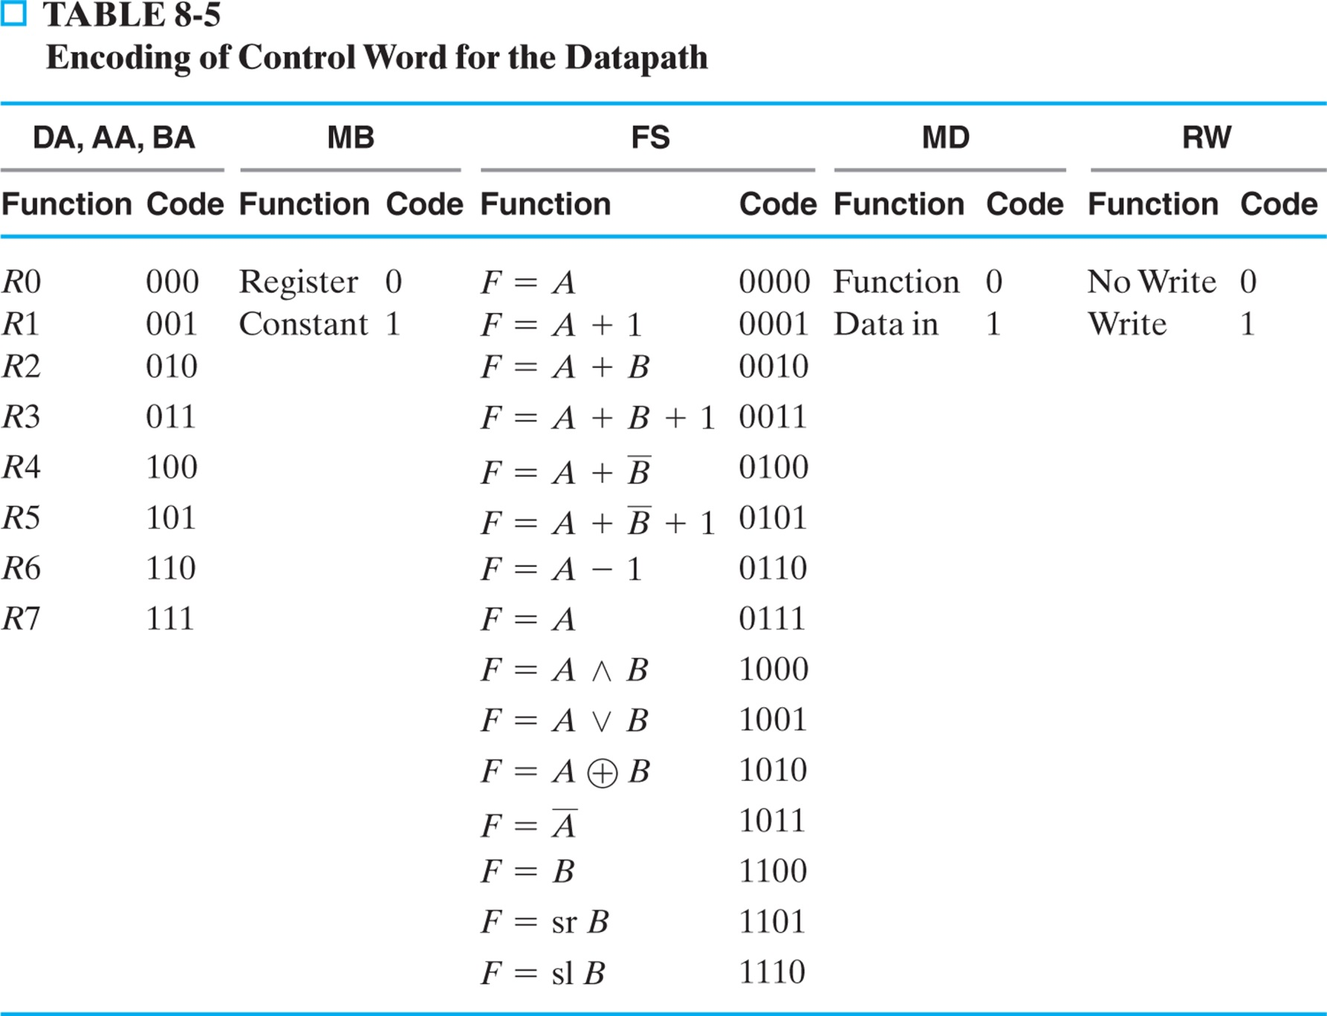
Encoding The Control Word

Slide 25
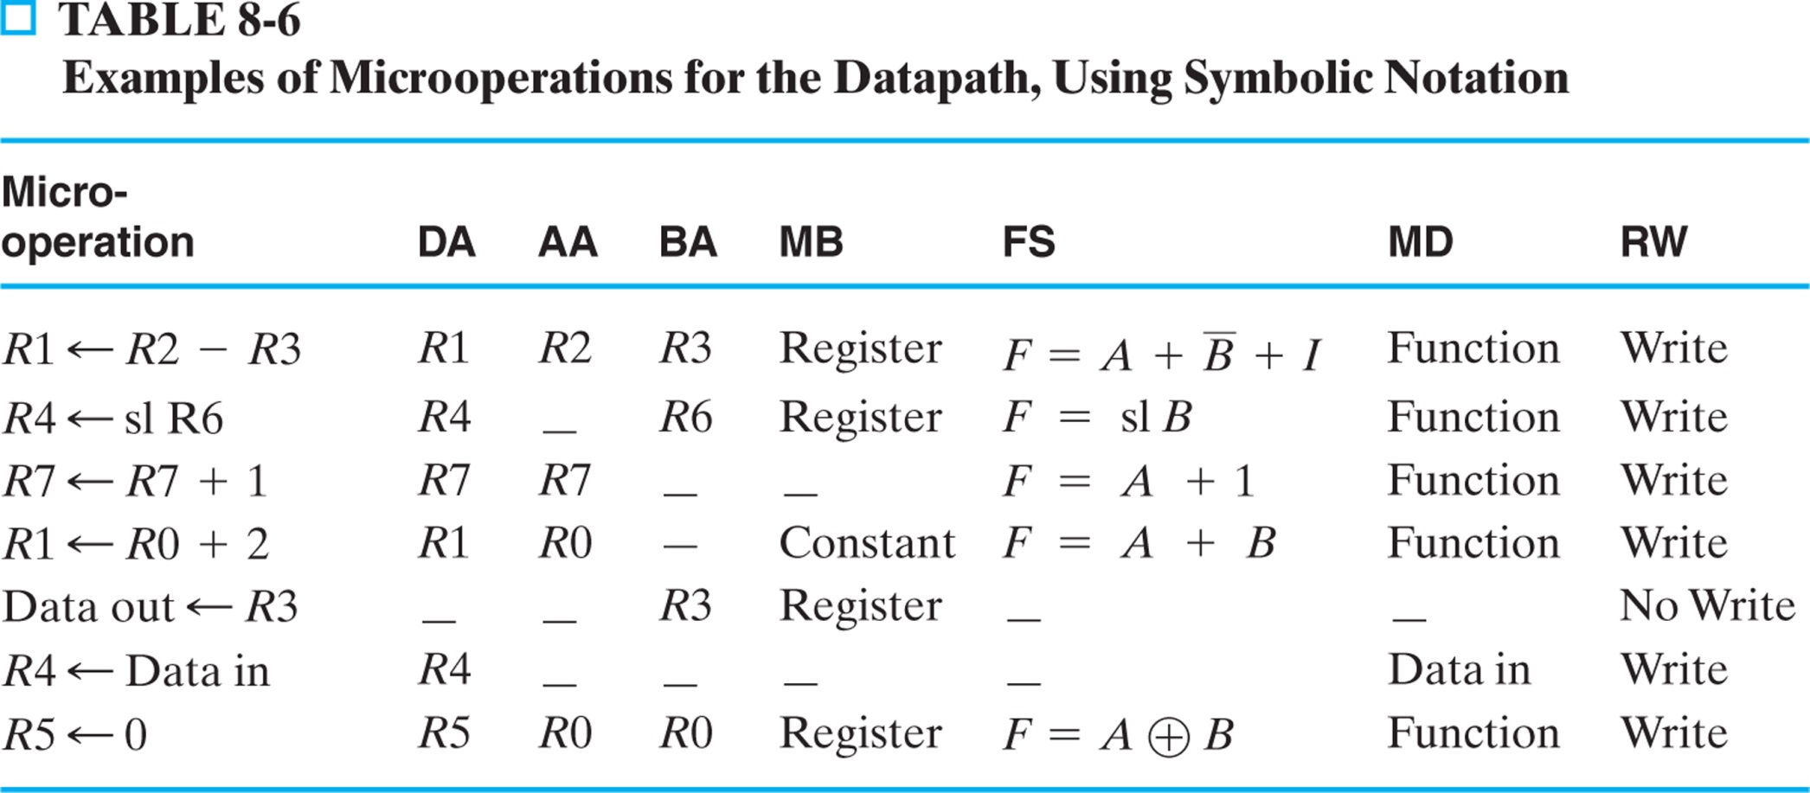
Microoperations for the Datapath - Symbolic Representation

Slide 26
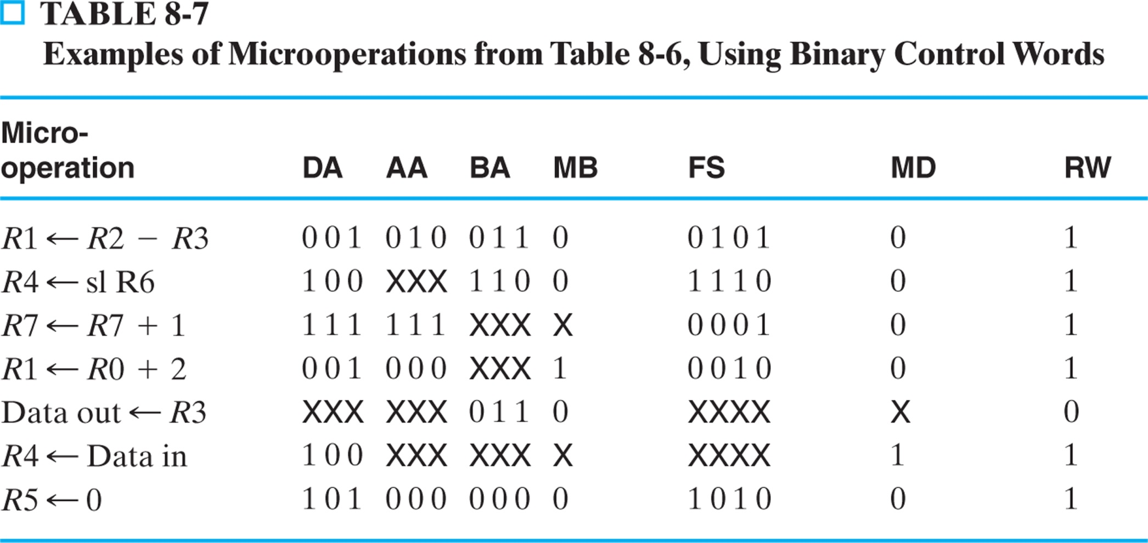
Microoperations for the Datapath - Binary Representation
Results of simulation of the above on the next slide

Slide 27
Datapath Simulation Results of simulation of the above
clock
1
2
3
4
5
6
7
8
DA
1
4
7
1
0
4
5
AA
2
0
7
0
BA
3
6
0
3
0
FS
5
14
1
2
0
10
Constant_in
X
2
X
MB
Address_out
2
0
7
0
Data_out
3
6
0
2
3
0
Data_in
18
18
MD
RW
reg0
0
reg1
1
255
2
reg2
2
reg3
3
reg4
4
12
18
reg5
5
0
reg6
6
reg7
7
8
Status_bits
2
0
0
1
X

Slide 28
Stored Program Computer
Control words operate the datapath
Store control words in memory
Sequence through them to perform a series of computational steps
This is what a computer does

