Slide 1
RHS 434
Tutorial lecture for the guideline presentation assignment
Kawthar, 2016

Slide 2
http://www.slideshare.net/yassersami/clinical-practice-guidelines-implementation-auditing-in-the-pediatrics-department-in-king-saud-university-medical-city

Slide 3
It’s importance
“Good Clinical Practice is an international ethical and scientific quality standard for the design, conduct, performance, monitoring, analyses and reporting of clinical trials. ”
A Vijayananthan, O Nawawi Biomed Imaging Interv J. (2008) The importance of Good Clinical Practice guidelines and its role in clinical trials; 4(1): e5. Published online 2008 January 1. doi: 10.2349/biij.4.1.e5

Slide 4
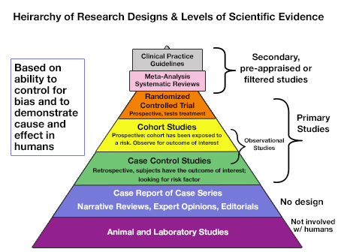
http://www.dentalcare.ca/en-CA/dental-education/continuing-education/ce311/ce311.aspx?ModuleName=coursecontent&PartID=4&SectionID=-1

Slide 5
Oxford Centre for Evidence-based Medicine – Levels of Evidence (March 2009)
http://www.cebm.net/oxford-centre-evidence-based-medicine-levels-evidence-march-2009/

Slide 6
Kawthar, 2016

Slide 7
examples
National Institute for Health and Care Excellence
Clinical guideline for Achilles Pain, stiffness
http://www.orthopt.org/ICF/icf_2010/Achilles%20Tendinitis%20Clinical%20Guideline%20-%20JOSPT%20-%20Sept%202010.pdf
Pedro
http://www.pedro.org.au/
Extra helpful link
http://www.students4bestevidence.net/
What makes a good clinical guideline?
http://www.medicine.ox.ac.uk/bandolier/painres/download/whatis/whatareclinguide.pdf
https://www.nice.org.uk/

