Slide 1
Trends in Translation Studies
Dania Salamah
College of Languages and Translation, KSU
Research Week
19th of February 2018

Slide 2
Contents
Translation Studies
Approaches to Translation Studies
Some Trends

Slide 3
Translation Studies

Slide 4
Translation studies (TS) was first used as a term by the Dutch-based US scholar James Holmes in 1972 to refer to the discipline that deals with “the complex of problems clustered round the phenomenon of translating and translations” (Holmes, 1988, p. 67)

Slide 5
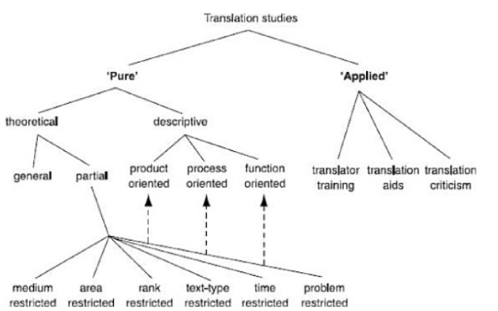
The Holmes/Toury Map of TS
(Munday, 2016, p. 18)

Slide 6
The Applied Branch of TS (2001)
(Munday, 2001, p. 13)

Slide 7
The Applied Branch of TS (2008)
(Munday, 2008, p. 12)

Slide 8
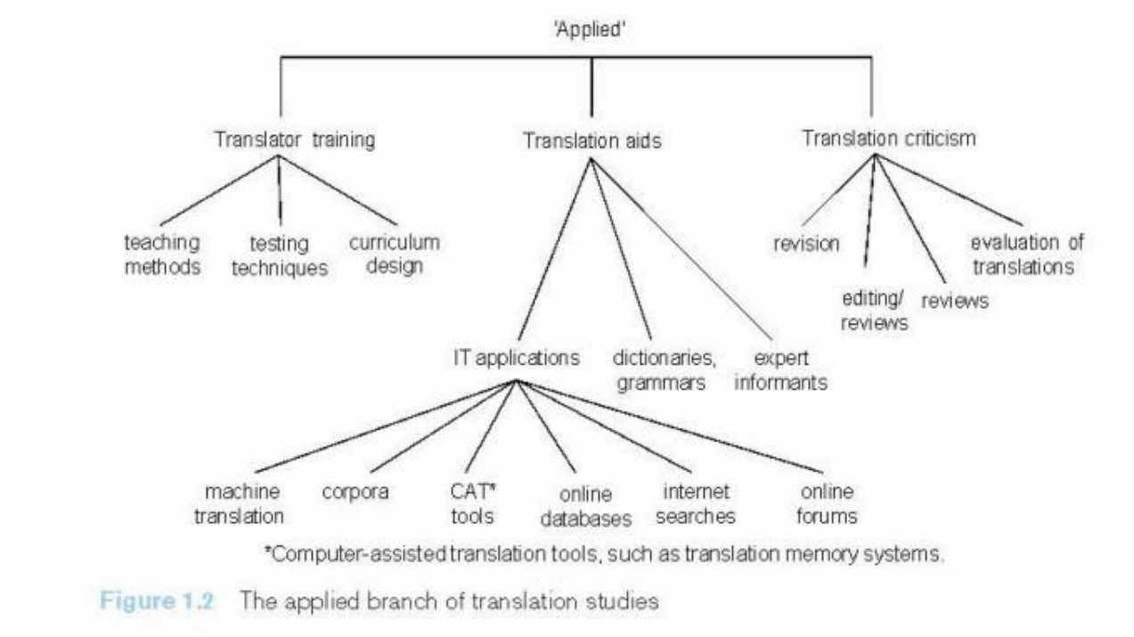
The Applied Branch of TS (2012)
(Munday, 2012, p. 19)

Slide 9
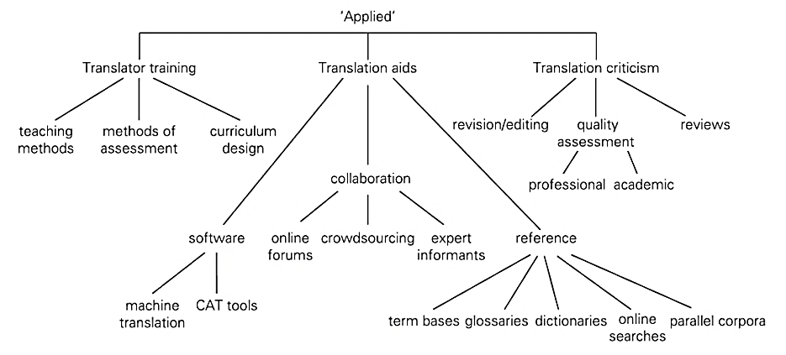
The Applied Branch of TS (2016)
(Munday, 2016, p. 20)

Slide 10
Approaches to TS

Slide 11
Linguistic Approaches
Vinay and Darbelnet (1958): comparative linguistic analysis
Roman Jakobson (1959): structural linguistic approach, types of translation, equivalence
Georges Mounin (1963): linguistic view of translation
Eugine Nida (1964): applied Chomsky’s transformational generative grammar, formal and dynamic equivalence
John Catford (1965): Firth and Halliday’s functional grammar, formal correspondence and textual equivalence, translation shift

Slide 12
Text and Discourse Analysis Approaches
Mona Baker (1992): the notion of equivalence in light of Halliday’s functional grammar; cohesion; pragmatics
Julianne House (1997): translation quality assessment based on Halliday’s systemic functional grammar
Basil Hatim and Ian Mason (1997): adopted an approach based on Halliday’s systemic functional grammar especially the analysis of ideational and interpersonal levels of meaning

Slide 13
Functional Approaches
Katherine Reiss (1971): text-type approach based on Karl Buhler’s categorization of text functions into informative, expressive, and operative
Christiane Nord (1988): textual functional approach to translation
Mary Snell Hornby (1988): an integrated approach based on text type and drawing on the notion of prototypes
Hans Vermeer (1989): Skopos theory, the purpose of the translation

Slide 14
Communicative Approaches
Peter Newmark (1981): communicative translation vs semantic translation
Werner Koller (1995): types of equivalence based on communicative situation

Slide 15
Sociocultural Approaches
Susan Bassnett (1980): ideology and power in translation
Antoine Berman (1985): naturalization, negative and positive analytic
Lawrence Venuti (1995): domestication, foreignization, the translator’s invisibility

Slide 16
Some Trends

Slide 17
Participant-Oriented Approaches
Aim to examine areas like translator style, translator training, translator competence, the revision part of the translation process
Rely on methods borrowed from the social sciences (e.g., questionnaires/surveys, interviews, focus groups)

Slide 18
Ideology in TS/Cultural Turn
Not a completely new approach having its roots in approaches that adopted a systemic functional framework
Emphasis on translations as instruments to maintain relations of power and domination
Viewed as a set of beliefs and values that direct the view of individuals and institutions of the world guiding their interpretation of the world and experience
Deals with issues like the selection of texts, the translation strategies uses, and the intended influence the TT is to have on the target audience

Slide 19
Ethics in TS
The focus is on the translator
Addresses the translator’s responsibility and awareness of the ethics involved in his actions as a translator
Deals with issues related to ethical practices and codes of ethics especially when translator’s perform obvious “visible” social roles (e.g., in courtrooms, hospitals, prisons, etc.)

Slide 20
Corpus-Based TS
Pioneered by several scholars including Baker, corpus-based TS draw on:
Comparable corpora: collections of texts including a collection of original texts in a certain language and another collection or more of translated text into that language from one or more source languages
Parallel corpora: original texts in one language and their translations in another language
Notes:
Product-oriented studies

Slide 21
Increase reliability and validity of results
Can help in identifying patters of translation regularities
Enable the investigation of certain language features and their associations, or the characteristics of certain varieties of language

Slide 22
Cognitive Approaches
Investigate the process of translation:
What goes on in the mind of the translator during the process of translation
The translator’s awareness of the translation process
Rely on methods that include verbal reports (think-aloud-protocols), eye-tracking metrics, keystroke logs

Slide 23
Translation Competence/Training
PACTE (Process of Acquisition of Translation Competence and Evaluation) (1997)
Project-based approaches to translation
Task-based approaches to translation → genre-based approaches to translation

Slide 24
Bibliography
Holmes, J. (1972/1988). The name and nature of translation studies. In J. Holmes (Ed.), Translated! Papers on Literary Translation and Translation Studies (pp. 67-80). Amsterdam: Rodopi.
House, J. (2016). Translation as communication across languages and cultures. UK: Routledge.
Munday, J. (2001, 2008, 2012, 2016). Introducing translation studies: Theories and applications (1st, 2nd, 3rd, 4th eds.). UK: Routledge.
Saldanha, G., & O’Brien, S. (2013). Research methodologies in translation studies. UK: Routledge.

