Slide 1
Kinetics analysis of β-fructofuranosidase enzyme
3-The effects of temperature on the rate of an enzyme catalyzed reaction.

Slide 2
What Is The Effect Of Temperature On Enzyme Activity?
The rate of an enzyme catalyzed reaction is affected by changes in temperature.
Increases in the temperature of a system results from increases in the kinetic energy of the system. This has several effects on the rates of reactions.
1)More energetic collisions
2)The number of collisions per unit time will increase.
3)The heat of the molecules in the system will increase.

Slide 3
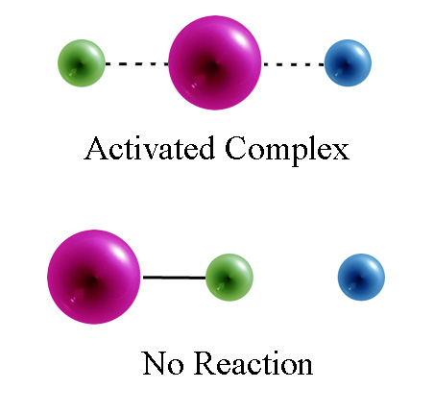
1)More energetic collisions:
When molecules collide, the kinetic energy of the molecules can be converted into chemical potential energy of the molecules.
As the temperature of a system is increased it is possible that more molecules per unit time will reach the activation energy. Thus the rate of the reaction may increase.

Slide 4
2) The number of collisions per unit time will increase:
In order to convert substrate into product, enzymes must collide with and bind to the substrate at the active site.
Increasing the temperature of a system will increase the number of collisions of enzyme and substrate per unit time.
Thus ,within limits ,the rate of the reaction will increase

Slide 5
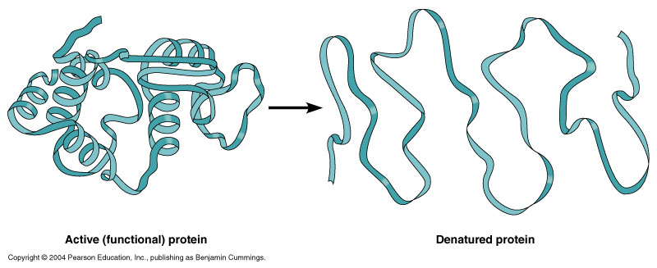
3) The heat of the molecules in the system will increase.
As the temperature of the system is increased ,the internal energy of the molecules in the system will
increase.
Some of this heat may be converted into chemical potential energy.
If this chemical potential energy increase is great enough some of the weak bonds that determine the three dimensional shape of the active proteins may be broken.
This could lead to a thermal denaturation
of the protein and thus
inactivate the protein.

Slide 6
Objectives:
1-To establish the relationship between temperature and the
rate of an enzyme catalyzed reaction.
2-To determine the optimum temperature for
ß-Fructofuranosidase enzyme .

Slide 7
Principle
At low temperature (0˚C), the rate of reaction is low. As the temperature is increased, the rate of reaction increase until an optimum temperature is reached. Within this temperature range, the rate of reaction is approximately doubled for every 10 ˚C rise in temperature.
With further rise in temperature, above the optimum temperature, the rate of reaction decreases due to denaturation of the enzyme protein and hence loss of activity.

Slide 8
The optimum temperature is the result of the balance between the rate of an increase in the enzyme activity on the one hand and the rate of decrease due to denaturation on the other.
Most enzymes are inactivated at temperatures above 60 ˚C . For most enzymes, the optimum temperature is at or above the temperature of the cells in which the enzyme is found in vivo.

Slide 9
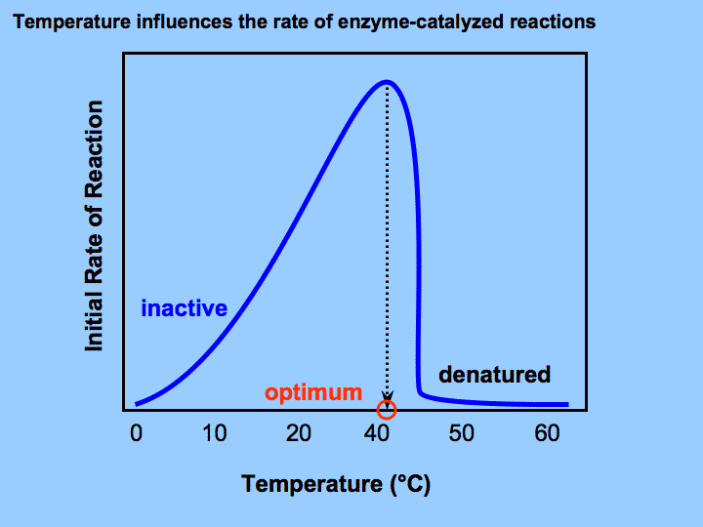
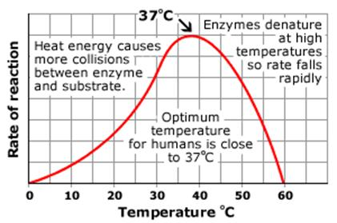
The relationship between the rate of the enzymatic reaction and the temperature is shown in the figure below

Slide 10
Materials:
Solutions :
0.05M Sodium Acetate buffer , pH 4.7 .
0.18 M Sucrose
Reducing sugar (0.005M glucose + 0.005M fructose)
ß- Fructofuranosidase enzyme extract from yeast.
DNS (dinitrosalicylicacid )Reagent .
Sodium Bicarbonate .

Slide 11
Method:
1- Prepare 14 tubes in the following manner, table ( 1 ) :
Tube | Acetate buffer (ml) | 0.3M Sucrose (ml)
A Blank A | 1.0 | 2.0
 | 1.0 | 2.0
B Blank B | 1.0 | 2.0
 | 1.0 | 2.0
C Blank C | 1.0 | 2.0
 | 1.0 | 2.0
D Blank D | 1.0 | 2.0
 | 1.0 | 2.0
E Blank E | 1.0 | 2.0
 | 1.0 | 2.0
F Blank F | 1.0 | 2.0
 | 1.0 | 2.0

Slide 12
Method:
2- Mix ,then place each tube and its corresponding blank in the corresponding water bath and leave for 5 min to reach the required temperature .
Table (3).
Tube | Temperature
A | 4˚C
B | Room temperature
C | 40˚C
D | 50˚C
E | 60˚C
F | 100˚C

Slide 13
3- Then add 0.05ml of distilled water to the Blank tubes and 0.05ml of the enzyme to the test tubes according to the following time table (3) , mix and incubate all tubes for 10 minutes . Stop the reaction by adding 2ml of DNS to all tubes according to the timing in table (3) .
Note : Mix each tube frequently during the incubation time

Slide 14
Table (3).
Tube | Start by add E on test & H2O on blanks | Stop
Blank A A | 0 | 5
Blank B B | 1 | 6
Blank C C | 2 | 7
Blank D D | 3 | 8
Blank E E | 4 | 9
Blank F F | 5 | 10

Slide 15
4- Mix properly , remove from water bath , cover each tube by aluminium foil and place in a boiling water bath for 5min to allow the colour to develop .
5- Then remove from boiling water bath, cool under tap water , add 20ml of distilled water to each tube , mix properly then measure the absorbance at 540nm against corresponding blank..

Slide 16
Result
6- Record the absorbance of each test tube in the following table ( 4),
7- Convert the Absorbance reading obtained to micromoles of sucrose hydrolyzed making use of the standard reducing sugars calibration curve , then divide by 10 to obtain the number of micromoles of sucrose hydrolyzed /min (v_{i} ).
8 – Draw a graph between the (v_{i} ) the micromoles of sucrose hydrolyzed /min and Temperature .

Slide 17
Result
Table (4)
Tube | Absorbance 540nm | µmoles of sucrose hydrolyzed | µmoles /min ( v_{i} )
A
B
C
D
E
F

Slide 18
Discussion
Comment on the curve shape and conclude the relationship between Temperature and the rate of an enzyme catalyzed reaction.
Determine the optimum temperature for
ß-Fructofuranosidase enzyme .

Slide 19
Thank You

