Slide 1
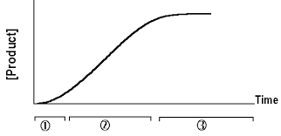
The effect of incubation time on the rate of an enzyme catalyzed reaction

Slide 2
Objectives
To monitor the progress of an enzyme catalyzed reaction (Acid phosphatase).
To determine the initial rate of the reaction (V_{i}).
Important terms and points:
Enzyme kinetics
Measuring the rate of the reaction
Initial velocity

Slide 3
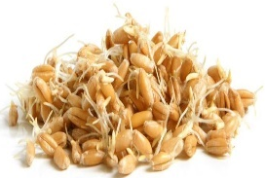
Acid phosphatase
Time
Enzyme Conc
pH
Temp
Substrate conc
Inhibitor

Slide 4
Enzyme kinetics
The central approach for studying the mechanism of an enzyme-catalyzed reaction is to study enzyme kinetics.
It determines the rate of the enzymatic reaction (velocity) and its changes in response with the changes in parameters such as substrate concentration, enzyme concentration, pH, temperature.

Slide 5
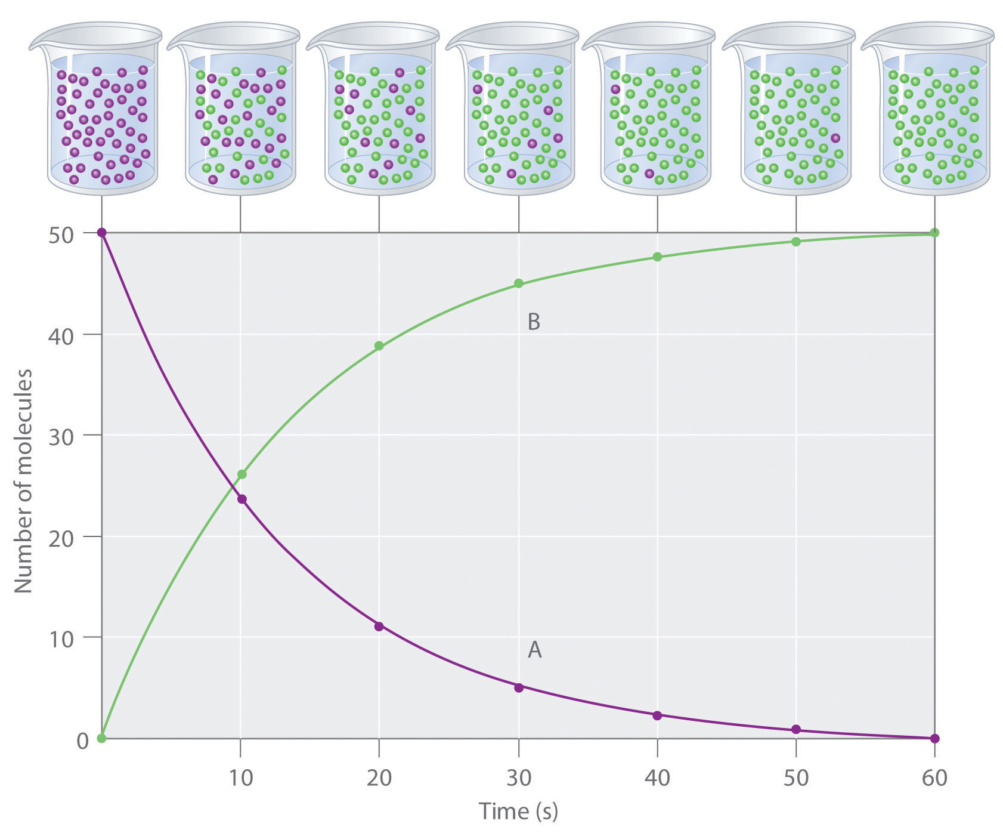
Measuring the rate of reaction (velocity)
The progress of an enzyme catalyzed reaction may be followed by measuring either the
amount of substrate consumed, or
Amount of product formed
Velocity (V) = rate of reaction= change in [P] or [S] per unit time
Unit : µmoles/minute
per unit time.

Slide 6
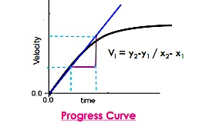
initial velocity
The initial rate of reaction is used in the study of enzyme kinetics
The initial rate of reaction (V_{i}) is measured as the slope at the origin (time= 0).
Plateau
Product formed (µmole)

Slide 7
Why we measure initial velocity?
The rate of the reaction is highest at time zero and decreases with increasing time, eventually falling to zero itself, reaching a plateau.
This usually occurs either when all the substrate is used up or when equilibrium is reached.
The Solution is to Measure V at very early times in reaction, before [S] decreases significantly
The initial rate of reaction, vi, measured as the slope to the above curve at the origin (time= 0)
Plateau
Product formed (µmole)

Slide 8
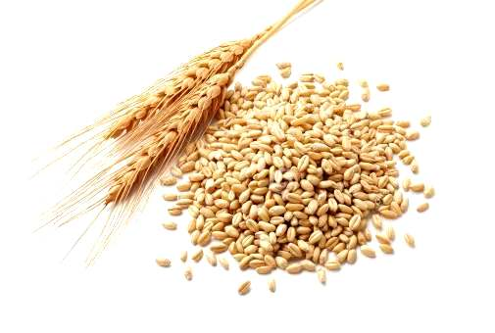
Acid phosphatase
In this experiment, you will measure the velocity of the reaction catalyzed by purified acid phosphatase (ACP) from wheat germ.
Acid phosphatase is a phosphatase that acts on monoesters of orthophosphoric acid. It does not act on phosphoric diesters or triesters.
Acid phosphatase is an important enzyme that plants use to obtain their energy from phosphate. Acid phosphatase’s function in plants is to hydrolyze phosphate esters during energy metabolism.

Slide 9
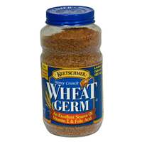
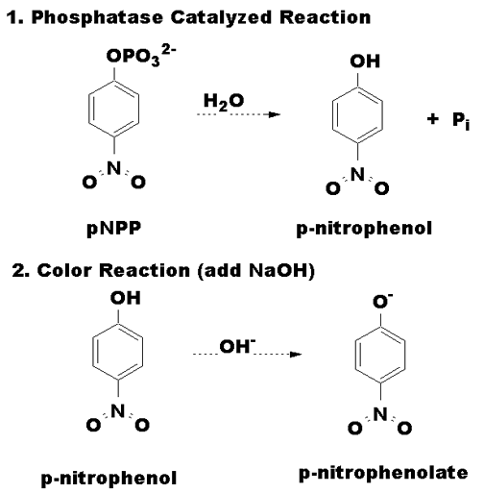
Acid phosphatase from wheat germ
The enzyme catalyzes the hydrolysis of p-nitrophenyl phosphate to inorganic phosphate and p-nitrophenol, under acidic conditions (pH=5.7), with optimum temperature 37◦C
Mg⁺⁺ ion act as an activator for the enzyme
ACP
Mg⁺⁺
pH=5.7
37◦C

Slide 10
Principal of the enzyme assay in vitro
1.
2.
Both p-nitrophenyl phosphate and p-nitrophenol are colorless at acidic pH values.
Addition of alkaline solution, p-nitrophenol is converted to a p-nitrophenolate (yellow color) and concentration can be measured at 405 nm.
Note: Since ACP works under acidic condition, adding alkaline will cause the enzymatic reaction to stop.

Slide 11
Method: The effect of incubation Time
The reaction is stopped after 5 minutes intervals (by Addition of KOH ), hence called Fixed-time assay

Slide 12
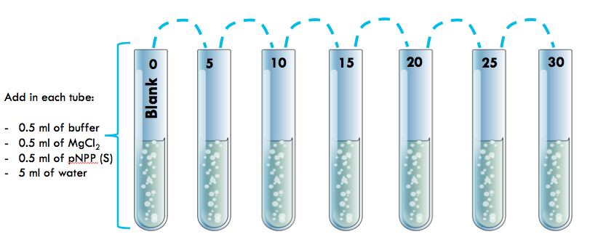
Method
Prepare a series of seven reaction tubes labeled 0 through 30 minutes at 5 minute intervals (Blank, 5, 10 … minutes).
Follow the following addition protocol for all the tubes:
Place in a water bath maintained at 37 ºC for 5 minutes.

Slide 13
To start the reaction → add 0.5ml of E
To stop the reaction → add 0.5ml of KOH
Start at (min) | 0 | 0 | 2 | 4 | 6 | 8 | 10
Stop at (min) | 0 | 5 | 12 | 19 | 26 | 33 | 40
Add KOH to blank ((FIRST)), to prevent the reaction from happening.
After all the reactions have been terminated, determine the absorbance at 405 nm for each sample against blank.

Slide 14
Tube | 5 | 10 | 15 | 20 | 25 | 30
Start at (min) | 0 | 2 | 4 | 6 | 8 | 10
Stop at (min) | 5 | 12 | 19 | 26 | 33 | 40
To convert the time table to an easier way try the following

Slide 15
Results
[P] (µmoles) | Absorbance at 405nm | Time (min)
 |  | 0
 |  | 5
 |  | 10
 |  | 15
 |  | 20
 |  | 25
 |  | 30
[P] = ( A x 10⁶ ) / E X L= µmole
E= extension coefficient=18.8x10³
A= absorbance
L= path length (1 cm)

Slide 16
Product formed (µmole)

Slide 17
Discussion
Draw the graph [ do not forget the title and the units ]
X axis = Time (min)
Y axis = [P] (µmoles)
Calculate from the graph the value initial velocity
Principle
Comment on the graph that you get in details

Slide 18
Questions
How is the initial velocity of an enzymatic reaction determined?
What are the factors that influence the rate of enzyme catalyzed reactions?
What is the pH which the acid phosphatase activity is measured?

