Slide 1
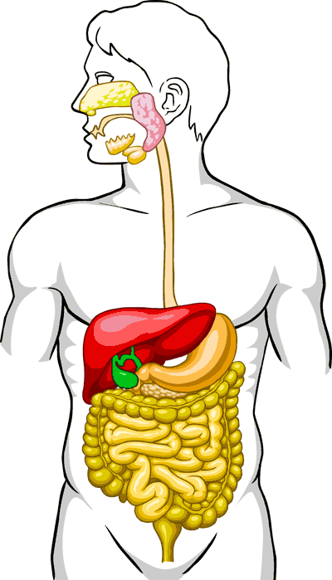
Digestive system
Dr. Malak Qattan

Slide 2
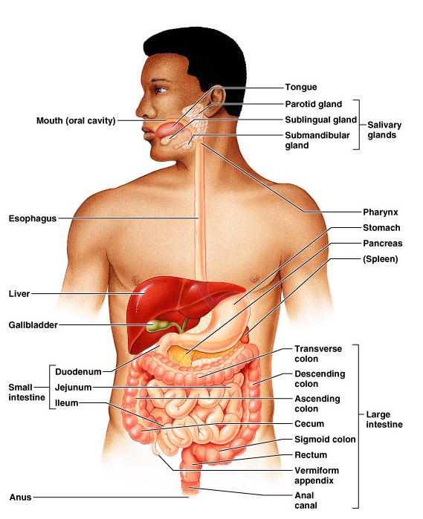
The GI tract (gastrointestinal tract)
Mouth
Pharynx
Esophagus
Stomach
Small intestine
Large intestine
Anus
The accessory digestive organs
Supply secretions contributing to the breakdown of food
Teeth & tongue
Salivary glands
Gallbladder
Liver
Pancreas

Slide 3
Digestive system function
Acquires nutrients from environment
Anabolism
Uses raw materials to synthesize essential compounds
Catabolism
Decomposes substances to provide energy cells need to function

Slide 4
Actions of Digestive (GI) Tract
Ingestion
Occurs when material enters via the mouth
Mechanical Processing
Crushing – makes material easier to move through the tract
Digestion
Chemical breakdown of food into small organic compounds for absorption
Secretion
Release of water acids, buffers, enzymes & salts by epithelium of GI tract and glands
Absorption
Movement of substrates, electrolytes, vitamins & water across digestive epithelium
Excretion
Removal of waste products from body fluids

Slide 5
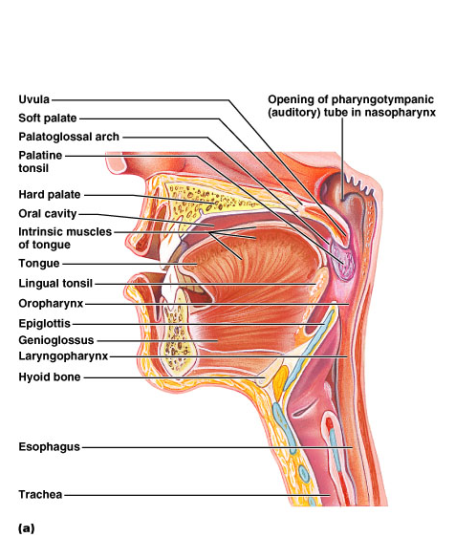
The Mouth
Mouth = oral cavity
Lips
Cheeks

Slide 6
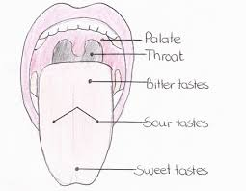
Tongue
Mostly muscles
Grip food
Help in swallowing
Taste buds
Tonsil – back of tongue

Slide 7
Pharynx
Oropharynx and laryngopharynx
Sequentially squeeze food into esophagus
___oropharynx
___laryngopharynx

Slide 8
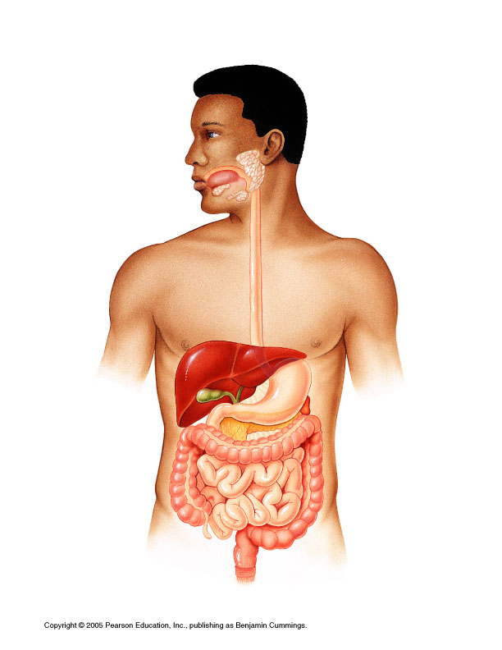
Esophagus
Continuation of pharynx in mid neck
Muscular tube collapsed when lumen empty
Descends through thorax
Esophagus___________

Slide 9
Stomach
J-shaped; widest part of alimentary canal
Temporary storage and mixing – 4 hours
Starts food breakdown
Pepsin
HCl (hydrochloric acid) helps kill bacteria
Stomach tolerates high acid content but esophagus doesn’t – why it hurts so much when stomach contents refluxes into esophagus (heartburn)
Most nutrients wait until get to small intestine to be absorbed; exceptions are:
Water, electrolytes, some drugs like aspirin and alcohol (absorbed through stomach)
Capacity: 1.5 L food; max capacity 4L (1 gallon)

Slide 10
Small intestine
Longest part of alimentary canal (2.7-5 m)
Most enzymatic digestion occurs here
Most enzymes secreted by pancreas, not small intestine
Almost all absorption of nutrients
3-6 hour process
Small intestine___________

Slide 11
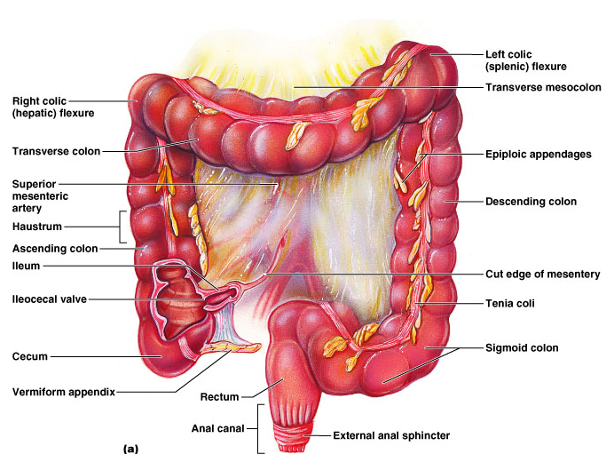
Large intestine
Main function: to absorb water and electrolytes
Subdivisions
Cecum
Appendix
Colon
Rectum
Anal canal

Slide 12
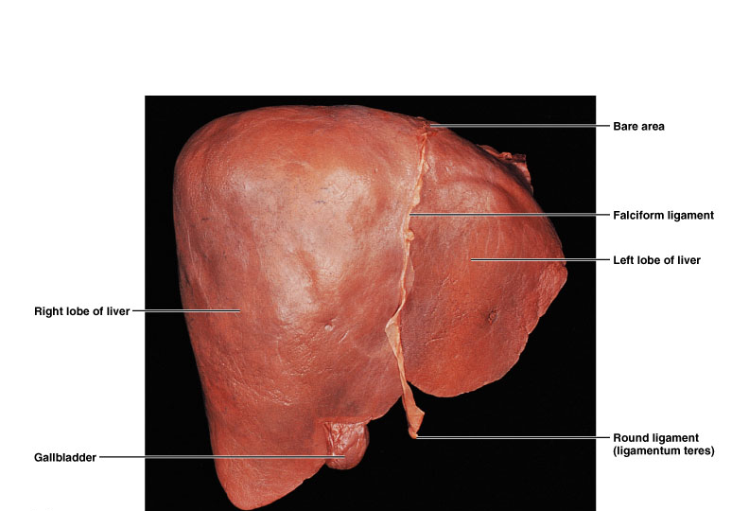
The Liver
Largest gland in the body
Over 500 functions
R and L lobes

Slide 13
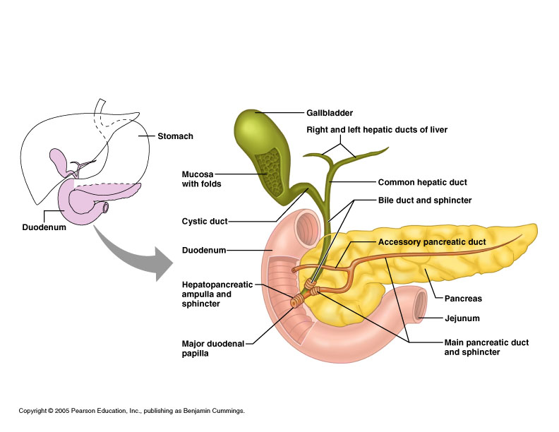
Gallbladder
Bile is produced in the liver
Bile is stored in the gallbladder
Bile is excreted into the duodenum when needed (fatty meal)
Bile helps dissolve fat and cholesterol
If bile salts crystallize, gall stones are formed
*

Slide 14
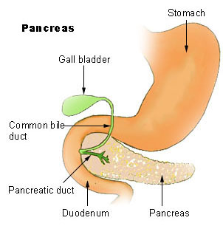
Pancreas
Pancreatic function (hormones released into blood)
Islets of Langerhans are the hormone secreting cells
1. Insulin
Lowers blood glucose (sugar)
2. Glucagon
Raises blood glucose (sugar)

Slide 15
Diseases of the Digestive System
The most common problems experienced are: bloating, heartburn and acidity, colitis, constipation, diarrhea, nausea and vomiting, trouble digesting...
Tooth Decay (dental caries) Bacterial Diseases of the Upper Digestive Tract (Mouth)
Most common infectious disease of humans
Young are more susceptible than old

Slide 16
Diseases of the Digestive System
2. Gastritis
Inflammation of the stomach associated with the production of gastric ulcers
Caused by Helicobacter pylori
Infection can persist for years or life
Can develop either peptic or duodenal ulcers or both

Slide 17
Diseases of the Digestive System
3. Mumps
Mumps is an acute viral infection of the parotid glands (Parotitis)
Humans are the only source of the virus

Slide 18
Diseases of the Digestive System
4. Hepatitis – inflammation of the liver (A, B, C, D, E, & G)
Hepatitis A (HAV) – formerly called infectious hepatitis
Spreads via fecal-oral route
Most infections are asymptomatic or show only mild symptoms

Slide 19
References
1. Maton, Anthea.(1993). Human Biology and Health.
2. Thompson WG, Longstreth GL, Drossman DA et al. (2000). Functional Bowel Disorders

