Slide 1
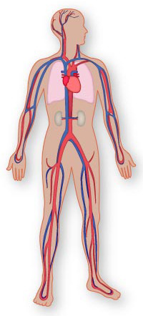
Cardiovascular system

Slide 2
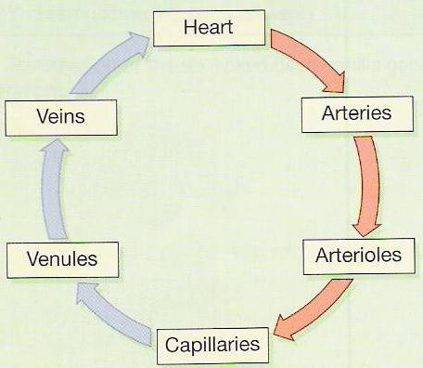
The main components of the human circulatory system are:
1) The Heart. 2) The Blood. 3) The Blood vessels.

Slide 3
What Does C-V System do?
• Circulate blood throughout entire body for
1-Transport of oxygen to cells
2-Transport of CO2 away from cells
3-Transport of nutrients (glucose) to cells
4- Movement of immune system components (cells, antibodies)
5-Transport of endocrine gland secretions
How does it do it?
• Heart is pump
• Arteries and veins are main tubes
• Arteries Away from Heart
• Veins to Heart
• Diffusion happens in capillaries (oxygen, CO2, glucose diffuse in or out of blood).

Slide 4
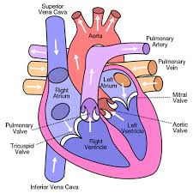
The Heart:
The heart is the pump responsible for maintaining adequate circulation of oxygenated blood around the vascular network of the body. It has four chambers:
1)Right Atrium
2)Right Ventricle
3)Left Atrium
4)Left Ventricle

Slide 5
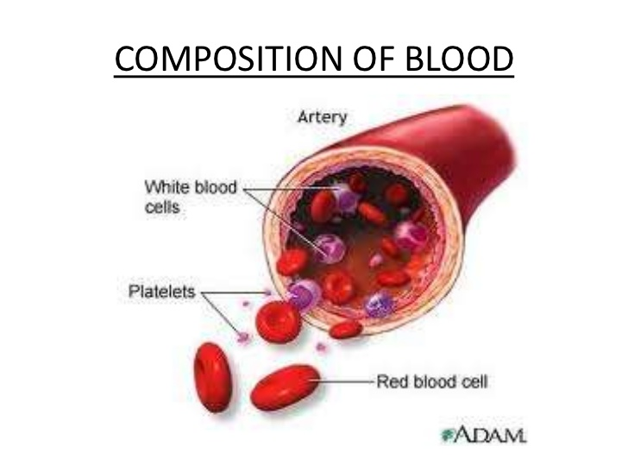
Composition of blood
Red blood cells
White blood cells
Platelets
Floating in a liquid
called plasma

Slide 6
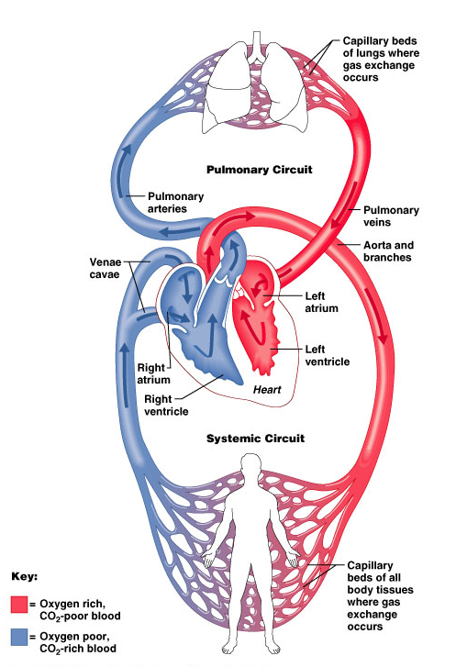
3 Major types of blood vessels
Arteries
Capillaries
Veins
Arteries carry blood away from the heart
Veins carry blood toward the heart

